Slide 1
Bring Your Presentations to Life with 3D
How to get started with 3D in PowerPoint
About this deck
Office 365 subscribers can add 3D models to documents and rotate the angle to show the right view. If you don’t have a subscription, the deck simply shows a single view.

Slide 2
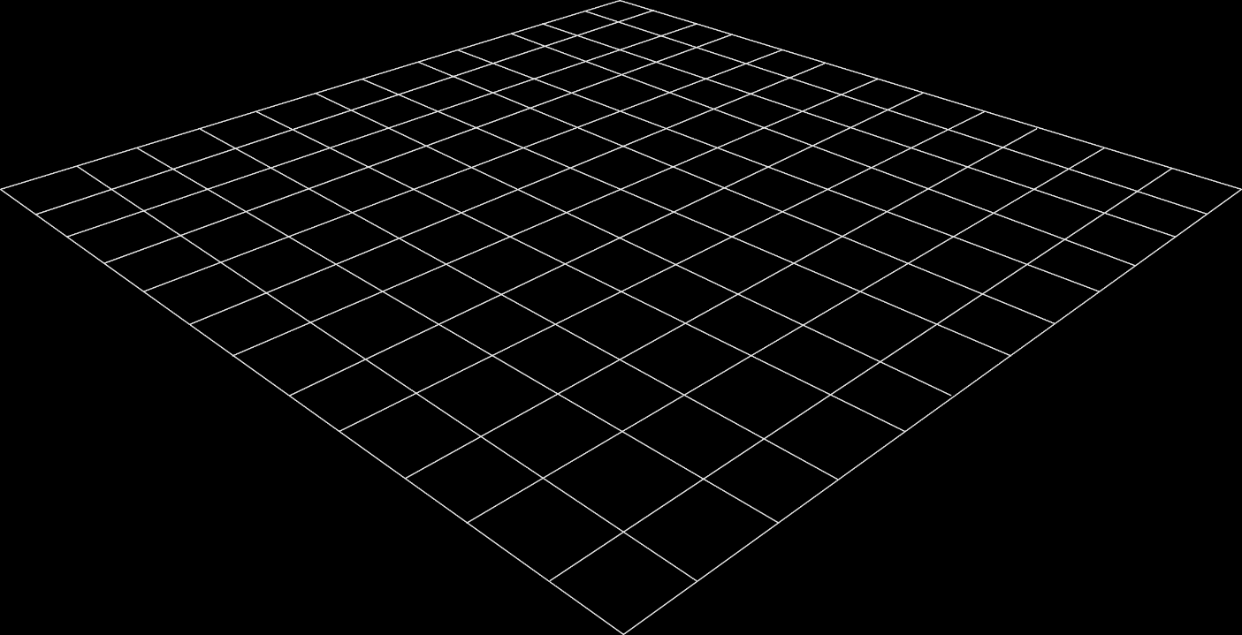
Why Use 3D?
2D Slides
3D Models
Slides are a static portrait.
3D helps foster conceptual understanding and visual and spatial thinking.
Audience is passive and cannot interact.
Animated 3D models display objects within space in ways text and images cannot.

