Slide 1
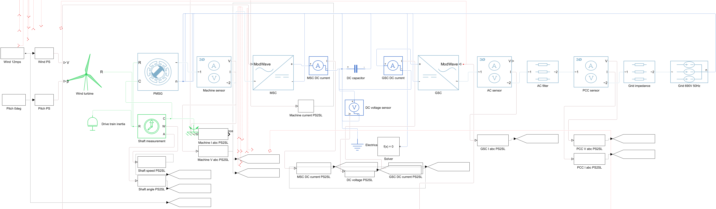
PMSG-Based Wind Turbine System: Simulink Model Architecture
ACTUAL SIMULINK POWER PATH
COMPLETE MODEL
Wind > shaft > PMSG > MSC > DC link > GSC > filter > PCC > grid
The MSC controls generator torque and current. The GSC regulates the DC link and grid current through the PLL.
Native equipment; averaged converters
VATaleni PMSG–SSO | 1/3
Notes:
Both model views are direct crops of the actual final saved Simulink model exported at high resolution. The lower controller subsystems are visible in the complete model inset. The machine is a native PMSM with full d/q electrical dynamics. Sources: project technical report and MathWorks block documentation.

Slide 2
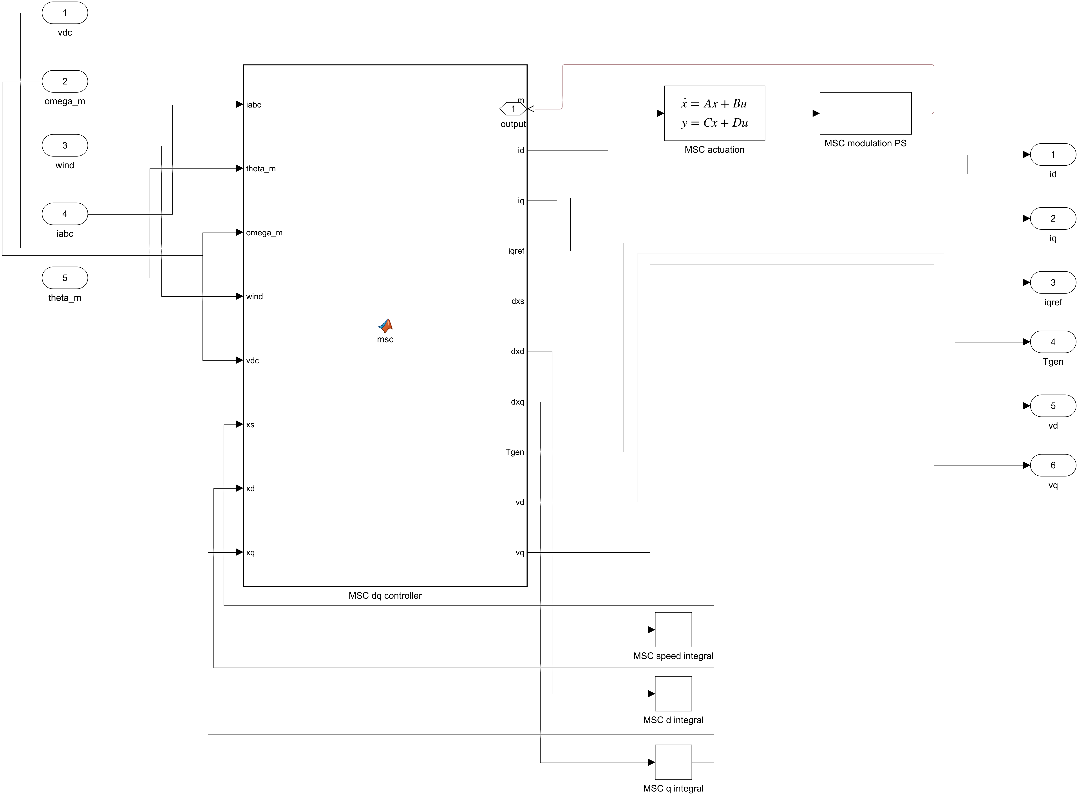
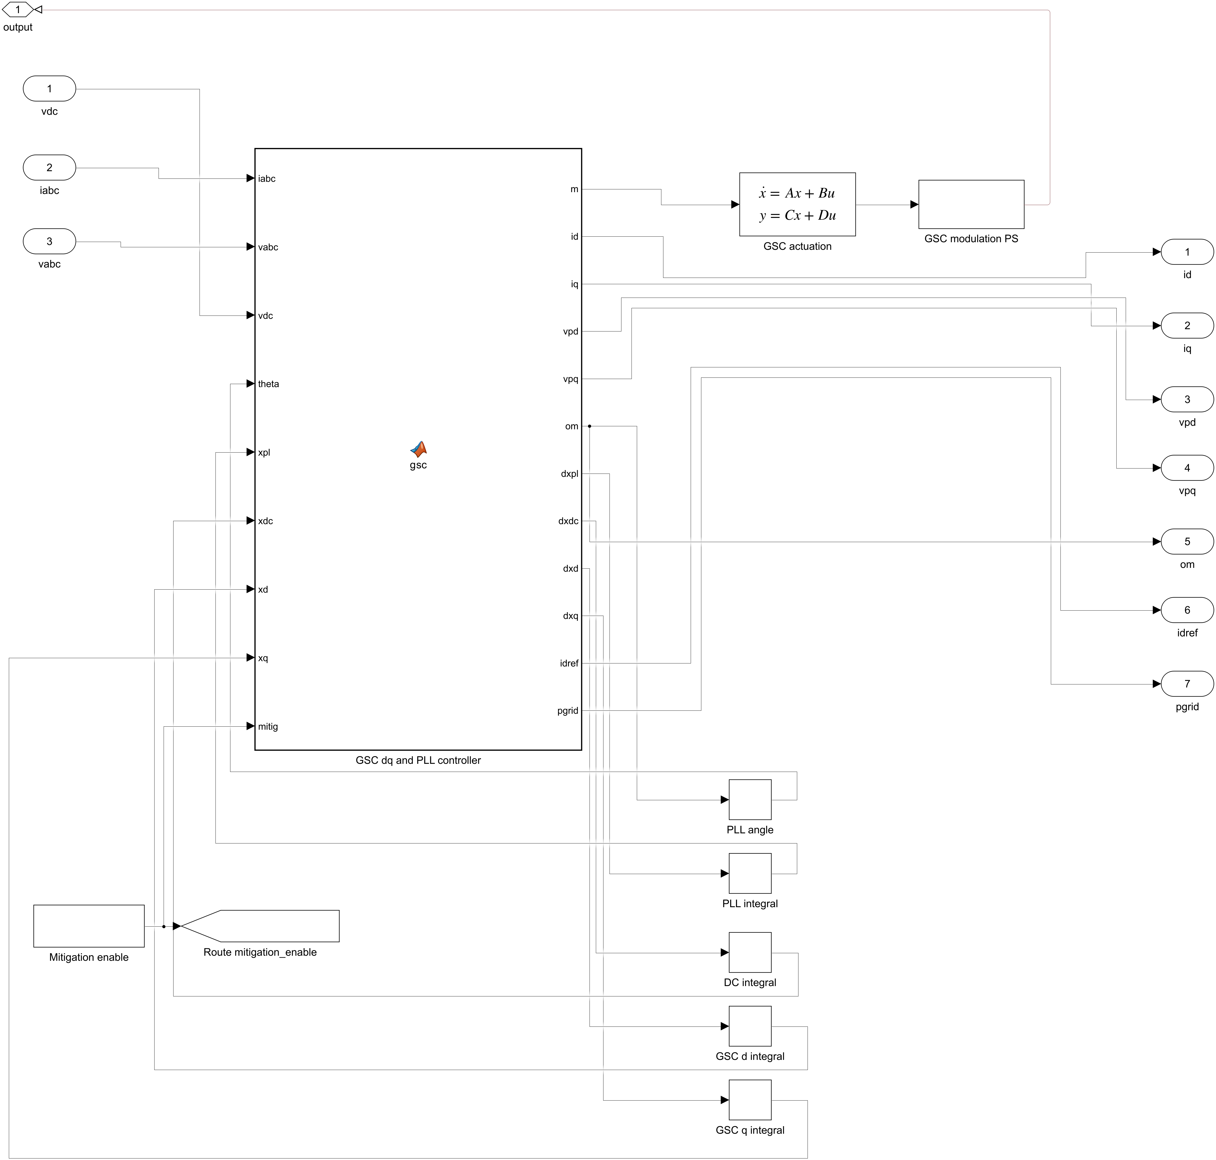
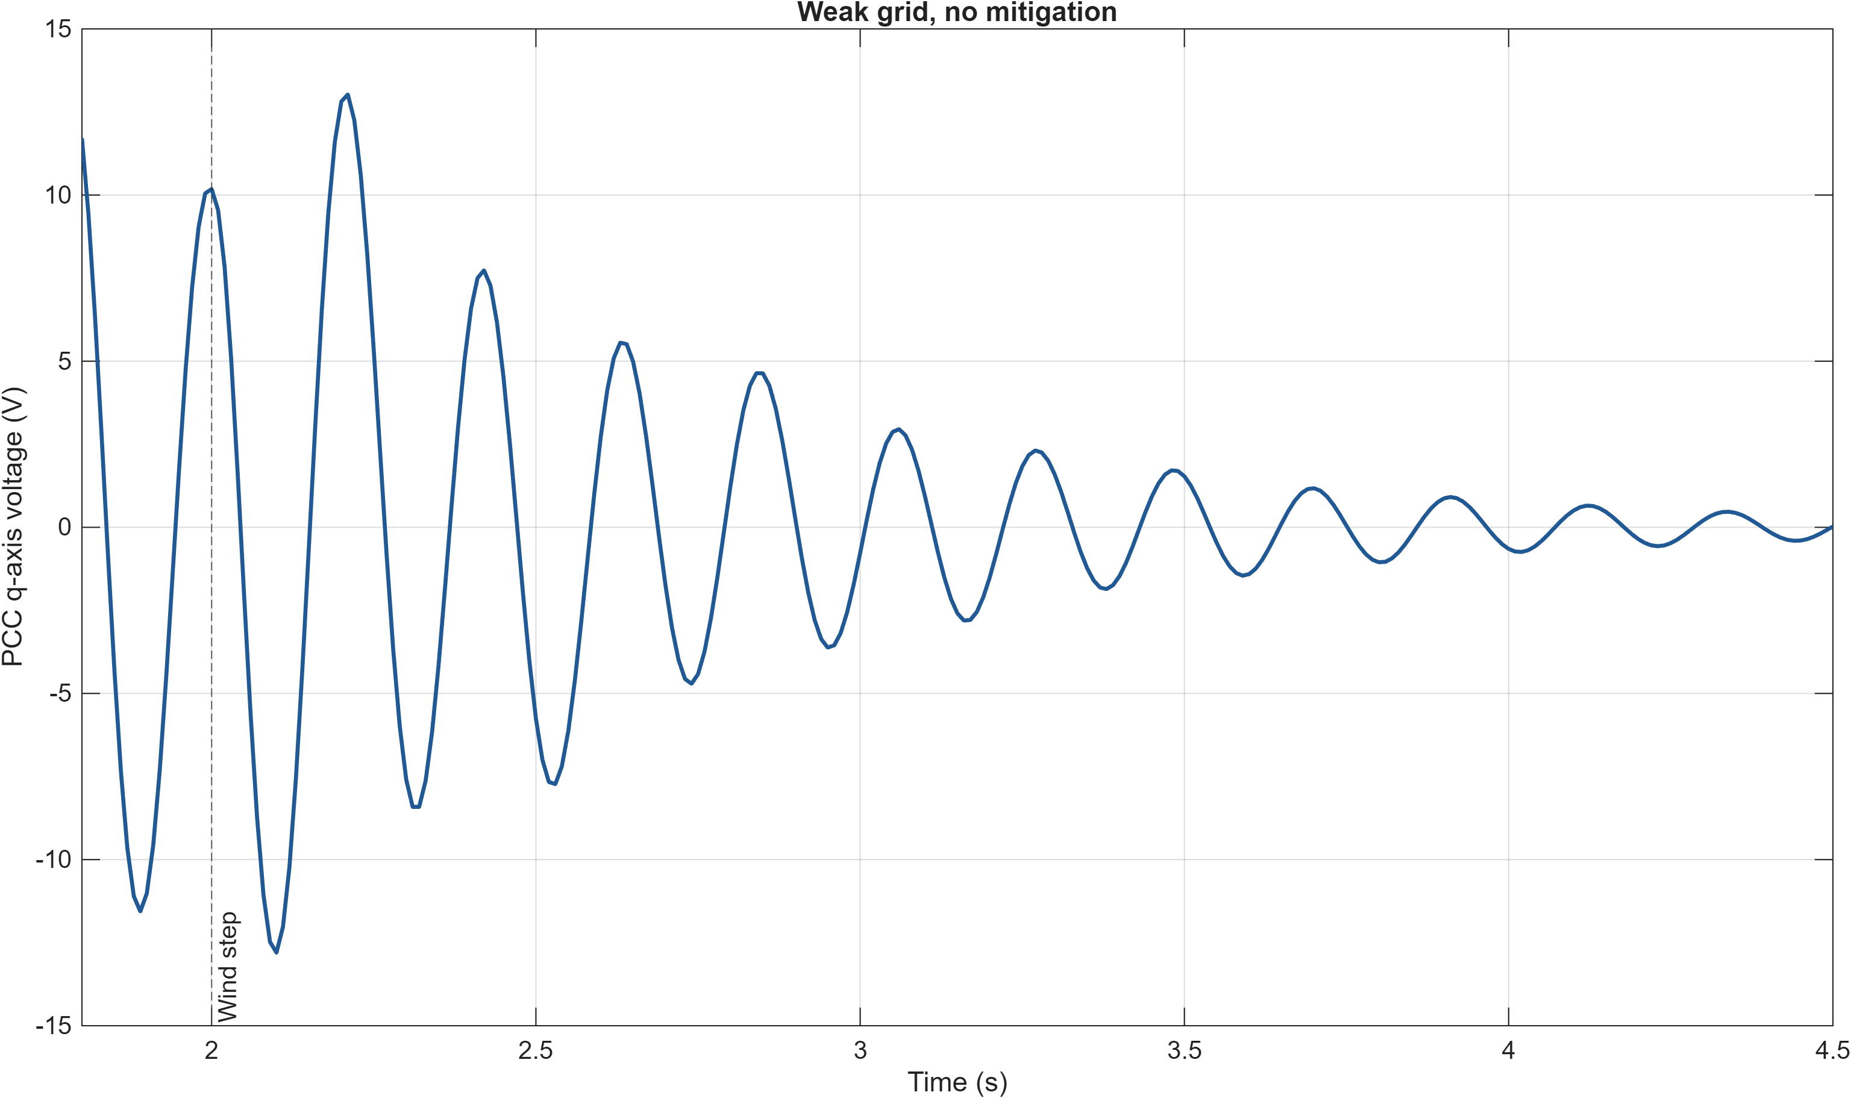
Converter Control, Grid Interaction and Subsynchronous Oscillation
MACHINE-SIDE SPEED + d/q CURRENT LOOPS
GRID-SIDE DC + d/q CURRENT + PLL LOOPS
At nominal external SCR 5, the same wind step excites a decaying 4.6–4.7 Hz network/controller mode. No oscillation is injected into the plant.
Measured peak: 4.681 Hz • Snapshot damping: 5.24%
VATaleni PMSG–SSO | 2/3
Notes:
The control images are genuine exports from the saved Simulink model. The lower graph is a native MATLAB figure generated from the final physical-model weak-grid run. The wind step at 2 s is the disturbance. External SCR refers to the separately modelled grid impedance. Reference: Wang et al., DOI 10.1109/EI247390.2019.9061793; project technical report.

Slide 3
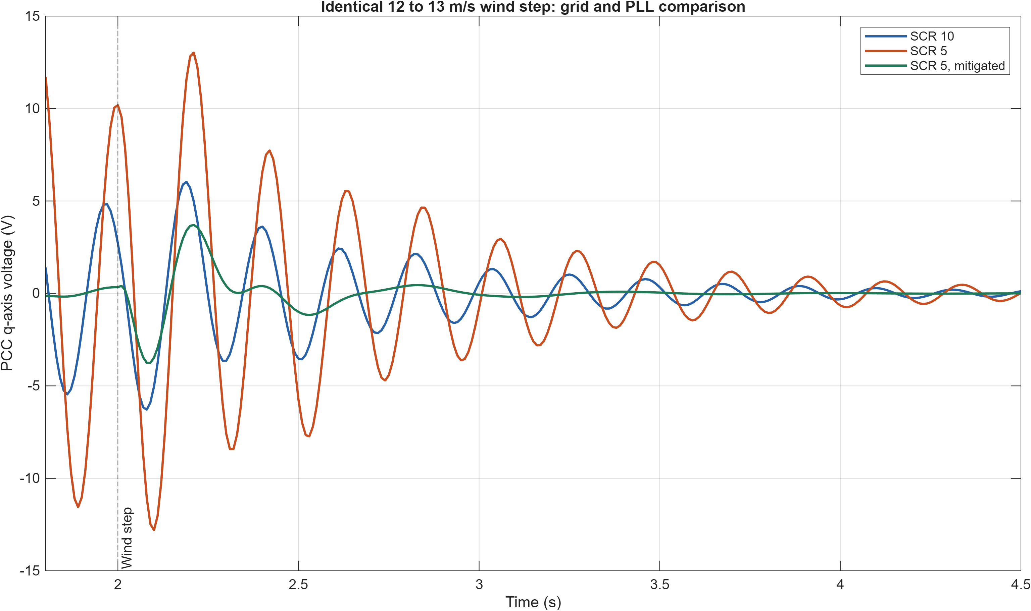
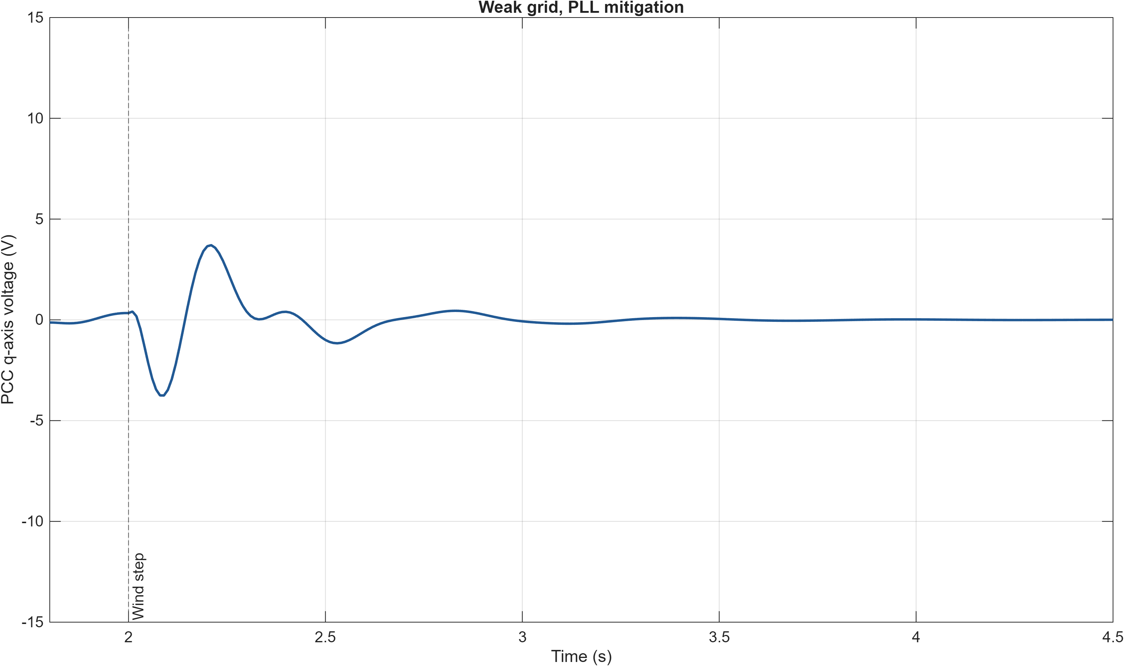
Simulation Results and SSO Mitigation Performance
WEAK GRID — UNMITIGATED
WEAK GRID — PLL RETUNED
Early PCC q-voltage variation (2.25–3.25 s)
SCR 10: 1.788 V • SCR 5: 3.997 V • mitigated: 0.554 V
PLL Kp 0.00558 → 0.02 rad/(s·V); matched 4.6 Hz mode damping 5.24% → 18.99%. The response decays in all tested runs.
VATaleni PMSG–SSO | 3/3
Notes:
Both left plots have identical axes and are native MATLAB exports from the final saved physical SLX. The comparison is from identical 12 to 13 m/s wind steps at 2 s. Early values are standard deviations of PCC q-axis voltage over 2.25–3.25 s. The 4.6 Hz mode is the matched snapshot linearization mode, not the least-damped mitigated mode overall. No unstable SSO or site-specific prediction is claimed. Source: project technical and verification reports.

