Slide 1
Linker & Loader

Slide 2
C program
Starting A Program
Compiler
Transforms the C program into an assembly language program.
Assembly language program
Assembler
Object: Machine language module
Object: Library routine (machine language)
Linker
Executable: Machine language program
Loader
Memory

Slide 3
Assembler
Assembler
The assembler turns the assembly language program into an object file.
Symbol table: A table that matches names of labels to the addresses of the memory words that instruction occupy.

Slide 4
Object file header
 | Name | Procedure A
 | Text size | 100hex
 | Data size | 20hex
Text segment | Address | Instruction
 | 0 | ld x10,0(x3)
 | 4 | Jal x1, 0
 | … | …
Data segment | O | (X)
 | … | …
Relocation information | Address | Instruction Type | Dependency
 | 0 | ld | X
 | 4 | jal | B
Symbol table | Label | Address
 | X | —
 | B | —
ld x10, x
jal x1, B

Slide 5
Assembler (cont.)
Psudoinstruction: a common variation of assembly language instructions often treated as if it were an instruction in its own right.
li x9, 123 -> addi x9, x0, 123
mv x10, x11 -> addi x10, x11, 0

Slide 6
Linker (Link editor)
Linker takes all the independently assembled machine language programs and “stitches” them together to produce an executable file that can be run on a computer.
There are three steps for the linker:
Place code and data modules symbolically in memory.
Determine the addresses of data and instruction labels.
Patch both the internal and external references.

Slide 7
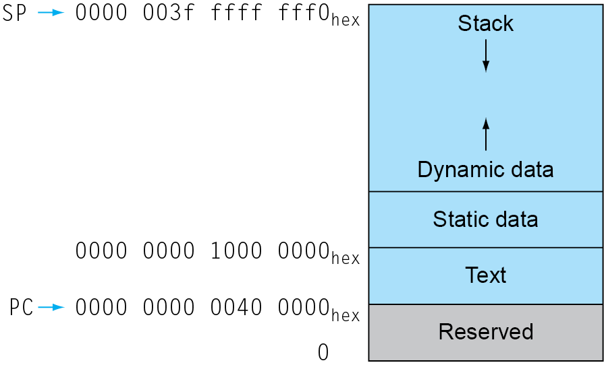
Object file header
 | Name | Procedure A
 | Text size | 100hex
 | Data size | 20hex
Text segment | Address | Instruction
 | 0 | ld x10 , 0(x3)
 | 4 | jal x1,0
 | … | …
Data segment | O | (X)
 | … | …
Relocation information | Address | Instruction Type | Dependency
 | 0 | ld | X
 | 4 | jal | B
Symbol table | Label | Address
 | X | —
 | B | —
x3
Executable file header
 | Text size | 300hex
 | Data size | 50hex
Text segment | Address | Instruction
 | 0040 0000hex | ld $x10, 0 (x3)
 | 0040 0004hex | Jal x1, 252ten
 | … | …
 | 0040 0100hex | sd $x11, 32 (x3)
 | 0040 0104hex | jal x1, -260ten
 | … | …
Data segment | Address
 | 1000 0000hex | (X)
 | … | …
 | 1000 0020hex | (Y)
 | … | …
Object file header
 | Name | Procedure B
 | Text size | 200hex
 | Data size | 30hex
Text segment | Address | Instruction
 | 0 | sd $x11, 0(x3)
 | 4 | jal x1, 0
 | … | …
Data segment | O | (Y)
 | … | …
Relocation information | Address | Instruction Type | Dependency
 | 0 | sd | Y
 | 4 | jal | A
Symbol table | Label | Address
 | Y | —
 | A | —
Notes:
How to represent -8000 in two’s complement
1000,0000,0000,0000
0111,1111,1111,1111 + 1 = 8000,0000,0000,0000

Slide 8
Loader
Read the executables file header to determine the size of the text and data segments
Creates an address space large enough for the text and data
Copies the instructions and data from the executable file into memory
Copies the parameters (if any) to the main program onto the stack
Initializes the machine registers and sets the stack pointer the first free location
Jump to a start-up routine
main();
_start_up:
lw a0, offset($sp) ## load arguments
jal main;
exit

Slide 9
Loading a Program
Load from image file on disk into memory
1. Read header to determine segment sizes
2. Create virtual address space
3. Copy text and initialized data into memory
Or set page table entries so they can be faulted in
4. Set up arguments on stack
5. Initialize registers (including sp, fp, gp)
6. Jump to startup routine
Copies arguments to x10, … and calls main
When main returns, do exit syscall
main();
_start_up:
lw x10, offset($sp) ## load arguments
jal x1, main;
exit

Slide 10
Dynamically Linked Libraries (DLL)
Disadvantages with traditional statically linked library
Library updates
Loading the whole library even if all of the library is not used
Dynamically linked library
The libraries are not linked and loaded until the program is run.
Lazy procedure linkage
Each routine is linked only after it is called.

Slide 11
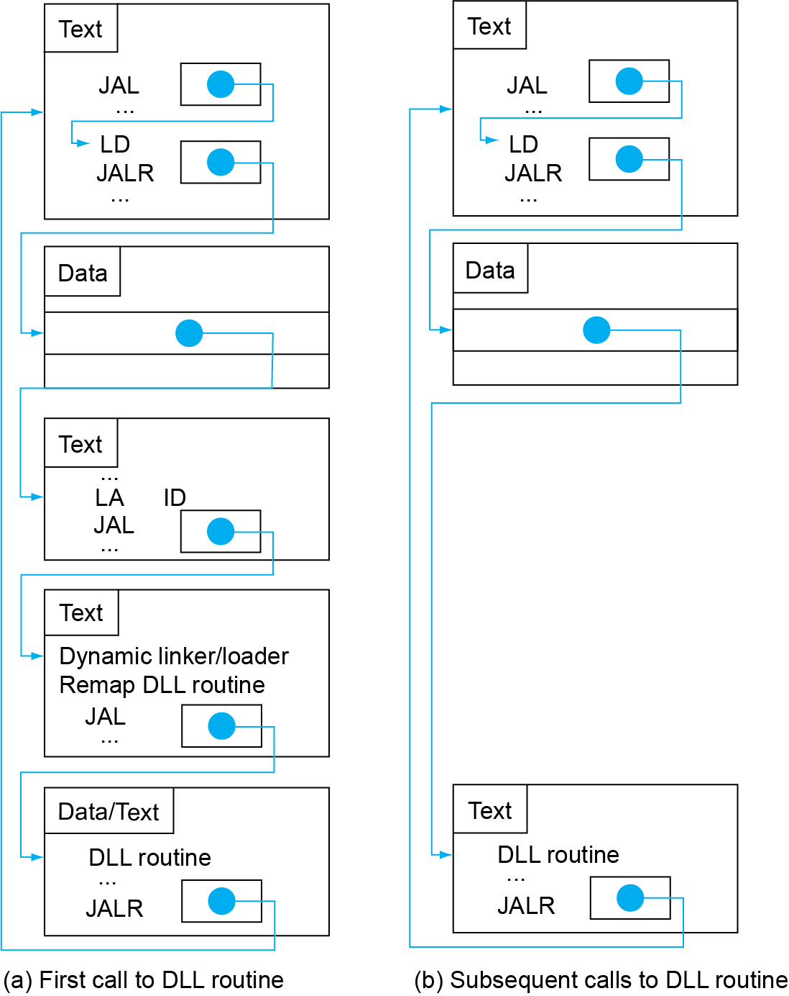
Lazy Linkage
Indirection table
Stub: Loads routine ID, Jump to linker/loader
Linker/loader code
Dynamically mapped code

Slide 12
Text
jal printf();
printf ()
{ lD x5, printf_addr
JALR x0, 0(x5)}
Data
printf_addr .word L1
Data
printf_addr 0x400000
Text
L1: LA ID
JAL x1, DLL;
Text
printf()
:::::::
JALR x0, 0(x1)
Assume this is loaded into
0x400000

Slide 13
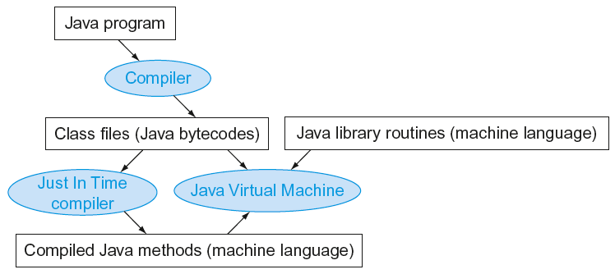
Starting Java Applications
Simple portable instruction set for the JVM
Compiles bytecodes of “hot” methods into native code for host machine
Interprets bytecodes

Slide 14
MIPS Instructions
MIPS: commercial predecessor to RISC-V
Similar basic set of instructions
32-bit instructions
32 general purpose registers, register 0 is always 0
32 floating-point registers
Memory accessed only by load/store instructions
Consistent use of addressing modes for all data sizes
Different conditional branches
For <, <=, >, >=
RISC-V: blt, bge, bltu, bgeu
MIPS: slt, sltu (set less than, result is 0 or 1)
Then use beq, bne to complete the branch
§2.16 Real Stuff: MIPS Instructions

Slide 15
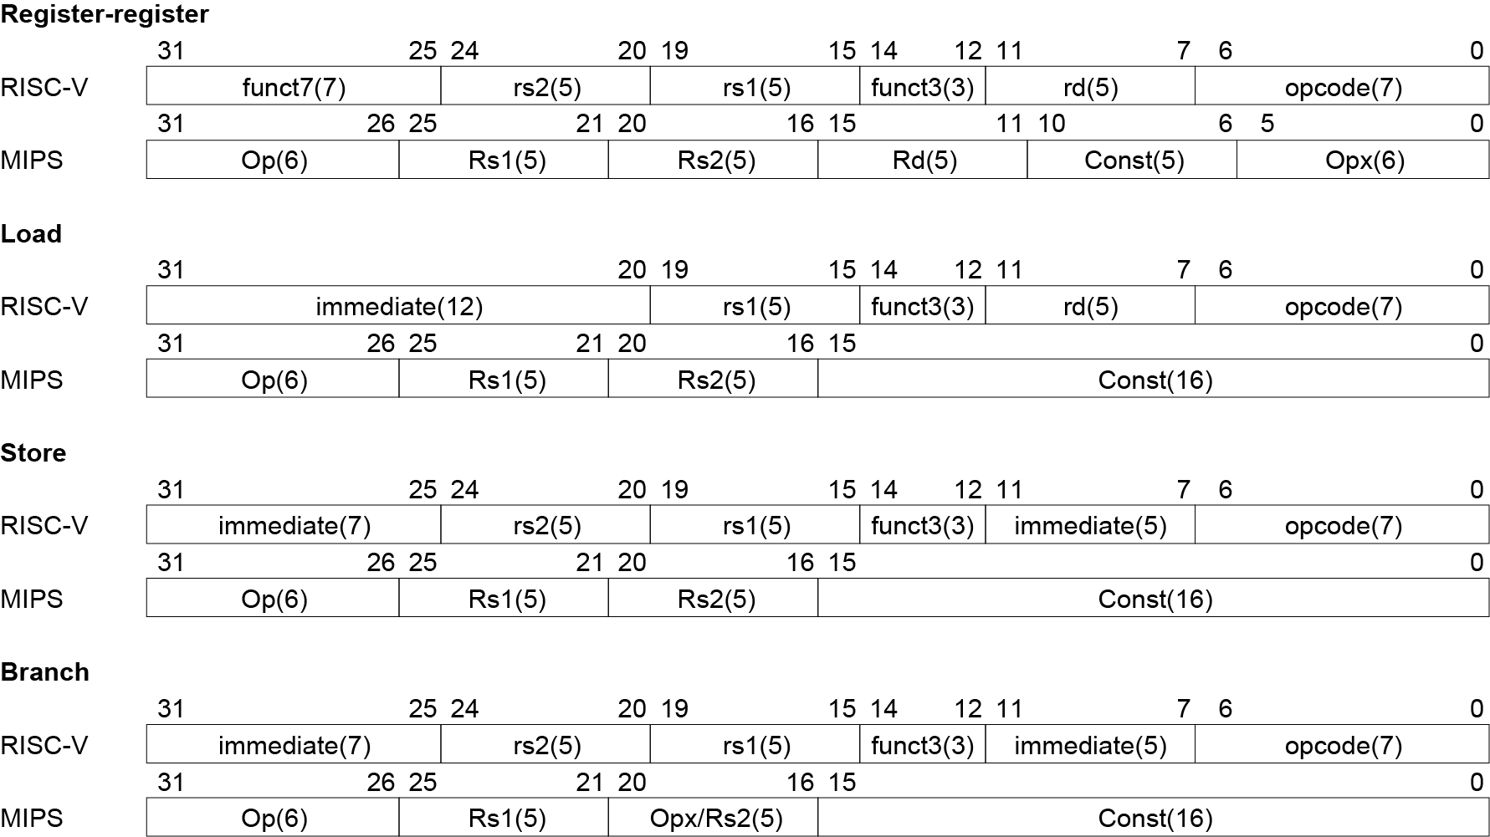
Instruction Encoding

Slide 16
The Intel x86 ISA
Evolution with backward compatibility
8080 (1974): 8-bit microprocessor
Accumulator, plus 3 index-register pairs
8086 (1978): 16-bit extension to 8080
Complex instruction set (CISC)
8087 (1980): floating-point coprocessor
Adds FP instructions and register stack
80286 (1982): 24-bit addresses, MMU
Segmented memory mapping and protection
80386 (1985): 32-bit extension (now IA-32)
Additional addressing modes and operations
Paged memory mapping as well as segments
§2.17 Real Stuff: x86 Instructions

Slide 17
The Intel x86 ISA
Further evolution…
i486 (1989): pipelined, on-chip caches and FPU
Compatible competitors: AMD, Cyrix, …
Pentium (1993): superscalar, 64-bit datapath
Later versions added MMX (Multi-Media eXtension) instructions ~ 57 instructions
The infamous FDIV bug
Pentium Pro (1995), Pentium II (1997)
New microarchitecture (see Colwell, The Pentium Chronicles)
Pentium III (1999)
Added SSE (Streaming SIMD Extensions) and associated registers ~ 70 instructions
Pentium 4 (2001)
New microarchitecture
Added SSE2 instructions ~ 144 instructions

Slide 18
The Intel x86 ISA
And further…
AMD64 (2003): extended architecture to 64 bits
EM64T – Extended Memory 64 Technology (2004)
AMD64 adopted by Intel (with refinements)
Added SSE3 instructions
Intel Core (2006)
Added SSE4 instructions, virtual machine support
AMD64 (announced 2007): SSE5 instructions
Intel declined to follow, instead…
Advanced Vector Extension (announced 2008)
Longer SSE registers, more instructions
If Intel didn’t extend with compatibility, its competitors would!
Technical elegance ≠ market success

Slide 19
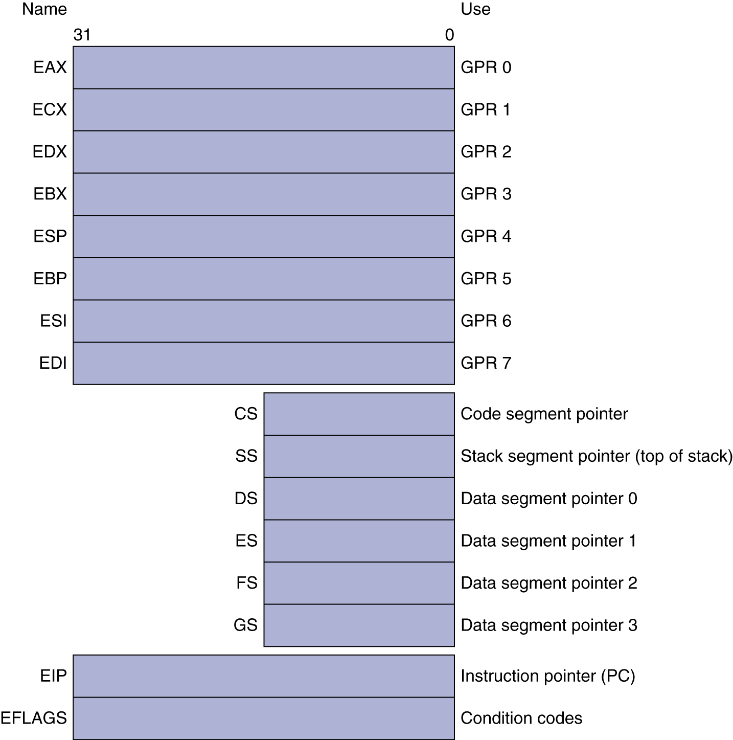
Basic x86 Registers

Slide 20
Basic x86 Addressing Modes
Two operands per instruction
Source/dest operand | Second source operand
Register | Register
Register | Immediate
Register | Memory
Memory | Register
Memory | Immediate
Memory addressing modes
Address in register
Address = R_{base} + displacement
Address = R_{base} + 2^{scale} × R_{index} (scale = 0, 1, 2, or 3)
Address = R_{base} + 2^{scale} × R_{index} + displacement

Slide 21
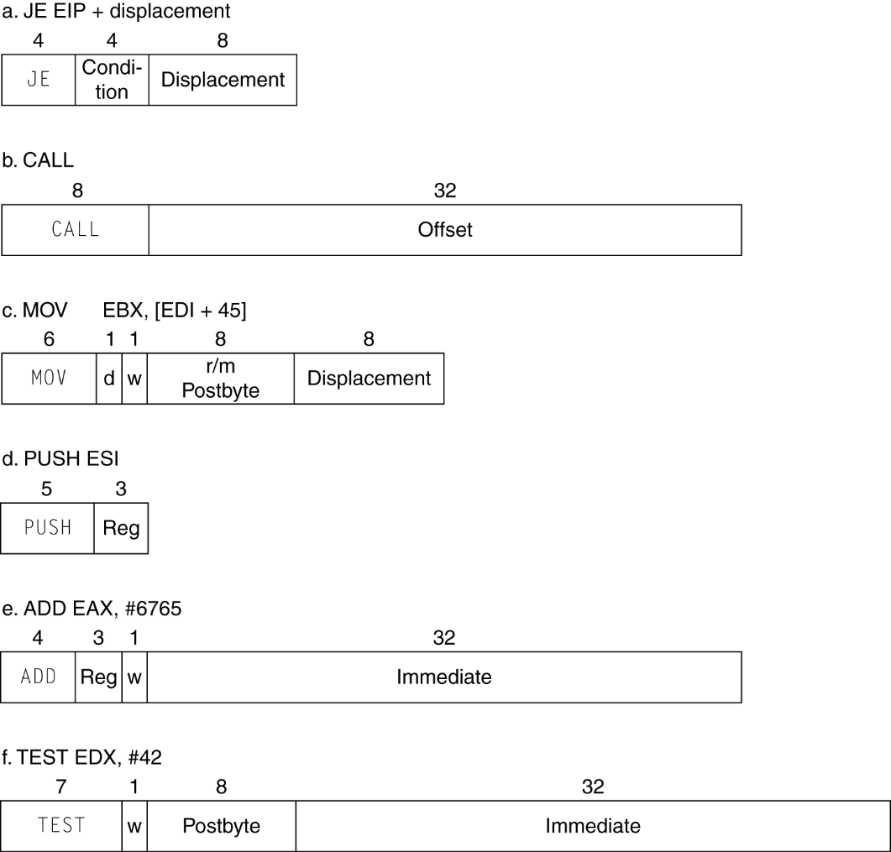
x86 Instruction Encoding
Variable length encoding
Postfix bytes specify addressing mode
Prefix bytes modify operation
Operand length, repetition, locking, …

Slide 22
Implementing IA-32
Complex instruction set makes implementation difficult
Hardware translates instructions to simpler microoperations
Simple instructions: 1–1
Complex instructions: 1–many
Microengine similar to RISC
Market share makes this economically viable
Comparable performance to RISC
Compilers avoid complex instructions

Slide 23
Effect of Compiler Optimization
Compiled with gcc for Pentium 4 under Linux

Slide 24
Effect of Language and Algorithm

Slide 25
Fallacies
Powerful instruction ⇒ higher performance
Fewer instructions required
But complex instructions are hard to implement
May slow down all instructions, including simple ones
Compilers are good at making fast code from simple instructions
Use assembly code for high performance
But modern compilers are better at dealing with modern processors
More lines of code ⇒ more errors and less productivity
§2.19 Fallacies and Pitfalls

Slide 26
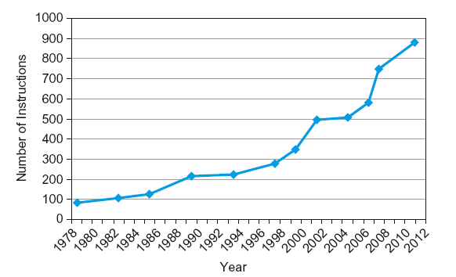
Fallacies
Backward compatibility ⇒ instruction set doesn’t change
But they do accrete more instructions
x86 instruction set

