Slide 1
Multiple Issue Processsor
Lecture 7: Pipelining (III)
Notes:
Lecture 9: need more preparation

Slide 2
Multiple Issue
Static multiple issue
  Compiler groups instructions to be issued together
  Packages them into “issue slots”
  Compiler detects and avoids hazards
Dynamic multiple issue
  CPU examines instruction stream and chooses instructions to issue each cycle
  Compiler can help by reordering instructions
  CPU resolves hazards using advanced techniques at runtime
IF | ID | EX | MEM | WB
IF | ID | EX | MEM | WB
 | IF | ID | EX | MEM | WB
 | IF | ID | EX | MEM | WB
 |  | IF | ID | EX | MEM | WB
 |  | IF | ID | EX | MEM | WB
Notes:
Morgan Kaufmann Publishers
Chapter 4 — The Processor

Slide 3
Speculation
“Guess” what to do with an instruction
  Start operation as soon as possible
  Check whether guess was right
    If so, complete the operation
    If not, roll-back and do the right thing
Common to static and dynamic multiple issue
Examples
  Speculate on branch outcome
    Roll back if path taken is different
  Speculate on load
    Roll back if location is updated
Chapter 4 — The Processor — <number>
Notes:
Morgan Kaufmann Publishers
Chapter 4 — The Processor

Slide 4
Compiler/Hardware Speculation
Compiler can reorder instructions
  e.g., move load before branch
  Can include “fix-up” instructions to recover from incorrect guess
Hardware can look ahead for instructions to execute
  Buffer results until it determines they are actually needed
  Flush buffers on incorrect speculation
Chapter 4 — The Processor — <number>
Notes:
Morgan Kaufmann Publishers
Chapter 4 — The Processor

Slide 5
Speculation and Exceptions
What if exception occurs on a speculatively executed instruction?
  e.g., speculative load before null-pointer check
Static speculation
  Can add ISA support for deferring exceptions
Dynamic speculation
  Can buffer exceptions until instruction completion (which may not occur)
Chapter 4 — The Processor — <number>
Notes:
Morgan Kaufmann Publishers
Chapter 4 — The Processor

Slide 6
Static Multiple Issue
Compiler groups instructions into “issue packets”
  Group of instructions that can be issued on a single cycle
  Determined by pipeline resources required
Think of an issue packet as a very long instruction
  Specifies multiple concurrent operations
  ⇒ Very Long Instruction Word (VLIW)
Chapter 4 — The Processor — <number>
Notes:
Morgan Kaufmann Publishers
Chapter 4 — The Processor

Slide 7
Scheduling Static Multiple Issue
Compiler must remove some/all hazards
  Reorder instructions into issue packets
  No dependencies with a packet
  Possibly some dependencies between packets
    Varies between ISAs; compiler must know!
  Pad with nop if necessary
Chapter 4 — The Processor — <number>
Notes:
Morgan Kaufmann Publishers
Chapter 4 — The Processor

Slide 8
RISC-V with Static Dual Issue
Two-issue packets
  One ALU/branch instruction
  One load/store instruction
  64-bit aligned
    ALU/branch, then load/store
    Pad an unused instruction with nop
Address | Instruction type | Pipeline Stages
n | ALU/branch | IF | ID | EX | MEM | WB
n + 4 | Load/store | IF | ID | EX | MEM | WB
n + 8 | ALU/branch |  | IF | ID | EX | MEM | WB
n + 12 | Load/store |  | IF | ID | EX | MEM | WB
n + 16 | ALU/branch |  |  | IF | ID | EX | MEM | WB
n + 20 | Load/store |  |  | IF | ID | EX | MEM | WB
Chapter 4 — The Processor — <number>
Notes:
Morgan Kaufmann Publishers
Chapter 4 — The Processor

Slide 9
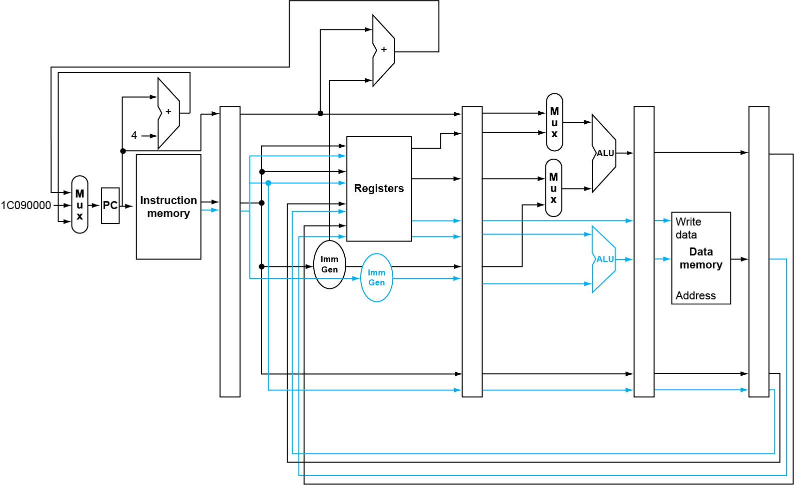
RISC-V with Static Dual Issue
Chapter 4 — The Processor — <number>
Notes:
Morgan Kaufmann Publishers
Chapter 4 — The Processor

Slide 10
Hazards in the Dual-Issue RISC-V
More instructions executing in parallel
EX data hazard
  Forwarding avoided stalls with single-issue
  Now can’t use ALU result in load/store in same packet
    add x10, x0, x1
    ld x2, 0(x10)
    Split into two packets, effectively a stall
Load-use hazard
  Still one cycle use latency, but now two instructions
More aggressive scheduling required
Chapter 4 — The Processor — <number>
Notes:
Morgan Kaufmann Publishers
Chapter 4 — The Processor

Slide 11
Scheduling Example
Schedule this for dual-issue RISC-V
Loop: ld x31,0(x20) // x31=array element
add x31,x31,x21 // add scalar in x21
sd x31,0(x20) // store result
addi x20,x20,-8 // decrement pointer
blt x22,x20,Loop // branch if x22 < x20
 | ALU/branch | Load/store | cycle
Loop: |  |  | 1
 |  |  | 2
 |  |  | 3
 |  |  | 4
  IPC =
Notes:
Morgan Kaufmann Publishers
Chapter 4 — The Processor

Slide 12
Scheduling Example
Schedule this for dual-issue RISC-V
Loop: ld x31,0(x20) // x31=array element
add x31,x31,x21 // add scalar in x21
sd x31,0(x20) // store result
addi x20,x20,-8 // decrement pointer
blt x22,x20,Loop // branch if x22 < x20
 | ALU/branch | Load/store | cycle
Loop: |  |  | 1
 |  |  | 2
 |  |  | 3
 |  |  | 4
nop
ld x31, 0(x20)
addi x20, x20,–8
nop
add x31, x31, x21
nop
blt x22, x20, Loop
sd x31, 0(x20)
  IPC = 5/4 = 1.25 (c.f. peak IPC = 2)
Notes:
Morgan Kaufmann Publishers
Chapter 4 — The Processor

Slide 13
Loop Unrolling
Replicate loop body to expose more parallelism
  Reduces loop-control overhead
Use different registers per replication
  Called “register renaming”
  Avoid loop-carried “anti-dependencies”
    Store followed by a load of the same register
    Aka “name dependence”
      Reuse of a register name
Notes:
Morgan Kaufmann Publishers
Chapter 4 — The Processor

Slide 14
Loop: ld x31,0(x20) // x31=array element
add x31,x31,x21 // add scalar in x21
sd x31,0(x20) // store result
addi x20,x20,-8 // decrement pointer
blt x22,x20,Loop // branch if x22 < x20

Slide 15
Unrolled Loop That Minimizes Stalls
Renaming
Loop: ld x31, 0(x20)
add x31, x31, x21
sd x31, 0(x20)
ld x31, -8(x20)
add x31, x31, x21
sd x31, -8(x20)
ld x31, -16(x20)
add x31, x31, x21
sd x31, -16(x20)
ld x31, -24(x20)
add x31, x31, x21
sd x31, -24(x20)
addi x20, x20,–32
blt x22,x20,Loop
Loop: ld x31, 0(x20)
add x31, x31, x21
sd x31, 0(x20)
ld x30, -8(x20)
add x30, x30, x21
sd x30, -8(x20)
ld x29, -16(x20)
add x29, x29, x21
sd x29, -16(x20)
ld x28, -24(x20)
add x28, x28, x21
sd x28, -24(x20)
addi x20, x20,–32
blt x22,x20,Loop

Slide 16
Loop Unrolling Example
ld x31, 0(x20)
add x31, x31, x21
sd x31, 0(x20)
ld x30, -8(x20)
add x30, x30, x21
sd x30, -8(x20)
ld x29, -16(x20)
add x29, x29, x21
sd x29, -16(x20)
ld x28, -24(x20)
add x28, x28, x21
sd x28, -24(x20)
addi x20, x20,–32
blt x22, x20, Loop
 | ALU/branch | Load/store | cycle
Loop: |  |  | 1
 |  |  | 2
 |  |  | 3
 |  |  | 4
 |  |  | 5
 |  |  | 6
 |  |  | 7
 |  |  | 8
 |  |  | 9
 |  |  | 10
Notes:
Morgan Kaufmann Publishers
Chapter 4 — The Processor

Slide 17
Loop Unrolling Example
ld x31, 0(x20)
add x31, x31, x21
sd x31, 0(x20)
ld x30, -8(x20)
add x30, x30, x21
sd x30, -8(x20)
ld x29, -16(x20)
add x29, x29, x21
sd x29, -16(x20)
ld x28, -24(x20)
add x28, x28, x21
sd x28, -24(x20)
addi x20, x20,–32
blt x22, x20, Loop
 | ALU/branch | Load/store | cycle
Loop: |  |  | 1
 |  |  | 2
 |  |  | 3
 |  |  | 4
 |  |  | 5
 |  |  | 6
 |  |  | 7
 |  |  | 8
 |  |  | 9
 |  |  | 10
addi x20, x20,–32
ld x31, 0(x20)
ld x30, -8(x20)
add x31, x31, x21
ld x29, -16(x20)
add x30, x30, x21
sd x31, 0(x20)
add x29, x29, x21
sd x30, -8(x20)
sd x29, -16(x20)
ld x28, -24(x20)
add x28, x28, x21
sd x28, -24(x20)
Original version
Notes:
Morgan Kaufmann Publishers
Chapter 4 — The Processor

Slide 18
Loop Unrolling Example
ld x31, 0(x20)
add x31, x31, x21
sd x31, 0(x20)
ld x30, -8(x20)
add x30, x30, x21
sd x30, -8(x20)
ld x29, -16(x20)
add x29, x29, x21
sd x29, -16(x20)
ld x28, -24(x20)
add x28, x28, x21
sd x28, -24(x20)
addi x20, x20,–32
blt x22, x20, Loop
 | ALU/branch | Load/store | cycle
Loop: |  |  | 1
 |  |  | 2
 |  |  | 3
 |  |  | 4
 |  |  | 5
 |  |  | 6
 |  |  | 7
 |  |  | 8
 |  |  | 9
 |  |  | 10
addi x20, x20,–32
ld x31, 0(x20)
ld x30, 24(x20)
add x31, x31, x21
ld x29, 16(x20)
add x30, x30, x21
sd x31, 32(x20)
add x29, x29, x21
sd x30, 24(x20)
sd x29, 16(x20)
ld x28, 8(x20)
add x28, x28, x21
blt x22, x20, Loop
sd x28, 8(x20)
Original version
Notes:
Morgan Kaufmann Publishers
Chapter 4 — The Processor

Slide 19
Loop Unrolling Example
ld x31, 0(x20)
add x31, x31, x21
sd x31, 0(x20)
ld x30, -8(x20)
add x30, x30, x21
sd x30, -8(x20)
ld x29, -16(x20)
add x29, x29, x21
sd x29, -16(x20)
ld x28, -24(x20)
add x28, x28, x21
sd x28, -24(x20)
addi x20, x20,–32
blt x22, x20, Loop
 | ALU/branch | Load/store | cycle
Loop: |  |  | 1
 |  |  | 2
 |  |  | 3
 |  |  | 4
 |  |  | 5
 |  |  | 6
 |  |  | 7
 |  |  | 8
 |  |  | 9
 |  |  | 10
addi x20, x20,–32
ld x31, 0(x20)
ld x30, 24(x20)
add x31, x31, x21
ld x29, 16(x20)
add x30, x30, x21
sd x31, 32(x20)
add x29, x29, x21
sd x30, 24(x20)
sd x29, 16(x20)
ld x28, 8(x20)
add x28, x28, x21
blt x22, x20, Loop
sd x28, 8(x20)
Another optimization opportunity!!
Chapter 4 — The Processor — <number>
Notes:
Morgan Kaufmann Publishers
Chapter 4 — The Processor

Slide 20
Loop Unrolling Example
ld x31, 0(x20)
add x31, x31, x21
sd x31, 0(x20)
ld x30, -8(x20)
add x30, x30, x21
sd x30, -8(x20)
ld x29, -16(x20)
add x29, x29, x21
sd x29, -16(x20)
ld x28, -24(x20)
add x28, x28, x21
sd x28, -24(x20)
addi x20, x20,–32
blt x22, x20, Loop
 | ALU/branch | Load/store | cycle
Loop: |  |  | 1
 |  |  | 2
 |  |  | 3
 |  |  | 4
 |  |  | 5
 |  |  | 6
 |  |  | 7
 |  |  | 8
 |  |  | 9
 |  |  | 10
addi x20, x20,–32
ld x31, 0(x20)
nop
ld x30, 24(x20)
add x31, x31, x21
ld x29, 16(x20)
add x30, x30, x21
ld x28, 8(x20)
add x29, x29, x21
sd x31, 32(x20)
add x28, x28, x21
sd x30, 24(x20)
nop
sd x29, 16(x20)
blt x22, x20, Loop
sd x28, 8(x20)
IPC = 14/8 = 1.75
  Closer to 2, but at cost of registers and code size
Chapter 4 — The Processor — <number>
Notes:
Morgan Kaufmann Publishers
Chapter 4 — The Processor

Slide 21
Dynamic Multiple Issue
“Superscalar” processors
CPU decides whether to issue 0, 1, 2, … each cycle
  Avoiding structural and data hazards
Avoids the need for compiler scheduling
  Though it may still help
  Code semantics ensured by the CPU
Chapter 4 — The Processor — <number>
Notes:
Morgan Kaufmann Publishers
Chapter 4 — The Processor

Slide 22
Dynamic Pipeline Scheduling
Allow the CPU to execute instructions out of order to avoid stalls
  But commit result to registers in order
Example
  ld x31, 20(x21)
  add x1, x31, x2
  sub x23, x23, x3
  andi x5, x23, 20
  Can start sub while add is waiting for ld
Notes:
Morgan Kaufmann Publishers
Chapter 4 — The Processor

Slide 23
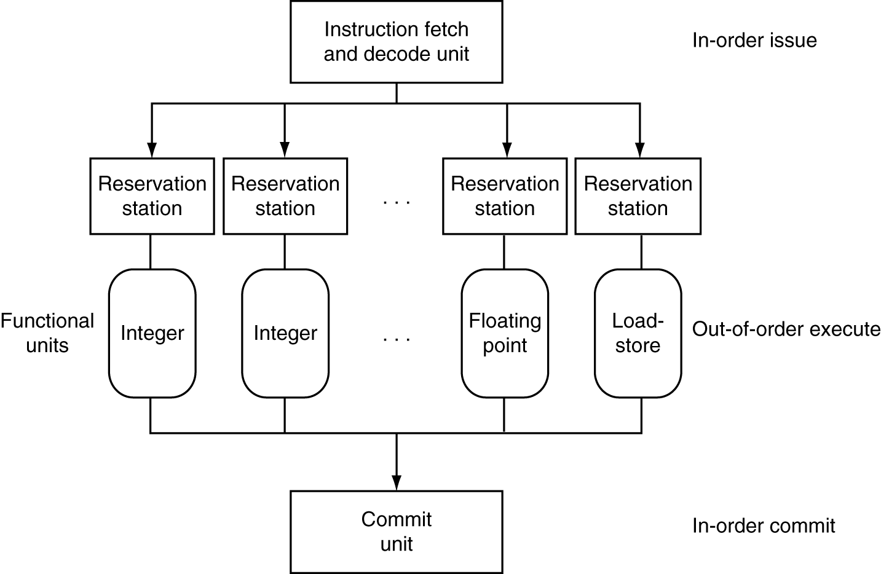
Dynamically Scheduled CPU
Preserves dependencies
Hold pending operands
Results also sent to any waiting reservation stations
Reorders buffer for register writes
Can supply operands for issued instructions
Notes:
Morgan Kaufmann Publishers
Chapter 4 — The Processor

Slide 24
Why Do Dynamic Scheduling?
Why not just let the compiler schedule code?
Not all stalls are predicable
  e.g., cache misses
Can’t always schedule around branches
  Branch outcome is dynamically determined
Different implementations of an ISA have different latencies and hazards
Notes:
Morgan Kaufmann Publishers
Chapter 4 — The Processor

Slide 25
Does Multiple Issue Work?
The BIG Picture
Yes, but not as much as we’d like
Programs have real dependencies that limit ILP
Some dependencies are hard to eliminate
  e.g., pointer aliasing
Some parallelism is hard to expose
  Limited window size during instruction issue
Memory delays and limited bandwidth
  Hard to keep pipelines full
Speculation can help if done well
Notes:
Morgan Kaufmann Publishers
Chapter 4 — The Processor

Slide 26
Power Efficiency
Complexity of dynamic scheduling and speculations requires power
Multiple simpler cores may be better
Microprocessor | Year | Clock Rate | Pipeline Stages | Issue width | Out-of-order/ Speculation | Cores | Power
i486 | 1989 | 25MHz | 5 | 1 | No | 1 | 5W
Pentium | 1993 | 66MHz | 5 | 2 | No | 1 | 10W
Pentium Pro | 1997 | 200MHz | 10 | 3 | Yes | 1 | 29W
P4 Willamette | 2001 | 2000MHz | 22 | 3 | Yes | 1 | 75W
P4 Prescott | 2004 | 3600MHz | 31 | 3 | Yes | 1 | 103W
Intel Core | 2006 | 2930MHz | 14 | 4 | Yes | 2 | 75W
UltraSparc III | 2003 | 1950MHz | 14 | 4 | No | 1 | 90W
UltraSparc T1 | 2005 | 1200MHz | 6 | 1 | No | 8 | 70W
Notes:
Morgan Kaufmann Publishers
Chapter 4 — The Processor

Slide 27
Concluding Remarks
ISA influences design of datapath and control
Datapath and control influence design of ISA
Pipelining improves instruction throughput
using parallelism
  More instructions completed per second
  Latency for each instruction not reduced
Hazards: structural, data, control
Multiple issue and dynamic scheduling (ILP)
  Dependencies limit achievable parallelism
  Complexity leads to the power wall
§4.14 Concluding Remarks
Notes:
Morgan Kaufmann Publishers
Chapter 4 — The Processor

