Slide 1
Lecture 8
Virtual Memory

Slide 2
Levels of the Memory Hierarchy
Upper Level
Capacity
Access Time
Staging
Xfer Unit
faster
CPU Registers
< 1K Bytes
0.25 – 0.5ns
Registers
Instr. Operands
prog./compiler
1-8 bytes
Cache
< 16 MB Bytes
0.5 - 25 ns
Cache
Blocks
cache cntl
8-128 bytes
Main Memory
M< 16 GBytes
80 – 250 ns
Memory
Pages
OS
512-4K bytes
Disk
100 G Bytes,
5 ms
(5,000,000 ns)
Disk
Files
user/operator
Mbytes
Larger
Tape
infinite
sec-min
Tape
Lower Level

Slide 3
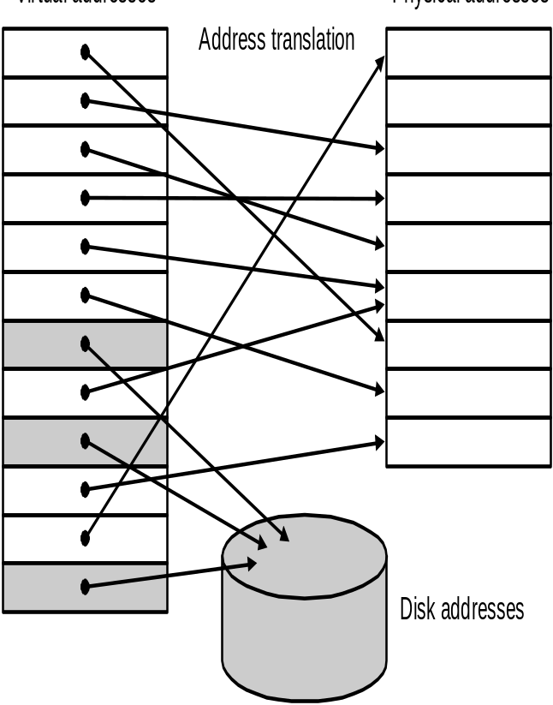
Virtual Memory: Motivation
Virtual memory is a technique that uses main memory as a “cache” for secondary storage.
Allow safe sharing of memory among multiple programs
  Each program has its own address space
  (Virtual address)
  Virtual memory implements the translation from a program’s address to physical address (provide protection)
Allow a single user program to exceed the size of physical memory
Simplify loading a program for execution by providing relocation
virtual address space
Physical memory

Slide 4
Virtual Memory Terminology
Page or segment
  A block transferred from the disk to main memory
    Page: fixed size
    Segment: variable size
Page fault
  The requested page is not in main memory (miss)
Address translation or memory mapping
  Virtual to physical address

Slide 5
Mapping from a Virtual to a Physical Address
4KB page size → 12 bits
20 bits
12 bits
Virtual address:
Virtual page #
Page offset
32 bits → 4GB address space
=
Page table
Physical address:
Physical page #
Page offset
512MB physical memory→
29 bits
17 bits
12 bits

Slide 6
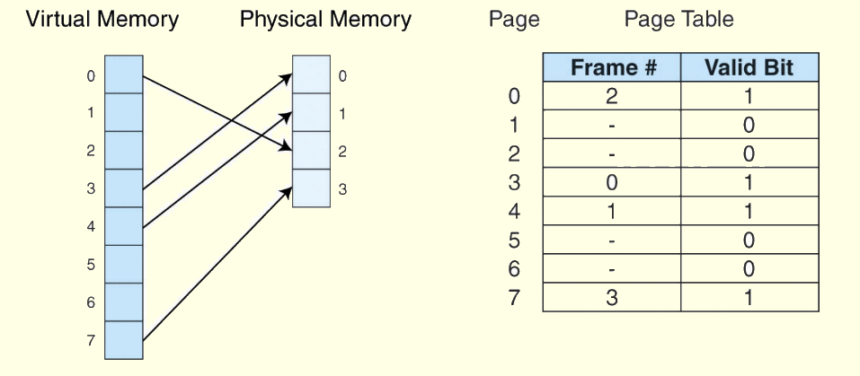
How to Find a Page: Page Table

Slide 7
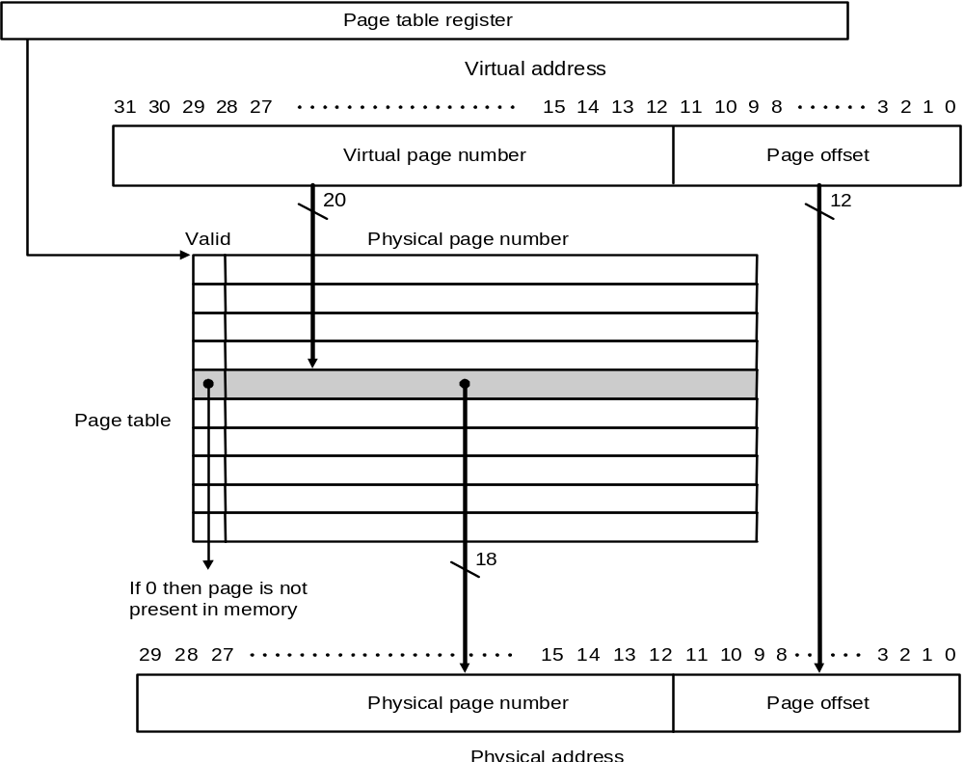
Page Table (cont.)

Slide 8
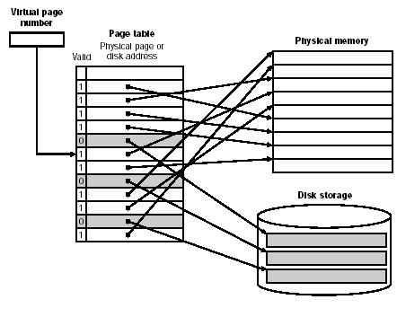
Page Fault
If the valid bit for a virtual page is off, a page fault occurs.
Page fault
An exception handler is invoked to handle the page fault
Find the page in the disk, fetch it, replace a page in the main memory
if there is no free page in the main memory

Slide 9
Key Decisions in Paging
Huge miss penalty: a page fault may take millions of cycles to process
  Pages should be fairly large (e.g., 4KB) to amortize the high access time
  Reducing page faults is important
    LRU replacement is worth the price
    fully associative placement
    => use page table (in memory) to locate pages
  Handle the faults in software instead of hardware, because handling time is small compared to disk access
    the software can be very smart or complex
    the faulting process can be context-switched
  Using write-through is too expensive, so we use write back

Slide 10
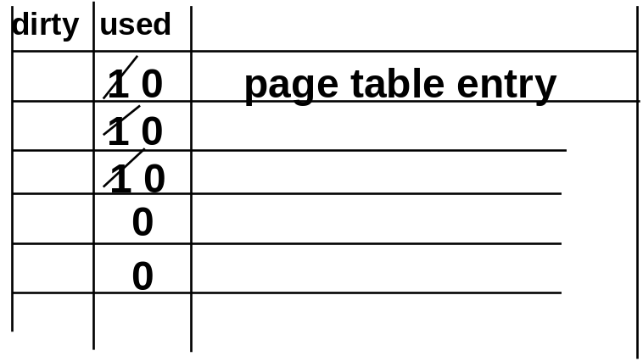
Page Replacement: 1-bit LRU
Associated with each page is a reference bit (use bit):
  Ref. bit = 1 if page has been referenced in recent past
  Ref. bit = 0 otherwise
OS periodically clears the reference bit
If replacement is necessary, choose any page frame such that its reference bit is 0. This is a page that has not been referenced in the recent past
1
1
0
1
Choose a page with (use-bit = 0)
Clear use bits periodically

Slide 11
Problems with Address Translation
Address translaction table can be very large!
  What is the size of the page table given a 32-bit virtual address, 4 KB pages, and 4 bytes per page table entry?
  Solution: inverted page table &two-level
Every memory access may need to access the main memory twice
  TLB

Slide 12
Inverted Page Table (HP, IBM)
One PTE per page frame
Pros & Cons:
  The size of table is the number of physical pages
  Must search for virtual address (using hash)
virtual page number
page offset
Inverted page table
hash
VA PA
Hash Another Table (HAT)

Slide 13
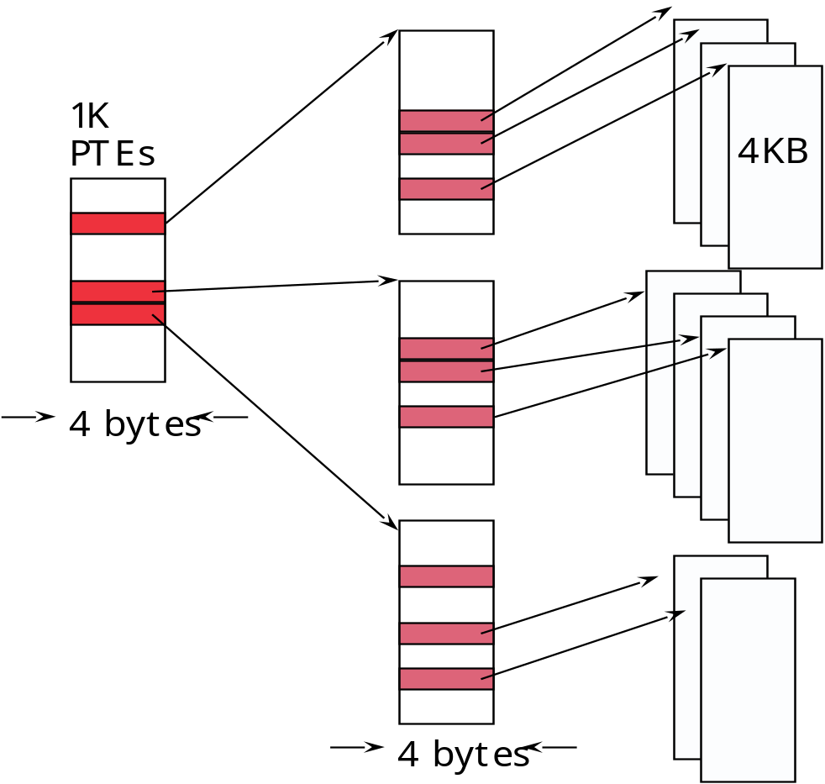
Two-level Page Tables
10
10
12
32-bit address:
4GB virtual address space
4 KB of PTE1
4 MB of PTE2
P1 index
P2 index
page offset
10
10
12
P1 index
P2 index
page offset
+
PTE1
PTE2

Slide 14
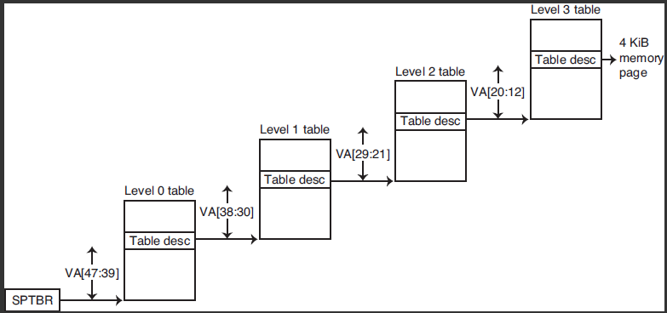
RISC-V: 4 level to translate 48-bit VA to 40-bit PA
(supervisor page table base register)

Slide 15
Fast Translation: Translation Look-aside Buffer (TLB)
Memory
TLB
Page Table
tag
Data
0
2
0
2
3
3
1
-
6
0
2
-
7
1
3
3
4
-
virtual page number
Physical page number
5
-
6
0
7
1
TLB: Cache of translated addresses

Slide 16
Fast Translation: Translation Look-aside Buffer (TLB)
Example: 48-bit virtual address, 44-bit physical address, 8K page, 128 entry fully associative
Address space #
<8>
page frame address <35>
page offset <13>
ASN Prot V Tag <35> Physical page # <31>
::::
<13>
44-bit
physical
address
128:1 Mux
<31 >

Slide 17
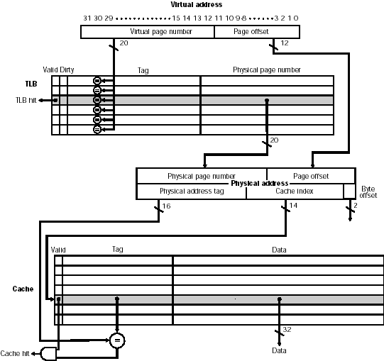
Integrating Virtual Memory, TLBs, and Caches- Intrinsity FastMATH

Slide 18


CPU
Memory request
Virtual Address
Physical Address
Page number(0x03)
Offset
TLB
V
D
Virtual Page Addr.
Physical Page Addr.
1. Check TLB
No 0x03 found
➔TLB miss
1
1
00
0
07
V
D
tag
block
0
5A
2. Check Page Table
➔0x03 is in disk
➔ page fault!
1
0
B3
…
1
1
A0
Y
1
0
C1
Cache
Page Table
DRAM
Data
0x00
0x00
0x01
0x01
0x02
0x02
0x03
0
0x04
0x33
…
…
0xFF
0x4F

Slide 19

CPU
Virtual Address
Physical Address
Page number(0x03)
Offset
TLB
V
D
Virtual Page Addr.
Physical Page Addr.
1. Check TLB
No 0x03 found
➔TLB miss
1
1
00
0
07
V
D
tag
block
0
5A
2. Check Page Table
➔0x03 is in disk
➔ page fault!
1
0
B3
…
1
1
A0
Y
1
0
C1
Cache
Page Table
DRAM
Data
0x00
3. Load,
Update Page Table
➔0x03 now in 0x3A
0x00
0x01
0x01
0x02
0x02
0x03
1
0x3A
0x04
…
0x33
0x3A
…
…
0xFF
0x4F

Slide 20

CPU
Virtual Address
Physical Address
Page number(0x03)
Offset
TLB
V
D
Virtual Page Addr.
Physical Page Addr.
1. Check TLB
No 0x03 found
➔TLB miss
1
1
00
0
03
3A
V
D
tag
block
1
0
07
0
5A
4. Update TLB
➔0x03 now in 0x3A
2. Check Page Table
➔0x03 is in disk
➔ page fault!
1
0
B3
…
1
1
A0
Y
1
0
C1
Cache
Page Table
DRAM
Data
0x00
3. Load,
Update Page Table
➔0x03 now in 0x3A
0x00
0x01
0x01
0x02
0x02
0x03
1
0x3A
0x04
…
0x33
0x3A
…
…
0xFF
0x4F

Slide 21




CPU
Virtual Address
Physical Address
Page number(0x03)
Offset
Memory Access
Address translation:
0x03➔3A
0x3A
offset
TLB
tag
index
Blk
V
D
Virtual Page Addr.
Physical Page Addr.
X
2
ID
1. Check TLB
0x03 found and valid!
➔TLB hit
Valid?, X==Y?
1
1
00
=
1
0
03
3A
V
D
tag
block
=
0
5A
=
1
0
B3
=
…
1
1
A0
Y
=
1
0
C1
=
Cache
Page Table
DRAM
Cache miss
Data
0x00
0x00
0x01
0x01
0x02
0x02
0x03
0x3A
0x04
…
0x33
0x3A
…
…
0xFF
0x4F

Slide 22
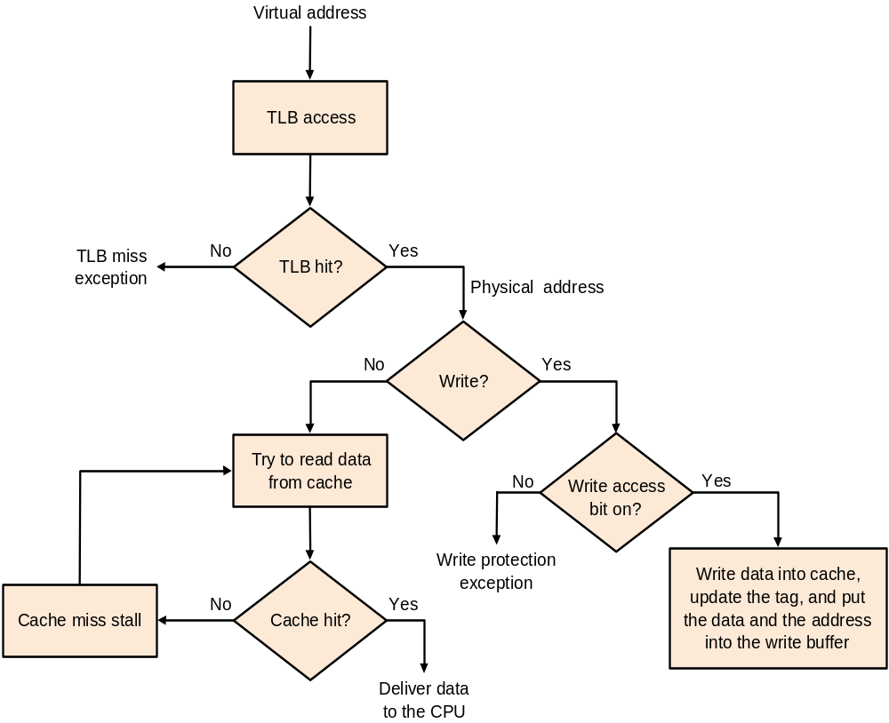
Processing in TLB+Cache
Page table
Hit?
Update TLB
Page fault

Slide 23
Possible Combinations of Events
TLB | Page table | Cache | Possible? If so, under what situations
Hit | Hit | Miss | Possible, although the page table is never really checked if TLB hits.
Miss | Hit | Hit | TLB misses, but retry found in page table; after retry, data found in cache.
Miss | Hit | Miss | TLB misses, but retry found in page table; after retry, data misses in cache.
Miss | Miss | Miss | TLB misses and is followed by a page fault; after retry, data misses in cache.
Hit | Miss | Miss | Impossible: cannot have a translation in TLB if page is not present in memory.
Hit | Miss | Hit | Impossible; cannot have a translation in TLB if page is not present in memory.
Miss | Miss | Hit | Impossible: data cannot be allowed in cache if the page is not in memory.

Slide 24
TLB & Caches
CPU
CPU
VA
VA
TB
VA
Tags
$
PA
VA
$
TB
PA
PA
MEM
MEM
Conventional
Organization
Virtually Addressed Cache
Translate only on miss
Problem: long cache access latency

Slide 25
Virtual Cache
Advantage:
  Avoid address translation before accessing cache
    Faster hit time
Problems:
  How do we distinguish data of different processes?
    Flush the cache during context switch
    Add processor id (PID) to cache
  I/O (physical address) must interact with cache
    Physical -> virtual address translation
  Aliases (Synonyms)
    Two virtual addresses map to the same physical addresses
      Two identical copies in the cache
Process A
Address Space
X
X
Y
Y
Physical Memory
Cache
Process B
Address Space

Slide 26
Virtually indexed & physically tagged cache
CPU
VA
Overlap the time to
read the tags with address translation
PA
Tags
$
TB
PA
MEM
It is actually a physical cache but we can find the set using a virtual address

Slide 27
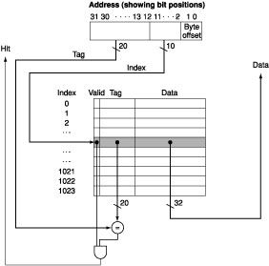
virtual address
page offset <13>
ASN Prot V Tag <35> Physical page # <31>
::::
Step1:Read tag
<13>
overlap step1
44-bit
physical
address
128:1 Mux
<31 >
Physical address
step2: tag comparison
step3: physical addr
Step1:Read tag
step2: tag comparison
Use the part of addresses that is not affected by address translation to index a cache
  Which part of an address can we use?

Slide 28
Virtually indexed & physically tagged cache (cont.)
What is the size of index & block-offset for a
4K direct-mapped cache?
Do two addresses with the same lower 12 bits map to the same set for a 4K direct-mapped cache?
Assume a 4K page. The lower 12 bits of a virtual address is the same as its physical address.
  -- We can find the cache set using the virtual address
If page size = 4K, what is the size limitation on a direct-mapped, virtually indexed, physically tagged cache?
< 12 >
4K
Direct-Mapped
VA: 0x000c00ff
index bit block offset
PA: 0x000100ff
index bit block offset
page offset

Slide 29
A Common Framework for Memory Hierarchies
Four questions for memory hierarchy:
  Where can a block be placed in upper level?
    Block placement: one place (direct mapped), a few places (set associative), or any place (fully associative)
  How is a block found if it is in the upper level?
    Block identification: indexing, limited search, full search, lookup table
  Which block should be replaced on a miss?
    Block replacement: LRU, random
  What happens on a write?
    Write strategy: write through or write back

Slide 30
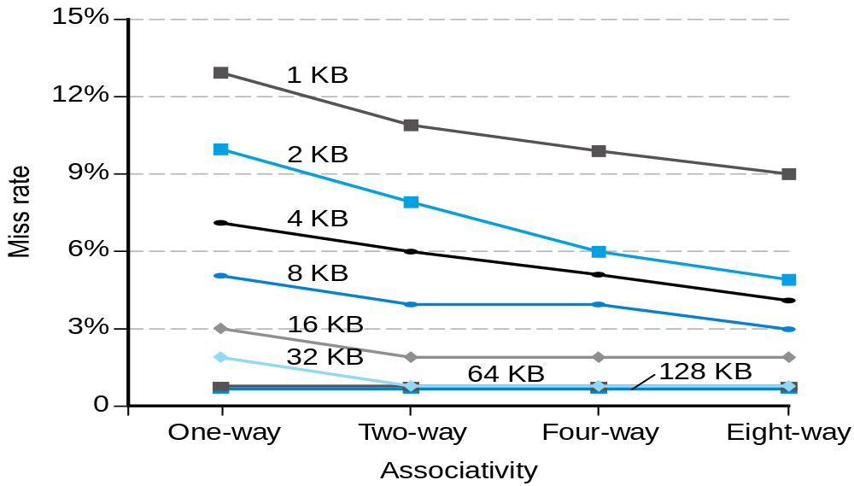
Q1: Where can a Block be placed
Scheme name | No. of sets | Blocks/set
Direct mapped | No. of blocks in cache | 1
Set associative | No. of blocks in cache ------------------------ Associativity | Associativity (2-16)
Fully associative | 1 | No. of blocks in cache

Slide 31
Q2: How is a Block Found?
Associativity | Location method | Comparisons required
Direct mapped | Index | 1
Set associative | Index the set, search among elements | Degree of associativity
Full | Search all cache entries | Size of the cache
 | Separate lookup table | 0
Virtual memory systems almost use fully associative placement.
Set-associative placement is often used for caches and TLB.
Direct-mapped caches have less access time and simplicity.

Slide 32
Q3: Which Block Should Be Replaced on a Cache Miss
In a fully associative cache, all blocks are candidates for replacement.
In a set associative cache, the blocks in the set are candidates for replacement.
In a directed-mapped cache, there in only one candidate.
Primary strategies for replacement in set-associative or fully associative caches:
  Random
  Least recently used (LRU)

Slide 33
Q4: What Happens on a Write?
Write-through: The information is written to both the block in the cache and to the block in the lower level of the memory hierarchy.
  Misses are simpler and cheaper.
  Easier to implement.
Write-back: The information is written only to the block in the cache. The modified block is written to the lower level of the hierarchy only when it is replaced.
  Individual words can be written by the processor at the rate of the cache.
  Multiple writes within a block require only one write action.
  The system can use high bandwidth transfer.

Slide 34
Three Cs
Classifying Misses: 3 Cs
  Compulsory—The first access to a block is not in the cache, so the block must be brought into the cache. Also called cold start misses or first reference misses.
  (Misses in even an Infinite Cache)
  Capacity—If the cache cannot contain all the blocks needed during execution of a program, capacity misses will occur due to blocks being discarded and later retrieved.
  (Misses in Fully Associative Size X Cache)
  Conflict—If block-placement strategy is set associative or direct mapped, conflict misses (in addition to compulsory & capacity misses) will occur because a block can be discarded and later retrieved if too many blocks map to its set. Also called collision misses or interference misses.
  (Misses in N-way Associative, Size X Cache)

Slide 35
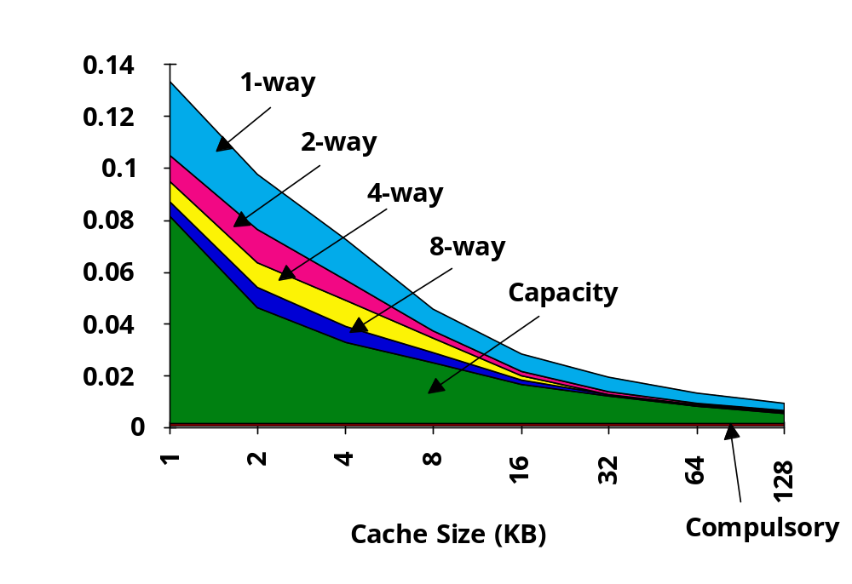
3Cs Absolute Miss Rate
Conflict

Slide 36
Challenge in Memory Hierarchy
Every change that potentially improves miss rate can negatively affect overall performance
Design change Effects on miss rate Possible negative effects
size ↑ capacity miss ↓ access time ↑
associativity ↑ conflict miss ↓ access time ↑
block size ↑ spatial locality ↑ miss penalty ↑
Trends:
  Redesign DRAM chips to provide higher bandwidth or processing
  Use prefetching & non-blocking cache (make cache visible to ISA)
  Restructure code to increase locality

Slide 37
Techniques to reduce miss penalty
Non-blocking caches
Prefetching
Third-level caches

Slide 38
Non-blocking Caches to reduce stalls on misses
Non-blocking cache or lockup-free cache allowing the data cache to continue to supply cache hits during a miss
“hit under miss” reduces the effective miss penalty by being helpful during a miss instead of ignoring the requests of the CPU
“hit under multiple miss” or “miss under miss” may further lower the effective miss penalty by overlapping multiple misses
  Significantly increases the complexity of the cache controller as there can be multiple outstanding memory accesses

Slide 39
Lock-up free Cache Architecture
LOCKUP-FREE INSTRUCTION FETCH/PREFETCH CACHE ORGANIZATION - DAVID KROFT
Upper-level Cache (or CPU)
MSHR (Miss Status Handling Register)
Lower-level Cache

Slide 40

Non-Blocking Cache
ld r1, 100(r2) /* inst 1 */
add .. /* inst 2 */
sub .. /* inst 3 */
ld r2, 100(r3) /* inst 4 /
add r1, r1,r2 /* inst 5 */
ld r4, 100(r5) /* inst 6 /
blocking cache
CPU stall
inst 1: cache miss
CPU stall
Hit under miss
inst 1: cache miss
inst 4: cache miss
CPU stall
Hit under 2 misses
inst 1: cache miss
inst 4: cache miss
inst 5: cache miss
Cache performance:
  A cache miss does not necessarily stall the CPU
  Avoiding a cache miss that is completely hidden does not help performance

Slide 41
Pre-fetch
ld r1, 100(r2) /* inst 1 : address q = 100+[r2] */
:
:
add r1, r1,r2 /* inst 2 */
q arrives
CPU stall
Inst 1: demand fetch q
inst 2
q arrives
prefetch q
Inst 1: demand fetch q
inst 2
  Pre-fetching = Requesting data early, so it’s in cache when needed.

Slide 42
Pre-fetching (cont.)
    For (i = 0; i< 100; i++)
    prefetch (a[i+4]);
    a[i] = a[i]+ 8
Two basic approaches:
  Static: Compiler inserts load instructions into code.
  Dynamic: Hardware looks ahead in code for memory accesses.
  Miss penalty determines how early to pre-fetch.
  Processor may be able to load into cache w/o loading into register.
  Safe to pre-fetch speculatively.
Problem: May replace data in cache that is still needed.

Slide 43
Third-level Caches
Intel Pentium Xeon
  1 MB, L3 cache
Intel Pentium 4 Extream Edition
  2MB, L3 cache

Slide 44
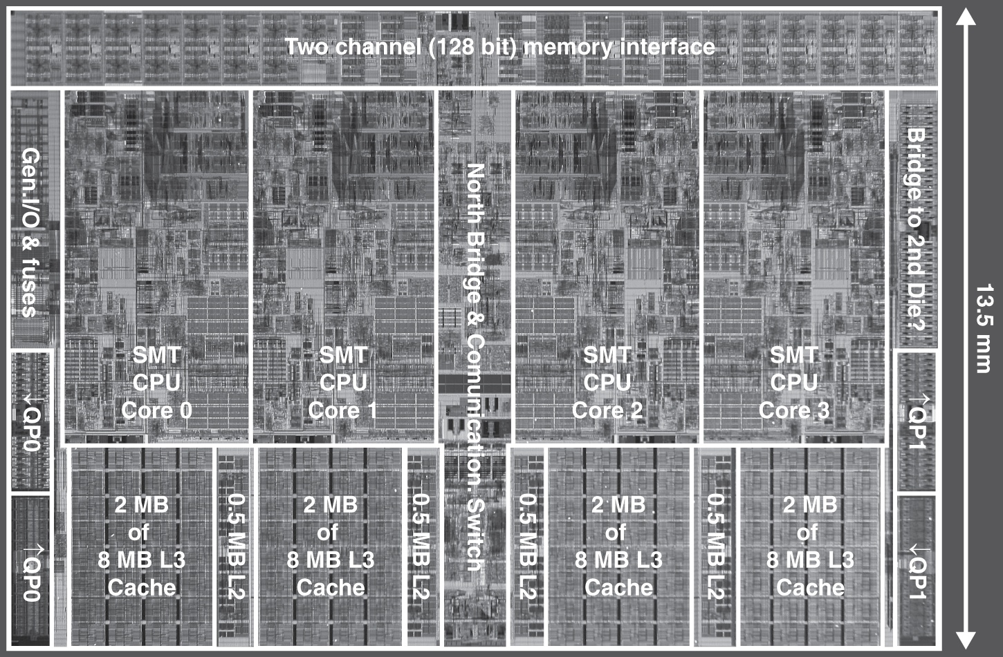
Multilevel On-Chip Caches
Intel Nehalem 4-core processor
§5.10 Real Stuff: The AMD Opteron X4 and Intel Nehalem
Per core: 32KB L1 I-cache, 32KB L1 D-cache, 512KB L2 cache
Notes:
Morgan Kaufmann Publishers
Chapter 5 — Large and Fast: Exploiting Memory Hierarchy

Slide 45
2-Level TLB Organization
 | Intel Nehalem | AMD Opteron X4
Virtual addr | 48 bits | 48 bits
Physical addr | 44 bits | 48 bits
Page size | 4KB, 2/4MB | 4KB, 2/4MB
L1 TLB (per core) | L1 I-TLB: 128 entries for small pages, 7 per thread (2×) for large pages L1 D-TLB: 64 entries for small pages, 32 for large pages Both 4-way, LRU replacement | L1 I-TLB: 48 entries L1 D-TLB: 48 entries Both fully associative, LRU replacement
L2 TLB (per core) | Single L2 TLB: 512 entries 4-way, LRU replacement | L2 I-TLB: 512 entries L2 D-TLB: 512 entries Both 4-way, round-robin LRU
TLB misses | Handled in hardware | Handled in hardware
Notes:
Morgan Kaufmann Publishers
Chapter 5 — Large and Fast: Exploiting Memory Hierarchy

Slide 46
3-Level Cache Organization
 | Intel Nehalem | AMD Opteron X4
L1 caches (per core) | L1 I-cache: 32KB, 64-byte blocks, 4-way, approx LRU replacement, hit time n/a L1 D-cache: 32KB, 64-byte blocks, 8-way, approx LRU replacement, write-back/allocate, hit time n/a | L1 I-cache: 32KB, 64-byte blocks, 2-way, LRU replacement, hit time 3 cycles L1 D-cache: 32KB, 64-byte blocks, 2-way, LRU replacement, write-back/allocate, hit time 9 cycles
L2 unified cache (per core) | 256KB, 64-byte blocks, 8-way, approx LRU replacement, write-back/allocate, hit time n/a | 512KB, 64-byte blocks, 16-way, approx LRU replacement, write-back/allocate, hit time n/a
L3 unified cache (shared) | 8MB, 64-byte blocks, 16-way, replacement n/a, write-back/allocate, hit time n/a | 2MB, 64-byte blocks, 32-way, replace block shared by fewest cores, write-back/allocate, hit time 32 cycles
n/a: data not available
Notes:
Morgan Kaufmann Publishers
Chapter 5 — Large and Fast: Exploiting Memory Hierarchy

Slide 47
Cache Coherency Problem
Traffic per processor and the bus bandwidth determine the # of processors
Caches can lower bus traffic
  Cache coherency problem
Processor
Processor
Processor
Processor
Caches
Caches
Caches
Caches
Main Memory
I/O System

Slide 48
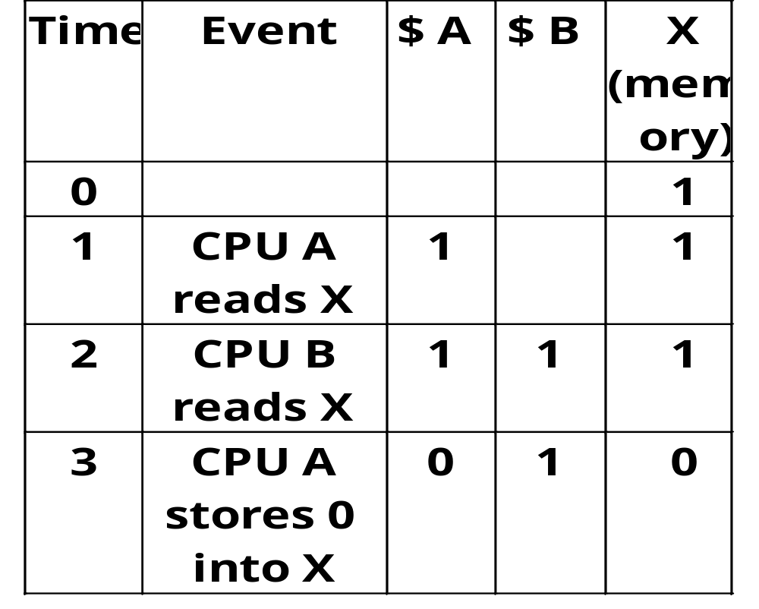
Cache Coherency

Slide 49
Cache Coherency Protocol
Snooping Solution (Snoopy Bus):
  Send all requests for data to all processors
  Processors snoop to see if they have a copy and respond accordingly
  Requires broadcast, since caching information is at processors
  Works well with bus (natural broadcast medium)
  Dominates for small scale machines (most of the market)

Slide 50
Basic Snoopy Protocols
Write Invalidate Protocol:
  Multiple readers, single writer
  Write to shared data: an invalidate is sent to all caches which snoop and invalidate any copies
  Read Miss:
    Write-through: memory is always up-to-date
    Write-back: snoop in caches to find most recent copy
Write Update Protocol:
  Write to shared data: broadcast on bus, processors snoop, and update copies
  Read miss: memory is always up-to-date
What happens if two processors try to write to the same shared data word in the same clock cycle?
  Write serialization: bus serializes requests

Slide 51
Basic Snoopy Protocols
Invalidation
Update
Processor activity Bus activity Contents of Contents of Contexts of memory
CPU A’ cache CPU B’s cache location X
0
CPU A reads X Cache miss for X 0
CPU B reads X Cache miss for X 0 0 0
CPU A writes a 1 to X Invalidation for X 1 0
CPU B reads X Cache miss for X 1 1 1
Processor activity Bus activity Contents of Contents of Contexts of memory
CPU A’ cache CPU B’s cache location X
0
CPU A reads X Cache miss for X 0
CPU B reads X Cache miss for X 0 0 0
CPU A writes a 1 to X Write broadcast of X 1 1 1
CPU B reads X 1 1 1

Slide 52
Basic Snoopy Protocols
Write Invalidate versus Broadcast:
  Invalidate requires one transaction per write-run
  Invalidate uses spatial locality: one transaction per block
  Update has lower latency between write and read
  Update: BW (increased) vs. latency (decreased) tradeoff
Invalidate protocol is more popular than update !

Slide 53
An Example Snoopy Protocol
Invalidation protocol, write-back cache
Each block of memory is in one state:
  Clean in all caches and up-to-date in memory
  OR Dirty in exactly one cache
  OR Not in any caches
Each cache block is in one state:
  Shared: block can be read
  OR Exclusive: cache has only copy, its writeable, and dirty
  OR Invalid: block contains no data
Read misses: cause all caches to snoop
Writes to clean line are treated as misses (or write invalidate)

Slide 54
Snoopy-Cache State Machine-I
CPU Read hit
State machine
for CPU requests
for each
cache block
CPU Read
Shared
(read/only)
Invalid
Place read miss
on bus
CPU Write
Place Write
Miss on bus
CPU read miss
Write back block,
Place read miss
on bus
CPU Read miss
Place read miss
on bus
CPU Write
Place Write Miss on Bus
Cache Block
State
Exclusive
(read/write)
CPU read hit
CPU write hit
CPU Write Miss
Write back cache block
Place write miss on bus
Notes:
Invalid:
read => shared
write => dirty
shared looks the same

Slide 55
Snoopy-Cache State Machine-II
State machine
for bus requests
for each
cache block
Write miss
for this block
Invalid
Shared
(read/only)
Write miss
for this block
Write Back
Block; (abort
memory access)
Read miss
for this block
Write Back
Block; (abort
memory access)
Exclusive
(read/write)

Slide 56
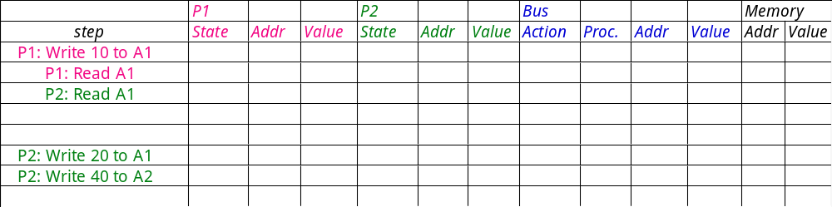
Example
Processor 1
Processor 2
Bus
Memory
Assumes initial cache state
is invalid and A1 and A2 map
to same cache block,
but A1 != A2
Remote Write
CPU Read hit
Invalid
Shared
CPU Read Miss
Read
miss on bus
Write
miss on bus
Remote
Write
Write Back
CPU Write
Place Write
Miss on Bus
Remote Read
Write Back
Exclusive
CPU read hit
CPU write hit
CPU Write Miss
Write Back

Slide 57
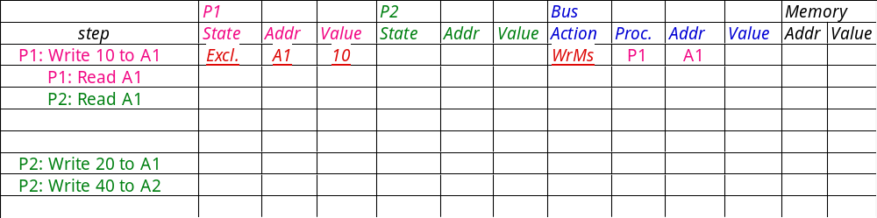
Example: Step 1
Assumes initial cache state
is invalid and A1 and A2 map
to same cache block,
but A1 != A2.
Active arrow =
Remote Write
CPU Read hit
Invalid
Shared
CPU Read Miss
Read
miss on bus
Write
miss on bus
Remote
Write
Write Back
CPU Write
Place Write
Miss on Bus
Remote Read
Write Back
Exclusive
CPU read hit
CPU write hit
CPU Write Miss
Write Back

Slide 58
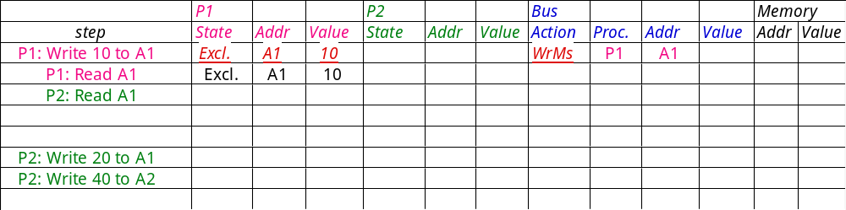
Example: Step 2
Assumes initial cache state
is invalid and A1 and A2 map
to same cache block,
but A1 != A2
Remote Write
CPU Read hit
Invalid
Shared
CPU Read Miss
Read
miss on bus
Write
miss on bus
Remote
Write
Write Back
CPU Write
Place Write
Miss on Bus
Remote Read
Write Back
Exclusive
CPU read hit
CPU write hit
CPU Write Miss
Write Back

Slide 59
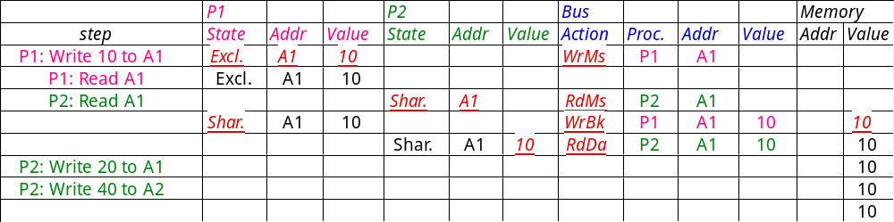
Example: Step 3
A1
A1
Assumes initial cache state
is invalid and A1 and A2 map
to same cache block,
but A1 != A2.
Remote Write
CPU Read hit
Invalid
Shared
CPU Read Miss
Read
miss on bus
Write
miss on bus
Remote
Write
Write Back
CPU Write
Place Write
Miss on Bus
Remote Read
Write Back
Exclusive
CPU read hit
CPU write hit
CPU Write Miss
Write Back

Slide 60
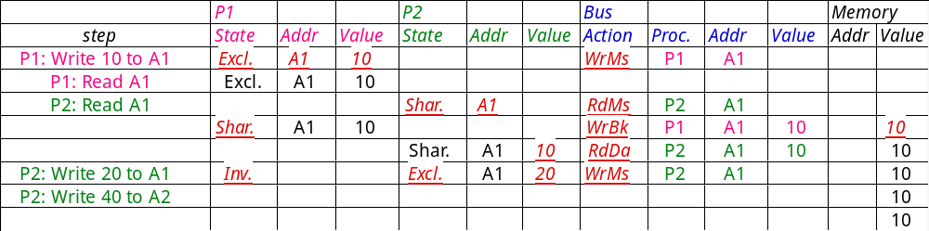
Example: Step 4
A1
A1
A1
Assumes initial cache state
is invalid and A1 and A2 map
to same cache block,
but A1 != A2
Remote Write
CPU Read hit
Invalid
Shared
CPU Read Miss
Read
miss on bus
Write
miss on bus
Remote
Write
Write Back
CPU Write
Place Write
Miss on Bus
Remote Read
Write Back
Exclusive
CPU read hit
CPU write hit
CPU Write Miss
Write Back

Slide 61
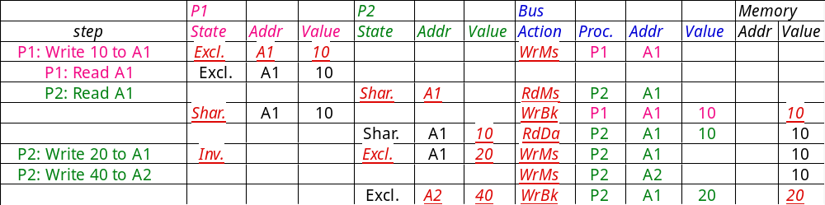
Example: Step 5
A1
A1
A1
A1
A1
Assumes initial cache state
is invalid and A1 and A2 map
to same cache block,
but A1 != A2
Remote Write
CPU Read hit
Invalid
Shared
CPU Read Miss
Read
miss on bus
Write
miss on bus
Remote
Write
Write Back
CPU Write
Place Write
Miss on Bus
Remote Read
Write Back
Exclusive
CPU read hit
CPU write hit
CPU Write Miss
Write Back
Notes:
Why write miss first?
Because in general, only write a piece of block, may need to read it first so that can have a full vblock; therefore, need to get
Write back is low priority event.

Slide 62
Coherency Misses: 4th C
Joins Compulsory, Capacity, Conflict
True sharing misses arise from the communication of data through the cache coherence mechanism
  Invalidates due to 1st write to shared block
  Reads by another CPU of modified block in different cache
  Miss would still occur if block size were 1 word
False sharing misses when a block is invalidated because some word in the block, other than the one being read, is written into
  Invalidation does not cause a new value to be communicated, but only causes an extra cache miss
  Block is shared, but no word in block is actually shared
  ⇒ miss would not occur if block size were 1 word

Slide 63
Example: True vs. False Sharing vs. Hit?
Assume x1 and x2 in same cache block.
P1 and P2 both read x1 and x2 before.
Time | P1 | P2 | True, False, Hit? Why?
1 | Write x1
2 |  | Read x2
3 | Write x1
4 |  | Write x2
5 | Read x2
True miss; invalidate x1 in P2
False miss; x1 irrelevant to P2
False miss; x1 irrelevant to P2
False miss; x1 irrelevant to P2
True miss; invalidate x2 in P1

