Slide 1
OS Homework 1
2020

Slide 2
Outline
Linux Installation
Linux Kernel Compilation
System Call Development
Kernel Modules
/ 45
2

Slide 3
Part I
Linux Installation

Slide 4
Kernel versus Distribution
Kernel is the core of the operating system including scheduler, memory management, file system, etc.
Distribution is a full functional environment including the kernel and a large collection of software applications.
The following slides are based on Ubuntu 16.04.4 (desktop version).
Download Link:
https://www.ubuntu.com/download/desktop/thank-you?country=TW&version=16.04.4&architecture=amd64(64-bit)
https://www.ubuntu.com/download/desktop/thank-you?country=TW&version=16.04.4&architecture=i386
(32-bit)
/ 45
4

Slide 5
Preparation (1/2)
A computer
An Ubuntu 16.04 DVD or image
/ 45
5

Slide 6
Preparation (2/2)
If you want to install Linux on your hard disk, please set at least 16GB unpartitioned space.
You may want to shrink your existing disk by disk management if there is no more unpartitioned space.
Ubuntu can coexist with Windows.
Change the boot sequence to boot from usb device or CD-ROM first.
If you want to install Linux on a virtual machine, you can use VirtualBox or VMware.
VirtualBox Website: https://www.virtualbox.org/
/ 45
6

Slide 7
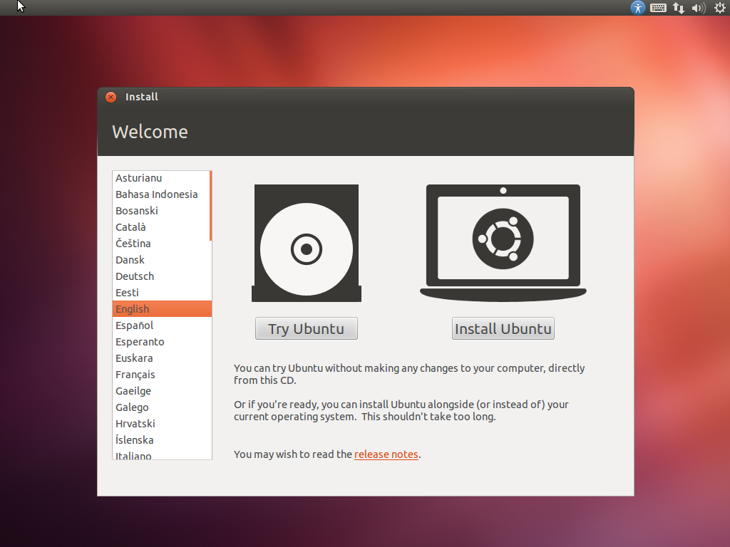
/ 45
7

Slide 8
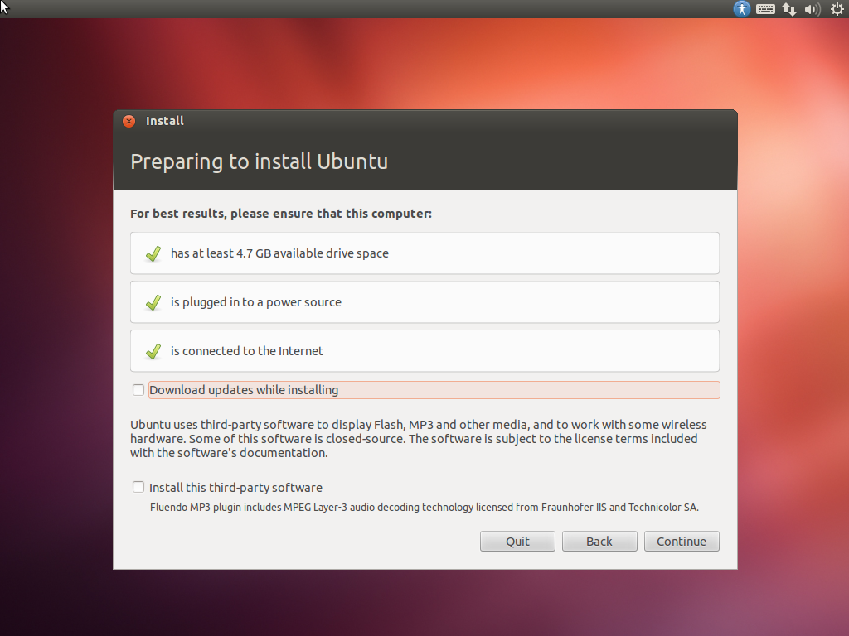
/ 45
8

Slide 9
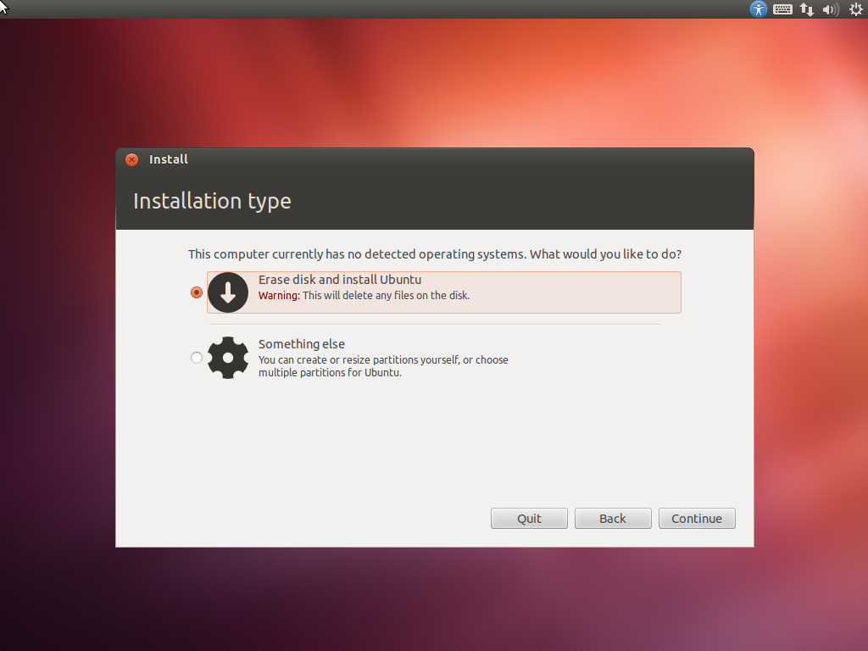
/ 45
9

Slide 10
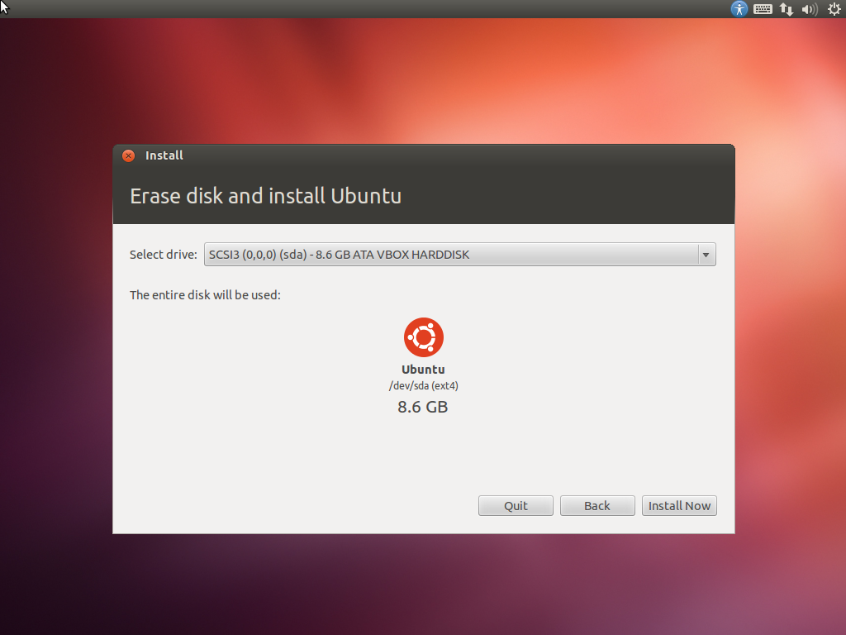
/ 45
10

Slide 11
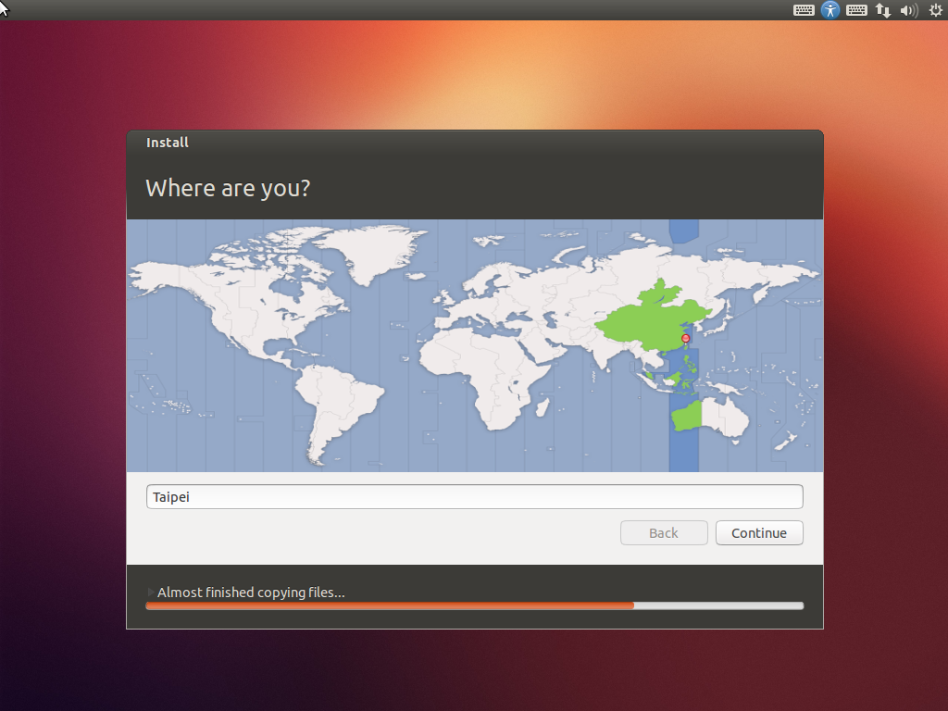
/ 45
11

Slide 12
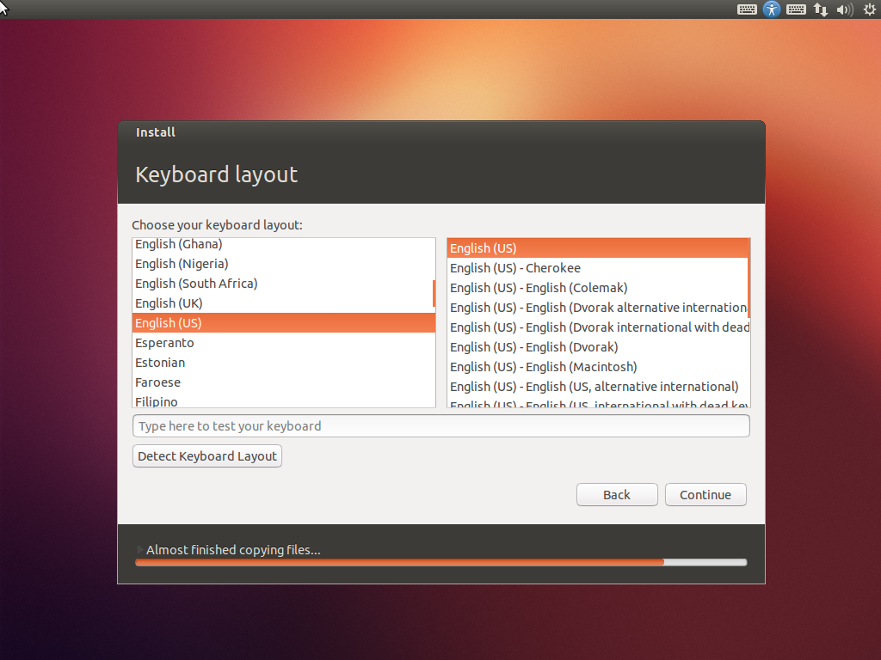
/ 45
12

Slide 13
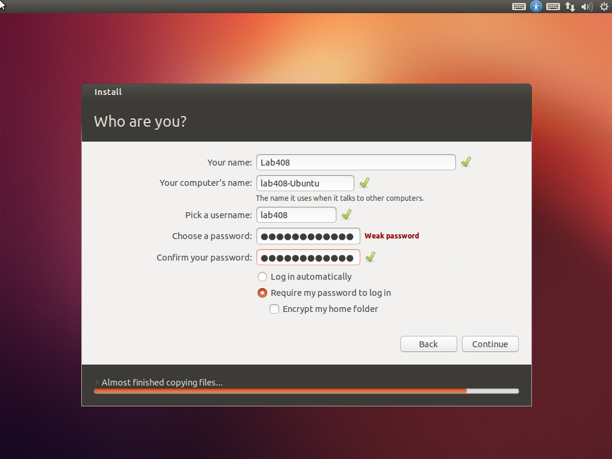
/ 45
13

Slide 14
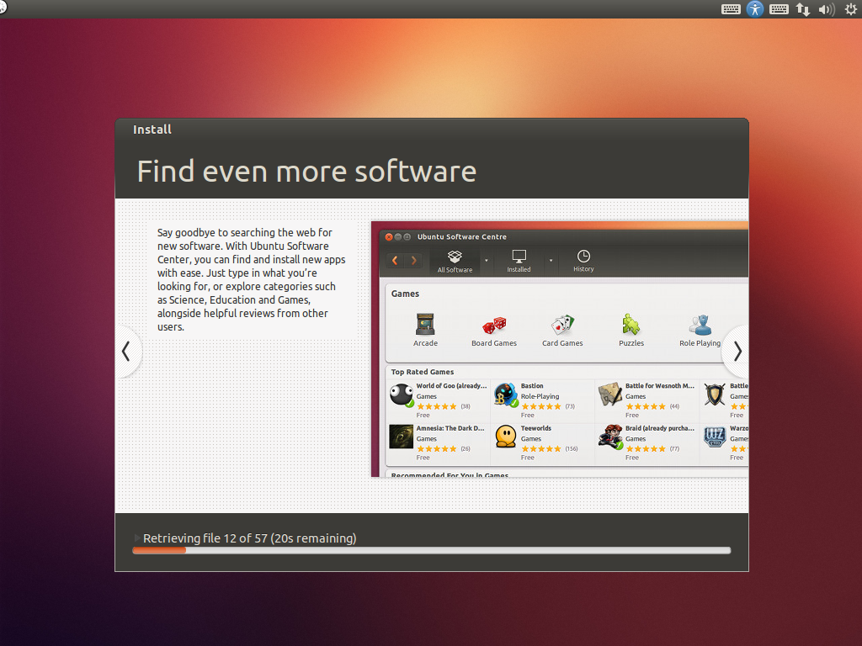
/ 45
14

Slide 15
References
鳥哥的私房菜
http://linux.vbird.org
Ubuntu 正體中文站
http://www.ubuntu-tw.org
Ubuntu Homepage
http://www.ubuntu.com
/ 45
15

Slide 16
Part II
Linux Kernel Compilation

Slide 17
When Should We Compile Kernel?
There are various situations we have to compile the kernel.
Try new kernel patches for the latest laptops.
Enable/disable features built in the kernel.
Develop new features.
…
This slide is based on Linux 4.14.25.
https://cdn.kernel.org/pub/linux/kernel/v4.x/linux-4.14.25.tar.xz
/ 45
17

Slide 18
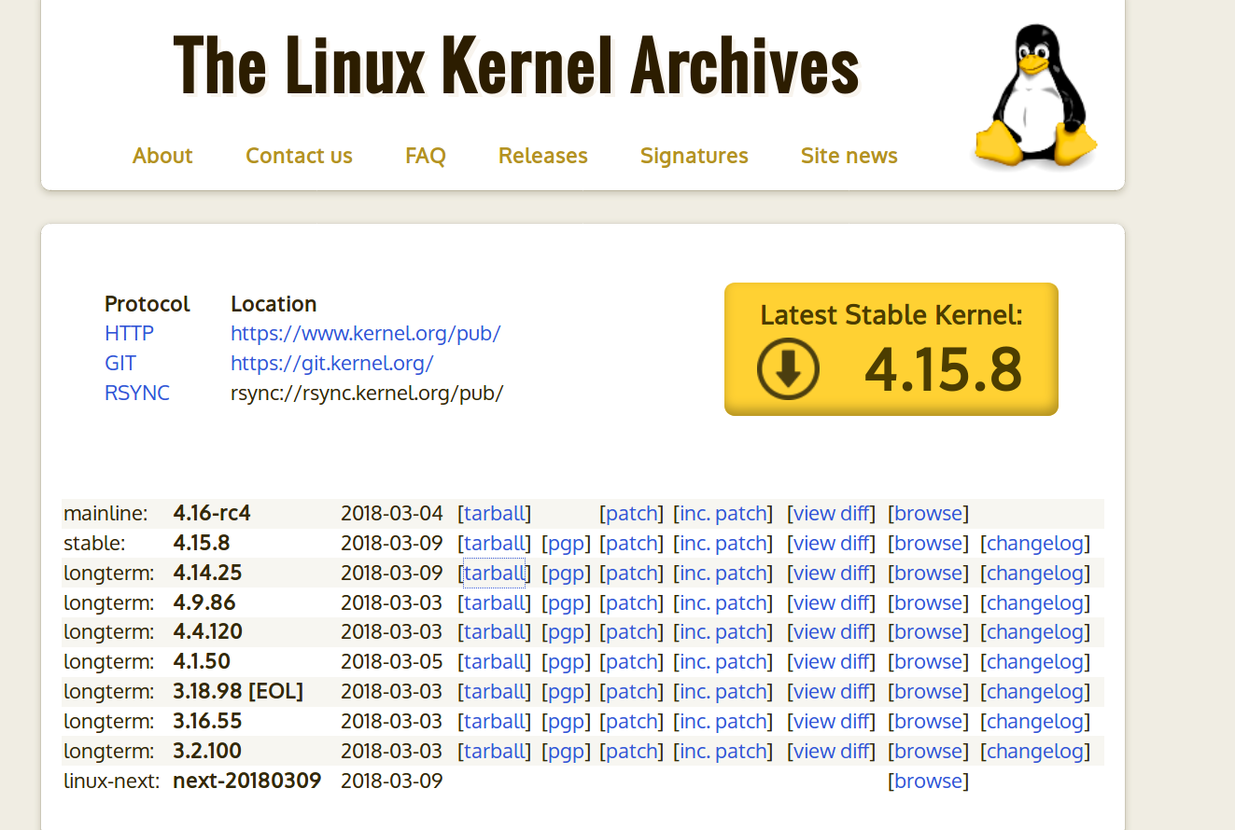
去哪下載？
Kernel Website: http://www.kernel.org
臺大鏡像: http://ftp.ntu.edu.tw/linux/kernel/v4.x/
/ 45
18

Slide 19
下載並解壓縮
Setting up build environment
$ sudo apt-get update
$ sudo apt-get install gcc vim ssh wget libncurses5-dev libssl-dev
Getting the source archive
$ cd ${HOME}
$ wget https://cdn.kernel.org/pub/linux/kernel/v4.x/linux-4.14.25.tar.xz
Extracting the archive
$ tar Jxvf linux-4.14.25.tar.xz
$ cd linux-4.14.25
/ 45
19

Slide 20
產生 .config
在開始編譯之前，得先建立一份設定檔 (.config)，說明我們希望核心具備哪些功能。
核心源碼提供了數種工具方便使用者建立 .config (執行過程中缺什麼就裝什麼)
$ make config （不建議）
$ make menuconfig （使用 ncurses 做使用者介面）
$ make xconfig （用 qt 做使用者介面）
...
你也可以直接複製自己系統裡 /boot 中的設定檔.
$ cp /boot/config-$(uname -r) .config
$ make olddefconfig(檢查新舊版設定檔的相容性)
$ make menuconfig（若想基於該設定檔繼續修改）
/ 45
20

Slide 21
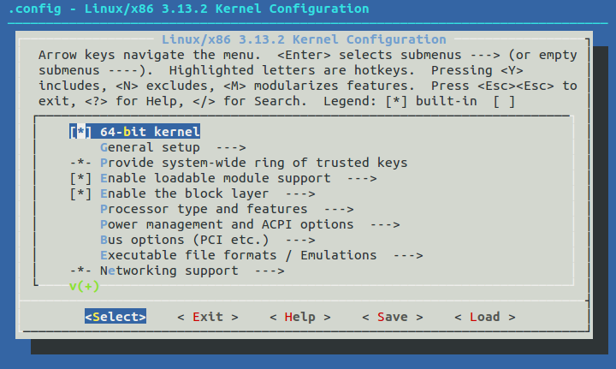
make menuconfig 的使用者介面
/ 45
21

Slide 22
Kernel Compilation
The first time (在助教 i5-7200u 的筆電跑了 46 分鐘):
$ make bzImage (編譯核心並壓縮)
$ make modules (編譯各個核心模組)
$ sudo make modules_install(安裝模組)
$ sudo make install（安裝核心）
$ sudo mkinitramfs -o /boot/initrd.img-4.14.25
Do this whenever you reinstall the modules.
reboot!
Others (about 5~10min):
$ make bzImage
$ sudo make install
Then reboot!
/ 45
22

Slide 23
Kernel Compilation with Multiple Cores
See how many cores on your machine.
$ cat /proc/cpuinfo | grep processor | wc -l
E.g., 4.
Compile with the number of jobs (threads).
$ make -j4 bzImage
$ make -j4 modules
...
/ 45
23

Slide 24
Boot Loader Configuration (Optional)
Ubuntu will do this for you when installing the kernel.
Adding a new entry to /boot/grub/grub.cfg
/ 45
24

Slide 25
Rebooting
Do not forget to reboot every time you install a new kernel image!
You can use ‘uname -a’ to check current system information.
/ 45
25

Slide 26
Part III
System Call Development

Slide 27
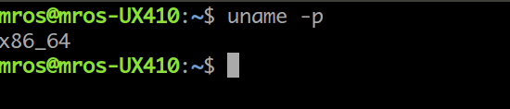
Preparation
Find out whether the kernel is 32-bit or 64-bit version.
$ uname -p
32-bit: i386 i686
64-bit: x86_64
之後的操作都基於 x86_64 版本，不介紹 32-bit 的版本
/ 45
27

Slide 28
Adding a System Call (1/4)
Create a new file kernel/my_add.c.
asmlinkage 是什麼作用？
01
02
03
04
05
06
07
08
#include <linux/linkage.h>
#include <linux/kernel.h>
asmlinkage int sys_my_add(int a, int b)
{
printk("my_add is invoked!\n");
return a + b;
}
/ 45
28
Notes:
系統呼叫時，發生 context switch ，一定會將暫存器的資料丟進堆疊，若仍然硬要使用以暫存器來傳參數的二進位 convention ，只會徒然損耗效能

Slide 29
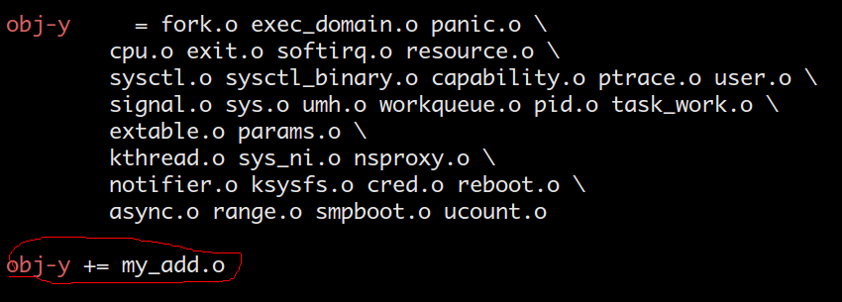
Adding a System Call (2/4)
Add this new file to kernel/Makefile.
obj-y += my_add.o
/ 45
29

Slide 30
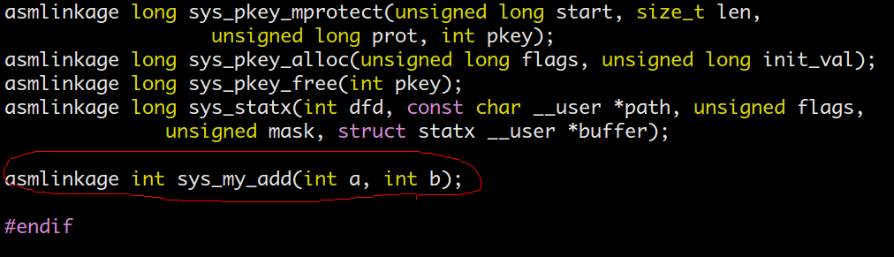
Adding a System Call (3/4)
Declare the prototype of your system calls.
Add the declaration to include/linux/syscalls.h.
asmlinkage int sys_my_add(int a, int b);
/ 45
30

Slide 31
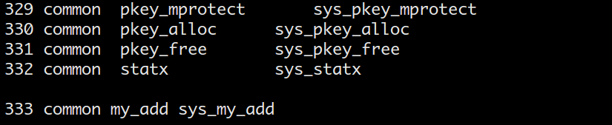
Adding a System Call (4/4)
Register a system call number.
Add a new entry to arch/x86/entry/syscalls/syscall_64.tbl
333 common my_add sys_my_add
修改完成！請重新編譯安裝再重開機
/ 45
31

Slide 32
System Call Invocation
Create a test file ap.c to try your system call.
Compile & execute.
$ gcc -o ap ap.c
$ ./ap
01
02
03
04
05
06
07
08
09
10
#include <stdio.h>
#define _GNU_SOURCE
#include <unistd.h>
#include <sys/syscall.h>
int main(int argc, char** argv)
{
printf("%d\n", syscall(333, 1, 1));
}
/ 45
32

Slide 33
References
Kernel Website
https://www.kernel.org/doc/html/v4.12/process/adding-syscalls.html
Implementing a system call in Linux Kernel 4.7.1
https://medium.com/@ssreehari/implementing-a-system-call-in-linux-kernel-4-7-1-6f98250a8c38
/ 45
33

Slide 34
Part IV
Kernel Modules

Slide 35
編譯、使用核心模組
請見 https://github.com/MROS/hello-kernel-module
有範例程式碼跟說明
/ 45
35

Slide 36
Contact me
Lab 408
TA：lab408ta@gmail.com
吳澤南
康譽騰
白雨生
洪瑞隆
/ 45
36
Notes:
36

