Slide 1
Operating Systems
On-line, NTUCOOL
薛智文
cwhsueh@csie.ntu.edu.tw
https://ceiba.ntu.edu.tw/1082CSIE3310_OS
2020 Spring

Slide 2
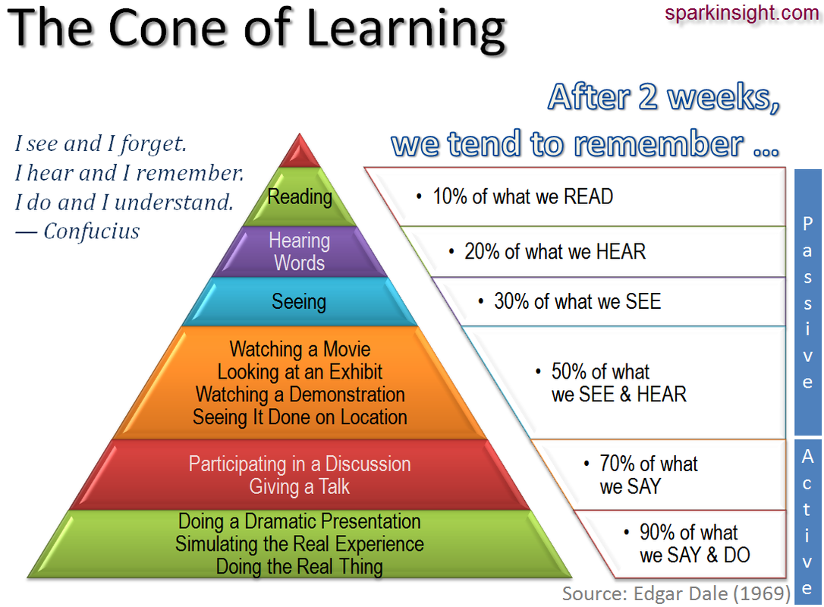
靈感
腦補
Verbal receiving
荀子《儒效篇》：「不聞不若聞之，聞之不若見之，見之不若知之，知之不若行之；學至于行之而止矣。」
visual receiving
participating

Slide 3
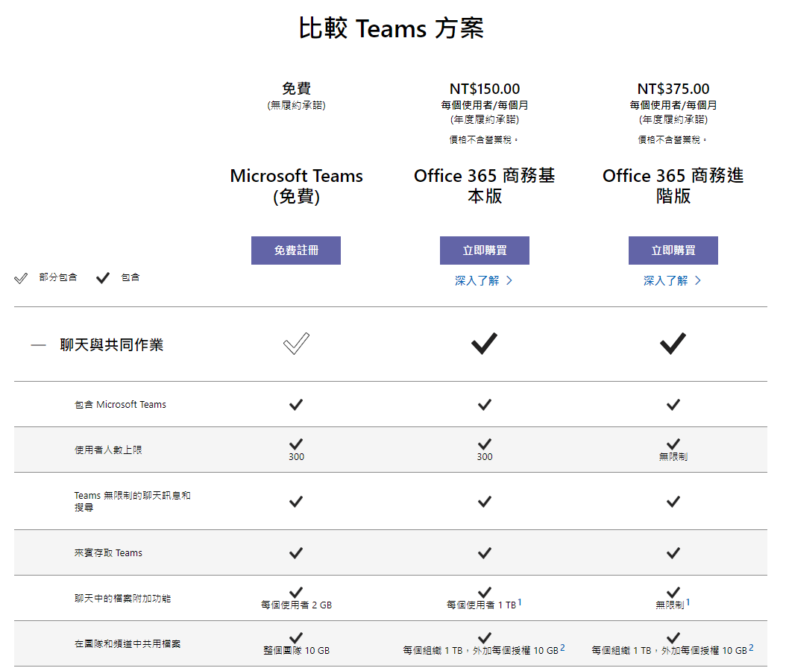
Notes:
https://products.office.com/zh-tw/microsoft-teams/free

Slide 4
市值 2015/03/02
Application Software
System Software
Hardware
台積電 2120x5.15
訊連 5x
系微 1x (18.2 億台幣)
趨勢 82x
鴻海 707x1.72
PC Home 17x
聯發科 411x1.00
宏達電 華碩 廣達 68x 132x 169x
Adobe 681x
Citrix 176x0.43
Intel 2720x6.61
Semantec 297x
Vmware 628x1.53
TI 1063x2.59
Microsoft 6213x15.10
ARM 432x1.05
Google 6564x15.96
QCOM 2066x5.02
Facebook 3835x
IBM 2764x 6.72
Alibaba 3662x
Apple 12922x31.41

Slide 5
市值 2016/03/01
Application Software
System Software
Hardware
台積電 4163x10.42
訊連 8x
系微 1x (9.28 億台幣)
趨勢 187x
鴻海 1314x3.29
PC Home 38x
聯發科 400x1.00
宏達電 華碩 廣達 72x 219x 234x
Adobe 1519x
Citrix 389x0.97
Intel 5003x12.52
Semantec 451x
Vmware 763x1.91
TI 1919x4.80
Microsoft 14404x36.04
ARM 687x1.72
Google 17190x43.01
QCOM 2718x6.80
Facebook 10892x
IBM 4530x11.34
Alibaba 6024x
Apple 19188x48.01

Slide 6
百分數 | 等第 | 定義
90-100(95) | A+ | All goals achieved beyond expectation 所有目標皆達成且超越期望
85-89(87) | A | All goals achieved 所有目標皆達成
80-84(82) | A- | All goals achieved, but need some polish 所有目標皆達成，但需一些精進
77-79(78) | B+ | Some goals well achieved 達成部分目標，且品質佳
73-76(75) | B | Some goals adequately achieved 達成部分目標，但品質普通
70-72(71) | B- | Some goals achieved with minor flaws 達成部分目標，但有些缺失
67-69(68) | C+ | Minimum goals achieved 達成最低目標
63-66(65) | C | Minimum goals achieved with minor flaws 達成最低目標，但有些缺失
60-62(61) | C- | Minimum goals achieved with major flaws 達成最低目標但有重大缺失
<59(含) | F | No goals achieved 所有目標皆未達成

Slide 7
Course Expectation
Understand the OS concepts
Why and how you study OS?
Quick but no rush, get your hands dirty!
Participation
Ask and answer questions
Do not skip the recordings unless …
Team Work, Peer Appraisal
No Cheating
Software Engineering
Turn in projects in time (minimum)
Check your final scores

Slide 8
NOTE that in the question, it is intended to provide redundant or miss certain assumption to disguise you. Please make your own assumption if necessary to answer the questions.
For Midterm and
Final
(25 points) On Singles Day (光棍節), millions of on-line shopping transactions are processed in a very short period of time. The supply of each product is limited. We need to make sure there is enough supply for each commit transaction and processing should be as soon as possible.
(5 points) What kind of transaction scheduling algorithm can generate the most revenue for the shopping service provider (such as PCHome)
(5 points) How do we guarantee that the earlier transaction is the earlier processed? Hint: The earlier sent or arrived? There is no global clock.
(5 points) If we would concurrently process the transactions in a distributed manner, how to synchronize so that the products are not over sold while the process time is minimized as possible.
(5 points) The transactions might be cancelled by users for any reason or by the system because there is no enough supply. How do we design the file system to store transactions so that it is both trustful and efficient?
(5 points) What attacks need to be handled at this high-speed transaction? How?

Slide 9
(20 points) For each of the following statements, answer True/False followed by the number with the closest reason in the providing reason list or write your own brief reason.
[2 points] The more threading, the more performance.
[2 points] The more frames, the less page fault rates.
[2 points] The bigger time quantum, the less average turnaround time.
[2 points] Multiprocessor system increases throughput.
[2 points] Firmware can be executed faster in RAM.
[2 points] Modularity is one of the reasons to support process cooperation.
[2 points] A safe state is not a deadlocked state.
[2 points] UNIX Semantics: Writes to an open file by a user are visible immediately to other users who have this file open.
[2 points] A real-time scheduler schedules tasks according to their priority in a fastest manner.
[2 points] The two-phase locking protocol ensures conflict serializability and prevents deadlock.
Reason List
It depends on the number of processors.
It might have thrashing.
Because of Belady’s anomaly
Sample Answer
False, 2.
False,
False, 3.
For Quiz

Slide 10
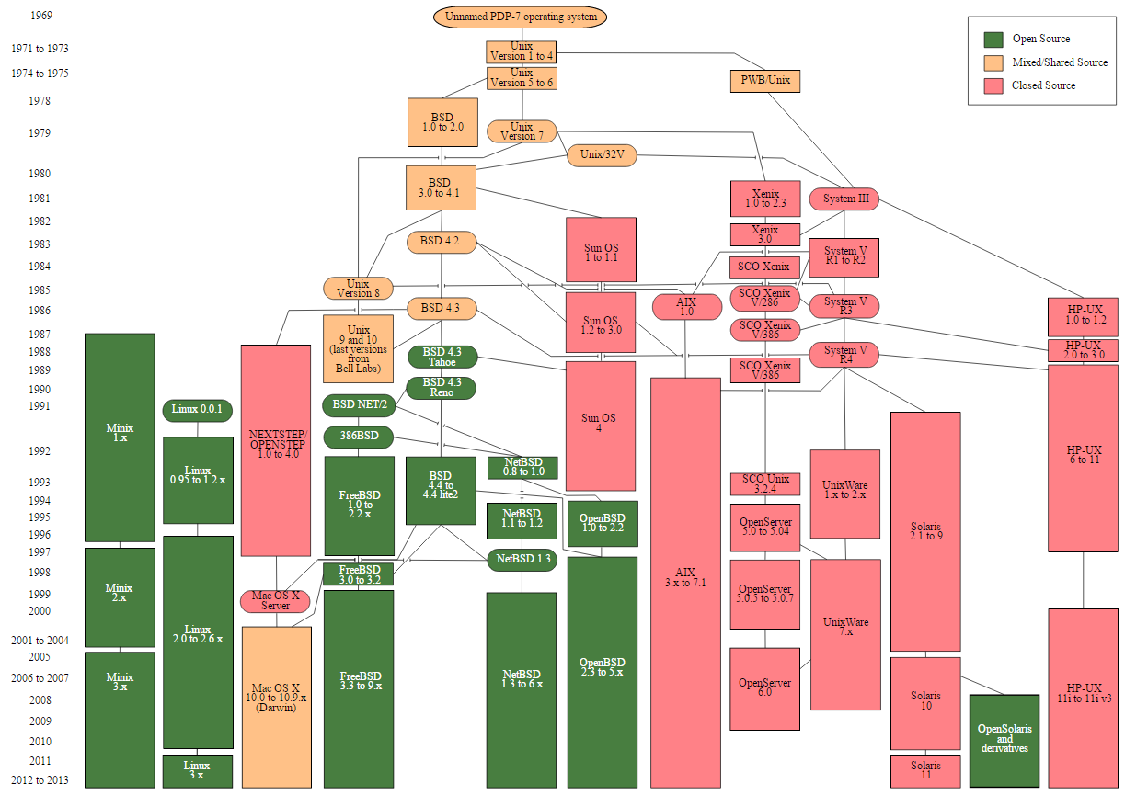

Slide 11
RTOS at a Glance - http://www.onesmartclick.com/rtos/rtos.html
AMX, KwikNet, KwikPeg (from KADAK Products Ltd.)
C EXECUTIVE (from JMI Software Systems, Inc.)
CMX-RTX (from CMX Systems, Inc.)
DeltaOS (from CoreTek Systems, Inc.)
eCos (from Red Hat, Inc.)
embOS (from SEGGER Microcontroller Systeme GmbH)
eRTOS (from JK microsystems, Inc.)
ETS (from VenturCom)
EYRX (from Eyring Corporation)
INTEGRITY (from Green Hills Software, Inc.)
INtime® real time extension to Windows® (from TenAsys Corporation)
IRIX (from SGI)
iRMX (from TenAsys Corporation)
Jbed (from esmertec, inc.)
LynxOS (from LynuxWorks)
MQX (from Precise Software Technologies Inc)
Nucleus PLUS (AcceleratedTechnology, ESD Mentor Graphics)
On Time RTOS-32 (from On Time Informatik GmbH)
OS-9 (from Microware Systems Corporation)
OSE (from OSE Systems )
PDOS (from Eyring Corporation)
PSX (from JMI Software Systems, Inc.)
QNX Neutrino (from QNX Software Systems Ltd.)
QNX4 (from QNX Software Systems Ltd.)
REDICE-Linux (from REDSonic, Inc.)
RTLinux (from Finite State Machine Labs, Inc.)
RTX 5.0 (from VenturCom)
Portos (from Rabih Chrabieh)
smx (Micro Digital, Inc.)
SuperTask! (from US Software)
ThreadX (from Express Logic, Inc.)
Treck MicroC/OS-II (from Elmic Systems USA, Inc.)
TronTask! (from US Software)
TTPos: (from TTTech Computertechnik AG)
VxWorks 5.4 (from Wind River)
SCORE, DACS and TADS (from DDC-I)
Nimble - the SoC RTOS (from Eddy Solutions)
Nucleus (from Accelerated Technology)
Fusion RTOS (from DSP OS, Inc.)
FreeRTOS (from Richard Barry)

Slide 12
作業系統特徵遷移示意圖
Cloud OS?
WeOS?
Blockchain
1950 1960 1970 1980 1990 2000 2010 2020
MULTICS
大型電腦
無軟體 編譯器 分時 多使用者 分散式系統
批次 多處理器
常駐監控常式 網路 容錯
UNIX
虛擬化
virtualization
虛擬機器
迷你電腦
無軟體 編譯器
分時 多使用者 多處理器
常駐監控常式 網路 容錯
叢集
UNIX
虛擬機器
個人電腦
無軟體 編譯器
交談式 多處理器
多使用者
網路
UNIX
虛擬機器
虛擬化
virtualization
手持式電腦
編譯器 無軟體
交談式
網路 多處理器
虛擬機器
虛擬化
virtualization

Slide 13
OS Sizes
Linux | image | files | directories | lines | bytes
2.6.4 | 1150K | 13400 | 960 | 5.6M | 167M
2.4.25 | 1177K | 11000 | 670 | 5M | 149M
2.2.26 | 507K | 5100 | 280 | 2.5M | 75M
ThreadX | 129K | 158 | 1 | 29K | 1.5M
uC/OS-II | 55K | 13 | 1 | 5.5K | 0.4M
Tinix’ | 0.5K | 1 | 1 | 20 | 0.5K
Window 2000, 30M lines.
Netscape Communicator 5, 17M lines.
A GO (圍棋) program, 0.01M lines.
A SOHO router, 0.6M lines.
What is Embedded (OS/system)?

Slide 14
Tinix’ -“自己動手寫作業系統,” 于淵
org 07c00h ; tell the assembler to load onto 7c00, 0100h for DOS
mov ax, cs
mov ds, ax
mov es, ax
call DispStr ; call string display procedure
jmp $ ; infinite loop
DispStr:
mov ax, BootMessage
mov bp, ax ; ES:BP = string address
mov cx, 16 ; CX = string length
mov ax, 01301h ; AH = 13, AL = 01h
mov bx, 000ch ; page number is 0 (BH = 0) black background red character
; (BL = 0Ch, highlight)
mov dl, 0
int 10h ; the 10h software interrupt
ret
BootMessage: db "Hello, OS world!"
times 510-($-$$) db 0 ; fill the rest of sector (512 bytes) with 0
dw 0xaa55 ; end of sector
Notes:
AH=13 mode AL=01 write
one of them ( $ ) may refer to the program counter, as we all know, and the other one ( $$ ) to the location counter, which doesn't have to be the same as the program counter. The location counter could be the address in memory where the program is first assembled.

Slide 15
電子書包與數位學習輔具分工架構圖
數位學習平台
數位學習輔具
電子書包平台結構
開發工具
數位學習輔具
數位學習平台閱讀
程式SCORM
HTML
XML
電子書包教學數位內容
電子書包數位內容
開發工具
Physical
Serial
USB
1394
IrDA
Bluetooth
802.11
教師教學應用軟體
同儕群體應用軟體
教學 / 同儕群體
應用軟體開發工具
電子書包教學應用平台
系統軟體開發工具 (SDK)
相容性測試軟體工具(TCK)
電子書包作業系統 (OS / UI / CM)
Protocol
SyncML
電子書包發展硬體
ICE
DDK

Slide 16

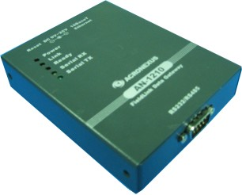
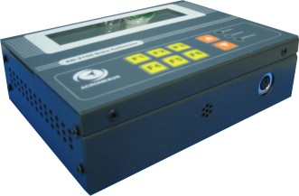
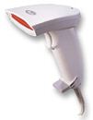
Case Study
Ethernet
RS485
Ethernet
RS485

Slide 17
德
老子38章—
上德不德
是以有德 …
故
失道而後德 失德而後仁
失仁而後義 失義而後禮 夫禮者
忠信之薄
而亂之首
金剛經—
一切
聖賢
皆以
無為法
而
有差別
public chain
private chain
peer
X
3 blocks
to peer
consensus
信
distributed
… 忠孝仁愛
信義和平 …
autonomous
proof of work

Slide 18
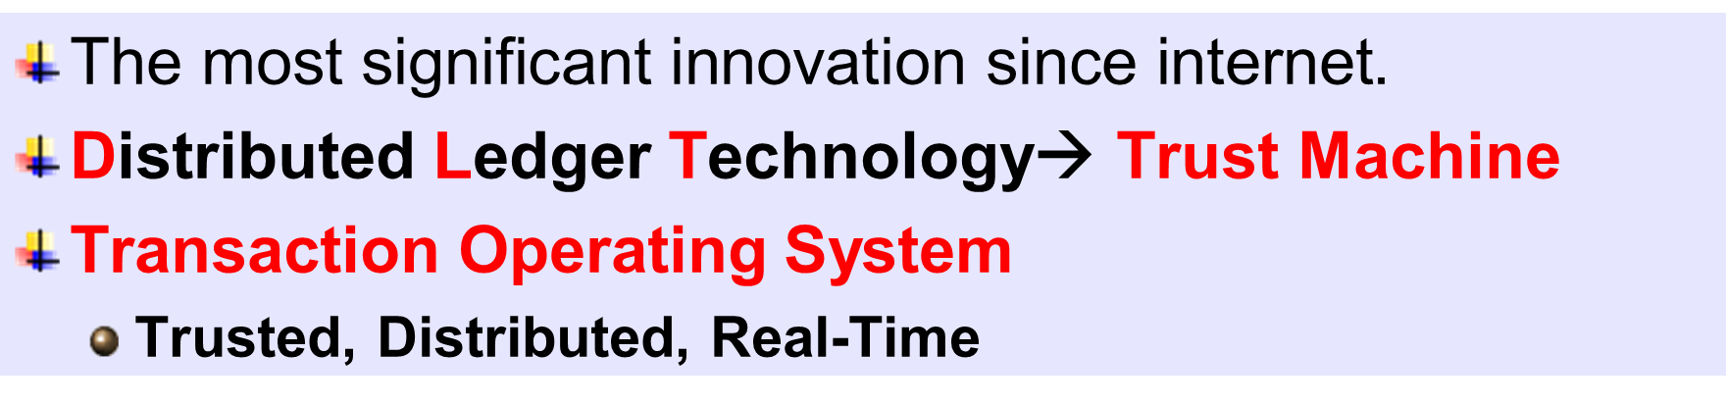

BlockChain:
$$\frac{\text{Trust} }{\text{Any} \text{Computers}}$$
資訊(OS, AI), 網路,
密碼, 數學, 機率, 統計, 政治, 經濟, 金融,
企管, 心理, 犯罪 …
各行業專業知識
方興未艾
CSIE(OS, AI), Network,
Cryptography, Math, Probability, Statistics, Politics, Economics, finance,
MBA, Psychology, Criminology …
Domain Knowhows
Yet To Come
$\text{The} \text{most} \text{significant} \text{innovation} \text{since} \text{internet}$.
Distributed Ledger Technology→ Trust Machine
Transaction Operating System
Trusted, Distributed, Real-Time
Priority Scheduling
Single tasking
Memory
Distributed File System
PoW
Consensus
Cryptocurrency
Smart Contract
UTXO
MemPool
Level-DB
IPFS
Notes:
The soul of world computer
還沒成熟

Slide 19
OurChain Architecture
OurCoin
ChainWallet
ContractStore
ChainFoundry
OurChain
ChainID
…
OurExchange
WeOS
Profile
Tx
contract
OurCertificate
OurOracle
Reward
Facebook
…
OurChain Core
BitCoin
Ethereum
BitCoin
OurPoW
OurContract
IOTA
OurFinality
Store
Vote
segwit
OurSharding
Token
Hyperleger
Certificate
lightning
C-
OurDB
…
…

Slide 20

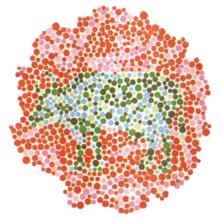
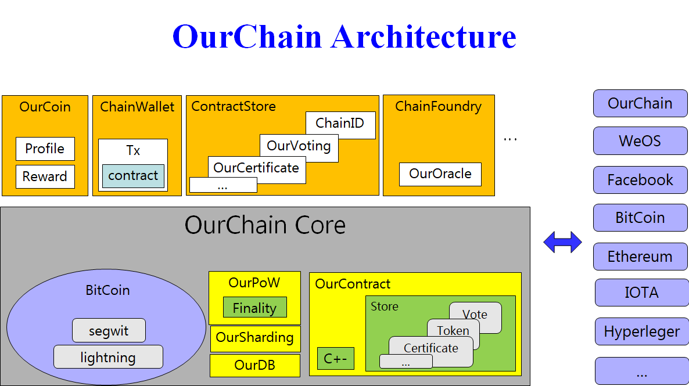
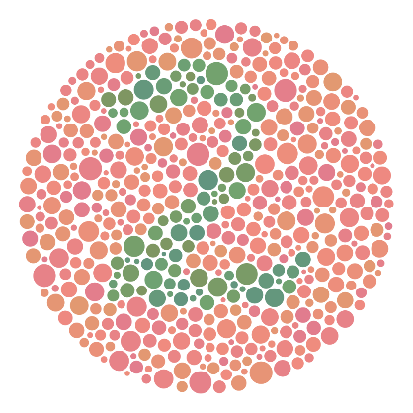
三點成鏈 於公無限 公中有私 鏈鏈相連
以物易物
以幣易幣
交易自主
剝削壟斷
平台共享
…
…

Slide 21
Autonomous ID
Autonomous ID
2 | Default Index (for ad or image)
0 | _AID
1 | Selfie ID
2 | OpenID (Acer, Google, …)
3 | Chain ID
4 | Official ID / Mobile ID
5 | NTU ID, CAS
… | Bank ID (Sweden)
11 | 1
12 | 0 | 1
13 | 3 | 1
14 | 3 | 1 | 2
15 | 3 | 4
16 | 5
…
_AID (Self certified authentication)
ID | UUID
Hash | public key from password in local
Selfie ID (Self certified authentication)
ID | Official ID
Photo | Selfie
Video | Selfie
Chain ID (How the ID is certified?)
ID | BitCoin Address (Auto change later)
ID System Index |  | Hash | Parameters
Official ID (Certified by Authorities)
Country | Nationality/District
ID | Social Security/Passport
NTU ID
Account | Password
Notes:
捐款 10元/ID
Bank ID, just learn from it

Slide 22
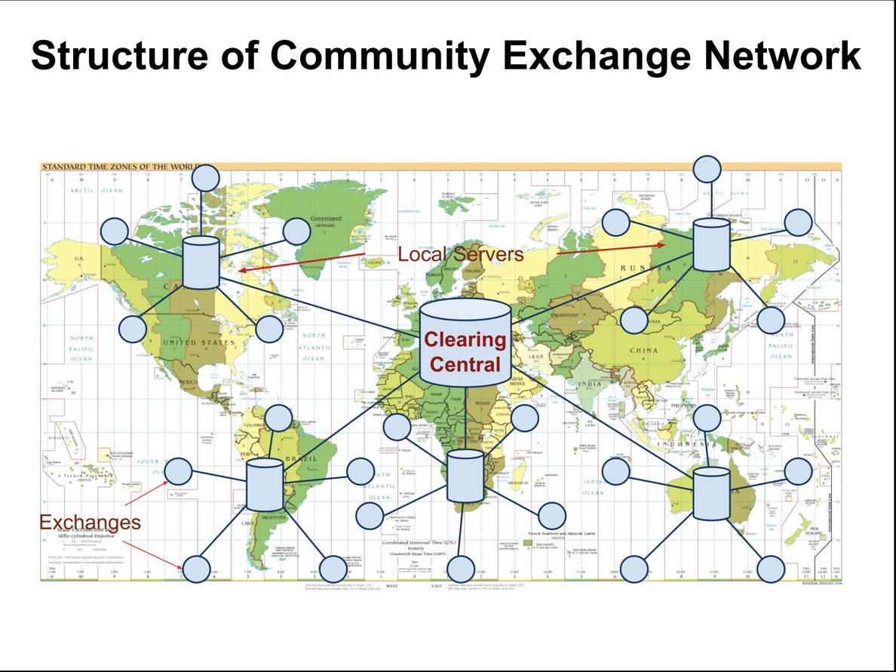
www.community-exchange.org
Tim Jenkin
97 Countries, 1013 Communities (2003-2018 Oct)
Notes:
https://en.wikipedia.org/wiki/Tim_Jenkin

Slide 23
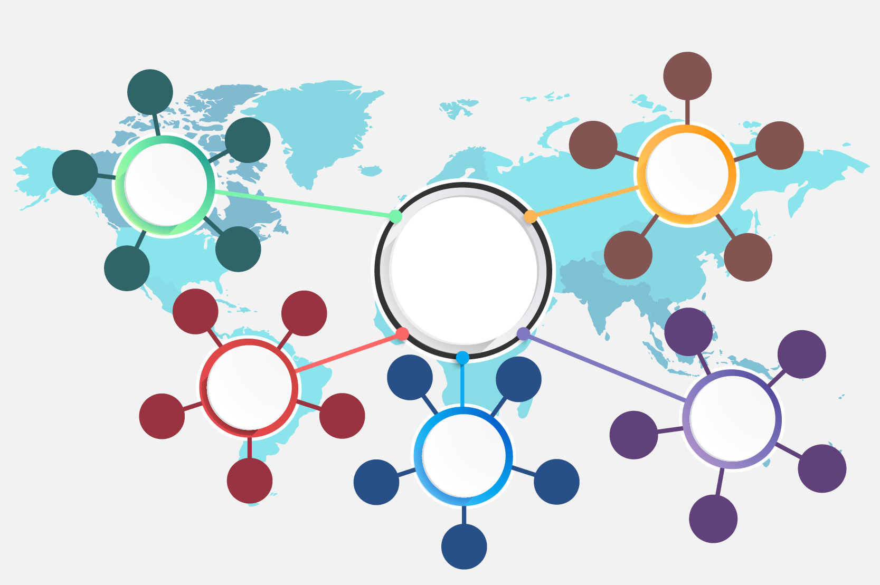
TW Community Exchange System
國家
交換所
區域
交換所
跨國界
中央交換所
Global Hub
交換
交換
區域
交換所
國家
交換所
國家
交換所
: CE 或 TB 單位
CE: Community Exchange Unit
社區交換單位
TB: Time Bank Unit 時間銀行單位

Slide 24
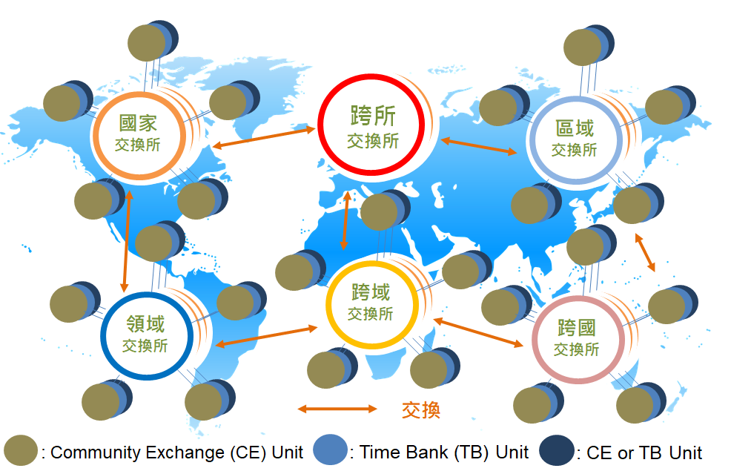
Alternative Exchange System
Notes:
Alternative Exchange System
An exchange 交換所 is supported by OurAgent or OurExchange.
OurExchange is a built-in centralized oracle as an exchange while OurAgent is an intelligent agent (IA) or an decentralized service as a Blockchain talking to other OurAgents.
A 跨所交易所 (B2B manner) is to exchange among exchanges, supported by a public OurChain.
Other exchanges are supported by private OurChains.
One or more units are supported by a public or private OurChain.
A public OurChain needs to open all data to its users, while private OurChain doesn’t.
Users can get enough information from their supporting private OurChains to verify their transactions from a public OurChain supporting the private OurChains.
Every user or exchange is identified by AIM seminymously.

