Slide 1
Webtop Automation - Handover
By Vivian Wang
2015.9

Slide 2
Handover List
--------- Part A--------------------------
Webtop basic to new comer
Installation
--------- Part B--------------------------
Robot Framework
Case Design Logic
Test Scope and coverage
Script Structure
--------- Part C--------------------------
Work Flow
Report method

Slide 3
Robot Framework

Slide 4

Robot Framework
Import test suites from Robot Ride
Get the structure of a test case
Config the resource of test suite

Slide 5
Robot Framework
Import test suites from Robot Ride
Please use demo for temp
Whole codes are in Bitbucket
Repository: https://bitbucket.org/katewang-owmessaging/webtop_api_test

Slide 6
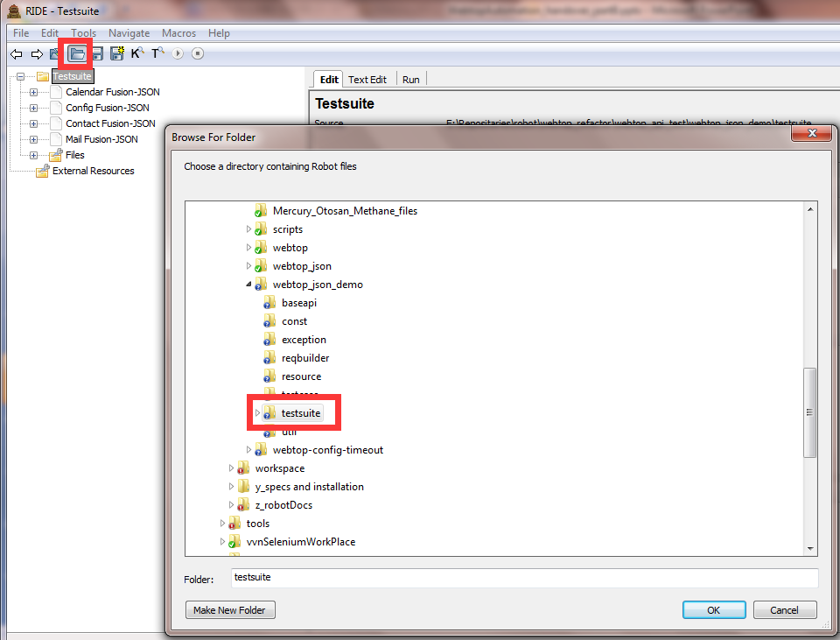
Import test suites
Import the whole test suites from path

Slide 7
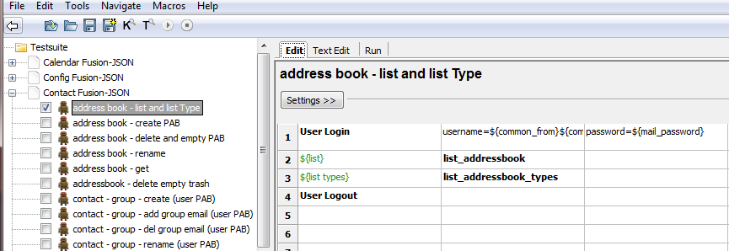
Get the structure of a test case
Select test case
Edit view in GUI

Slide 8
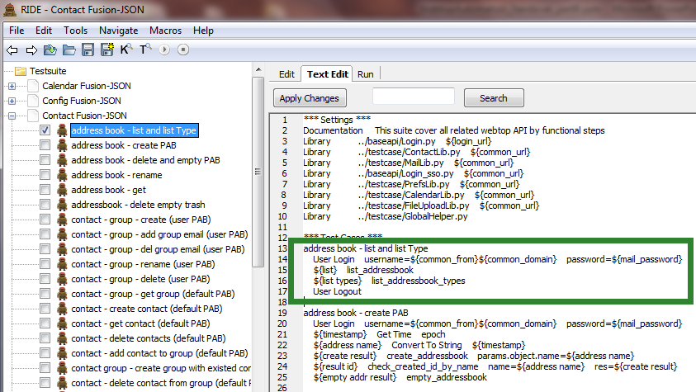
Get the structure of a test case
Select test case
Text Edit view in GUI

Slide 9
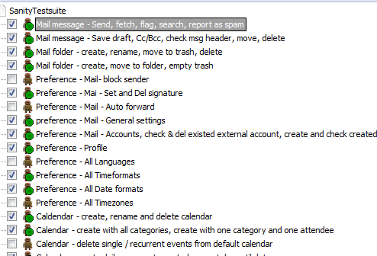
Get the structure of a test case
Test suite
Select cases and run

Slide 10
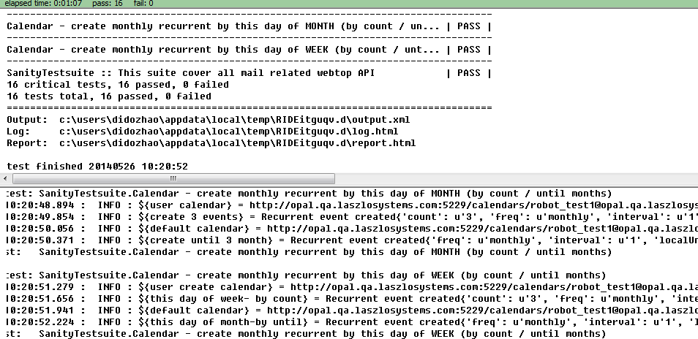
Get the structure of a test case
Each test case result
results
Local logs

Slide 11
Robot Framework
Import test suites from Robot Ride
Get the structure of a test case
3 parts structure
Function driven by keywords
Output
Input parameters
One step in one line

Slide 12
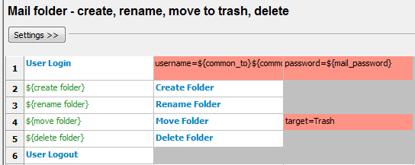
Get the structure of a test case
Keyword – Lib
Parameters – Input variables
Output – print and log variable
Here is just a case title
S
T
E
P
S
Parameters
Output
Keywords

Slide 13
Get the structure of a test case
Keywords

Slide 14
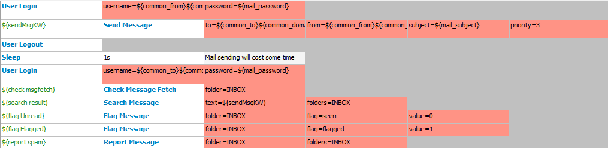
Get the structure of a test case
Match Keywords:
User Login
Send Message
…
Robot match function automatically
Mail Lib
send Message()
check_message_header()
check_message_fetch()
search_message()
…
Each keyword call a function
Each function could return something as output

Slide 15
Get the structure of a test case
Output

Slide 16
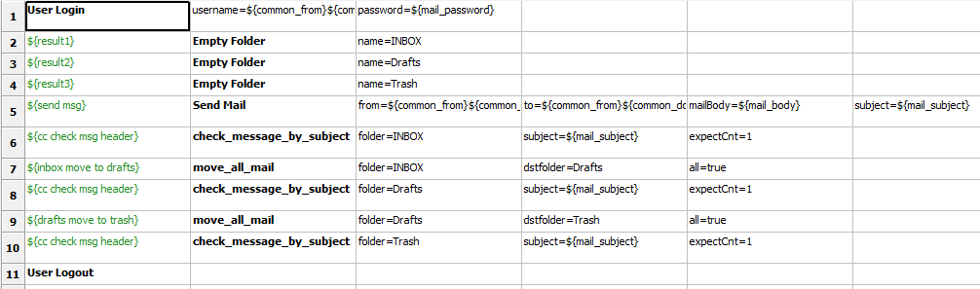
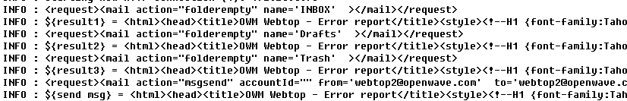
Get the structure of a test case
run

Slide 17
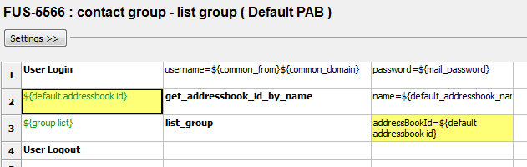
Get the structure of a test case
The output from last step can be used as input for next step
Input will be explained on next page

Slide 18
Get the structure of a test case
Parameters

Slide 19
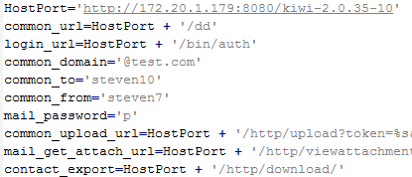
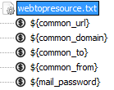
Get the structure of a test case
Input parameters - all follow with keyword
Params valued like ${} are read from resource
i.e. Folder=INBOX
Resource detail is in next part
i.e. Password=${mail_password}
resource_mail.py
resource.txt

Slide 20
Get the structure of a test case
Test suite must contain test cases
Test suite must contain reference libs
(optional) Test suite contain resources
Test suite
Resource
Resource detail is in next part
Libs
Steps

Slide 21
Robot Framework
Import test suites from Robot Ride
Get the structure of a test case
Config the resource of test suite
Method 1 – by test suite
Method 2 – by command line (recommended)

Slide 22
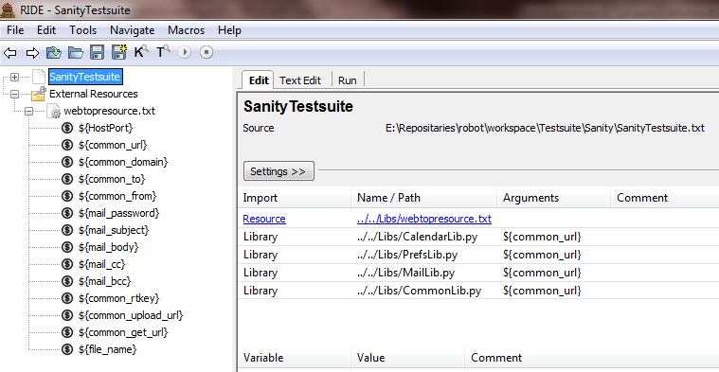
Config the resource of test suite – by test suite
SanityTestSuite.txt
Settings
Imported resources
Imported libraries
Method 1

Slide 23
Config the resource of test suite
SanityTestSuite.txt
Method 1
Following settings are all defined in test suite.txt
*** Settings ***
Documentation This suite cover all mail related Webtop API
Resource webtopresource.txt
Library ../Library/MailLib.py ${common_url}
Library ../Library/CommonLib.py ${common_url}
Library ../Library/PrefsLib.py ${common_url}
Library ../Library/CalendarLib.py ${common_url}

Slide 24
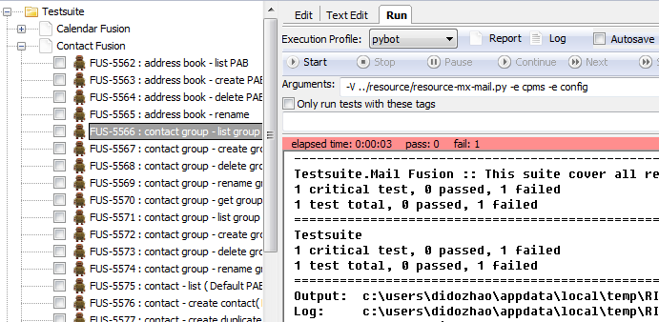
Config the resource of test suite – by command line
Resource import by command line will benefit Jenkins Job for multi-environments
Method 2 - recommended

Slide 25
Config the resource of test suite – by command line
The reason and benefit of resource imported by command line
Test resource contains URI for each test environment
Each test suite reused for multiple environment
Fusion-MX
Fusion-CPMS
Otosan
Telstra
…
Resource for Fusion-MX
Fusion-MX environment variables
One test suite
- contact
Resource for Fusion-CPMS
Fusion-CPMS environment variables
Resource for Otosan
Otosan environment variables

Slide 26
Case Design Logic

Slide 27

Case Logic
For single API:
1 case = 1 test point
list
add + check by list
add + check by read
add + delete + check by list
add + update + check by read
...

Slide 28
Case Logic
For function:
1 case = 1 test function
add from block list + test for block function
add from allow list + test for allow function
update from block list + test for block function
update from allow list + test for allow function
remove from (allow/block) list + test for function
(add/update) alarm + test for alarm arrive
…

Slide 29
Test Scope
& Coverage

Slide 30
Test Scope summary
4 environments:
Request – XML and JSON
Backend – MX and CPMS
3 components:
Mail
Contact
Calendar
(Preference included above)
Test URL:
E2E – MX backend (172.20.0.78)
E2E – CPMS backend (172.20.1.179)
E2E – Otosan SSO
Total Test suites: 14
Fusion:
3components * 2 requests(XML +JSON) * 2backends = 12
Otosan: 2components (XML)

Slide 31
Code Scope Matrix
Env | E2E-MX 172.20.0.78 |  | E2E-CPMS 172.20.1.179 |  | E2E-Otosan
Req | Json | XML | Json | XML | XML
Mail | Developing Based on requirement | Developing Based on requirement |  |  | Maintain
Contact | Developing | Developing |  |  | Maintain
Calendar | Developing | Developing
Reuse
MX
test suites
Reuse
MX
test suites

Slide 32
Script Structure

Slide 33
Codes Branch
Location
https://bitbucket.org/katewang-owmessaging/webtop_api_test
Master branch
XML \webtop_api_test\webtop
JSON \webtop_api_test\webtop_json
Develop branch (only for XML and it’s out of date)
Jenkins Jobs |  |  |  | Automation Code Repositary (all in master)
Product | environment | Back-end | Request | https://vivianwang-owmessaging@bitbucket.org/katewang-owmessaging/webtop_api_test.git
Fusion |  | MX | XML | XML -> webtop_api_test/webtop
 |  | CPMS
 | E2E Local (cass) | MX | JSON | JSON -> webtop_api_test/webtop_json
 |  | CPMS
Otosan |  | MX | XML | XML -> webtop_api_test/webtop

Slide 34
Codes Branch - Master
Baseapi
Directly call from Robot, each function only send a single request
Const
Default request with default parameters, designed to be added with more parameters
Exception
Designed to use for negative test
Rebuilder
Build request by connection of request template and inserted parameter values
Resource
Parameters for individual environment
Testcase
Package of requests+ logical function, like get_mail_id_by_subject
or for check response, like check_message_fetch_by_subject

Slide 35
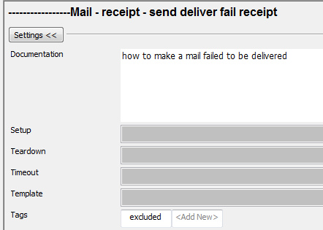
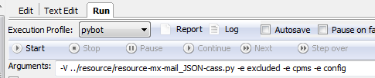
Codes Branch - Master
testsuite – test cases
MX and CPMS share the same codes and test suites, but it could be easily divided by “Tag” for Robot Framework (Tag is used on both GUI and command line)
Way of adding Tag
Way of using Tag
Util
Devide XML and Json builder and decided which one to use
-----------------Mail - receipt - send deliver fail receipt
[Documentation] how to make a mail failed to be delivered
[Tags] excluded
User Login …
……
-V ../resource/resource-mx-mail_JSON-cass.py -e excluded -e cpms -e config

