Slide 1
Webtop Automation - Handover
By Vivian Wang
2015.9

Slide 2
Handover List
--------- Part A--------------------------
Webtop basic to new comer
Installation
--------- Part B--------------------------
Robot Framework
Case Design Logic
Test Scope and coverage
Script Structure
--------- Part C--------------------------
Work Flow
Report method

Slide 3
Work Flow

Slide 4
Work Flow List
Below is the work list summery
Environment for development
Environment for running test
Start servers and services
Detail of Local environment and E2E environment
Update new build manually
Update new build automatically
Start to run tests on Jenkins
For more detail, follow the next pages

Slide 5
Develop and Test Environments
Develop on Windows
Test Drive - develop on robot ride (GUI tool) against Fusion Mx
Code repositary – Bit bucket, now codes are all in master branch
https://bitbucket.org/katewang-owmessaging/webtop_api_test
Account:
SSH: git@bitbucket.org:katewang-owmessaging/webtop_api_test.git
HTTPS: https://vivianwang-owmessaging@bitbucket.org/katewang-owmessaging/webtop_api_test.git
Advantages - easy to update test resource locally for special environment
Disadvantages – low efficient for regression test
Run Test on Linux
Test Drive – Jenkins and Robot framework command Line
Jenkins link: http://10.13.6.63:8080/jenkins/
Jenkis account: jenkins / letmein
Advantages - Run parallel, high efficient
Disadvantages – codes need to be very stable

Slide 6
Start servers and services
For start servers on local environment
IP: 172.20.1.123~172.20.1.126, plus one add-on scality: 172.20.0.129
AWS address: https://us-west-1.console.aws.amazon.com/ec2/v2/home?region=us-west-1#Instances:sort=instanceId
Start services on 10.13.6.63 (same machine as Jenkins server)
Server account: root / 123qwe
Script path: /root/startservers.sh
Environment and services
Details are in next page
For start servers on E2E
IP: 172.20.0.78, 79, 80, 104
Environment and services https://village.owmessaging.com/display/EN/Platform+Integration+Fusion+-+QE+Lab
Start-up scripts are already added on 104, 79, need manually check:
Scality web page
Services on 78 and 80

Slide 7
Local environment
Not sure of
Service Port and SSL Port

Slide 8
Run on new build process
First, make sure all servers and services are up (by previous page)
Manually update
New build location (This is automatically got from Dev’s Jenkins, usually on Wed.)
10.13.6.63:/home/kiwi_octane_build/kiwi-octane
Build process:
update build -> update script -> update code resource -> create accounts
Automatically update – on local Jenkins
Update build on 172.20.1.123~126
Job: Update build - 172.20.1.123
Update script for latest code and clean code environment
Job: a_init-mx_json-123
Update script resource for latest build environment
Job: Update_resources_forNewBuild_123
Delete and Recreate new test account
Job: create accounts - 1.123
Note: Need to restart tomcat manually

Slide 9
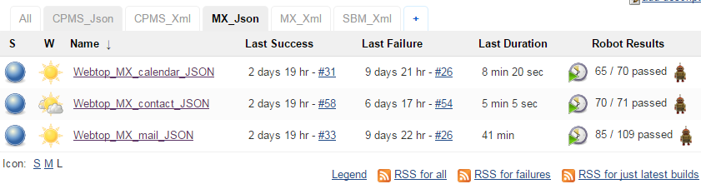
Jenkins Jobs
These jobs are only for running stable build
Each group contains execution Jobs
Current focus on this group against Webtop master branch
Different group for different environment
Which match the test scope matrix

Slide 10
Jenkins Jobs
Core robot command line and parameters for execution job
pybot: the command
--nostatusrc
Contibue to run test if current case is failed
-V ../resource/resource-cpms-contact.py
To use the certain resource (compulsive here)
-e config
Skip the cases with “config” Tag
-o ${WORKSPACE}/output-cpms-contact.xml
Save output xml file (compulsive here)
-r ${WORKSPACE}/output-cpms-contact.html
Save report file
(last one) Contact_Fusion.txt
Point to the test suite (compulsive here)

Slide 11
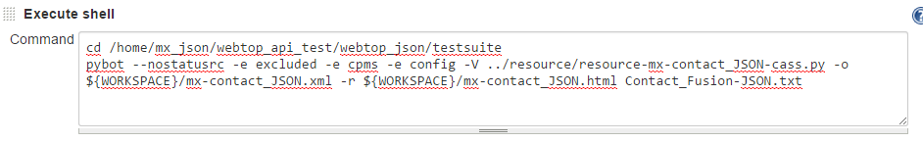
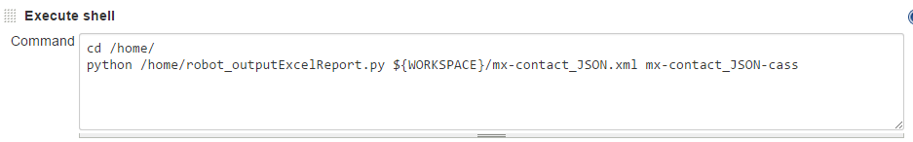
Jenkins Jobs
Configuration for JSON job
Run test suite
Output result to Xls file – details will be covered in next part “Report Method”

Slide 12
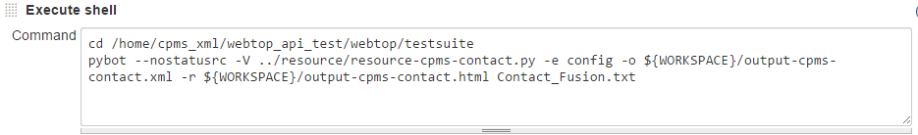
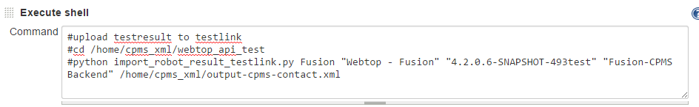
Jenkins Jobs
Configuration for XML job
Run test suite
Output result to Testlink – details will be covered in next part “Report Method”

Slide 13
Report Method

Slide 14
Test Report Methods - Pro and Con
Excel
Clear comparison of history of versions
Automatically to adjust cases by test suites - add, delete, update, etc
Need to combine the 3 Xls manually (Mail, Contact, Calendar)
Final result could be lost on local disk (manually delete)
Mail
Report will arrive as soon as Jenkins test job done
Need script very stable
Report isn’t final result, need to analyze manually
Testlink
Result will be saved permanently
Impossible to update test suites when it has a result for very first version
Not very easy to compare history results
Result isn’t final if QA just import from Jenkins without any analyze
Current Report

Slide 15
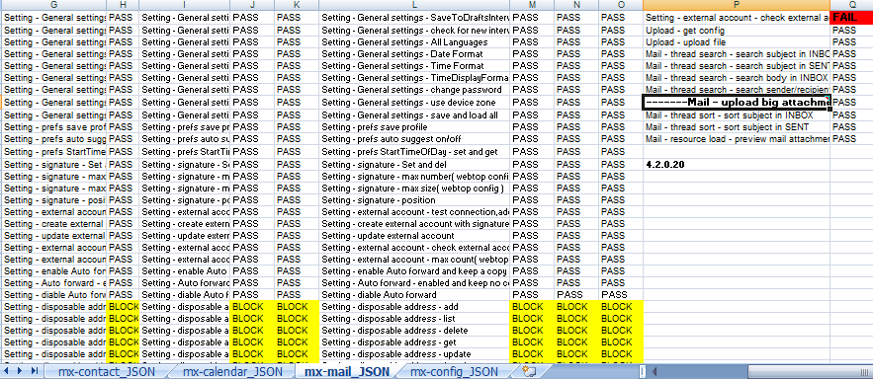
Test Report and Current Report
Excel
Convert XML to Excel filed after test, triggered by individual test job
Currently implemented for group “MX_Json” jobs
Location: 10.13.6.63:/home, XLS files are individually for mail/contact/calendar/config/
Need to combine manually locally and analyze the result for FAILED and BLOCKED
Finally result: \\10.13.6.180\public\QA\Fusion\Webtop_automation

Slide 16
Test Report and Current Report
Mail
Cannot use lately, for Sender (Jenkins-notif@owmessaging.com) doesn’t work now. If the tests are stable enough for sending mail, please contact the one who manages owmessaging mail system
System configurations and Job configurations are done
Following are the detail page

Slide 17
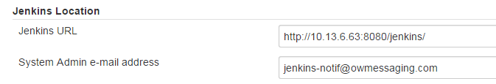
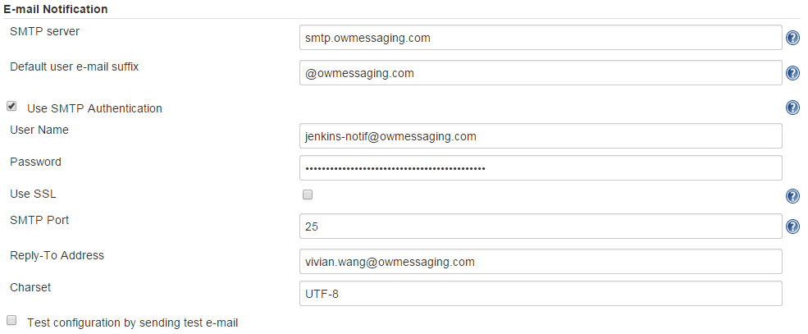
Test Report and Current Report
Jenkins system configuration for sending report
http://10.13.6.63:8080/jenkins/configure

Slide 18
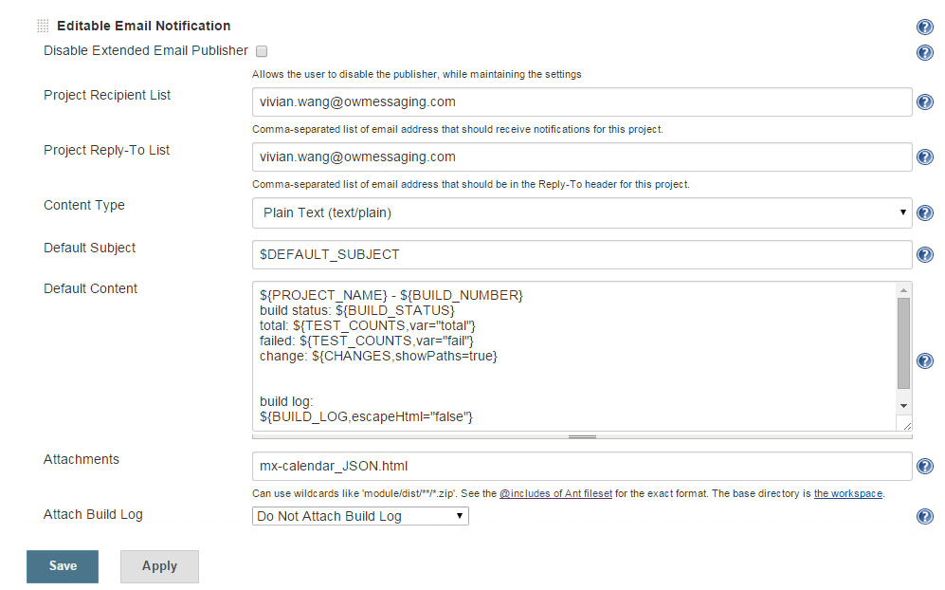

Test Report and Current Report
Mail
Job configuration

Slide 19
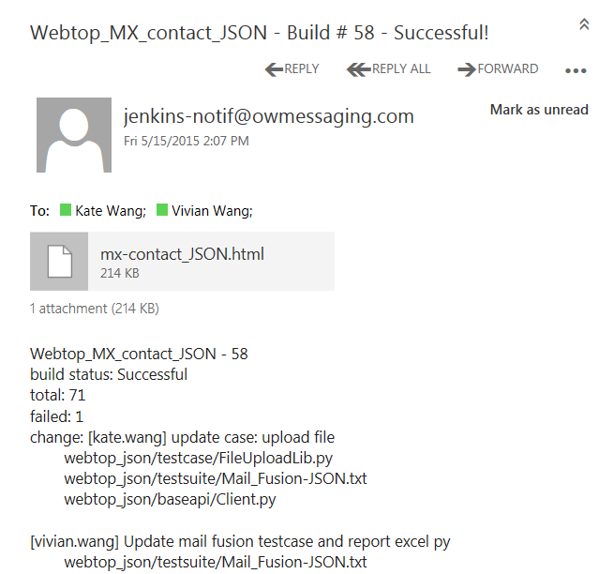
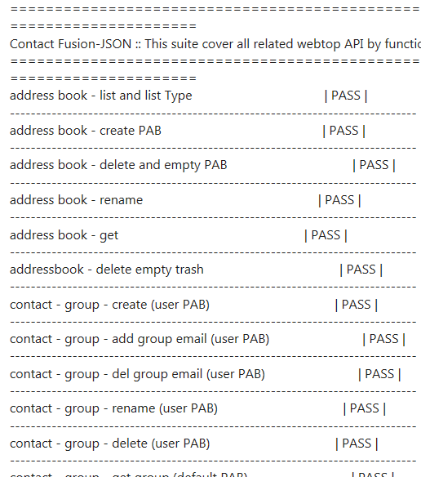
Jenkins - Report Mail

Slide 20
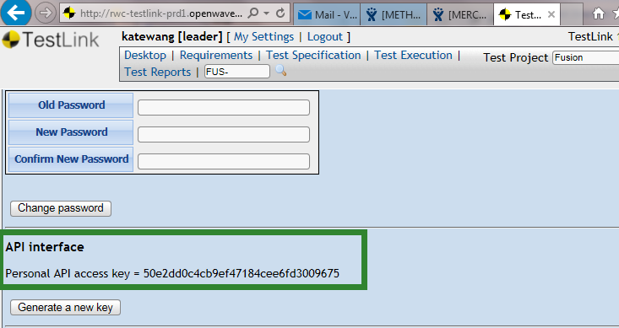
Test Report and Current Report
Testlink
Add API and Testlink’s URL into Jenkins
Check for Testlink’s API
Notice the Testlink URL: http://rwc-testlink-prd1.openwave.com/testlink/index.php

Slide 21
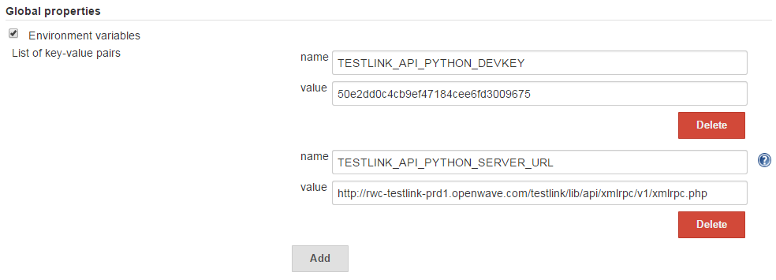
Test Report and Current Report
Testlink
Add API and Testlink’s URL into Jenkins
Jenkins system configuration: API and URL (last page)

Slide 22
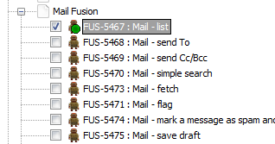
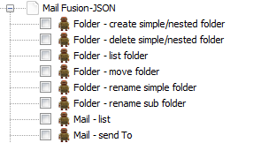
Test Report and Current Report
Testlink
So far, only XML test suites support upload to Testlink.
For Json, need to:
Upload all test cases to Testlink and get all IDs
Rename all test cases in TXT files followed the format: FUS-5467 : Mail – list
Case name format must be <caseID><space>:< space>
Then script could be used for upload, parameters same as XML (next page)
Xml test name used CORRECT format
Will be sucessfully uploaded to Testlink
Json test name used WRONG format
Will be FAILed when uploaded to Testlink
Correct name
Wrong name

Slide 23
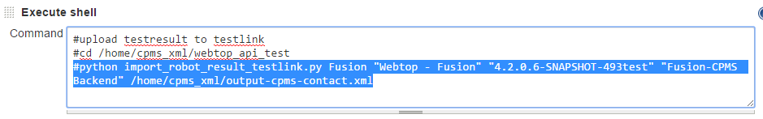
Test Report and Current Report
Testlink
Add API and Testlink’s URL into Jenkins
Jenkins system configuration: API and URL (last page)
Job configuration
Install testlink 3rd party codes: unzip “testlink.zip” and put it here: \Python27\Lib\testlink
Use shell to call a Python script which reads robot result xml file and import results to Testlink (alreay done in XML jobs)
python import_robot_result_testlink.py <project> <test plan> <build name> <platform or “no_platform “> <robot output xml>

Slide 24
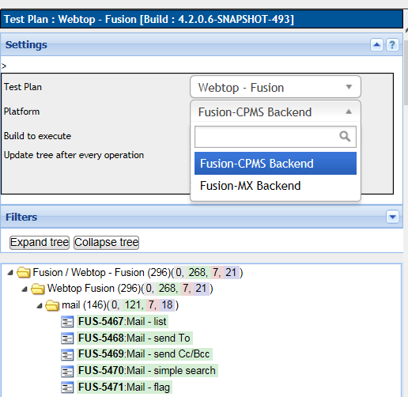
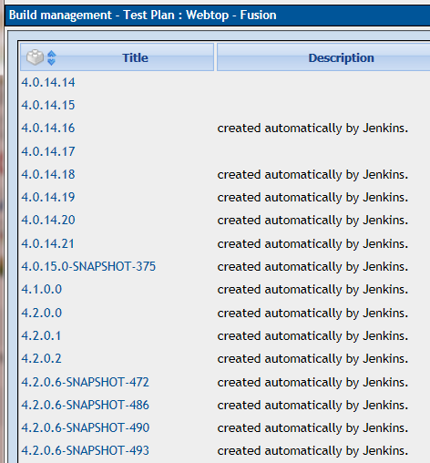
Testlink – Fusion Back ends
This was added for XML:
- Fusion MX/CPMS
- SBM

Slide 25
That’s all Thanks

