Slide 1

AI Deployment in Marriott Hotels, Singapore
Exploring Solutions for Marriott International's AI Strategy
Group 7
YWCC 307- Project 3
Presentation by John Rizkalla, Dave Persaud, and Tsewang Sherpa

Slide 2

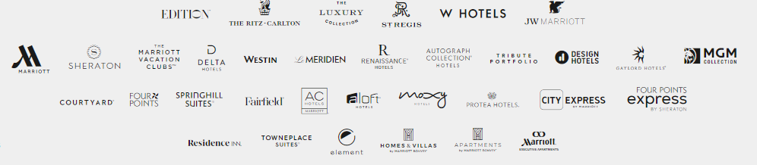
Introduction
Marriott International, Inc. is an American multinational company that operates, franchises, and licenses various lodging brands.
Owns 30 leading brands and nearly 8,800 properties in 139 countries.
Marriott is the second largest hospitality player in terms of market share in Singapore.
They are facing pressure to innovate and review the AI strategy for its hotel brands.
SHOULD MARRIOTT PROCEED WITH IMPLEMENTATION OF GUEST FACING AI?

Slide 3

Singapore’s Government and AI
Singapore was among the first countries to publish an AI plan in 2019.
Singapore’s government is committed to embracing AI as a key driver of economic growth, innovation, and societal progress.
They support successful use cases of front-facing AI solutions such as chatbots, service robots, and more.
AI has the ability to increase guest satisfaction in luxury hotels.
The Singapore government is making efforts to promote the responsible use of AI.

Slide 4

Marriott’s Current Status without AI
Competitive Disadvantage
- Other hotels are integrating AI in their systems, gaining an edge in
personalization and customer engagement
- Hilton's Connie, powered by IBM Watson AI, acts as a concierge, assist guests
with information about hotel amenities, dining recommendations, and local attractions.
Guest Expectations
- Guests now expect smart, connected experiences tailored to their preferences,
so the current non-AI approach may not meet the evolving demands of the modern
travelers.
Strategic Response to Market Dynamics
- Delaying the adoption of AI tactics could hinder the company’s ability to stay ahead in the dynamic market, because Singapore is slowly turning into a cashless society.

Slide 5

Research Findings on Impact of AI on Hotels
AI adoption exceeds guest expectations by providing convenient stays.
AI can be used for:
Chat Bot: Automating processes like check-in/out, room service, and reservations.
Customer Service: Efficiently handling inquiries and issues.
Revenue Optimization: Using dynamic pricing and demand forecasting.
Personalized Experiences: Tailoring services based on guest preferences.
Predictive Maintenance: Anticipating equipment failures to reduce downtime.
Enhanced Security: Monitoring guest behavior and detecting threats.

Slide 6

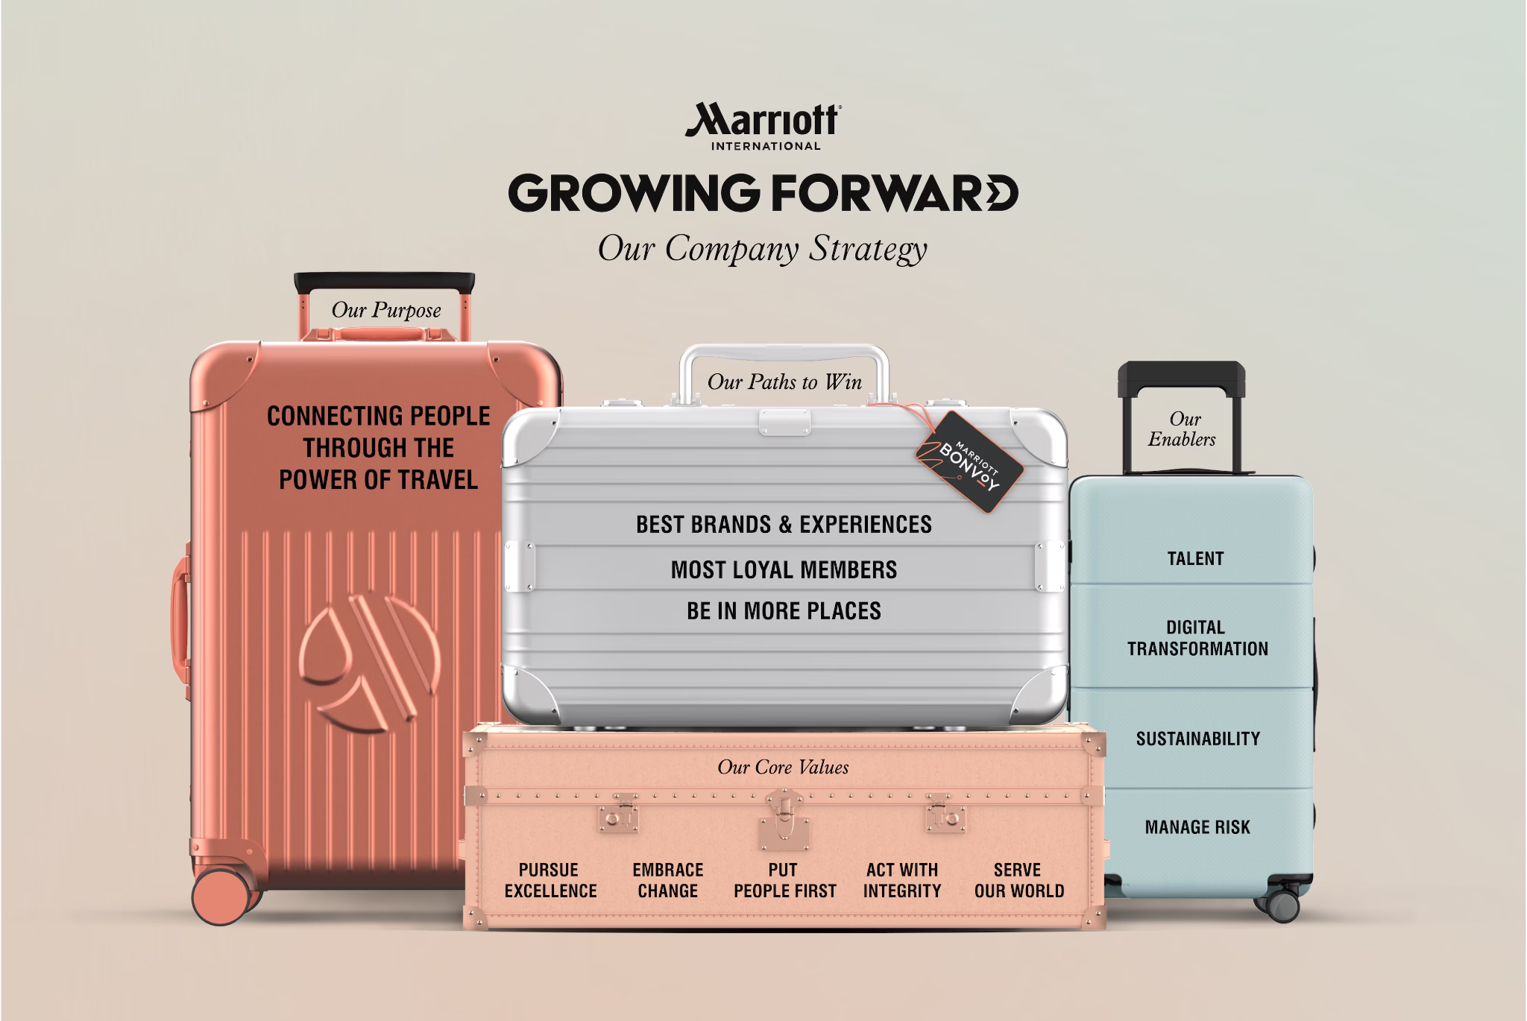
Notes:
Before going into implementation of the solution, we need to consider the beliefs and values of Marriott, and we see that their purpose is to connect people through the power of travel, and embrace change, pursue excellence, and perform digital transformation while maintaining sustainability. THis means AI adoption is the right way to go, however we need to keep in mind that while we adopt AI, we dont lose hu

Slide 7


What We think?
The adoption of AI aligns with Marriott's values.
While AI has the potential to significantly enhance guest satisfaction in luxury hotels.
It is essential to ensure AI adoption preserves human interaction alongside technological advancements.
Enhance rather than replace human interaction with guest.

Slide 8

Start of AI implementation.
AI should complement human interaction and make the hotel services convenient.
Keep people connected and embrace human interaction while performing digital transformation.
The city-state has initiated pilot projects like the FinTech Regulatory Sandbox and healthtech sandbox, allowing industry players to test products in a live environment before market launch.
Best way to test the services would be to start with pilot projects in Select Brand.

Slide 9
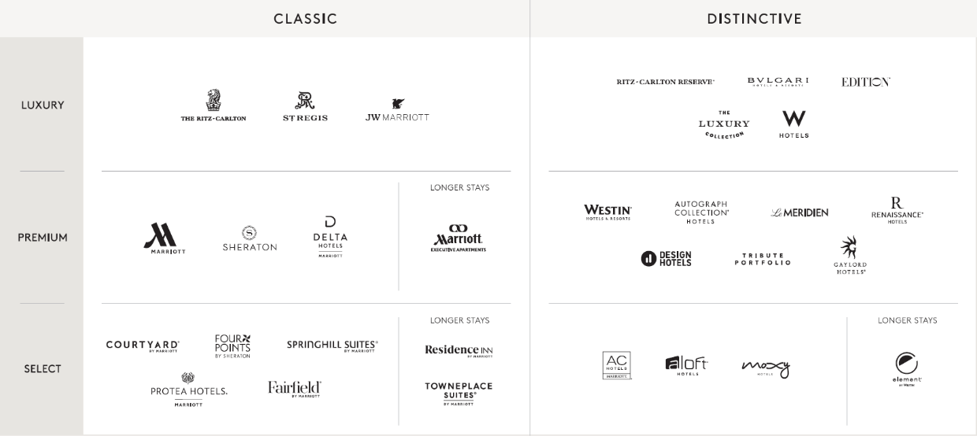
BRANDS BREAKDOWN

Slide 10

Focus on Select Brand
Marriott Select Brands are synonymous with innovation.
They shape the future of hospitality.
Utilize diverse construction types such as modular builds and market-targeted designs.
Offer innovative F&B (Food and Beverage) solutions.
Drive guest preference and profitability for owners.
Provide comprehensive support throughout project lifecycles.
Ideal for launching pilot projects to test AI capabilities and suitability for the brand.

Slide 11
Proposed Solutions
Deploy guest-facing AI in Marriott's select hotels in Singapore.
Focus areas: Customer Service, Predictive Maintenance, Security.
Implement personalized chatbots for fast check-in/out.
Utilize AI-controlled amenities and predictive services for guest convenience.
Goals: Enhance guest satisfaction, streamline operations, and provide personalized experiences.

Slide 12
Potential Outcome
Potential benefits of AI deployment include:
Improved guest satisfaction.
Enhanced operational efficiency.
Attainment of a competitive advantage/ keep up with competitors
Expected impact on Marriott's brand image and market position in Singapore is positive.

Slide 13
Conclusion
AI innovation is crucial for Marriott's success in Singapore.
Marriott should prioritize AI implementation without losing the human connection.
Hospitality are best given by friendly human faces.
Ongoing evaluation and adaptation of AI through pilot projects are essential for sustained success.
Seizing this opportunity will elevate guest experiences and maintain competitiveness.
Implementation of AI aligns with Singapore’s government value.

Slide 14

Questions & Answers

Slide 15
Works Cited
Chiang, Sheila. “Singapore Is Not Looking to Regulate A.I. Just Yet, Says the City-State’s Authority.” CNBC, 19 June 2023, www.cnbc.com/2023/06/19/singapore-is-not-looking-to-regulate-ai-just-yet-says-the-city-state.htm.
Hadeel Sa’ad AL-HYARI, et al. “THE IMPACT of ARTIFICIAL INTELLIGENCE (AI) on GUEST SATISFACTION in HOTEL MANAGEMENT: AN EMPIRICAL STUDY of LUXURY HOTELS.” THE IMPACT of ARTIFICIAL INTELLIGENCE (AI) on GUEST SATISFACTION in HOTEL MANAGEMENT: AN EMPIRICAL STUDY of LUXURY HOTELS, vol. 48, no. 2 supplement, 30 June 2023, pp. 810–819, https://doi.org/10.30892/gtg.482spl15-1081.
Pillai, Rajasshrie, and Brijesh Sivathanu. “Adoption of AI-Based Chatbots for Hospitality and Tourism.” International Journal of Contemporary Hospitality Management, vol. 32, no. 10, 11 Sept. 2020, pp. 3199–3226, https://doi.org/10.1108/ijchm-04-2020-0259.

