Slide 1

APP: Delivery Assistant
Group: Simple APP
Hunan university of arts and science · EI1 – 5/14/2019

Slide 2
01
Introduction
，
02
CONTENT
What we done in this week?
，
>>
03
What we will do in next week ?

Slide 3

1
Introduction

Slide 4
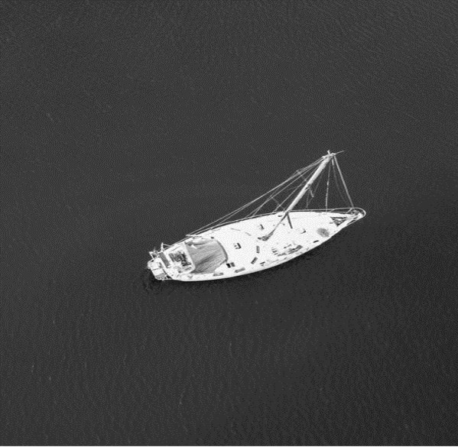
Introduction
Group Name: ___Simple App___
App Name: ___Delivery Assistant___
Member Name:
___Sophie(leader)___ , ___Xiaojiao___ , ___Panmi___ , ___Hupin___ , ___Yangjinle___

Slide 5
2
What we done in this week?

Slide 6
What we done in this week?
48%
52%

Slide 7
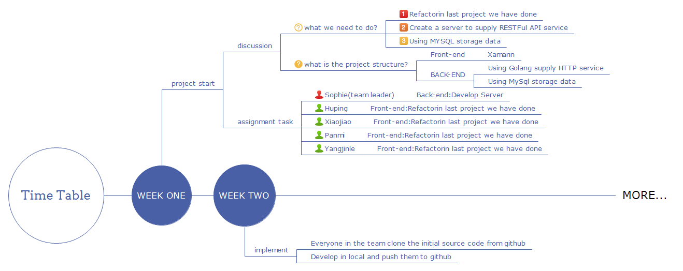
We done - Plainning
http://naotu.baidu.com/file/dcce888cbb98eff09e947b19ed6645ea?token=da529395c1abaf66

Slide 8
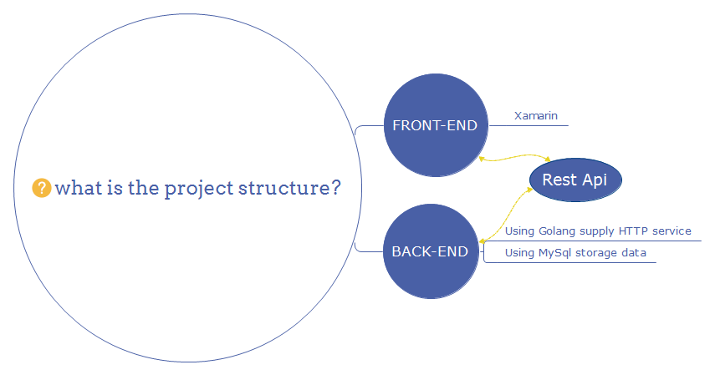
We done - Plainning

Slide 9
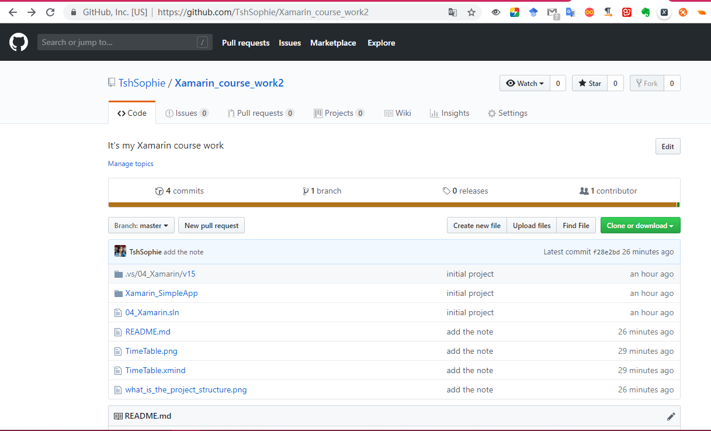
We done - Initial project
https://github.com/TshSophie/Xamarin_course_work2

Slide 10
3
What we will do in next week ?

Slide 11
What we will do in next week ?

Slide 12
THANK YOU

