Slide 1
FUSION HIGH EDUCATIONAL ECOSYSTEM
Comprehensive Role-by-Role System Presentation & Technical Architecture Walkthrough
Complete Walkthrough: Admin, Educator, Parent & Learner Portals (Page by Page) Multi-Tenant Scope: 12 Active Campuses across Limpopo (Capricorn South) & Gauteng (Tshwane) Curriculum Standards: Department of Basic Education (DBE CAPS & SASAMS Compliant)

Slide 2
Presentation Roadmap: User-by-User Portals
Four dedicated stakeholder chapters showcasing live screens, features, and workflows.
Chapter 1: Administrator Hub
Chapter 2: Educator Workspace
10 Core Modules: Command Center, User Permissions, Inter-School Derbies, Mark Audits, Timetables, Fees, Matric Projector, Relief Scheduler, Exams.
7 Core Modules: Teaching Schedule, Subject Workload, Resources Studio, CAPS Markbook, Attendance Register, AI Lesson Planner, Homework Hub.
Chapter 3: Parent Family Portal
Chapter 4: Learner Learning Hub
5 Core Modules: Multi-Child Dashboard, Academic Reports, 20-Min Teacher Consultations, Digital Fee Statements, Child Weekly Timetables.
6 Core Modules: Student Overview, Subject Topics, School-Aware AI Tutor, Fusion Arcade Games, NSFAS Bursaries, Career Advisor.

Slide 3

Universal Multi-School Landing Portal
Public & Authentication Portals • Dynamic 12-School Campus Selector, Live Statistics & Admissions Gateway
Core Features & Capabilities
• Live counters querying verified enrolled learners, classes, and academic faculty directly from PostgreSQL.
• 1-click institution switcher across 12 high schools in Limpopo (Capricorn South / Mankweng) & Gauteng (Tshwane).
• Official branding, verified DBE EMIS numbers, and circuit details per campus.
• Direct online learner application portal and prospective parent registration.
Notes:
Explain that the public gateway provides institutional branding for all 12 campuses while directing users to their respective portals.

Slide 4
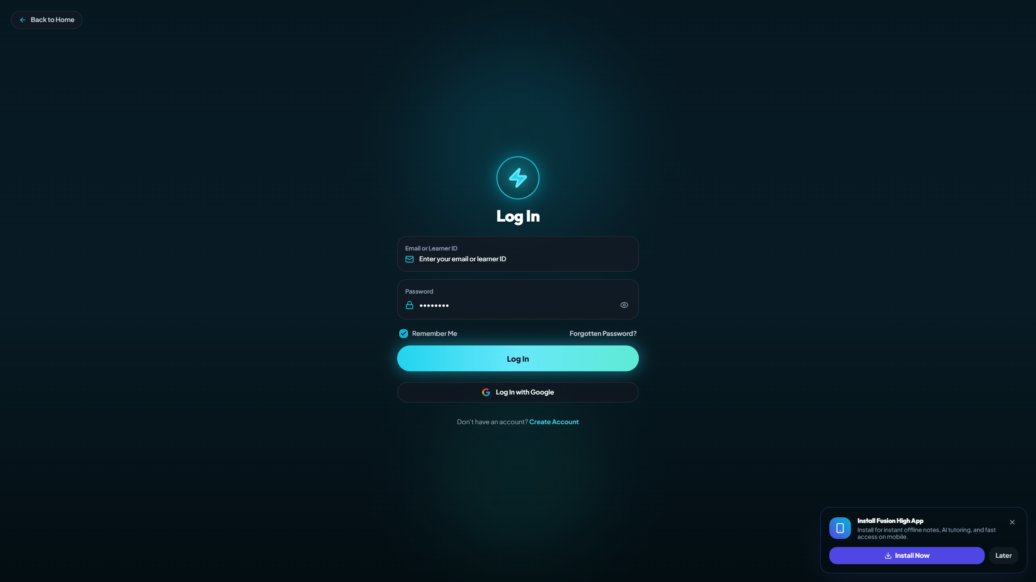
Role-Based Authentication Gateway
Public & Authentication Portals • Secure Sign-In for SuperAdmin, SubAdmin, Educator, Parent & Learner
Core Features & Capabilities
• Multi-role login supporting email address, learner ID number, and employee credentials.
• Bcrypt-encrypted password hashing and signed JWT session token generation.
• Automated redirect to role-specific dashboard with strict permission isolation.
• 60-second time-based OTP password recovery workflow with direct email verification.
Notes:
Highlight how the authentication engine automatically routes users to their respective workspaces based on verified database roles.

Slide 5
1. EXECUTIVE ADMINISTRATOR DASHBOARD & OPERATIONS
In-depth page-by-page screen walkthrough with live database metrics & operational workflows

Slide 6
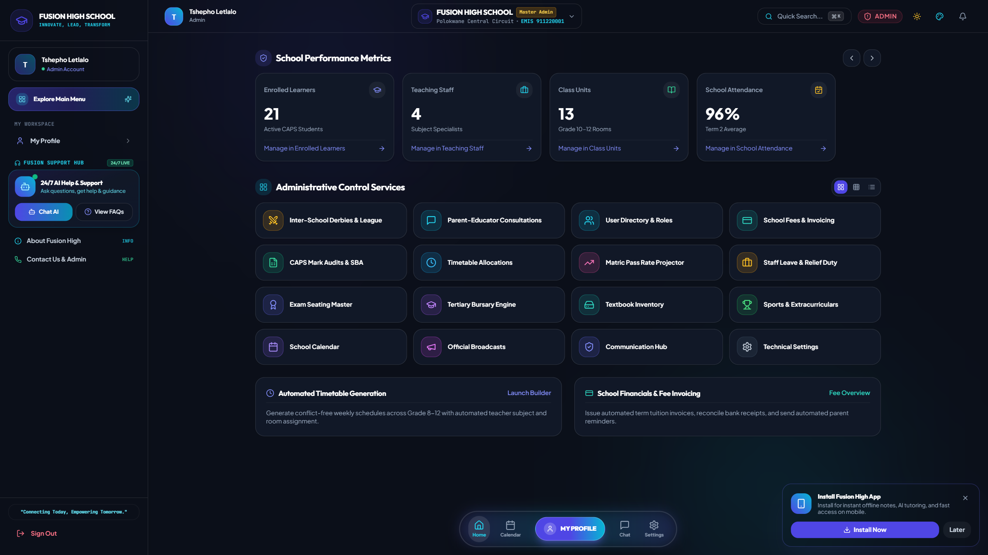
Executive School Overview & Macro KPIs
1. Executive Administrator Dashboard & Operations • Institutional Operational Dashboard & Rapid Module Dispatch
Core Features & Capabilities
• Instant overview cards: Total Enrolled Learners, Academic Staff Roster, Classrooms, and Attendance Rate.
• Real-time executive actions: Launch Admissions, Open Mark Audits, Schedule Timetables, and Manage Fees.
• Live school calendar feed displaying upcoming district assessments and circuit events.
• Universal module back-navigation bar enabling seamless transitions between tools.
Notes:
Demonstrate the primary command overview where school principals and executive directors monitor daily institutional operations.

Slide 7
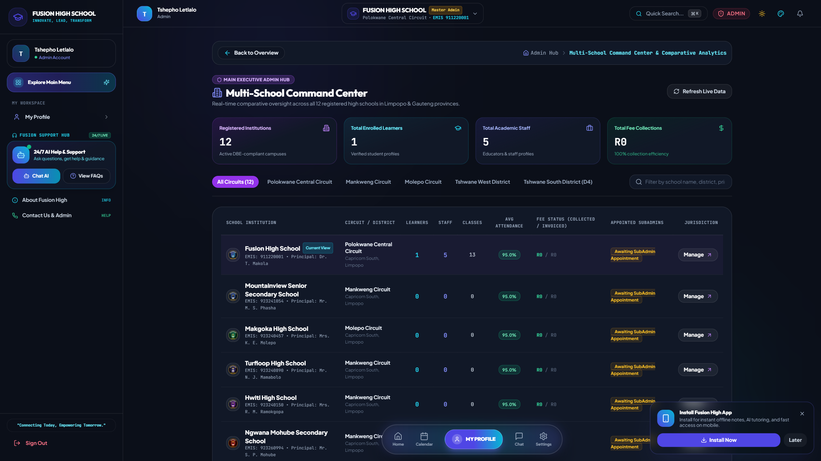
Multi-School Command Center (SuperAdmin)
1. Executive Administrator Dashboard & Operations • Universal Comparative Analytics Across All 12 High Schools
Core Features & Capabilities
• Side-by-side comparative table for all 12 schools in Limpopo and Gauteng.
• Monitors student enrollment vs capacity, educator rosters, and classroom metrics.
• Tracks fee billing, total collections, and financial efficiency per school.
• 1-click "Manage & Switch View" to jump directly into any institution.
Notes:
Emphasize that the SuperAdmin can oversee the entire educational group while ensuring each school has its own dedicated SubAdmin.

Slide 8
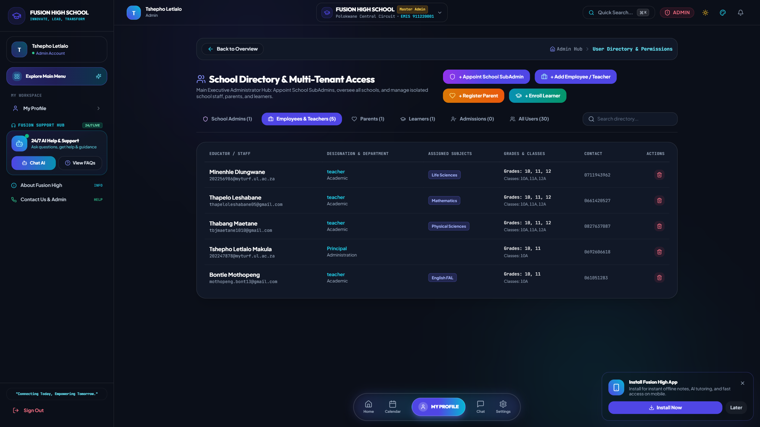
User Directory & SubAdmin Appointments
1. Executive Administrator Dashboard & Operations • Multi-Tenant Permission Hierarchy & Faculty Onboarding
Core Features & Capabilities
• Main Admin appoints dedicated School SubAdmins for specific institutions.
• Automated onboarding email dispatch with temporary password and school details.
• SubAdmins onboard faculty, assign subject workloads, and manage parents.
• Strict database role separation (Admin, Teacher, Parent, Learner).
Notes:
Show how SubAdmins are appointed and how faculty members receive automated login credentials with assigned grades and subjects.

Slide 9
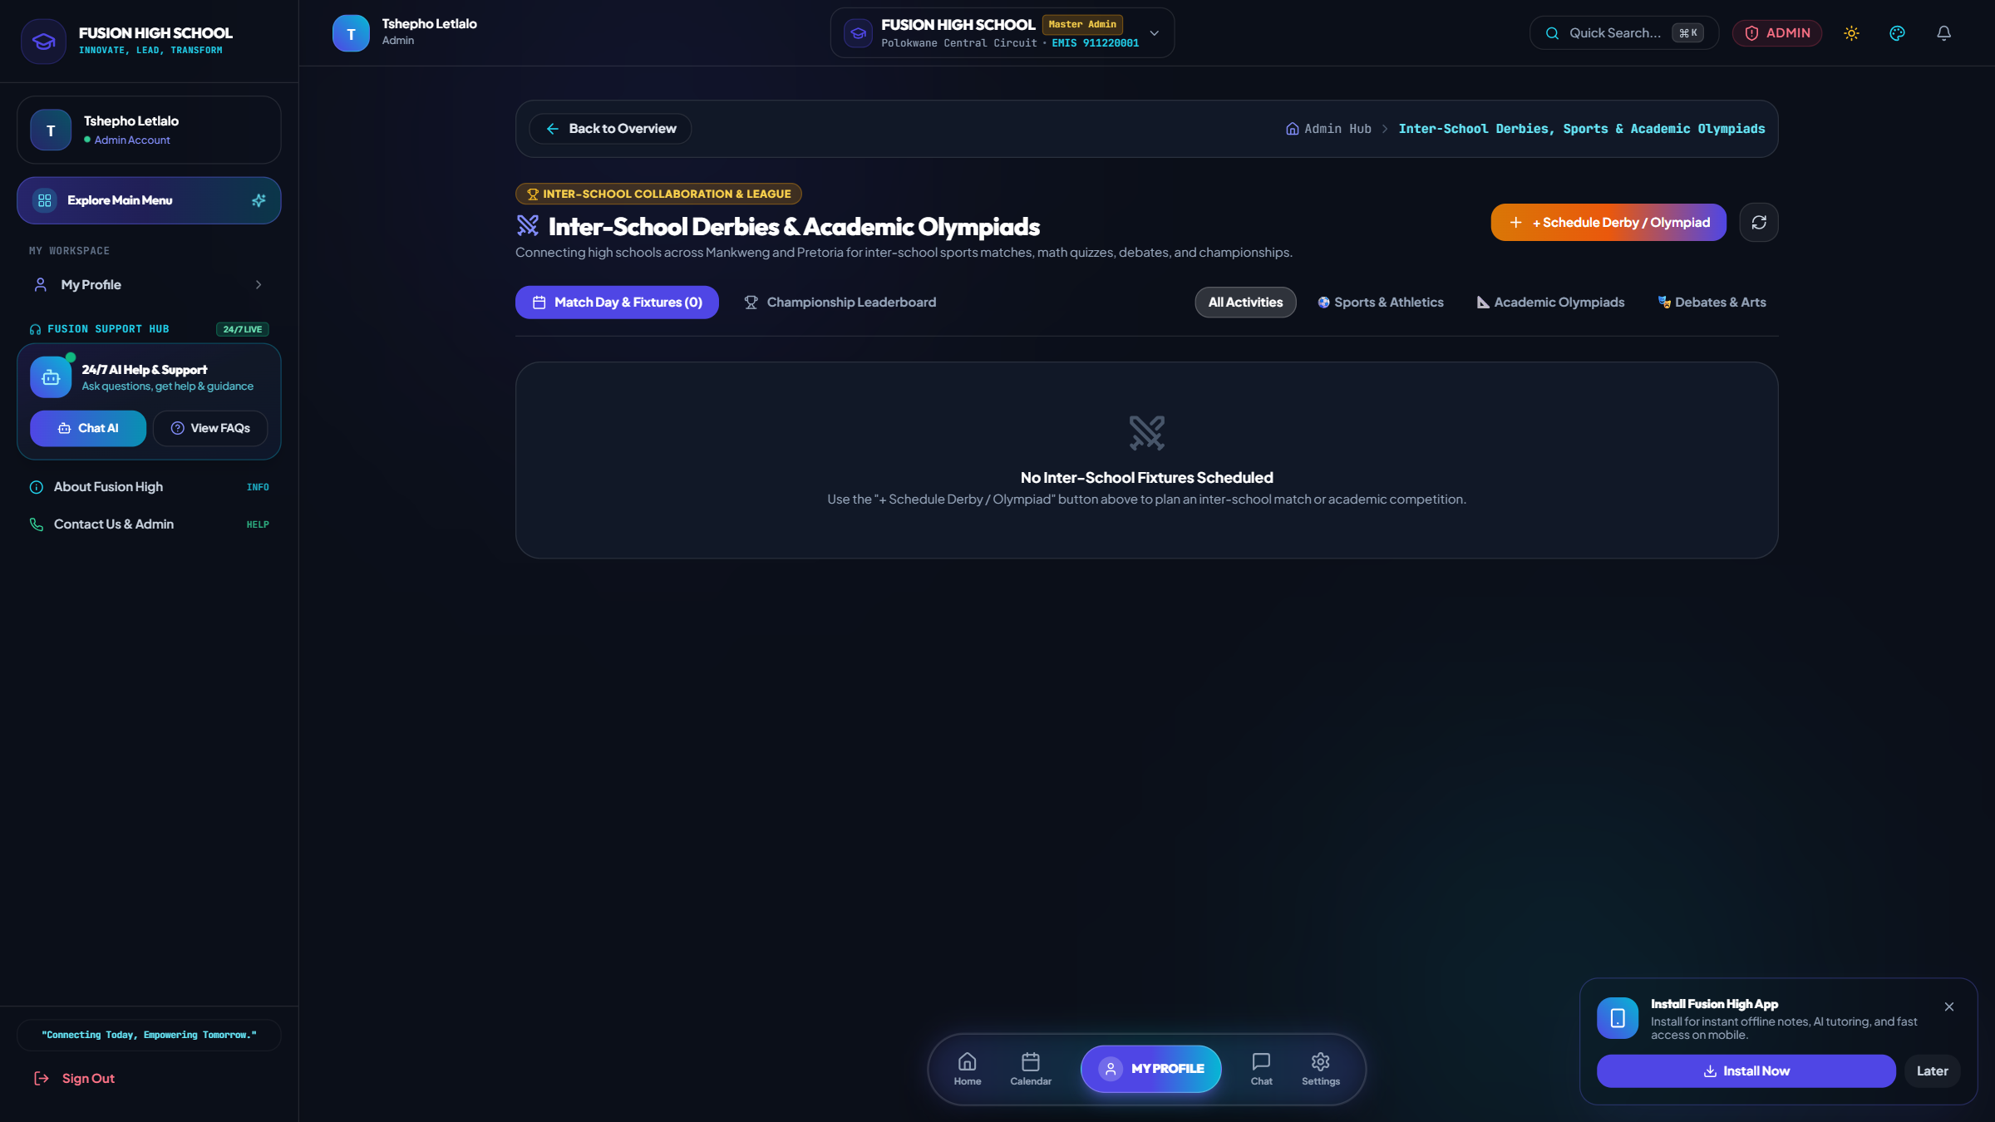
Inter-School Derbies & Academic Olympiads
1. Executive Administrator Dashboard & Operations • Circuit Collaboration, Sports Leagues & Trophies
Core Features & Capabilities
• Schedule inter-school sports matches (Soccer, Netball, Athletics) & academic tournaments.
• Live match scoreboards with school crests, venue details, and match summaries.
• Circuit championship leaderboard with automated points (Win=3, Draw=1, Loss=0).
• Fosters cross-school camaraderie and competitive district excellence.
Notes:
Explain that the derby league brings schools together for sports tournaments and academic quizzes with live leaderboards.

Slide 10
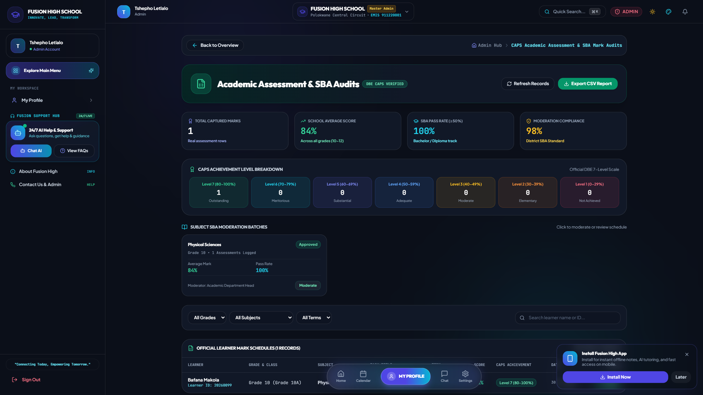
CAPS Mark Audits & SBA Moderation
1. Executive Administrator Dashboard & Operations • Continuous Assessment Quality Assurance & Statistical Distribution
Core Features & Capabilities
• Term 1–4 SBA weightings and Practical Assessment Task (PAT) tracking.
• Statistical distribution analysis identifying at-risk students and high achievers.
• Departmental moderation workflow for subject heads and curriculum advisors.
• Full compliance with Department of Basic Education National Protocol for Assessment.
Notes:
Walk through how subject heads verify teacher marking standards and ensure curriculum compliance before term report card publishing.

Slide 11
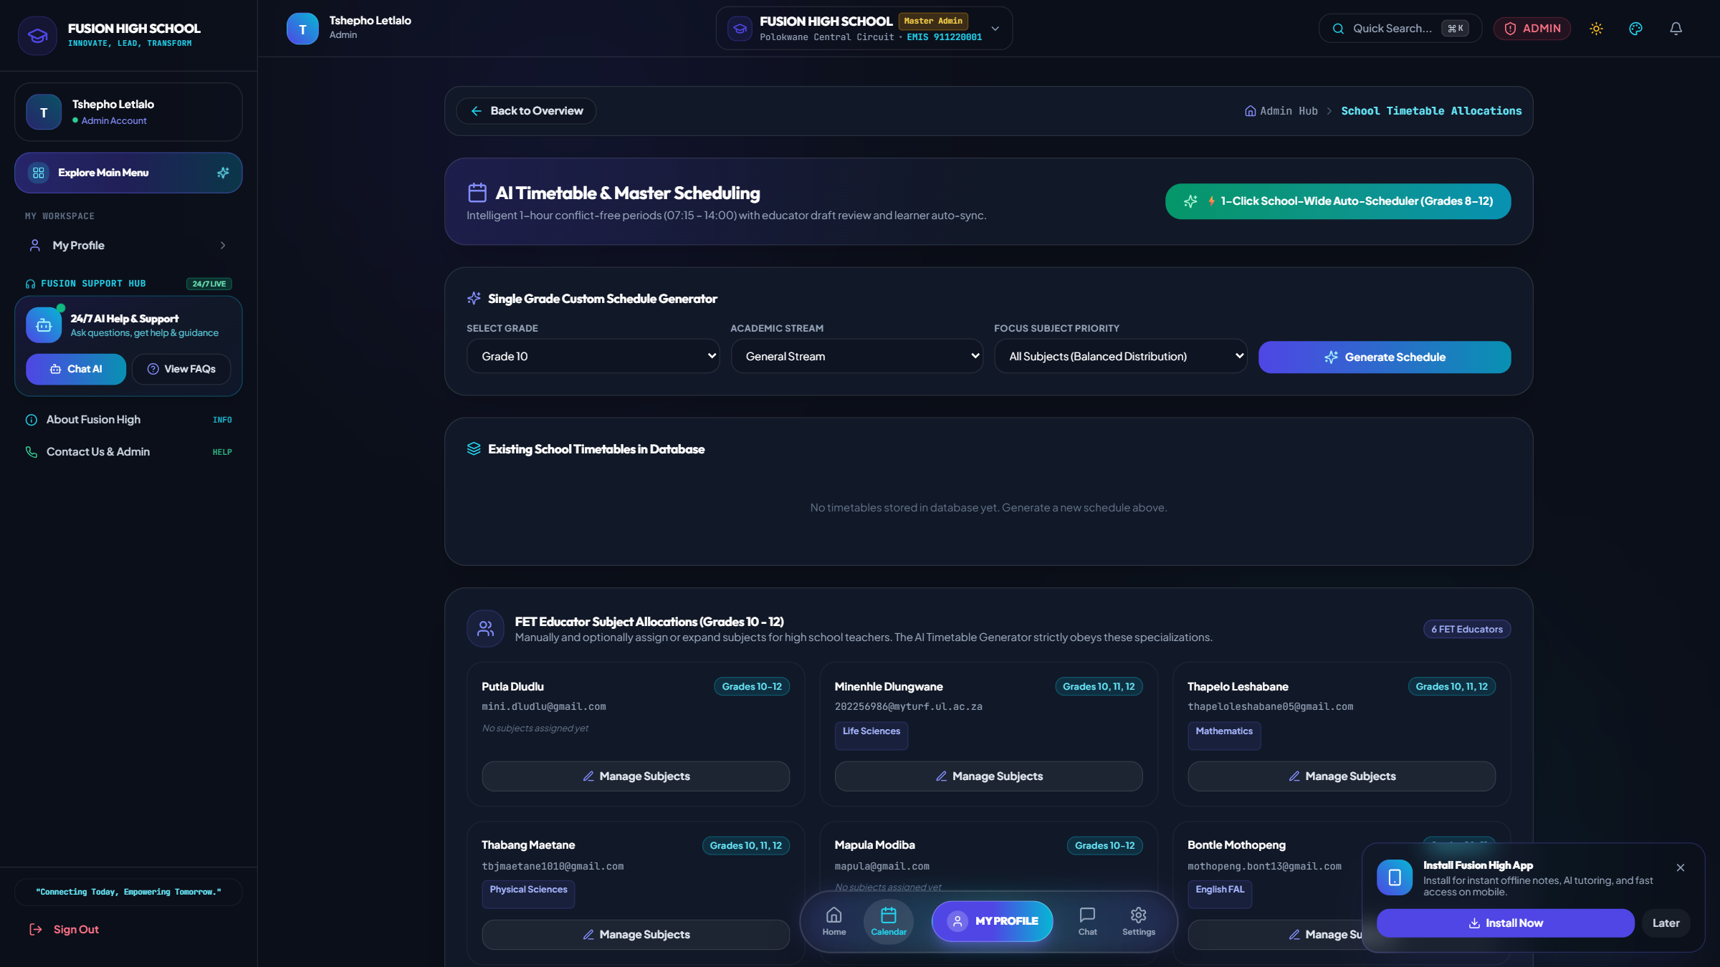
Conflict-Free Timetable Master Planner
1. Executive Administrator Dashboard & Operations • Algorithmic School-Wide Scheduling & Venue Allocations
Core Features & Capabilities
• Algorithmic timetable generator allocating subjects, educators, and classrooms.
• Guarantees zero educator double-booking and zero classroom clashes.
• School-specific isolated schedule ensuring each institution has its own unique timetable.
• Real-time slot swap request workflow for educator relief management.
Notes:
Reiterate that each school maintains its own distinct timetable schedule tailored to its faculty and classroom facilities.

Slide 12
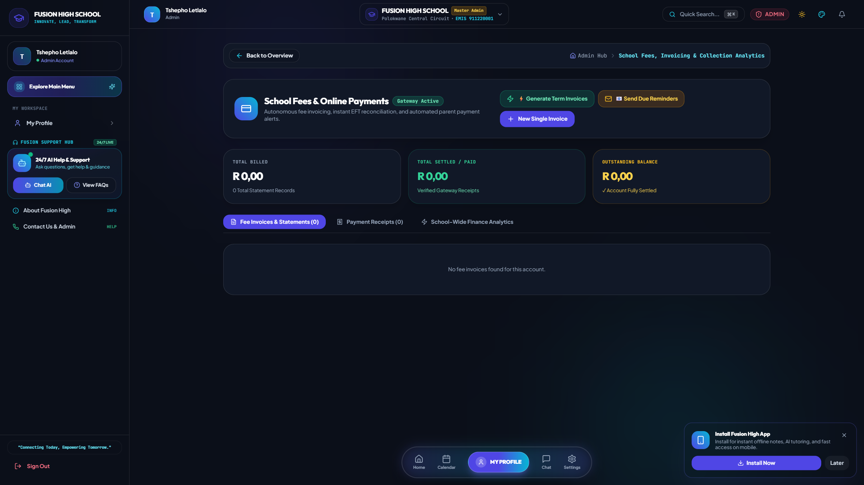
School Fees, Statements & Invoicing
1. Executive Administrator Dashboard & Operations • Automated Billing, Payment Audits & Financial Analytics
Core Features & Capabilities
• Itemized term fee invoices generated per grade and curriculum stream.
• Real-time payment tracking, digital receipts, and outstanding balance alerts.
• Automated Sunday parent digest with attendance and fee account statements.
• Executive financial collection efficiency analytics for school treasurers.
Notes:
Show the financial collection rate metrics and itemized term billing capabilities.

Slide 13

Matric Pass Rate Projector (Grade 12)
1. Executive Administrator Dashboard & Operations • Predictive Endorsement Analytics & Early Warning Diagnostics
Core Features & Capabilities
• Simulates final NSC examination pass rates based on preliminary SBA marks.
• Predicts Bachelor's, Diploma, and Higher Certificate endorsement percentages.
• Identifies subject bottlenecks (e.g. Mathematics P2, Physical Sciences Chemistry).
• Enables targeted revision bootcamps before final National Senior Certificate exams.
Notes:
Highlight how high schools can boost their provincial matric rankings through predictive diagnostics.

Slide 14
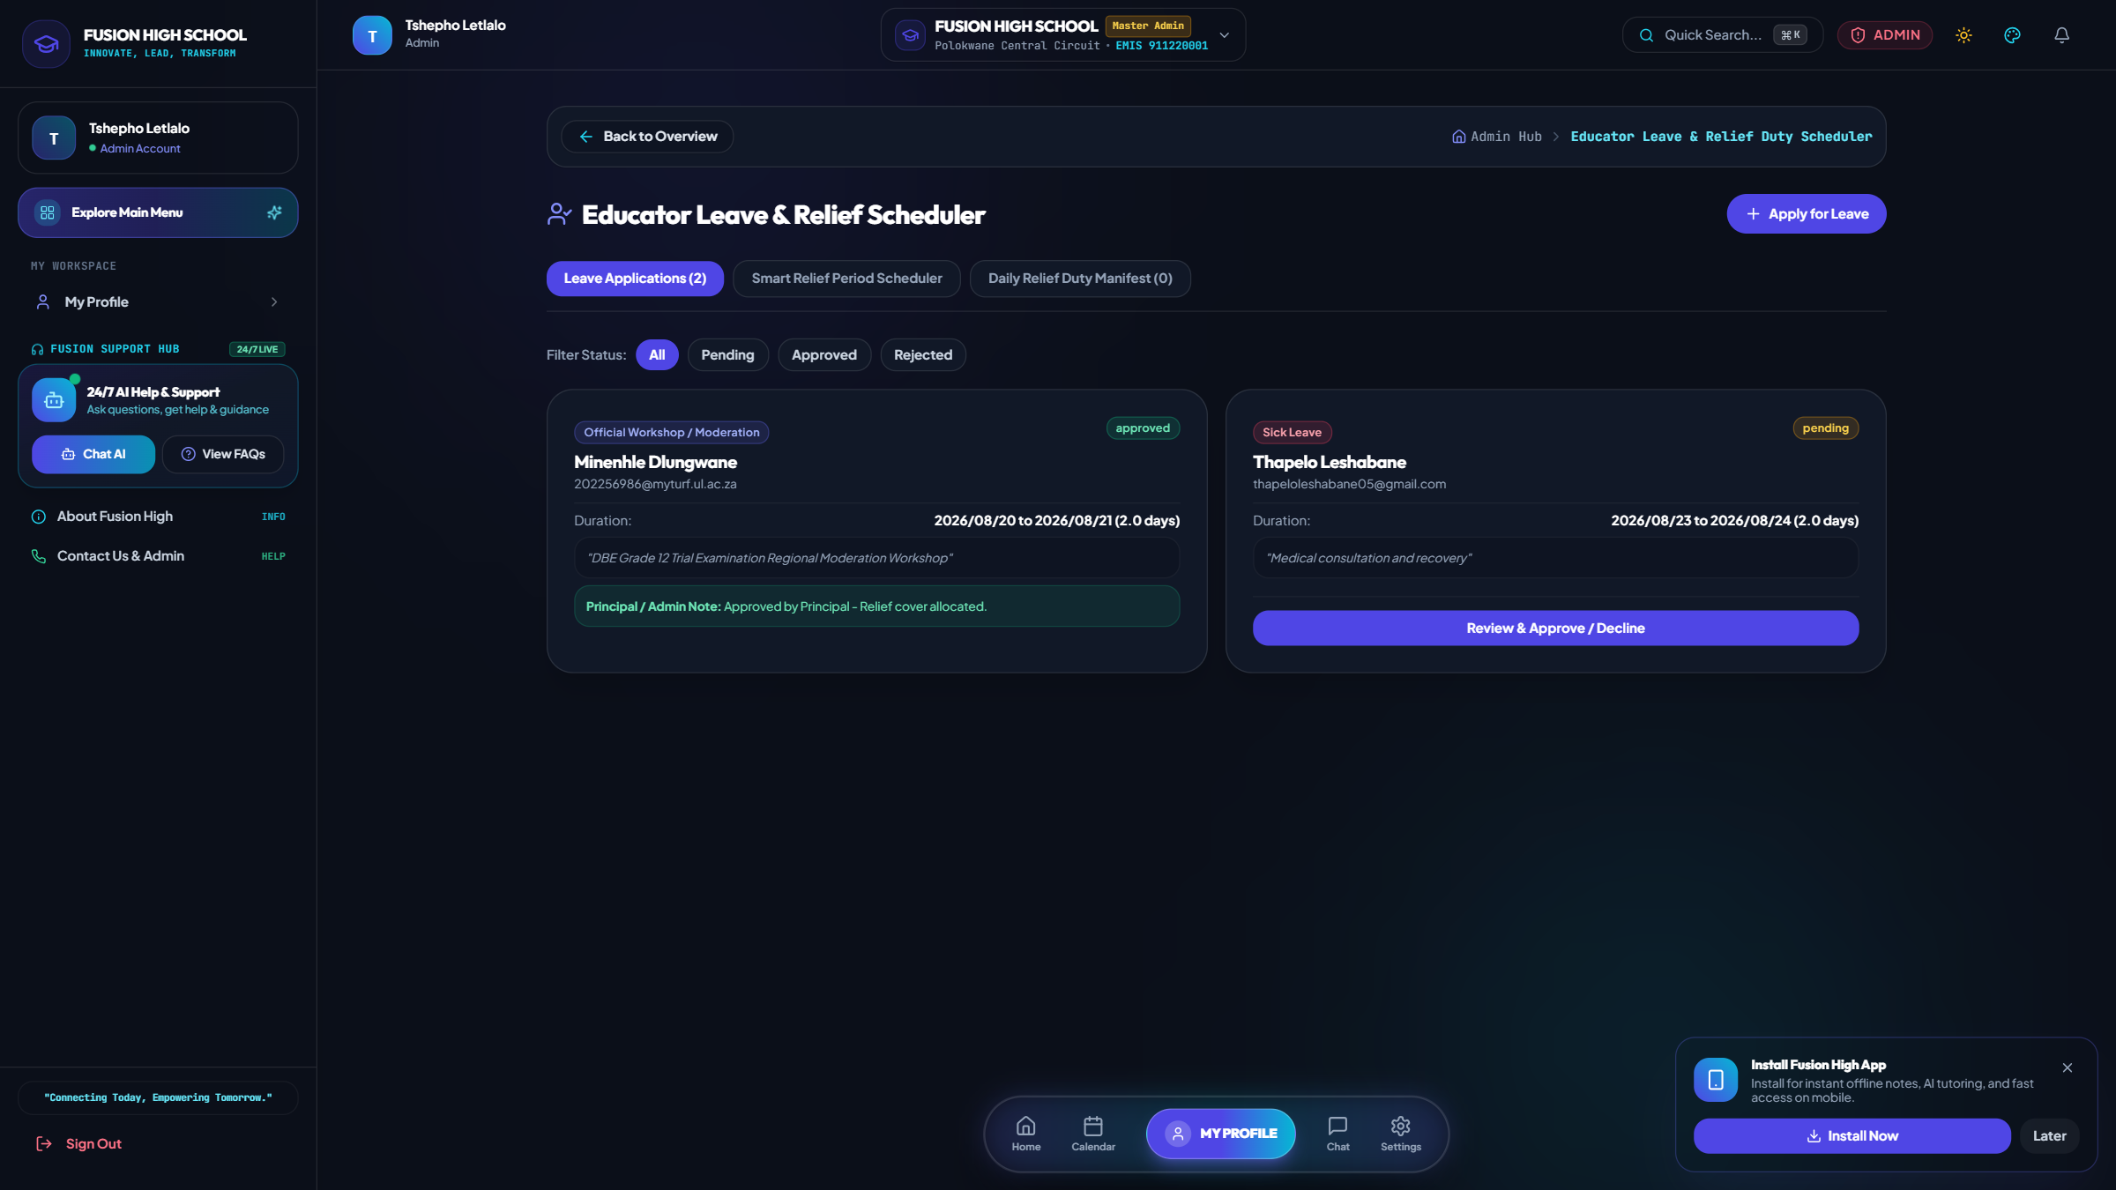
Educator Leave & Relief Duty Scheduler
1. Executive Administrator Dashboard & Operations • Emergency Substitute Matching & Continuous Classroom Supervision
Core Features & Capabilities
• Educators submit digital leave requests with medical/personal documentation.
• Instant detection of open free periods for relief educators in the same department.
• Automated daily relief roster ensuring zero unattended learner classrooms.
• Audit trail of educator attendance for DBE provincial reporting.
Notes:
Demonstrate how the system eliminates unsupervised classrooms by matching relief teachers during staff absence.

Slide 15
2. EDUCATOR & TEACHER WORKSPACE
In-depth page-by-page screen walkthrough with live database metrics & operational workflows

Slide 16
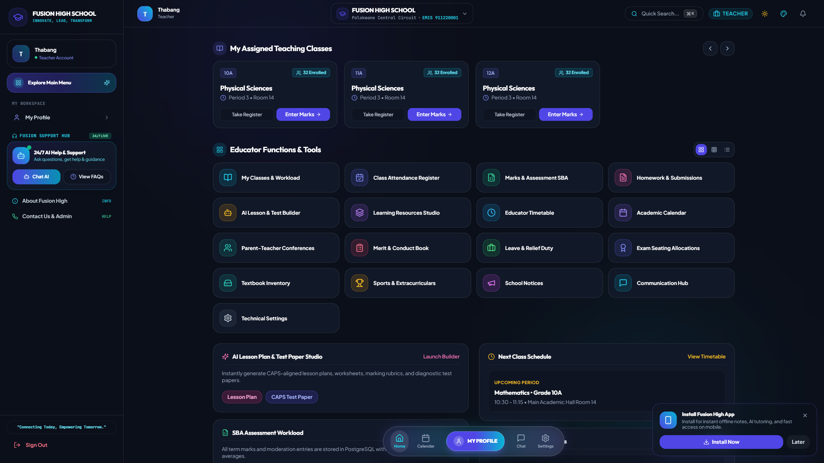
Educator Workspace & Daily Schedule
2. Educator & Teacher Workspace • Today's Classes, Pending Marks & Rapid Academic Tools
Core Features & Capabilities
• Personalized daily teaching schedule highlighting current and upcoming class periods.
• Pending assessment marks alert and quick submission shortcut.
• Unread parent communications and consultation appointment notifications.
• Quick access to AI Lesson Planner, Test Generator, and Attendance registers.
Notes:
Walk through the educator's daily launchpad designed for maximum teaching efficiency.

Slide 17
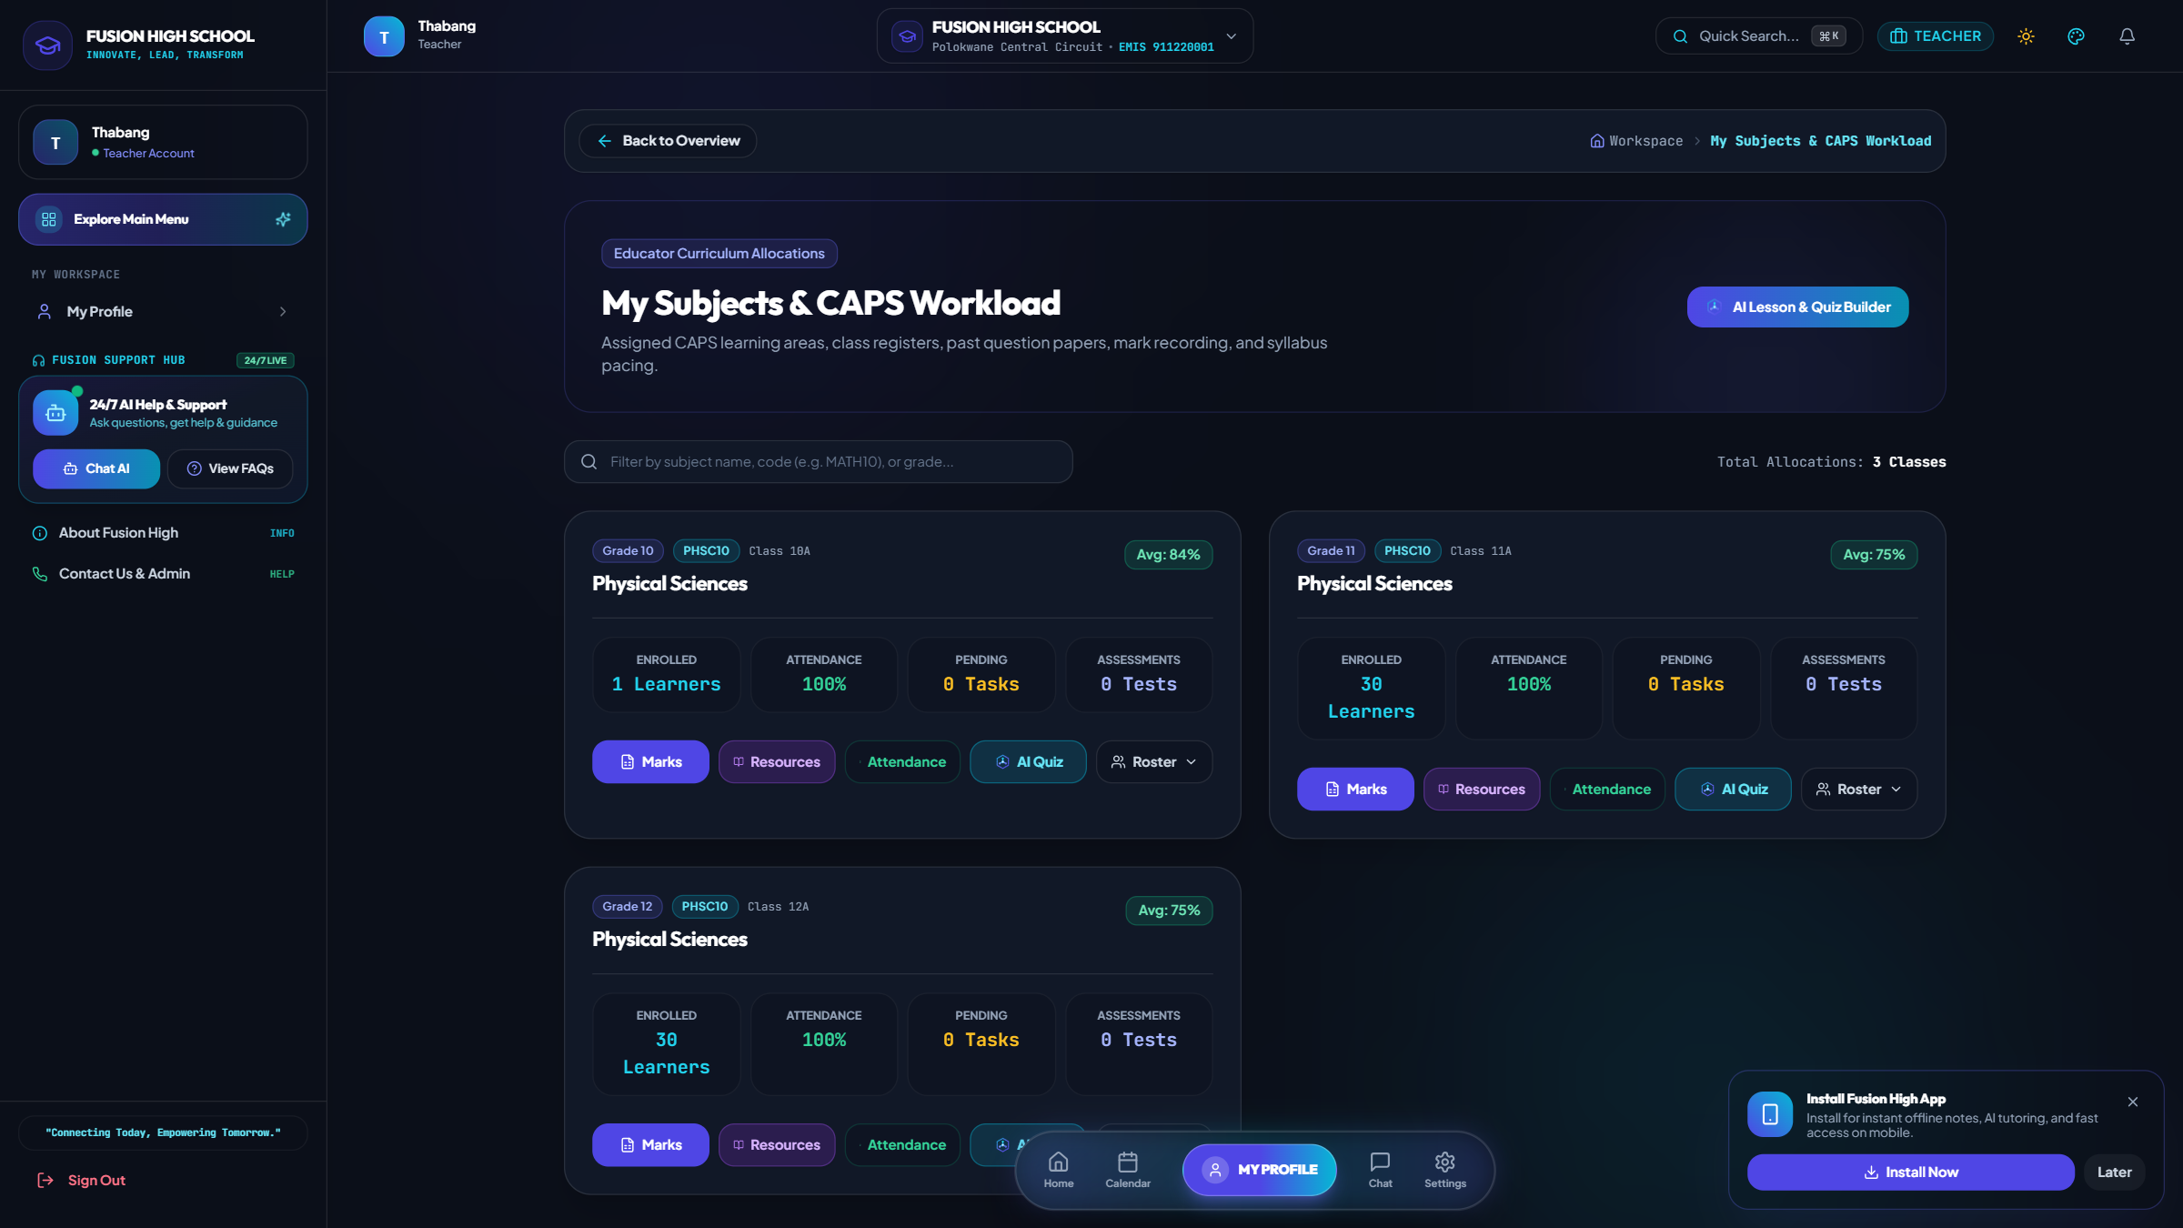
Subject Workload & Class Rosters
2. Educator & Teacher Workspace • Assigned Teaching Classes, Learner Lists & Performance
Core Features & Capabilities
• Complete breakdown of allocated teaching grades, streams, and subject classes.
• Class learner rosters with direct student profile inspections and attendance history.
• Individual and class-wide academic averages with performance trend indicators.
• 1-click shortcut to launch subject-specific announcements or assign homework.
Notes:
Show how teachers manage their assigned subjects, view enrolled learners, and track grade averages.

Slide 18
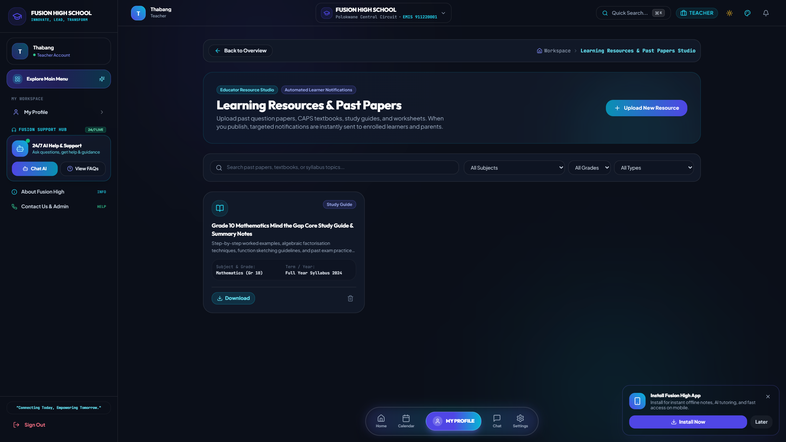
Learning Resources & Past Papers Studio
2. Educator & Teacher Workspace • On-Demand Question Paper, Textbook & Worksheet Uploads
Core Features & Capabilities
• Educators upload past question papers, exam memorandums, study guides, and worksheets at their own convenience.
• Categorization by Subject, Grade (8–12), Term, and Academic Year.
• Instant broadcast notification dispatched to enrolled learners and linked parents upon publication.
• Completely eliminates project disk bloat while empowering educators with full material control.
Notes:
Emphasize that teachers have full autonomy to upload their own revision materials whenever needed.

Slide 19
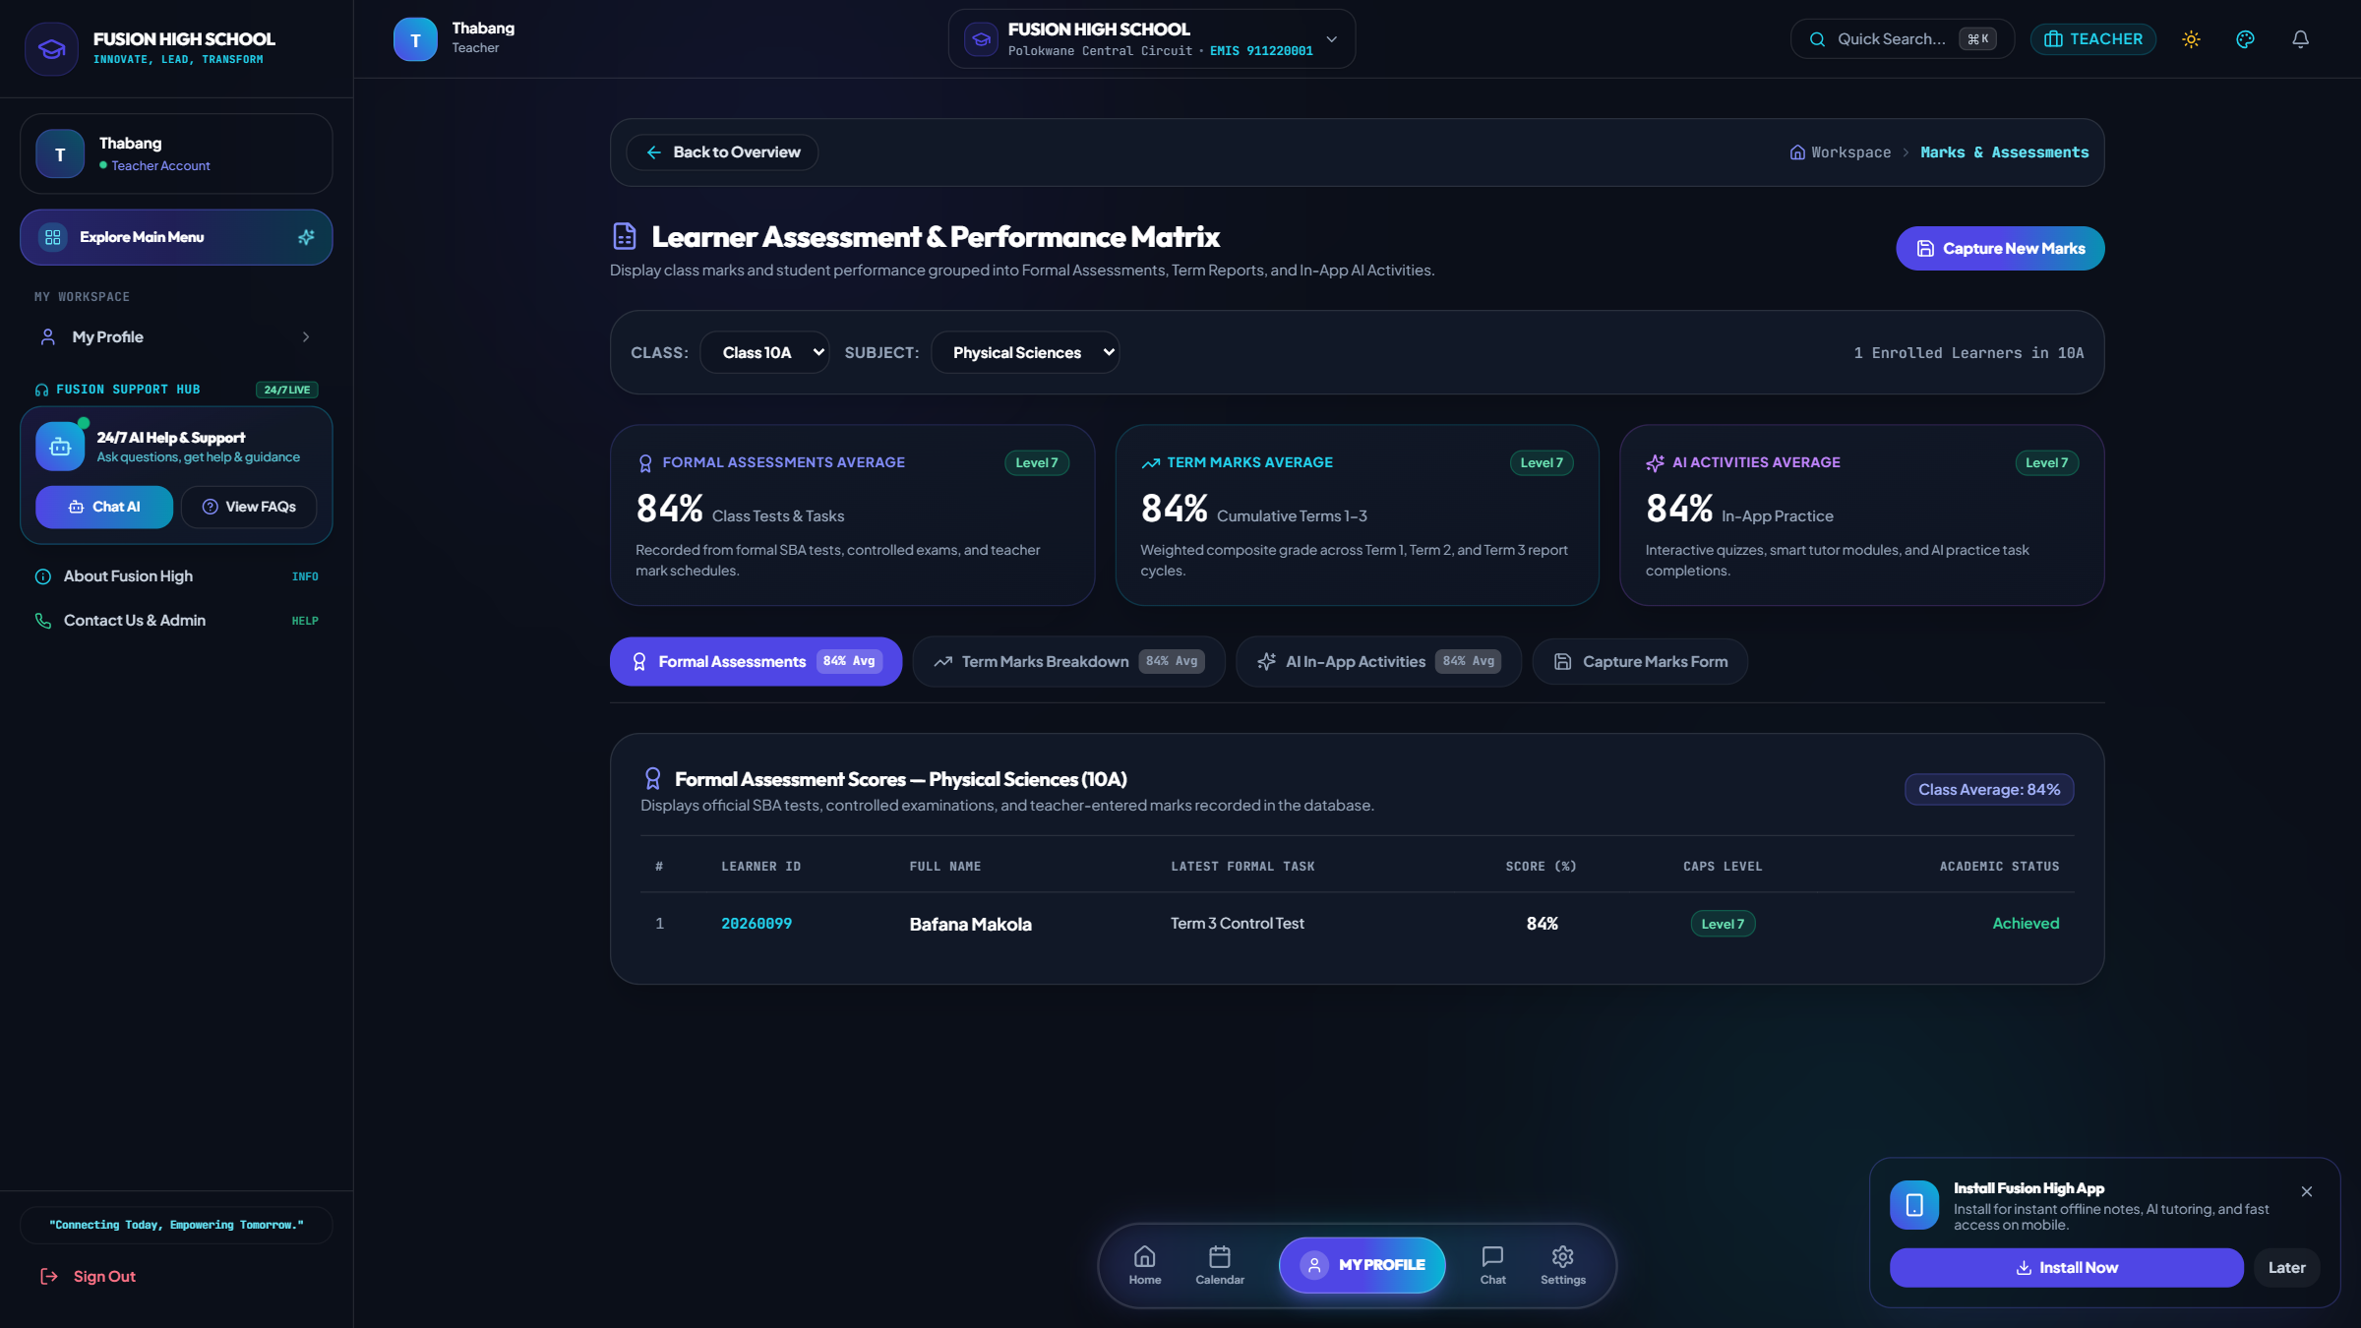
CAPS Markbook & Assessment Recording
2. Educator & Teacher Workspace • Task Mark Entry, Formal SBA Weightings & Auto-Calculations
Core Features & Capabilities
• Digital gradebook for recording class tests, assignments, practicals, and exams.
• Automated CAPS SBA percentage weighting calculations (e.g. 25% SBA + 75% Exam).
• Bulk mark entry with keyboard navigation and instant validation against total marks.
• Audit trail ensuring marks are ready for moderation and official report card generation.
Notes:
Explain the digital markbook entry workflow that calculates CAPS SBA totals automatically.

Slide 20
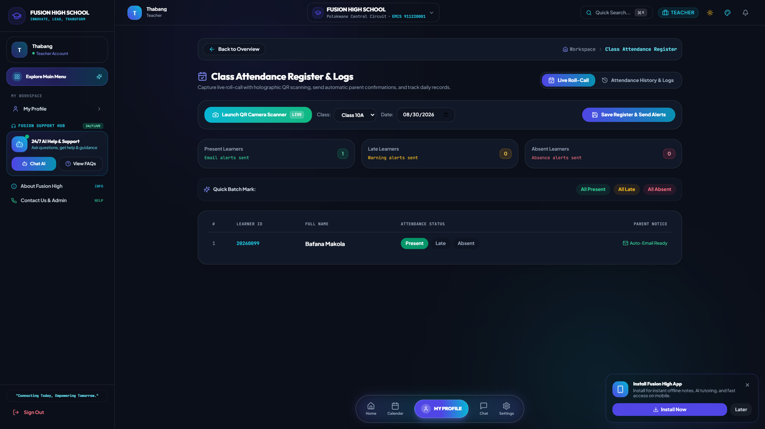
Class Attendance & Punctuality Register
2. Educator & Teacher Workspace • Period-by-Period Student Attendance & Absence Tracking
Core Features & Capabilities
• Fast 1-click attendance marking (Present, Absent, Late, Excused).
• Automated parent SMS / email trigger when a learner is marked unexcused absent.
• Monthly attendance aggregation feeding into DBE provincial SASAMS statistics.
• Historical absence pattern recognition for early student welfare intervention.
Notes:
Show the period attendance register and automated parent notification triggers.

Slide 21
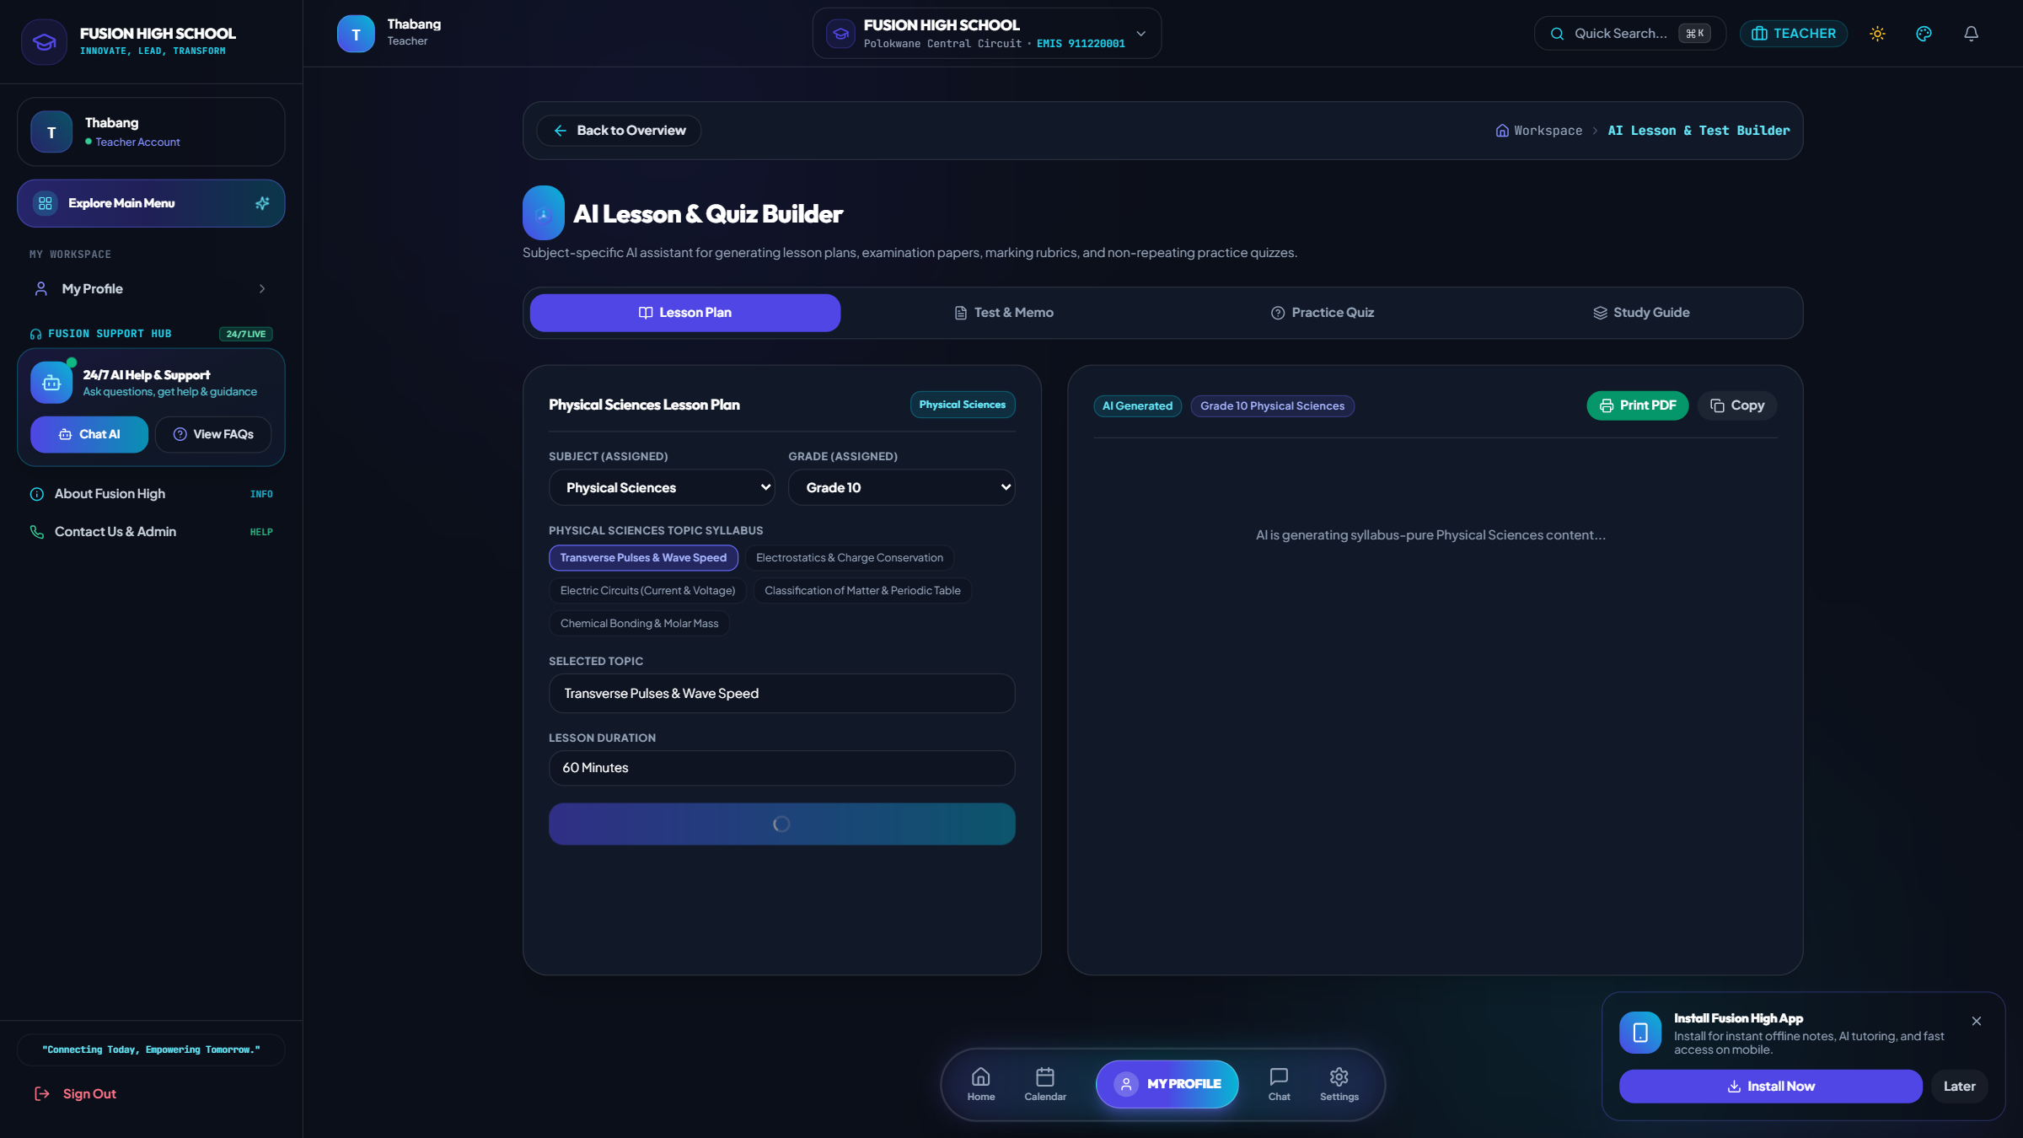
AI Lesson Planner & Test Generator
2. Educator & Teacher Workspace • CAPS-Aligned Curriculum Planning & Examination Creator
Core Features & Capabilities
• Generates complete 45-minute CAPS lesson plans with learning outcomes, activities, and homework.
• Creates customized examination papers with step-by-step marking memorandums.
• Adjustable difficulty levels (Foundational, Intermediate, Advanced / Olympiad).
• Saves teachers hours of administrative preparation each academic week.
Notes:
Demonstrate how the AI Lesson Planner assists teachers in creating CAPS-aligned teaching plans and tests in seconds.

Slide 22
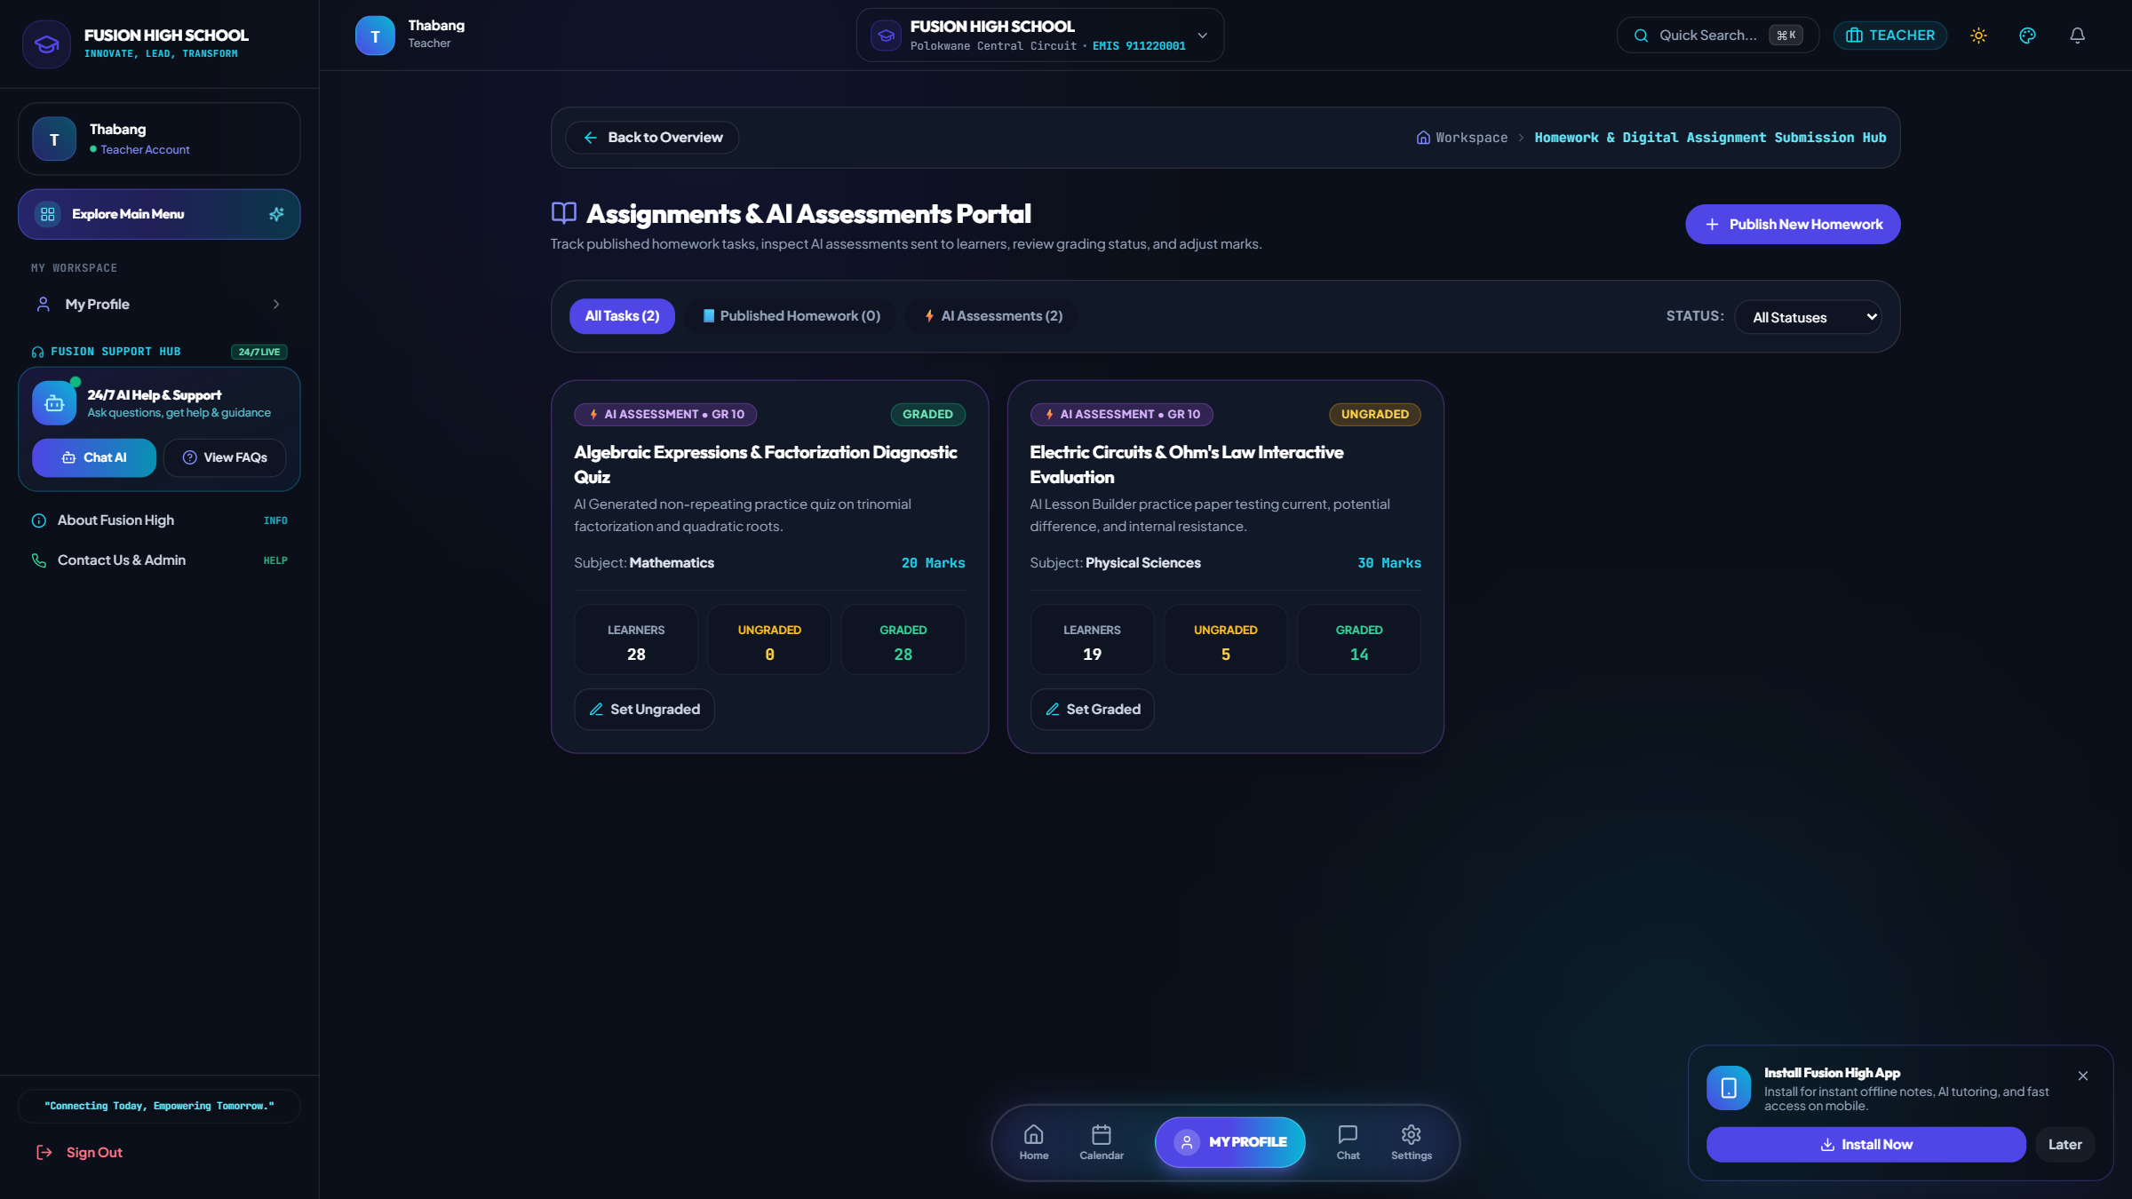
Digital Homework & Assignments Studio
2. Educator & Teacher Workspace • Online Assignment Publishing, Submissions & Grading
Core Features & Capabilities
• Publish digital homework tasks with attached instructions, due dates, and rubrics.
• Learners submit digital answers and files directly through their student portal.
• Online submission review with educator feedback notes and mark recording.
• Automated reminders sent to students with pending submissions approaching deadlines.
Notes:
Walk through the homework assignment creation and submission review workflow.

Slide 23
3. PARENT & FAMILY LEARNING PORTAL
In-depth page-by-page screen walkthrough with live database metrics & operational workflows

Slide 24
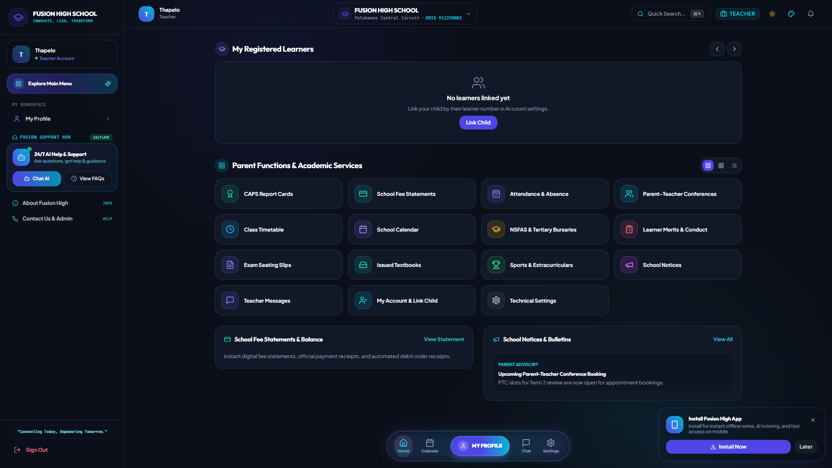
Family Learning Hub & Child Overview
3. Parent & Family Learning Portal • Comprehensive Multi-Child Dashboard & Real-Time Monitoring
Core Features & Capabilities
• Multi-child linking allowing parents with multiple enrolled children to switch seamlessly.
• Real-time snapshot of children's current academic averages, attendance %, and conduct points.
• Quick access to fee payment balance, upcoming consultations, and school notices.
• Direct messaging link to communicate with subject teachers and school administrators.
Notes:
Highlight how parents can monitor all their children across grades from a single dashboard.

Slide 25
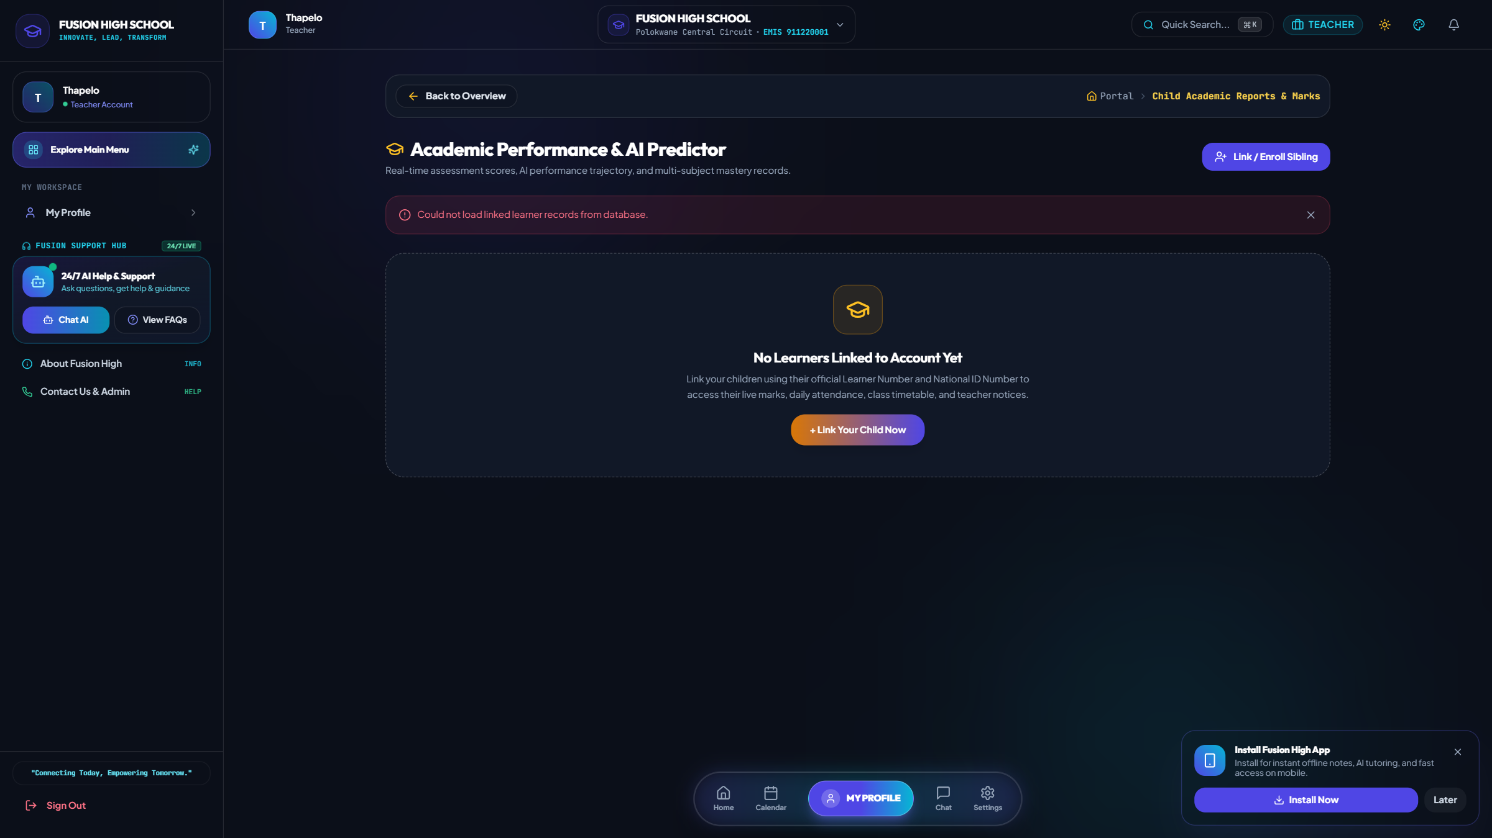
Child Academic Progress & Marks Breakdown
3. Parent & Family Learning Portal • Subject Marks, SBA Tasks & Continuous Assessment History
Core Features & Capabilities
• Detailed subject-by-subject performance tracking for every registered learning area.
• Continuous assessment task history showing test scores, assignments, and term exams.
• Visual progress bars highlighting subject strengths and areas requiring revision.
• Direct link to download official DBE CAPS term academic report cards.
Notes:
Show how parents inspect their child's subject grades and track their academic trajectory throughout the year.

Slide 26
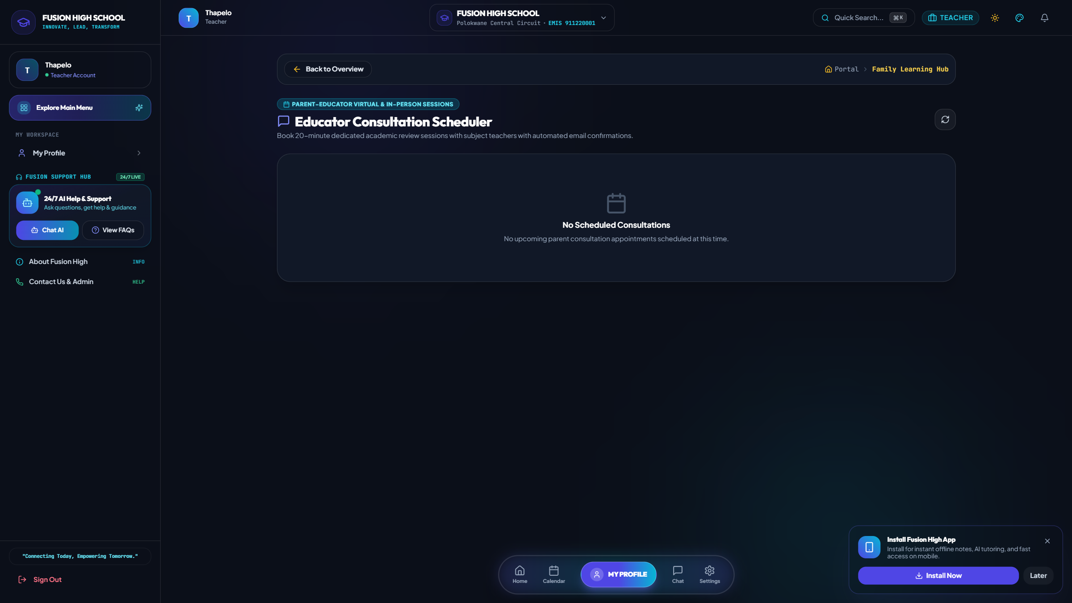
Parent-Educator Consultation Scheduler
3. Parent & Family Learning Portal • Virtual & In-Person 20-Minute Appointment Booking
Core Features & Capabilities
• Parents select their child and choose specific subject educators for consultation.
• Real-time calculation of open 20-minute consultation time slots.
• 1-click booking with automated email confirmation sent to educator and parent.
• Educators manage their consultation roster and record academic action plans.
Notes:
Demonstrate how parents can schedule targeted 20-minute reviews with subject teachers to discuss academic progress.

Slide 27
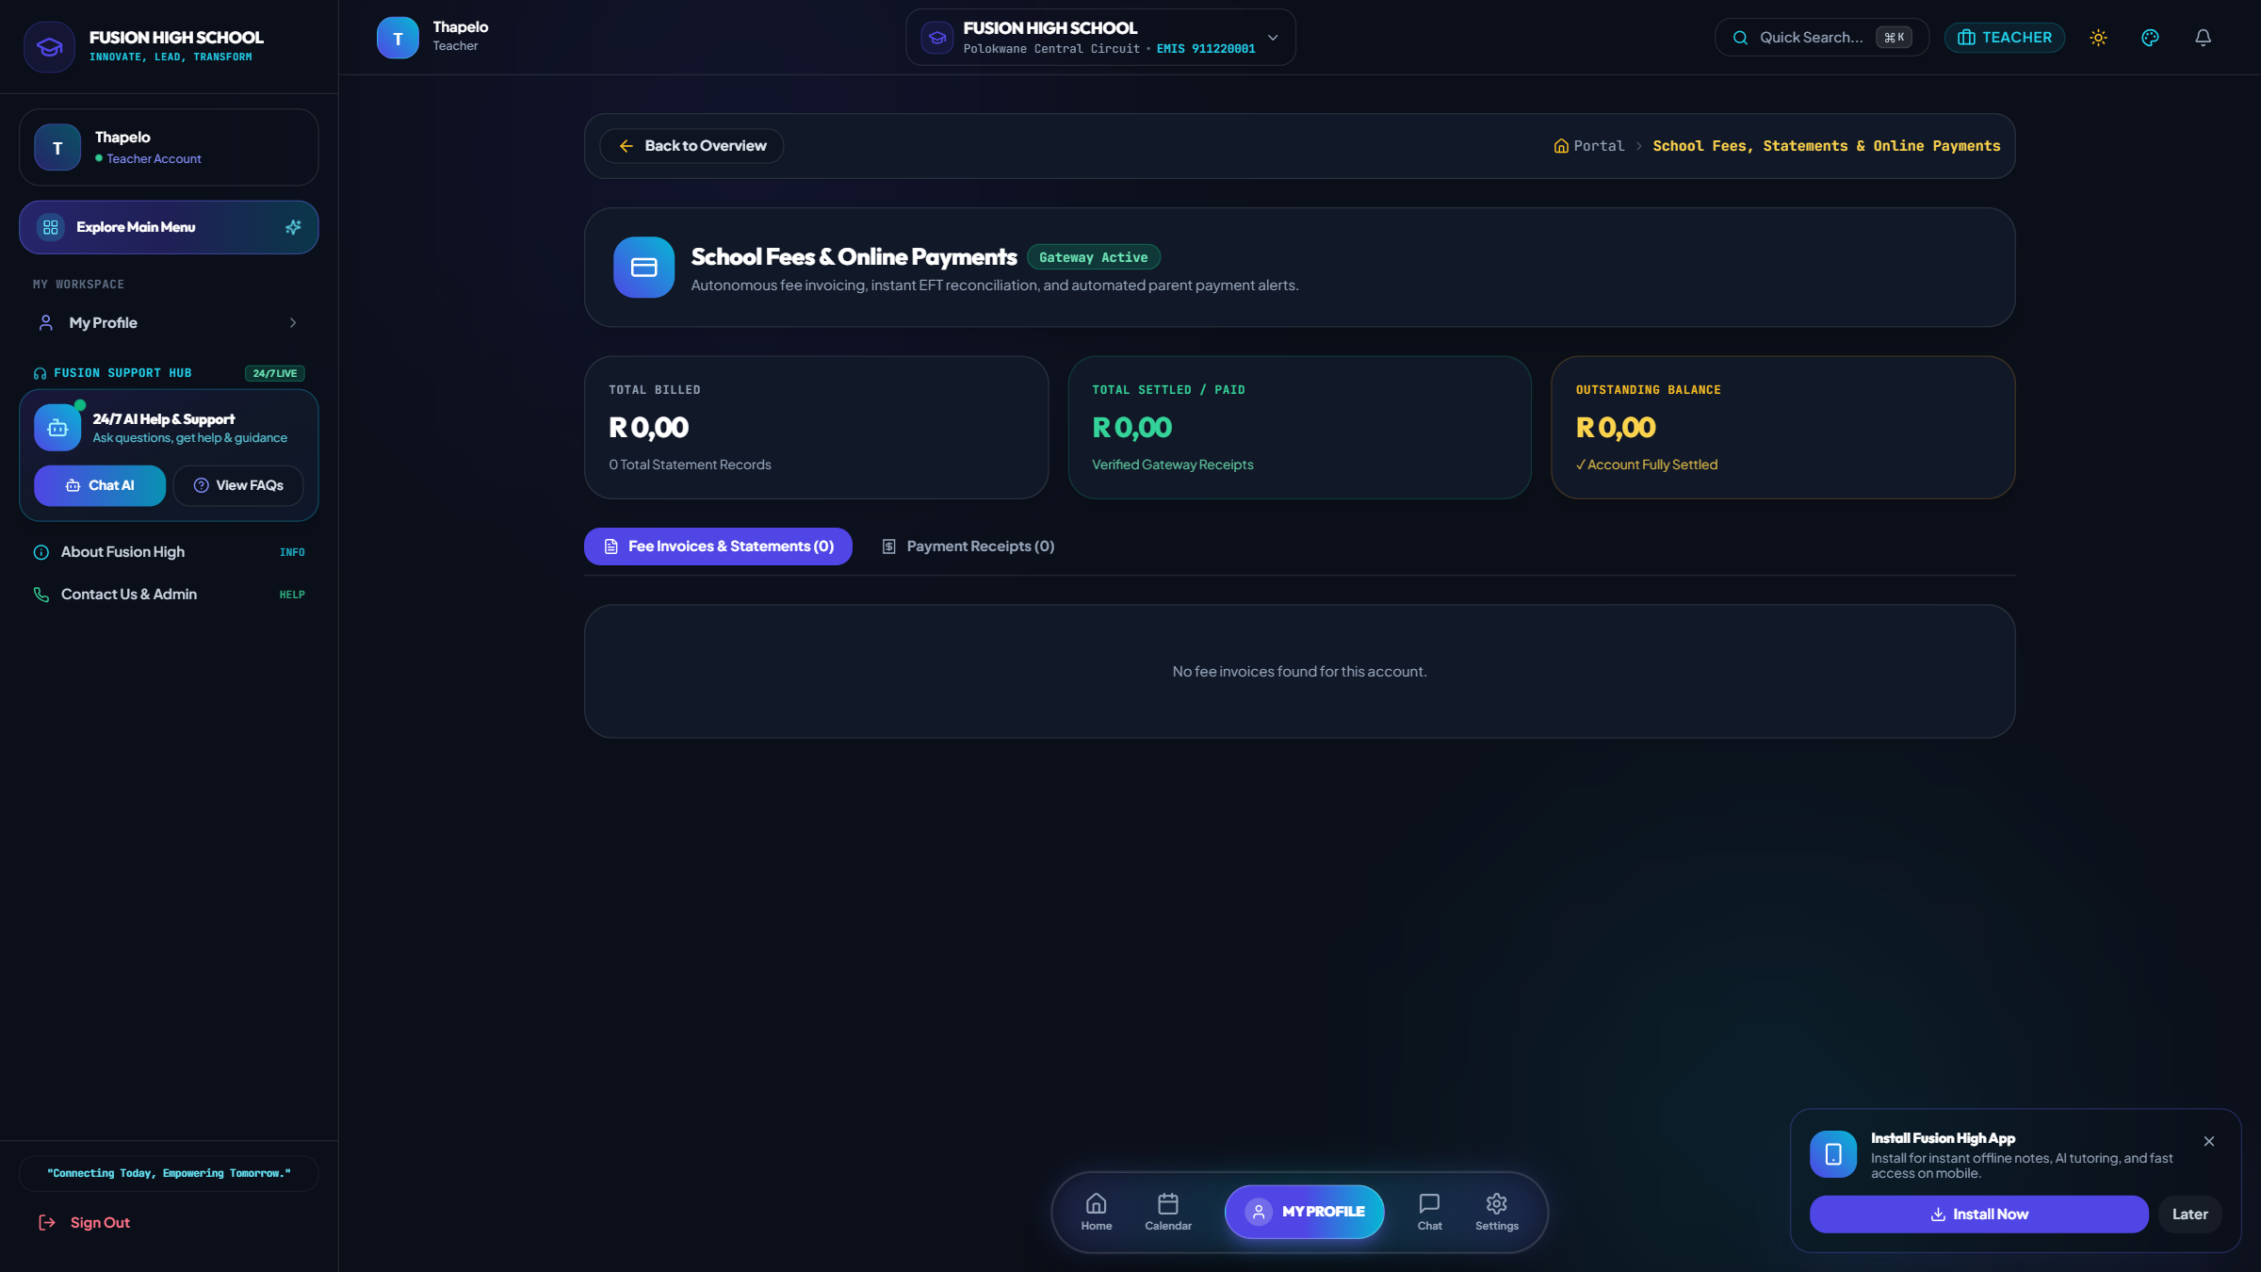
School Fees & Digital Statements
3. Parent & Family Learning Portal • Online Account Statements, Invoices & Payment Receipts
Core Features & Capabilities
• Live fee statement detailing term tuition, textbook levies, and extracurricular fees.
• Downloadable PDF tax-compliant invoices and official school payment receipts.
• Transparent payment breakdown showing paid amounts, current balance, and due dates.
• Automated Sunday parent digest summarizing weekly attendance and fee account balances.
Notes:
Show the parent fee statement view with transparent accounting and payment receipts.

Slide 28
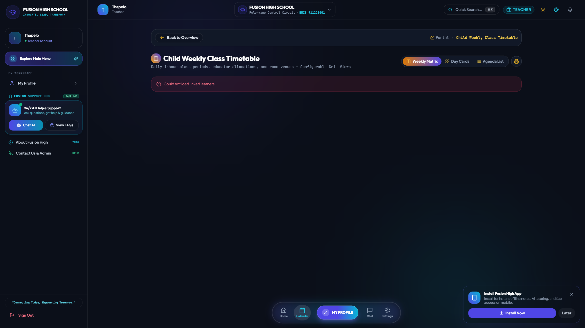
Child Weekly Class Timetable
3. Parent & Family Learning Portal • Daily Subject Schedule, Periods & Classroom Venues
Core Features & Capabilities
• Full weekly view of the child's class schedule across Monday to Friday.
• Identifies exact classroom locations, subject educators, and period times.
• Helps parents ensure learners are properly equipped for daily practicals and tests.
• Live integration with teacher relief duty changes during educator absence.
Notes:
Explain that parents can follow their child's daily timetable to ensure proper study routines.

Slide 29
4. LEARNER & STUDENT LEARNING HUB
In-depth page-by-page screen walkthrough with live database metrics & operational workflows

Slide 30
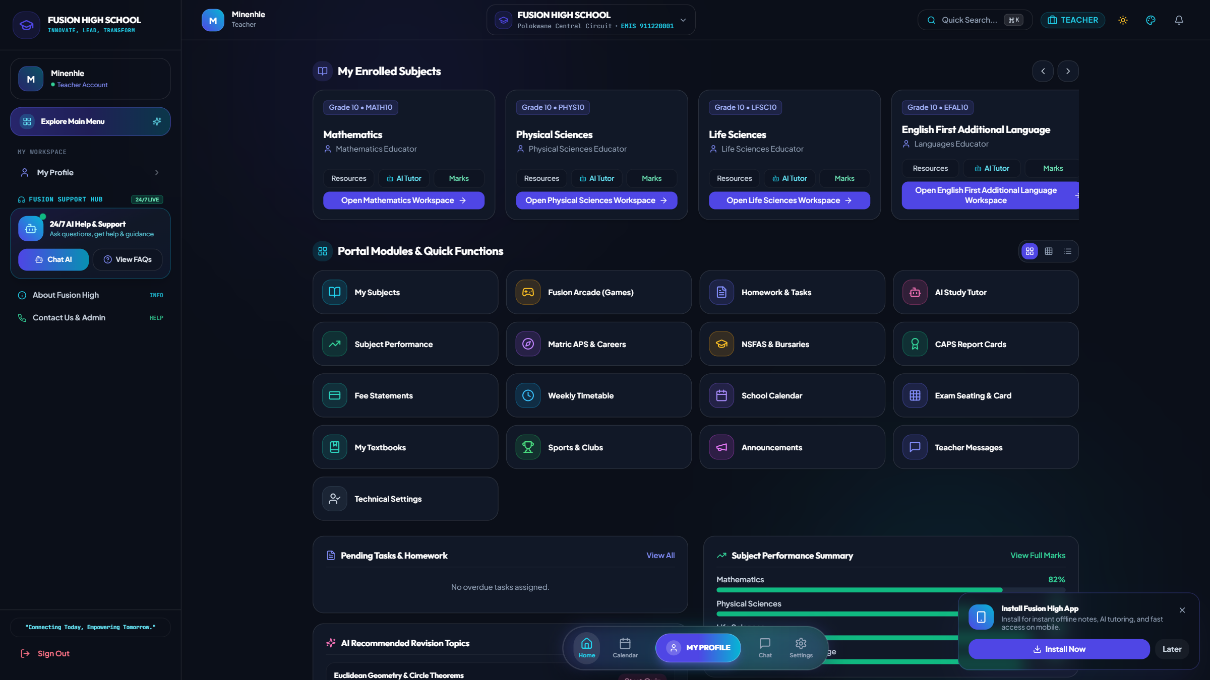
Student Learning Hub & Study Dashboard
4. Learner & Student Learning Hub • Enrolled Subjects, Daily Streak XP & Upcoming Tasks
Core Features & Capabilities
• Personalized student dashboard showcasing enrolled CAPS subjects and active grade.
• Daily study streak, gamified XP points, and academic achievement badges.
• Upcoming homework assignments, test dates, and official school announcements.
• 1-click launchpad into the AI Tutor, Past Papers bank, and Fusion Arcade.
Notes:
Walk through the student home screen designed to motivate learners through gamification and structured study.

Slide 31
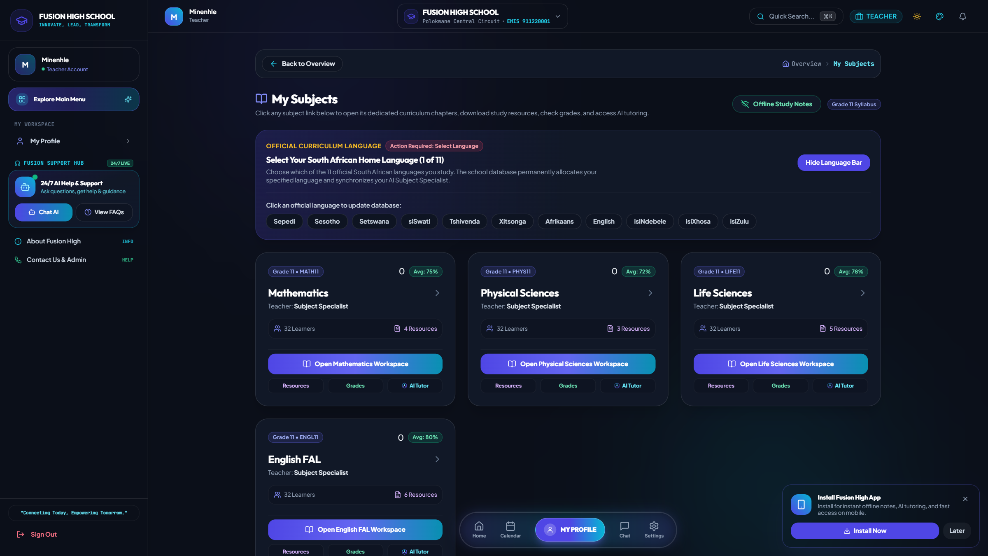
Subject Curriculum & Topic Revision
4. Learner & Student Learning Hub • CAPS Topics, Study Guides, Formula Sheets & Notes
Core Features & Capabilities
• Curriculum breakdown of all enrolled subjects (Maths, Sciences, Accounting, Languages).
• Structured topic chapters with revision notes, video lessons, and formula summaries.
• 1-click "Revise with AI" button to practice problem solving on specific CAPS sub-topics.
• Subject teacher contact shortcut for academic inquiries.
Notes:
Show how learners navigate their subject curriculum, read revision notes, and trigger AI study sessions.

Slide 32
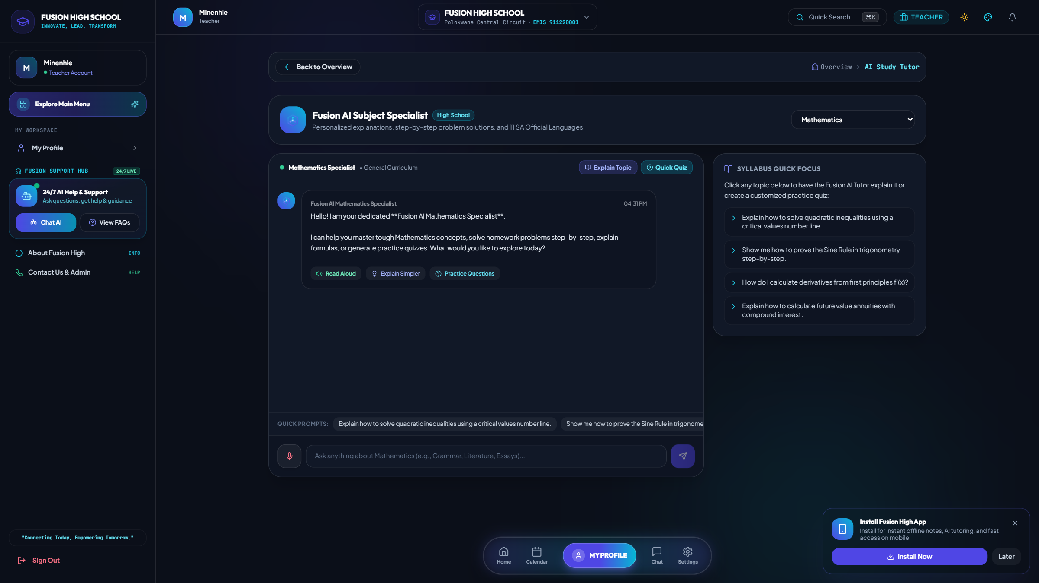
School-Aware AI Subject Specialist & Academic Tutor
4. Learner & Student Learning Hub • Multi-Tenant Grounding, Past-Paper Quizzes & 11 SA Languages
Core Features & Capabilities
• Automatically senses the learner's registered school (e.g. Flavius Mareka, Fusion High).
• Strict multi-tenant prompt grounding preventing institutional leakage.
• Generates past-paper examination questions and step-by-step marking memorandums.
• Fluent in all 11 official South African languages for mother-tongue bilingual revision.
Notes:
Emphasize that the AI assistant represents the learner's own school campus, adhering strictly to the CAPS syllabus.

Slide 33
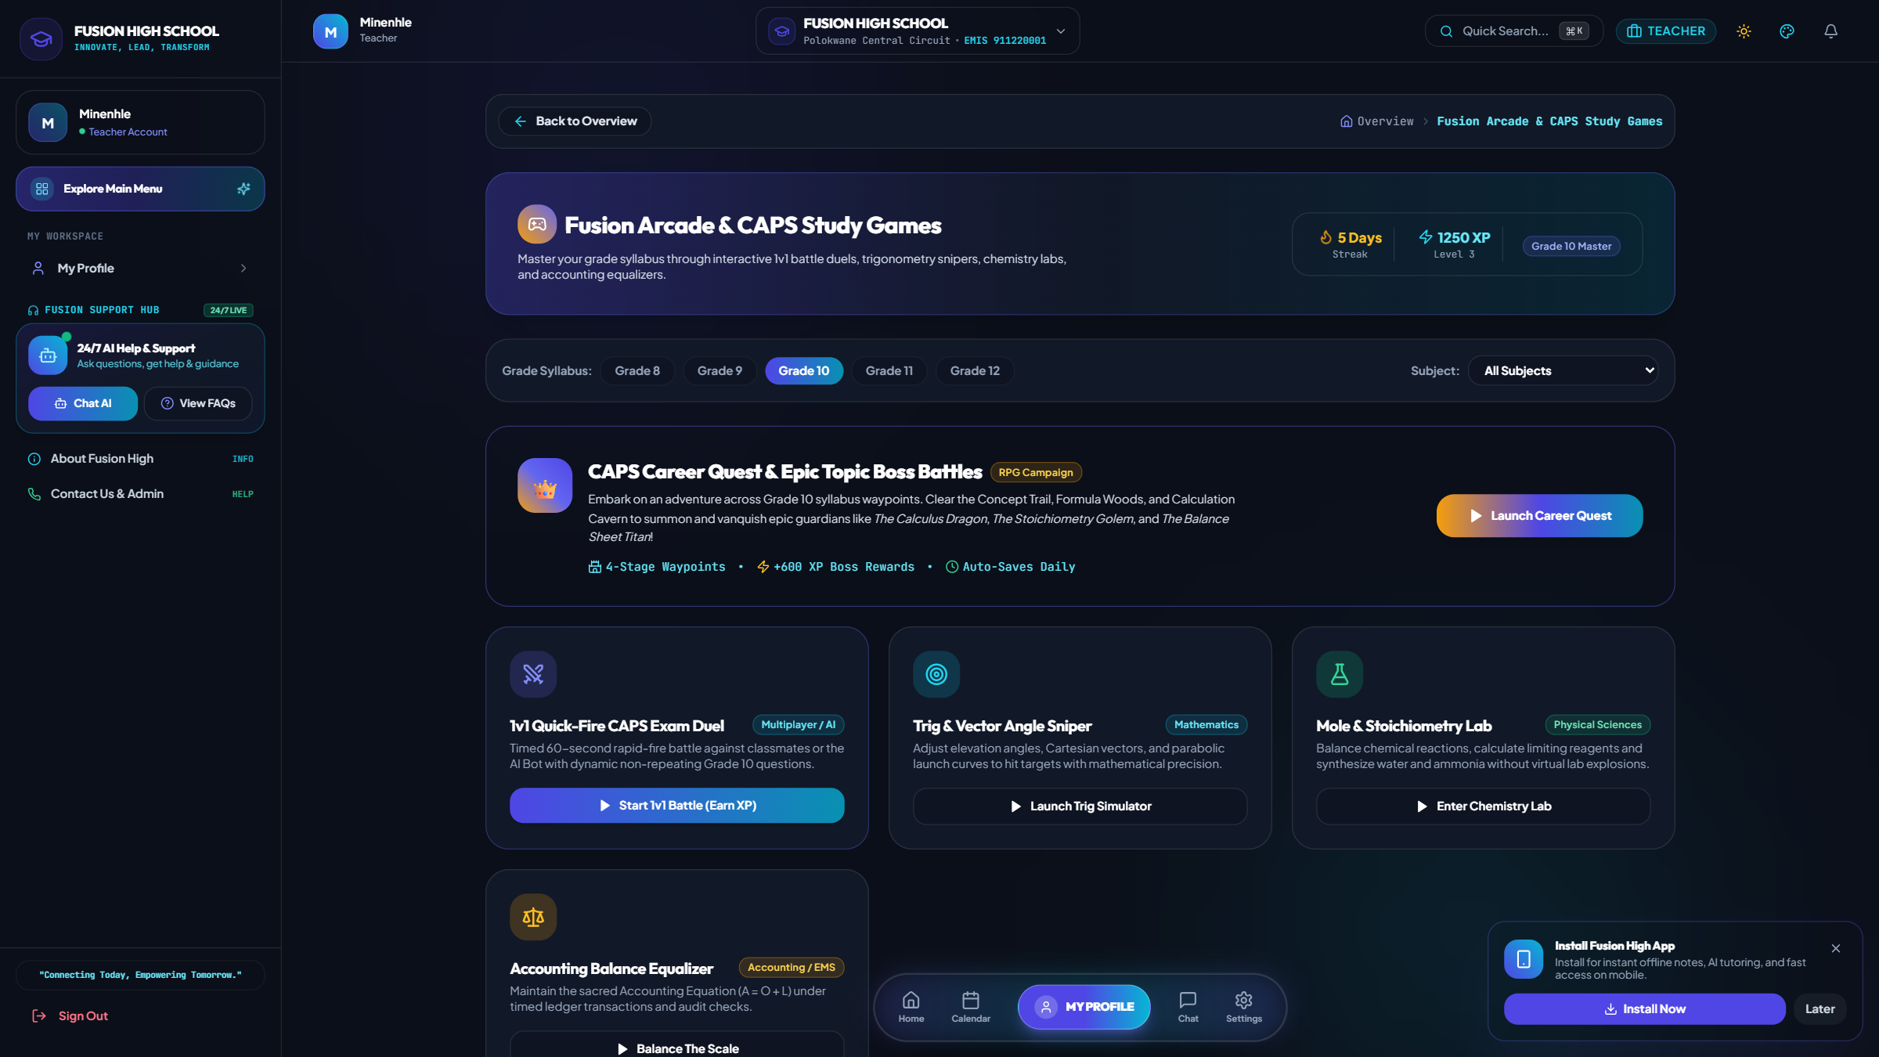
Fusion Arcade & CAPS Study Games
4. Learner & Student Learning Hub • Gamified Exam Quizzes, Level Progression & XP Leaderboards
Core Features & Capabilities
• Interactive rapid-fire revision quizzes across all Grade 8–12 CAPS subjects.
• Level progression system awarding XP, streak multipliers, and mastery trophies.
• Circuit and school leaderboards encouraging healthy academic competition.
• Instant question explanations helping students master challenging concepts.
Notes:
Showcase the Fusion Arcade where students reinforce their classroom learning through engaging revision games.

Slide 34
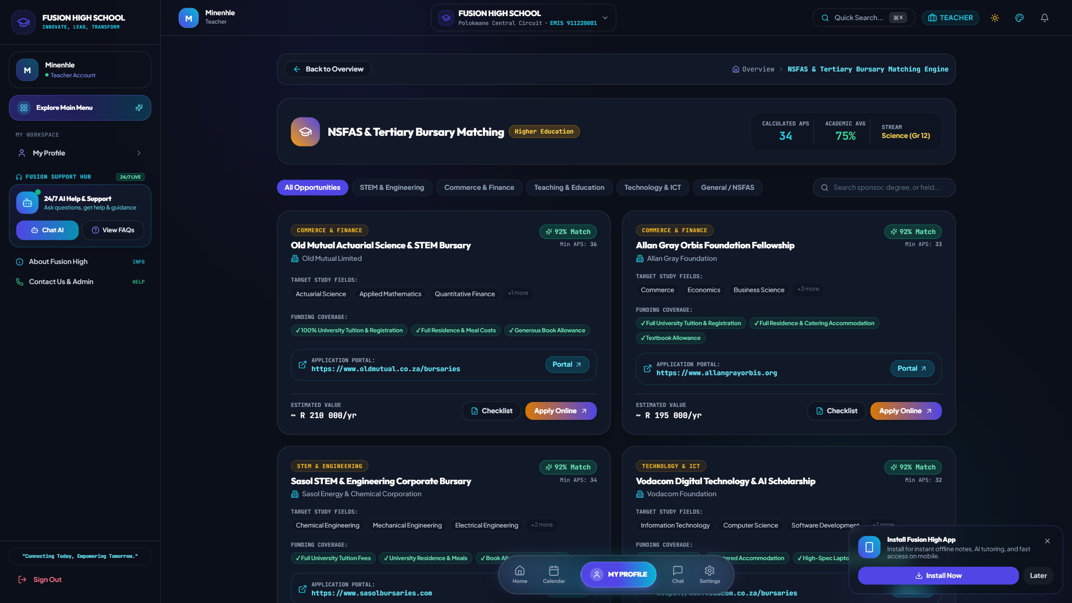
NSFAS & Tertiary Bursary Matching Engine
4. Learner & Student Learning Hub • Simulated APS Points, Degree Matching & Funding Applications
Core Features & Capabilities
• Comprehensive database of South African tertiary bursaries & NSFAS schemes.
• Automatically matches Grade 11 & 12 learners based on simulated APS points & stream.
• Step-by-step checklist tracking application deadlines and required documents.
• Empowers disadvantaged learners with direct access to higher education funding.
Notes:
Demonstrate how the bursary engine unlocks university and TVET college funding opportunities for matriculants.

Slide 35
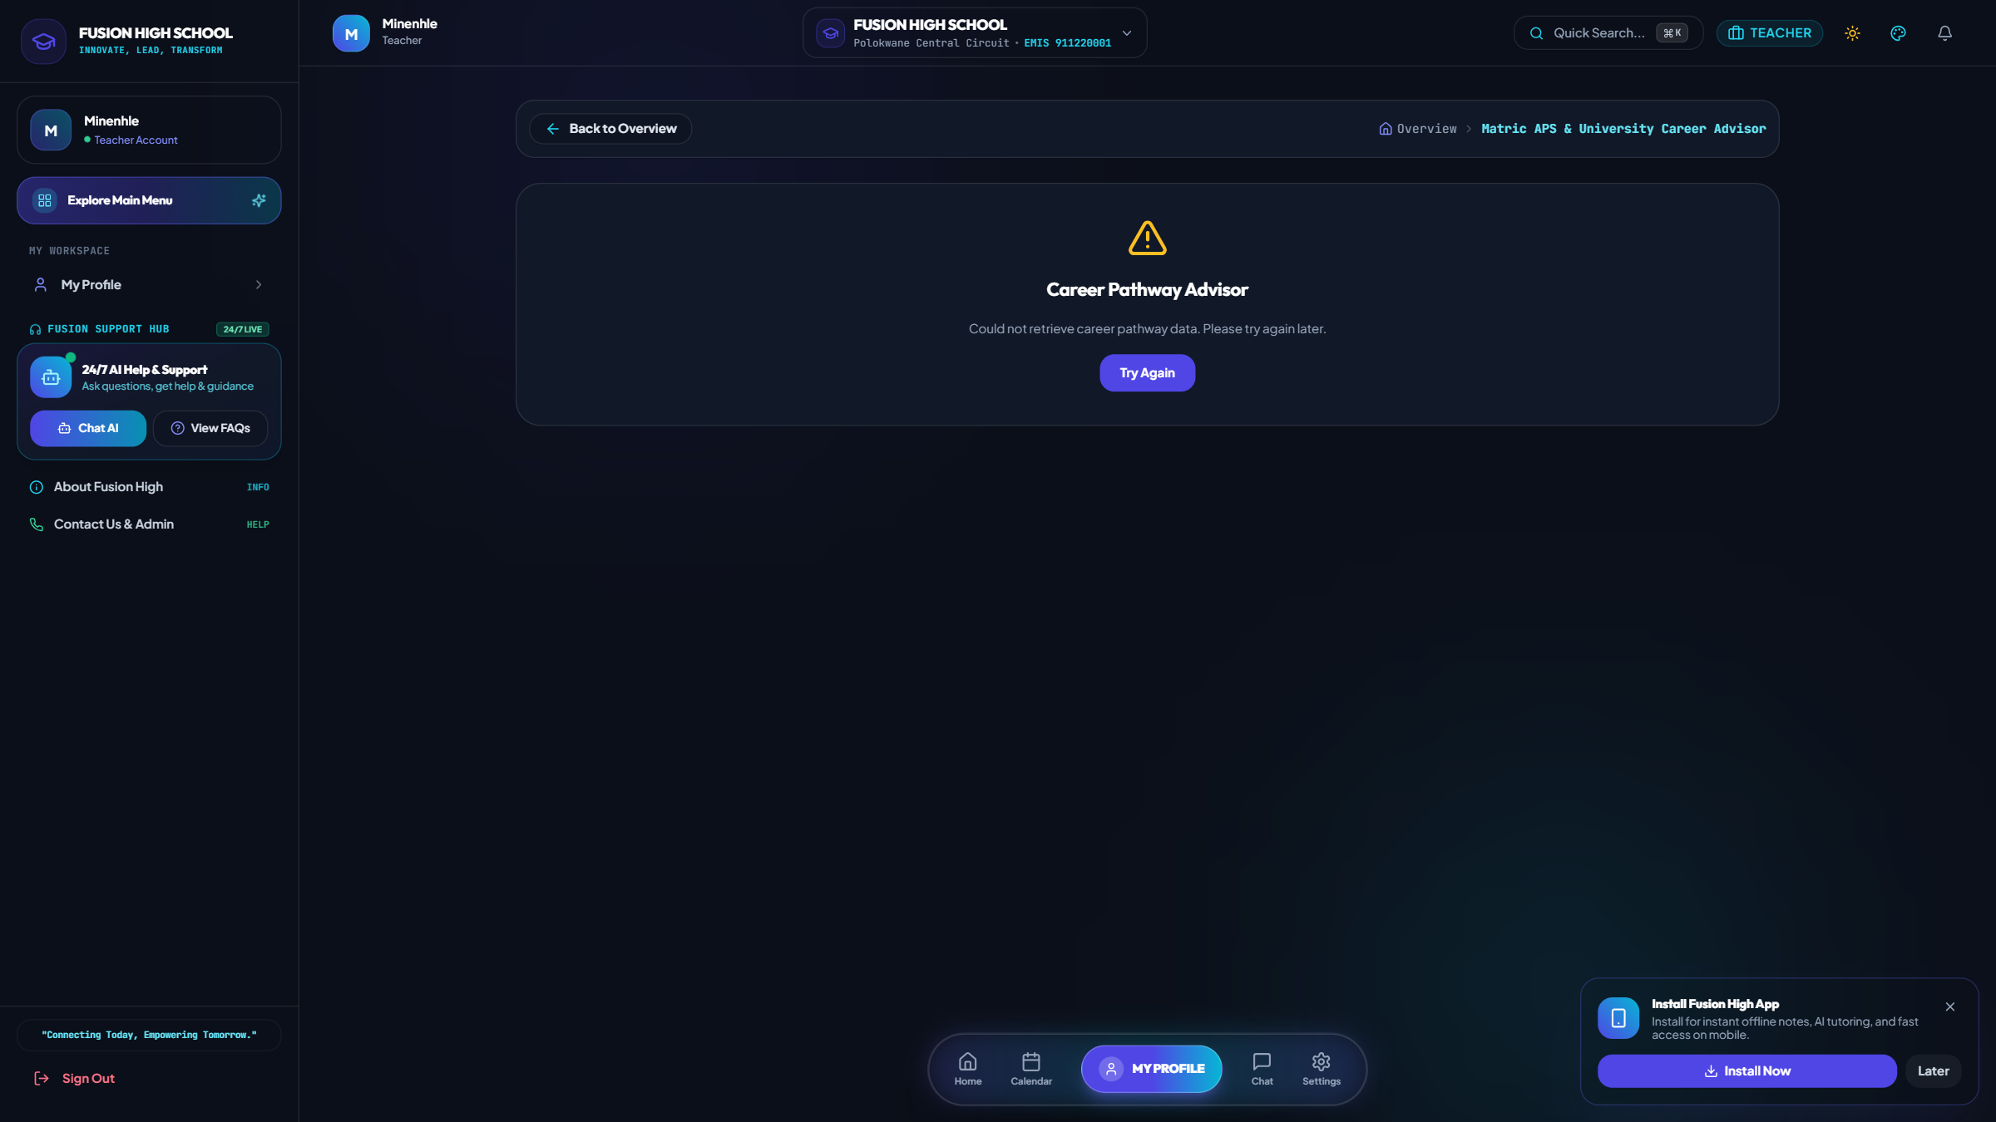
Career Pathway & University Admission Advisor
4. Learner & Student Learning Hub • Degree Requirements, Faculty APS & South African Career Paths
Core Features & Capabilities
• Evaluates current subject package against entry requirements for SA universities.
• Calculates Admission Point Scores (APS) across faculties (Engineering, Health, Commerce, Law).
• Explores high-demand scarce skill careers in South Africa.
• Provides actionable advice on target marks needed to secure degree admissions.
Notes:
Explain that the Career Advisor guides high school learners toward viable university and vocational career paths.

Slide 36
Conclusion & Operational Readiness
The Fusion High Multi-School Educational Ecosystem delivers a unified, production-ready solution tailored specifically to South African high schools.
✓ 12 Isolated Campuses Configured: Full provincial profiles for Limpopo and Gauteng. ✓ Role-Based Portals: Dedicated interfaces for Admins, Educators, Parents, and Learners. ✓ Real Database Integration: All stats, marks, and rosters query real PostgreSQL tables. ✓ Autonomous Teacher Uploads: Educators upload question papers and resources on demand with zero disk bloat.

