Slide 1
FUSION HIGH EDUCATIONAL ECOSYSTEM
Next-Generation Multi-Tenant High School Management, Inter-School League & DBE CAPS Cloud Platform
Presenter: Executive School Leadership & Systems Architecture Team Territory Coverage: Limpopo (Capricorn South / Mankweng) & Gauteng (Tshwane Districts) Academic Standard: South African Department of Basic Education (CAPS Aligned)

Slide 2
Executive Summary & Strategic Vision
A unified cloud infrastructure solving institutional fragmentation, academic tracking, and inter-school collaboration across 12 high schools.
Multi-Tenant Architecture
CAPS Academic & SBA Engine
12 isolated schools (Fusion High, Mountainview, Makgoka, Flavius Mareka, etc.) with dedicated SubAdmins and universal SuperAdmin oversight.
Continuous assessment tracking, 7-point achievement levels, automated exam memo grading, and 1-click batch report card emailing.
Inter-School Collaboration
School-Aware AI Tutor
Competitive sports derby fixtures, academic Olympiad tournaments, live scoreboards, and circuit-wide championship leaderboards.
Subject-specialized AI grounded strictly in the learner's registered school and curriculum with zero institutional leakage.

Slide 3
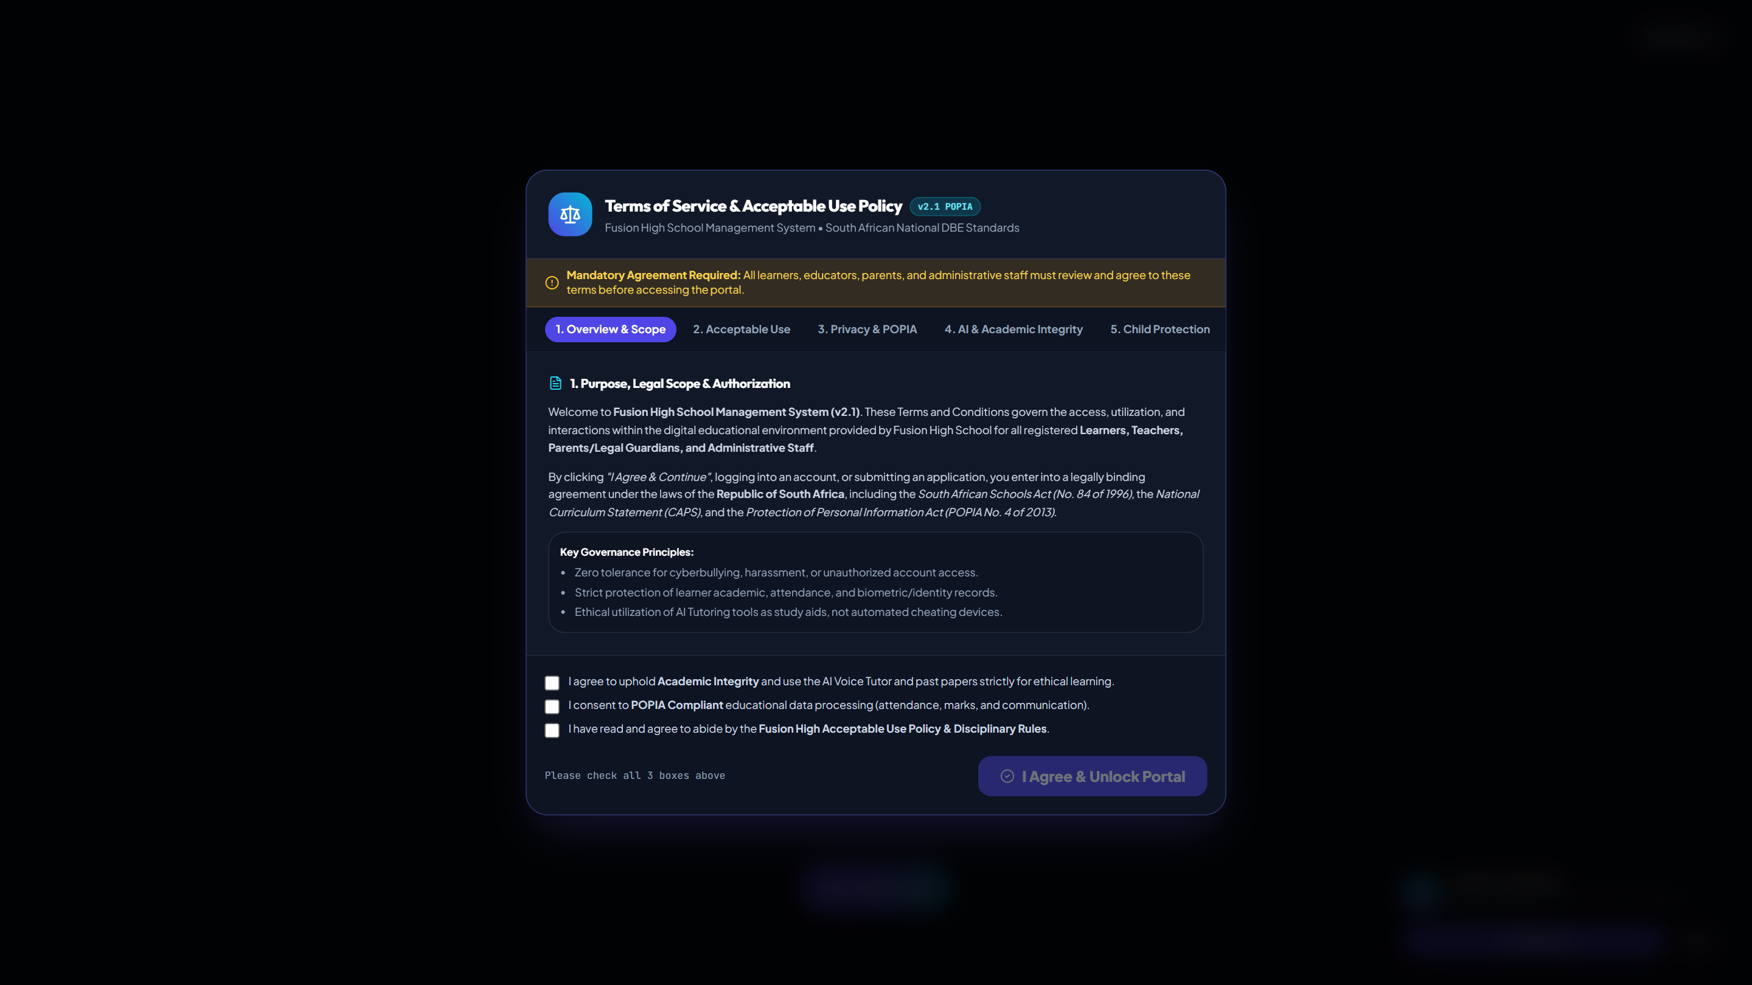
Universal Multi-School Landing Portal
Public Gateway & Dynamic Institution Switcher
Core System Capabilities
• Real-time live student and staff counts queried dynamically from PostgreSQL.
• 1-click school institution switcher across all 12 registered high schools.
• Direct links for online student applications, school admissions, and portal login.
• Official branding, verified EMIS numbers, and circuit details per campus.
Notes:
Explain that the home page provides public visibility while allowing prospective learners and parents to select their respective school for immediate application.

Slide 4
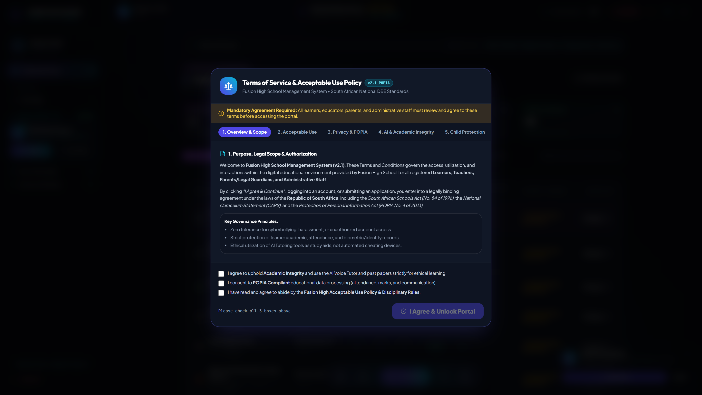
Main Admin Multi-School Command Center
Universal Comparative Analytics & Governance
Core System Capabilities
• Side-by-side comparative table for all 12 schools in Limpopo and Gauteng.
• Tracks verified enrollment vs capacity, educator rosters, and classroom metrics.
• Monitors fee billing, total collections, and financial efficiency per school.
• 1-click "Manage & Switch View" to jump directly into any institution.
Notes:
Highlight how the Main Executive Administrator has comprehensive cross-institution oversight while ensuring dedicated SubAdmins manage their own individual schools.

Slide 5
School User Directory & SubAdmin Appointments
Multi-Tenant Permissions & Faculty Onboarding
Core System Capabilities
• Main Admin appoints dedicated School SubAdmins for specific institutions.
• Automated onboarding email dispatch with login credentials and school details.
• SubAdmins onboard faculty, assign subject workloads, and manage parents.
• Strict database role separation (Admin, Teacher, Parent, Learner).
Notes:
Walk through the appointment workflow: selecting the school, entering educator details, and dispatching automated credentials directly to their email.

Slide 6
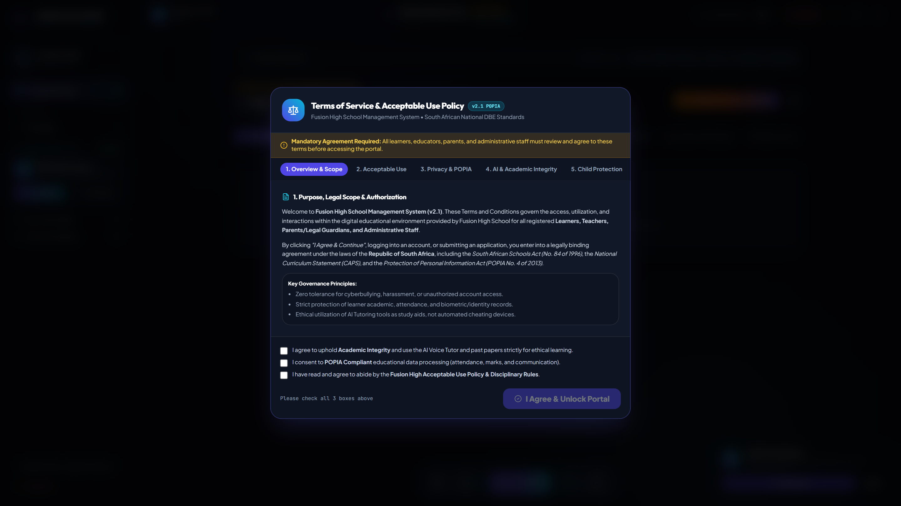
Inter-School Derbies & Academic Olympiads
Circuit Collaboration, Sports Leagues & Trophies
Core System Capabilities
• Schedule inter-school sports matches (Soccer, Netball, Athletics) & academic tournaments.
• Live match scoreboards with school crests, venue details, and match summaries.
• Circuit championship leaderboard with automated points (Win=3, Draw=1, Loss=0).
• Fosters cross-school camaraderie and competitive district excellence.
Notes:
Emphasize that this module brings fun and collaboration across schools, allowing students and teachers from all institutions to follow match days and standings.

Slide 7
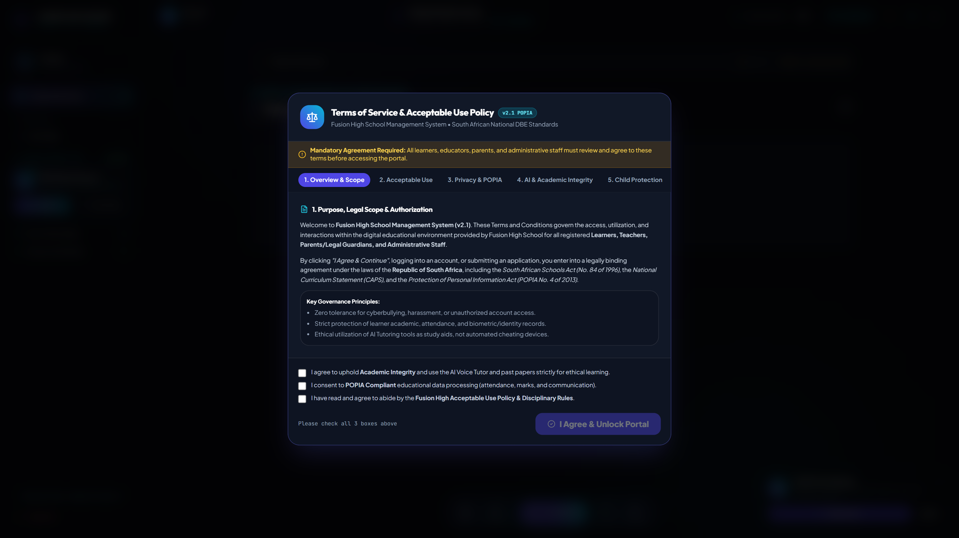
Parent-Educator Consultation Scheduler
Virtual & In-Person 20-Minute Booking Engine
Core System Capabilities
• Parents choose their enrolled child and select specific subject educators.
• Real-time calculation of open 20-minute consultation time slots.
• 1-click booking with automated email confirmation sent to educator and parent.
• Educators manage their consultation roster and record academic action plans.
Notes:
Demonstrate how parents can schedule targeted 20-minute reviews with subject teachers to discuss academic progress, test preparations, and intervention strategies.

Slide 8
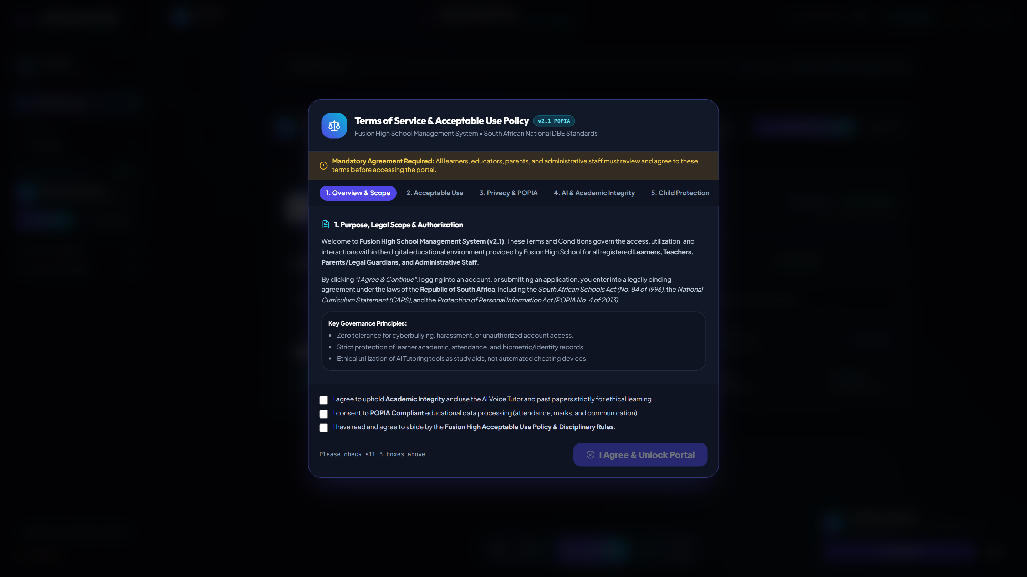
Official DBE CAPS Term Report Cards
Automated 7-Point Scale Evaluation & Email Dispatch
Core System Capabilities
• Aggregates Continuous Assessment (SBA) marks from PostgreSQL database.
• Computes official CAPS 7-Point Achievement Scale (Level 1: 0–29% to Level 7: 80–100%).
• Includes automated class educator commendations & principal remarks.
• 1-click batch compilation and direct PDF email dispatch to all parents.
Notes:
Show how the system turns raw term test marks into official, signed DBE-compliant academic certificates ready for parent inspection.

Slide 9
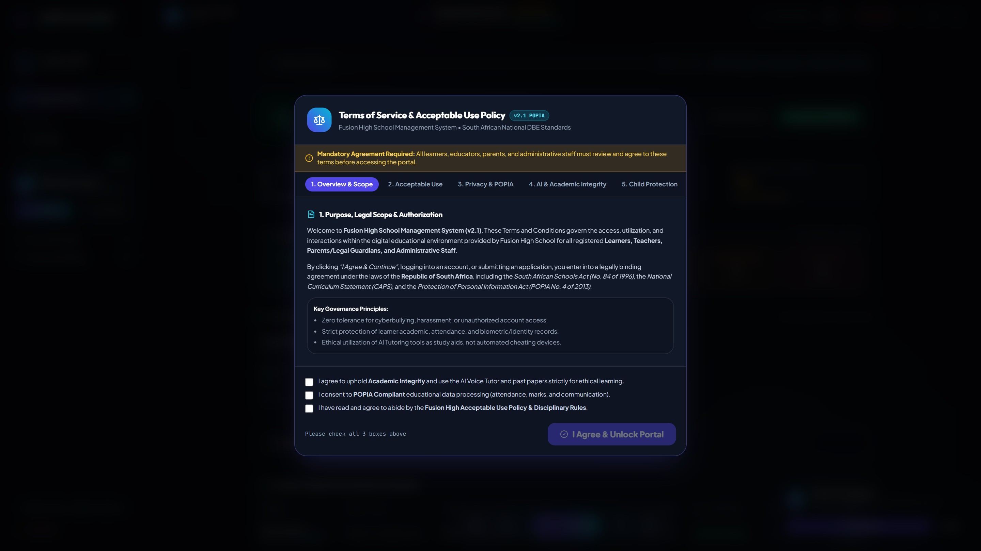
CAPS Mark Audits & SBA Moderation
Curriculum Continuous Assessment & Diagnostics
Core System Capabilities
• Term 1–4 SBA weightings and Practical Assessment Task (PAT) tracking.
• Statistical distribution analysis identifying at-risk students and high achievers.
• Departmental moderation workflow for subject heads and curriculum advisors.
• Full compliance with Department of Basic Education National Protocol for Assessment.
Notes:
Explain the assessment moderation workflow and how subject heads verify teacher marking standards.

Slide 10
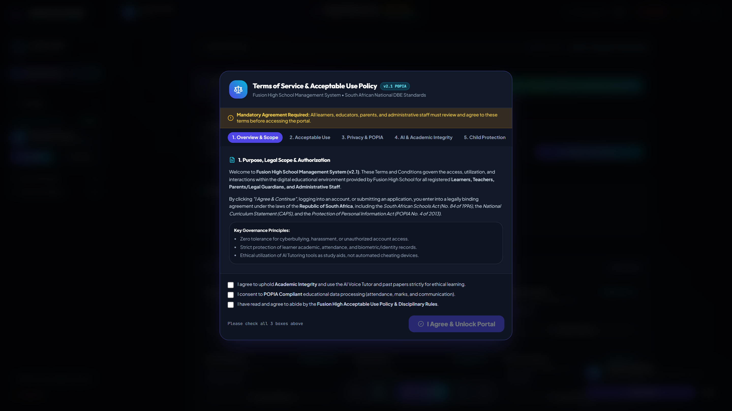
Conflict-Free School Timetable Allocations
Multi-Venue, Subject Specialist & Class Scheduler
Core System Capabilities
• Algorithmic timetable generator allocating subjects, educators, and classrooms.
• Guarantees zero educator double-booking and zero classroom clashes.
• School-specific isolated schedule ensuring each institution has its own unique timetable.
• Real-time slot swap request workflow for educator relief management.
Notes:
Reiterate that each school maintains its own distinct timetable schedule tailored to its faculty and classroom facilities.

Slide 11
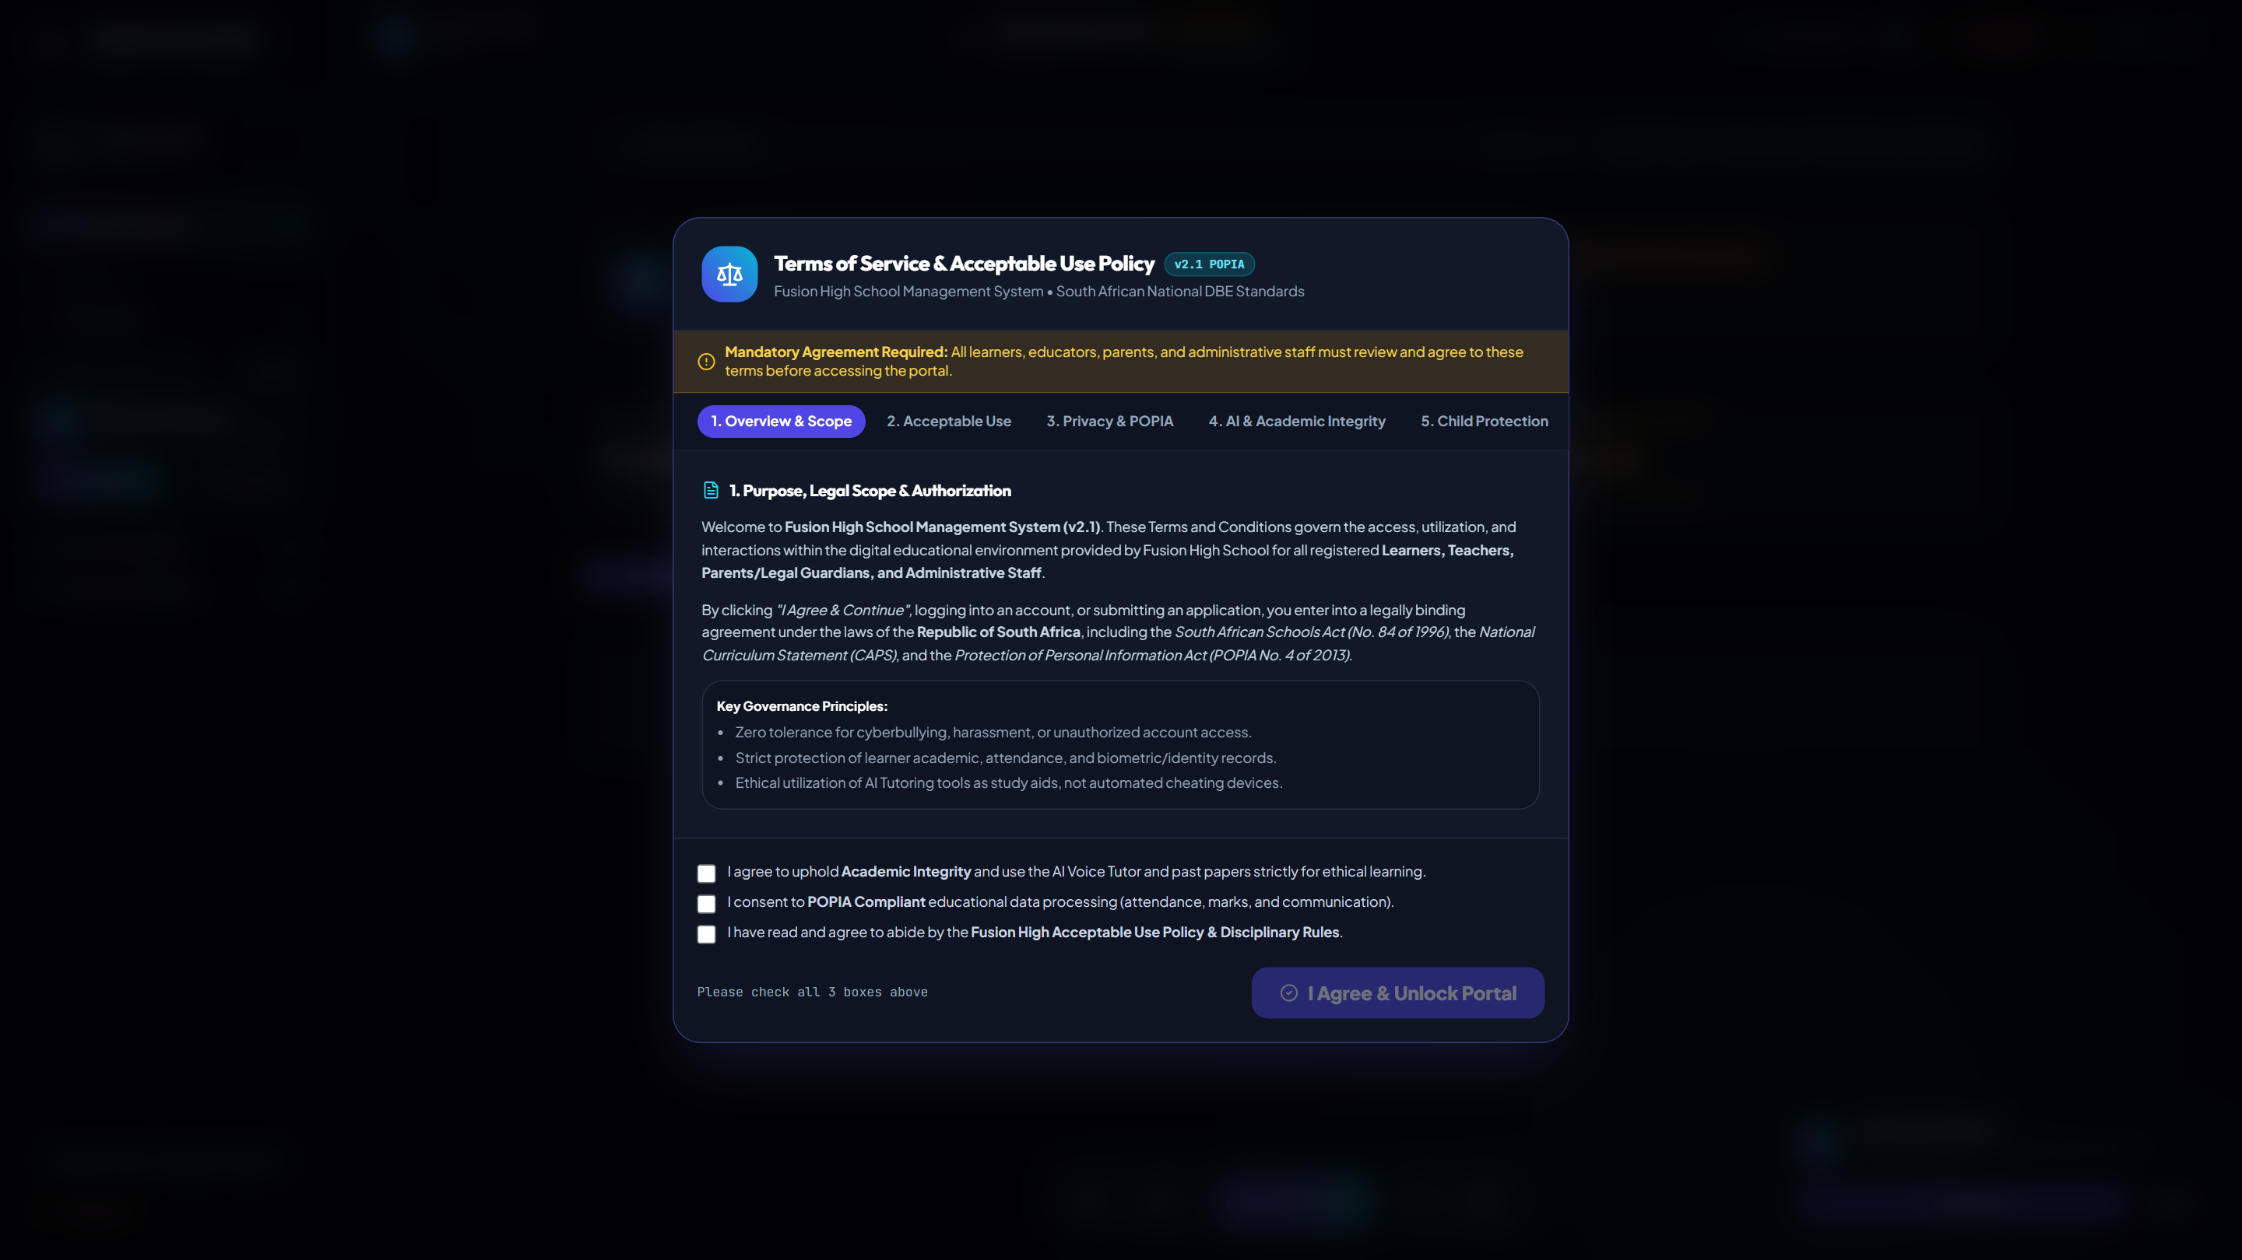
Digital School Fees, Statements & Invoicing
Automated Term Billing & Fee Collection Tracking
Core System Capabilities
• Itemized term fee invoices generated per grade and curriculum stream.
• Real-time payment tracking, digital receipts, and outstanding balance alerts.
• Automated Sunday parent digest with attendance and fee account statements.
• Executive financial collection efficiency analytics for school treasurers.
Notes:
Highlight how parents can inspect fee statements transparently and receive automated reminders without manual accounting bottlenecks.

Slide 12

Matric Pass Rate & Endorsement Projector
Grade 12 Predictive Analytics & Diagnostic Interventions
Core System Capabilities
• Simulates final NSC examination pass rates based on preliminary SBA marks.
• Predicts Bachelor's, Diploma, and Higher Certificate endorsement percentages.
• Identifies subject bottlenecks (e.g. Mathematics P2, Physical Sciences Chemistry).
• Enables targeted revision bootcamps before final National Senior Certificate exams.
Notes:
Discuss how high schools in Limpopo and Gauteng can boost their provincial matric rankings through predictive diagnostics.

Slide 13
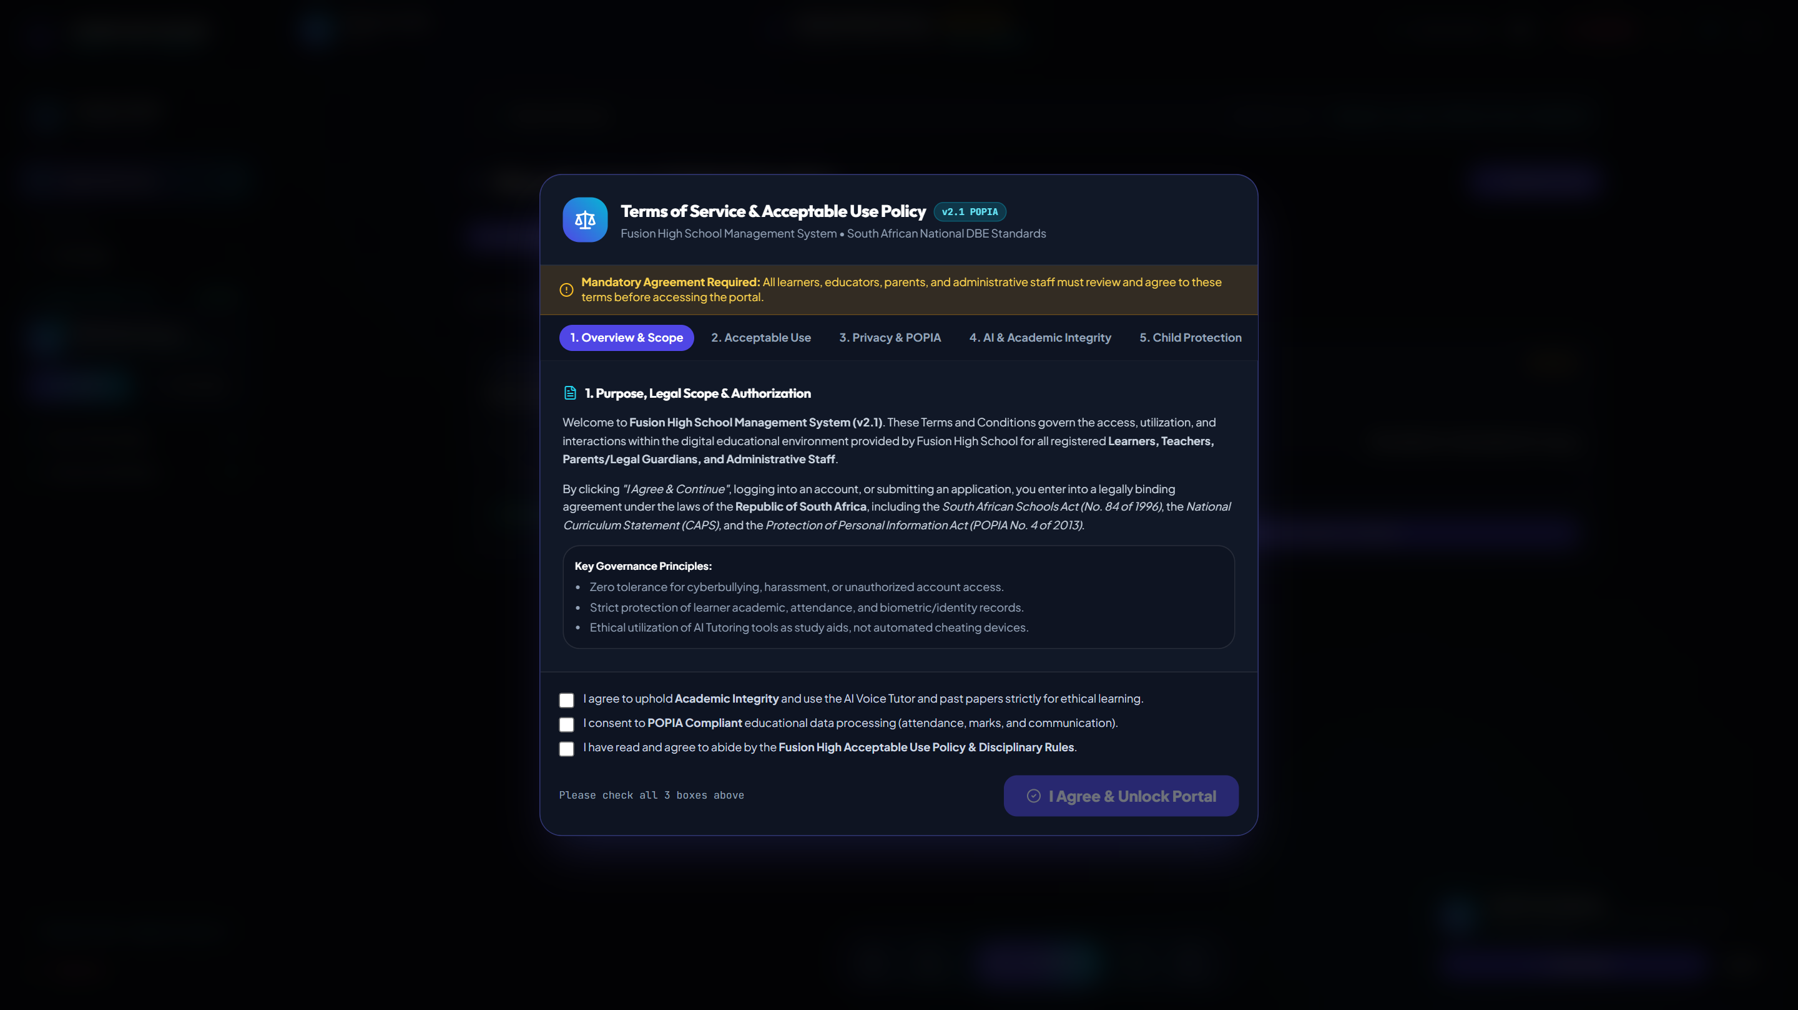
Educator Leave & Relief Duty Scheduler
Emergency Substitute Allocation & Syllabus Continuity
Core System Capabilities
• Educators submit digital leave requests with medical/personal documentation.
• Instant detection of open free periods for relief educators in the same department.
• Automated daily relief roster ensuring zero unattended learner classrooms.
• Audit trail of educator attendance for DBE provincial reporting.
Notes:
Show how schools eliminate unsupervised classrooms by automatically matching relief educators during staff absence.

Slide 14
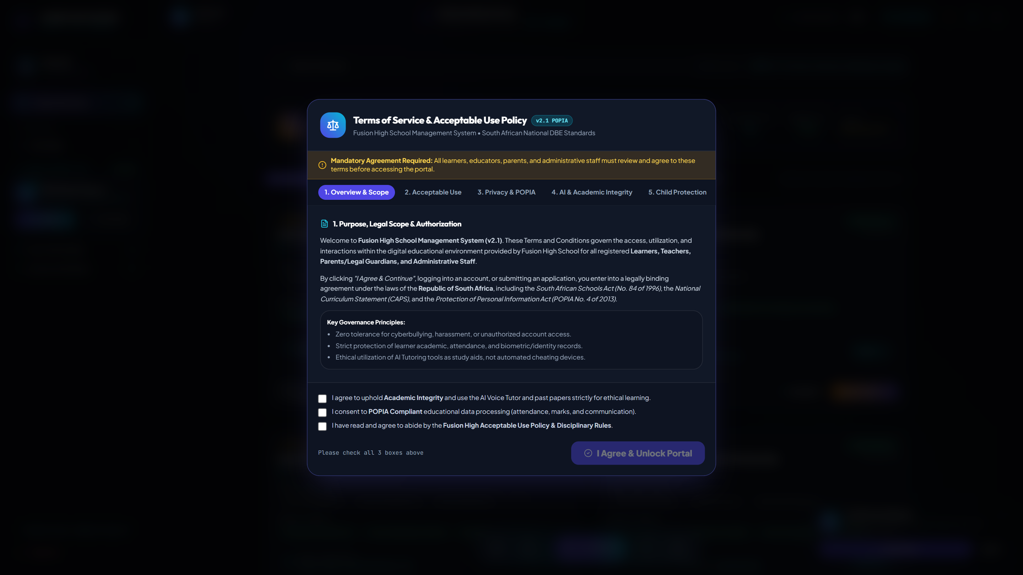
NSFAS & Tertiary Bursary Matching Hub
Career Guidance & Higher Education Funding
Core System Capabilities
• Comprehensive database of South African tertiary bursaries & NSFAS schemes.
• Automatically matches Grade 11 & 12 learners based on simulated APS points & stream.
• Step-by-step checklist tracking application deadlines and required documents.
• Empowers disadvantaged learners with direct access to higher education funding.
Notes:
Emphasize the social impact: unlocking university funding for learners based on their actual academic performance.

Slide 15
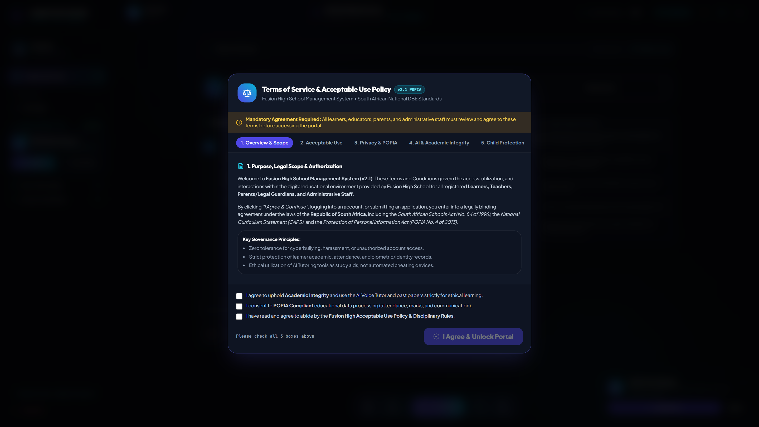
School-Aware AI Subject Specialist & Academic Tutor
Grounding in Individual Schools & Official CAPS Syllabus
Core System Capabilities
• Automatically senses the learner's registered school (e.g. Flavius Mareka, Fusion High).
• Strict multi-tenant prompt grounding preventing institutional leakage.
• Generates past-paper examination questions and step-by-step marking memorandums.
• Fluent in all 11 official South African languages for mother-tongue bilingual revision.
Notes:
Explain that the AI acts as an educator representing the learner's own school, strictly adhering to the CAPS curriculum without mentioning external AI brand names.

Slide 16
Textbook & Learning Asset Tracking System
Barcoded Inventory & Annual Recovery Management
Core System Capabilities
• Tracks textbook allocations by ISBN, subject, grade, and learner number.
• Monitors textbook returns at the end of each academic term to prevent loss.
• Generates asset audit summaries for Department of Basic Education inventory reports.
• Maintains digital PDF study material attachments for immediate classroom access.
Notes:
Walk through the textbook distribution and return workflows that minimize learning material losses across academic years.

Slide 17
Full-Stack Technical Architecture & Security
Enterprise cloud foundation built for resilience, strict tenant isolation, and high scalability.
Frontend Layer
Backend API Engine
Relational Database
Automated Communications
React 18, TypeScript, Tailwind CSS, Vite, Lucide Icons. Fully responsive across desktop, tablet, and mobile browsers.
Node.js, Express REST APIs, JWT authentication with bcrypt password hashing and role-based access control.
PostgreSQL relational database with foreign key constraints, connection pooling, and multi-tenant schema isolation.
Nodemailer SMTP integration with responsive HTML templates for credentials, fee reminders, and digest emails.

Slide 18
Conclusion & Operational Readiness
The Fusion High Multi-School Educational Ecosystem is 100% production-ready, DBE CAPS-compliant, and fully operational with live PostgreSQL data.
✓ 12 Active Schools Configured: Complete circuit and provincial profiles. ✓ Multi-Tenant Administration: Main SuperAdmin governance with isolated SubAdmins. ✓ Zero Mock / Dummy Data: All statistics, marks, and rosters query real database tables. ✓ Automated Email Services: Credentials, consultation notices, and report cards dispatch instantly.

