Slide 1
Absenteeism in the company
Tshiamo Setshwaelo

Slide 2
Agenda
01
Data Explained
02
Methods Used
03
Results
04
Further Improvements

Slide 3
Data Explained

Slide 4
Data Exploration
Here are a few intersting factors about the employees absenteeism data:
Data contains 740 entries of 36 employees.
We have 21 features that explain the 740 employees.
We have 28 reasons for their absenteeism.
The month with most absenteeism is March.
On average the people who are absent stay about 30km from work.
28 year olds and 38 year olds are the most absent.
Most of the absent people are smokers and drinkers.
Lastly as seen by the graph on the left most employees have only high-school

Slide 5
Methods used

Slide 6
Method Used
Ivis was used for dimentionality reduction, using ANN to do the dimentionality reduction.
Dimensionality reduction (DR) algorithms enable useful exploration of feature-rich datasets.
The reason we choose Ivis was because it reduce data dimensionality whilst preserving both global and local structures.
Once we had the feature-rich dataset we could then start modelling.
Made use of an unsupervised technique called HDBSCAN.
The reason why we choose is because I do not have to set clusters initially, unlike k-means. Instead HDBSCAN makes use of hierarchy and density. So I can have big clusters and small clusters, I can have dense clusters as well as non-dense clusters.
From there we were able to look at the clusters formed and find out the ‘star’ of each cluster.
A ‘star’ is a person whose attrubutes best describes a cluster. (main_people = 1)
So if we were to build an action campaign to reduce absenteeism they would be our test case.

Slide 7
Results

Slide 8
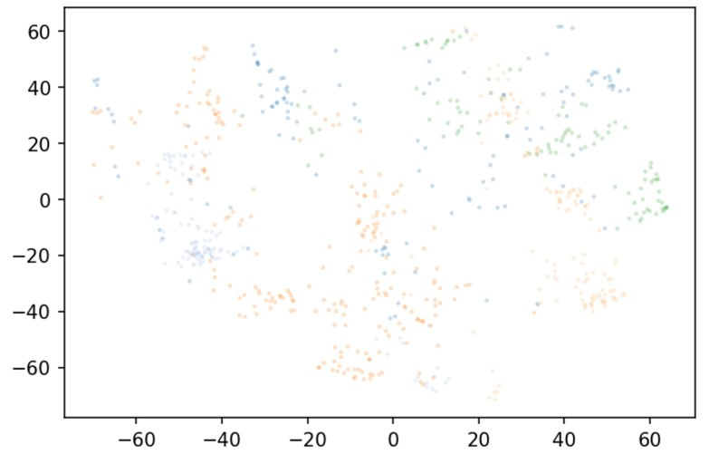
Results - HDBSCAN
If we look at the HDBSCAN results, its hard to see how many colours(clusters) we have.
However if we use the built in “labels_.max” feature we see that we have 5 different clusters.

Slide 9
Clusters Explained
So what does having 5 clusters mean?
Lets have a look at the 5 of the stats for each cluster:

Slide 10
Clusters Explaining members
Cluster 0:
Absent because of diseases of the genitourinary system.
Absent on a Wednesday.
On average stay 21 km from work
On average they are 39 years of age.
Highest qualification is High School.
Cluster 1:
Absent because of blood donation.
Absent on a Wednesday.
On average stay 51 km from work
On average they are 38 years of age.
Highest qualification is High School.
Cluster 2:
Absent because of external causes of morbidity and mortality
Absent on a Wednesday.
On average stay 33 km from work
On average they are 39 years of age.
Highest qualification is High School.

Slide 11
Clusters Explaining members
Cluster 3:
Absent because of external causes of morbidity and mortality.
Absent on a Wednesday.
On average stay 24 km from work
On average they are 33 years of age.
Highest qualification is High School.
Cluster 4:
Absent because of Symptoms, signs and abnormal clinical and laboratory findings, not elsewhere.
Absent on a Wednesday.
On average stay 19 km from work
On average they are 32 years of age.
Highest qualification is Graduate degree.
Also note that we also have outliers in our data, where cluster is labelled as (-1). These are employees who way act different from other employees in the clusters.

Slide 12
Conclusion
Campaigns to run:
Looks like most of the employees are absent on Wednesday. Maybe make Wednesday a work from home day for everyone. That way they are productive without travelling to work.
Cluster 1 employees main reason for being absent is blood donation. Since saving lives means a lot to them, maybe bring in the Blood Bank so they can donate blood without missing work.
Out of the 5 clusters that we have, only 1 cluster is graduates. Maybe we should see how we can help upskill our employees so they can move on to other levels of education.
On average across all clusters on minimum our employees drive 40km daily. Maybe have an open space closer to their homes, for them to work there.
There are many action campaigns we can run to help reduce the number of absenteeism. It however all depends of our employees and what they need. In order for us to better help them, we need to first understand them.

Slide 13
Further Improvements

Slide 14
Further Improvements
This first run showed us a lot of insights. However there is room for improvement:
Add more data to see if we will get more clusters.
Change your parameters, based on what business thinks is optimal. This will ensure that we are able to get the best clusters to describe employees.
Run some of the action campaigns and see if the level of absenteeism changes overall/

Slide 15
Thank You!!

