Slide 1

How consistent are EMG Signals across different people?
Figure 1: Illustration of an EMG test. Source: Advanced Spine and Pain (2024).

Slide 2
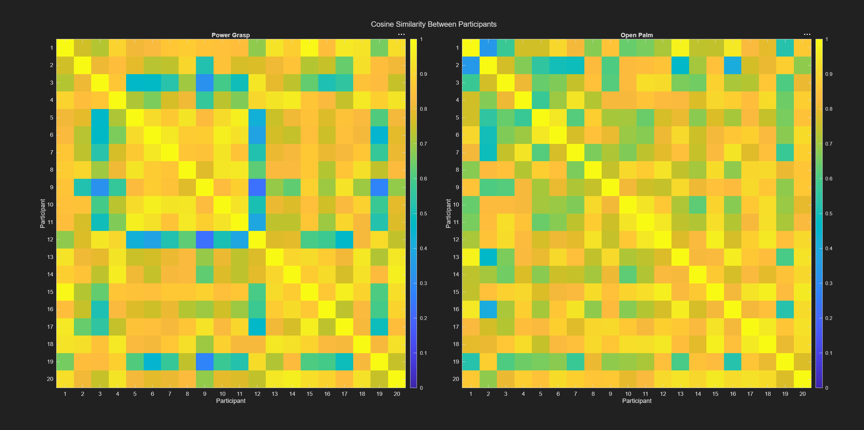

Cosine Similarities Between Participants and their normalized EMG Signal : Power Grasp and Open Palm
Power Grasp
Figure 2 illustrates a power-grasp movement, in which the fingers flex around an object [2].
Variation:
Electrode placement
muscle mass
BF percentage
Gender.
Varying recruitment of forearm muscles
Data accessed and analyzed via MATLAB
Plot of cosine similarity between 20 different participants from the NinaPro Dataset doing a open palm and power grasp position

Slide 3
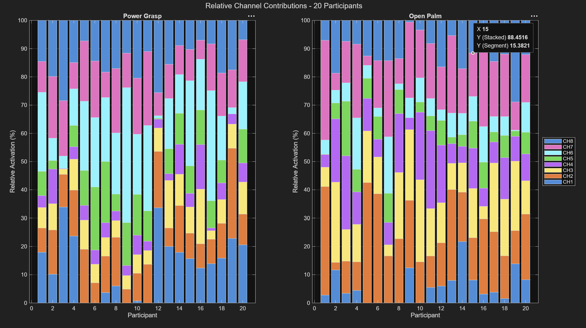
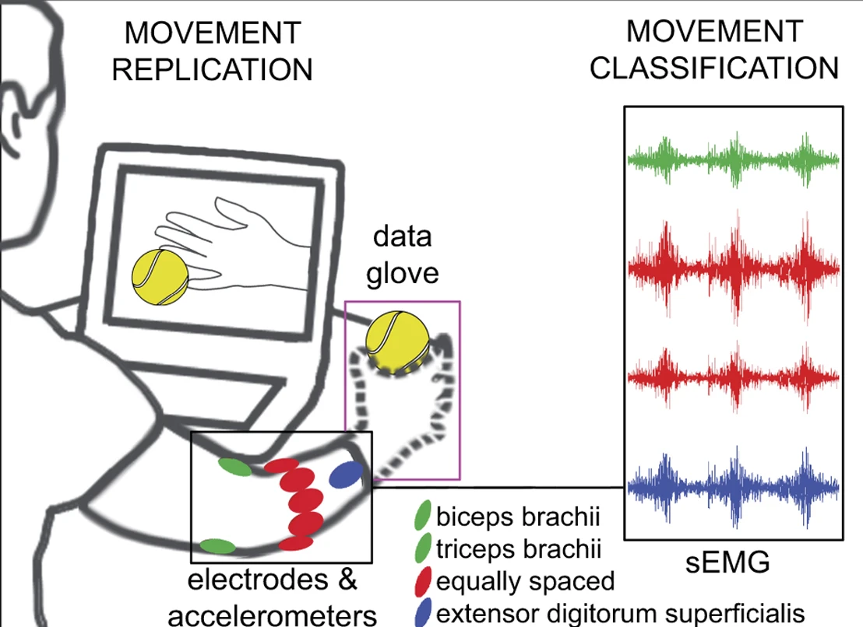
Muscle Synergies: Power Grasp and Open Palm
Fig. 1. NinaPro experimental acquisition procedure illustrating electrode placement, surface EMG recording, movement replication and prosthetic hand control.
How to Improve Reliability of Readings:
Individual calibration
More robust signal-processing methods
Data accessed and analyzed via MATLAB
Plot of proportional contribution from each EMG sensor towards the power grasp and open hand movements.

Slide 4
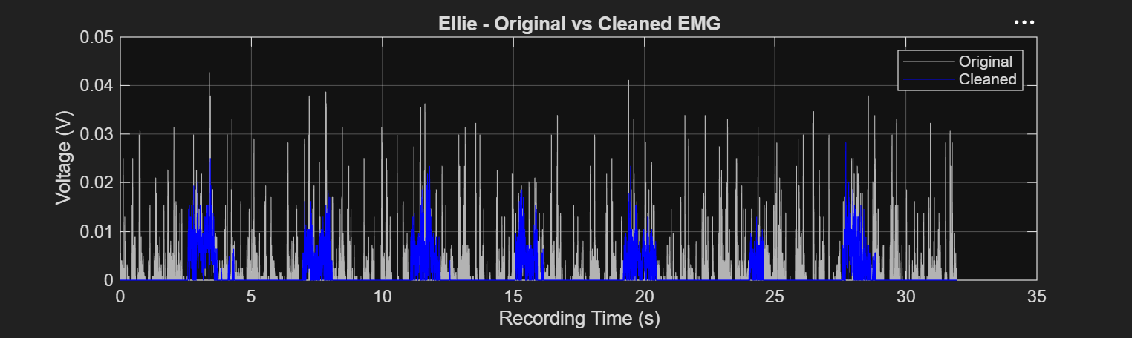

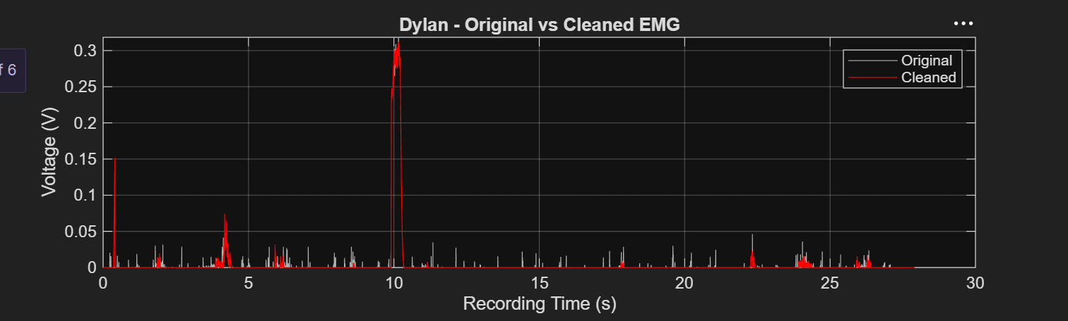
Proving variations and similarities in EMG readings by taking self-measurements
More consistent muscle activation patterns
Removal of Narrow Peaks
Cleaning may of removed actual muscle activity instead of noise.
Very large noticeable signal increase 10s into measurements
Higher mean voltage recorded
Removal of multiple narrow peaks
Data accessed and analyzed via MATLAB
Plot of voltage against recording time cleaned using moving median outlier-detection filter

Slide 5
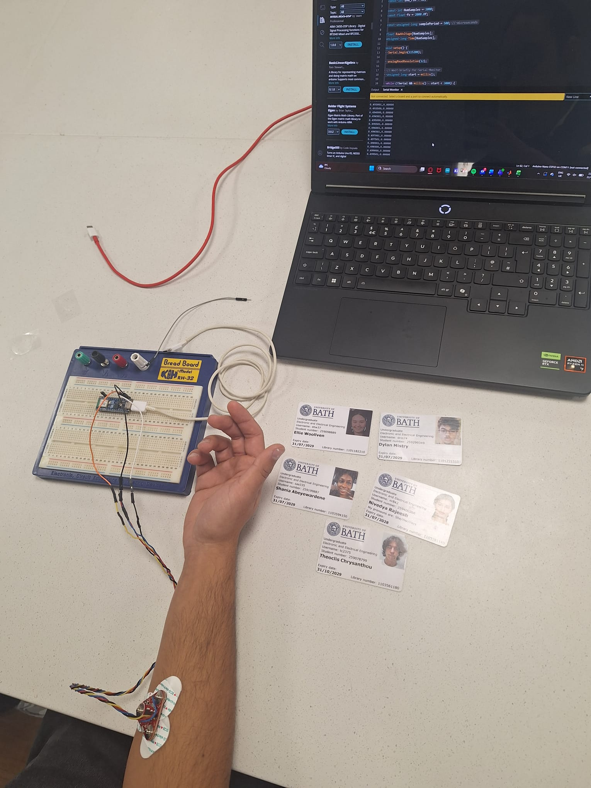
What can we Conclude?
EMG signals can be broadly similar between individuals, but important differences remain.
Challenging to obtain reliable measurements and distinguishing genuine activity from noise.
In the future:
Record movements under controlled conditions.
Test whether gesture-recognition algorithms can generalize between participants.
Bibliography
[1] Advanced Spine and Pain (2024) How to interpret EMG test results. Available at: https://www.asappaindocs.com/articles/interpret-EMG-test-results (Accessed: 4 November 2026).
[2] The Slow GIF Movement, “Heart Hand GIF,” GIPHY. [Online]. Available: https://giphy.com/gifs/hand-slow-squeeze-TLIed7IwyosvDnXZLD. [Accessed: Nov. 4, 2026].
[3] M. Atzori et al., “Electromyography data for non-invasive naturally-controlled robotic hand prostheses,” Scientific Data, vol. 1, Art. no. 140053, 2014, doi: 10.1038/sdata.2014.53.

