Slide 1
WORKFORCE EVIDENCE REVIEW
What the evidence says about the Gen Z workplace disconnect
South African labour-market pressure, development expectations, employer concerns and career preferences. Each figure remains tied to its original source and population.
Published figures only
Prepared by Sphamandla Nkosi
Starting brief: IOL Cape Argus, 24 June 2026

Slide 2
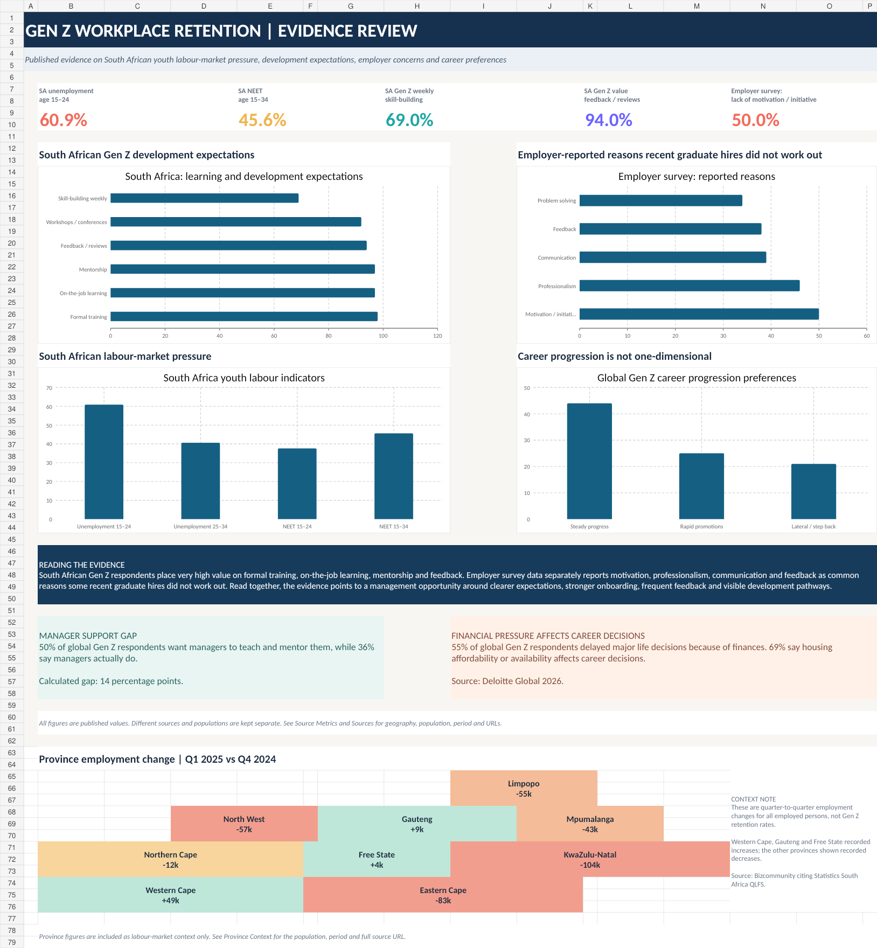
Evidence at a glance
The Excel view keeps the populations separate while bringing the main signals onto one page.
Sources shown in workbook: Statistics South Africa; Deloitte South Africa; Deloitte Global; Intelligent.com.

Slide 3
South African youth enter work under significant labour-market pressure
Q1 2026 indicators from Statistics South Africa.
SOUTH AFRICA · Q1 2026
SOUTH AFRICA · Q1 2026
SOUTH AFRICA · Q1 2026
SOUTH AFRICA · Q1 2026
60.9%
40.6%
37.6%
45.6%
Unemployment, age 15–24
Unemployment, age 25–34
NEET rate, age 15–24
NEET rate, age 15–34
Where employed youth work
Trade
23.6%
Why this matters for retention
Community & social services
19.9%
The workplace conversation sits inside a difficult entry-level labour market. These figures do not explain why an individual leaves a job, but they provide important context for how younger workers experience risk, opportunity and career decisions.
Finance
18.5%
Context only: labour-market indicators should not be interpreted as employee-retention rates.
Statistics South Africa — South Africa’s Youth and the Labour Market in Q1 2026 · https://www.statssa.gov.za/?p=19526

Slide 4
South African Gen Z respondents report a strong appetite for development
Deloitte South Africa country findings from the 2025 global survey.
Formal training
98%
97%
Reading the signal
On-the-job learning
Mentorship
97%
It is difficult to reduce the workplace disconnect to a simple lack of interest in growth.
Feedback / performance reviews
94%
Workshops / conferences
92%
The published South African figures show very high value placed on structured learning, practical learning, mentorship and feedback.
Active skill-building weekly
69%
Management question: Are expectations, learning opportunities and feedback clear enough for early-career employees to know what good performance looks like?
Deloitte South Africa · https://www.linkedin.com/posts/deloitte_careergrowth-genz-millennials-activity-7346447611979071489-KPCC

Slide 5
Employer concerns are also visible in the survey data
Intelligent.com survey of 966 business leaders involved in entry-level hiring, August 2024.
Lack of motivation / initiative
50%
EMPLOYER SURVEY · 2024
Lack of professionalism
46%
75%
Poor communication
39%
Said some or all recent graduate hires were unsatisfactory
Struggles with feedback
38%
Problem-solving
34%
EMPLOYER SURVEY · 2024
60%
Reported some recent graduate hires were fired
These are employer-reported perceptions and outcomes from this survey. They should not be treated as a South African Gen Z prevalence estimate.
Intelligent.com · https://www.intelligent.com/1-in-6-companies-are-hesitant-to-hire-recent-college-graduates/

Slide 6
Career ambition does not always mean chasing the next title
Global Gen Z findings from Deloitte 2025 and 2026.
Career progression preference
Steady progress
44%
Manager development gap
Rapid promotions
25%
50%
want managers to teach and mentor them
Lateral move / step back
21%
36%
say this happens in practice
14 percentage-point gap
55%
delayed major life decisions because of finances
69%
say housing affordability affects career decisions
44%
prefer steady career progress
Deloitte Global 2026 and 2025 · https://www.deloitte.com/global/en/issues/work/genz-millennial-survey.html

Slide 7
The useful management response is measurable, not generational
The evidence suggests areas to test internally rather than assumptions to make about every young employee.
1
Clarify expectations
State what good performance looks like, where initiative is expected and when approval is required.
2
Strengthen onboarding
Build professional norms, communication expectations and practical work examples into the first weeks.
3
Increase feedback cadence
Use short, specific feedback loops instead of waiting for formal performance reviews.
4
Create visible development
Use mentoring, on-the-job learning and clear skill pathways alongside promotion opportunities.
5
Measure the outcome
Track early-tenure exits, performance issues, feedback quality, learning participation and internal movement.
These are management actions suggested by the evidence review. They are not presented as proven causal interventions.
Interpretation based on the sourced evidence in the workbook and the IOL Cape Argus starting brief.

Slide 8
Source register
Every number shown in the analysis can be traced back to a published source.
Starting brief
IOL Cape Argus · 24 Jun 2026
iol.co.za/capeargus/opinion/2026-06-24-understanding-the-disconnect-why-employers-are-firing-gen-z-employees/
South Africa labour market
Statistics South Africa · Q1 2026
statssa.gov.za/?p=19526
South Africa Gen Z development
Deloitte South Africa · 2025 findings
linkedin.com/posts/deloitte_careergrowth-genz-millennials-activity-7346447611979071489-KPCC
Global Gen Z 2026
Deloitte Global Gen Z & Millennial Survey 2026
deloitte.com/global/en/about/press-room/deloitte-2026-gen-z-and-millennial-survey.html
Global Gen Z 2025
Deloitte Global Gen Z & Millennial Survey 2025
deloitte.com/global/en/about/press-room/deloitte-2025-gen-z-and-millennial-survey.html
Employer survey
Intelligent.com · Aug 2024 · n=966
intelligent.com/1-in-6-companies-are-hesitant-to-hire-recent-college-graduates/
Province context
Bizcommunity summary of Stats SA QLFS · Q1 2025
bizcommunity.com/article/unemployment-climbs-to-329-in-2025-q1-473939a
The Excel workbook includes the metric table, population, geography, period, source name and full URL for auditability.

