Slide 1

FINTRUST DIGITAL BANK
Week 4 Data Analytics
Final Project Presentation
Tsholofelo Hope Motlhatlhedi • Data Analytics Track
From raw customer and transaction data → validated analysis → SQL insights → Power BI management view
Notes:
The overall workflow was to validate the data, explore it, deepen the analysis with SQL, build the management-facing Power BI view, and then translate the findings into recommendations.

Slide 2
My contribution to the project
What I developed, tested, improved, finalized and delivered
DATA PREPARATION
PYTHON / JUPYTER
SQL ANALYSIS
Profiled customer and transaction datasets; checked blank spaces, duplicates, IDs, dates and data types; documented limitations.
Built the EDA workflow, visualizations, customer-level integration and evidence-based interpretations.
Expanded business analysis using joins, grouping, CASE logic, subqueries and analytical/window functions.
POWER BI
BUSINESS INSIGHTS
Converted validated metrics into management-facing KPIs, visuals, filters and an integrated dashboard.
Translated results into findings and practical recommendations rather than reporting numbers alone.
Notes:
I first profiled and validated the customer and transaction datasets. I then developed the Python exploratory analysis and integrated the customer and transaction information using Customer_ID.
I used SQL to answer business questions and deepen the analysis using joins, grouping, conditional logic, common table expressions, subqueries and analytical functions.
I then translated the validated metrics into a Power BI dashboard structure and developed business findings and recommendations from the evidence.
So, in summary, I developed the analysis, tested it, improved the technical output, finalized the findings and delivered the integrated analytical story.

Slide 3
End-to-end analytical workflow
The same underlying fields were carried through each stage
1
2
3
4
5
Excel
Python
SQL
Power BI
Insights
Initial quality assessment
Preparation + EDA
Business questions + deeper analysis
Validated KPI dashboard
Recommendations + final communication
INTEGRATION PRINCIPLE
Customer_ID was the key integration field. KPI definitions were kept consistent so that Python, SQL and Power BI could tell the same story.
Notes:
Excel was used for the initial quality assessment. Python and Jupyter were then used for preparation, exploratory analysis and visualization.
PostgreSQL was used to answer business questions in a structured way and to deepen the analysis beyond simple descriptive charts.
Power BI then converted the validated metrics into a management-facing dashboard.

Slide 4
Data validation & quality assessment
Evidence used before deeper analysis
1,500
customer records
12,000
transaction records
0
duplicate transaction IDs
0
unmatched transaction Customer_IDs
192
missing transaction cells
MISSINGNESS TREATMENT
96 Device_Type values and 96 Location values were missing. They were not replaced with invented values; device/location comparisons explicitly excluded missing observations.

Slide 5
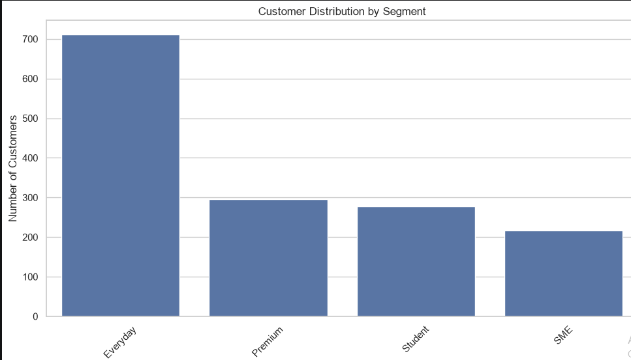
Customer & transaction mix
What the EDA established about who is active and what they do
TRANSACTION TYPES
Transfer: 3,549 transactions — the highest transaction count and the highest total transaction value.
Card Purchase: 3,033 transactions.
Deposit has the highest average transaction value: NGN 98,633.33.
TRANSACTION VALUE
CHANNELS
Total transaction value: NGN 560,477,354.85.
Mean: NGN 46,706.45.
Median: NGN 10,305.94.
The large gap between mean and median confirms a right-skewed distribution where high-value transactions pull the mean upward.
Mobile App is the leading channel with 5,102 transactions and NGN 240.10M in total transaction value.
It is the dominant channel across every customer segment.
Notes:
Everyday is the largest segment: 711 customers.
Premium: 295 • Student: 278 • SME: 216
The largest segment naturally has more opportunity to generate transaction volume, so segment size was considered when interpreting activity.

Slide 6
Operational performance
Transaction outcomes and month-to-month movement
90.47%
successful transactions
19.60%
risk-review rate
196.20M
March transaction value (NGN)
FAILURE / REVERSAL SIGNAL
MONTHLY TREND
USSD has the highest combined failure/reversal rate among channels at 8.66%.
Airtime/Data has the highest combined failure/reversal rate among transaction types at 8.95%.
These are operational investigation signals, not explanations of why transactions failed.
January: 4,133 transactions; NGN 188.49M
February: 3,734 transactions; NGN 175.79M
March: 4,133 transactions; NGN 196.20M
March matched January's volume but produced the highest value.

Slide 7
Customer behaviour & digital adoption
SQL deepened the Python findings
99.80%
digital adoption
1,497 / 1,500
customers using a defined digital channel
0.0380
engagement ↔ transaction-count correlation
SEGMENT BEHAVIOUR
INTERPRETATION
Everyday generated the largest overall transaction volume because it is the largest segment.
Student customers had the highest average transaction frequency at approximately 8.23 transactions per customer.
Average digital-engagement differences between segments were modest.
The 0.0380 correlation is very weak. Higher digital-engagement scores did not translate into substantially higher transaction counts in this dataset.
This prevents the project from making a simplistic 'more engagement = more activity' claim.

Slide 8


Device & geographic analysis
SQL added customer counts, transaction share and location context
DEVICE USAGE
GEOGRAPHIC ACTIVITY
Android: 4,797 transactions • 39.98% of non-missing device transactions
iOS: 2,920 • 24.33%
POS Terminal: 1,571 • 13.09%
Web Browser: 1,447 • 12.06%
ATM Terminal: 1,169 • 9.74%
Android is the most common device category. 96 device values were missing and excluded from the comparison.
Ibadan recorded the highest activity among the supplied locations:
1,550 transactions • NGN 81.42M total value.
Kano: 1,526 transactions
Port Harcourt: 1,520
Enugu: 1,484
Kaduna: 1,481
Benin City: 1,451
Abuja: 1,461
Lagos: 1,431
Geographic conclusions are limited to the eight locations represented in the data.
Notes:
these geographic findings are limited to the locations actually present in the dataset. I did not infer anything about rural or urban populations because that classification is not provided.

Slide 9
Risk-review patterns
A monitoring lens — not a fraud conclusion
28.49%
Transfer risk-review rate
21.35%
Web channel risk-review rate
21.64%
ATM Terminal risk-review rate
OTHER HIGHER-RATE GROUPS
CONTROLLED INTERPRETATION
Premium segment: 20.33%
Benin City: 20.68%
Cash Withdrawal: 25.31%
Risk-review rates vary across transaction type, channel, device, segment and location.
Risk_Review_Flag is a synthetic educational label supplied with the dataset.
A higher rate identifies an association worth investigating; it does not establish fraud, suspicious behaviour or causation.

Slide 10
Power BI integration
The dashboard turns validated analysis into a management view
1,500
Total Customers
12,000
Total Transactions
NGN 560.48M
Total Transaction Value
NGN 46.71K
Average Transaction Value
90.47%
Transaction Success Rate
19.60%
Risk Review Rate
DASHBOARD COVERAGE
Customer segments • transaction types • channels • monthly trends • transaction status • risk patterns • slicers/filters
Notes:
I then translated the validated metrics into the Power BI management view.
The dashboard uses six core KPI measures: total customers, total transactions, total transaction value, average transaction value, transaction success rate and risk-review rate.
The validated values are 1,500 customers, 12,000 transactions, approximately 560.48 million naira in total transaction value, approximately 46.71 thousand naira average transaction value, a 90.47 percent success rate and a 19.60 percent risk-review rate.
The dashboard also covers customer segments, transaction types, channels, trends, status and risk-review patterns, with filters to support exploration.
The important point is that Power BI is not a separate analysis. It is the communication layer built from the validated analytical definitions.

Slide 11
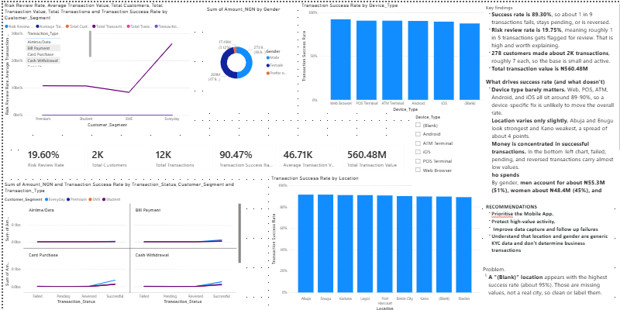
Power BI integration

Slide 12
Testing, validation & improvement
What I checked before treating the output as final
DATA INTEGRITY
FIELD CONSISTENCY
Record counts, missingness, duplicates and join integrity checked.
Customer_ID used consistently across Excel, Python and SQL joins.
NUMERIC VALIDATION
ANALYTICAL VALIDATION
Amount_NGN converted/treated numerically; mean, median and totals reconciled.
Python findings compared against SQL aggregations and monthly totals.
DASHBOARD VALIDATION
TECHNICAL IMPROVEMENT
Power BI KPIs were tied to the same underlying fields and definitions.
Jupyter plotting issue was corrected; stale outputs cleared and execution counts reset.

Slide 13
What I developed and finalized
Deliverables and integration
DEVELOPED
IMPROVED
DELIVERED
• Excel data-quality assessment
• Python/Jupyter EDA workflow
• Customer + transaction integration
• SQL business analysis
• Deeper SQL analysis patterns
• Power BI KPI/dashboard structure
• Business insights and recommendations
• Corrected notebook file-loading logic
• Removed stale notebook error outputs
• Stabilized visualizations
• Kept missing values transparent
• Separated association from causation
• Final Jupyter notebook
• SQL analysis file
• Power BI dashboard/model
• Validated KPI set
• Findings and recommendations
• Final presentation

Slide 14
Recommendations
Actions supported by the evidence — not assumptions
1
Prioritise mobile-first service optimisation
Mobile App leads transaction volume and total channel value. Continue improving reliability, usability and customer journeys there.
2
Investigate transfer-related risk-review patterns
Transfer has the highest transaction-type risk-review rate (28.49%). Review underlying characteristics before changing controls.
3
Investigate USSD operational performance
USSD has the highest combined failure/reversal rate (8.66%). Examine failure causes, customer journeys and service availability.
4
Monitor high-value transaction behaviour
Deposits have the highest average transaction value (NGN 98,633.33), while transfers generate the highest total value.
5
Improve device/location data completeness
Missing Device_Type and Location each affect 96 transactions. Better capture would strengthen device and geographic monitoring.
6
Extend the observation period
The analysis covers Jan–Mar 2026. Longer history would improve seasonality, trend and stability assessment.
Source: FinTrust Excel validation • Python/Jupyter EDA • PostgreSQL SQL • Power BI model

Slide 15
Limitations & analytical discipline
What the results do not claim
• Observation period is January–March 2026; results are not a full-year view.
• 96 Device_Type values and 96 Location values are missing; device/location comparisons exclude those records.
• Geographic conclusions are limited to the locations represented in the supplied dataset.
• Monthly income is supplied as bands, so it is treated as categorical/ordinal rather than exact income.
• Risk_Review_Flag is synthetic and should not be described as proof of fraud or wrongdoing.
• Correlation and visual patterns show association, not causation.
• Transaction volume and customer adoption are deliberately treated as different measures.
Source: FinTrust Excel validation • Python/Jupyter EDA • PostgreSQL SQL • Power BI model

Slide 16
Lessons learned
What changed in my analytical approach
DATA QUALITY FIRST
COUNT ≠ ADOPTION
MEAN ≠ TYPICAL
I learned that analysis is only as reliable as the validation underneath it.
I learned to distinguish transaction volume from unique-customer usage.
I learned why skewed financial data requires both mean and median.
SQL IS BUSINESS LOGIC
DASHBOARDS NEED DEFINITIONS
ASSOCIATION NEEDS CAUTION
I learned to use SQL not just to retrieve rows, but to answer structured business questions.
I learned that KPI consistency matters more than visual complexity.
I learned to describe patterns without turning them into causal or fraud claims.
Source: FinTrust Excel validation • Python/Jupyter EDA • PostgreSQL SQL • Power BI model

Slide 17
Thank you
Notes:
To conclude, I transformed the supplied FinTrust customer and transaction data into a validated and integrated analytical story.
I validated the data, explored the customer and transaction behaviour, used SQL to deepen the analysis, translated the validated metrics into Power BI, and converted the findings into practical recommendations.
The strongest overall patterns were very high digital adoption, heavy Mobile App usage, high transaction value concentrated in transfers, a strongly right-skewed transaction amount distribution, and meaningful variation in operational and risk-review rates.
The final output is therefore not just a collection of charts and queries. It is a reproducible analytical workflow that connects data quality, analysis, validation, dashboard communication and business recommendations.
Thank you.

