Slide 1
Windchill/Creo File Naming Convention

Slide 2
CAD File Naming
New Models will no longer have the DESCRIPTION parameter.
The following slides will describe the naming conventions for various situations.
Some older models will need to be renamed to create BOMs properly.

Slide 3
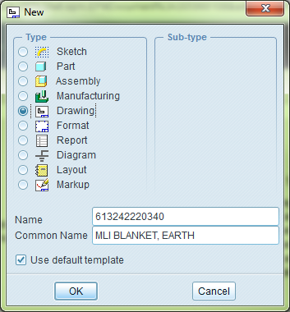
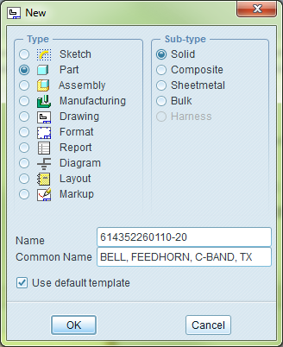
New CAD File Creation
Begin by selecting File > New… or Ctrl+N or ( )
Dialog box will appear for creating a new CAD object,
Select the radio button for Type and Sub-type.
Name is equal to part number, assembly number or
drawing number being created.
Do not include underscores or any other
identifiable information after this number,
unless directed by admin.
Common Name is equal to the description of your
part, assembly or drawing.
Type in all capital letters
This will populate nomenclature in parts lists,
E-BOM’s and be used in drawings

Slide 4
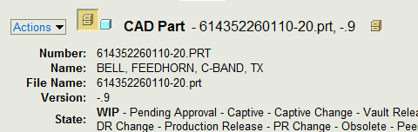
How to decipher Windchill Column Headings
The Number of a CAD object is created only when checked into Windchill for the first time. Windchill copies the File Name (Which was originally typed in as Name in the New CAD object dialog box) and converts it to all caps.
Common Name from the new CAD file creation dialog box becomes the Name in Windchill.
Name from the new CAD object dialog box becomes the File Name in Windchill. It will add the file extension based on the radio button chosen when creating the CAD object.
Manual/Automatic
PTC Common name
Name

Slide 5
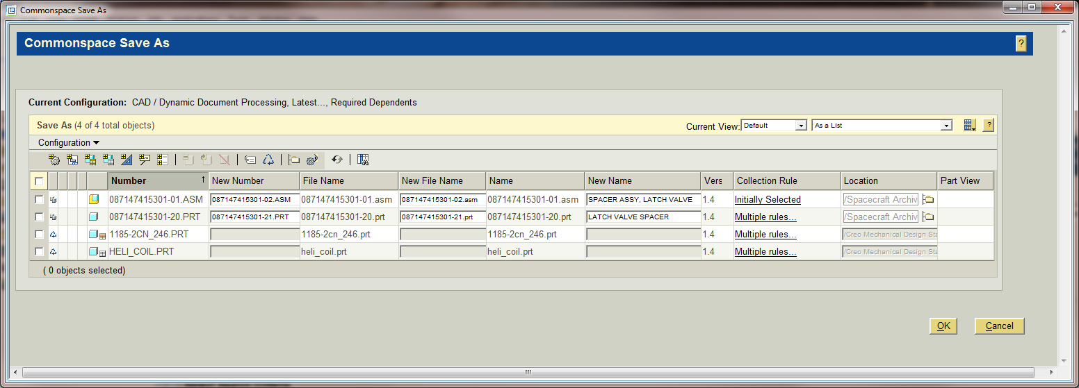
Windchill - Actions> Save As
New Number
New File Name
New name
It is best to save a copy in Windchill rather than in Creo
If in Creo, after using File>Save a Copy… filling in the Common Name in any letter case does not matter, the system will convert any text down to lower case.
There is no opportunity to change the Number during the save process either, so renaming again in Windchill is necessary anyway.

Slide 6
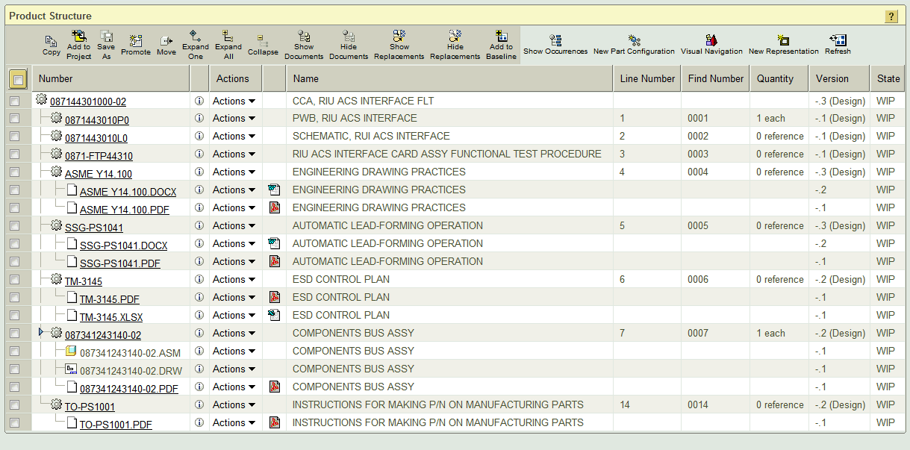
BOM example
If a BOM does not look correct, follow the renaming help on the next slide.

Slide 7
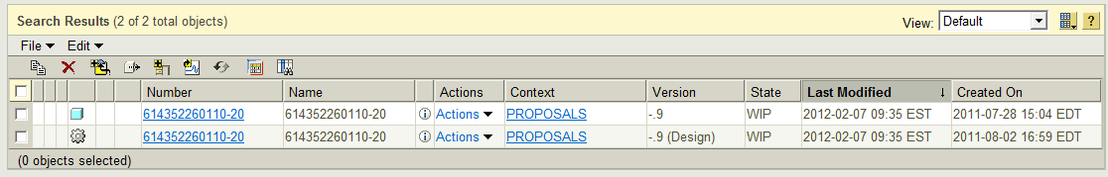
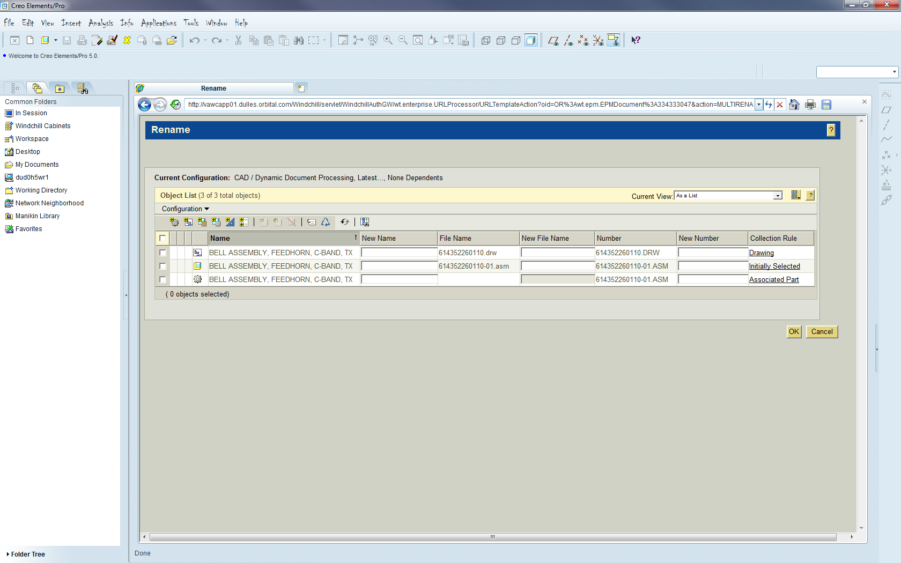
Renaming
Search for model in commonspace
Click on Actions > Rename, next to the CAD Model
Fill in empty boxes to conform to naming standard.
The WTpart is an object collector so it has no filename

