Slide 1
Secure Voting Application
Thomas Simmons, Noah Caldwell, Ricky Matherly, Jalen Keller, Lee Hong

Slide 2

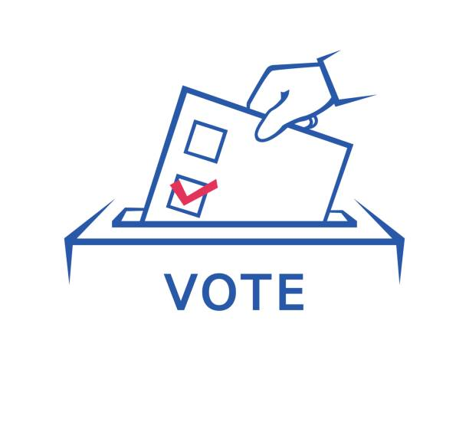
Introduction
For our group project we have developed a secure voting system in Java. This application emphasizes strong defensive programming to ensure as little tampering as possible. Our project attempts to serve as a demonstration of defensive programming principles we have learned in class.

Slide 3
The Data

Slide 4
Database
The database made for this project is a very simple 4 column database. That includes:
Username
Password
Candidate #
Hash
As stated above the database takes in the user input being their login/signup info, and after that it takes in the candidate that the user voted for.

Slide 5
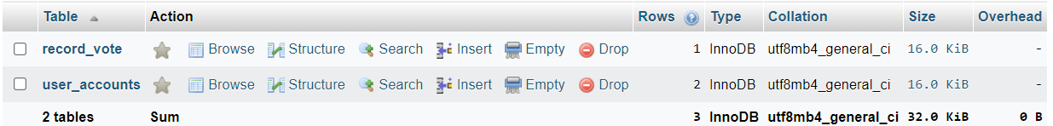
Database Structure

Slide 6
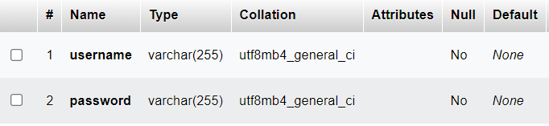
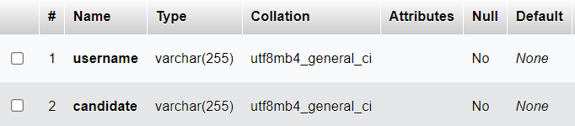
Database Tables Structures
record_vote
user_accounts

Slide 7
Database Backend
If you want to connect to the database, you will need to know three different things. You will need to know:
URL of the database
The Admin’s User
The Admin’s Password

Slide 8
Java GUI
A primary component, especially in Java. Creates a visual representation for creation. It can display the main database, methods and classes that are used for instantiations.

Slide 9
Our Voting Application

Slide 10
System Review
The application consists of a Swing GUI, server side code to connect to a MySQL database, and the MySQL database itself.
The program consists of four classes
VotingApp (main class)
createAccount
Login
Ballot

Slide 11
VotingApp (main class)
The VotingApp (main) class instantiates the program. When instantiated the VotingApp class creates a new JFrame consisting of two buttons: Login, and Sign Up. The Login button creates a new instance of the Login Class and then calls the showLogin method. The showLogin method displays the Login screen. The Sign Up button creates a new instance of the createAccount class and calls the showCreateAccount method.

Slide 12
createAccount
Once the showCreateAccount method is called, a new JFrame displays with two fields: Username and Password. In this GUI element, the user is to enter a desired username and password. When the desired username and password is entered, the login information will be logged to the database, a “Account creation successful” message is displayed, and the user is redirected to the login screen via the showLogin method.

Slide 13
Login
The Login class is a mirror image of the createAccount class with a few minor modifications. The Login class uses the same input validation as the createAccount class, however reads from the database instead of writing to it.

Slide 14
Ballot
The Ballot class allows the user to select a candidate using a radio button. This prevents the user from being able to select two candidates. The candidate, the username, and the vote hash are then logged to the database.

Slide 15
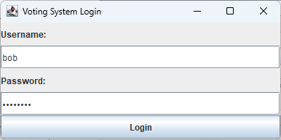
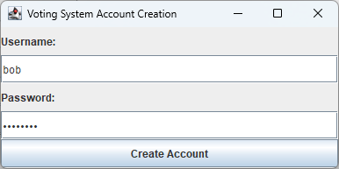
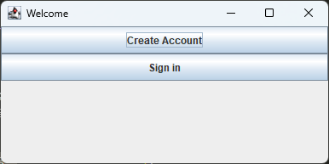
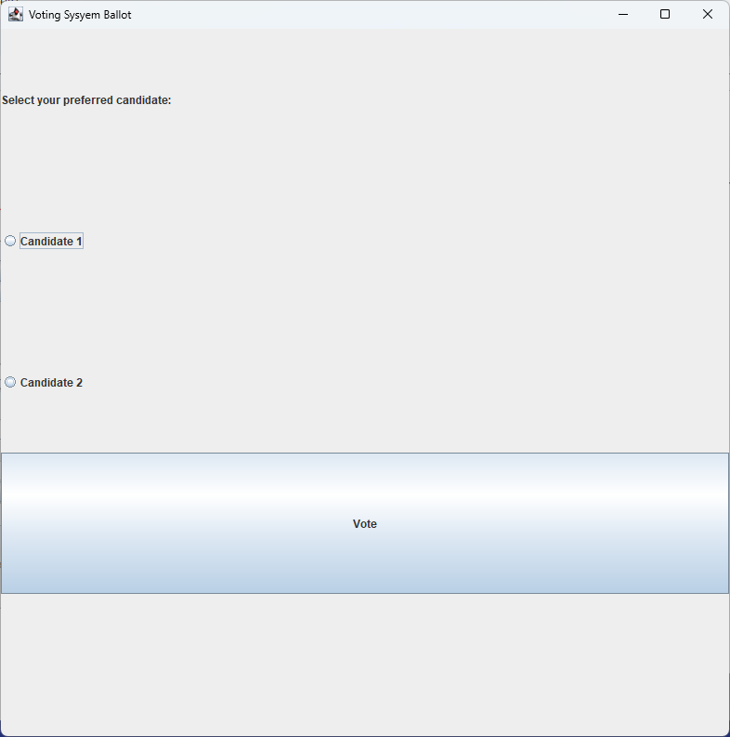
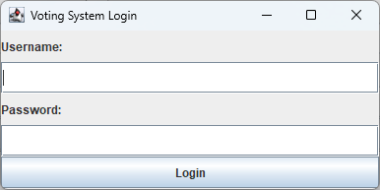
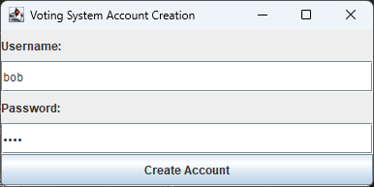
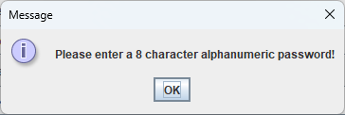
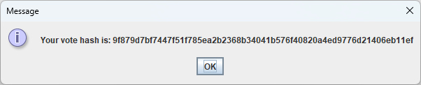
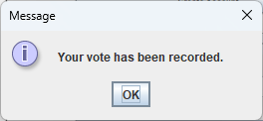
UX Walk Through

Slide 16
This Project has Potential!

Slide 17
Future Research
Unique identification codes: Each user can be assigned a unique identification code that can be used to validate their vote. This code can be sent to the user's email address or mobile phone and can be used to verify their identity when they cast their vote.
IP address tracking: The online voting system can track the IP addresses of users who cast their vote. This can help to identify users who attempt to cast multiple votes using different accounts or devices.
Time-stamping: Each vote can be time-stamped, so that if a user tries to cast a second vote, the system will recognize that the vote has already been cast and will not allow the user to cast a second vote.

Slide 18
Future Research (Cont.)
Password hashing: Due to time constraints, we were unable to implement password hashing techniques. In practice,
IP address tracking: The online voting system can track the IP addresses of users who cast their vote. This can help to identify users who attempt to cast multiple votes using different accounts or devices.
Time-stamping: Each vote can be time-stamped, so that if a user tries to cast a second vote, the system will recognize that the vote has already been cast and will not allow the user to cast a second vote.

Slide 19
Future Research(Cont.)
Blockchain can help with voting by providing a secure and transparent way to record and store votes. It eliminates the need for intermediaries, increases accessibility, and boosts voter confidence in the electoral process. However, implementing a blockchain-based voting system would require careful planning and coordination to ensure its effectiveness and security.

Slide 20
Sources
Seacord, Robert C. Secure Coding in C and C++. 2nd ed., Addison-Wesley
Professional, 2013. OWASP Foundation. "OWASP Secure Coding Practices Quick Reference Guide." OWASP, 2021, https://owasp.org/Top10/A7_2021-Cross-Site_Scripting_(XSS).html#references
Java Documentation. https://docs.oracle.com/en/java/
Java Manual. https://www.java.com/en/download/manual.jsp

Slide 21
Questions?

