Slide 1
‘Little Hand’ as ‘Finger’
Zinan Liang (Tsinam Leung) & Cheng Hei Yim
National University of Singapore & University of Helsinki
A Study of Hand-Diminutive Morphology Strategies in Southern Sinitic varieties
Notes:
Open with the lexical puzzle, not with the theoretical apparatus. The title should feel simple and direct: “little hand” is the hook.

Slide 2
OVERVIEW
Roadmap
The talk follows the data from observation to interpretation.
•
Start from a direct descriptive fact: 手兒 / 手仔 / 手囝 can mean ‘finger’.
•
Show why this is morphologically unusual inside Sinitic.
•
Use CLRPP(Chinese Language Resource Protect Project 中國語言保護工程) data and appendix forms to build a transparent coding scheme.
•
Map the distribution and ask whether it is an areal pattern.
•
Discuss a Kra-Dai-centered diffusion hypothesis, with careful limits.
Notes:
This roadmap tells the audience what each part does. The point is not to dump data, but to show a sequence: observation, coding, distribution, interpretation.

Slide 3
PART 1
A direct descriptive observation
Some varieties express ‘finger’ without an overt 指 morpheme.
•
Many Sinitic varieties use expected forms such as 手指 or 指頭.
•
But descriptive sources and CLRPP entries also show 手兒, 手仔, and 手囝 for ‘finger’.
•
These forms are structurally different because they are built on 手 ‘hand’.
•
The project begins from this small but striking lexical fact.
Notes:
Do not explain too much yet. The audience should first feel the puzzle: the expected finger morpheme is absent, yet the meaning is “finger”.

Slide 4
PART 1
The unexpected pattern
The unusual forms are hand-based, not finger-based.
Form | Literal str ucture | Why it matters
手兒 (e.g., 玉林) | hand + 兒 | hand + child as diminutive marker, Without overt 指
手仔 (e.g., 台山淡村) | hand + 仔
手囝 (e.g., 畬話) | hand + 囝
Notes:
Here introduce the structural formula. X is not treated as the whole explanation. It is the material that lets hand function as a base for a finger expression.

Slide 5
PART I
A typological baseline: ‘finger’ vs. ‘hand’ (WALS Ch. 130)
Brown (2013): 521 of 593 sampled languages differentiate ‘finger’ from ‘hand’ — identity is rare (72/593) and clusters in Australia and the Americas.
•
Where languages differentiate, ‘finger’ built overtly on HAND (e.g. Choctaw ‘son of hand’) is common;
the reverse is unattested — the very structure of Sinitic Type A.
Notes:
This slide should be spoken slowly. It is the main problem of the talk.

Slide 6
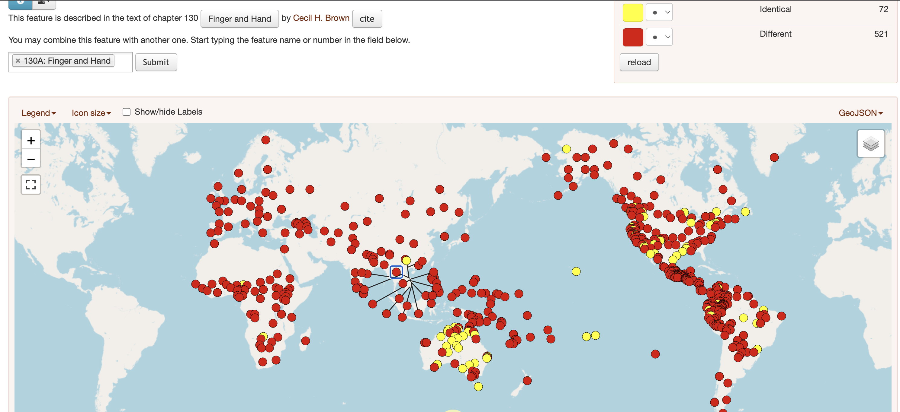
PART I
A typological baseline: ‘finger’ vs. ‘hand’ (WALS Ch. 130)
Notes:
This slide should be spoken slowly. It is the main problem of the talk.

Slide 7
PART II
A more precise formulation
The object of study is a morpholexical template.
HAND + DIM
→
FINGER
•
The template may be realized through 儿, 仔, 囝, or comparable child/offspring material.
The form is analytically important only when the base is HAND and no overt finger morpheme appears.
This prepares the coding distinction between Type A, Type B, and Type C.
Notes:
Here introduce the exact object of analysis. This slide will help later when Kra-Dai and diffusion are discussed: what may diffuse is the template, not necessarily a whole lexical item.

Slide 8
PART III
Why CLRPP?
CLRPP makes it possible to move from examples to distribution.
•
The Chinese Language Resource Protection Project provides broad lexical coverage across local varieties.
•
Body-part terms such as ‘finger’ are basic vocabulary and are suitable for cross-variety comparison.
Entries include locality information, coordinates, phonetic transcription, and Chinese-character transcription.
•
This makes the dataset useful for asking whether a lexical structure has a geography.
•
Notes:
The key justification is simple: a broad dataset is needed to test whether the observed form is scattered or patterned.

Slide 9
PART III
From raw entries to linguistic coding
Selection criterion: every CLRPP entry whose elicited meaning is ‘finger’. Other fields support coding when needed.
Field | Role in this study
Elicited meaning | Selection criterion — every entry tagged ‘finger’
Character transcription | Basis for morphological segmentation
Phonetic transcription | Consulted only when needed — mainly Tai-Kadai later
Coordinates / locality | Map coded types geographically
Language labels | Group entries by Sinitic variety bucket
Notes:
This slide replaces a heavy raw data display. It tells the audience what each field contributes to the analysis.

Slide 10
PART III
The most recurrent forms in the appendix
The most common forms are still finger-base expressions.
Coding category | Source labels included | Classification rule
Northern Mandarin 北方官話 | 北京官话, 东北官话, 冀鲁官话, 胶辽官话, 中原官话, 兰银官话 | Directly coded as Northern Mandarin because the label refers to a northern Mandarin branch.
Southern Mandarin 南方官話 | 西南官话, 江淮官话, 西南方言, 官话西南次方言, 云南方言西南官话 | Directly coded as Southern Mandarin because the label refers to Southwestern or Jianghuai Mandarin.
Ambiguous Mandarin labels | 官话, 北方官话, 北方方言, 官话区, 官话方言区, 北方方言岛 | Resolved by geography rather than by label alone.
Notes:
This chart should make the audience see the baseline. The most frequent forms contain 指 or related finger-base material.

Slide 11
PART III
Northern Mandarin and Jin
Northern zones mainly show 指 / 指頭 morphology.
Dialect bucket | High-frequency forms
Northern Mandarin | 手指頭 118 | 指頭 33 | 手指 22 | 手指頭兒 10
Jin | 指頭 17 | 指頭兒 13 | 手指頭 9 | 指頭子 5
These groups are dominated by overt finger-base forms.
This prepares the later contrast with strict hand-based Type A forms.
Notes:
The key idea is that the presence of 兒 does not automatically make a form Type A.

Slide 12
PART III
Southern Mandarin
Southern Mandarin show more use of diminutive marker.
Form | Count in Southern Mandarin | Analytical note
手指拇兒 | 59 | finger base + Diminutive marker
手指 | 43 | Finger base
手指頭 | 32
指拇兒 | 13 | finger base + Diminutive marker
指頭子 | 7
Notes:
This slide prevents a false explanation: southern varieties may have rich suffixation, but Type A is narrower than suffixation.

Slide 13
PART III
Yue and Pinghua
The puzzle becomes visible where 手兒 and 手仔 appear beside 手指.
Bucket | Finger-lexiconized forms | Hand-Diminutive forms
Yue | 手指 34 | 手兒 3 | 手仔 2 | 手兒指 1
Pinghua | 手指 6 | 手指頭 3 | 手兒 2
•
The mixed form 手兒指 already suggests possible layering or reanalysis.
Notes:
This slide makes the pattern less absolute and more realistic. It is not all or nothing; coexistence is part of the story.

Slide 14
PART III
Min
Min shows especially visible child/diminutive morphology.
Form | Count in Min | Analytical interest
手指 | 13 | overt 指
手囝 (Exclusively on 畬話 Shehua) | 11 | hand + child/diminutive-like
掌頭仔 | 8 | finger-base + diminutive-like material
掌頭囝 | 3
手指仔 / 指囝 | 3 / 2
Southern Min show board use of diminutive marker after finger-base term
Notes:
Use Min to show complexity. The form 手囝 is central, but there are also forms where the child/diminutive element attaches to an already finger-denoting base.

Slide 15
PART III
Wu
Wu shows various morphology of finger
Form | Count in Wu | Analytical note
手指頭 | 20 | finger-base
指頭兒 | 3 | finger-base + Diminutive Marker
節頭管 | 3 | finger-base
手指末頭 | 3 | finger-base
手節頭 | 2 | finger-base
Notes:
Wu helps avoid oversimplification. There are many local ways to name the finger, but Type A remains structurally specific.

Slide 16
PART III
Xiang, Hakka, and Gan
Diminutive Marker used in Southern Sinitic Varieties
Sinitic Bucket | Selected forms | Point
Xiang | 手指腦 14 | 指腦子 3 | finger-base + 子 as diminutive marker
Hakka | 手指 24 | 手指仔 2 | 手子指 1 | finger-base + 仔/子 as diminutive marker
Gan | 手指 15 | 手指腦 12 | 指頭佬 2 | 手指仂 1 | finger-base + 仂 li0 as diminutive marker
Notes:
This slide closes the dialect tour by emphasizing that other forms are interesting but not the main target of the project.

Slide 17
PART IV
Coding principle: three structural types
Three types based on HAND vs. FINGER base ± a diminutive (DIM).
Type | Structure and examples
Type A | HAND + DIM only (no overt finger morpheme) — 手兒, 手仔, 手囝
Type B | FINGER-base + DIM — 手指兒, 手指仔, 指頭兒
Type C | FINGER lexicon, no DIM — 手指, 指頭
Note: Type AB (mixed HAND-DIM + FINGER, e.g. 手兒指, 手仔指) is attested but very rare — treated as a marginal case.
Notes:
This slide teaches the audience how to think with your coding scheme.

Slide 18
PART IV
Why code these forms at all?
Separate a real pattern from coincidence — are Type A forms clustered or scattered?
Group by language bucket and geography to test areal vs. inherited explanations.
Sets up the diffusion question in Part V.
Notes:
This is the methodological core of the project. Emphasize that the categories are not arbitrary labels; they come from morphological structure.

Slide 19
PART IV
Type B
Type B shows that diminutive availability alone cannot explain Type A.
Type B
Type A
•
手指兒
•
手兒
•
手指仔
•
手仔
•
指頭兒
•
手囝
•
The base already means ‘finger’.
•
The base is 手 ‘hand’.
Notes:
This slide should be used to prevent the audience from thinking the talk is simply about diminutives.

Slide 20
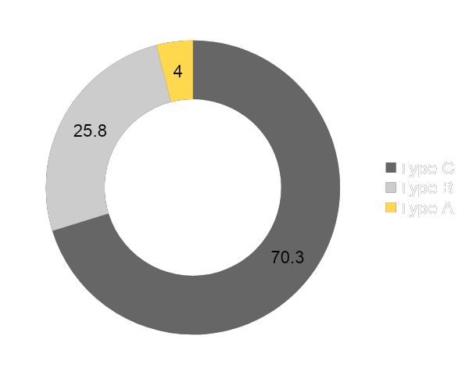
PART V
Overall distribution
Type A is rare in the full Sinitic dataset.
Type | Count | Share
Type C | 917 | 70.3%
Type B | 336 | 25.8%
Type A | 52 | 4.0%
Notes:
Use this slide as a twist: after all the work of coding, the phenomenon is only 4%. But that makes the geography more important, not less.

Slide 21
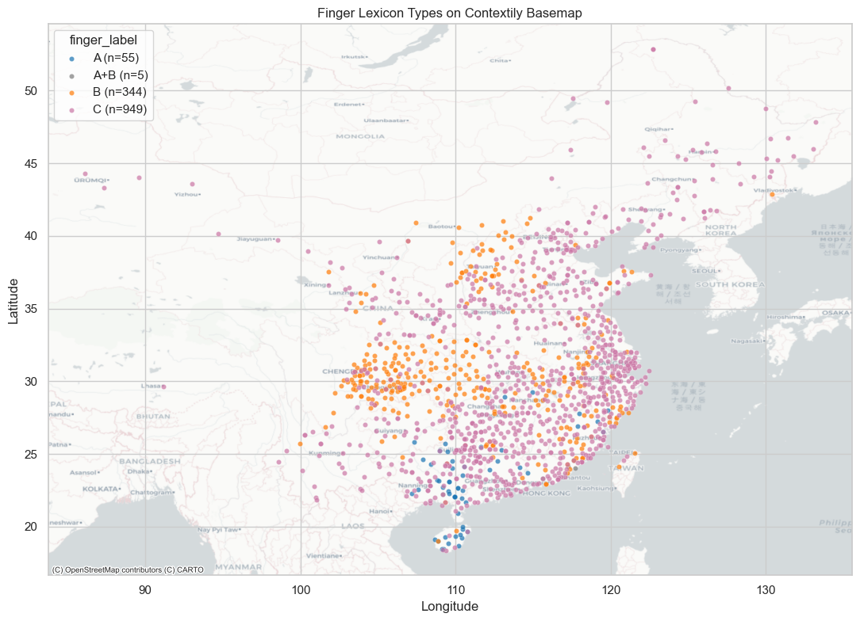
PART V
Overall distribution
Notes:
Use this slide as a twist: after all the work of coding, the phenomenon is only 4%. But that makes the geography more important, not less.

Slide 22
PART V
Main distributional finding
Type A is rare overall, but geographically patterned.
•
It is not a general Sinitic strategy.
•
It is not simply the result of having diminutive morphology.
It is a restricted southern pattern that requires an areal interpretation.
Notes:
This slide states the main result of the Sinitic part. It should be the audience’s takeaway before you move into Kra-Dai.

Slide 23
PART VI
Why bring in Kra-Dai?
The Sinitic cluster overlaps with long-term Sinitic-Kra-Dai contact zones.
•
Guangxi and Hainan are not only Sinitic spaces; they are historically multilingual contact zones.
•
Southern Sinitic varieties have long coexisted with Kra-Dai languages and other regional languages.
•
If Type A is geographically southern and contact-zone concentrated, Kra-Dai comparison becomes necessary.
•
The question is not whether every case is borrowed, but whether the pattern is areally compatible.
Notes:
Use “Kra-Dai” rather than “Tai-Kadai” if following the professor’s suggestion. This slide justifies the comparison; it should not sound like a sudden detour.

Slide 24
PART VI
Main distributional finding
A Telling Geographic Overlap
Type A concentrations in Sinitic map onto Tai-Kadai contact provinces
Province | Sinitic Type A | Tai-Kadai Type A-like
Hainan 海南 | 72.2% (n=18) | 16.7% (n=6)
Guangxi 廣西 | 23.4% (n=111) | 22.7% (n=22)
Guizhou 貴州 | 4.0% (n=25) | 29.4% (n=17)
Guangdong 廣東 | 7.9% (n=76) | 33.3% (n=3)
Yunnan 雲南 ⚑ | < 1% | 2.6% (n=39) — largest TK sample
⚑ Yunnan — the largest Tai-Kadai sample — shows only 2.6%. Overlap is specific, not general.
Notes:
This slide states the main result of the Sinitic part. It should be the audience’s takeaway before you move into Kra-Dai.

Slide 25
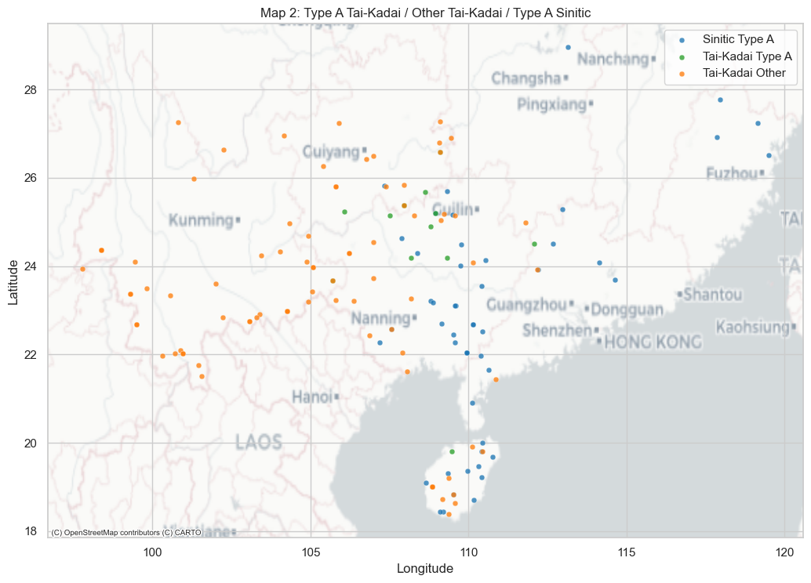


PART VI
The Kra-Dai side is not merely sporadic
Notes:
This slide incorporates the professor’s constructive comments. Phrase it as strengthened comparative context unless all Kra-Dai data have been fully rechecked.

Slide 26
PART VI
The Kra-Dai side is not merely sporadic
Comparative feedback suggests a stronger Kra-Dai pattern than the initial deck showed.
•
Northern Tai / Northern Zhuang varieties frequently show a ‘child/son + hand’ strategy for ‘finger’.
•
Kam-Sui languages reportedly show the same strategy as a regular pattern.
•
Ong-Be / Lingao in Hainan is crucial because of direct relevance to Hainan Sinitic.
•
This makes the Sinitic Type A pattern look less isolated and more areally embedded.
Notes:
This slide incorporates the professor’s constructive comments. Phrase it as strengthened comparative context unless all Kra-Dai data have been fully rechecked.

Slide 27
PART VI
Northern Tai / Northern Zhuang
Northern Tai provides a strong comparative anchor for Type A.
Domain | Reported pattern | Relevance
Northern Tai / Northern Zhuang | child/son + hand for ‘finger’ | systematic Type A-like strategy
Wuming Zhuang | lɯk + faɯ (Child + hand) | clear micro-example
The important point is not one example, but may reflect Tai contact
This makes parallel isolated innovation less likely as the only explanation.
Notes:
Do not overclaim if you have not fully incorporated all Northern Tai data. Present this as a stronger comparative clue.

Slide 28
PART VI
Kam-Sui should be brought into the comparison
Kam-Sui may be crucial for showing that Type A is not only a Zhuang fact.
•
Kam, Mulam, Sui, and Maonan are reported to express ‘finger’ with comparable hand + child/offspring constructions.
•
If this holds across the branch, the Type A-like pattern is broader within Kra-Dai than the initial comparison suggested.
•
Kam-Sui therefore strengthens the idea of a shared regional morpholexical innovation.
•
This should be added to the discussion as a necessary expansion of the comparative dataset.
Notes:
This slide gives Kam-Sui its own place rather than hiding it in a bullet. It is important because it broadens the Kra-Dai side of the argument.

Slide 29
PART VI
Ong-Be / Lingao and Hainan
Ong-Be is crucial because Hainan is where Sinitic Type A is strongest.
•
Hainan Sinitic has a striking concentration of Type A forms in the current dataset.
•
Ong-Be / Lingao is the relevant Kra-Dai language with long-term contact in the Hainan-Leizhou region.
•
If Ong-Be systematically shows a child + hand strategy for ‘finger’, it becomes a strong candidate source or mediator.
•
This shifts the discussion from “contact-compatible” to a more concrete Hainan contact scenario.
Notes:
This is one of the most important additions from the professor’s feedback. The claim should remain conditional unless you have checked multiple Ong-Be dialects.

Slide 30
PART VI
Central Tai and the importance of contrast
Not all Kra-Dai branches behave the same way.
•
Many Central Tai / Southern Zhuang varieties retain a dedicated finger root cognate with Proto-Tai *ni:wC.
•
This means Kra-Dai itself contains both Type A-like and Type C-like strategies.
•
Type A exceptions in Central Tai areas may reflect contact, borrowing, or subgrouping issues.
•
The unevenness is important because areal diffusion is not expected to be uniform.
Notes:
This slide prevents overgeneralizing Kra-Dai. The contrast makes the diffusion hypothesis more nuanced.

Slide 31
PART VI
Contact: southern Sinitic shares its ‘finger’ typology with Kra-Dai
The asymmetry points to a Kra-Dai-centered template adopted into Sinitic through sustained contact.
•
The pattern is systematic in Kra-Dai — Northern Tai, Kam-Sui, and Ong-Be — but rare and patchy in Sinitic.
•
Sinitic Type A concentrates exactly where historical contact was heaviest: the far south and Hainan.
•
What spread was a morpholexical template, not just individual words — the mechanism either way is contact.
•
Central Tai unevenness matches the expected signature of contact diffusion.
Notes:
This is the strongest version of the revised argument while still remaining cautious.

Slide 32
PART VII
A hypothesis, not final proof
The evidence supports a contact account; direction and chronology remain open.
•
Strong: the cross-family asymmetry and the Hainan contact link via Ong-Be / Lingao.
•
Open: the chronology and exact pathways of adoption into Sinitic.
•
Open: speaker-level variation and ongoing change.
•
Next step: historical and lexical comparison to ground the areal account.
Notes:
This slide makes the added comparative section clear and digestible.

Slide 33
PART VII
Final takeaway
“Little hand” is not just a cute lexical form; it is a clue to how morphology, body-part categorization, and contact history intersect.
The data is attractive because the pattern is visible once the forms are carefully coded.
The theory should support the data, not overwhelm it.
The central contribution is to make a small morpholexical pattern visible as an areal problem.
Notes:
This is a good closing slide for an academic presentation. It sounds interpretive but remains grounded in the data.

Slide 34
CLOSING
Selected references
•
Brown, Cecil H. 2013. Finger and Hand. World Atlas of Language Structures Online.
•
Chappell, Hilary. 2017. Languages of China in their East and Southeast Asian Context.
•
Enfield, N. J. 2017. Language in the Mainland Southeast Asia Area.
•
Jurafsky, Daniel. 1996. Universal Tendencies in the Semantics of the Diminutive.
•
Kwok, Bit Chee. 2016. 粵語方言小稱變音的類型及其歷史來源.
•
Pittayaporn, Pittayawat. 2009. The Phonology of Proto-Tai.
Wang et al. 1984; Zhang et al. 1999; Liang & Zhang 1996. Kra-Dai comparative lexical sources.
Notes:
Keep the references slide readable. Add full details once you verify the exact bibliographic entries.

Slide 35
Acknowledgement
Thank You For Listening!
Q & A
Liang Zinan & Cheng-Hei Yim
zinan.liang@u.nus.edu
ching.yim@Helsinki.fi
Thanks to Dr. Liao hanbo for constructive Tai-Kadai comments.
Notes:
This acknowledgement can be placed before references or at the end. If using unpublished comments in the written paper, cite as personal communication if appropriate.

