Slide 1
SecEdge: Place Edge Applications with Network Security Components
Chengjun Jia
2020/01/08
Notes:
Good morning, everyone. I am honored to be here to present my final project: SecEdge, place edge applications with network security components.

Slide 2
Contents
Background
Edge Computing
Network Security Implementation
Problem & Challenges
SecEdge
Edge NSC Placement
Evaluation
Related Works
Conclusion
Notes:
I will show my presentation as the following six parts.

Slide 3
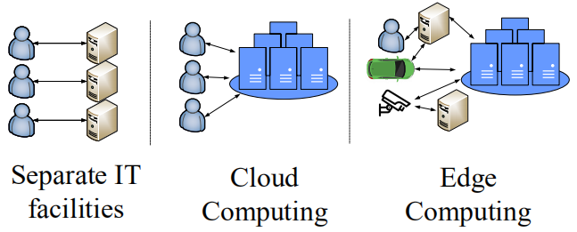
Edge Computing
Computing Infrastructure is developing
Mainframe → PC/Servers → Cloud Computing → Edge Computing
Notes:
First of all, let’s see some background about Edge Computing. Computing Infrastructure is developing, from Mainframe: one big machine and many monitors. To PC or personal servers which are separate. To Cloud Computing. I think we all know about Cloud Computing. Then what’s next after Cloud Computing. Many people think it is the Edge Computing.

Slide 4
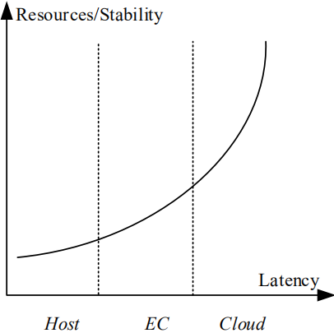
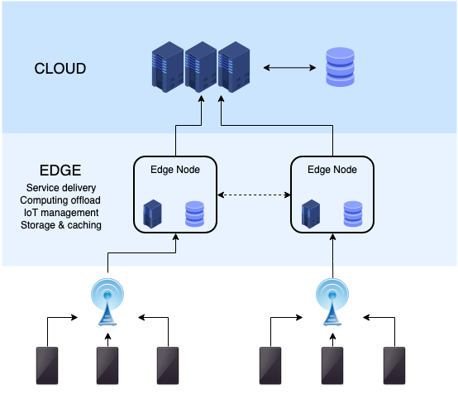
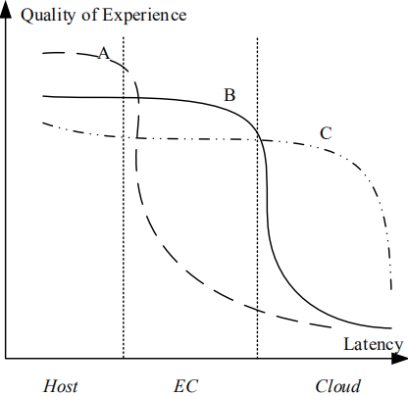
Edge Computing Infrastructure
Application Features:
- 10ms latency is OK
- More resources needed
Potentials:
- Cloud Computer/Games
- Video Analysis
- IoT
Notes:
Edge Computing is very easy to understand. Let’s see the picture. We can add some computation resources between Cloud and Host to help us compute faster. We can think about these resources as the right picture. From Host to Edge Computing to Cloud, the computation resources or the stability is increasing; the latency from host is also increasing. Computation at the Host is about 1ms while at Edge, the network latency will be about 10 ms and to Cloud it will be 100ms. Some applications are very sensitive to latency, such as self-driving car. We can the curve of A in the picture. Some are not very sensitive, such as download a file, we can see the curve C. There are some applications which are a little sensitive. [C] For them, 10ms latency is OK and they need more resources than Host. These applications include Cloud Computer, Cloud Games, Video Analysis and some IoT applications.

Slide 5
Edge Computing Development
Concept
Cloudlet: CMU(2008-), extensions to OpenStack: OpenStack++
Fog Computing: Cisco(2015-)
Multi-access EC: ETSI(2014-)
Companies
AWS(Cloud Provider): AWS IoT for the Edge
Fastly(CDN Provider): Content -> Function Delivery
AT&T(ISP): MEC
Open Project
Cloud Native Computing Foundation (LF): KubeEdge(Huawei)，K3S(Lightweight Kubernetes distribution built for IoT&EC)
Linux Foundation Edge: Edge XFoundry, HomeEdge...
Notes:
Next, let us see the development of edge computing. [C] There are many different concepts provided by different teams. For example, Cisco gives the concept of Fog Computing which means that computing can happen in the network devices. [C] There are also many companies, Cloud Provider, CDN Provider and ISP all want to provide their own solutions of Edge Computing.[C] Besides, there are many open projects from Linux Foundation.
值得一提的是，CNCF下属除了KubeEdge还有很多Sandbox的project，例如针对telemetry的open telemetry、针对networking、storage、monitor和security都有一些项目，kubeedge是其中针对edge的sandbox项目。 Kubernetes项目是CNCF的毕业项目(graduated project)
ETSI: european telecommunications standards institute

Slide 6
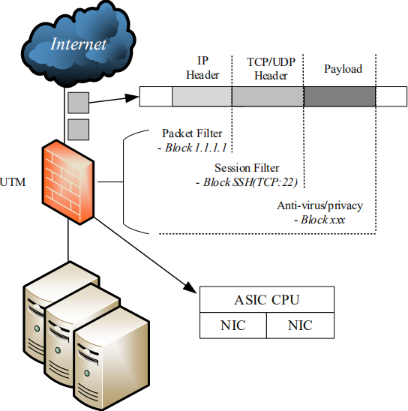
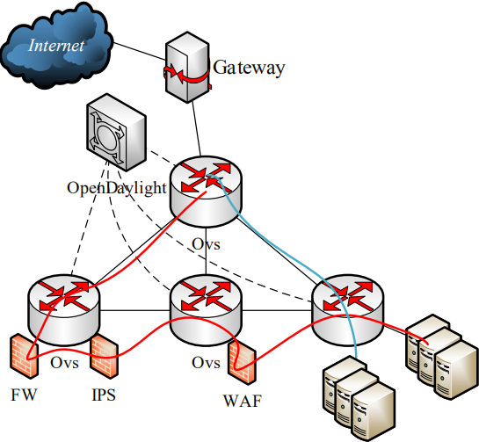
Network Security Develops
Hardware: MiddleBox
Hillstone SG-6000 E1100
In Cloud
Software & Virtualization
NFV, Service Function Chain
In Edge？
?
Notes:
We have known that Network Security Implementation develops with the computing infrastructure. At the beginning, we have hardware as a middlebox and we have learned to use the Hillstone Device. When it comes to Cloud, we use NFV to make a service function chain

Slide 7
Contents
Background
Edge Computing
Network Security Implementation
Problem & Challenges
SecEdge
Edge NSC Placement
Evaluation
Related Works
Conclusion

Slide 8
NS Implementation in EC
Compared with Cloud
Limited computation resources
EC applications are sensitive to latency
Instead of LAN, WAN/SD-WAN
Requirement
Occupy as few resources as possible
Erase useless stages as much as possible
Zero-Trust (Do not make a SFC in many nodes)

Slide 9
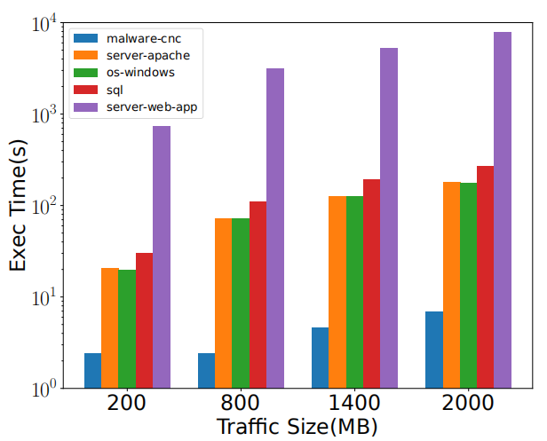
How NS works?
Some methods+many Rulesets
IP Block(FW): DDoS(SYN/UDP Flood)
Regular Expression(DPI): Malware, XSS, SQL Injection
Statistic Analysis/Machine Learning...
But the performance of rulesets differ a lot
Notes:
two order of magnitude

Slide 10
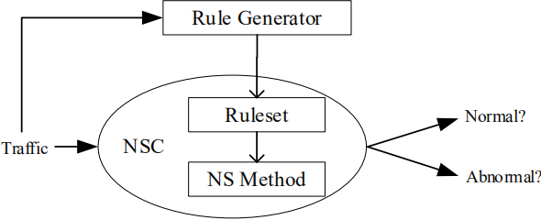
Redefine NS module: NSC
Luckily, we can separate the method and ruleset
In Cloud, provider does not know what application is running, IaaS
In EC, provider can know exactly, SaaS
We can combine ruleset + method --> NS Component
schedule for fine-grained computation resources

Slide 11
Contents
Background
Edge Computing
Network Security Implementation
Problem & Challenges
SecEdge
Edge NSC Placement
Evaluation
Related Works
Conclusion

Slide 12
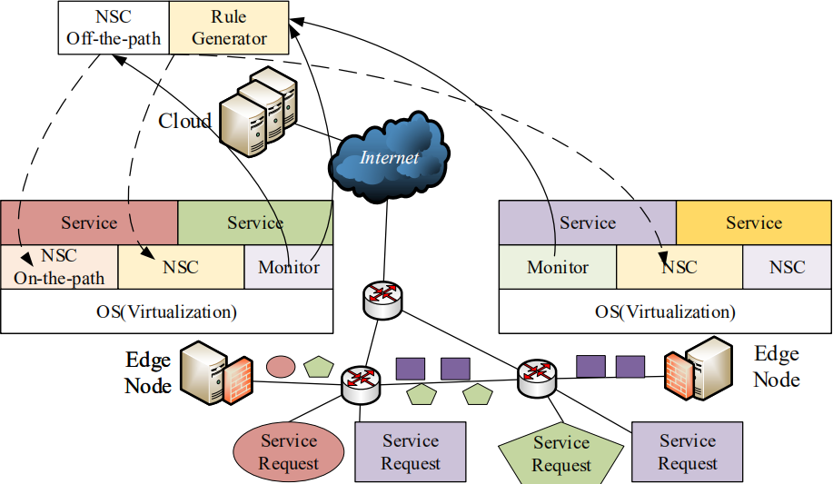
SecEdge Infrastructure

Slide 13
SecEdge Infrastructure
On-the-path NSCs are all at the Edge
Off-the-path NSCs are in the Cloud

Slide 14
SecEdge Infrastructure
Edge Services and corresponding on-the-path NSCs are at the same Edge node
- We do not want to schedule traffic throught many nodes

Slide 15
SecEdge Infrastructure
Monitor mirrors traffic/ extract the feature to Rule Generator to generate rules
- It works for new attacks such as DDoS.

Slide 16
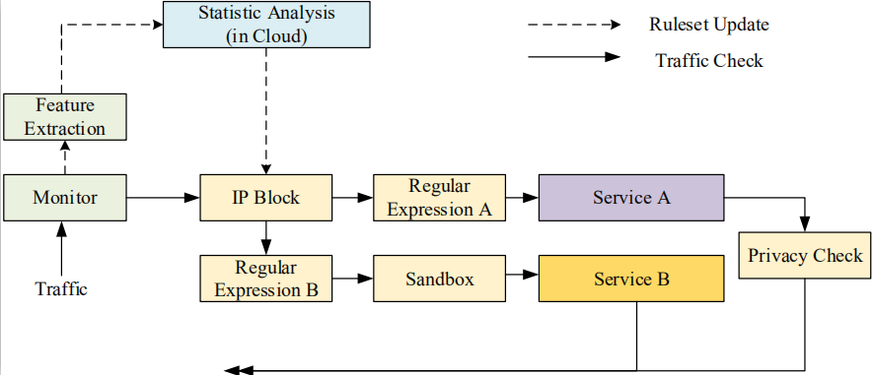
Edge Node Infrastructure

Slide 17
Edge Node Infrastructure
Some NSCs only work for a service, we should separate them to reduce the response latency of other services.

Slide 18
Edge Node Infrastructure
The same NS method with different rulesets are different NSCs.

Slide 19
Edge Node Infrastructure
Some NSCs can be sharable, which can work for multiple services to save computation consumption.

Slide 20
Which service should be placed at which edge node?

Slide 21
It is an optimization problem
Target:
minimize: weighted sum of computation consumption and total application response latency
Constraints:
computation constraint for each node
bandwidth constraint for each node
traffic amount for each service from different hosts
Special Conditions
non-linearity in computation consumption

Slide 22

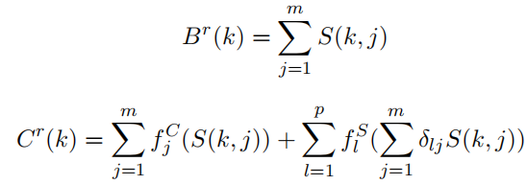






Mathematical Expression
min
s.t.
where
It is a Mixed Integer Linear Programming Problem

Slide 23
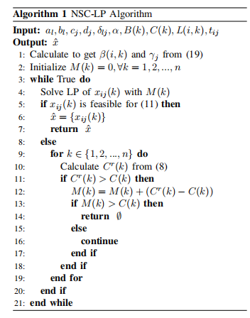
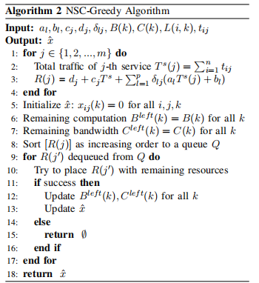
Heuristic Algorithms

Slide 24
Contents
Background
Edge Computing
Network Security Implementation
Problem & Challenges
SecEdge
Edge NSC Placement
Evaluation
Related Works
Conclusion

Slide 25
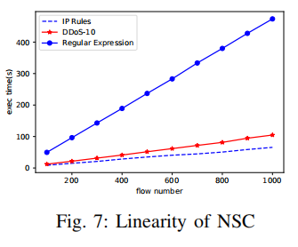
Evaluation
Demonstrate the linearity assumption in the math model

Slide 26
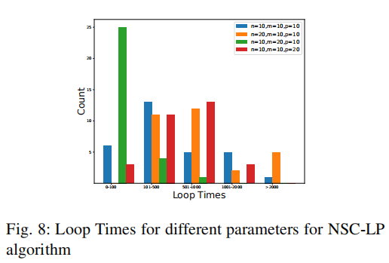
Evaluation
NSC-LP: loop times are not high
always less than 1000 times

Slide 27
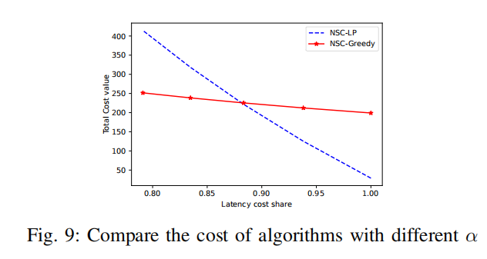
Evaluation
NSC-LP works better for latency
NSC-Greedy works better for resources

Slide 28
Contents
Background
Edge Computing
Network Security Implementation
Problem & Challenges
SecEdge
Edge NSC Placement
Evaluation
Related Works
Conclusion

Slide 29
Related Works
EC with NS
Authentication
NS with EC
DDoS (kill the traffic early)
better privacy for IDS (do not upload traffic to Cloud)

Slide 30
Contents
Background
Edge Computing
Network Security Implementation
Problem & Challenges
SecEdge
Edge NSC Placement
Evaluation
Related Works
Conclusion

Slide 31
Conclusion
Requirement
Occupy as few resources as possible
Edge NSC Placement
Erase useless stages as much as possible
NSC: combine ruleset, separate rule generator
Zero-Trust (Do not make a SFC in many nodes)
Security defined in each node
SecEdge satisifies these requirements

Slide 32
Thanks & QA

