Slide 1



Optimizing Cost and Performance for Content Multihoming
Hongqiang Harry Liu
Ye Wang
Yang Richard Yang
Hao Wang
Chen Tian
Aug. 16, 2012
Notes:
Good afternoon Everyone
Today I will present our study on how to leverage multiple content delivery networks to achieve efficient content services.
This is a joint work with Ye Wang, Richard Yang, Hao Wang from Google and Chen Tian.
<click>

Slide 2


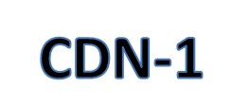
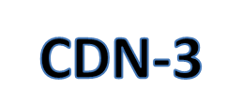



Content Multihoming is Widely Used
Content Publisher
Content Viewers
Notes:
Content multihoming means content publishers (such as Netflix and Hulu who own and serve content objects) utilize multiple CDNs to serve content requests. The content publisher is able to select one or more than one CDNs to serve a content viewer.
Many content publishers are currently using content multihoming. In our recent survey, we found that Hulu, Netflix, Facebook, MSNBC, Microsoft, etc., all use multiple CDNs.

Slide 3
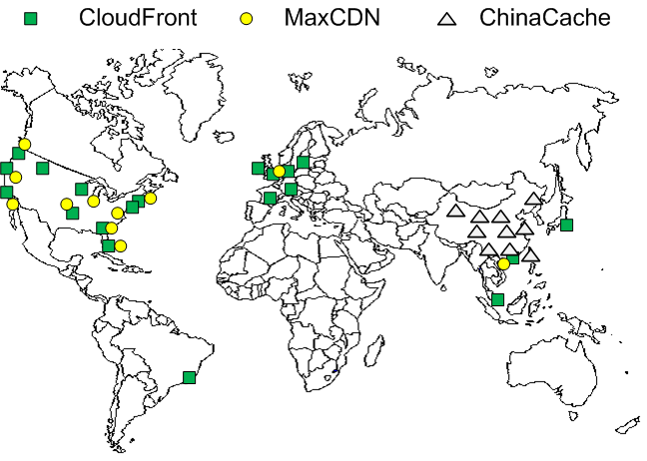
Why Content Multihoming:
Performance Diversity
Notes:
First let us understand the motivation of content multihoming.
Content multihoming is adopted to address a basic problem of today’s CDN infrastructures: a single CDN’s coverage is usually limited and its performance and cost diverse much in different regions.
First we look at the performance diversity. This picture shows the footprint of three real CDNs.
We can see that China Cache has more edge servers in China. CloudFront has edge servers in South America while the other two do not. And the performance of a CDN in a region is usually decided by the edge servers deployed in that region.

Slide 4
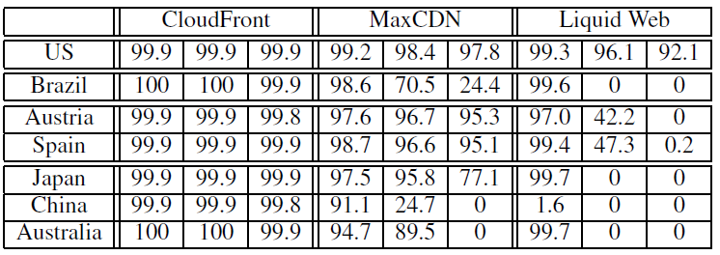
Why Content Multihoming: Performance Diversity
Table: The fraction of successful deliveries for objects with streaming rate of 1Mbps | 2Mbps | 3Mbps.
Diversity in different areas
Diversity in different streaming rates
Notes:
We demonstrate performance diversity with a measurement on three CDNs. We control clients from different regions to repeatly request for three videos with 1,2 and 3 Mbps video rates for 48 hours. Our performance metrics is the fraction of successful content deliveries (no lag in video playing) for different regions and different video rates. The values in the cells are percentage and each column inside a CDN is for a particular streaming rate.
From this table, we observe that a single CDN’s performance is various in different regions. Additionally, the CDN’s performance is also related with some object properties, such as streaming rate.

Slide 5
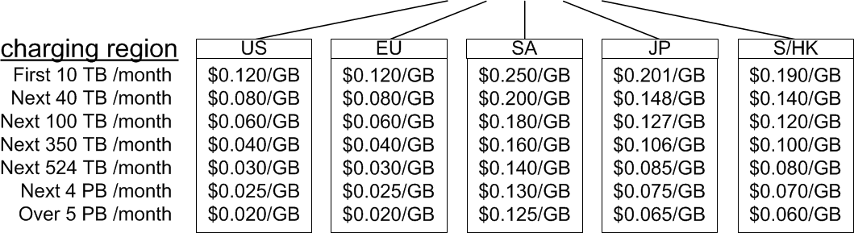
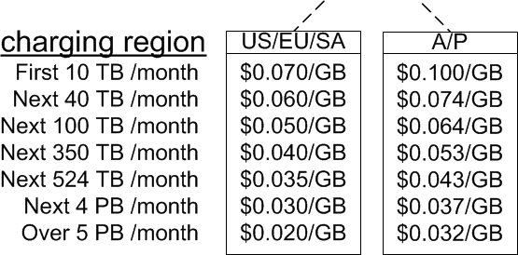
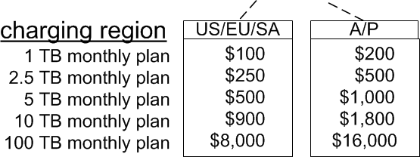
Why Content Multihoming:
Cost Diversity
Amazon CloudFront
Volume in a charging period
Concave Function
Region Based
MaxCDN
LiquidWeb
Notes:
Next we look at cost diversity. This is the price structure of Amazon CloudFront. There are three interesting points shown here. First, the final charge of the CDN usage is based on the total traffic volume in a charging period (one month here). Second, the more you use, the more discount you have. This results in a concave charging function. Third, the prices in different regions are different. The total charge is the sum of all regions.
This is a typical “pay-as-you-go” model which is used by many CDNs. But each CDN has their own definition of charging regions.
Another charging model is “plan-based”, which means a fixed charge is made for a usage commitment, but it is still regional.
There are more complex charging models such as percentile based charging.

Slide 6
Our Goal
Design algorithms and protocols for content publishers to fully take advantage of content multihoming to optimize
  publisher cost and
  content viewer performance.
Notes:
Given the preceding observations, our goal is easy to state. Our goal is to design algorithms and protocols…

Slide 7
Key Question
A content object can be delivered from multiple CDNs, which CDN(s) should a content viewer use?
Notes:
To reach the goal, we ask the following key, simple question:

Slide 8
Key Challenges
Online vs statistical CDN performance
  e.g., real-time network congestions or server overloading
Complex CDN cost functions
  e.g., the cost of assigning one object to CDN(s) depends on other assignments => coupling
Notes:
There are two key challenges to answer the key question.
First, on one hand, the performance of an individual delivery session depends on real-time random events, such as network congestion and server overload. On the other hand, for feasibility and scalability, optimizing CDN selection should use long-term, aggregated statistics. Therefore, how to handle the difference between online performance and long-term statistics based optimization?
Second, as we have seen, CDN charging functions can be complex.
The cost of one object assignment depends on the other assignments.
Given such dependency, straightforward methods, such as exhaustive enumerations, can lead to exponential complexity.

Slide 9


Our Approach: Two-Level Approach
Efficient Optimal Object Assignment Algorithm
Guidance from Content Publishers
Local, Adaptive Clients
Notes:
We design a two-level approach to address preceding challenges and achieve our goal.
On the global level, we design an efficient optimal object assignment algorithm. This algorithm uses long term statistics, satisfies performance constraints and minimizes CDN cost.
The at each content viewer, we implement a local, adaptive client download scheduling algorithm. The local clients protect online performance by adapting to real-time, random events and download form multiple CDN servers.
These two levels are connected by the guidance from content publishers to clients. Then the clients perform the adaptation with respects on publishers’ global optimization.

Slide 10
Roadmap
Motivations
Global optimization
  Problem definition
  CMO: An efficient optimization algorithm
Local active client adaptation
Evaluations
Notes:
This is the road map our the following talk. We will look into the global level optimization and active client adaptation. Finally, I will show the evaluation results of both of them.

Slide 11
Roadmap
Motivations
Global optimization
  Problem definition
  CMO: An efficient optimization algorithm
Local active client adaptation
Evaluations
Notes:
For global optimization , let us first precisely formulate the problem.

Slide 12



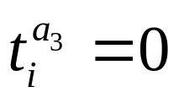


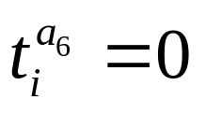




Problem Definition:
Network Partition
Location Area
Global Network
Exclusion
Location Object
Object-i
Notes:
Given a global network, the content publisher partitions it into multiple location areas such as cities, states, or countries. The definition of location areas can be content publisher dependent.
The content publisher publishes a set of content objects. An object-i generates t_i traffic in total. This traffic distributes into location areas. We define a notion of “location object”, which is the amount of traffic of an object towards an area.
If an object should not be distributed to a location area, say due to licensing constraints, its traffic volume is zero in the location area.

Slide 13


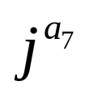
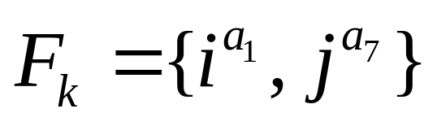
Problem Definition:
CDN Statistical Performance
Global Network
Target Performance: 90%
99%
80%
92%
Statistical Performance: e.g., probability of successful deliveries in an area
CDN-k
Notes:
Now, we introduce performance constraints on selecting CDNs. For concreteness, we use the performance metric of “the probability of successful delivery in an area”. One can define other performance statistics.
We assume that a content publisher has a target performance, say 90%, and each CDN that the publisher selects for an area should achieve no less than this target.
For example, the performance in a1 is 99% so i^a1 can be assigned to CDN-k, i^a2 can not and j^a7 can.
We introduce F_{k} as the set of all location objects that can be assigned to CDN-k.

Slide 14
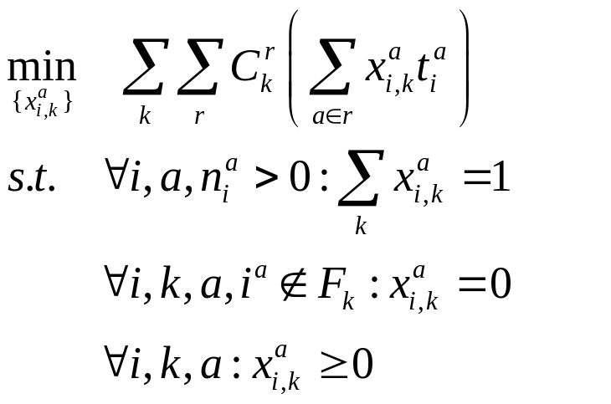

Problem Definition:
Optimization Formulation
Problem Q
Charging function in region r of CDN-k
Traffic volume in charging region-r of CDN-k
All requests are served
Performance constraints
is the fraction of traffic put into CDN-k for location object
Notes:
With the preceding definitions, we introduce the problem definition which we call problem Q. The component in the blue circle is the traffic volume in charging region-r of CDN-k. The one in the red is the charging function in region-r of CDN-k. The objective function is the total CDN cost.
The first constraint states that all requests should be served.
The second constraint states the performance constraints. For any location object that is not in Fk, the fraction should be 0, i.e., not use the CDN.

Slide 15
Solving Problem Q:
Why not Standard Convex Programming or LP
To minimize a concave objective function
Problem scale is too large to be tractable:
  N objects, A locations and K CDNs =>
  N*A*K variables, and N*K constraints
  For example, given N=500K, A=200 and K=3 =>
  300M variables and 100M constraints
Notes:
How to solve Problem Q? One might wonder that it is standard mathematical programming. Unfortunately no generic solver we know of can handle Problem Q due to two reasons.
First, notice that problem Q has a concave objective function, not a convex objective function.
Second, the scale of Problem Q can be quite large.

Slide 16
Roadmap
Motivations
Global optimization
  Problem definition
  CMO: An efficient optimization algorithm
Local active client adaptation
Evaluations
Notes:
Next I will introduce our efficient algorithm to solve problem Q. It is called content multihoming optimization (CMO)

Slide 17
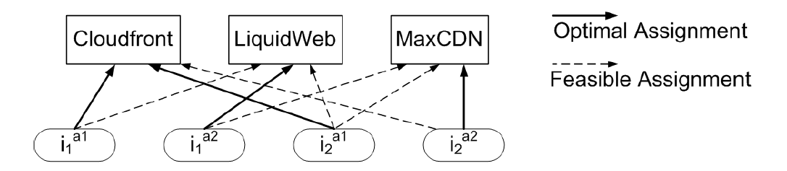
Developing the CMO Algorithm: Base
Problem Q has an optimal solution which assigns a location object into a single CDN.
The object assignment problem is still hard:
Assignment Space
K CDNs and
N location objects
=>
K^{N} assignment
possibilities
Notes:
CMO starts from a basic observation that there is one optimal solution of problem Q which assigns a location object into a single CDN.
This observation transfers problem Q into an object assignment problem. Each location object has some feasible assignments, and we are searching for the optimal object assignment to the CDNs.
However, the object assignment problem is still hard, because the number of potential assignments is exponential with the number of #objects which can be huge.

Slide 18





CMO Key Idea:
Reduction in the Outcome Space
Assignment Space
Outcome (CDN Usage) Space
Infeasible Assignments
There are only vertices points, where is the # of charging regions (a small #)
There are up to points with CDNs and location objects
Notes:
An assignment defines a CDN usage, which we call outcome, which further decide the CDN cost.
Instead of looking into assignment space directly, let us look into the outcome space.
Each assignment is mapped to a point in the outcome space.
Therefore, we have exponentially many of outcome points.
According to performance constraints, there can be some infeasible assignments and we remove them and their outcomes from the spaces.
The key idea of CMO is that it only enumerates the vertices of the convex hull formed by all outcome points.
We prove that the #vertex is polynomial with the number of objects.
CMO directly finds the vertices. The algorithm and the proofs of its correctness is in the paper.

Slide 19

















Mapping From Object Assignment to Outcome
Location Objects
Traffic in Area-1
Traffic in Area-2
CDNs | CDN-1 | CDN-2
Traffic in Region-1
Traffic in Region-2
Example assumption: Area-i is in charging Region-i
Notes:
An assignment is complicated, but its outcome is simple.
This is a simple example showing the mapping from an object assignment to an outcome.
Suppose we have four location objects, there is an assignments putting the first 3 into CDN-1 and the last into CDN-2.
We then get a matrix showing the traffic volume in each charging region of each CDN. It is a point in a 4D linear space.

Slide 20
Extensions
CDN subscription levels (e.g. monthly plan)
  Introducing CDN capacity constraints
Per-request cost
  Adding a row which indicates the #request in outcome
Multiple streaming rates
  Considering each video at each encoding rate as an independent object
Notes:
Problem Q is a basic setting for content multihoming. It can also be extended to handle some practical concerns.
We show three examples. First, for the plan-based charging model, we can introduce CDN capacity constraints into problem Q. Then the cost of a plan is fixed with an upper bound of volume in the CDN.
Most of the CDNs also charge on #request. This cost is important to small object delivery, such as images. By adding a row which indicates the #request in outcome space, we can consider both traffic and per-request costs in our model. We will have an example for this in next slide.
In dynamic streaming, one video has multiple encoding rates. By considering each video at each encoding rate as an independent object, CMO naturedly supports dynamic streaming.

Slide 21







Extension Example: Per-request Cost
Location Objects
Traffic in Area-1
Traffic in Area-2
#Request
CDNs | CDN-1 | CDN-2
Traffic in Region-1
Traffic in Region-2
#Request
Example assumption: Area-i is in charging Region-i
Notes:
Here is an example to show how CMO support both traffic and per-request costs.
Each location object has an additional dimension recording their #request, and then the outcome space will have additional two dimensions indicating the #request falling in two the CDNs. CMO will operate on this 6D space and finds the optimal assignment.

Slide 22
From Algorithm to System
Long-term scale statistics
Client IP → area
Optimizer
CPDNS
Resolve obj-i.cp.com
CDN1
CloudFront
Fast-scale fluctuations
CNAME
d3ng4btfd31619.cloudfront.net
CDN2
MaxCDN
Passive Client
Notes:
CMO runs in a central optimizer. Passive clients, which use simple HTTP requests to obtain objects, are redirected into the CDN given by the optimal solution via DNS redirection.
This system architecture depends on a central optimizer and controller. The inputs to the optimizer are long-term scale statistics. But there can be fast-scale fluctuations such as individual CDN performance fluctuation or even individual server performance fluctuations. It is not scalable or feasible to use a central optimizer to handle such cases.

Slide 23
Roadmap
Motivations
Global optimization
  Problem definition
  CMO: An efficient optimization algorithm
Local active client adaptation
Evaluations
Notes:
Our approach to complement and take advantage of the optimizer is to introduce active clients.

Slide 24


Active Clients
Primary CDN
Backup CDN
h12
h11
h21
Notes:
Active clients means the clients which can run scripts to do more complicated jobs rather than simple HTTP.
An active clients can connect and download content from multiple servers.

Slide 25

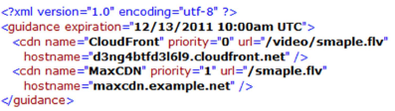
Informing Active Client
Manifestation Server
Optimizer
Request
cp.com/sample.flv
Resolve obj-i.cp.com
CDN1
CloudFront
Get CNAME
d3ng4btfd31619.cloudfront.net
Multiple CDNs with priorities
CDN2
MaxCDN
Passive Client
Active Client
Notes:
For informing active clients, the optimizer pushes the solution from CMO to a manifestation server.
The CDNs are ranked and returned to active clients with a manifest file.

Slide 26
How to Select Multiple CDNs?
The same CMO algorithm, where input CDNs are virtual CDNs (ranked CDN combinations)
Example: Select 2 CDNs (primary + backup) for an active client:
  Each pair of CDNs is a “virtual CDN”: k’ = (k, j)
  F_{k’} : the set of location objects that CDN k and CDN j together can achieve performance requirement
    Each with 90% statistics => together > 90%
  Objective function: for each location object iª , primary CDN k delivers the normal amount of traffic and backup j incurs backup amount of traffic.
Notes:
To this point, someone might wonder how CMO selects multiple CDNs for active clients?
The method is that we use virtual CDNs rather than individual real CDNs. A virtual CDN is a ranked CDN combination.
For example, if the optimizer wants to select two CDNs for active clients, each pair of CDNs is a virtual CDN.
Two elements in problem Q need to be updated. First, Fk’, second, Objective function.
CMO finds the optimal assignment to the virtual CDNs, which means assigning an object to a CDN pair.

Slide 27
Active Clients: Adaptation Goals
QoE protection (feasibility):
  Achieve target QoE through combined available resources of multiple CDN servers
Prioritized guidance:
  Utilize the available bandwidth of a higher priority server before that of a lower priority server
Low session overhead (stability):
  No redistributing load among same-priority servers unless it reduces concurrent connections
Notes:
There are three goals in the design of client adaptation algorithm: it should protect online QoE of content viewers; it should utilize the available bandwidth of a higher priority server before that of a lower priority server; it is stable with low session overhead.

Slide 28
Active Clients: Control Diagram
Primary CDN
Backup CDN
h₁₁<R and h₁₂>R
h₁₁
h₁₂
h₁₁+h₁₂+h₂₁
h₁₁>R and h₁₂<R
h₁₁<R and h₁₂<R?
h₁₁>R
h₁₂>R
h₁₁ + h₁₂>R
h₁₁ + h₁₂<R
h₁₁+h₁₂
h₁₁<R and h₁₂<R
h₁₁+ h₁₂>R
Notes:
The goals can be captured by a control diagram. The states indicate the servers an active client is using for downloading.

Slide 29
Realizing Control Diagram: Key Ideas
Controlling the windows
  AIMD
  Total load control
Using the sliding windows
  Priority assignment
h₂₁
h₁₂
# pieces can be downloaded from the server in a period T
h₁₁
Pieces to request in T
Notes:
This is the algorithm design to realize the preceding control diagram. The client maintains a window for each server indicating how many pieces can be downloaded from the server in a period T. The windows size is adjusted by AIMD for congestion control.
We limit the total load in a period. It means in each period T, there are limited pieces being scheduled to download.
Then the pieces to be downloaded are assigned to servers in priority. The servers in low priority cannot get any tasks if the ones in high priority have large window sizes.
We will see its behaviors of this design in the evaluation.

Slide 30
Roadmap
Motivations
Global optimization
  Problem definition
  CMO: An efficient optimization algorithm
Local active client adaptation
Evaluations

Slide 31
CMO Evaluation Setting
6-month traces from two VoD sites (CP1 and CP2):
  Video size
  #request in each area (learned from clients’ IP)
Three CDNs
  Amazon CloudFront
  MaxCDN
  CDN3 (private)
#request prediction
  Directly using #request last month in each area
Compare 5 CDN selection strategies:
  Cost-only, Perf-only, Round-robin, Greedy, CMO
Notes:
We use a trace driven simulation to evaluate the cost saving of CMO compared with other simple algorithms.
The last four algorithms all satisfy the performance constraints.

Slide 32
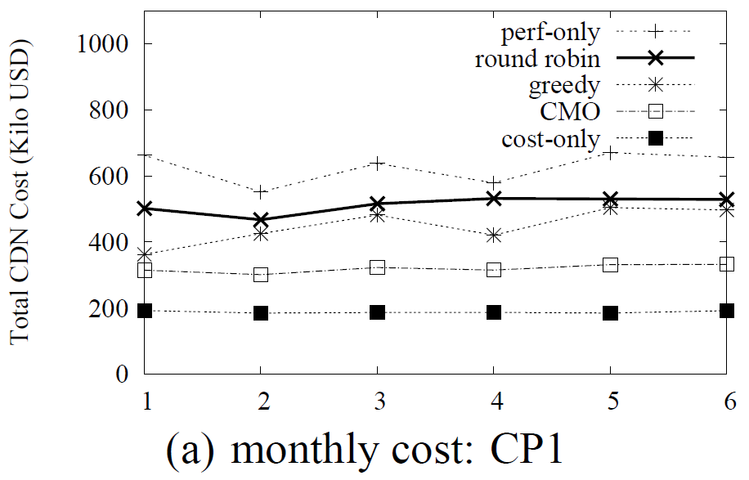
Cost Savings of CMO
Avg Saving: ~35% compared with Greedy
Notes:
Here is the monthly cost of CP1. The x-axis in the time line in month and the y-axis is the cost.
Cost-only has the lowest cost and perf-only has the highest.
Among all the algorithms that satisfy the performance constraints, CMO remains the lowest cost. Its saving compared with Greedy, which is the closest to CMO, is about 35%.

Slide 33
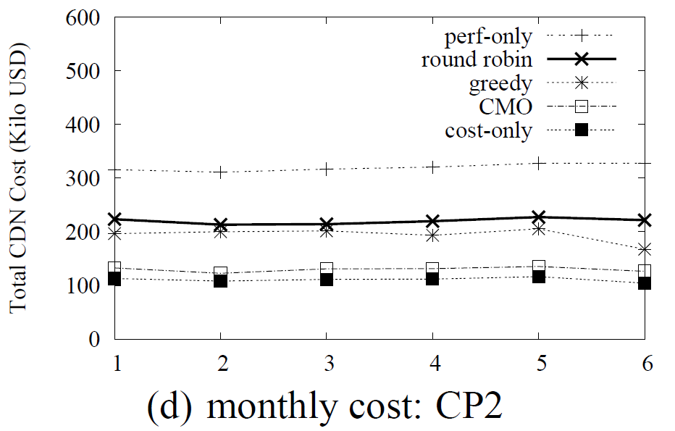
Cost Savings of CMO
Avg Saving: ~40% compared with Greedy
All three CDNs have good performance in US/EU
Notes:
The situation is similar in CP2 whose major traffic volume are in US/EU.
We observe that CMO is very close to cost-only, which is because all three CDNs have good performance in US/EU.
So the performance constraints did not impact the CDN selection much.

Slide 34
Active Client Evaluation Setting
Clients
  500+ Planetlab nodes with Firefox 8.0 + Adobe Flash 10.1
Two CDNs
  Amazon CloudFront
  CDN3
Notes:
To evaluate the active clients, we installed Firefox 8.0 and Adobe Flash in more than 500 Planetlab nodes.
We rent Amazon CloudFront and CDN3 and the clients request objects from the two CDNs.

Slide 35
Active Client Test Cases
Stress test
  CDN3 as primary; CloudFront as backup
    Two servers in two CDNs: primary1, backup1
    Two servers in the primary CDN: primary1, primary2
  Control primary1’s capacity
    Step-down -> recover
    Ramp-down -> recover
    Oscillation
Large scale performance test:
  CloudFront as primary, CDN3 as backup
  We saw real performance degradations

Slide 36
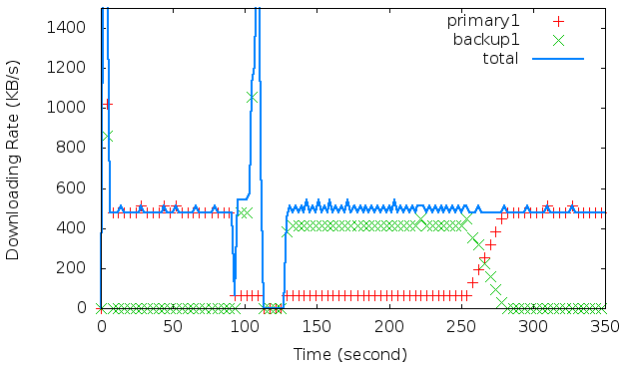
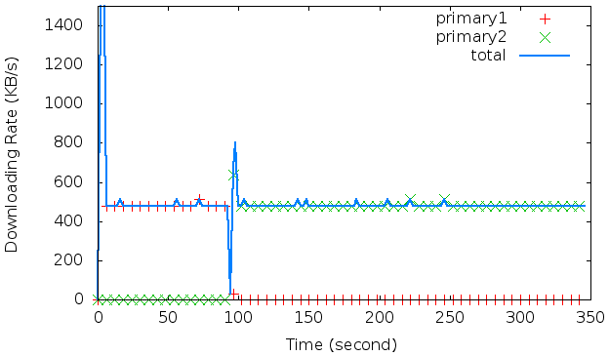
Stress Tests (Step-down)
Different Priority
Step-down
Recovery
Same Priority
Notes:
If the servers have different priority, we can see that when primary1 gets congested, the clients will try to use up the available bandwidth in primary1 and complement the rest using primary2. After primary1 recovers, it will gradually take over the downloading tasks.
However, if the servers have the same priority, the primary2 takes full responsibility and it never changes back even if primary1 recovers.

Slide 37
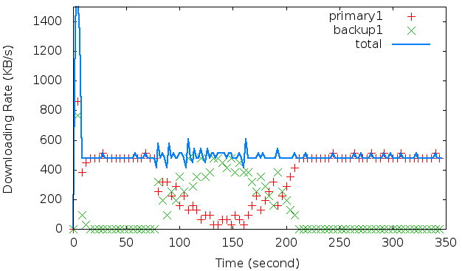
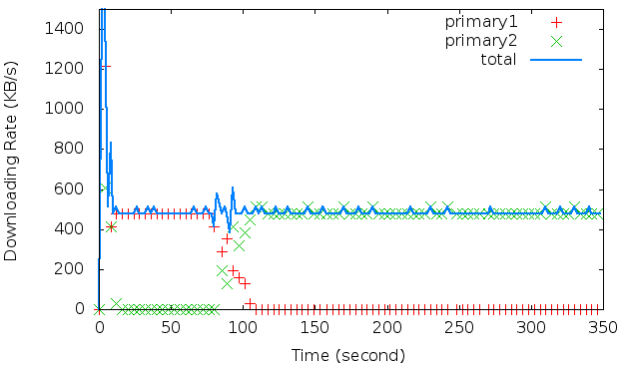
Stress Tests (Ramp-down)
Different Priority
Recovery
Ramp-down
Same Priority
Notes:
In the ramp-down it is similar.

Slide 38
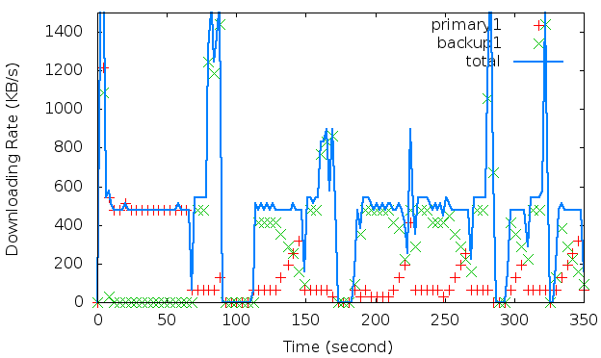
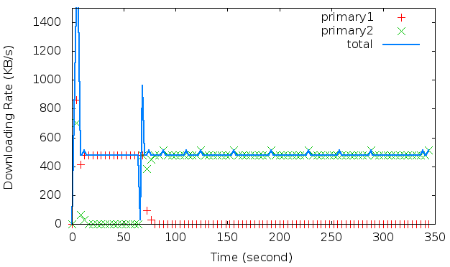
Stress Tests (Oscillation)
Different Priority
Same Priority
Notes:
In the oscillation case, the same logic but the client’s download is oscillating with primary1 if the servers have different priority

Slide 39
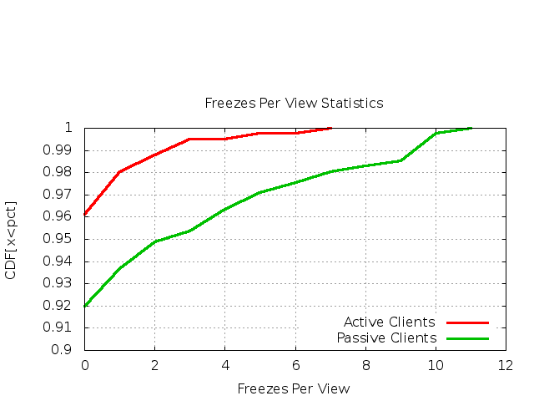
Active Client QoE Gain (CloudFront + CDN3)
Notes:
This figure shows the performance gain with active clients. The x-axis is the #of playing freezes per view and the y-axis is a CDF.
The 99% percentile is reduced from 9 to 2.

Slide 40
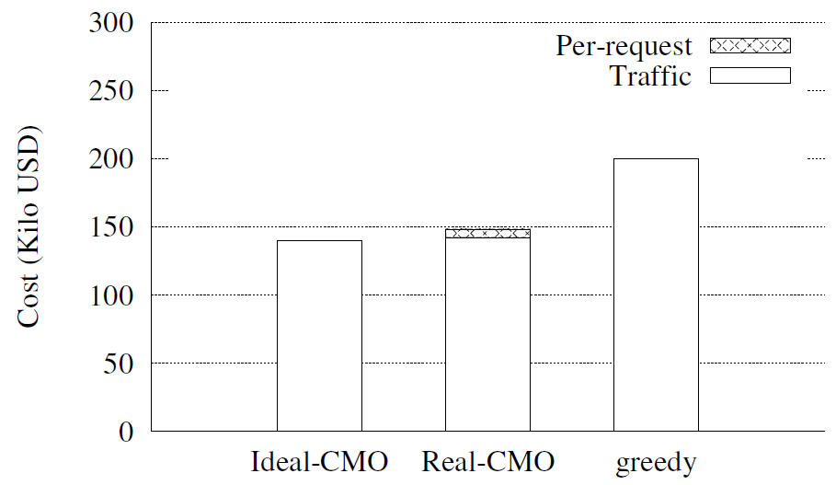
Active Client: Cost Overhead
Notes:
We also evaluate the cost overhead of active clients. Because active clients’ requests for pieces are much more than passive clients, there will be some additional cost for #request. From this picture, we can see that the overhead is not significant in video services.

Slide 41
Conclusions
We develop and implement a two-level approach to optimize cost and performance for content multihoming:
  CMO: an efficient algorithm to minimize publisher cost and satisfy statistical performance constraints
  Active client: an online QoE protection algorithm to follow CMO guidance and locally handle network congestions or server overloading.

Slide 42
Q&A
Notes:
Care about cost?
Business care about cost
There are someone
Scale
12 min
Tech to simplify
Prediction
Orthogonal
Evaluation reason

Slide 43
Related Work and Conclusions
CDN switchers: seamless switch from one CDN to another
  One Pica Image
CDN Load Balancers: executing traffic split rules among CDNs
  Cotendo CDN
  LimeLight traffic load balancer
  Level 3 intelligent traffic management
CDN Agent: CDN business on top of multiple CDNs
  XDN
  MetaCDN
CDN Interconnection (CDNi)
  Content multihoming problem still exists in the CDN delegations.

Slide 44
Backup Slides

Slide 45









Searching Extremal Assignments
Space of
How to find a proper ?
How to enumerate all possible extremal assignments?
(1) Separation Lemma:
(2) Recall:
(3) We prove:
(4) With a proper , we can find an extremal assignment:
  For each object , there is a unique minimum element in set

Slide 46






Picking Proper P
  A Proper P:
    there is a unique minimum element in set
A special subset of P (S’): all elements in are distinct
Cell Enumeration of Hyperplane Arrangements
We prove:
  Each extremal assignment can be found by an element in S’
  Two interior points from the same cell find the same extremal assignment
Conclusion:
  All possible extremal assignments are exhausted by S’.
  The number of extremal assignments is no more than the #cell (polynamial with #object).

