Slide 1

The Only Constant is Change: Incorporating Time-Varying Bandwidth Reservations in Data Centers
Di Xie, Ning Ding, Y. Charlie Hu, Ramana Kompella

Slide 2
Review
Towards Predictable Datacenter Networks
SIGCOMM ’11
  Virtual Network Abstractions: Virtual Cluster & Virtual Oversubscribed Cluster
  Oktopus system: allocation methods – greedy algorithm
Performance guarantees, Tenants costs, Provider revenue

Slide 3
Contrast
Paper | Towards Predictable Datacenter Networks | The Only Constant is Change: Incorporating Time-Varying Network Reservations in Data Centers
Conference | SIGCOMM 11 | SIGCOMM 12
Team | Microsoft Research | Purdue University
Problem | Performance guarantee Tenants costs Provider revenue | Datacenter utilization Tenants cost
Virtual Network | VC/VOC | TIVC (Time-Interleaved Virtual Clusters)
Allocation methods | Greedy algorithms | Dynamic Programming

Slide 4

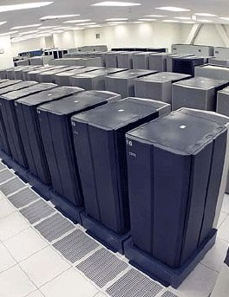



Cloud Computing is Hot
Private Cluster

Slide 5


Key Factors for Cloud Viability
Cost
Performance
BW variation in cloud due to contention
Causing unpredictable performance

Slide 6
Reserving BW in Data Centers
SecondNet [Guo’10]
  Per VM-pair, per VM access bandwidth reservation
Oktopus [Ballani’11]
  Virtual Cluster (VC)
  Virtual Oversubscribed Cluster (VOC)

Slide 7
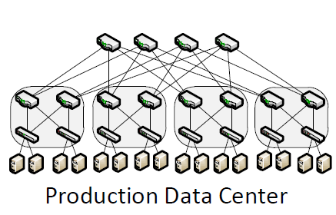


How BW Reservation Works
Only fixed-BW reservation
Request <N, B>
Bandwidth
B
Virtual
Switch
Time
0
T
. . .
N VMs
Virtual Cluster Model
1. Determine the model
2. Allocate and enforce the model

Slide 8
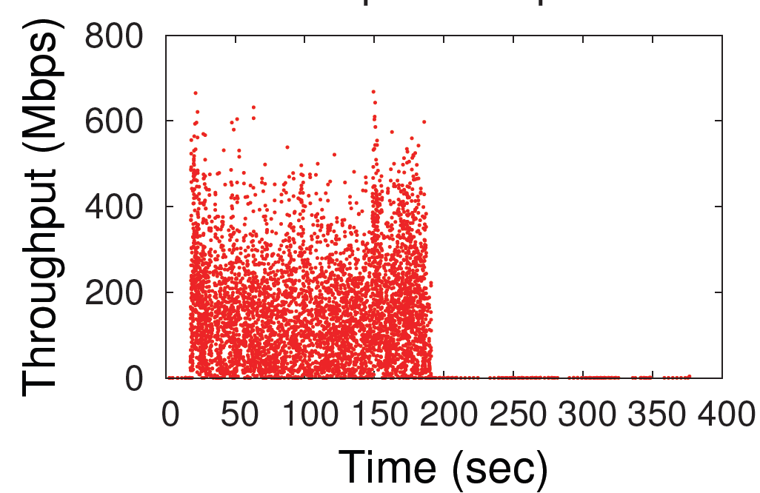
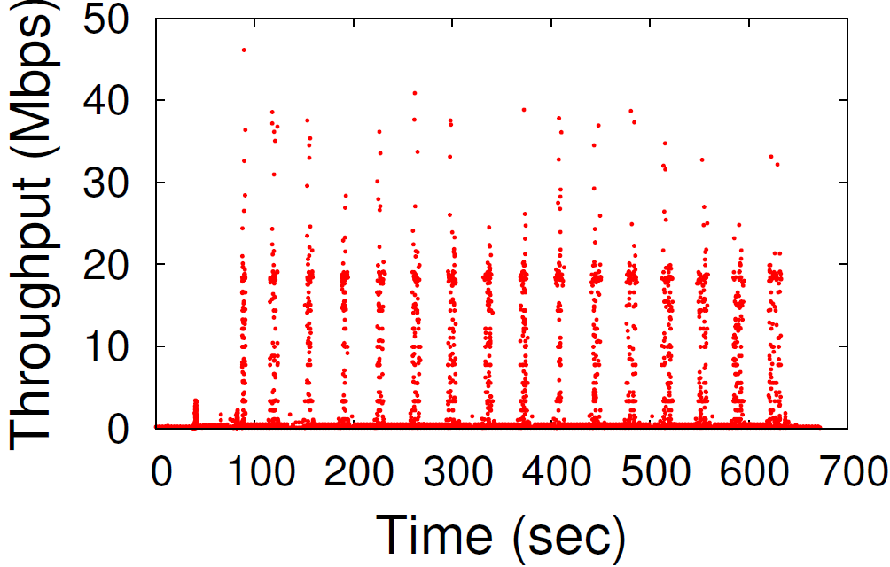
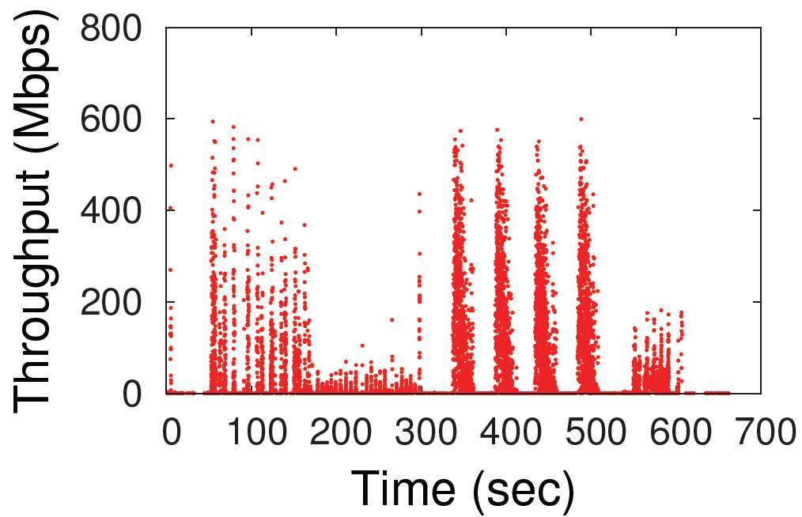
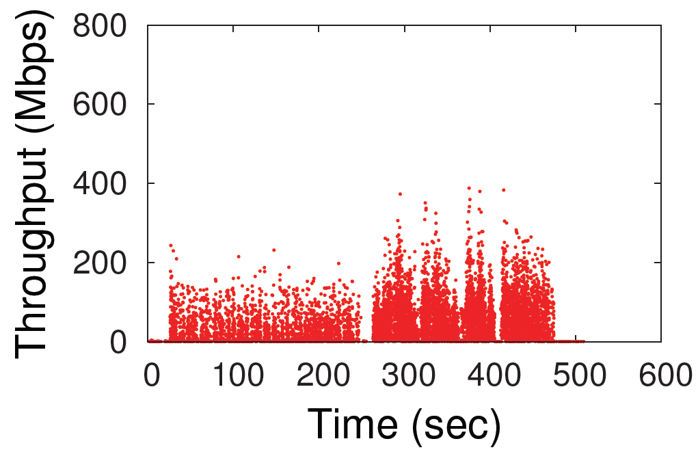
Network Usage for MapReduce Jobs
Time-varying network usage
Hadoop Sort, 4GB per VM
Hadoop Word Count, 2GB per VM
Hive Join, 6GB per VM
Hive Aggregation, 2GB per VM

Slide 9
Motivating Example
4 machines,
2 VMs/machine,
non-oversubscribed
network
Hadoop Sort
  N: 4 VMs
  B: 500Mbps/VM
Not enough BW
1Gbps
500Mbps
500Mbps
500Mbps

Slide 10
Motivating Example
4 machines,
2 VMs/machine,
non-oversubscribed
network
Hadoop Sort
  N: 4 VMs
  B: 500Mbps/VM
1Gbps
500Mbps

Slide 11
Under Fixed-BW Reservation Model
1Gbps
Bandwidth
500
500Mbps
Job1
Job2
Job3
Time
0 5 10 15 20 25 30
Virtual Cluster Model

Slide 12


Under Time-Varying Reservation Model
Hadoop
Sort
1Gbps
Bandwidth
500
500Mbps
Job2
Job3
Job4
Job1
Job5
Time
0 5 10 15 20 25 30
TIVC Model
Doubling VM, network utilization and the job throughput
J5
J3
J1
J4
J2

Slide 13
Temporally-Interleaved Virtual Cluster (TIVC)
Key idea: Time-Varying BW Reservations
Compared to fixed-BW reservation
  Improves utilization of data center
    Better network utilization
    Better VM utilization
  Increases cloud provider’s revenue
  Reduces cloud user’s cost
  Without sacrificing job performance

Slide 14
Challenges in Realizing TIVC
What are the right model functions?
How to automatically derive the models?
How to efficiently allocate TIVC?

Slide 15
How to Model Time-Varying BW?
Hadoop Hive Join

Slide 16
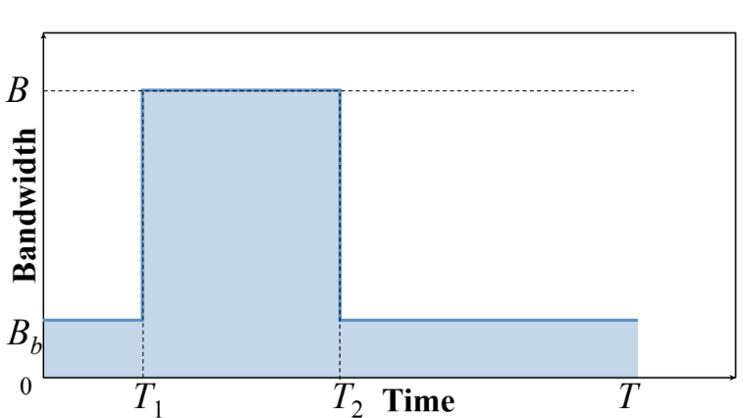
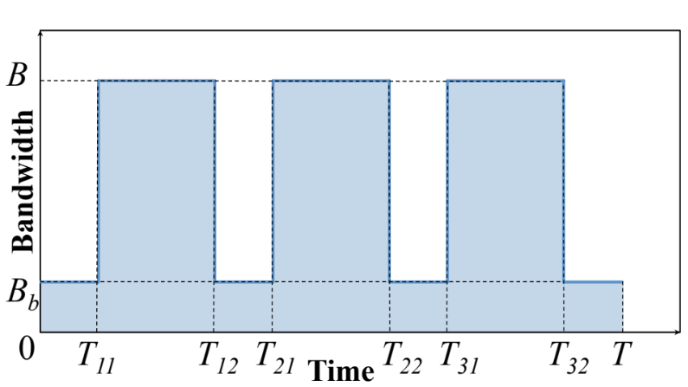
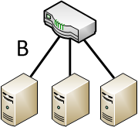
TIVC Models
Virtual Cluster
T₁₁
T₃₂

Slide 17
Hadoop Sort

Slide 18
Hadoop Word Count
v

Slide 19
Hadoop Hive Join

Slide 20
Hadoop Hive Aggregation

Slide 21
Our Approach
Observation: Many jobs are repeated many times
  E.g., 40% jobs are recurring in Bing’s production data center [Agarwal’12]
  Of course, data itself may change across runs, but size remains about the same
Profiling: Same configuration as production runs
  Same number of VMs
  Same input data size per VM
  Same job/VM configuration
How much BW should we give to the application?

Slide 22
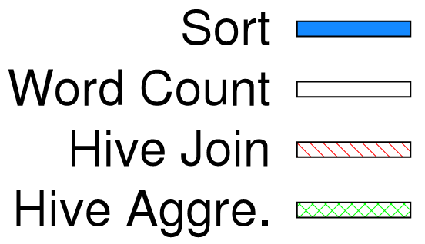
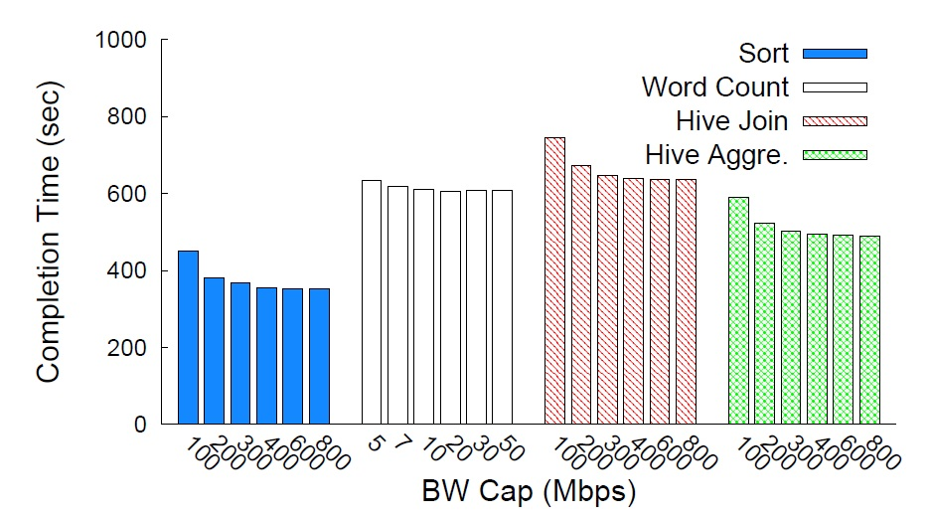
Impact of BW Capping
No-elongation BW threshold

Slide 23
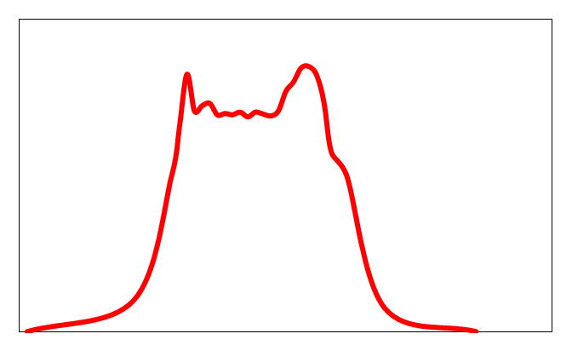
Generate Model for Individual VM
Choose B_{b}
Periods where B > B_{b}, set to B_{cap}
B_{cap}
BW
B_{b}
Time

Slide 24
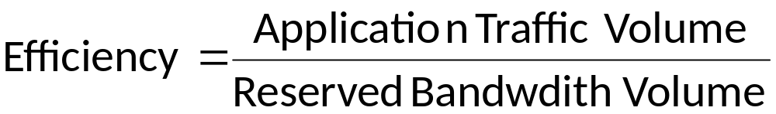
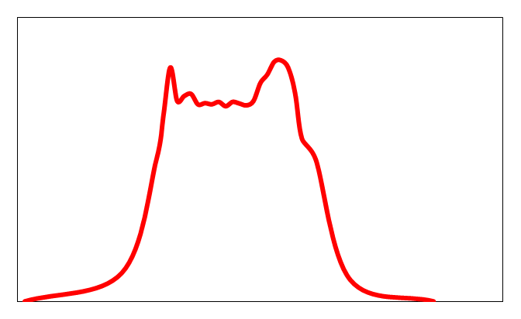
Maximal Efficiency Model
Enumerate B_{b} to find the maximal efficiency model
B_{cap}
BW
B_{b}
Time

Slide 25
TIVC Allocation Algorithm
Spatio-temporal allocation algorithm
  Extends VC allocation algorithm to time dimension
  Employs dynamic programming

Slide 26
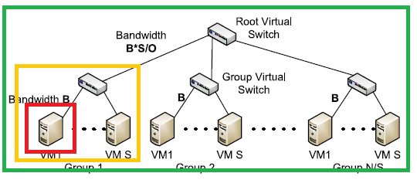
TIVC Allocation Algorithm
Bandwidth requirement of a valid allocation

Slide 27
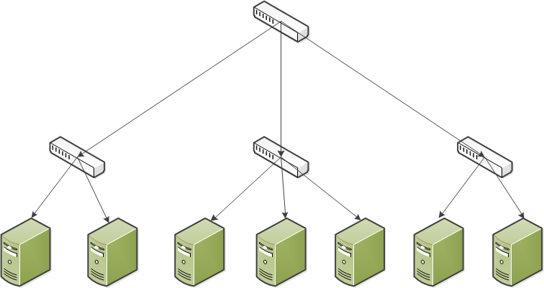
TIVC Allocation Algorithm
Allocate VMs needed by a job
Dynamic programming with depth & VMs
Depth +
VM numbers +
Observation: suballocation of K1 VMs in a depth-(d-1) subtree can be reused in searching for a valid suballocation of K2 VMs in the parent depth-d subtree (K2 > K1)

Slide 28
Challenges in Realizing TIVC
What are the right model functions?
How to automatically derive the models?
How to efficiently allocate TIVC?

Slide 29
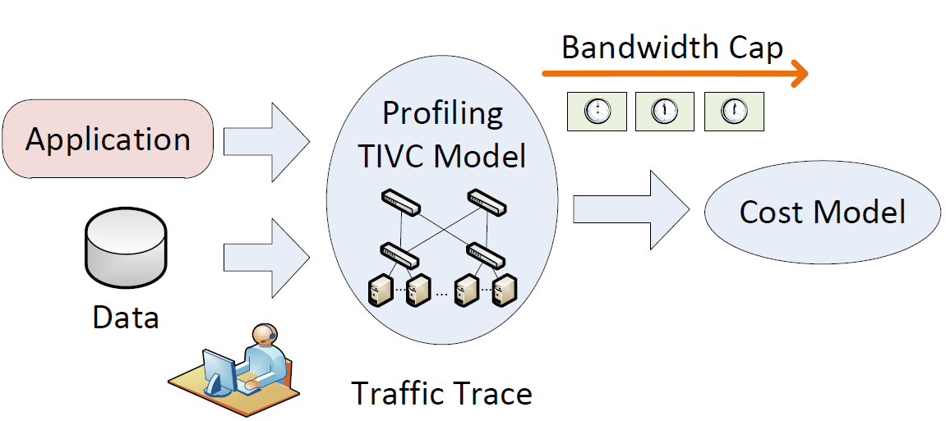
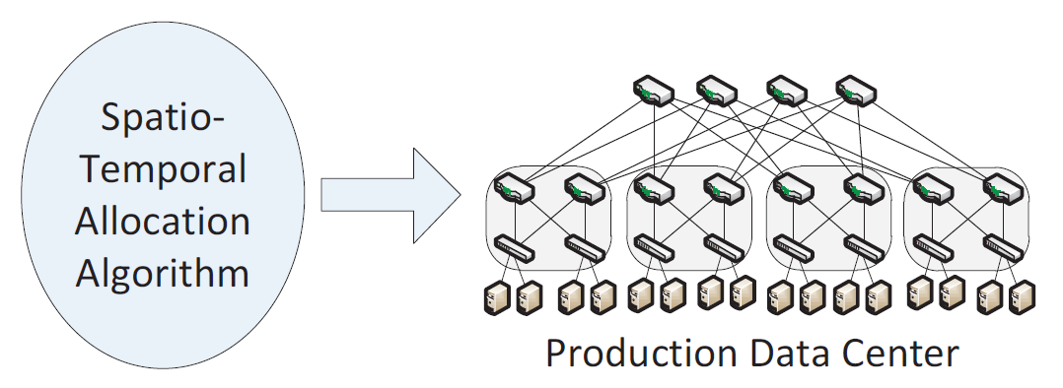
Proteus: Implementing TIVC Models
1. Determine the model
2. Allocate and enforce the model

Slide 30
Evaluation
Large-scale simulation
  Performance
  Cost
  Allocation algorithm
Prototype implementation
  Small-scale testbed

Slide 31
Simulation Setup
3-level tree topology
  16,000 Hosts x 4 VMs
  4:1 oversubscription
50Gbps
20 Aggr Switch
…
10Gbps
20 ToR Switch
…
…
40 Hosts
1Gbps
…
…
…
…

Slide 32
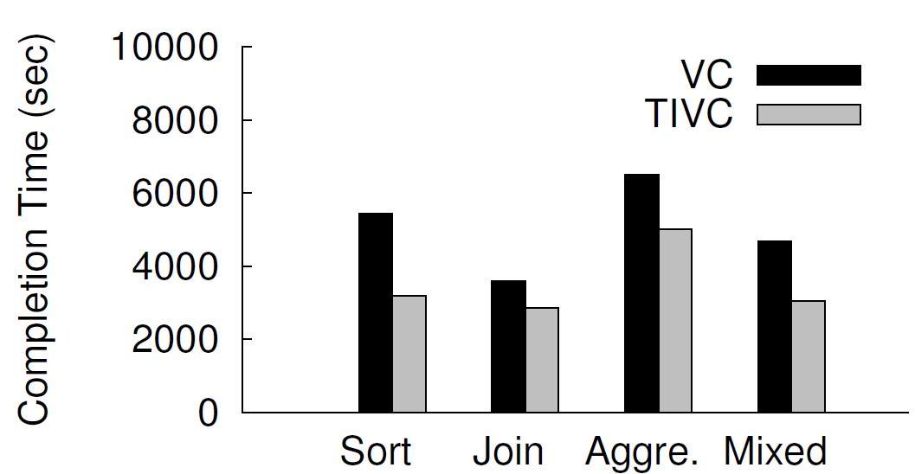
Batched Jobs
Scenario: 5,000 time-insensitive jobs
1/3 of each type
All rest results are for mixed
Completion time reduction
42%
21%
23%
35%

Slide 33
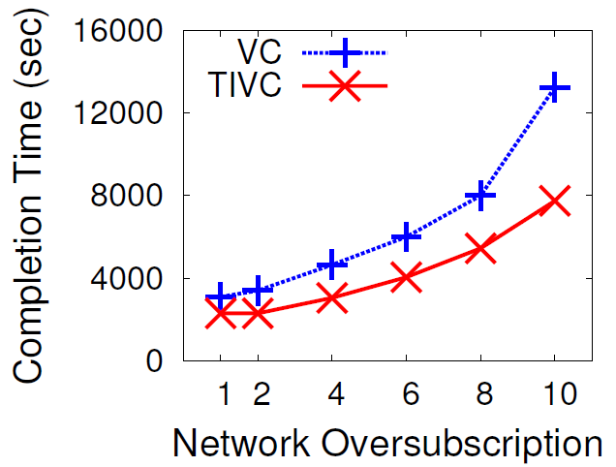
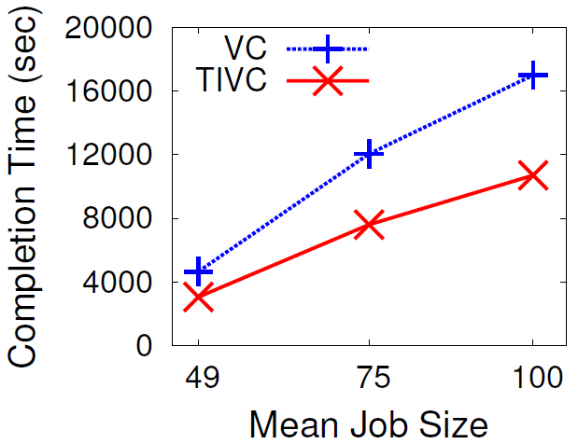
Varying Oversubscription and Job Size
25.8% reduction for non-oversubscribed network

Slide 34
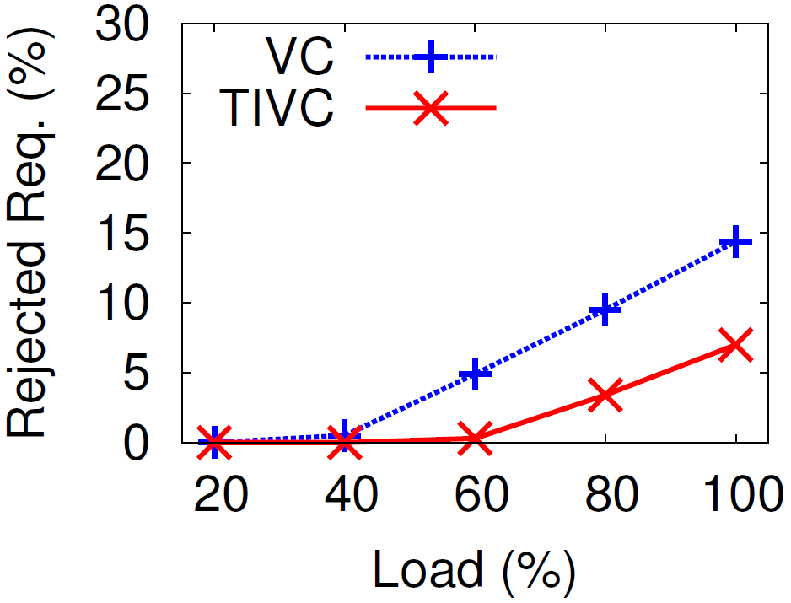
Dynamically Arriving Jobs
Scenario: Accommodate users’ requests in shared data center
  5,000 jobs, Poisson arrival, varying load
Rejected:
VC: 9.5%
TIVC: 3.4%

Slide 35
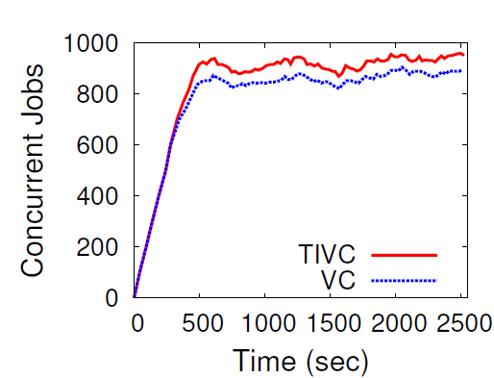
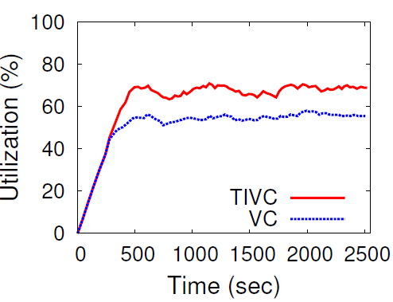

Analysis: Higher Concurrency
Under 80% load
Rejected jobs are large
28% higher VM utilization
Charge VMs
28% higher revenue
7% higher job concurrency

Slide 36
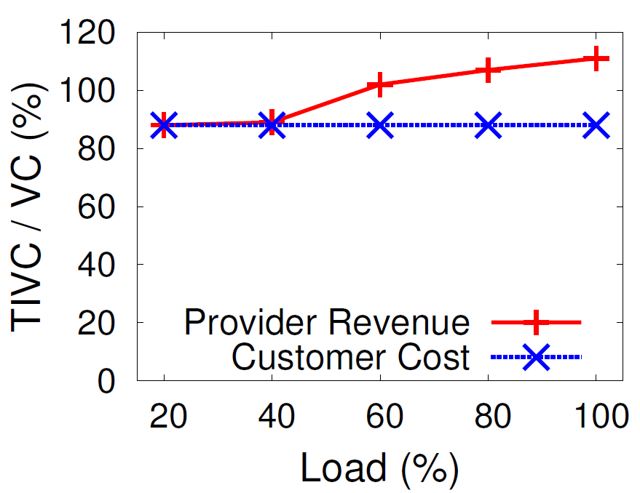
Tenant Cost and Provider Revenue
Charging model
  VM time T and reserved BW volume B
  Cost = N (k_{v} T + k_{b} B)
  k_{v} = 0.004$/hr, k_{b} = 0.00016$/GB
Amazon target utilization
12% less cost for tenants
Providers make more money

Slide 37
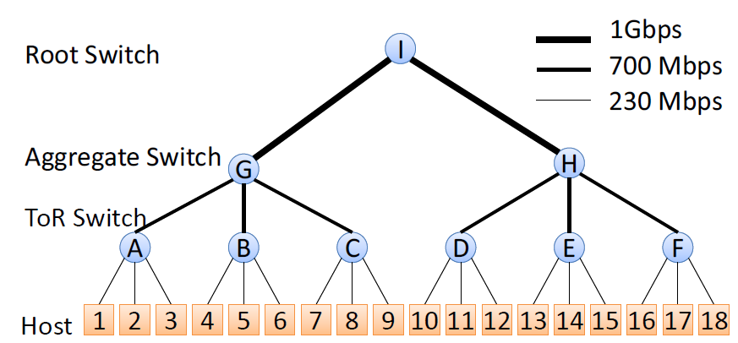
Testbed Experiment
Setup
  18 machines
  Tc and NetFPGA rate limiter
Real MapReduce jobs
Procedure
  Offline profiling
  Online reservation

Slide 38
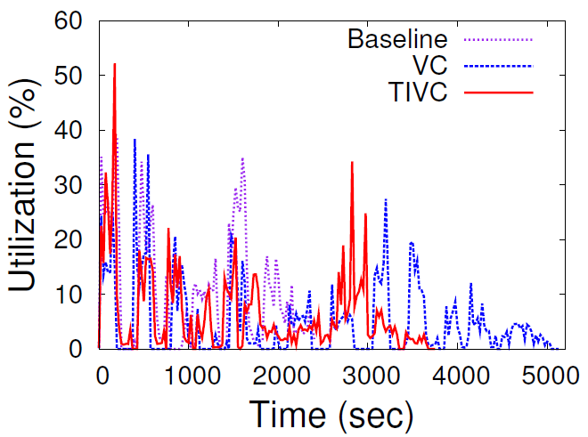
Testbed Result
TIVC finishes job faster than VC,
Baseline finishes the fastest

Slide 39
Conclusion
Network reservations in cloud are important
  Previous work proposed fixed-BW reservations
  However, cloud apps exhibit time-varying BW usage
We propose TIVC abstraction
  Provides time-varying network reservations
  Automatically generates model
  Efficiently allocates and enforces reservations
Proteus shows TIVC benefits both cloud provider and users significantly

Slide 40
Thanks

