Slide 1
Overview of Data Loss Prevention (DLP) Technology
Liwei Ren, Ph.D
Data Security Research, Trend Micro™
Classification 11/07/26

Slide 2
Backgrounds
Liwei Ren, Data Security Research, Trend Micro™
  Education
    MS/BS in mathematics, Tsinghua University, Beijing
    Ph.D in mathematics, MS in information science, University of Pittsburgh
  Research interests
    DLP, differential compression, data de-duplication, file transfer protocols, database security, and algorithms
  Major works
    N academic papers, M patents and K startup company where N≥10, M ≥12 and K=1
  TEEC member since 2005.
  liwei_ren@trendmicro.com
Trend Micro™
  Global security software company with headquarter in Tokyo, and R&D centers in Nanjing, Taipei and Silicon Valley.
  One of top 3 anti-malware vendors (competing with Symantec & McAfee)
  Pioneer in cloud security with product lines Deep Security™, SecureCloud™
  Major DLP vendor after Provilla™ acquisition

Slide 3
Agenda
What is Data Loss Prevention (数据泄露防护)?
DLP Models
DLP Systems and Architecture
Data Classification and Identification
Technical Challenges
Summary
Classification 11/07/26

Slide 4
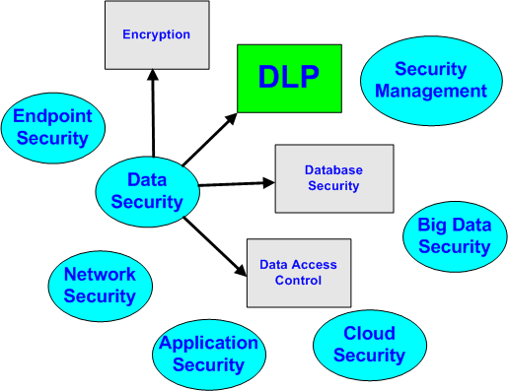
What Is Data Loss Prevention?
What is Data Loss Prevention?
  Data loss prevention (aka, DLP) is a data security technology that detects potential data breach incidents in timely manner and prevents them by monitoring data in-use (endpoints), in-motion (network traffic), and at-rest (data storage) in an organization’s network.
Classification 11/07/26

Slide 5
What Is Data Loss Prevention?
What drives DLP development?
  Regulatory compliances such as PCI,SOX, HIPAA, GLBA, SB1382 and etc
  Confidential information protection
  Intellectual property protection
What data loss incidents does a DLP system handle?
  Incautious data leak by an internal worker
  Intentional data theft by an unskillful worker
  Determined data theft by a highly technical worker
  Determined data theft by external hackers or advanced malwares or APT
Classification 11/07/26

Slide 6
What Is Data Loss Prevention?
The evolution of naming
  Information Leak Prevention (ILP)
  Information Leak Detection and Prevention (ILDP)
  DLP
    Data Leak Prevention
    Data Loss Prevention
Classification 11/07/26

Slide 7
DLP Models
A model is used to describe a technology with rigorous terms
We need models to define/scope what a DLP system should do
Three States of Data
  Data in Use (endpoints)
  Data in Motion (network)
  Data at Rest (storage)
Classification 11/07/26

Slide 8
DLP Models
The data in use at endpoints can be leaked via
  USB
  Emails
  Web mails
  HTTP/HTTPS
  IM
  FTP
  …
The data in motion can be leaked via
  SMTP
  FTP
  HTTP/HTTPS
  …
Classification 11/07/26

Slide 9
DLP Models
The data at rest could
  reside at wrong place
  Be accessed by wrong person
  Be owned by wrong person
Classification 11/07/26

Slide 10
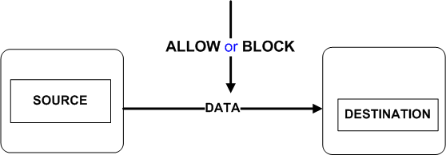
DLP Models
A conceptual view for data-in-use and data-in-motion:
Classification 11/07/26

Slide 11
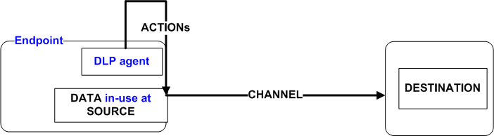
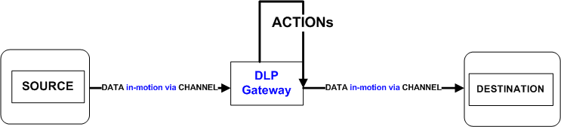
DLP Models
Technical views for data-in-use and data-in-motion:
Classification 11/07/26

Slide 12
DLP Models
DLP Model for data-in-use and data-in-motion:
  DATA flows from SOURCE to DESTINATION via CHANNEL do ACTIONs
    DATA specifies what confidential data is
    SOURCE can be an user, an endpoint, an email address, or a group of them
    DESTINATION can be an endpoint, an email address, or a group of them, or simply the external world
    CHANNEL indicates the data leak channel such as USB, email, network protocols and etc
    ACTION is the action that needs to be taken by the DLP system when an incident occurs
Classification 11/07/26

Slide 13
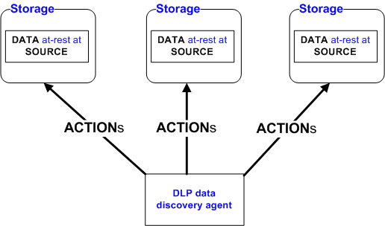
DLP Models
DLP Model for data-at-rest
Classification 11/07/26

Slide 14
DLP Models
DLP Model for data-at-rest
  DATA resides at SOURCE do ACTIONs
    DATA specifies what the sensitive data (which has potential for leakage) is
    SOURCE can be an endpoint, a storage server or a group of them
    ACTION is the action that needs to be taken by the DLP system when confidential data is identified at rest.
Classification 11/07/26

Slide 15
DLP Models
These two DLP models are fundamental
They basically define the formats of DLP security rules (or DLP security policies)
Classification 11/07/26

Slide 16
DLP Systems and Architecture
Typical DLP systems
  DLP Management Console
  DLP Endpoint Agent
  DLP Network Gateway
  Data Discovery Agent (or Appliance)
Classification 11/07/26

Slide 17
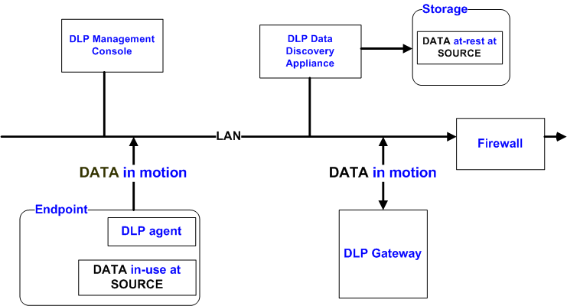
DLP Systems and Architecture
Typical DLP system architecture
Classification 11/07/26

Slide 18
Data Classification and Identification
One expects a DLP system can answer the following questions
  What is sensitive information?
  How to define sensitive information?
  How to categorize sensitive information?
  How to check if a given document contains sensitive information?
  How to measure data sensitivity?
Data inspection is an important capability for a content-aware DLP solution. It consists of two parts:
  To define sensitive data, i.e., data classification
  To identify sensitive data in real time
Classification 11/07/26

Slide 19
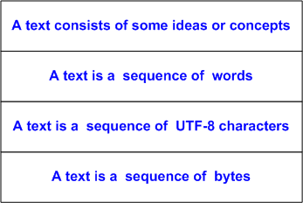
Data Classification and Identification
Sensitive data is contained in textual documents.
What does a document mean to you?
We need text models to describe a text:
Classification 11/07/26

Slide 20
Data Classification and Identification
I prefer to use UTF-8 text model
  Handling all languages, especially for CJK group.
  A textual document is normalized into a sequence of UTF-8 characters
Four fundamental approaches for sensitive data definition and identification:
  Document fingerprinting
  Database record fingerprinting
  Multiple Keyword matching
  Regular expression matching
Classification 11/07/26

Slide 21
Data Classification and Identification
What is document fingerprinting about?
  It is a solution to a problem of information retrieval:
    Identify modified versions of known documents
    Near duplicate document detection (NDDD)
  A technique of variant detection for documents
    Extract invariants from variants of digital objects
    Variant detection is a principle with 1-to-many capability
Classification 11/07/26

Slide 22
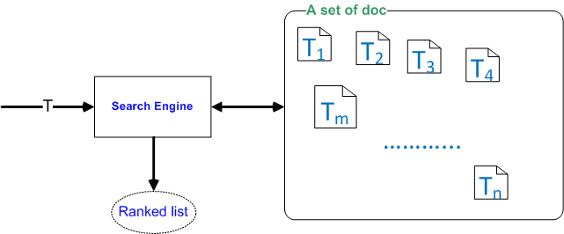
Data Classification and Identification
Problem Definition (a model):
  Let S= { T₁, T₂, …,T_{n}} be a set of known texts
  Given a query text T, one needs to determine if there exist at least a document t ϵ S such that T and t share common textual content significantly.
    Multiple documents are ranked by how much common content are shared.
Classification 11/07/26

Slide 23
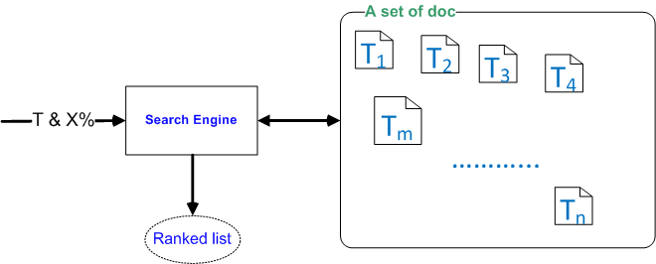
Data Classification and Identification
Alternative model:
  Let S= { T₁, T₂, …,T_{n}} be a set of known texts
  Given a query text T and X%, one needs to determine if there exist at least a document t ϵ S such that |T ∩t| /Min(|T|,|t|) ≥ X%
    Multiple documents are ranked by the percentils.
Classification 11/07/26

Slide 24
Data Classification and Identification
Solutions
  Liwei Ren & el., US patent 7516130, Matching engine with signature generation
  Liwei Ren & el., US patent 7747642, Matching engine for querying relevant documents
  Liwei Ren & el., US patent 7860853, Document matching engine using asymmetric signature generation
Solution Highlights:
  A document fingerprint is a textual feature that we extract from a given text which is a sequence of UTF-8 characters
  A single document has multiple fingerprints
  Uniqueness: Any two irrelevant documents should not have common fingerprints
  Robustness: If two documents share significantly common texts, they should have common fingerprints. In other words, when a document has moderate changes , its fingerprints should have good probability to survive.
  The key is to identify anchor points within text that can survive text changes. fingerprint can be generated from its textual neighborhood
  The major part of the solution is a fingerprint generation algorithm.
  Finally, we arrive at a fingerprint based search engine
Classification 11/07/26

Slide 25
Data Classification and Identification
How to evaluate a fingerprint generation algorithm?
  Accuracy in terms of false positive and false negative
  Performance
  Small fingerprint size that is required for an endpoint DLP solution
  Language independence
Classification 11/07/26

Slide 26
Data Classification and Identification
What is database record fingerprinting about?
  Also known as Exact Match in DLP field
  It is a technique to detect if there exist sensitive data records within a text.
Use Case:
  We have several personal data records of <SSN, Phone#, address> that are included in a text, we want to extract all records from the file to determine the sensitivity of the file.
Example: Two data records < 178-76-6754, 412-876-6789, 43 Atword Street, Pittsburgh, PA 15260> & <159-87-8965, (408)780-8876 , 76 Parkview Ave, Sunnyvale, CA 94086 > are embedded in text in an unstructured manner.
  Hhghghg 178-76-6754 ggkjkkkkk879-45-6785kjkjjk 43 Atword Street, Pittsburgh, PA 15260 kllkll 412-876-6789 kjkjjkj 76 Parkview Ave, Sunnyvale, CA 94086 hhjhjhj (408)780-8876 hjhjkjkjjj 159-87-8965hjhjhjhj
Classification 11/07/26

Slide 27
Data Classification and Identification
Problem Definition :
  Let S= { R₁, R₂, …,R_{n}} be a set of known data records of the same table.
  Given any text T, one needs to extract all records or sub-records from T while the record cells may appear randomly within the text.
A solution:
  Liwei Ren & el., US patent 7950062, Fingerprinting based entity extraction.
Classification 11/07/26

Slide 28
Data Classification and Identification
Multiple keyword match and RegEx match
  They are well-known & well-defined problems
  Very useful in DLP data inspection
Problem Definition for Keyword Match:
  Let S= {K₁,K₂,…,K_{n}} be a dictionary of keywords.
  Given any text T, one needs to identify all keyword occurrences from T.
Problem Definition for RegEx Match:
  Let S= {P₁,P₂,…,P_{m}} be a set of RegEx patterns.
  Given any text T, one needs to identify all pattern instances from T.
Easy problems?
  Not at all. For large n and m, one will have performance issue.
  That’s the problem of scalability.
  Scalable algorithms must be provided.
Classification 11/07/26

Slide 29
Data Classification and Identification
Data inspection template and framework
The 4 different data inspection techniques need to work together
  To meet various DLP use cases
  Especially, the regulatory compliances.
For example, PCI needs the following Boolean logic supported by both keyword match and RegEx match:
  SSN-Entity (2) OR [CCN(1) AND NAME(1) ] OR [CCN(1) AND Partial-Date(1) AND Expiration-Keyword ]
  That is the PCI data template
Classification 11/07/26

Slide 30
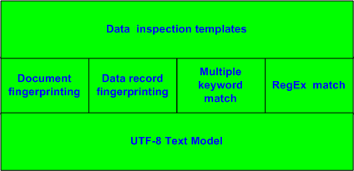
Data Classification and Identification
Data template framework:
Classification 11/07/26

Slide 31
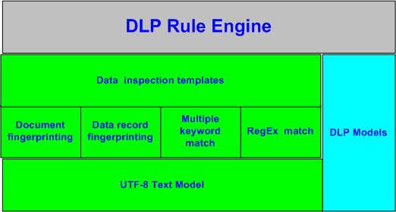
Data Classification and Identification
DLP rule engine works on top of both DLP models and data template framework:
Classification 11/07/26

Slide 32
Technical Challenges
Some areas with challenges
  Concept Match
  Data Discovery
  Document Classification Automation
  Determined Data Theft Detection
Classification 11/07/26

Slide 33
Summary
What DLP is about
DLP models
DLP systems
Text Models
Data template framework with
  4 data inspection techniques on top of a text model
Classification 11/07/26

Slide 34
Q&A
Thanks for your time
Any questions?
Classification 11/07/26

