Slide 1
Group Recommendations with Rank Aggregation and Collaborative Filtering
Linas Baltrunas, Tadas Makcinskas, Francesco Ricci
Free University of Bozen-Bolzano
Italy
fricci@unibz.it
Notes:
This is primarily based on the Master thesis project of Tadas.

Slide 2

Motivations
Rank aggregation techniques are useful
for building meta search engines, selecting documents satisfying multiple criteria, and spam reduction
  There are similarities between these problems and group recommendation
Q1: Can we reuse rank aggregation techniques for group recommendation?
Q2: Is group recommendation really a hard problem? – or building a recommendation for a group may result - in practice – easier than building an individual recommendation?

Slide 3
Content
Two approaches for generating recommendations
Rank aggregation – optimal aggregation
Rank aggregation for group recommendation
Dimensions considered in the study
  Group size
  Inter group similarity
  Rank aggregation methods
Conclusions
  Generated group recommendations are good - may be even better than individual ones
  Groups with similar users are better supported.

Slide 4

Group Recommendations
Recommenders are usually designed to provide recommendations adapted to the preferences of a single user
In many situations the recommended items are consumed by a group of users
  A travel with friends
  A movie to watch with
  the family during
  Christmas holidays
  Music to be played in a
  car for the passengers
Notes:
Obviously the main problem is that the group’s members may have different preferences and therefore should receive different recommendation – but we cannot

Slide 5
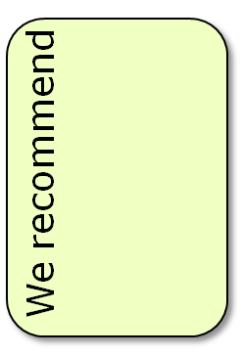






First Mainstream Approach
Creating the joint profile of a group of users
Then build a recommendation for this “average” user
Issues
  The recommendations may be difficult to explain – individual preferences are lost
  Recommendations are customized for a “user” that is not in the group
  There is no well founded way to “combine” user profiles – why averaging?
+
+
=
Notes:
Dire che queste icone rappresentano dei profili
Andare piu’ veloce qui

Slide 6


Second Mainstream Approach
Producing individual recommendations
Then “aggregate” the recommendations:
Issues
  How to optimally aggregate ranked lists of recommendations?
  Is there any “best method”?

Slide 7
Optimal Aggregation
Paradoxically there is not an optimal way to aggregate recommendations lists (Arrows’ theorem: there is no fair voting system)
[Dwork et al., 2001] “Rank aggregation methods for the web” WWW ’01 Proceedings – introduced the notion of Kemeny-Optimal aggregation
  Given a distance function between two ranked lists (Kendall tau distance)
  Given some input ranked lists to aggregate
  Compute the ranked list (permutation) that minimize the average distance to the input lists.
Notes:
In short, no "fair" voting system can be designed to satisfy these three criteria:
If every voter prefers X over Y, then the group prefers X over Y.
If every voter's preferences between X and Y remain unchanged when Z is added to the slate, then the group's preference between X and Y will also remain unchanged.
There is no "dictator": no single voter possesses the power to determine the group's preference.
But why the Kendal-tau distance? They do not say why!!!!!

Slide 8
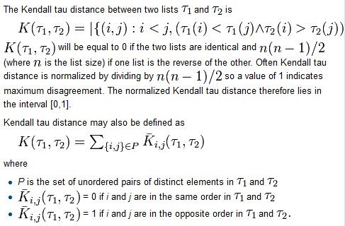
Kendall tau Distance
Notes:
Andare piu’ veloce qui

Slide 9
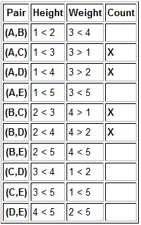


An Example
Notes:
Andare piu’ veloce qui

Slide 10

Kemeny Optimal Aggregation
Kemeny optimal aggregation is expensive to compute (NP hard – even with 4 input lists)
There are other methods that have been proved to approximate the Kemeny-optimal solution
  Borda count – no more than 5 times the Kemeny distance [Dwork et al., 2001]
  Spearman footrule distance – no more than 2 times the Kemeny distance [Coppersmith et al., 2006]
  Average – average the predicted ratings and sort
  Least misery- sort by the min of the predicted ratings
  Random – 0 knowledge, only as baseline
Notes:
The Spearman footrule distance (of two ranked lists) is the sum over all the elements of the absolute difference of their rank.

Slide 11

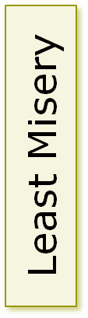
Borda Count vs. Least Misery
3
3
5
2
2
4
1
1
3
Score based on predicted rank
Kendall τ dist= 1+1
4.3
4
3
3.3
3
2.5
1
2.5
1
Predicted rating
Kendall τ dist= 0+2
Notes:
Kemeny distance is the number of pairwise disagreements. So it is the number of permutations to modify one ranked list in the other.
Both rank aggregations are optimal but they are different.
Both aggregations are kemeny optimal. Because a better one should have 0 distance from one of the two lists (to get global distance =1) but the first one has distance 2 from the second list (and vice versa) so the minimum is 2.

Slide 12
Evaluating Group Recommendations
Given a group of users including the active user
Generate two ranked lists of recommendations using a prediction model (matrix factorization SVD) and some training data (ratings):
  Either based only on the active user individual preferences
  Or aggregating recommendation lists for the group of users
Compare the recommendation list with the “true” preferences as found in the test set of the user
We have used Movielens 100K data (943 users, 1682 movies)
Comparison is performed using Normalized Discounted Cumulative Gain.

Slide 13
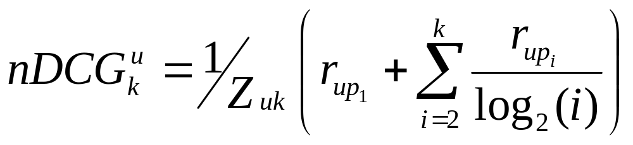
Normalized Discounted Cumulative Gain
It is evaluated over the k items that are present in the user’s test set
r_{upi} is the rating of the item in position i for user u – as it is found in the test set
Z_{uk} is a normalization factor calculated to make it so that a perfect ranking’s NDCG at k for user u is 1
It is maximal if the recommendations are ordered in decreasing value of their true ratings.
Notes:
This function is maximized by any sorting of the test items in decreasing value of their ratings
Andare veloce qui – dire solo quello di sopra.

Slide 14
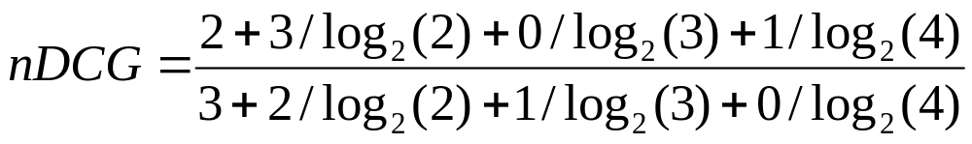
Example
There are four items i1,i2,i3,i4
The best order for them is (3,2,1,0)
However, the predicted order for them is (2,3,0,1)
Therefore, the nDCG value is:

Slide 15
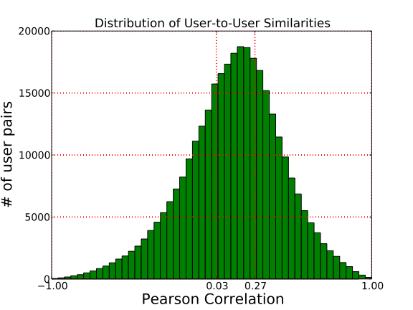

Building pseudo-random groups
Groups with high inner group similarity
Each pair of users has Pearson correlation larger than 0.27
One third of the users’ pairs has a similarity larger that 0.27
We built groups with: 2, 3, 4 and 8 users
Similarity is computed only if the users have rated at least 5 items in common.
Notes:
pseudo-random伪随机：group中用户随机聚合，但是内部成员之间存在一定的关系

Slide 16
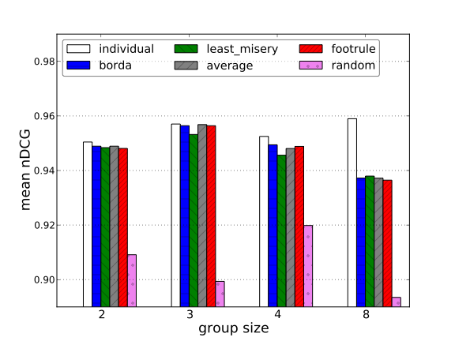
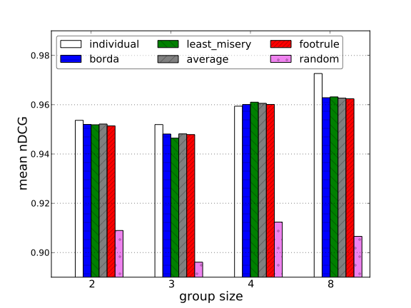
Random vs Similar Groups
Random Groups
High Inner Group Sim.
For each experimental condition – a bar shows the average over the users belonging to 1000 groups
Training set is 60% of the MovieLens data
Notes:
为什么随机的方法nDCG值也很高，主要原因在于对于一个长度为5的排序序列，随机排序平均nDCG值都能达到0.91，所以会很高

Slide 17
Random vs Similar Groups
Aggregation method itself has not a big influence on the quality, except for random aggregation
There is no clear winner and the best performing method depends on the group size and inner group similarity

Slide 18
Group Recommendation Gain
Is there any gain in effectiveness (NDCG) if a recommendation is built for the group the user belongs to?
Gain(u,g) = NDCG(Rec(u,g)) – NDCG(Rec(u))
When there is a positive gain?
  Does the quality of the individual recommendations matter?
  Inner group similarity is important?
Can a group recommendation be better (positive gain) than an individually tailored one?

Slide 19
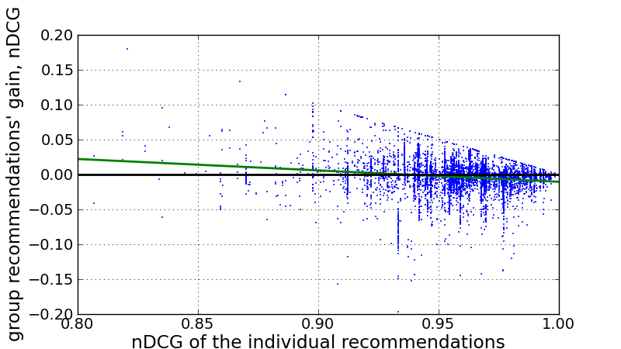
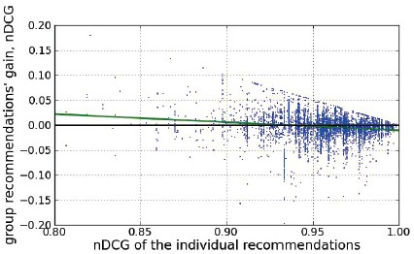
Effectiveness Gain: Individual vs. Group
3000 groups of 2 users
High similar users
Average aggregation
3000 groups of 3 users
High similar users
Average aggregation
Notes:
C’e’ quella linea verticale sopra perche’ il massimo del gain e’ comunque quello per il group recommendation che ottiene NDCG = 1. Infatti, per esempio quando la individual ha NDCG = 0.95 il gain puo’ al massimo essere 0.05, ovvero quando la group recommendation vale 1.

Slide 20
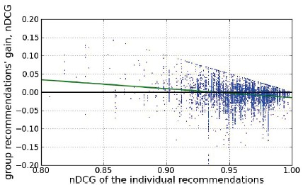
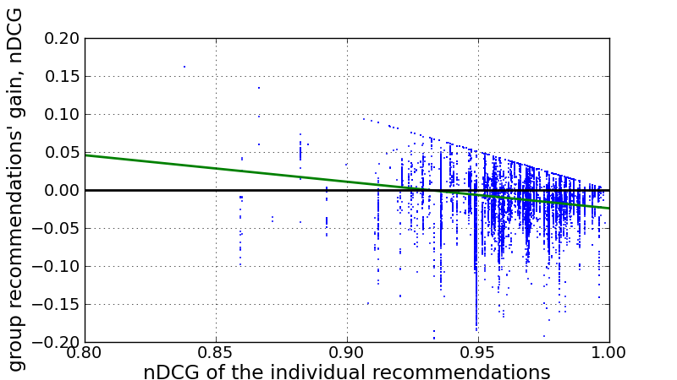
Effectiveness Gain: Individual vs. Group
3000 groups of 4 users
High similar users
Average aggregation
3000 groups of 8 users
High similar users
Average aggregation
Notes:
C’e’ quella linea verticale sopra perche’ il massimo del gain e’ comunque quello per il group recommendation che ottiene NDCG = 1. Infatti, per esempio quando la individual ha NDCG = 0.95 il gain puo’ al massimo essere 0.05, ovvero quando la group recommendation vale 1.

Slide 21
Effectiveness Gain: Individual vs. Group
The worse are the individual recommendations the better are the group recommendations built aggregating the recommendations for the users in the group.
This is a interesting result as it shows that in real RSs, which always make some errors, some users may be better served with the group recommendations than with recommendations personalized for the individual user. When the algorithm cannot make accurate recommendations personalized for a single user it could be worth recommending a ranked list of items that is generated using aggregated information from similar users.
Notes:
This result motivated the following experiment

Slide 22
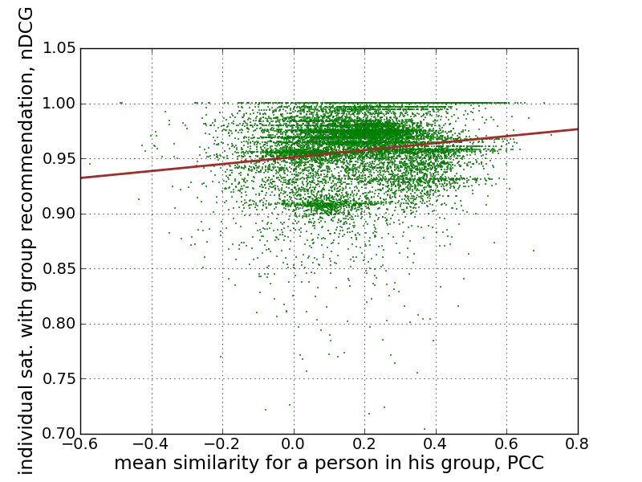
Effectiveness vs. Inner Group Sim
Random groups, 4 users
Average aggregation method
The larger the inner group similarity is the better the recommendations are – as expected.
Notes:
where we look at the correlation between the average similarity of a user to the other group members and the effectiveness of the group recommendations for this user.

Slide 23
Conclusions
Rank aggregation techniques provide a viable approach to group recommendation
Group recommendations may be better than individual recommendations
  When the individual recommendations are not good
The more alike are the users in the group, the more satisfied they are with the group recommendations
Notes:
Rank aggregation techniques 为group recommendation提供了实现的可能

Slide 24
Discussions
This paper produced groups by aggregating similar users, but it didn’t solve the problem that real group members faced.
The items recommended to the group are not selected by each of them in the group, therefore, the nDCG computed for every user in the group have shorter list, even sometime with only one item, then the nDCG will be 1 whatever.
The author concluded that when the individual recommendation for the user is not good, the group recommendation will improve the effectiveness. However, as we know, how to measure the goodness is difficult in real RSs and the group recommendation will lose some important information.

Slide 25




Questions?

