Slide 1
A Smart Pre-Classifier to Reduce Power Consumption of TCAMs for
Multi-dimensional Packet Classification
Yadi Ma, Suman Banerjee
University of Wisconsin-Madison
Notes:
Power-efficient TCAMs for multi-dimensional packet classification

Slide 2
Packet classification
S1
L1
Internet
S2
R
D
L2
Subnet A
Subnet B
Classifier at Router R
From | To | Traffic type | Action
S1 | D | Port 80 | Forward via L1
S2 | D | * | Drop all traffic
A | B | * | Reserve 50 Mbps

Slide 3
Definition
Packet classification: given a classifier, find the first (highest priority) matching rule for each incoming packet
A classifier contains a set of rules ordered by priority
  Our focus: n-tuple classification
Example classifier:
Rule # | Source IP | Dest. IP | Source Port | Dest. Port | Protocol | Action
1 | * | 10.112.*.* | 5001 - 65535 | * | TCP | deny
2 | 32.75.226.153 | * | * | 1001 - 2000 | UDP | deny
3 | 199.36.184.* | * | 49152 - 65535 | * | UDP | deny
4 | * | * | * | * | * | permit
Given a packet header: (32.75.226.153, 198.35.180.5, 80,1040, UDP)

Slide 4
Packet classification schemes
Software-based schemes
  Tradeoff between memory usage and speed
  Examples: HiCuts, HyperCuts, EffiCuts, etc
Hardware (TCAM)-based schemes
  Popular for high-throughput packet classification

Slide 5

TCAM
TCAM (Ternary Content Addressable Memory)
Used
blocks
TCAM
Result
Unused
blocks
High power consumption
A 18Mbit TCAM stores ~ 100K IPv4 rules, consumes up to 15W/Gbps!
Problem: Lookups in large classifiers (>100k rules) burns a lot of power!

Slide 6
Problem Statement
TCAMs are power-hungry
Design a TCAM-based method that:
  Greatly reduces power consumption of TCAMs, especially for large classifiers
  Uses commodity TCAMs
  Is easy to implement

Slide 7
Activate a small number of blocks?
TCAM
Result
Low power consumption
How to know which blocks to activate?

Slide 8
Our approach: SmartPC
SmartPC: Smart Pre-Classifier
  Two-stage classification system
Result
Pre-classifier
Low power consumption
Challenge: How to build an efficient pre-classifier?

Slide 9

Outline
Introduction and motivation
Design of SmartPC
  Algorithms to manage two-stage classification
Evaluation methods and results
Conclusion

Slide 10
Packet classification system for SmartPC
Two-stage classification
  First stage: pre-classifier
  Second stage: two parallel searches
Index TCAM
(Pre-classifier
entries)
TCAM
(Classifier
rules)
Associated SRAM
(priorities + actions)
Index SRAM
Match
index
Priority
resolution
“Specific”
block
“General” blocks
How to build an efficient pre-classifier?
Action

Slide 11
Pre-classifier
How to build a pre-classifier?
  Built on two dimensions: source IP address and destination IP addresses
  By expanding and combining two dimensional rules recursively
Also shuffle original rules into different TCAM blocks accordingly

Slide 12
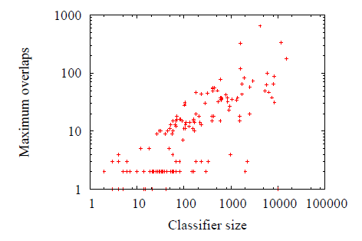
Why 5d to 2d is a good choice?
Analyze more than 200 real classifiers ranging in size from 3 to 15,181
Maximum number of overlapping rules
in the two-dimensional space
Maximum number of overlapping rules is an order of magnitude smaller than classifier size.
Notes:
看交叠最大的层数，一个包最多能够匹配一千的规则

Slide 13
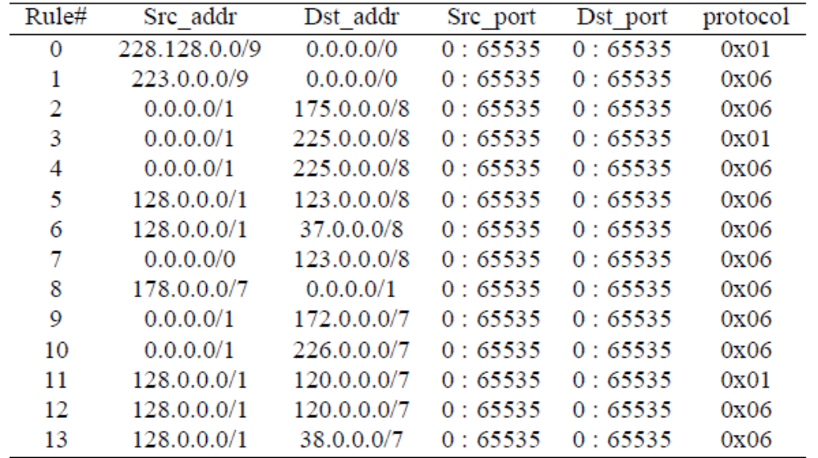
An example classifier containing 14 rules

Slide 14
Regular TCAM
Rules are stored in order by priority
Suppose block size = 5
TCAM
0,1,2,3,4
0,1,2,3,4
5, 6, 7,8,9
5, 6, 7,8,9
Result
10,11,12,13
10,11,12,13

Slide 15
Same example classifier containing 14 rules

Slide 16
SmartPC
Src_addr
6
11/12/13
5
P0
TCAM
0
1
8
9
2
2
3/4
10
P0,P1
Pre-classifier
7
P1
Dst_addr

Slide 17
SmartPC
Src_addr
6
11/12/13
5
P0
TCAM
0
1
0,1,5,6,8
8
9
2
2
3/4
10
P0,P1
Pre-classifier
7
P1
Dst_addr

Slide 18
SmartPC
Src_addr
6
11/12/13
5
Specific blocks
P0
TCAM
0
1
0,1,5,6,8
2, 3,4,9,10
8
9
2
3/4
10
P0,P1
Pre-classifier
7
P1
Dst_addr

Slide 19
SmartPC
Src_addr
6
11/12/13
5
Specific blocks
P0
TCAM
0
1
0,1,5,6,8
2, 3,4,9,10
8
9
2
3/4
10
P0,P1
7,11,12,13
Pre-classifier
General block
7
P1
Dst_addr

Slide 20
SmartPC
Src_addr
6
11/12/13
5
Specific blocks
P0
TCAM
0
packet
0,1,5,6,8
1
0,1,5,6,8
2, 3,4,9,10
8
9
2
3/4
10
P0,P1
P0,P1
7,11,12,13
7,11,12,13
Pre-classifier
General block
7
P1
Dst_addr

Slide 21
Example: how to build a pre-classifier
Src_addr
6
11/12/13
5
P0
0
1
8
9
2
2
3/4
10
P0
7
Dst_addr

Slide 22
Example: how to build a pre-classifier
Src_addr
6
11/12/13
5
P0
0
1
0
8
9
2
2
3/4
10
P0
7
Dst_addr
Notes:
先从0开始，直接加入P0，然后下一个规则1，扩展P0包含1，没有问题，同时发现5,6,7,11/12/13和P0有交叠，继续扩展P0，以至包含5，此时发现P0与6，7，8以及11/12/13有交叠，先处理6，因为在P0范围内，不用扩展，所以直接加入6，继续去扩展处理7，发现扩展后P0又和别的规则有交叠，所以标记7为general，继续处理原P0中包含的8，因为在范围内，所以直接加入8，再去处理11/12/13，因为已经达到了5个的上限，所以11/12/13标记为general，结束P0。9之后建立了新的P1

Slide 23
Example: how to build a pre-classifier
Src_addr
6
11/12/13
5
P0
0
1
0
, 1
8
9
2
2
3/4
10
P0
7
Dst_addr

Slide 24
Example: how to build a pre-classifier
Src_addr
6
11/12/13
5
P0
0
1
0
, 1
8
9
2
2
3/4
10
P0
7
Dst_addr

Slide 25
Example: how to build a pre-classifier
Src_addr
6
11/12/13
5
P0
0
0
, 1
1
, 5, 6
8
9
2
2
3/4
10
P0
7
Dst_addr

Slide 26
Example: how to build a pre-classifier
Src_addr
6
11/12/13
5
P0
0
0
, 1
1
, 5, 6
8
9
2
2
3/4
10
P0
7
7
Dst_addr

Slide 27
Example: how to build a pre-classifier
Src_addr
6
11/12/13
5
P0
0
0
, 1
1
, 5, 6
, 8
8
9
2
2
3/4
10
P0
7
7
Dst_addr

Slide 28
Example: how to build a pre-classifier
Src_addr
6
11/12/13
5
P0
0
0
, 1
1
, 5, 6
, 8
8
9
2
2
3/4
10
P0
7
,11,12,13
7
Dst_addr

Slide 29
Example: how to build a pre-classifier
Src_addr
6
11/12/13
5
P0
0
0
, 1
1
, 5, 6
, 8
8
9
2
2
3/4
10
P0
, P1
7
,11,12,13
7
P1
Dst_addr

Slide 30
Example: how to build a pre-classifier
Src_addr
6
11/12/13
5
Specific blocks
P0
0
packet
0
, 1
1
, 5, 6
, 8
2, 3,4,9,10
8
9
2
3/4
10
P0
, P1
7
,11,12,13
Pre-classifier
General block
7
P1
Dst_addr

Slide 31
Packet classification system for SmartPC
Index TCAM
(Pre-classifier
entries)
TCAM
(Classifier
rules)
Associated SRAM
(priorities + actions)
Index SRAM
Incoming
packet
Match
index
0, 1, 5, 6, 8
Priority
resolution
P0
P1
0
1
0, 1, 5, 6, 8
1, accept
1, accept
Specific
block
2 ,3, 4, 9, 10
.
.
.
.
.
.
1
7, deny
7, deny
7, 11, 12, 13
7, 11, 12, 13
General block(s)
accept

Slide 32
Properties of pre-classifiers
Entries in a pre-classifier are non-overlapping
Each rule in a classifier is either covered by only one pre-classifier entry, or marked as general

Slide 33
Rule update
Rule update overhead of SmartPC is generally smaller than that of regular TCAMs
The ordering of TCAM entries is kept within one specific block or within a small number of general blocks, rather than throughout all the blocks
Rule update
  Insert a rule
  Delete a rule

Slide 34
Outline
Introduction and motivation
Design of SmartPC
  Algorithms to manage two-stage classification
Evaluation methods and results
Conclusion

Slide 35
Experimental setup (1)
Summary of classifiers
10 real classifiers
10 synthetic classifiers
Name | Size | MaxOveralps | Wildcard
R1 | 5233 | 49 | 18
R2 | 5626 | 63 | 32
R3 | 5874 | 98 | 48
R4 | 6339 | 47 | 16
R5 | 7356 | 38 | 5
R6 | 8063 | 64 | 35
R7 | 8475 | 31 | 4
R8 | 10054 | 1 | 0
R9 | 11574 | 334 | 271
R10 | 15181 | 177 | 143
Name | Size | MaxOveralps | Wildcard
S1 | 9802 | 22 | 4
S2 | 9416 | 126 | 57
S3 | 9497 | 76 | 18
S4 | 9624 | 82 | 12
S5 | 7255 | 28 | 0
S6 | 99823 | 27 | 5
S7 | 87039 | 249 | 79
S8 | 99836 | 89 | 47
S9 | 99866 | 81 | 38
S10 | 99220 | 10 | 0

Slide 36
Experimental setup (2)
Block size of TCAMs
  Evaluated various sizes: 32, 64, 128, 256, 512 and 1024, respectively.
Metric
  Power reductions
    Percentage of reductions on activated blocks
  Storage overhead of pre-classifier entries
    Percentage of pre-classifier size compared to the size of a whole classifier
Schemes
  SmartPC
  Default TCAM (without SmartPC)
  A naïve scheme named Naive-divide

Slide 37
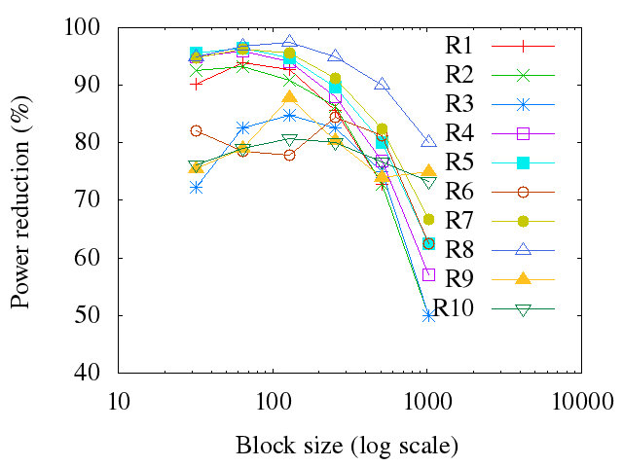
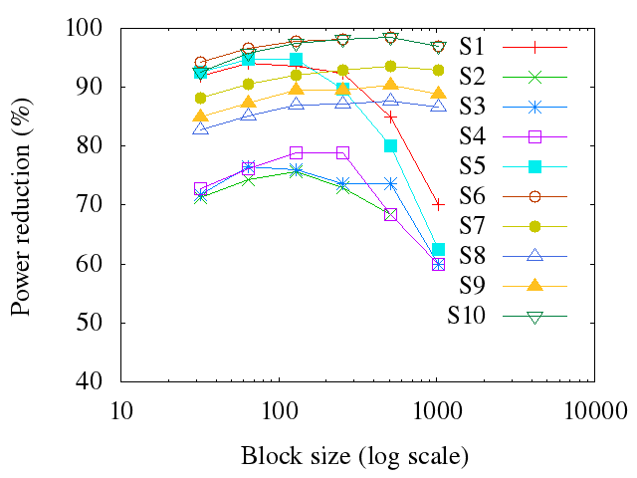
Power reductions
Real classifiers
Synthetic classifiers
Percentage of power reductions vs. TCAM block size
With block size 128, the median and average power reductions are 91% and 88%, respectively
Notes:
规则交叠数目并没有随着规则集的规模增加而增大，才出现了一直上升的现象。一般B上升的话，能够节省的B的数目就少了，power就省的少了。而pre-classifer占的Block少了，general占的Block也少了，于是出现了上升。

Slide 38
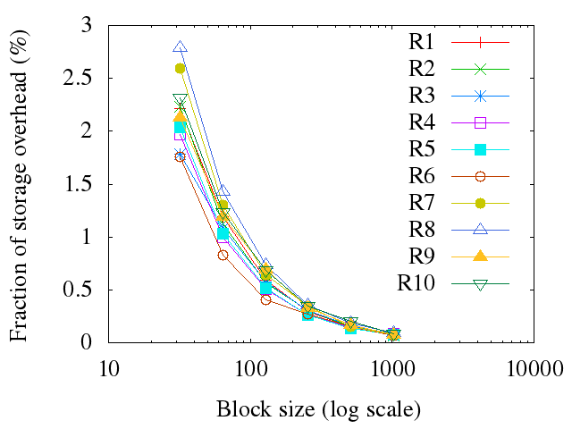
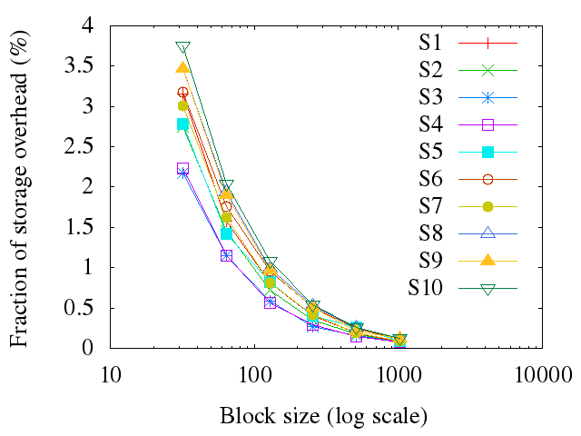
Storage overhead
Real classifiers
Synthetic classifiers
Fraction of storage overhead vs. TCAM block size
Small storage overhead, less than 4% for every classifier.

Slide 39
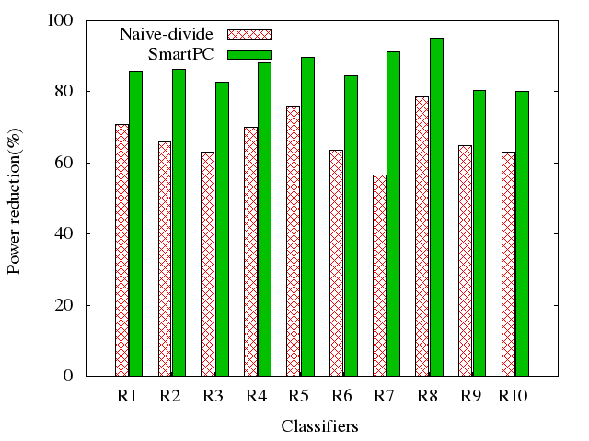
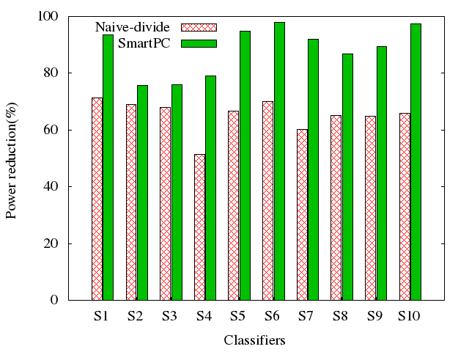
Comparison of SmartPC with Naïve-divide
Real classifiers
Synthetic classifiers
Percentage of power reductions with block size 128
SmartPC outperforms naïve-divide by more than 20% on average.

Slide 40
Discussion
Effect of prefix distribution and prefix length
Power reduction on small classifiers
Power reduction on IPv6 classifiers
Notes:
1、classbench生成的不同
2、只要多于3个block的small classifer情况都适用
3、方案同样适用于IPv6

Slide 41
Conclusion
Propose SmartPC, which:
  Greatly reduces power consumptions of TCAMs, especially for larger classifiers
  Uses commodity TCAMs
  Is easy to implement

Slide 42

Questions

Slide 43
Thanks

