Slide 1
Extensive Analysis and Large-Scale Empirical Evaluation of Tor Bridge Discovery
Zhen Ling
Southeast University
In collaboration with
Junzhou Luo, Southeast University
Wei Yu, Towson University
Ming Yang, Southeast University
Xinwen Fu, University of Massachusetts Lowell
31th IEEE International Conference on Computer Communications (INFOCOM), 2012

Slide 2
Outline
Introduction
Discovery of Tor Bridges
Evaluation
Summary

Slide 3
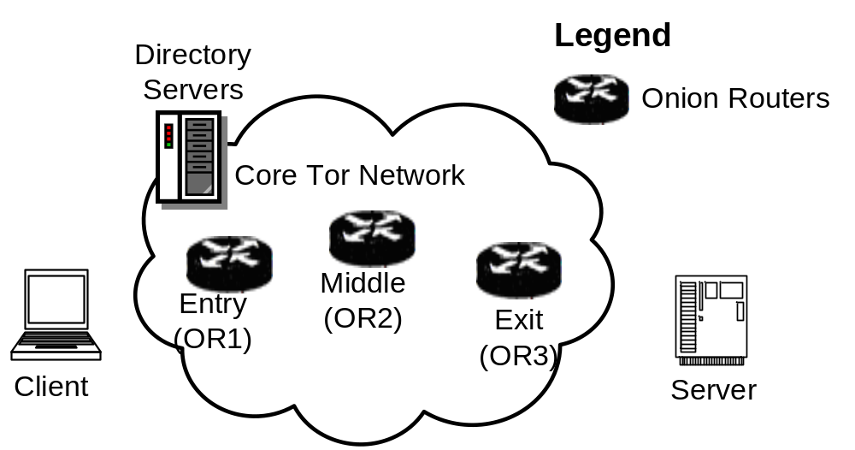

Introduction
Tor is a popular low-latency anonymous communication system and supports TCP applications over the Internet
  Source routing for communication privacy
  Publicly listed on the Internet
Circuit

Slide 4
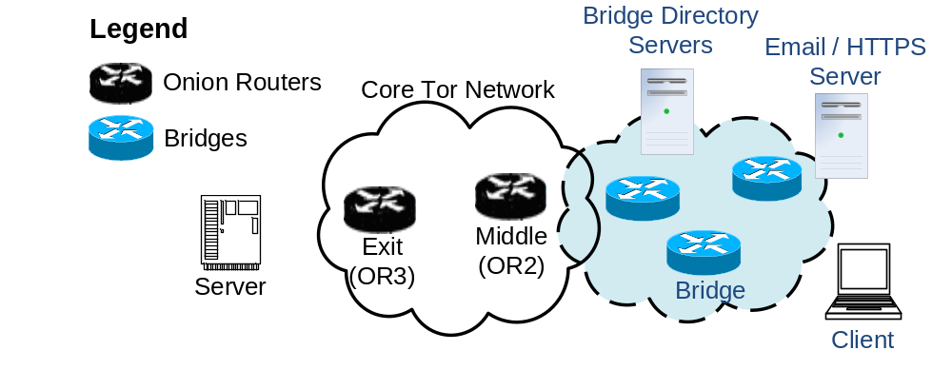
Tor Bridges
Tor introduce bridge to resist the censorship blocking of public Tor routers
  Bridge information not listed on the Internet
  Distribution via bridge https server / email server

Slide 5
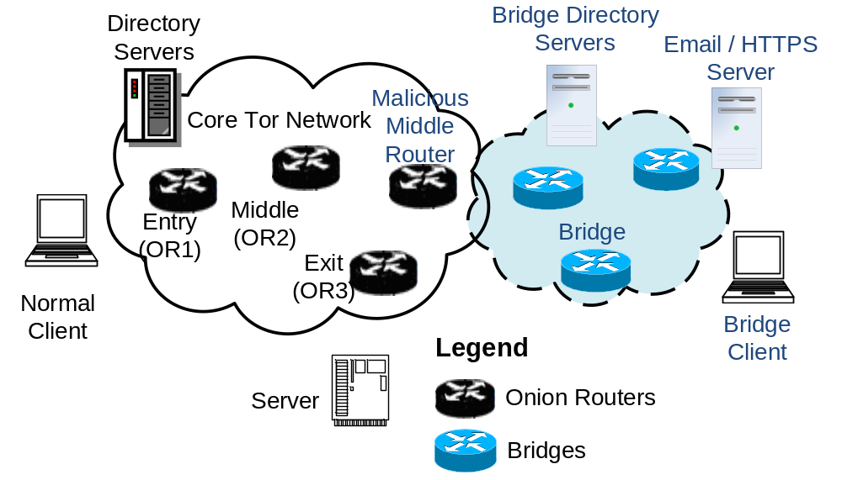
How Does Tor with Bridge Work?
Basic Components of Tor with Bridge

Slide 6

Two categories of bridge-discovery
The enumeration of bridges via bulk emails and Tor’s https server
The use of malicious middle routers to discover bridges

Slide 7
Outline
Introduction
Discovery of Tor Bridges
Evaluation
Summary
Notes:
Let me introduce the basic idea of these approaches.

Slide 8

Basic Idea
Email and https enumeration
  Yahoo and gmail to bridges@torproject.org
  https://bridges.torproject.org/
Discovery by bad middle routers
  Fact: a circuit passes both bridge and malicious middle router
  Middle routers at apartments, PlanetLab or Amazon EC2

Slide 9
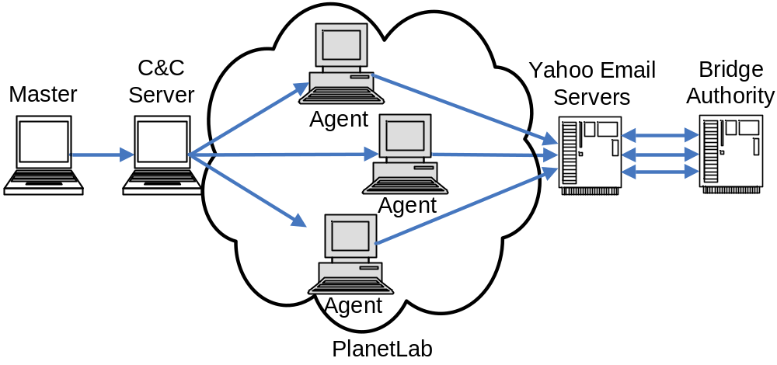
Enumerating Bridges via Email
Challenge: Tor limits bridge retrieval from each email account
500 PlanetLab nodes and 500+ Tor exit router as proxies to apply for 2000 email accounts via iMacros
A command-and-control architecture to send bulk emails
A tiny POP3 client Mpop to retrieve Yahoo emails via an emulated POP3 server FreePOPs

Slide 10
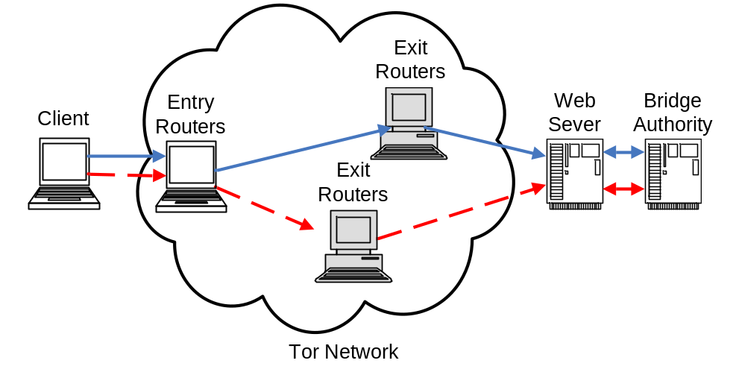
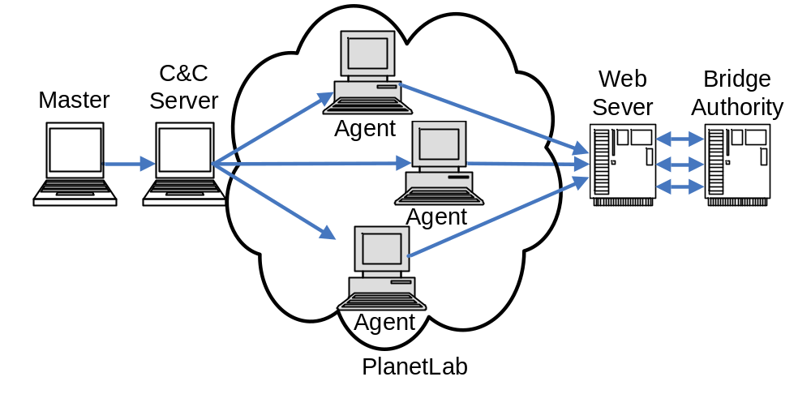
Enumerating Bridges via HTTPS
Challenge: Tor limits bridge retrieval from each class C network
https via PlanetLab nodes using a C&C architecuture
https via Tor exit nodes using customized two-hop circuits

Slide 11
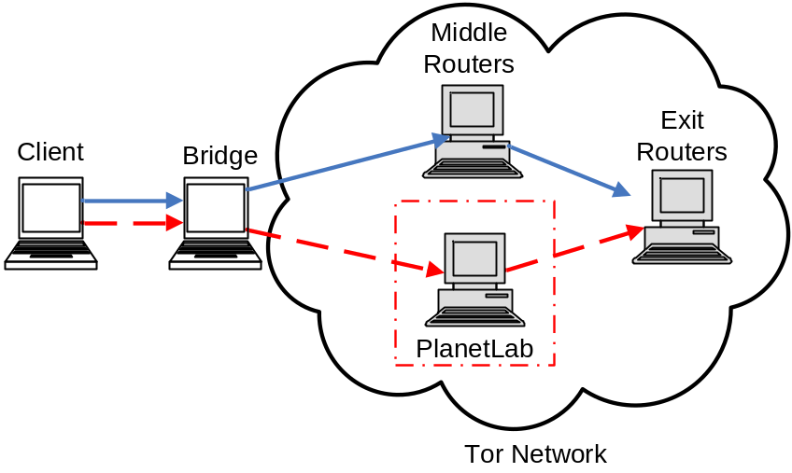
Discovering Bridges via Tor Middle Router
Deploy malicious Tor middle routers on PlanetLab to discover bridges connected to these Tor middle routers
Prevent malicious routers from becoming entry or exit routers automatically
  Reduce their bandwidth or control their uptime
  By configuring the exit policy, we can prevent those malicious routers from becoming exit routers

Slide 12
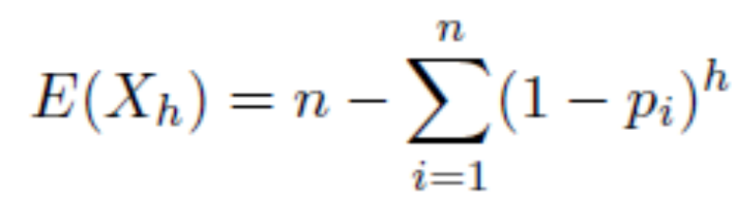
Analysis of Enumeration via Email and HTTPS
Coupon collection problem
Classic coupon collection problem:
  Bridges uniformly selected
  Collect nlog(n) coupons on average to collect all of the bridges
A weighted coupon collection problem:
  Bridges are selected according to the bandwidth
  Expected number of different bridges generated by these h samplings can be computed by

Slide 13

Analysis of Bridge Discovery via Middle Routers
Assume that k computers are injected into the Tor network with advertised bandwidth b
We can get the catch probability that a TCP stream from a bridge traverses malicious middle routers
  Catch probability increases with k and b, i.e., the total bandwidth of malicious middle routers

Slide 14
Outline
Introduction
Discovery of Tor Bridges
Evaluation
Summary

Slide 15
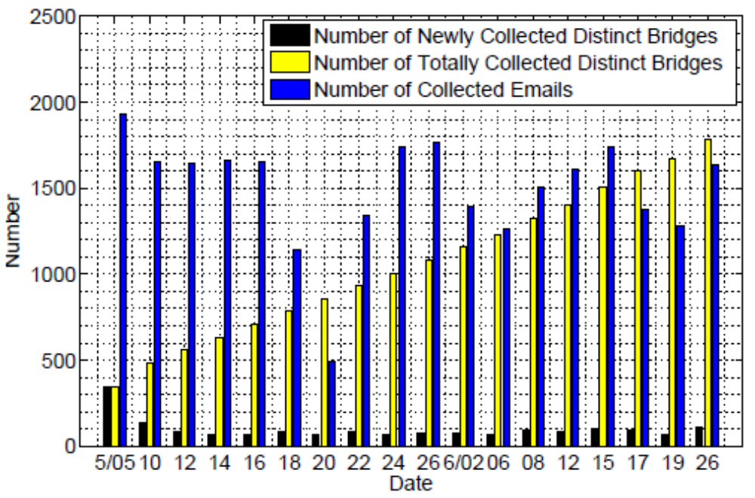
Enumerated Bridges via Emails

Slide 16
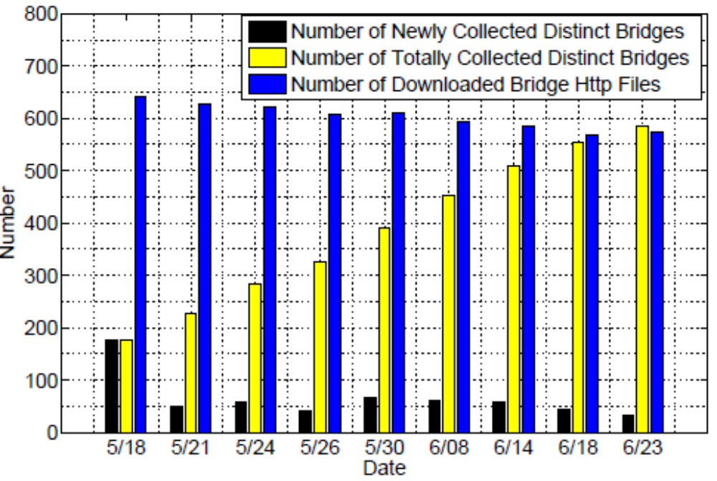
Enumerated Bridges via HTTPS

Slide 17
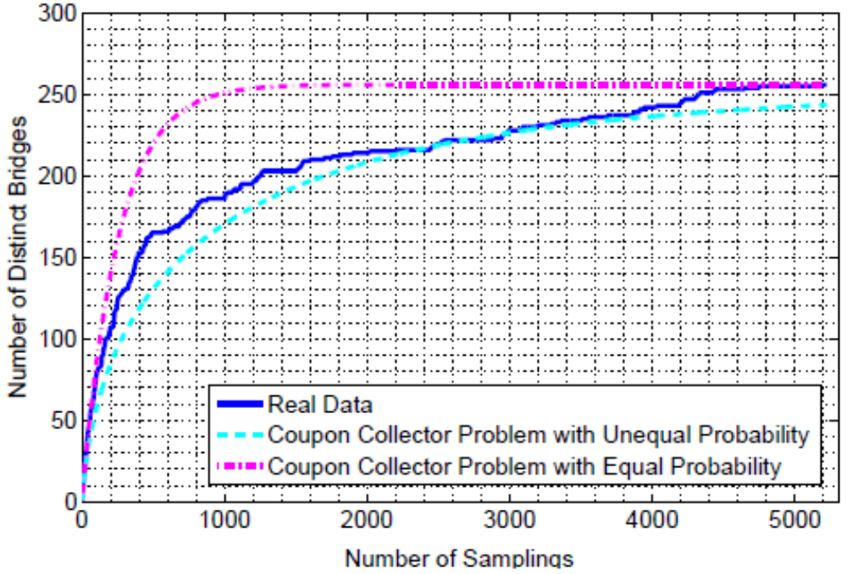
Number of Samplings v.s. Number of Distinct Bridges via Emails and HTTPs

Slide 18
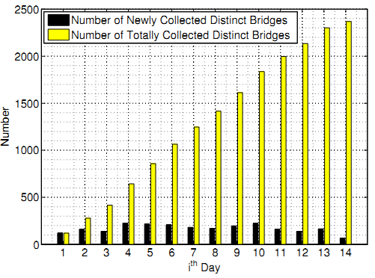
Discovery Bridges via ONE Tor Middle Router
2369 bridges in
in two weeks

Slide 19
Outline
Introduction
Discovery of Tor Bridges
Evaluation
Summary

Slide 20
Summary
Extensive analysis and large-scale empirical evaluation of Tor bridge discovery via email, https and malicious Tor middle routers
2365 Tor bridges enumerated via email and https
2369 bridges discoved by only one controlled Tor middle router in just 14 days
Countermeasure needed

Slide 21
Thank you!
Xinwen Fu
<number>/15

