Slide 1
Application of Dimensionality Reduction in Recommender Systems--A Case Study
Badrul M. Sarwar, George Karypis, Joseph A. Konstan, and John T. Riedl
GroupLens Research Group
Department of Computer Science and Engineering
University of Minnesota

Slide 2
Talk Outline
Introduction to Recommender Systems (RS)
Challenges
Dimensionality Reduction as a Solution
Experimental Setup and Results
Conclusion

Slide 3
Recommender Systems
Problem
  Information Overload
  Too Many Product Choices
Solution
  Recommender Systems (RS)
    Collaborative Filtering

Slide 4





Collaborative Filtering
Representation of input data
Neighborhood formation
Prediction/Top-N recommendation
Target
Customer
3

Slide 5
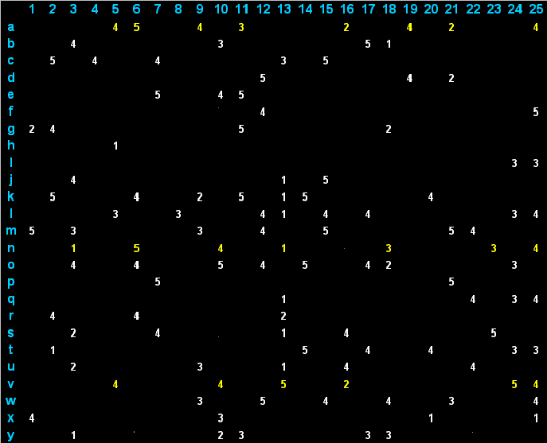
Challenges of RS
products
Scalability
  Enormous size of customer-product matrix
  Slow neighborhood search
  Slow prediction generation
Sparsity
  May hide good neighbors
  Results in poor quality and reduced coverage
Customers

Slide 6
Challenges of RS
Synonymy
  Similar products treated differently
  Increases sparsity, loss of transitivity
  Results in poor quality
Example
  C₁ rates recycled letter pads High
  C₂ rates recycled memo pads High
Both of them like
Recycled office products
Notes:
Letter pad信纸，memo pad便笺；增加数据集的稠密性，同义产品的整合

Slide 7
Idea: Dimensionality Reduction
Latent Semantic Indexing
  Used by the IR community for document similarity
  Works well with similar vector space model
  Uses Singular Value Decomposition (SVD)
Main Idea
  Term-document matching in feature space
  Captures latent association
  Reduced space is less-noisy
Notes:
Vector space model or term vector model is an algebraic model for representing text documents (and any objects, in general) as vectors of identifiers

Slide 8
SVD: Mathematical Background
=
V’
S
V_{k}’
R
U_{k}
S_{k}
R_{k}
U
k X n
m X k
r X n
m X r
r X r
m X n
k X k
The reconstructed matrix R_{k} = U_{k}.S_{k}.V_{k}’ is the closest
rank-k matrix to the original matrix R.

Slide 9
SVD for Collaborative Filtering
1. Low dimensional representation
O(m+n) storage requirement
k x n
.
m x k
m x n
2. Direct
Prediction
m x m
similarity
Top-N Recommendation
Prediction (CF algorithm)
3. Neighborhood
Formation

Slide 10
Experimental Setup
Data Sets
  MovieLens data (www.movielens.umn.edu)
    943 users, 1,682 items
    100,000 ratings on 1-5 Likert scale
    Used for prediction and neighborhood experiments
  E-commerce data
    6,502 users, 23,554 items
    97,045 purchases
    Used for neighborhood experiment
  Train and test portions
    Percentage of training data, x

Slide 11
Experimental Setup
Benchmark Systems
  CF-Predict
  CF-Recommend
Metrics
  Prediction
    Mean Absolute Error (MAE)
  Top-N Recommendation
    Recall and Precision
    Combined score F1

Slide 12
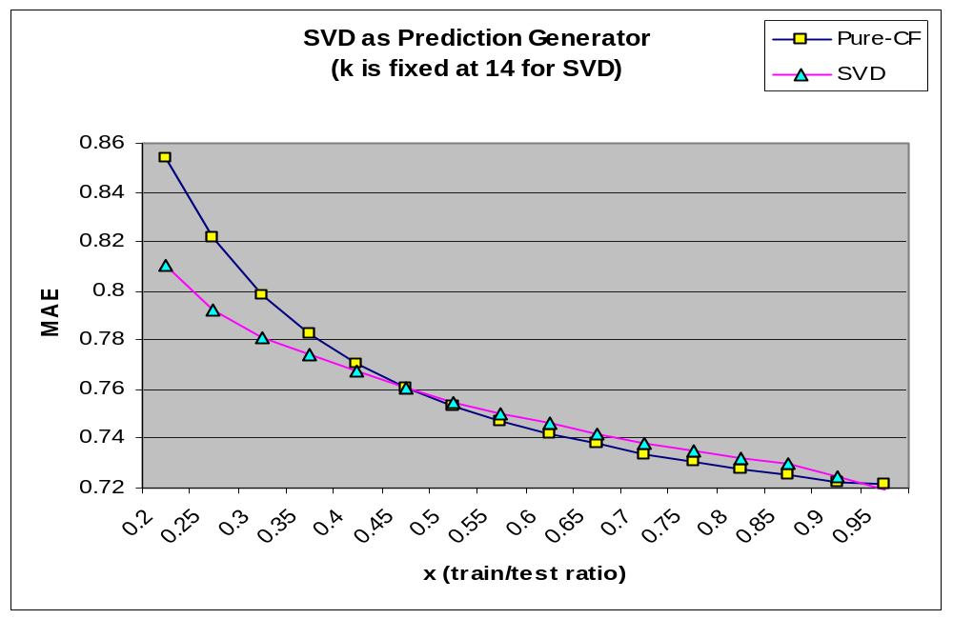
Results: Prediction Experiment
Movie data
Used SVD for prediction generation based on the train data
Computed MAE
Obtained similar results from CF-predict

Slide 13
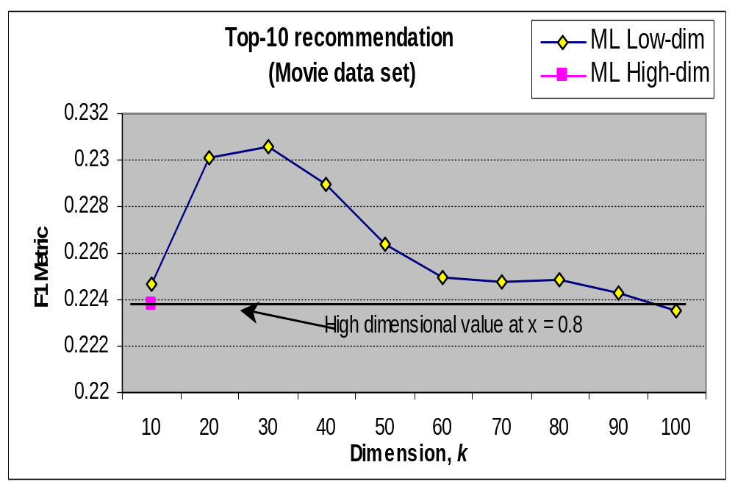
Results: Neighborhood Formation
Movie Dataset (converted to binary)
Used SVD for dimensionality reduction
Formed neighborhood in the reduced space
Used neighbors to produce recommendations
Computed F1
Obtained similar results from CF-Recommend

Slide 14
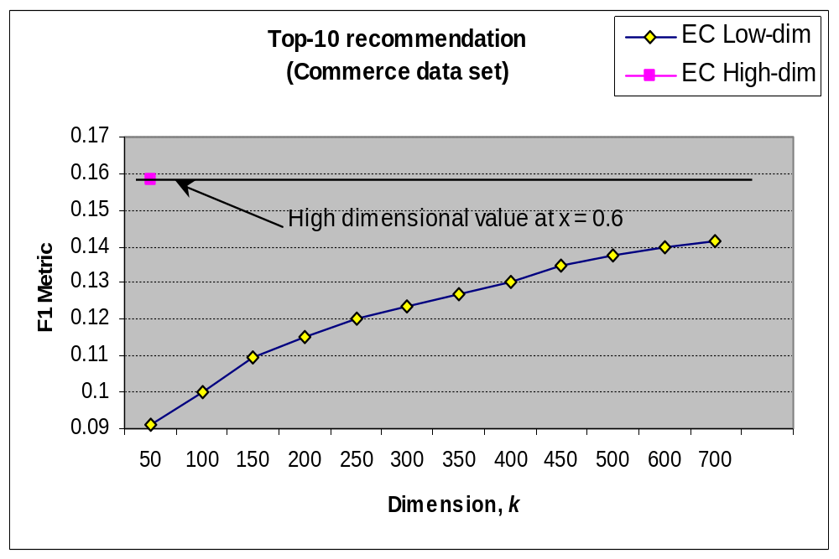
Results: Neighborhood Formation
E-Commerce Dataset
Used SVD for dimensionality reduction
Formed neighborhood in the reduced space
Used neighbors to produce recommendations
Computed F1
Obtained similar results from CF-Recommend

Slide 15
Conclusion
SVD results are promising
  Provides better Recommendations for Movie data
    Provides better Predictions for x<0.5
  Not as good for the E-Commerce data
    Even up to 700 dimensions!
SVD provides better online performance
  Storage O(m+n) vs. O(m²) Pure CF
SVD is capable of meeting RS challenges
  Sparsity
  Scalability
  Synonymy
A follow-up paper appears at EC’00 conference

Slide 16


