Slide 1


Unconstrained Endpoint Profiling
(Googling the Internet)‏
Ionut Trestian
Supranamaya Ranjan
Aleksandar Kuzmanovic
Antonio Nucci
Northwestern University
Narus Inc.
http://networks.cs.northwestern.edu
http://www.narus.com

Slide 2
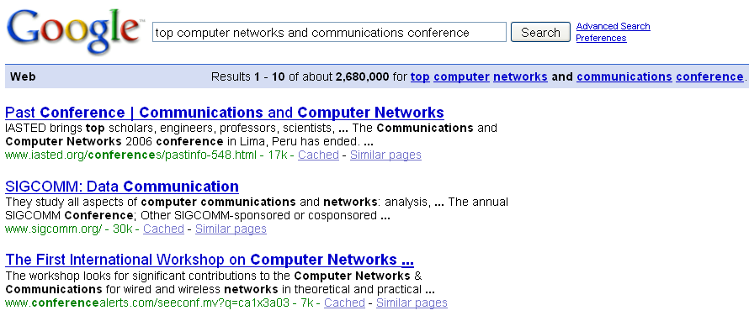

Slide 3

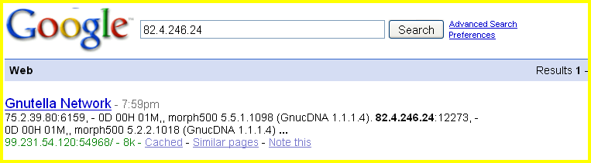


Introduction
Can we use Google for networking research?
Huge amount of endpoint information available on the web
Can we systematically exploit search engines to harvest endpoint information available on the Internet?

Slide 4
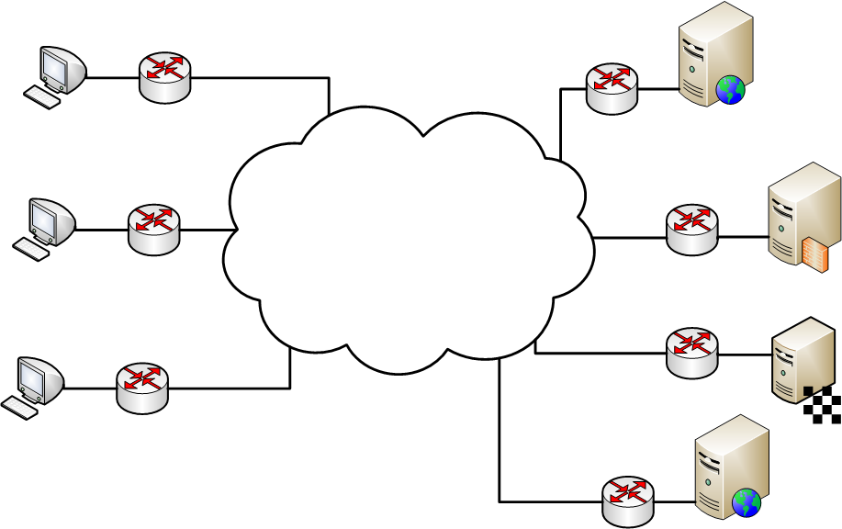





Where Does the Information Come From?
Some popular proxy services also display logs
Even P2P information is available on the Internet since the first point of contact with a P2P swarm is a publicly available IP address
Websites run logging software and display statistics
Blacklists, banlists, spamlists also have web interfaces
Popular servers (e.g., gaming) IP addresses are listed
Servers
Clients
P2P
Malicious

Slide 5


Inferring Active IP Ranges in Target Networks
Problem – detecting active IP ranges
Needed for large-scale measurements
  e.g., Iplane [OSDI’06]
Current approaches
  Active
  Passive
Our approach
  IP addresses that generate hits on Google could suggest active ranges

Slide 6






Detecting Application Usage Trends
Can we infer what applications people
are using across the world without
having access to network traces?

Slide 7
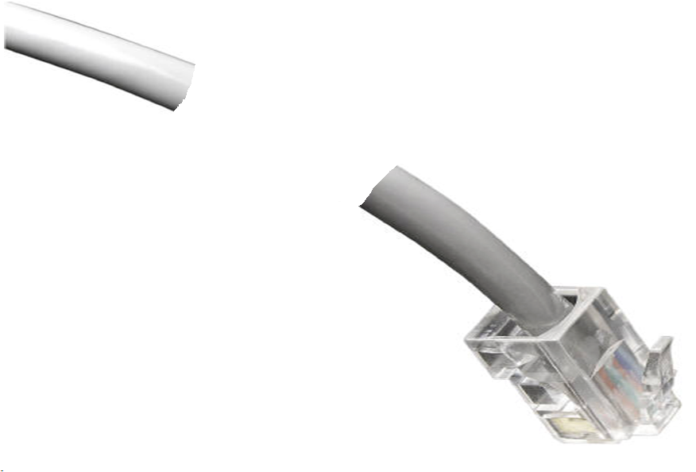









Traffic Classification
Problem – traffic classification
Current approaches
  (port-based, payload signatures,
  numerical and statistical etc.)
Our approach
  Use information about destination IP
  addresses available on the Internet

Slide 8
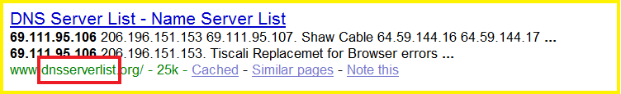
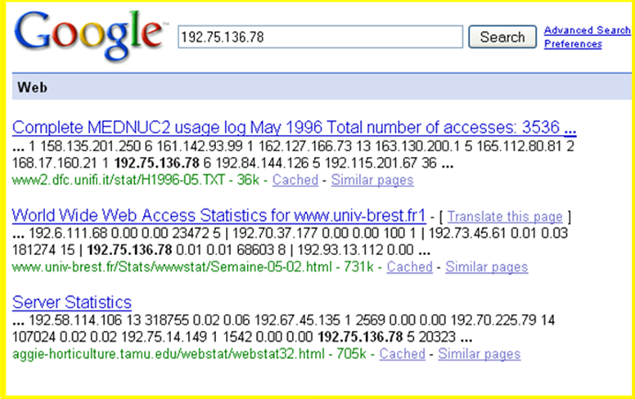
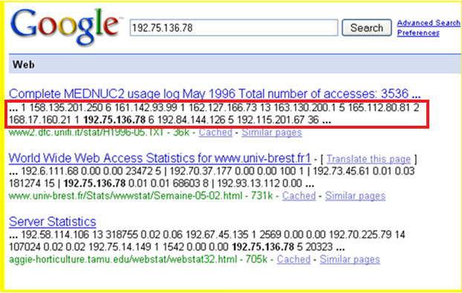
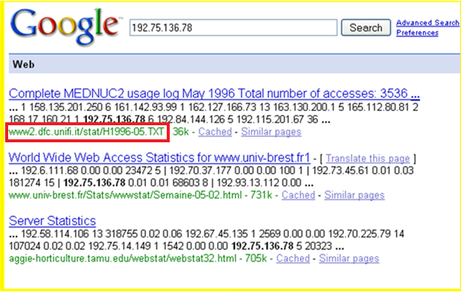
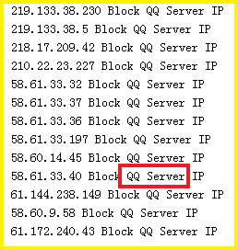

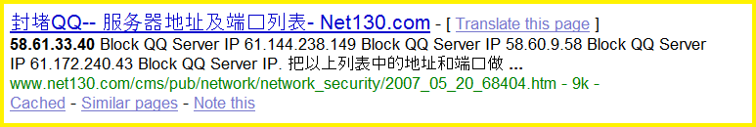






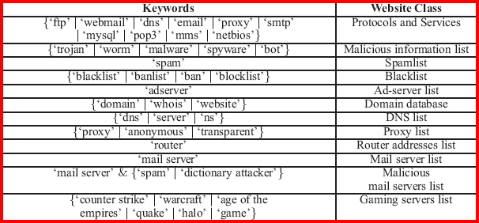
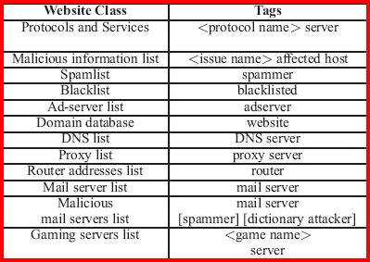






Methodology – Web Classifier and IP Tagging
IP Address
xxx.xxx.xxx.xxx
58.61.33.40 – QQ Chat Server
Rapid Match
IP tagging
URL
Hit text
URL
Hit text
URL
Hit text
Domain name
Keywords
….
….
Domain name
Keywords
Search hits
….
….
Website cache

Slide 9
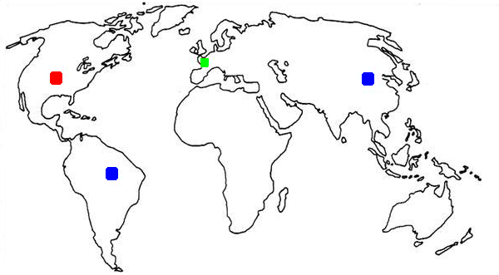
Evaluation – Ground Truth
France
● No traces available
China
● Packet level traces available
United States
● Sampled NetFlow available
Brasil
● Packet level traces available

Slide 10

Inferring Active IP Ranges in Target Networks

Slide 11
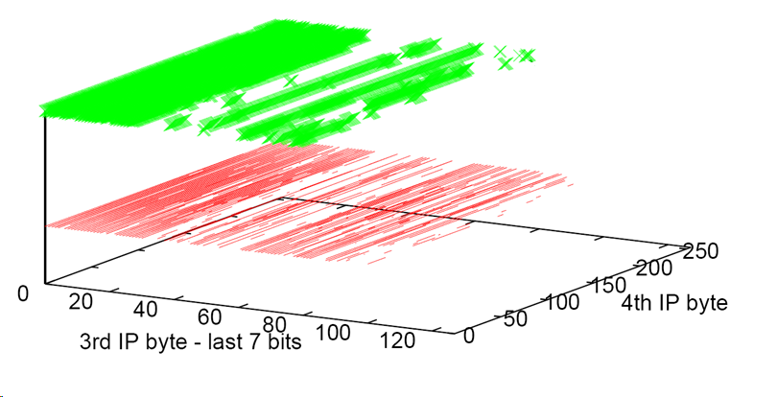

Inferring Active IP Ranges in Target Networks
Actual endpoints
from trace
Google hits
XXX.163.0.0/17 network range
Overlap is around 77%

Slide 12
Application Usage Trends

Slide 13
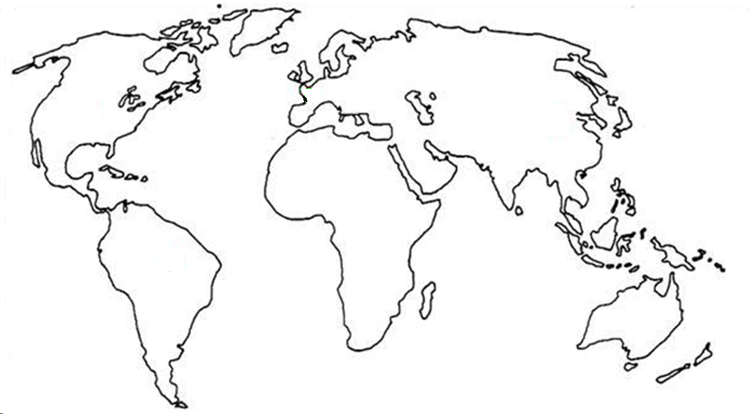



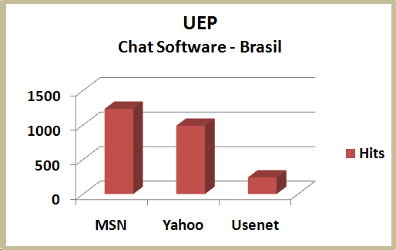
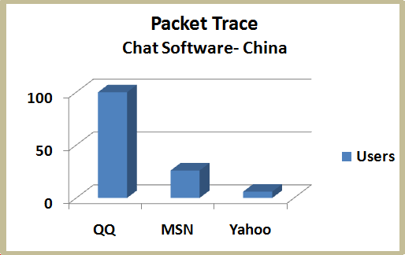
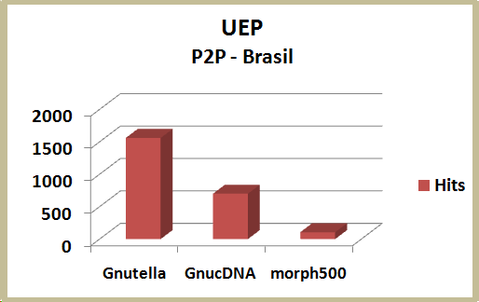
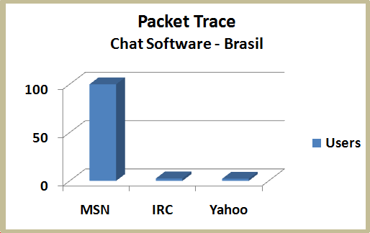
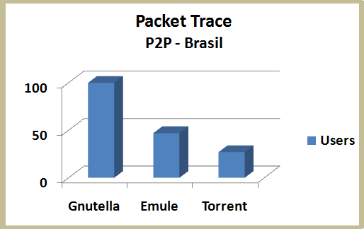
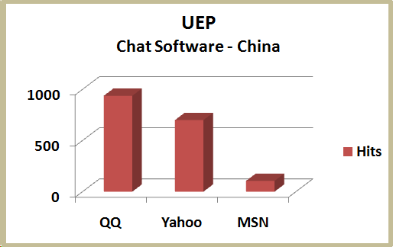
Correlation Between Network Traces and UEP

Slide 14
Traffic Classification

Slide 15

Traffic Classification
165.124.182.169
Mail server
193.226.5.150
Website
68.87.195.25
Router
Tagged IP Cache
186.25.13.24
Halo server
Hold a small % of the IP addresses seen
Look at source and destination IP addresses and classify traffic
Is this scalable?

Slide 16
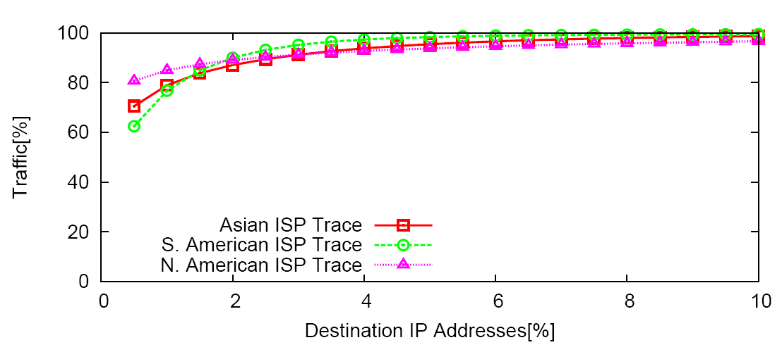
Traffic Classification
5% of the destinations sink 95% of traffic

Slide 17


BLINC vs. UEP
UEP (SIGCOMM 2008)
Uses information available on the web
Constructs a semantically rich endpoint database
Very flexible (can be used in a variety of scenarios)
BLINC (SIGCOMM 2005)
Works “in the dark” (doesn’t examine payload)
Uses “graphlets” to identify traffic patterns
Uses thresholds to further classify traffic

Slide 18
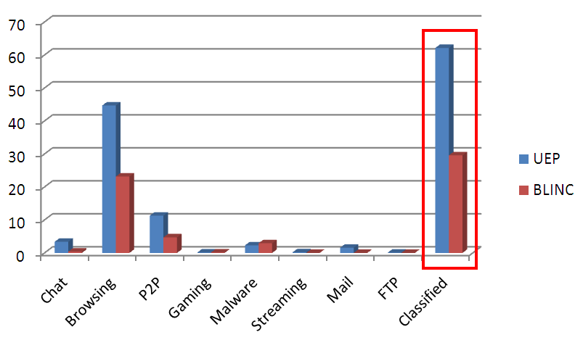
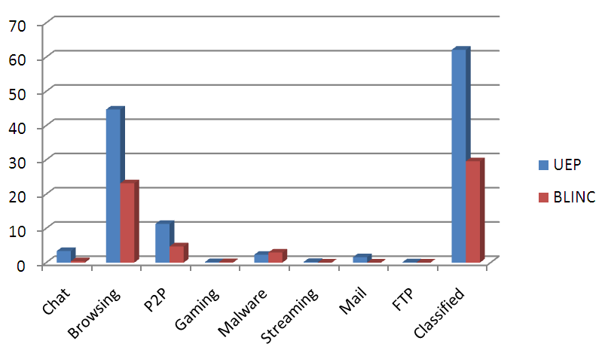
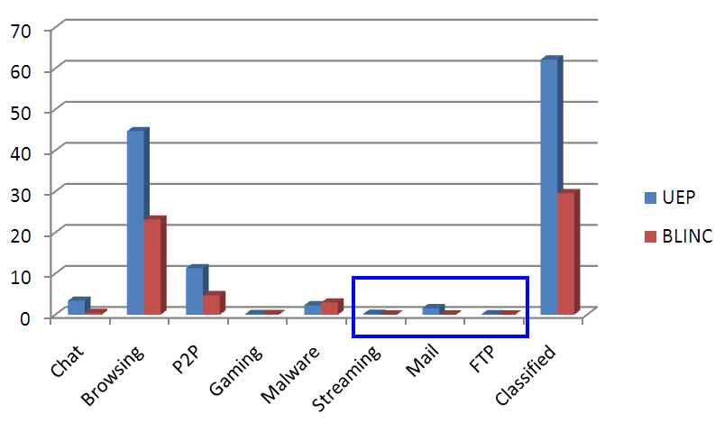

BLINC vs. UEP (cont.)
Traffic[%]
UEP classifies twice as much traffic as BLINC
BLINC doesn’t find
some categories
UEP also provides better semantics
Classes can be further divided into different services

Slide 19
Working with Sampled Traffic
Sampled data is considered to be poorer in information
However ISPs consider scalable to gather only sampled data
X
X
X
X
X
X
X
X
Each packet has a 1/Sampling rate chance of being kept
(Cisco Netflow)

Slide 20
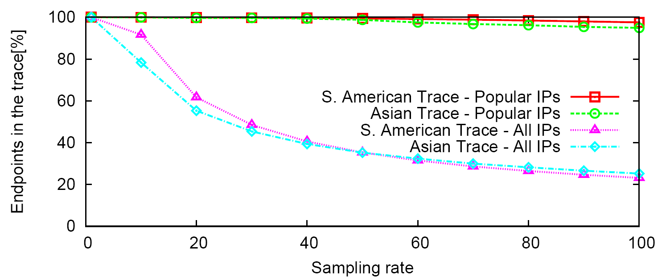
Working with Sampled Traffic
Most of the popular IP addresses still in the trace
A quarter of the IP addresses still in the trace at sampling rate 100

Slide 21
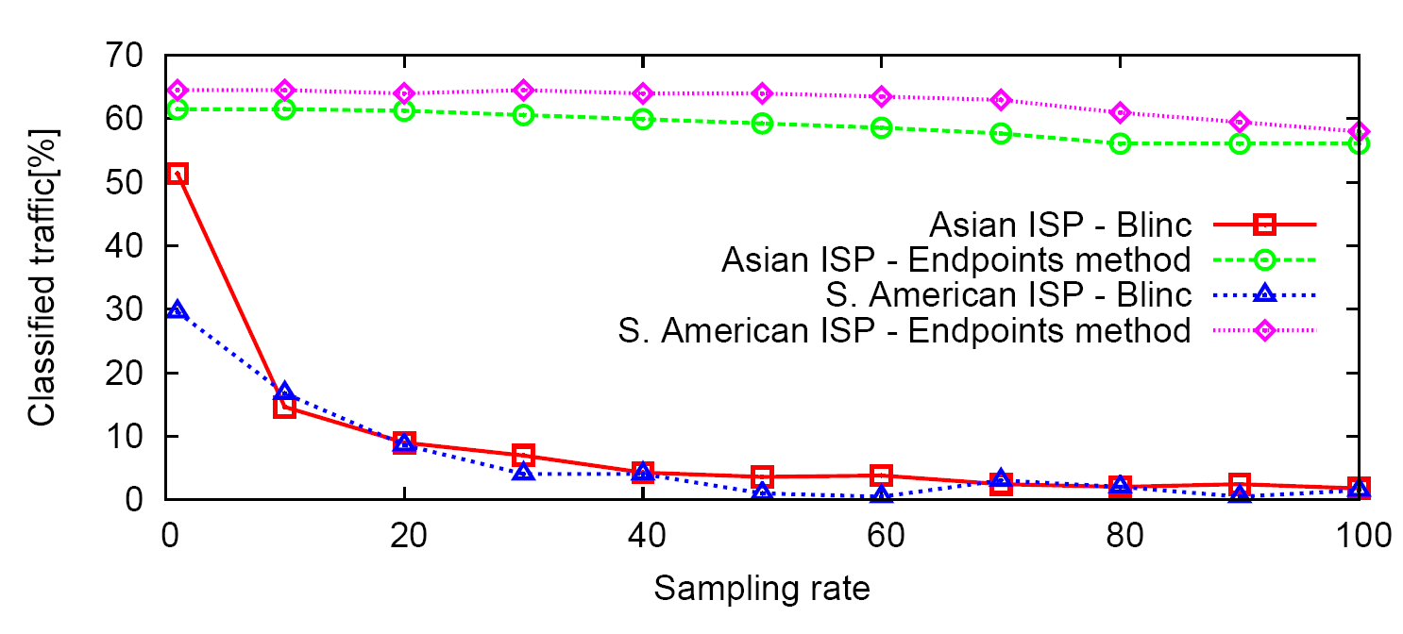

Working with Sampled Traffic
UEP maintains a large classification ratio even at higher sampling rates
When no sampling is done
UEP outperforms BLINC
BLINC stays in the dark
2% at sampling rate 100
UEP retains high classification
capabilities with sampled traffic

Slide 22

Endpoint Clustering
Performed clustering of endpoints in order to cluster out common behavior
Please see the paper for detailed results
Real strength:
We managed to achieve similar results both by using the trace and only by using UEP

Slide 23
Conclusions
Key contribution:
  Shift research focus from mining operational network traces to harnessing information that is already available on the web
Our approach can:
  Predict application and protocol usage trends in arbitrary networks
  Dramatically outperform classification tools
  Retain high classification capabilities when dealing with sampled data

