Slide 1

HybridCuts: A Scheme Combining Decomposition and Cutting for Packet Classification
Wenjun Li
Xianfeng Li
School of Electronic and Computer Engineering (ECE)
Peking University
IEEE Hot Interconnects 21
San Jose, CA, August 21-22, 2013

Slide 2
Outline
  Background
  HybridCuts
  Evaluation
  Conclusion
School of ECE, Peking University

Slide 3
PART I: Background
School of ECE, Peking University

Slide 4
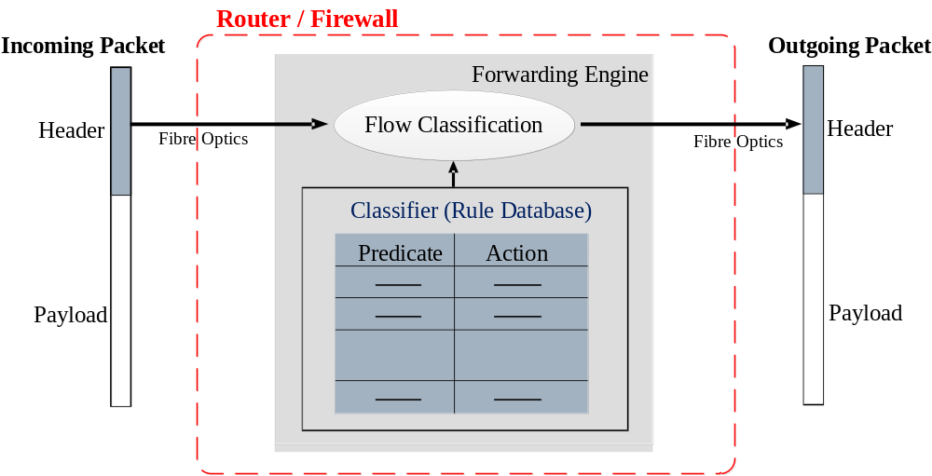
Packet Classification
Key for policy enforcement in packet forwarding
# | SA | DA | SP | DP | Prot | Action
r₁ | 1.2.3.0/20 | 192.168.0.1 | [1,65534] | [1,65534] | TCP | accept
r₂ | 1.2.3.11/24 | 1.2.3.11/24 | 80 | [1,65534] | UDP | accept
r₃ | * | * | * | * | * | discard
School of ECE, Peking University

Slide 5
Why Yet Another Paper?
A well established problem
  without
Well established solutions
Algorithmic: Desired but speed/memory inefficient
Architectural: Fast but expensive, power hungry, poor scalability and suffer from range expansion
School of ECE, Peking University

Slide 6
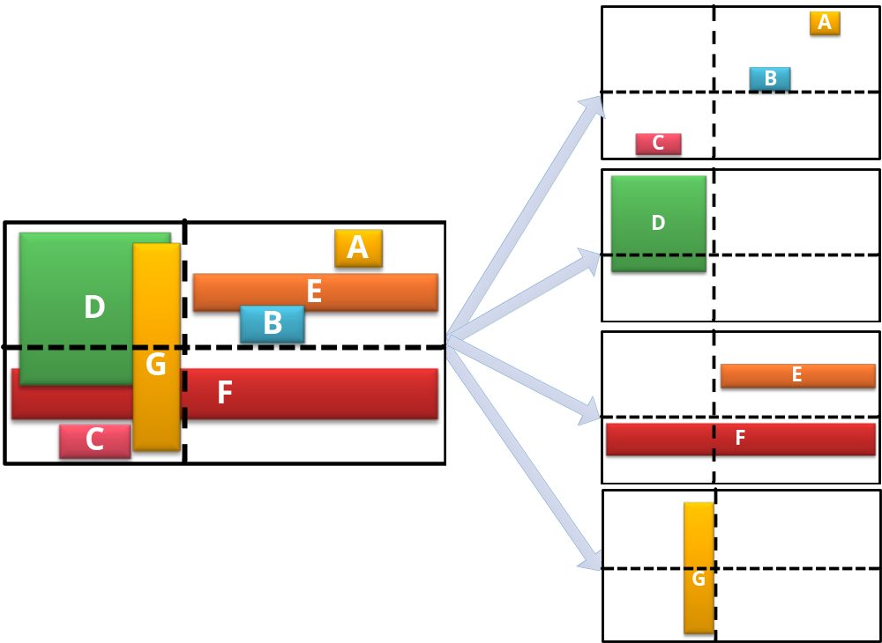
Recent Efforts on Algo. Solutions
EffiCuts [SIGCOMM’10]
Reduction by Separation
Equal-dense cutting, etc
Pros
Reduction on memory consumption
Cons
Increase on #memory accesses
School of ECE, Peking University

Slide 7
Better Solutions?
Rule separation: the right direction
Better separations
(with less rule groups)
+
Better cuttings
(by exploiting characteristics)
School of ECE, Peking University

Slide 8
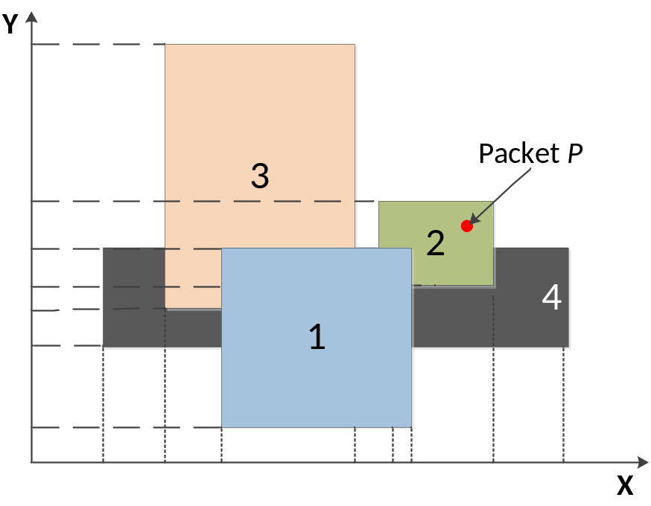
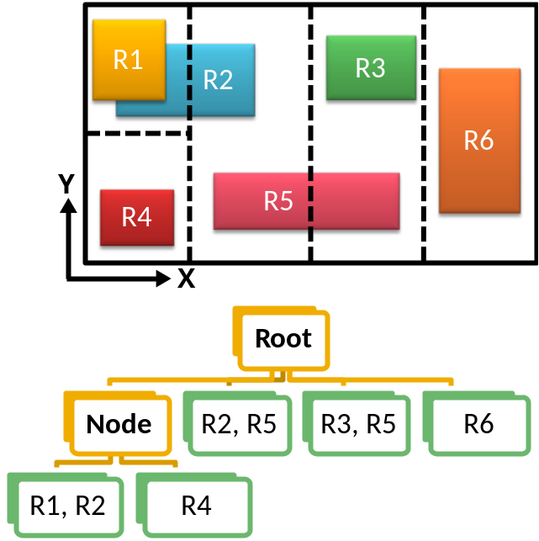
A Little Review...
Decomposition
Cutting
School of ECE, Peking University

Slide 9
  PART II: HybridCuts
School of ECE, Peking University

Slide 10
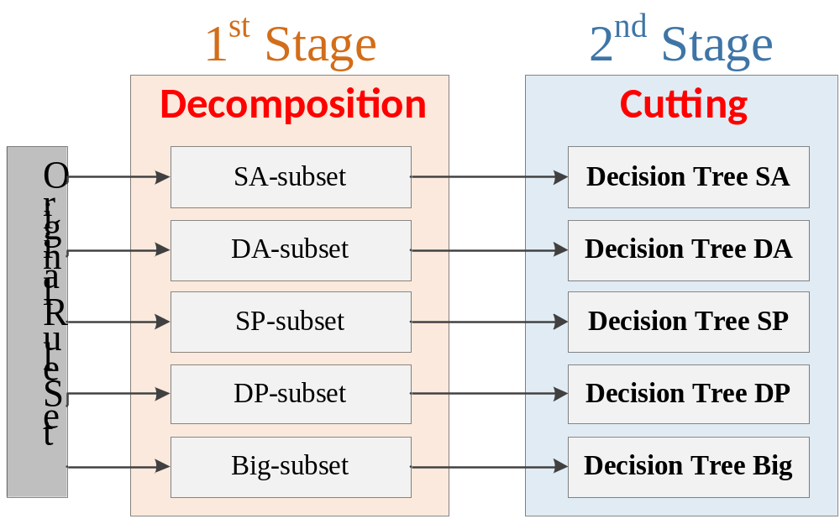
HybridCuts
A two-stage scheme
Preprocessing && Constructing search structure
School of ECE, Peking University

Slide 11
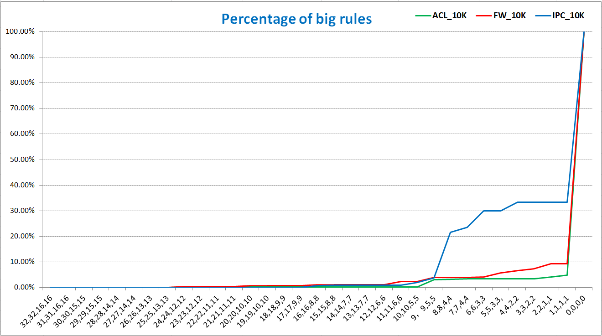
Observations (1)
Very few big rules!
Threshold: （SA，DA，SP，DP）
School of ECE, Peking University

Slide 12
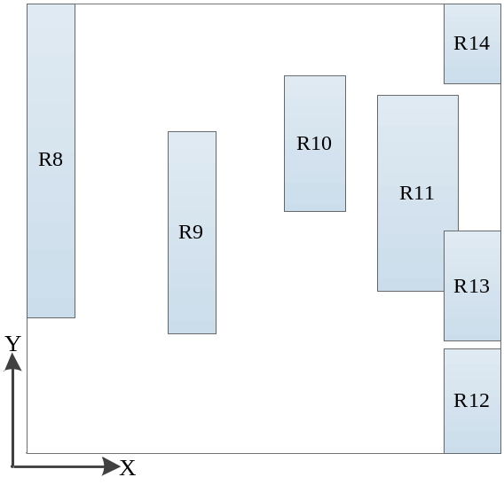
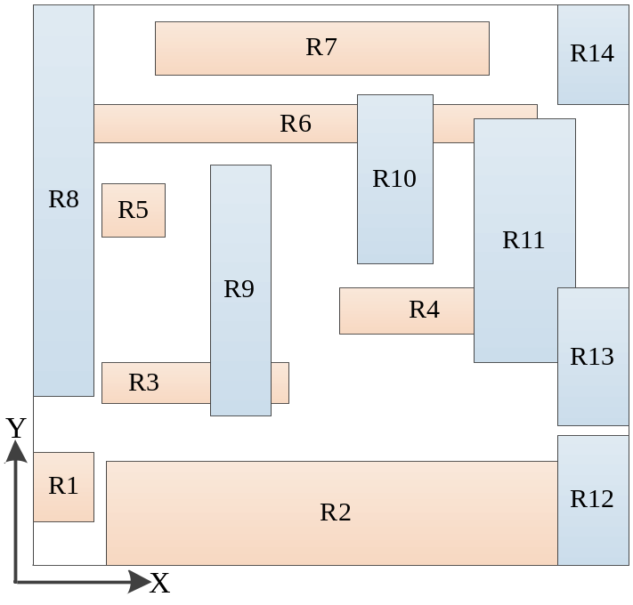
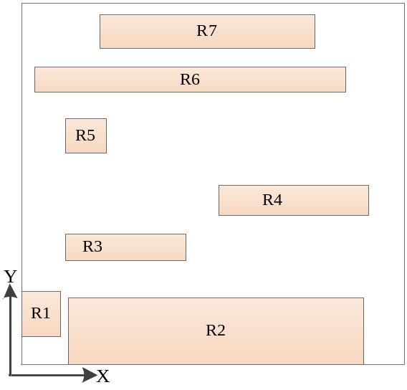
Observation (2)
X-Subset
Decomposition
Y-Subset
School of ECE, Peking University

Slide 13
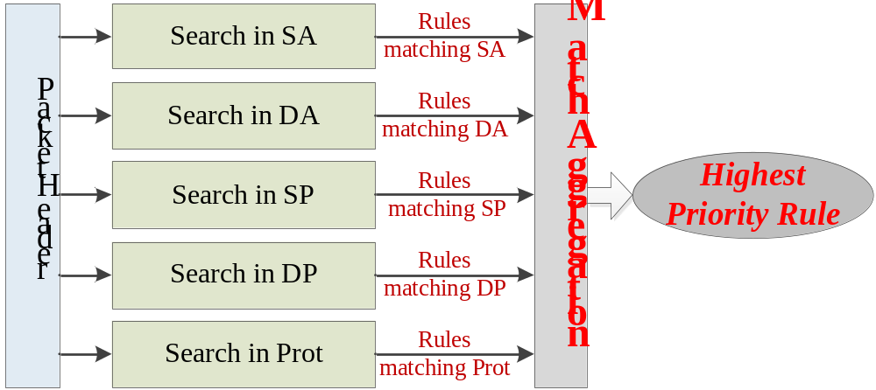
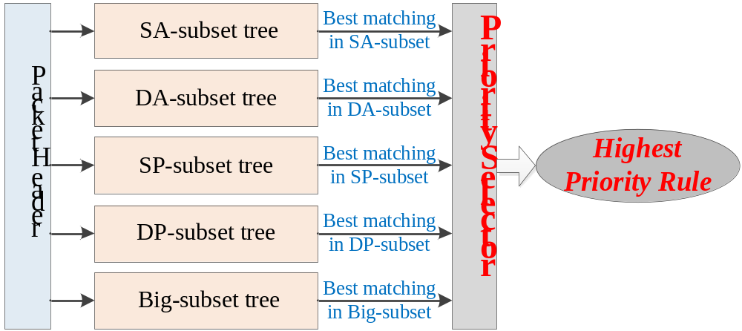
Decomposition
Traditional
Decomposition
Improved
Decomposition
School of ECE, Peking University

Slide 14
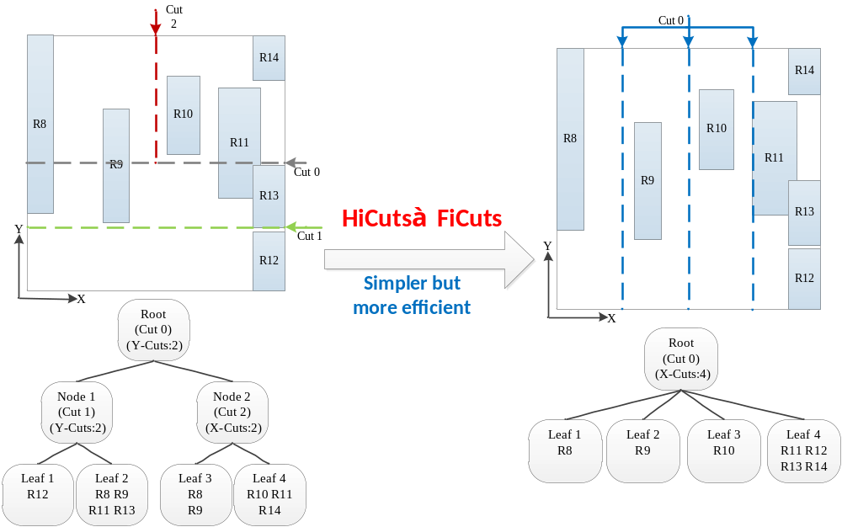
FiCuts: Fixed intelligent Cuttings
Global optimization wins!
School of ECE, Peking University

Slide 15
A hybrid FiCuts + HyperCuts
When to switch to HyperCuts?
  Subspace becomes small, and rule replication becomes intense
  A threshold to trigger the FiCut=>HyperCuts switching
School of ECE, Peking University

Slide 16
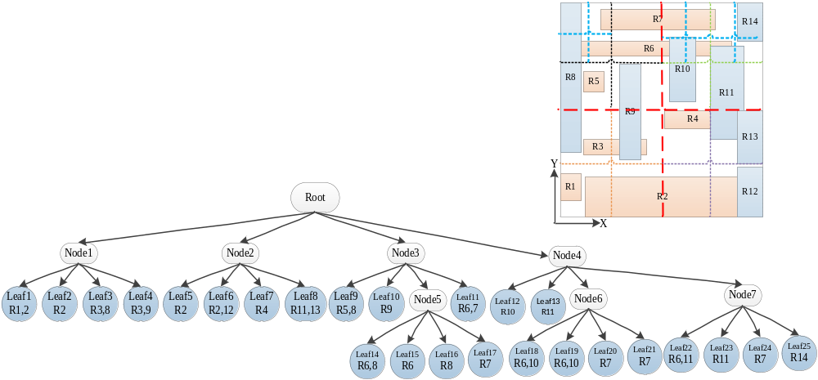
Effectiveness (1)
  14 →36 rules
HyperCuts
School of ECE, Peking University

Slide 17
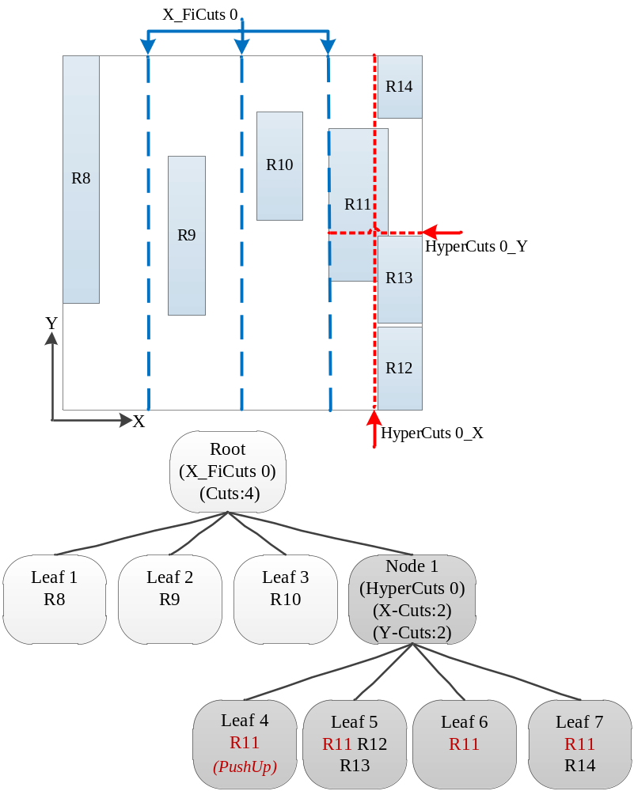
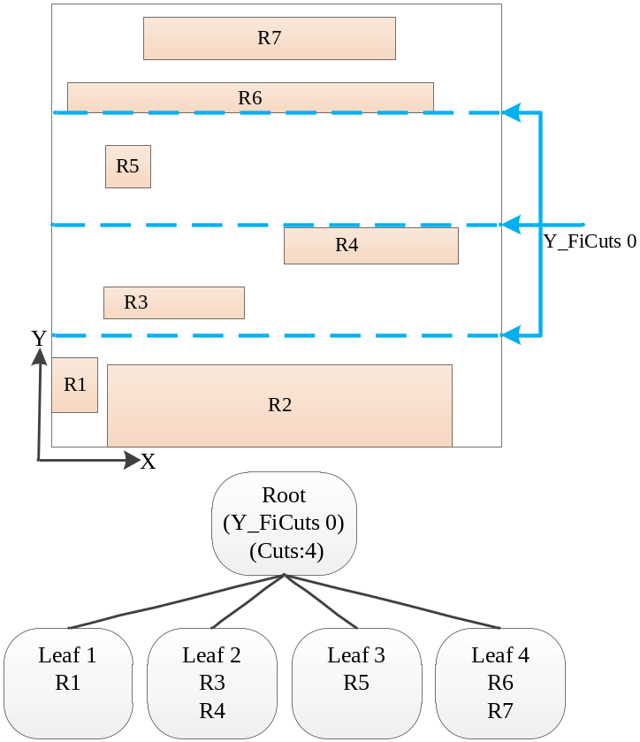
Effectiveness (2)
  14 →14 rules
Y-Subset
HybridCuts
X-Subset
School of ECE, Peking University

Slide 18
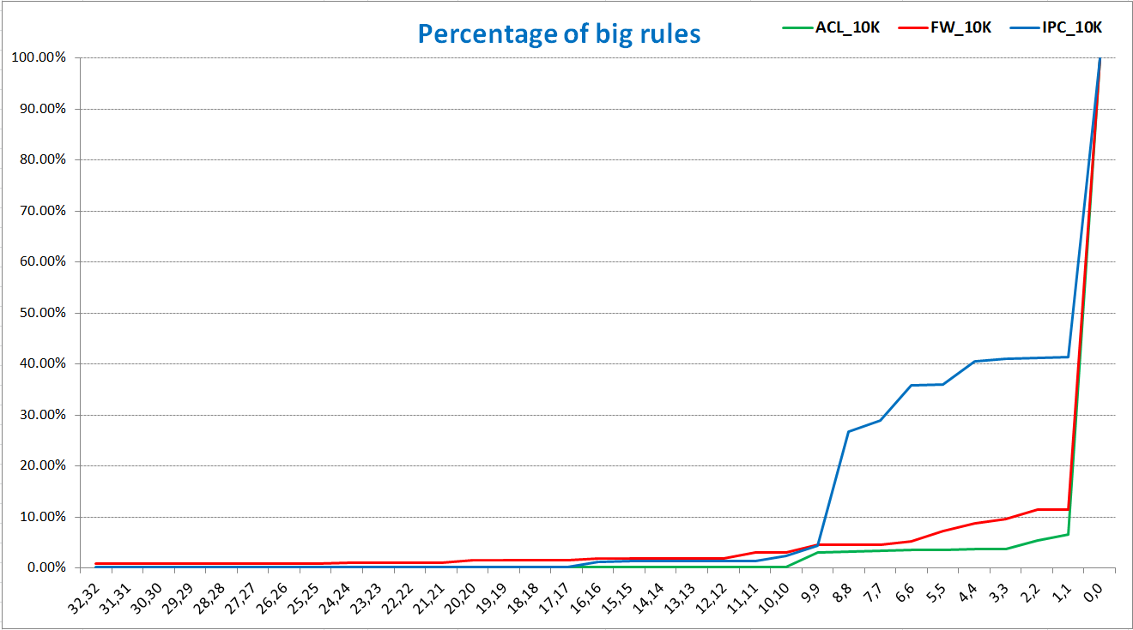
Optimization
Can be smaller? 5→3 subsets
Threshold: （SA，DA）
School of ECE, Peking University

Slide 19
  PART III: Evaluation
School of ECE, Peking University

Slide 20
Experimental Setup
Tested with
  A publicly available rule set from Washington University
    Used the ACL & FW & IPC 1K, 10K
  ClassBench
    Generate ACL & FW & IPC 100K
Compared with
  HyperCuts && EffiCuts
Primary metrics
  Memory consumption (Bytes/rule)
  Number of memory accesses
Open Source for HybridCuts
  https://github.com/lwj4333765/HybridCuts
School of ECE, Peking University

Slide 21
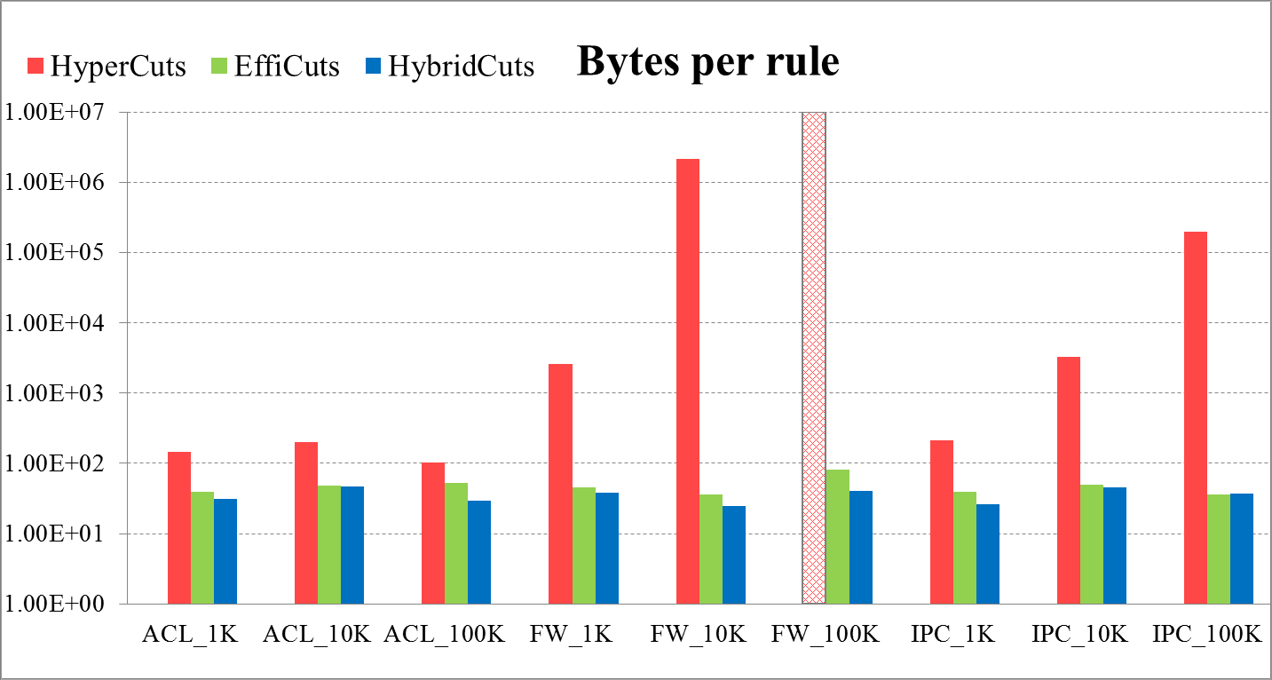
Memory Consumption
School of ECE, Peking University

Slide 22
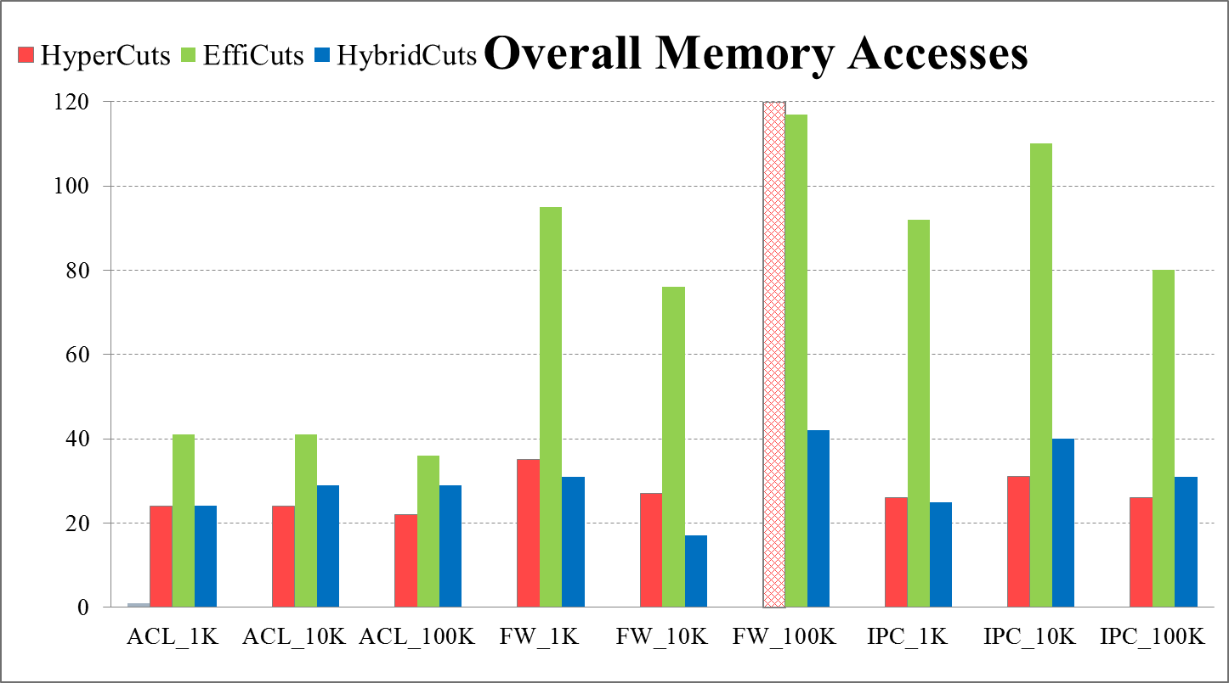
Memory Accesses
School of ECE, Peking University

Slide 23
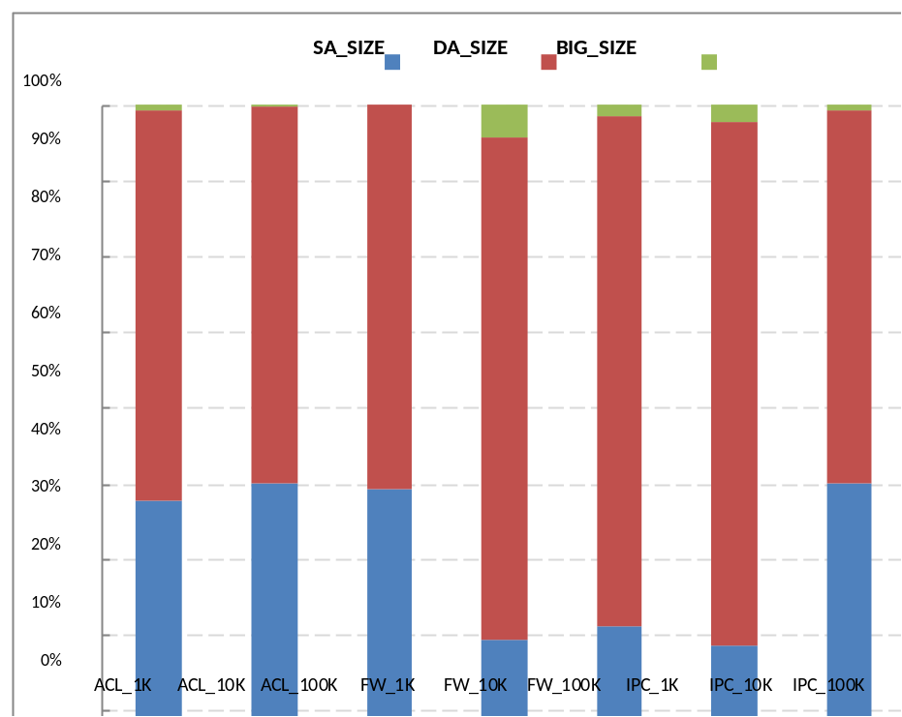
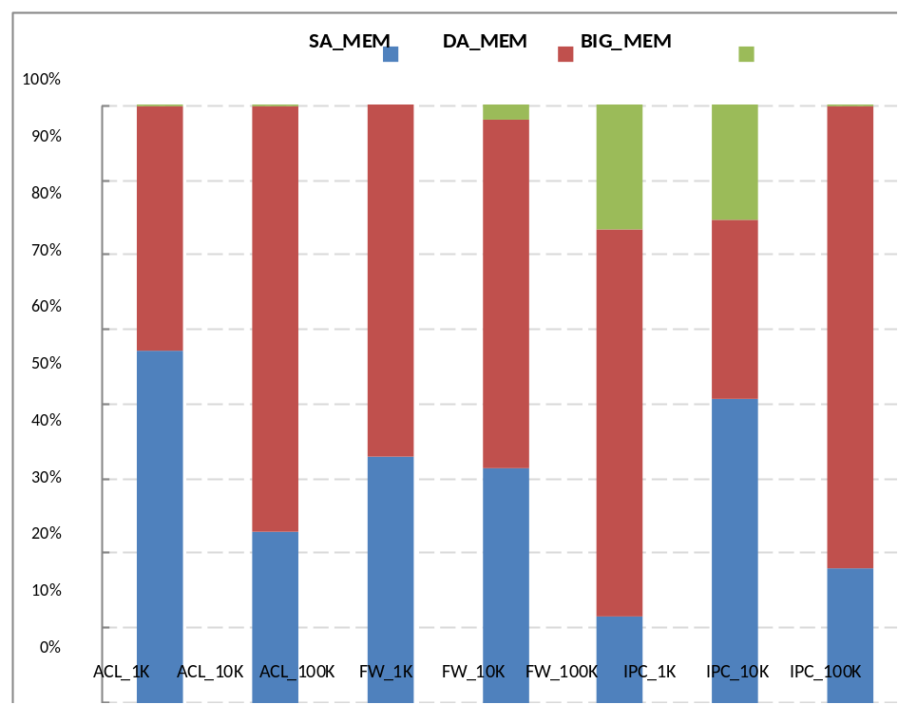
More Insights
The sizes of subsets
The sizes of trees
School of ECE, Peking University

Slide 24
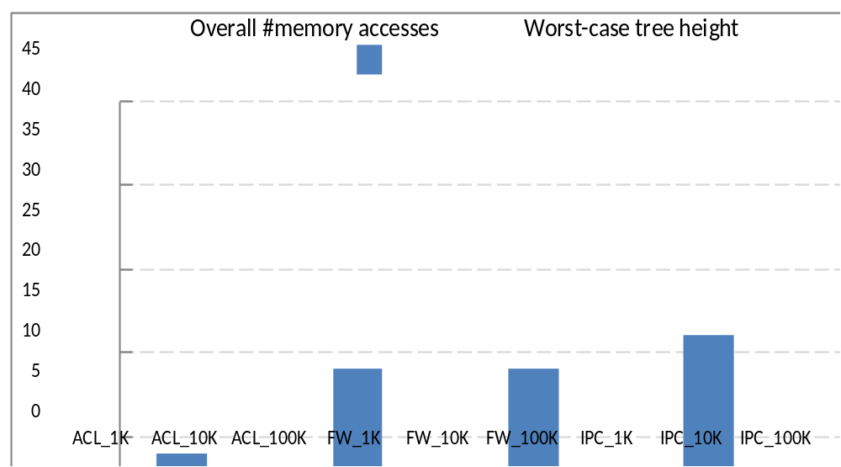
Potential Gain with Parallelization
School of ECE, Peking University

Slide 25
  PART V: Conclusion
School of ECE, Peking University

Slide 26
Conclusion
HybridCuts:
  decomposition + cutting
  New observations
  A new rule set decomposition
  A hybrid One- + Multi- dimensional cutting
Future Works
  OpenFlow
  Software-hardware combined, e.g., FPGA
  Combine with TCAM
School of ECE, Peking University

Slide 27
Thank you!
E-mail: liwenjun@sz.pku.edu.cn
wenjunli@pku.edu.cn
Web: http://liwenjun.weebly.com

