Slide 1
Data Center TCP
(DCTCP)
Mohammad Alizadeh, Albert Greenberg, David A. Maltz, Jitendra Padhye Parveen Patel, Balaji Prabhakar, Sudipta Sengupta, Murari Sridharan
Modified by Feng Xie

Slide 2

Data Center Packet Transport
Cloud computing service provider
  Amazon,Microsoft,Google
Transport inside the DC
  TCP rules (99.9% of traffic)
How’s TCP doing?

Slide 3
TCP in the Data Center
We’ll see TCP does not meet demands of apps.
  Incast
    Suffers from bursty packet drops
    Not fast enough utilize spare bandwidth
  Builds up large queues:
    Adds significant latency.
    Wastes precious buffers, esp. bad with shallow-buffered switches.
Operators work around TCP problems.
  Ad-hoc, inefficient, often expensive solutions
Our solution: Data Center TCP

Slide 4
Case Study: Microsoft Bing
Measurements from 6000 server production cluster
Instrumentation passively collects logs
  Application-level
  Socket-level
  Selected packet-level
More than 150TB of compressed data over a month

Slide 5







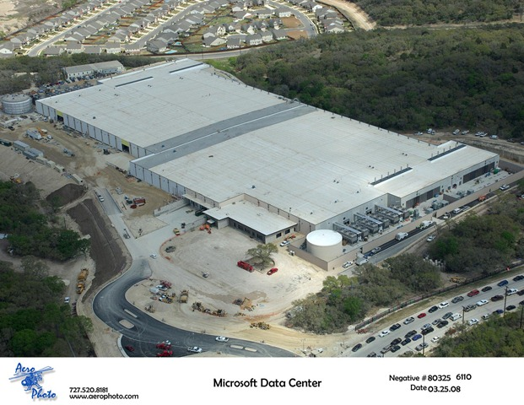










Partition/Aggregate Application Structure
TLA
1.
Picasso
Art is…
Deadline = 250ms
2. Art is a lie…
3.
…..
Picasso
Time is money
  Strict deadlines (SLAs)
Missed deadline
  Lower quality result
MLA
………
MLA
1. Art is a lie…
1.
Deadline = 50ms
2.
2. The chief…
…..
3.
…..
3.
“Bad artists copy.
Good artists steal.”
“The chief enemy of creativity is good sense.“
“I'd like to live as a poor man
with lots of money.“
“Computers are useless.
They can only give you answers.”
“Everything you can imagine is real.”
“It is your work in life that is the ultimate seduction.“
“Inspiration does exist,
but it must find you working.”
“Art is a lie that makes us
realize the truth.
Deadline = 10ms
Worker Nodes

Slide 6



Workloads
Partition/Aggregate
(Query)
Short messages [50KB-1MB]
(Coordination, Control state)
Large flows [1MB-50MB]
(Data update)
Delay-sensitive
Delay-sensitive
Throughput-sensitive
Notes:
Replace PDF

Slide 7
Impairments
Incast
Queue Buildup
Buffer Pressure

Slide 8



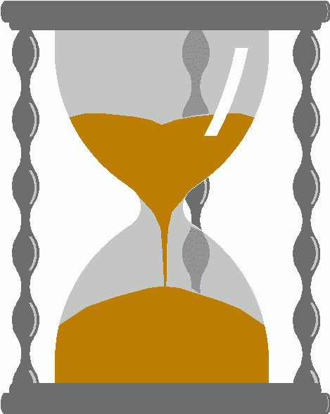
Incast
Worker 1
Synchronized mice collide.
  Caused by Partition/Aggregate.
Aggregator
Worker 2
Worker 3
RTO_{min} = 300 ms
Worker 4
TCP timeout

Slide 9
Queue Buildup
Sender 1
Big flows buildup queues.
  Increased latency for short flows.
Receiver
Sender 2
Measurements in Bing cluster
  For 90% packets: RTT < 1ms
  For 10% packets: 1ms < RTT < 15ms

Slide 10

Data Center Transport Requirements
High Burst Tolerance
  Incast due to Partition/Aggregate is common.
Low Latency
  Short flows, queries
3. High Throughput
  Large file transfers
The challenge is to achieve these three together.

Slide 11
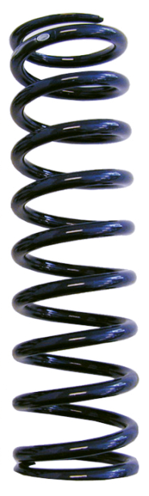

Balance Between Requirements
High Throughput
High Burst Tolerance
Low Latency
Deep Buffers:
Queuing Delays
Increase Latency
Shallow Buffers:
Bad for Bursts &
Throughput
Objective:
Low Queue Occupancy & High Throughput
DCTCP
Reduced RTO_{min} (SIGCOMM ‘09)
Doesn’t Help Latency
AQM – RED:
Avg Queue Not Fast
Enough for Incast
Notes:
Deep Buffers – bad for latency
Shallow Buffers – bad for bursts & throughput
Reduce RTO_{min} – no good for latency
AQM – Difficult to tune, not fast enough for incast-style micro-bursts, lose throughput in low stat-mux

Slide 12
The DCTCP Algorithm

Slide 13

Review: The TCP/ECN Control Loop
Sender 1
ECN = Explicit Congestion Notification
ECN Mark (1 bit)
Receiver
Sender 2
Notes:
DCTCP is based on the existing Explicit Congestion Notification framework in TCP.

Slide 14
Two Key Ideas
React in proportion to the extent of congestion, not its presence.
  Reduces variance in sending rates, lowering queuing requirements.
Mark based on instantaneous queue length.
  Fast feedback to better deal with bursts.
ECN Marks | TCP | DCTCP
1 0 1 1 1 1 0 1 1 1 | Cut window by 50% | Cut window by 40%
0 0 0 0 0 0 0 0 0 1 | Cut window by 50% | Cut window by 5%
18

Slide 15
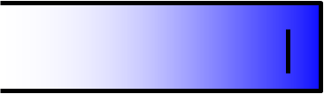
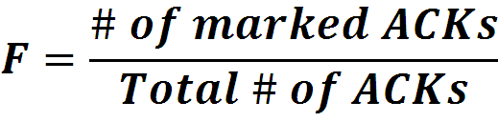

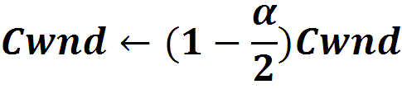
Data Center TCP Algorithm
B
K
Don’t
Mark
Switch side:
  Mark packets when Queue Length > K.
Mark
  Sender side:
  Maintain running average of fraction of packets marked (α).
  In each RTT:
Adaptive window decreases:
  Note: decrease factor between 1 and 2.
19
Notes:
very simple marking mechanism
not all the tunings other aqms have
on the source side, the source is tryign to estimate the fraction of packets getting marked
using the obs that there is a stream of ecn marks coming back – more info in the stream than in any single bit
trying to maintain smooth rate variations to operate well even when using shallow buffers, and only a few flows (no stat mux)
F over the last RTT. In TCP there is always a way to get the next RTT from the window size. Comes from the self-clocking of TCP.
Only changing the decrease. Simplest version – makes a lot of sense. So generic could apply it to any algorithm – CTCP, CUBIC – how to cut its window leaving increase part to what it already does. Have to be careful here.

Slide 16
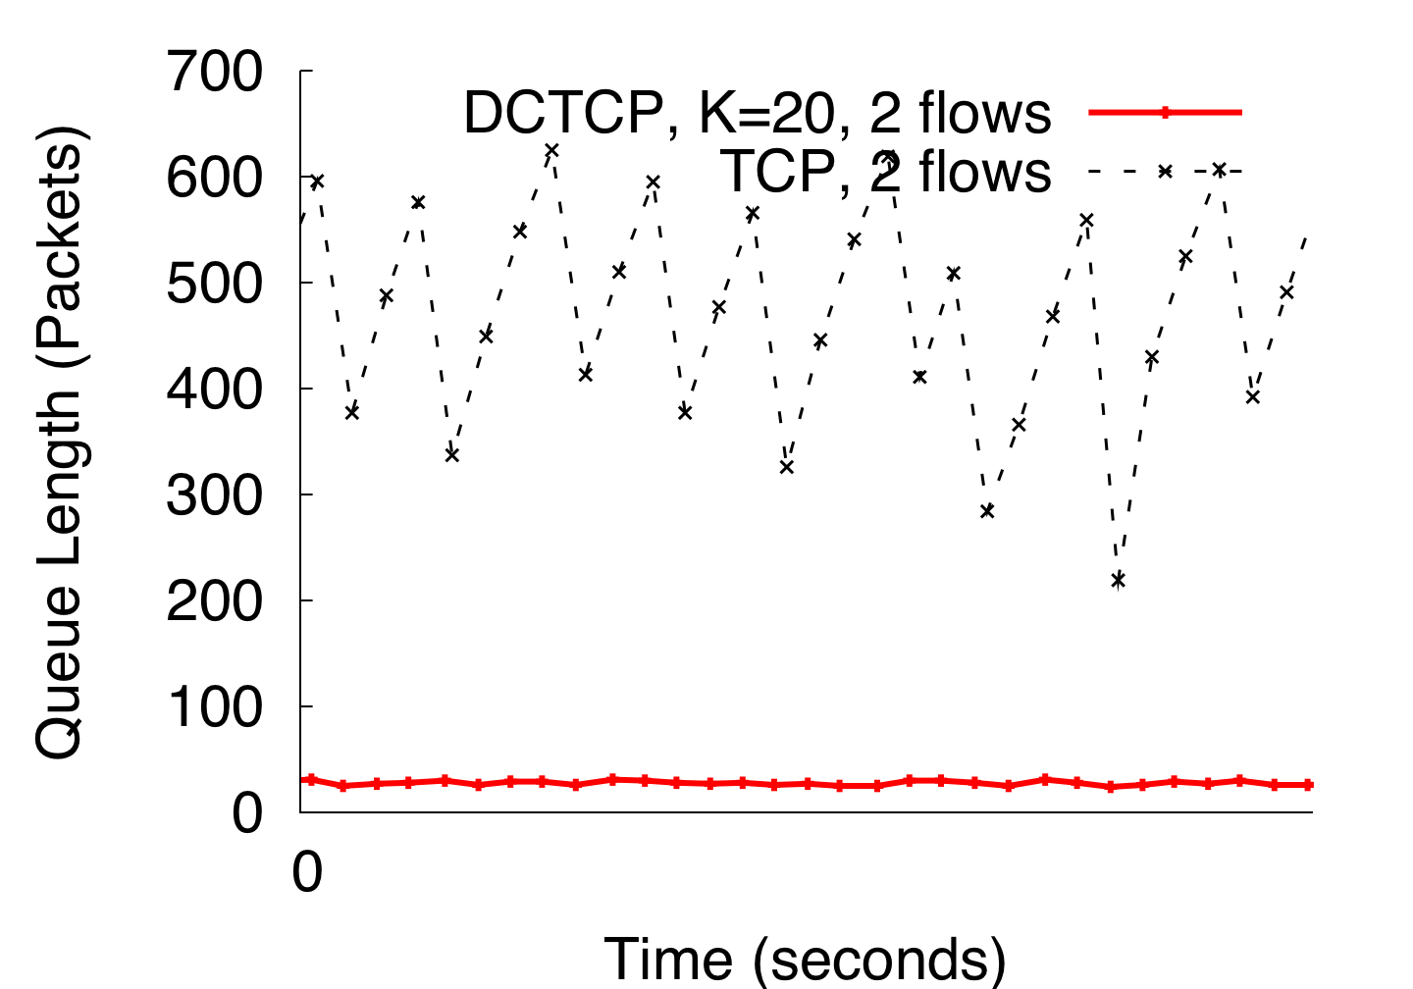
DCTCP in Action
(Kbytes)
Setup: Win 7, Broadcom 1Gbps Switch
Scenario: 2 long-lived flows, K = 30KB
20
Notes:
Not ns2.

Slide 17
Why it Works
High Burst Tolerance
  Large buffer headroom → bursts fit.
  Aggressive marking → sources react before packets are dropped.
Low Latency
  Small buffer occupancies → low queuing delay.
3. High Throughput
  ECN averaging → smooth rate adjustments, cwind low variance.
21

Slide 18
Analysis
Window Size
W*+1
W*
(W*+1)(1-α/2)
Time
22

Slide 19

Analysis
Packets sent in this
RTT are marked.
Window Size
W*+1
W*
(W*+1)(1-α/2)
Time
22

Slide 20

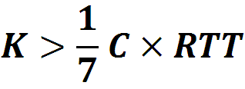

Analysis
How low can DCTCP maintain queues without loss of throughput?
How do we set the DCTCP parameters?
Need to quantify queue size oscillations (Stability).
85% Less Buffer than TCP
22

Slide 21
Evaluation
Implemented in Windows stack.
Real hardware, 1Gbps and 10Gbps experiments
  90 server testbed
  Broadcom Triumph 48 1G ports – 4MB shared memory
  Cisco Cat4948 48 1G ports – 16MB shared memory
  Broadcom Scorpion 24 10G ports – 4MB shared memory
Numerous benchmarks
  – Throughput and Queue Length
  – Multi-hop
  – Queue Buildup
  – Buffer Pressure
– Fairness and Convergence
– Incast
– Static vs Dynamic Buffer Mgmt
23

Slide 22
Experiment implement
45 1G servers connected to a Triumph, a 10G server extern connection
  1Gbps links K=20
  10Gbps link K=65
Generate query, and background traffic
  10 minutes, 200,000 background, 188,000 queries
Metric:
  Flow completion time for queries and background flows.
We use RTO_{min} = 10ms for both TCP & DCTCP.
24
Notes:
Put more details

Slide 23
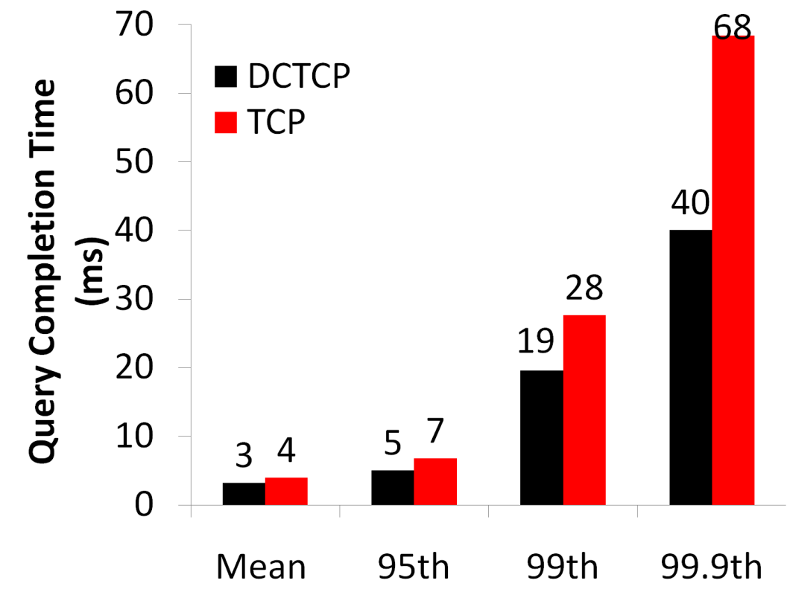
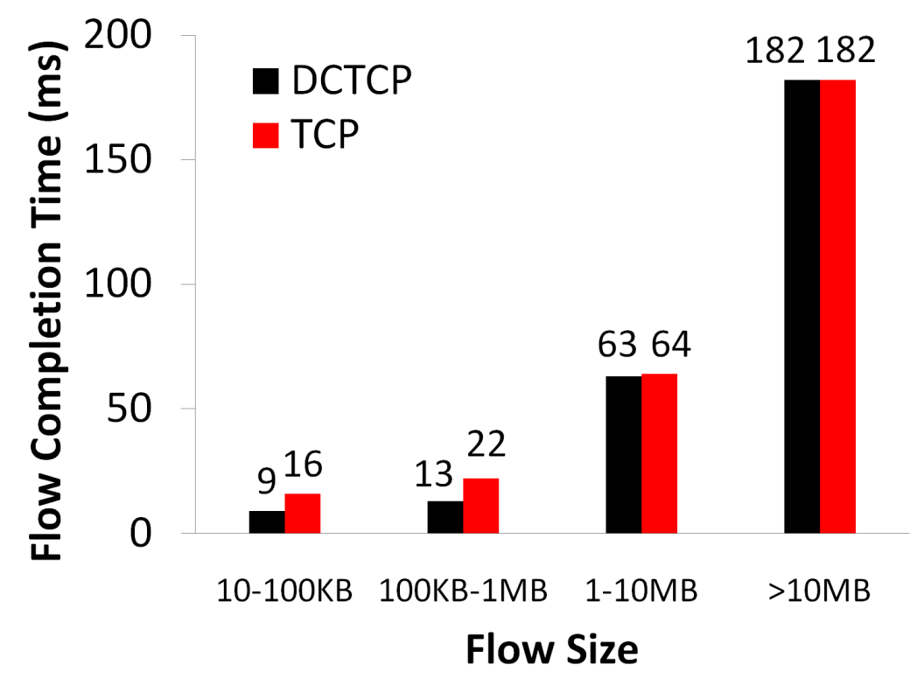
Baseline
Background Flows
Query Flows
25
Notes:
To transition to scaled traffic: people always want to get more out of their network.

Slide 24

Baseline
Background Flows
Query Flows
Low latency for short flows.
25
Notes:
To transition to scaled traffic: people always want to get more out of their network.

Slide 25

Baseline
Background Flows
Query Flows
Low latency for short flows.
High throughput for long flows.
25
Notes:
To transition to scaled traffic: people always want to get more out of their network.

Slide 26

Baseline
Background Flows
Query Flows
Low latency for short flows.
High throughput for long flows.
High burst tolerance for query flows.
25
Notes:
To transition to scaled traffic: people always want to get more out of their network.

Slide 27
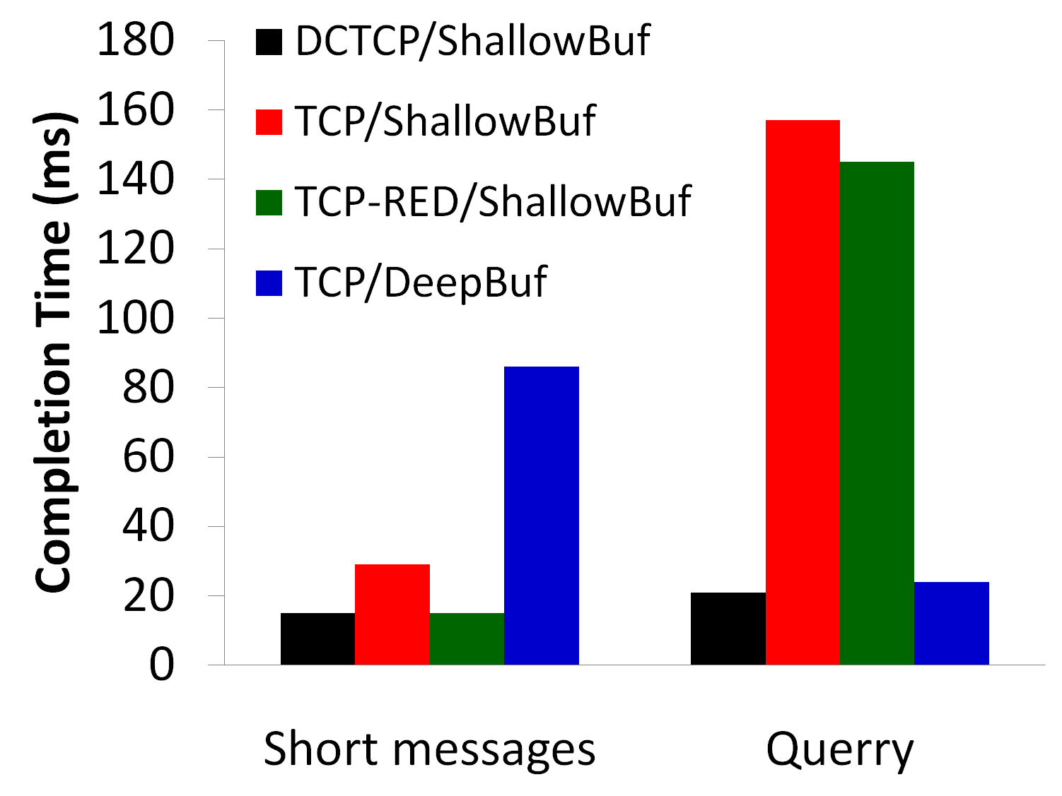
Scaled Background & Query
10x Background, 10x Query
26
Notes:
Need to put the take-aways on the slide, or at least have them in mind and slam them…
Deep buffer fixes incast, makes delay worse
RED, no good on the queries – doesn’t react fast enough

Slide 28
Conclusions
DCTCP satisfies all our requirements for Data Center packet transport.
  Handles bursts well
  Keeps queuing delays low
  Achieves high throughput
Features:
  Very simple change to TCP and a single switch parameter K.
  Based on ECN mechanisms already available in commodity switch.
27

Slide 29
Congestion Control for High Bandwidth-Delay Product Networks
D. Katabi (MIT), M. Handley (UCL), C. Rohrs (MIT) – SIGCOMM’02

Slide 30
Basics of TCP Congestion Control
Bandwidth-delay product
  Capacity of the “pipe” between a TCP sender and a TCP receiver
Congestion window (cwnd)
  Sender’s estimation of the capacity
Additive Increase and Multiplicative Decrease (AIMD) algorithm
  no loss: cwnd = cwnd + s
  loss: cwnd = cwnd – cwnd/2

Slide 31
Motivations
Inadequacy of TCP, as bandwidth-delay product increases
  Prone to instability
    regardless of AQM schemes
  Inefficient
Fairness concern
  TCP tends to bias against long RTT flows
    Satellite links, wireless links, etc.

Slide 32
Design Rationale
NOT an end-to-end approach
Using precise congestion signaling
Decoupling efficiency and fairness control

Slide 33
XCP (eXplicit Control Protocol)
Maintains high utilization, small queues, and almost no drops, as bandwidth/delay increases
  drop: less than one in a million packets
Maintains good performance in dynamic environment (with many short web-like flows)
No bias against long RTT flows

Slide 34
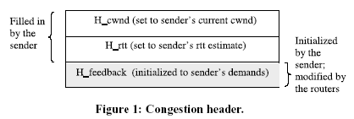
Sender&Receiver’s Role
Sender
  Fill the congestion header
  Update cwnd = max(cwnd + H_feedback, s)
Receiver
  Copy H_feedback to ACK

Slide 35
XCP – Router’s Role
Control Interval Estimation
  Average RTT
Efficiency Control
  Maximize link utilization
Fairness Control
  Achieve fairness among individual flows

Slide 36





Efficiency Controller (EC)
Aggragate feedback (total H_feedback)
  , : constant value
  d: control interval (average RTT)
  S: spare bandwidth
  Q: persistent queue size
Stability requirement determines
= 0.4; = 0.226
  Independent of delay, capacity and number of flows

Slide 37

Fairness Controller (FC)
Achieve fairness via AIMD algorithm
  > 0, equal throughput increment of all flows
  < 0, throughput decrement proportional to its current throughput

Slide 38
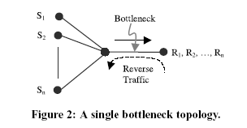
Performance Evaluation
Simulation topology

Slide 39
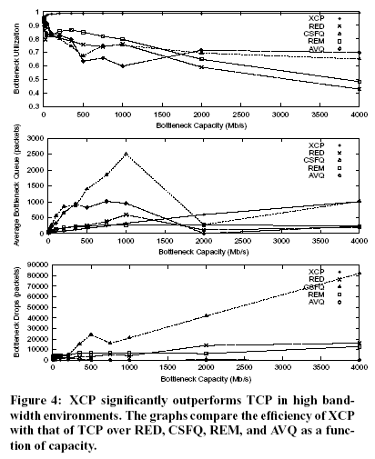
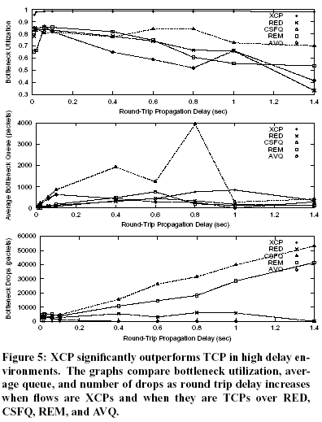
Performance Evaluation
Bandwidth
Delay

Slide 40
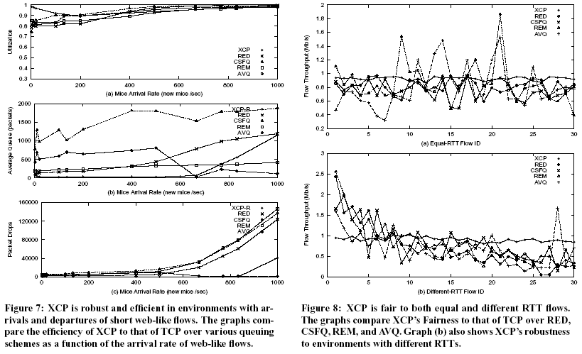
Performance Evaluation
Mice arrival rate
Different RTT flow

Slide 41
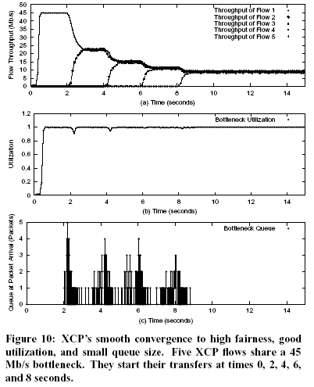
The dynamics of XCP

Slide 42
Conclusion
XCP provides a theoretically analysis, yet effective approach to congestion control. It obtains excellent performance, independent of link capacity, delay and number of flows.

Slide 43
DCTCP vs. XCP
Date center
Practical
High bandwidth-delay
Theoretic

Slide 44


