Slide 1
Topological Properties Affect the Power of Network Coding In Decentralized Broadcast
Zhiming Zhang
2010.05.25

Slide 2
Problems
Debate from previous literatures
  “Network Information Flow,” July 2000.
  “Network Coding for Large Scale Content Distribution,” March 2005
  “Avalanche: A Network Coding Analysis,” 2007
  “Algebraic Gossip: A Network Coding Approach to Optimal Multiple Rumor Mongering,” June 2006
  “Can Network Coding Help in P2P Networks?” April 2006
  “Rarest First and Choke Algorithms Are Enough,” October 2006

Slide 3
Objective of This Paper
To answer three questions:
  Is randomized Network Coding optimal in terms of broadcast delay?
  How much benefit can it bring?
  Are there any factors affecting the marginal benefit of Network Coding?

Slide 4
The Key Factors
Topological Properties
  Complete graphs
  Random topologies
  Clustered topologies
  Time-varying topologies

Slide 5
Definitions
Gossip (Streaming/Scheduling) Algorithms
  a) Randomly chooses one of its neighbors to serve, and
  b) Transmits one or a linear combination (in Galois field) of blocks it has obtained.
    Random Useful Block (RUB)
    Local Rarest First (LRF)
    Global Rarest First (GRF)
    Randomized Network Coding (NC)
    Ideal Gossip Algorithm (IDEAL)

Slide 6
The Optimality of Network Coding
Randomized Network Coding achieves the minimum possible broadcast delay for any topology and any transmission schedule with high probability

Slide 7
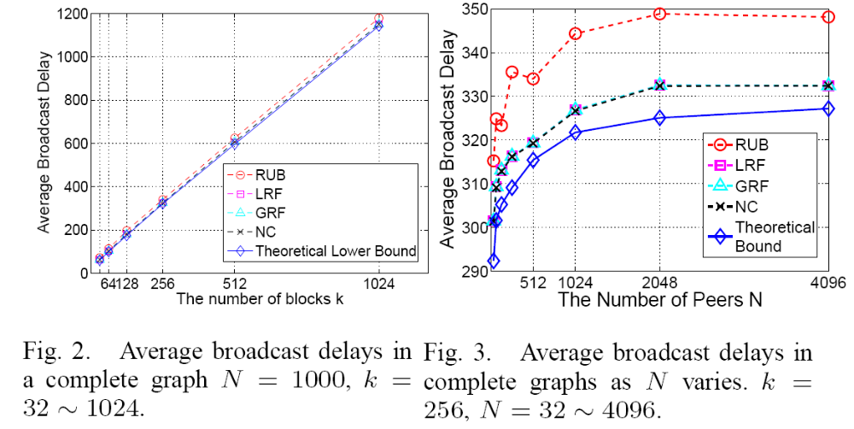
Complete and Random Graphs
Performance of different algorithms

Slide 8
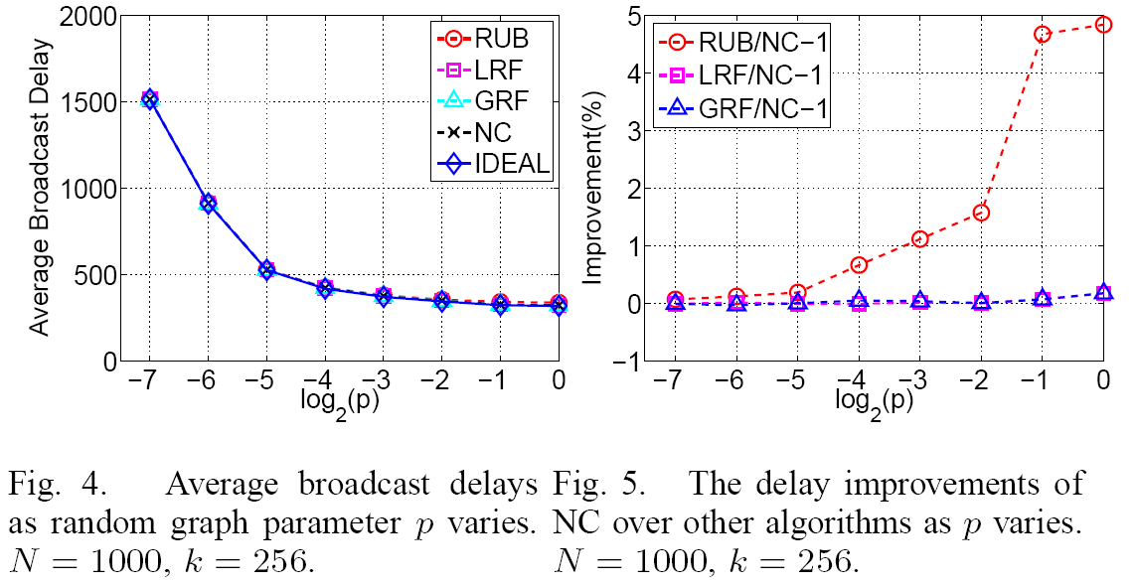
Complete and Random Graphs
Performance of different algorithms

Slide 9

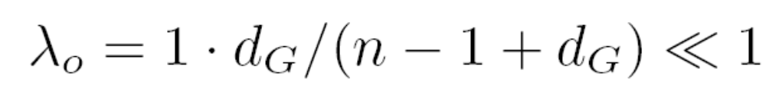
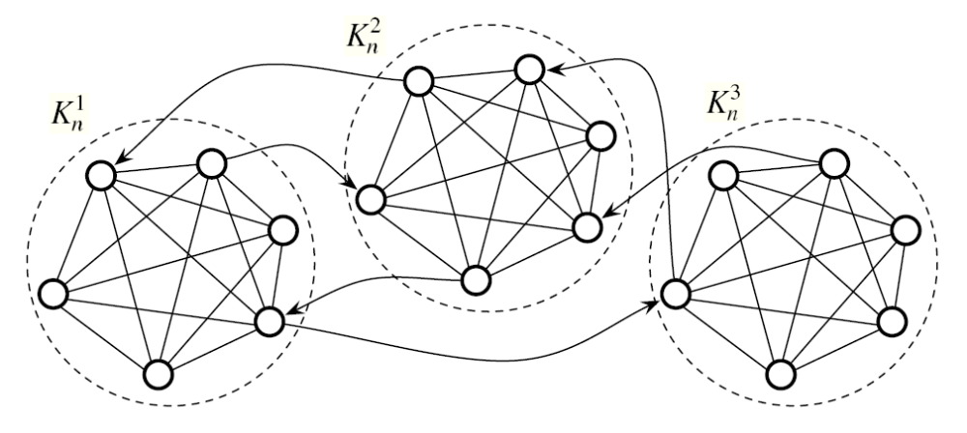
Clustered and Time-varying Topologies
Network Model: Gt(m.n), dG,

Slide 10
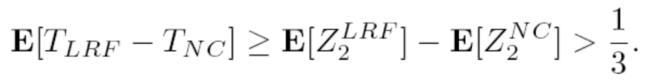
Clustered and Time-varying Topologies
Quantifying the bap between NC and LRF

Slide 11
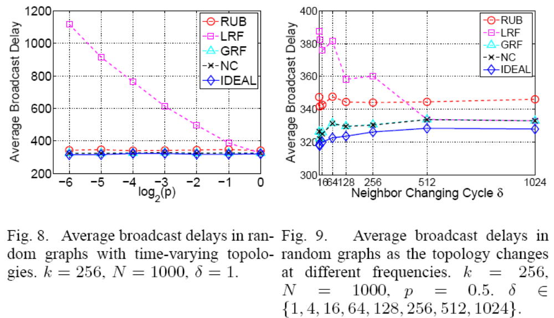
Clustered and Time-varying Topologies

Slide 12
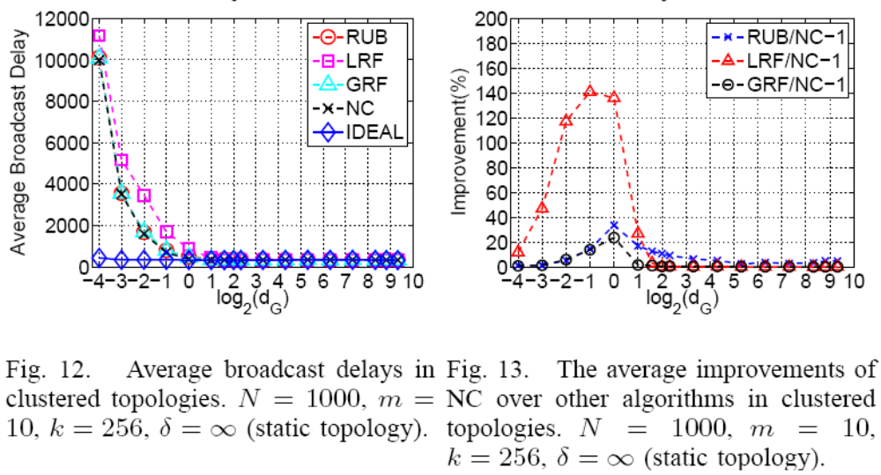
Clustered and Time-varying Topologies

Slide 13
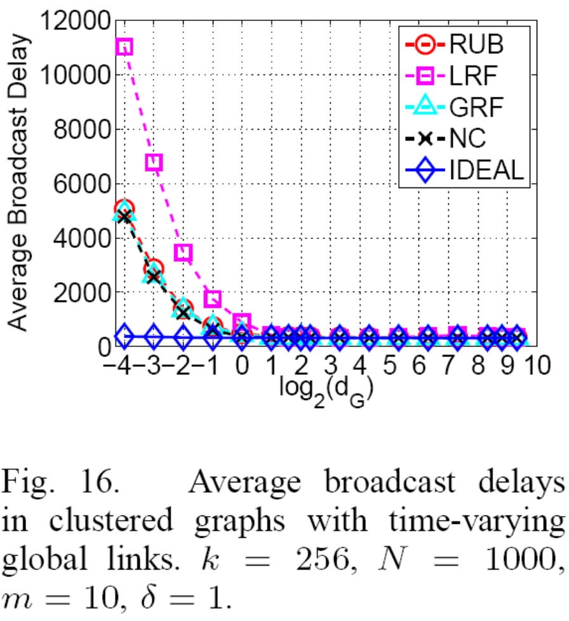
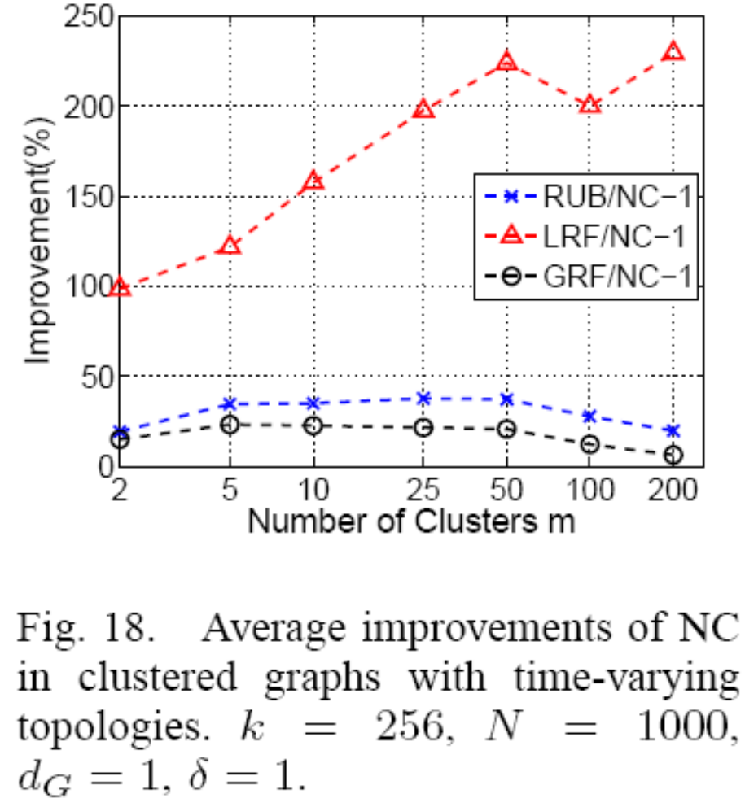
Clustered and Time-varying Topologies

Slide 14
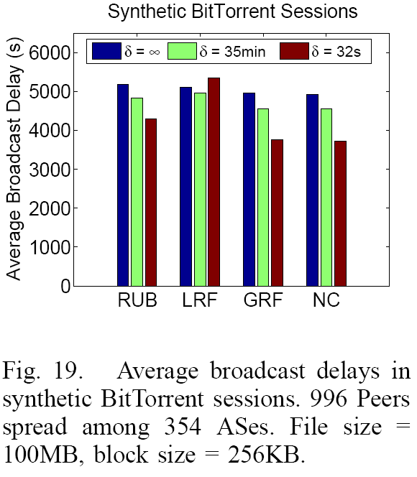
Clustered and Time-varying Topologies

Slide 15
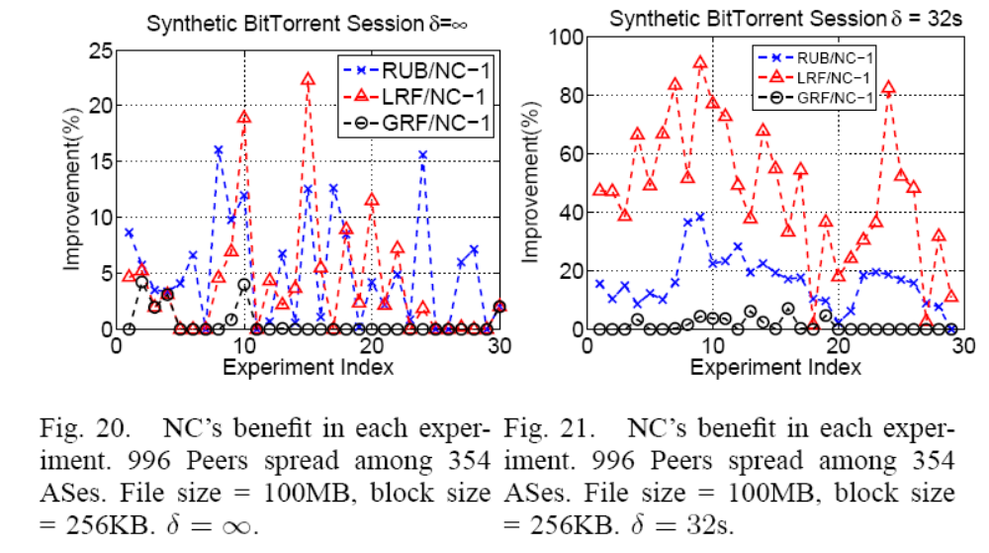
Clustered and Time-varying Topologies

Slide 16
Conclusions
Network Coding is optimal with high probability
Complete and Random Graphs
  Network Coding brings trivial marginal benefits compared with other block selection algorithms.
Clustered and Time-varying Topologies
  Network Coding is resilient to traffic locality mechanisms that are common in ISP-aware P2P applications
  And Network Coding can take the best advantage of the path diversity, introduced by either passive or proactive topological changes, whereas other decentralized block selection schemes suffer from different degrees of insufficiency in these cases.

