Slide 1

Some Hot Topics worth Discussing (or not)
Yaxuan Qi
NSLab Seminar, Mar 4, 2010

Slide 2

Outline
Driving forces
System
  Data center architecture
  Parallel application
  Service virtualization
Algorithm
  Practical and solutions
  Distributed algorithm

Slide 3
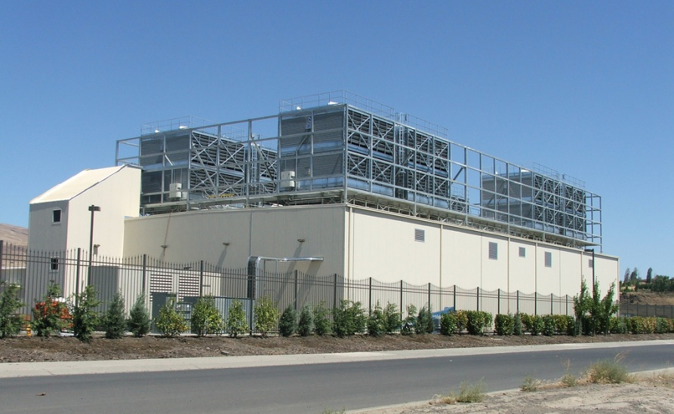
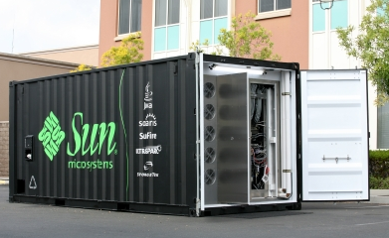
Driving forces
Datacenter
  Old machines
  Management
  .*aaS
Security
  Content awareness
  DoS
Green
  not just $$$

Slide 4
System
Data center architecture
  Google Architecture
  FatTree
  D-Cell/B-Cube

Slide 5
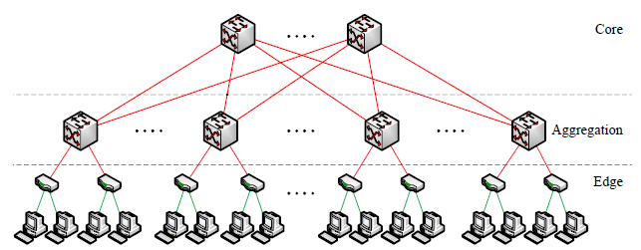
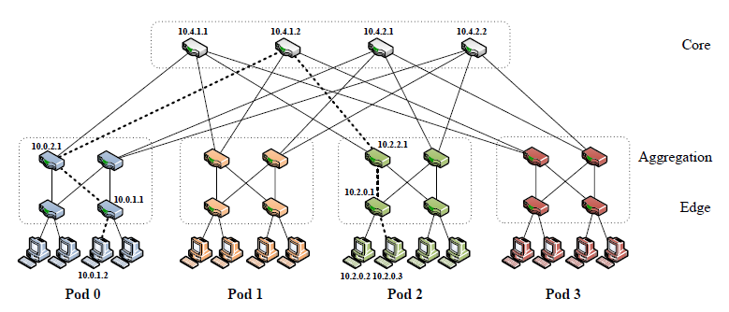
System

Slide 6
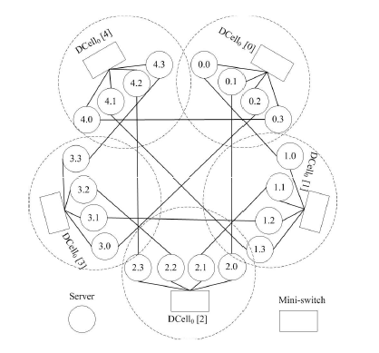
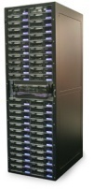

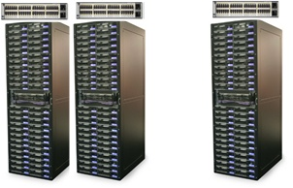
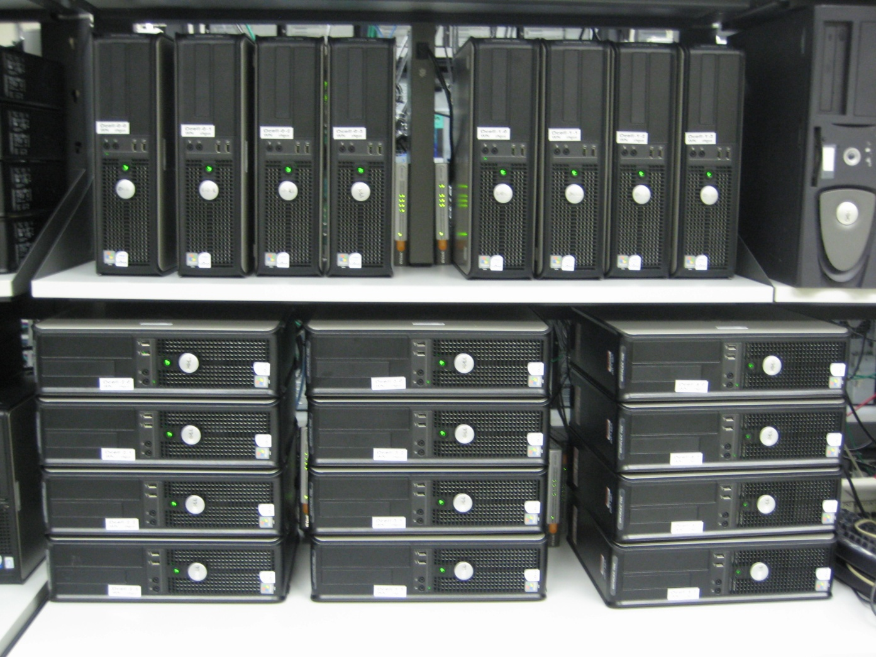
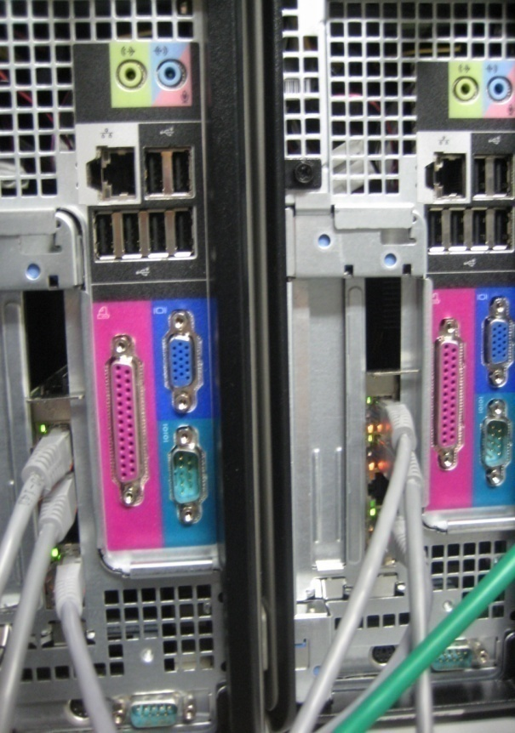


Slide 7
System
What we can contribute for DCs?
  Switching
  Routing
  Balancing
What to do?
  networking, for processing
  software, using hardware
  modeling, can be prototyping

Slide 8
System
Parallel application
  GFS, hadoop
  MapReduce
What to do?
  Locality: storage, cache
  Pipelining, Parallelism

Slide 9
System
Service virtualization
  Router
  Server
  Desktop
What to do?
  Security on the move?
  No gateway?
  Robust desktop?
  Public/Private/Personal clouds

Slide 10
Algorithm
Practical and solutions
  To solve practical problems
  Examples
    Classification of packets, or just get the action?
    Identification of flow, or just know the nature?
What to do?
  In-depth investigation
  Get your hands dirty
  Talk to experts

Slide 11
Algorithm
Distributed algorithm
  Common Scenario
    Distributed processing
    Powerful load-balancer
    Centralized management
  Applications
    Super/Scientific computing
    Web application

Slide 12
Algorithm
What to do?
  Intelligent switching?
    Policy, power, middle-box, locality
  Application-level LB?
    Collaborative app-identification, info-share, and traffic-control
  Take more things to trade off:
    Storage, bandwidth, speed, latency, price, stability
  Ensemble of simple solutions
    GFS, GDC

Slide 13
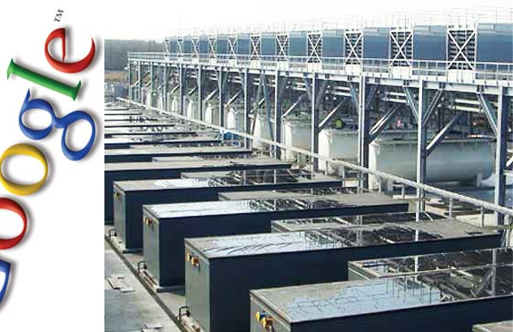
Summary
What is HOT?
  Clouds, data-centers, power, *aaS, wireless…
My suggestion?
  System research
    Compose sweet melody with simple chords
  Algorithm research
    Tame the wildest ox

