Slide 1

Field-Based Branch Prediction for Packet Processing Engines
Fifteenth International Conference on Parallel and Distribute Systems
ICPADS 09
Shenzhen, China
David Bermingham, Liu Zhen, Xiaojun Wang
Dublin City University
Liu Bin
Tsinghua University, Beijing
Present: Baohua Yang
Network Security LAB, RIIT, Tsinghua University, Beijing, China

Slide 2

Contents
Brief introduction to :
  Network processors & PE architectures
  Branch prediction
Simulation framework employed in this work
Evaluation of existing prediction scheme
  Branch behaviour within NP applications
Overview of proposed Field-Based predictor
Performance analysis of Field-Based predictor
Brief conclusions & summary

Slide 3
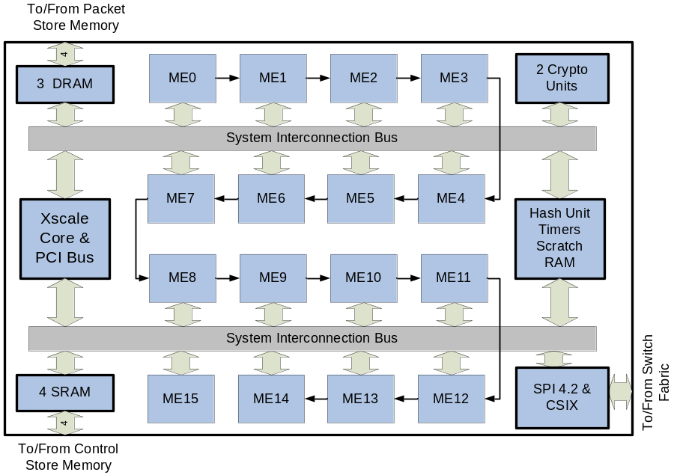

Network Processors
Network Processor
  N - Programmable RISC PEs.
  High bandwidth memory and bus Interconnections
    Multiple channels
  Optional
    Hardware blocks for common tasks
    Control Plane Processor
Intel IXP2805 Network Processor

Slide 4
Network Processors
Trends within Network Requirements
  Faster Connections
    Bandwidth growth continues to outstrip CPU/Memory performance growth
    Each increase in Optical Carrier Rate decrease available cycle budget by a factor of 4
  ‘Smarter’ Applications
    No longer limited to simple Packet Forwarding
      Classification, Encryption, Metering, Inspection
    Demands constantly evolving
      Highlights the need to retain flexibility within NP design

Slide 5
Future NP Performance
Methods of Scaling Future NP Performance
  Generally, 3 common methods available
  All have Pros/Cons
Methodology | Advantages | Disadvantages
Parallelisation | Flexible, Scalable | Load Balancing, Contention*
Hardware Offloading | Performance | Inflexible, ASIC-Type Lead Time
Micro-Architectural (ILP, Branch Prediction, Cache) | Flexible, Transparent, Reused from GPP | Low Utilisation Possible?*
Notes:
*Contention – Each additional PE reduces bandwidth (either memory or IO) available to other PEs
*Transparent – Superscalar (ILP – Instruction Level Parallelism), cache or Branch Prediction is largely transparent to programmer.
*Cache, branch prediction or ILP may have to be tailored to be justified on NP systems since common general purpose processing implementations may not be suited to NP workloads.
e.g certain NP applications exhibit low data spatial locality making cache less efficient.
GPP: General-purpose processor

Slide 6
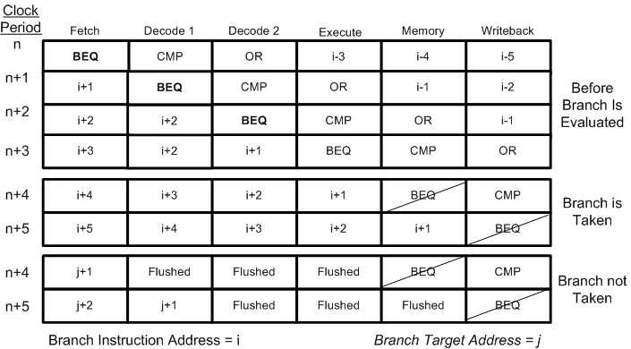
Branch Prediction
Deeper pipeline incurs higher penalty for each branch taken
  If branch is evaluated in stage n, must flush n-1 instructions each time a branch is taken
Notes:
After being evaluated in the decode stage, a branch instruction can be either taken or not taken.
In the case of a not-taken(default option), the next address can be fetched and the pipeline continues as normal
If branch is to be taken, all succeeding instructions (in the next sequential addresses) must be flushed from the pipeline since these instructions are no longer required to maintain correct program flow. The branch penalty are these lost cycles when no useful work is achieved.

Slide 7
Branch Predictors
Two general prediction solutions to problem
  Static Prediction
    Heuristic analysis at compile time
    Branches are hinted/calculated to follow the same behaviour always
  Dynamic Prediction
    Uses a series of 2-bit counters to maintain a history of a particular branch
    Numerous schemes
      GAp, Gag, PAg, PAp, Gshare, Bi-Mode, YAGS, Agree
  PE Silicon Cost is relatively low (no cache or FPU)
    Any predictor must be small relative to PE area
    Assume 200K PE -> a 25% Budget for Predictors
      Maximum Number of Table Entries = 512KB (4K entries)
Notes:
Static Branch prediction typically uses rules at compile time to determine if a branch will likely be taken
=> very difficult to achieve high hit rates with static prediction (typically less than 70%)
Dynamic Prediction is most common solution, used in nearly every pipeline processor (except where penalty is very small)
FPU: Floating point unit

Slide 8
Simulation Framework
SimNP Network Processor Simulator[1]
  Multiprocessor NP simulator
  ARM 7 RISC processor similar to PE structure
Network applications
  12 C-based applications
  Broad spectrum of traditional and modern network applications
Network data
  Semi-synthetic network traces with no geographic bias
    OC-3, OC-12 and OC-48 line rates utilized
Notes:
SimNP configured to simulate a single processor, processing packets in a run-to-complete manor
National Laboratory of Applied Network Research

Slide 9
Branch Operations in
NP Applications
Previous work found that Gshare was best existing solution [2]
  GHR Indexed Predictors
    GAg, Gap, PAp....
    Low performance due to high interference
  Combinational schemes
    Similar to Bi-modal, Agree
    Hit rate gain very small Vs Area cost
  Gshare is cheap to implement but provides mixed performance result
    Good for payload applications – Encryption, Error, etc…
    Less efficient for header tasks – Forwarding, Classification…
Notes:
Branch interference is where two branches map to same location, due to cost/speed limitation it is not possible to implement complex hash mechanisms for mapping a branch to a table entry. When two branches map to the same location we end up with interference where the branch history stored in the 2-bit counter does not represent either branch history.
Gshare found that by XOR the PC with the GHR, a good (and very) simple performance improvement could be acheived.
Combinational predictors are far too expensive for small PEs, only with a per-PE cache structure would the area be justified.

Slide 10
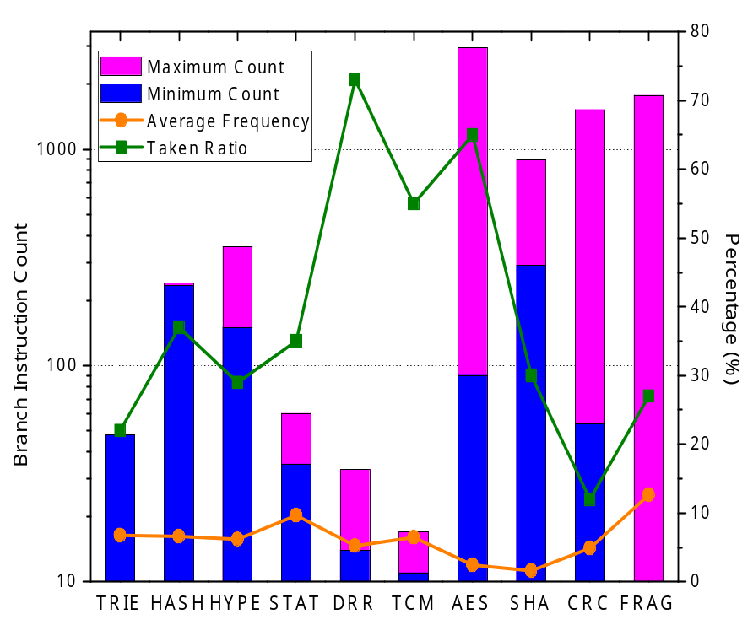
Branch Operations in
NP Applications
Payload Tasks
  Largely loop branches
  Easily predicted for most branches
Header Tasks
  Branches due to if/else statements
  More difficult to predict
  But only a small number of branches
Notes:
Blue highlight the minimum number of branches per packet, while pink is the maximum. For example, the TRIE algorithm requires about 50 branches per packet, with little or no difference between the maximum and minimum number of branches. For payload applications the opposite relationship is seen, the number of branches increases as the packet length increases.

Slide 11
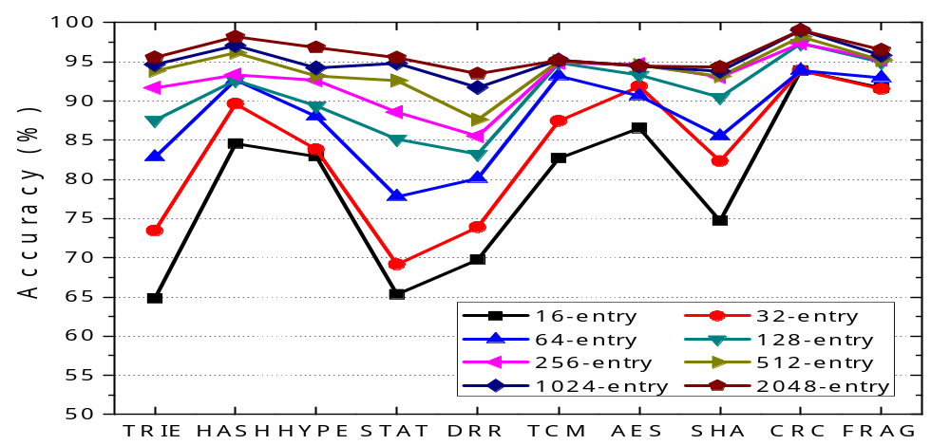
Gshare
Predictor Performance
  Gshare performance does improve as table size is increased
    Above 512 entries, the performance gain is very small
        Additional table entries only improve header tasks
Notes:
In general, payload applications start from a high prediction rate for even very small table sizes (< 128) and improve only slightly as the table size is increased.
On the other hand, the header applications do improve as the table size increases but remain highly dynamic. Prediction is greatly affected by the underlying control data structure. For example, changes to the routing table can alter prediction by up to 5%

Slide 12
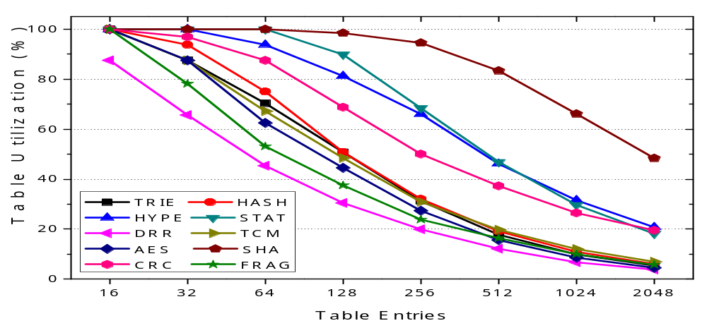
Gshare Utilisation
  Gshare utilisation is defined as the percentage of tables entries actually used during prediction
    For large tables (above 1K entries), the utilisation is very small, with less than 10% of the PHT entries used
Notes:
Major difficulty with a 2-bit table solution is that as the table size is increased, the utilisation falls greatly. For general purpose processing the utilisation is not as important since the application will change constantly. For NPs, the application remains in place for long periods of time. It is therefore not very efficient to have a solution where over 90% of the logic remains idle for long periods of time.

Slide 13
Field-Based Branch Predictor
Packet level information can be used to guide application flow (Conditional Flow)
  Examples:
    Packets going to address x will all follow the same application path during forwarding
    Packets with the same length will follow same application path during encryption, error, etc
  Parameters such as SRC/DST address, SRC/DST port will remain active while flow is active.
  Macro trends such as Length distribution remain over long periods of time

Slide 14
Field-Based Branch Predictor (2)
Using search key obtained from packet headers it is possible to quickly index an application branch history via a CAM
  N unique branch histories, each M-bits long
  For first iteration of a particular search key, fallback predictor (small Gshare (128-entries)) is used
For header applications
  Possible to cache entire branch history with little cost
For payload applications
  Not efficient to store entire history
  But enough branch history can be retained while fallback predictor is trained.

Slide 15
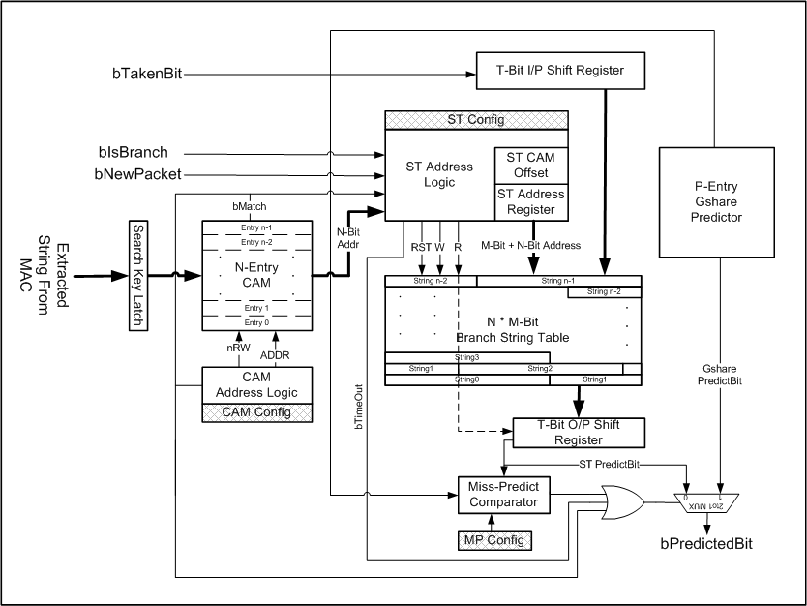
Field-Based Branch Predictor
Notes:
Incoming search key is fed into the CAM block, a match within the CAM structure activates the String Table (ST) logic, allowing T-bits of the matching history to be latched from the ST to the output shift register. For the next T branch operations, the prediction decision is taken from the output shift register. If the string history is longer than T-bits, the next T-bits of the string history can be latched out on branch T.
If no match was found, a similar process occurs via the T-bit input (I/P) shift register. In this case the search key is allocated the next location within the CAM block (fair round robin-Next location is re-allocated regardless of how often the contents were used). The address pointed to by this CAM location in the string table are then updated with the branch history.
If the string history does not match the application flow (false positive), the miss-prediction logic allows a means of stopping any further prediction via the string table. With prediction defaulting back to the fallback gshare predictor.

Slide 16
Performance Evaluation
Chip Area
  Clearly any solution must take into account the small footprint of NP based PEs
    No cache or FPU
  At 6 Transistors per CAM bit and 6T per SRAM bit
    A_{N/M/P}= (6 * N * 32) + (6 * N * M) + (6 * 2 * P)
    16/128/128 Predictor = 16.8 K Transistors
Latency
  If first instruction executed on a packet is NOT a branch, CAM lookup time and latching out of first section of branch history can be hidden (zero latency)
For branch prediction operations
  If using String Table => Latency is simple shift register O/P cycle
  If using Gshare => Latency is same as standard PHT lookup
Notes:
A_{N/M/P}= (6 * N * 32) + (6 * N * M) + (6 * 2 * P),
N/M/P represents:
N = number of CAM entries
M = width of the string table per entry (branch history length)
P = size of the fallback predictor

Slide 17
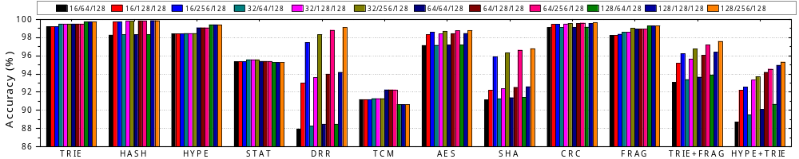
Performance Evaluation
Performance for various configurations with small fallback predictor (OC-3 Trace)
  Prediction > 98%
    TRIE, HASH, HYPER, CRC, FRAG, AES, DRR,
  SHA is difficult to predict since high number of setup branch operations
  TCM uses inter-arrival, impossible to predict!
Larger applications (TRIE+FRAG, HYPE-TRIE)
  More branches per packet but still able to achieve high prediction rate (> 94%)
Notes:
Graph identification – N/M/P
N = number of CAM entries
M = width of the string table per entry (branch history length)
P = size of the fallback predictor

Slide 18
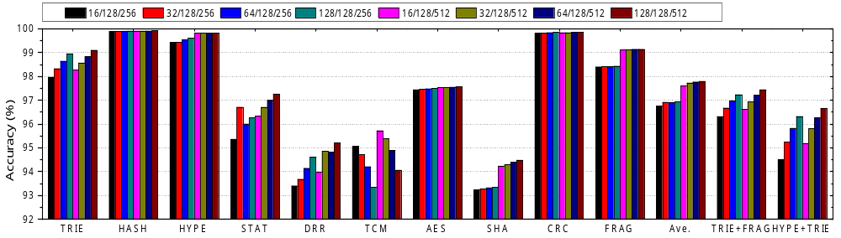
Performance Evaluation
For larger budget it is possible to expand either:
  The number of branch histories retained
  The width of each branch history
  The size of the fallback
Above graph shows performance as fallback predictor size is increased
Notes:
OC-12/OC-48 trace omitted for space

Slide 19
Conclusion
Highly repetitive nature of NP applications should allow high prediction rates (≈100%)
Dynamic predictors
  Good performance for payload applications
  Less efficient for header applications
Field-based scheme
  Allows packet level information to be utilised in branch prediction decision
  Capable of improving prediction to over 98% for applications such as IP Forwarding, Classification, queuing, fragmentation, etc.
  Can be scaled to meet various network line speeds
  Transparent to the programmer, retaining NP flexibility

Slide 20
Future Work
Examine more efficient methods of storing branch history within non-word aligned memory.
Investigate method for deciding which bits should be stored within the String Table
  Gshare predictor is correct 80%
  Ideal solution to only store miss-predicted branches
Investigate better methods of indexing the string history
  TCAM allows partial matching but is difficult to exploit
  Hash allows greater flexibility but involves collisions.
Notes:
Should be possible to guide more than just prediction via the string table (memory lookups, etc)

Slide 21
Any questions, feel free to contact the authors
David Bermingham, Liu Zhen, Xiaojun Wang
{david.bermingham, liuzhen, wangx}@eeng.dcu.ie
Thank you
This work is funded by the China-Ireland Research Collaboration Fund & The School of Electronic Engineering, Dublin City University.

Slide 22
References
[1] D. Bermingham, Z.Liu, X.Wang, “SimNP: A Flexible Platform for the Simulation of Network Processing System”, (ANCS2008)
[2] D.Bermingham, X. Wang, Z. Liu, B. Liu, “Branch Prediction For Network Processors”, ICM 2008

