Slide 1
Para-Snort : A Multi-thread Snort on Multi-Core IA Platform
Xinming Chen, Yiyao Wu, Lianghong Xu,
Yibo Xue and Jun Li
Tsinghua University
PDCS 2009
November 3, 2009
Notes:
Good afternoon, every one. Here I will introduce a Multi-thread Network intrusion detection system (NIDS), It’s name is Para-Snort, based on snort, It’s a popular NIDS. Our work has a clean-cut modular structure, and can fully utilize the processing capability of the multi-core Intel Architecture platform.

Slide 2
Outline
Introduction of NIDS* on IA*
Architecture of Para-Snort
Performance Evaluation
Optimize Load Balancing
Conclusions
*NIDS: Network Intrusion Detection System
*IA: Intel Architecture (also known as x86, or x64 for IA-64)
Notes:
Here is the outline. First I will introduce about current NIDS on IA platform. The normal structure of NIDS. Then I will introduce our system and show the differences against the existing work. I will also talk about the design of each modules, Following is the performance evaluation. I’ll also talk about issues on Load Balancing. At last, we have Conclusions.

Slide 3
NIDS on IA platform
NIDS looks into both header and payload of packets to identify intrusion
IA is not so fast as ASICs or FPGA, but it’s
  cheap
  easy to develop with
  flexible on structure and ruleset
Many NIDS on IA is not designed for multi-core processors.
*NIDS: Network Intrusion Detection System
*IA: Intel Architecture (also known as x86, or x64 for IA-64)
Notes:
NIDS is different from original firewalls, Firewalls usually looks into no higher than the transport layer, but NIDS looks into both header and payload of packets to identify intrusion. That means a great need of computing power. In fact, NIDS maybe the worst bottleneck in today’s networks. Some NIDS is based on ASICs or FPGA, they can achieve really high performance. So what’s the advantages of IA platform? It’s not so fast as ASICs or FPGA, but it’s cheap, and easy to develop with, and it can meet the complexity of the structure. So IA is still needed in middle and low end NIDS design.

Slide 4
Our purpose
To design NIDS that can utilize multi-core IA platforms.
  With modular design
  Shouldn’t introduce new bottlenecks
Our work is based on Snort.
  by Sourcefire Inc.
  The most popular open source NIDS on IA platform.
  It identifies intrusion by matching the coming packets with the signatures (ruleset)
  Single-thread
Notes:
Most of the popular NIDS are sigle-thread. They can only run on one of the processors. So our purpose is to design NIDS that can utilize multi-core IA platforms. As there are some previous work on parallel NIDS, we want a system with modular design, which means easy to design new parts. And the parallelism should not introduce new bottlenecks.
Our work is based on Snort. It’s one of the most popular NIDS on IA platform. It identifies intrusion by matching the coming packets with the signatures，which is called ruleset. And it’s single thread, can’t utilize multi-core IA platforms.

Slide 5
Outline
Introduction of NIDS* on IA*
Architecture of Para-Snort
Performance Evaluation
Optimize Load Balancing
Conclusions

Slide 6
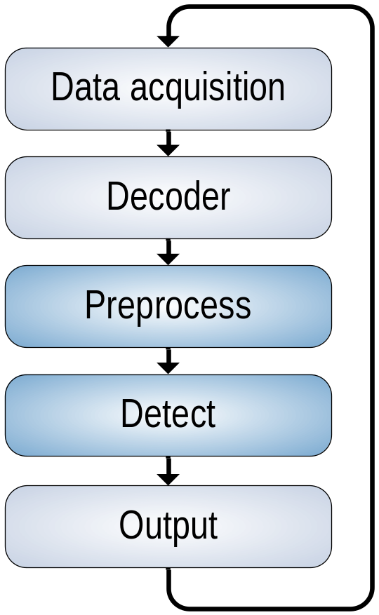
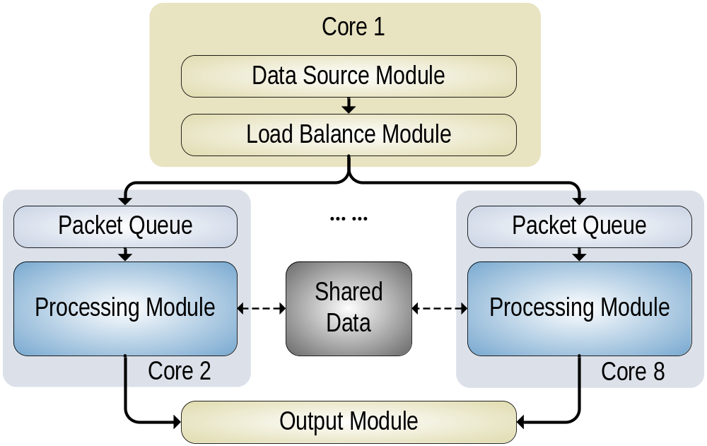
The architecture of Snort
The architecture of Para-Snort
Notes:
Here is the processing loop of Snort. First it acquire data from the kernel, using pcap or other library. Then decode the packet to unify the data structure. Following is the preprocess and detect step. Preprocess means do stream re-assembling, de-fragment, check for port scan and some other things. Detect means do the multi-pattern matching with rules and the network traffic. Snort is based on signature matching, when there is a match, an alert is generated. Preprocess and detect are the main parts and cost most of the processing time. Some research shows that they take nearly seventy percent of the processing time, so if we want to improve the performance, we should look into these two parts.
So here comes our design, combine data acquisition and decode into Data source module. And combine preprocess and detect into processing module. And we add load balance module and memory sharing, then para-snort comes out.

Slide 7
The architecture of Para-Snort
Based on SnortSP 3.0, a new different branch
Features:
  Modular design
  Multifunction processing modules
  Memory sharing
  Optimization on core algorithms
Notes:
This work is based on snort security platform, it’s a new branch of snort, and support new features like ipv6 or GRE. It also support multi-thread structure. We modified it and build ParaSnort. ParaSnort has a modular design, which is important for its flexibility. And it support multifunction processing modules, which means we can construct a pipe-line with several different processing modules. Each one is a different function and each one is a thread.
and Memory sharing, this is necessary for parallel Snort. The detection engine need a compiled ruleset, this ruleset is usually very large, in our experiment it’s 1.2 Gigabytes. It’s difficult to allocate 1.2 Gigabytes for each thread. And the ruleset is read-only after it is initialized, if it’s read-only we don’t need to lock the memory for multiple access, so it’s possible to share them between the threads. Without memory sharing, this system can not deployed on normal machines.
we also do some optimization on core algorithms , to ensure the parallelism will not introduce new bottlenecks, and we try to solve some of the original bottlenecks.

Slide 8
Detailed module design
Processing Module
  each is a single thread
  preprocessors and detection engine
  easy to develop functions other than intrusion detection, such as antivirus or URL filtering
  We designed a ClamAV processing module to do antivirus
Data Source Module
  data acquisition and decoder
Load Balance Module
  dispatches traffic and makes multi-staged processing
Output Module
  Generate alert
Notes:
Data source contained data acquisition and decoder. This module unified the data structure of the packet if they are from different interfaces (Ethernet, 802.11x, files, and so on), to decouple with the other modules.
Load balance module dispatches the packets to processing modules. The load balance module has a multi-staged feature , to make the packets processed by different types of processing modules, in pipelines.
Next is the processing module, every processing module is a single thread. These threads are mapped to certain CPU cores. Each processing module has a dedicated queue to accept the packets from Load balance module
Processing modules is built with the preprocessors and detection engine from Snort 2.x. It is made easy to develop processing modules with other functions. For example, we built a processing module with the anti-virus engine from ClamAV, and this scales Para-Snort into an integrated solution of NIDS and anti-virus.
For the output module there is not much to say, it accept the match signal and generate alert.

Slide 9
Outline
Introduction of NIDS* on IA*
Architecture of Para-Snort
Performance Evaluation
Optimize Load Balancing
Conclusions

Slide 10
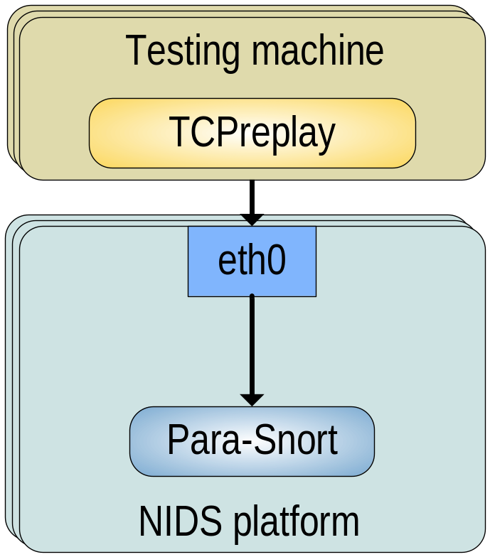
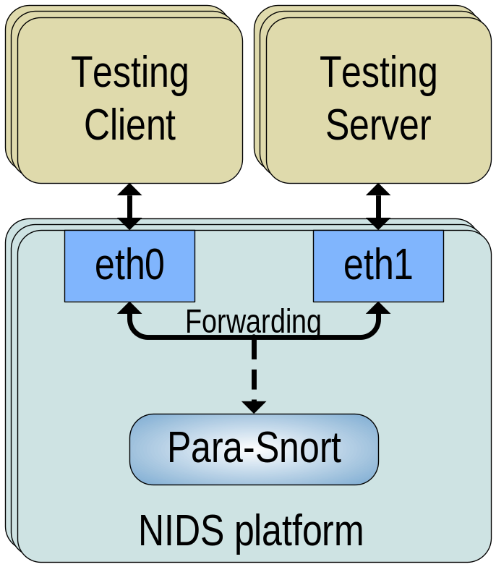
Performance Evaluation
two quad-core Xeon E5335 at 2.00GHz
4 GB DRAM
Ubuntu 8.04
Linux kernel version 2.6.27
For tcpdump traces
For real traffic
Notes:
Now let’s see the performance evaluation of Para-Snort. We ran it on a server with 8 CPU cores. The test network topography is like this. We have four testing traces. Three of them are tcpdump files and the other one is generated from real network. You can see the property of the traces in my paper. Para-Snort listens to the packets from the network interfaces, it’s not a inline system. So we use the processing speed, which is bit per second, to evaluate the performance of it.

Slide 11
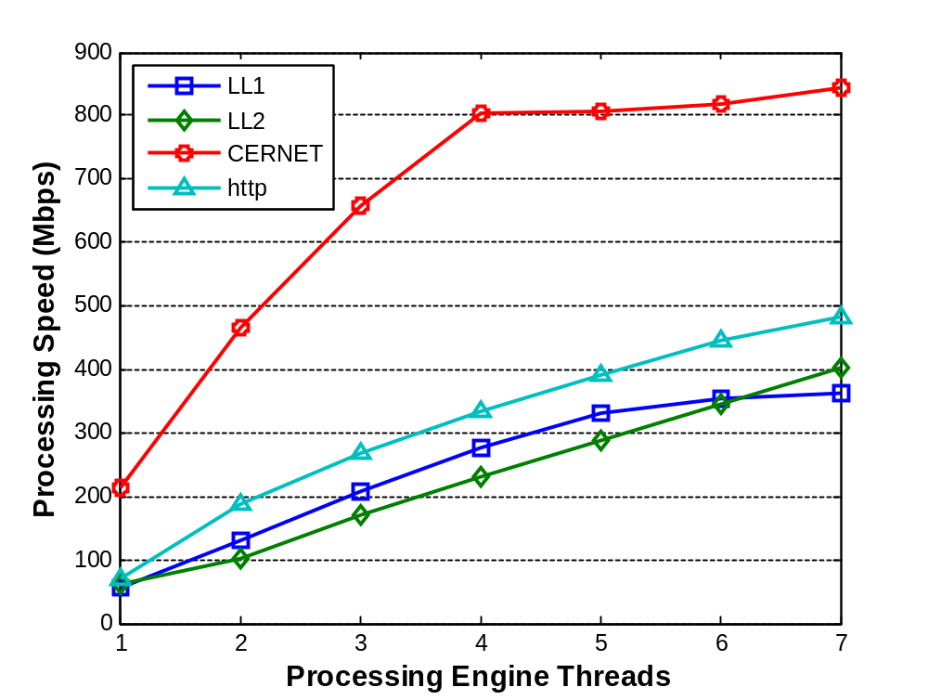
Performance Scaling with increase in Threads
Notes:
Here is the performance from 2 thread to 7 threads. The performance of single thread is the original speed of snort security platform. We can see that para-snort get a sufficient speed up. And for this red trace, the performance is much better, that’s because this trace has many UDP packets, and snort don’t check much about them. When it reaches 4 threads, it meets some other bottle necks and doesn’t increase much.

Slide 12
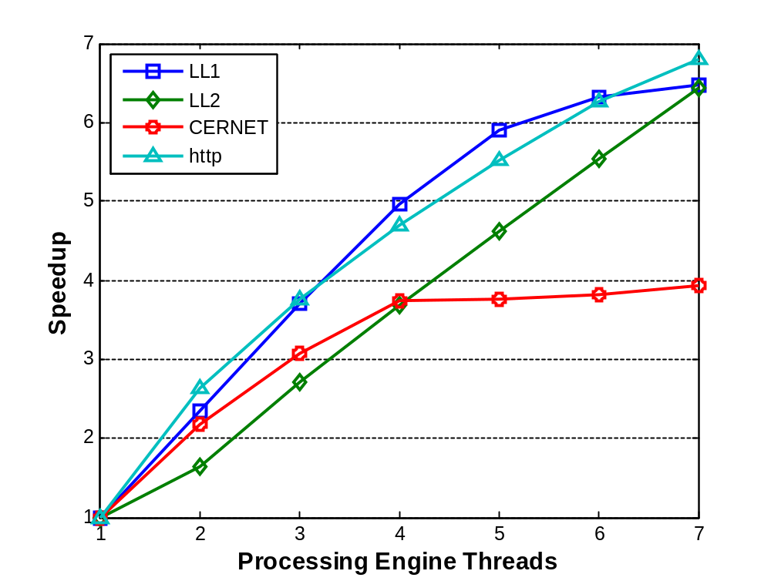
Speedup of 2~7 threads
Notes:
This is the speed up. We can see almost perfect linear speedup for these three traces. For the red trace, the single thread performance is good enough, so the final speed up is not so high.

Slide 13
Outline
Introduction of NIDS* on IA*
Architecture of Para-Snort
Performance Evaluation
Optimize Load Balancing
Conclusions

Slide 14
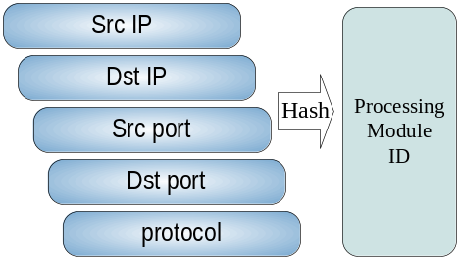
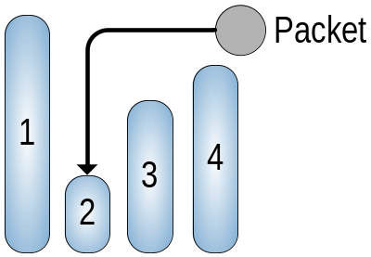
Optimize Load Balancing
SnortSP 3.0 provides IP hash algorithm
Not balanced when there are few flows
Three improve methods:
5-tuple hash
Join the Shortest Queue
Modified-JSQ
Reassign a flow when it has silenced for a long time
Notes:
Next we will talk about load balancing. It’s an important question for parallel programs. SnortSP provides IP hash algorithm, which is usable, but not so balanced when there are few flows. So we proposed three improve methods.
We should know that snort process traffic based on flows. So packets with the same 5-tuple must be assigned to the same processing module.
One is 5-tuple hash. It’s derived from IP hash, and can fully exploiting the 5-tuple information. So this algorithm is expected to achieve better distributing performance than IP hash in most cases.
Next we proposed a strategy named “join the shortest queue”, which assigns every new flow to the least busy processing module, and the following packets from the same flow go to the same module. There is a problem that some flows can last very long and we can consider there are few relations on security if they have silenced for a long time. So Modified-JSQ is proposed to make load balancing more balanced.

Slide 15
Modified-JSQ
Reassign a flow when it has silenced for a long time.
We use number of packets instead of time to identify if a flow has silenced for a long time.
Flow A
Other flows
Flow A
Threshold = n packets
Notes:
For the convenience of implement, we use number of packets instead of time to identify if a flow has silenced for a long time. If there are a number of packets that belong to other flows in the middle of flow A, we can reassign flow A at this point. When the threshold is positive infinity, M-JSQ reduce to JSQ.

Slide 16
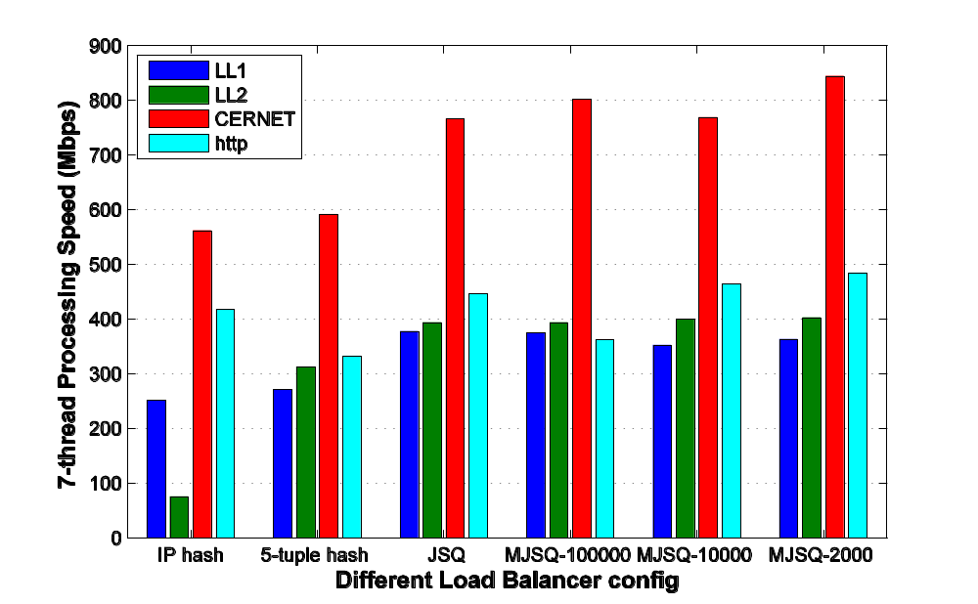
Performance of different load balancers
Notes:
We compared performance of those four load balancer with different traces. The threshold for Modified-JSQ algorithm is 100000, 10000 and 2000. This figure shows that they are mostly increasing from left to right. Modified-JSQ with threshold 2000 has the best performance for most cases, nearly 1.5 times as much as IP hash. So in the Performance Evaluation we use Modified-JSQ with threshold 2000 as our load balancing algorithm.
There are also optimization on other bottle necks, but I’m not going to talk about them because of the time. You can see them in my paper.

Slide 17
Outline
Introduction of NIDS* on IA*
Architecture of Para-Snort
Performance Evaluation
Optimize Load Balancing
Conclusions

Slide 18
Conclusions
Multi-thread design fully utilizes multi-core CPU
Modular design, multifunction process modules, easy to add modules.
Solve the issues in load balancing and other algorithms
Good speedup, up to 7. Performance up to 800Mbps
Notes:
Here is the conclusions. We designed a Multi-thread NIDS that can fully utilizes multi-core processors. It has a modular design, with multifunction process modules, which is easy to add modules. We also solve the issues in load balancing and other algorithms. Experiments shows it has a good speedup, almost perfect linear, and the Performance is up to 800Mbps.

Slide 19
Questions
Thank You

