Slide 1
Understanding the Performance Gap between Pull-based Mesh Streaming Protocols and Fundamental Limits
Chen Feng, Baochun Li and Bo Li
Presented by Zhiming Zhang
11/08/26

Slide 2
Targets
What are the fundamental limits of the performance of pull-based mesh protocols?
  Buffer map exchange
  Decentralized scheduling algorithm
How large is the gap between the fundamental limits and the actual performance?
What factors account for most of the gap separating the actual and optimal performance of pull-based mesh protocols?

Slide 3
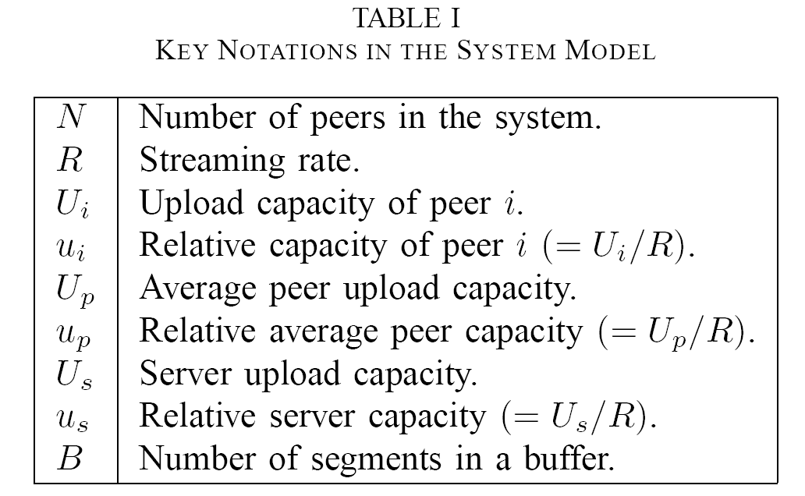

Slide 4
Assumptions
Peer upload capacities are the only bottlenecks in the streaming system;
There is only one streaming server in the system with upload capacity Us;
Time is slotted in the sense that it takes one time slot to playback a segment.
Ui & Us

Slide 5
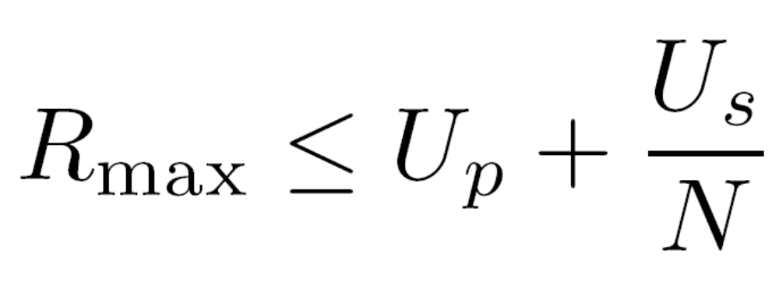
Lemma I:

Slide 6
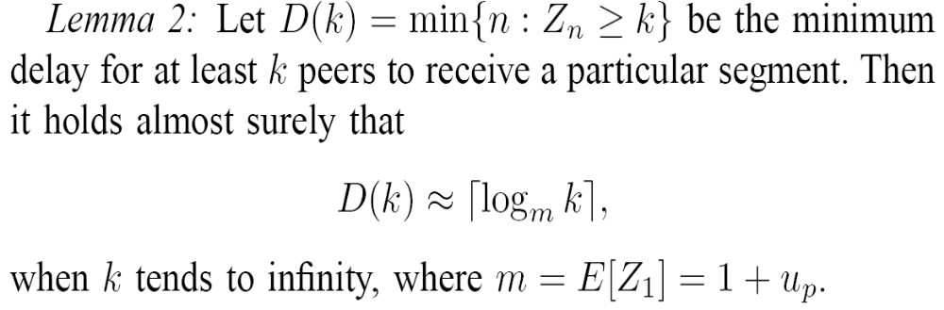
Fundamental Constraint:
  A peer cannot upload a segment until it completes the download of this segment

Slide 7
Question I
What is the minimum initial buffering delay that should be experienced by a flash crowd of N peers?

Slide 8
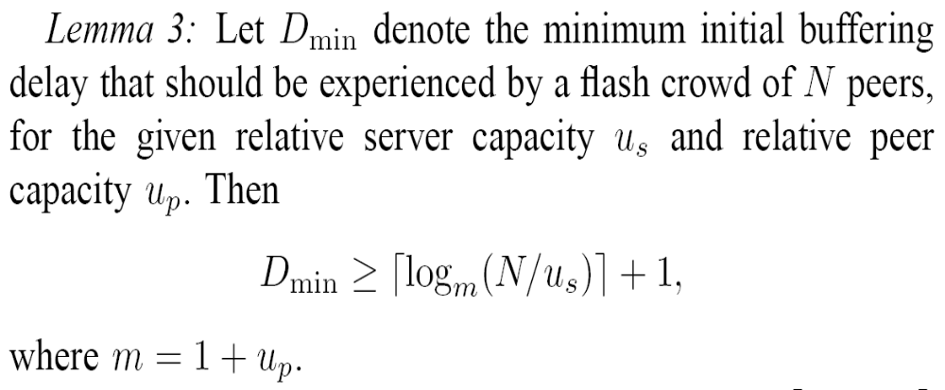

Slide 9
How to Achieve it?
Trellis Graphs

Slide 10
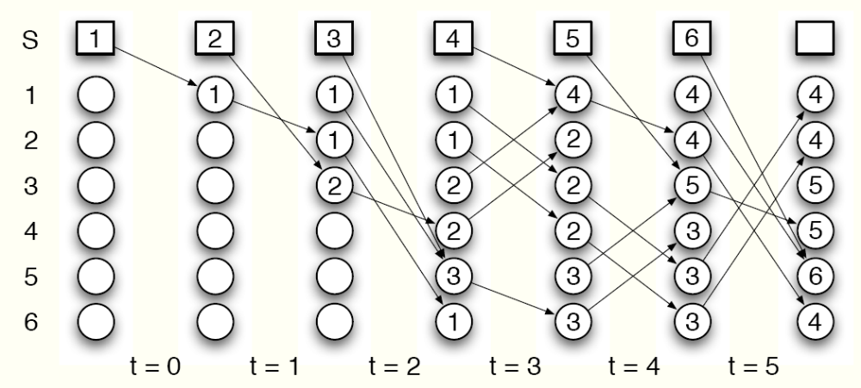
Example
Us = up = 1, N = 6
Dmin = [log(1+1)(6/1)] + 1 =4

Slide 11
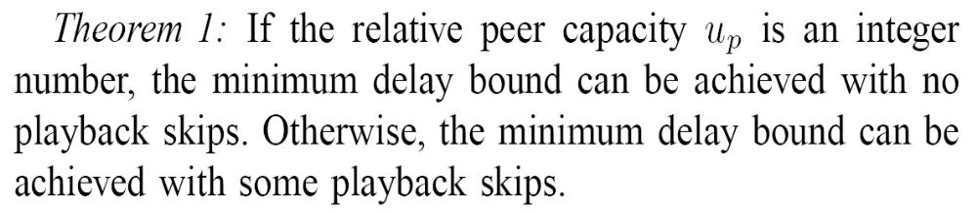

Slide 12
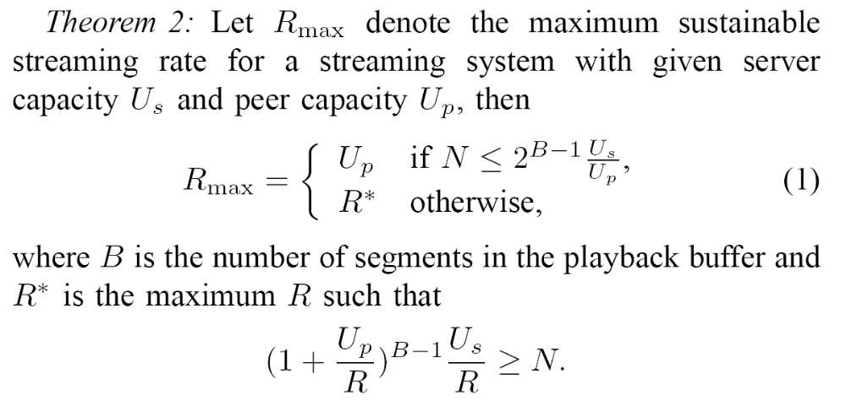

Slide 13
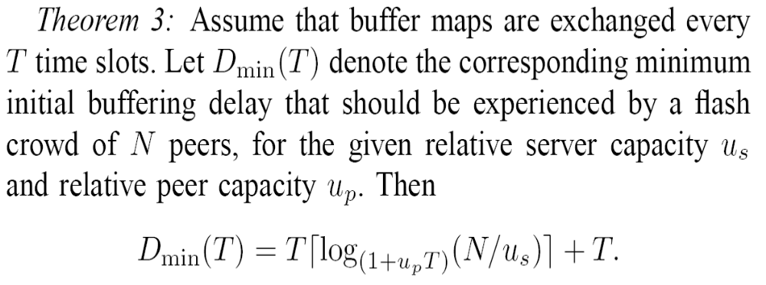
Effect of Periodic Buffer Map Exchanges

Slide 14
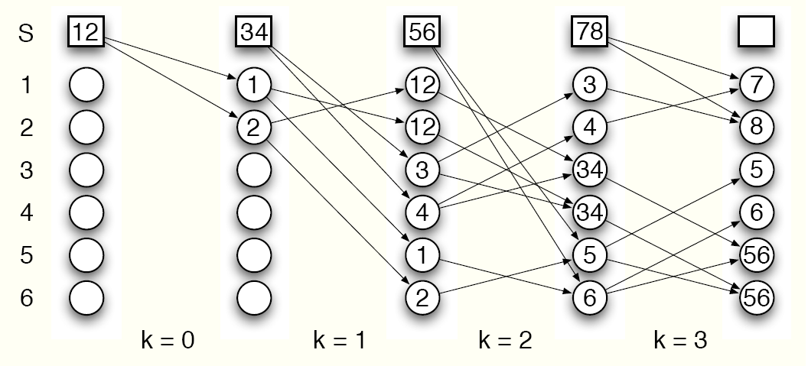
1
2
3
4
T = 2
1
1
2
4
1
1
2
4
2
2
3
2
2
3
1
3
3
1
3
3

Slide 15
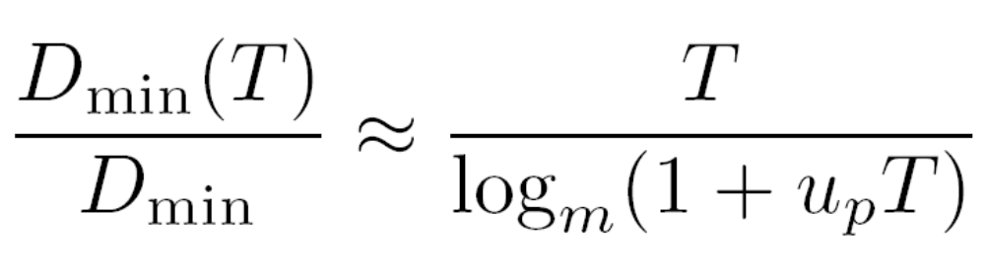
Corollary I:

Slide 16
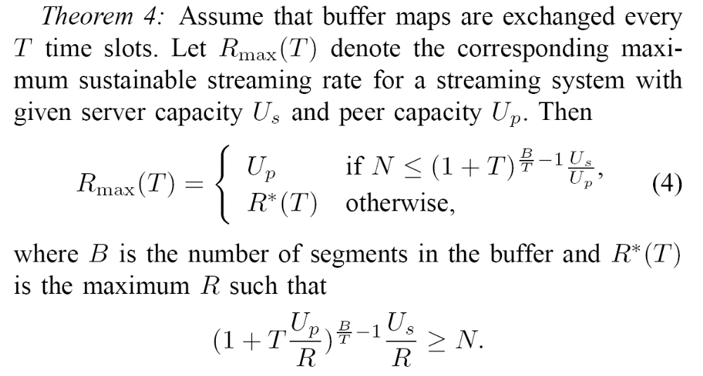

Slide 17
The Decentralized Scheduling
Newest group first segment selection strategy:
  when a downstream peer has a chance to request a segment from an upstream peer, it randomly selects a segment in the newest segment group on that upstream peer.

Slide 18
mi(k)
  To denote the average number of label i on the nodes in the trellis graph at the beginning of time unit k.
qi(k)
  To denote the average number of peers that have segment group i at the beginning of time unit k

Slide 19
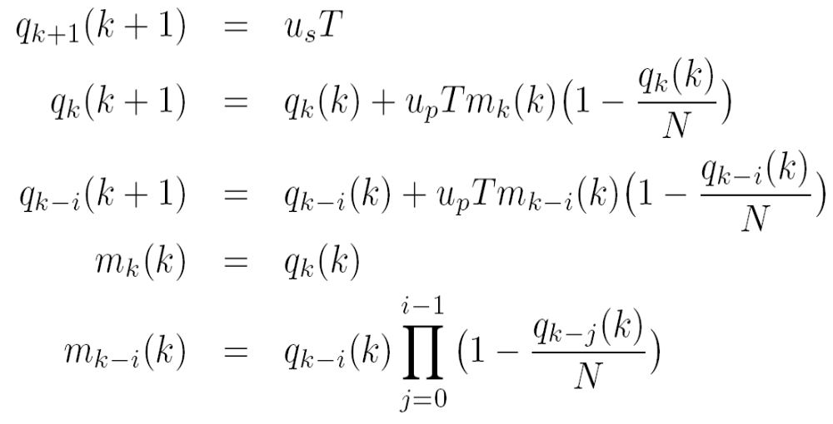
Proposition I

Slide 20
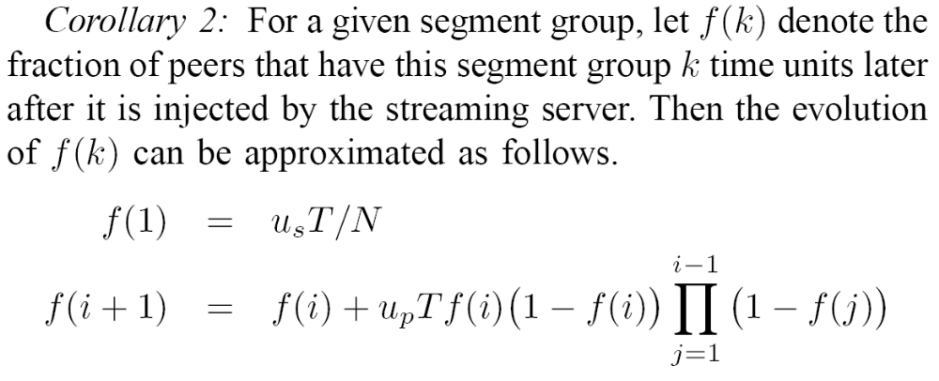

Slide 21
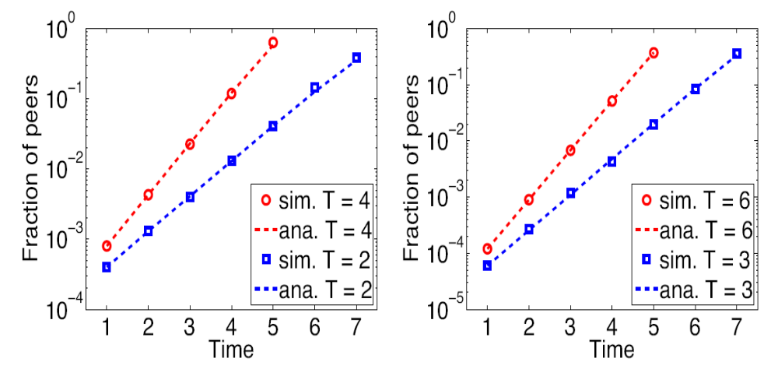
Validation

Slide 22
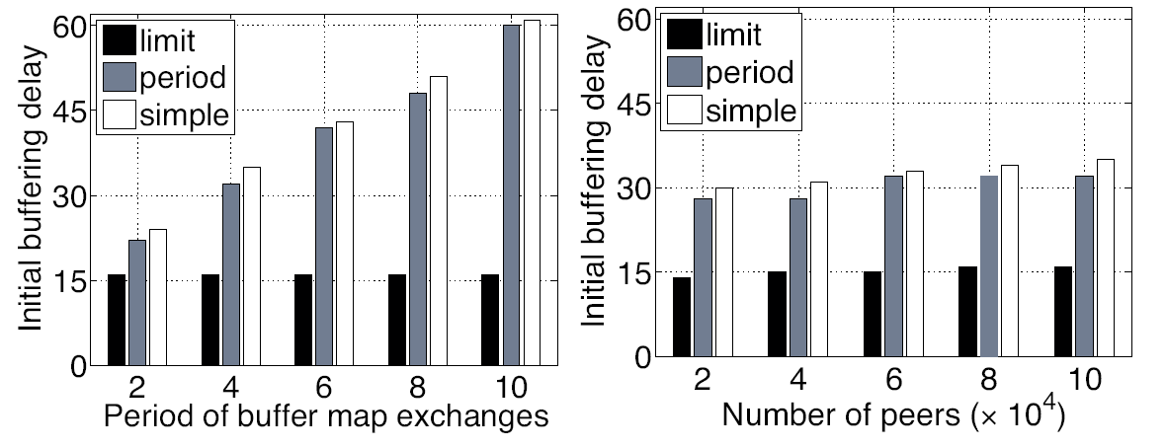
Comparisons of the performance gap in terms of the initial buffering delay

Slide 23
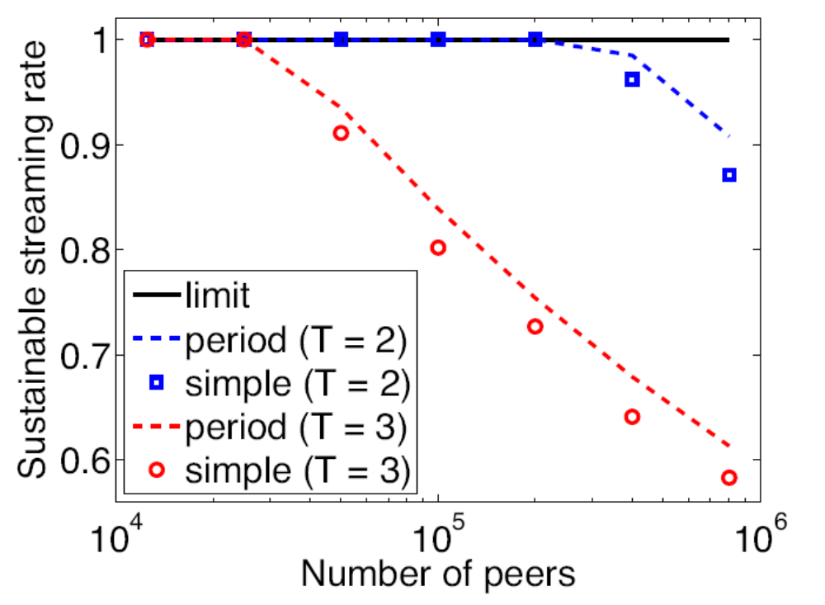
Comparisons of the performance gap in terms of the sustainable streaming rate

Slide 24
Conclusion
Periodic buffer map exchanges account for most of the gap that separates the actual and optimal performance of pull-based mesh protocols.
Overhead-delay tradeoff
Overhead-Scalability tradeoff

