Slide 1
Variable-Stride Multi-Pattern Matching
For Scalable Deep Packet Inspection
Nan Hua¹, Haoyu Song², T. V. Lakshman²
¹Georgia Tech, ²Bell Labs, Alcatel-Lucent
November 8, 2026

Slide 2
Introduction
  Deep Packet Inspection (DPI)
    Stateful inspection on packet header + packet payload
    Network Intrusion Detection & Prevention, Lawful Inspection, Censorship, Quality of Service …
  Focus of this work
    Fixed String Pattern Matching
    Why important?
      Key component of signature-based DPI system
      The basis for advanced inspection
      Performance bottleneck
    Requirement
      High speed, real time in-line processing
      Low memory storage and bandwidth consumption
      Low false positive rate and low miss rate
      Resilient to the worst case scenarios

Slide 3
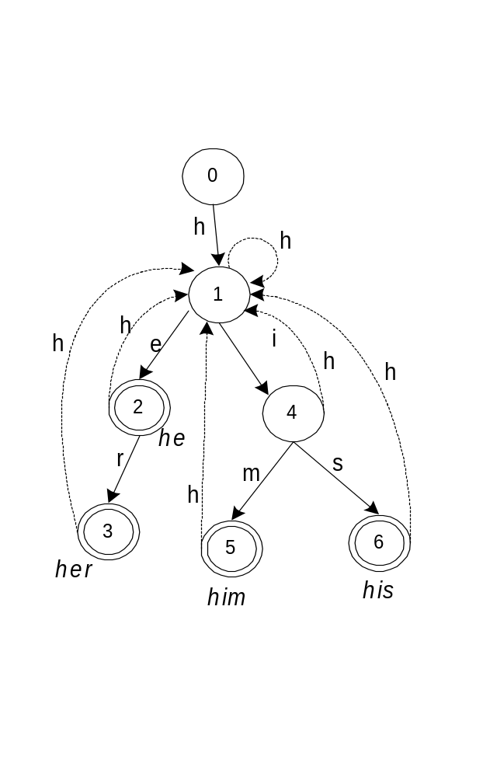
Classical Algorithm: Aho-Corasick DFA (1975)
String set:
{he, his, him, her}
init state
  Set the foundation for most of the latest multi-pattern matching algorithms
  Consumes one byte/character per lookup cycle
    10GbE/OC192 → ~1 gigabytes/sec.
  Too many state transitions even for such a small set
    state fan-out = alphabet size
accept state
Failure transitions back to init state are not shown.
Notes:
The figure shows an example of an Aho-Corasick DFA. The DFA can search for matching keywords {he, her, him, his}. A searching begins at start state, and transits by input characters until reaching an accept state. That can be state2, 3 ,5 , and 6.
The next slice will how the AC DFA is implemented in memory

Slide 4
Increasing Throughput Through Parallelism
  Multiple parallel load-balancing search engines
    Memory Bandwidth Intensive
    Complex packet scheduler
    Overall cost depends on each single engine
  Make a single search engine scalable
    Simple pipeline does not work due to the DFA feedback path
    Superscalar & Multi-threading works with complex packet scheduler
    Examine multiple bytes or characters per lookup step
  Our goal: Improving throughput without exploding the memory
    Better state machine implementation
    Better (on-chip and off-chip) memory organization

Slide 5
A Naive realization of multi-byte pattern matching
Input alignment problem.
e.g. it can match “phone”
but not “iphone”
s1 : technical
s1 : tech nica l
s2 : technically
s2 : tech nica lly
s3 : tel
s3 : tel
s4 : telephone
s4 : tele phon e
q₀
s5 : phone
s5 : phon e
tech
elep
s6 : elephant
s6 : elep hant
tel
tele
s₃
phon
q₁
s3,q₂
q₃
q₄
Still one character per lookup, but speedup can be achieved by …
nica
phon
e
hant
q₅
q₆
s₅
S₆ q₇
l
lly
e
s₁
S_{1,}s₂
S_{4,}s₅
Notes:
We first break the given set of strings into fixed length say k character groups as shown in this figure. Here k is 4. So we have 4 character segments and then a tail associated with each string. Now, each of this k character sub-strings can be treated as a single symbol.
So we have 6 unique symbols in this example colored in red. We now construct the Aho-Corasick automaton with the red strings treating the set of symbols as our alphabet. Note that the automaton is constructed of the 4 character segments. And not the tails of strings. So by executing this automaton we can match the red colored prefix of the string. And to match a complete string we need to match the tails too. So we add tails to the appropriate states. Like this…
But note that the tails don’t create a state. They are just pseudo state to which machine never goes.
Now the pattern matching is simple. We just execute a longest prefix match on each state by considering next 4 characters from the text. If we find a match for all the k characters we make the state transitions. And if we find a match for a shorter prefix then we declare a matching strings…and make a failure transition for that state.
Let’s see an example.

Slide 6
Deploying Multiple Multi-byte Search Engines
  Replicate the table for different shift offsets.
    Waste memory storage
  One lookup for each offset
    Waste memory bandwidth
  Many previous work can be classified as using this approach: ANCS’05, JSAC’06 …
x
y
z
t
e
c
h
n
i
c
a
l
l
y
a
b
Notes:
Hence we need k machines each scanning the data with a byte offset from the neighbor as shown in the figure.
With this arrangement we will never miss the detection of any string since each string will captured at the correct boundary by one of these k machines.
But it doesn’t make any sense to implement these machines using commodity memory chips since k machines will need k chips. However, we don’t implement these machines in off-chip memory. Like I mentioned before, we implement approximate machines in the on-chip memory and one machine in off-chip memory.

Slide 7
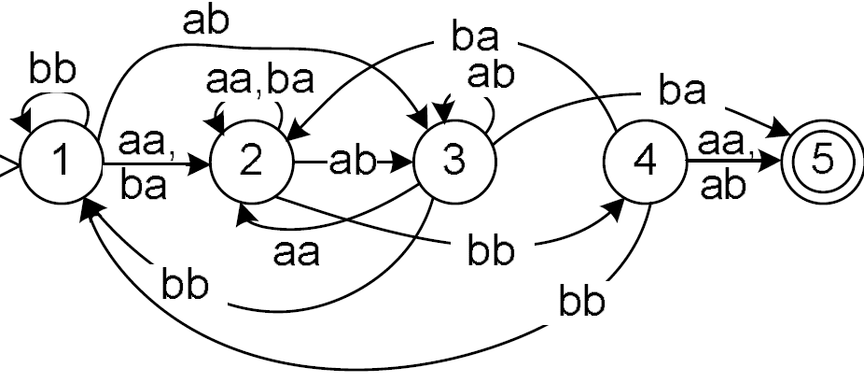
Amending Bandwidth with Storage (ISCA’06)
  Combining all possible offsets into one state machine
    leading to memory explosion
      state fan-out = Sⁿ, S is the alphabet size and n is the stride
DFA for one pattern: “abba” in alphabet {a, b}

Slide 8

Key Idea of Variable Stride DFA (VS-DFA)
  What is the problem of the naive approach?
    The segments within source and target are not aligned
x
y
z
t
e
c
h
n
i
c
a
l
l
y
a
b
Source (data flow)
t
e
c
h
n
i
c
a
l
l
y
Signature (to be matched)
  How does human recognize string patterns in natural language?
    Using words as atomic units separated by space and punctuation
this talk is interesting!
I
think
this
talk
is
boring!

Slide 9
Identifying Atomic Units using Winnowing
  Winnowing [S. Schleimer, et al, SIGMOD’03]
    extract documents’ signature for similarity comparison
  First: hash every k characters, say, k = 2
  Second: select the max hash value within a w-byte sliding window, say, w = 3
  Third (our extension): partition the string into blocks at the positions of chosen values
x
y
z
t
e
c
h
n
i
c
a
l
l
y
a
b
149
51
46
205
76
179
78
75
176
16
l49
168
105
54
99
149
51
149
51
46
205
76
179
78
75
176
16
l49
168
105
54
99

Slide 10
Segmenting Strings to Blocks using Winnowing
  Each pattern string is divided into a head block, one or more core blocks, and a tail block
    The core blocks are context independent
    The head block and the tail block are context dependent
    Some short pattern can be coreless or indivisible
  Key idea: Using the core blocks to identify the pattern and then using the head and tail to verify the matching
head
block
tail
block
core blocks
s1:
ridiculous
s1:
r
id | ic|ulo|u
s
s2:
authenticate
s2:
auth
ent|ica
te
s3:
identical
winnowed
s3:
id
ent|ica
l
s4:
confident
s4:
conf
id
ent
s5:
confidential
s5:
conf
id |ent
ial
s6:
entire
s6:
ent
(empty-core)
ire
s7:
set
s7:
---
(indivisible)
---

Slide 11
Building the Variable-Stride DFA
head
string
tail
string
core string
Short patterns are handled by TCAM
ent|ire
set
s1:
r
id | ic|ulo|u
s
s₆
s₇
s2:
auth
ent|ica
te
q₀
s3:
id
ent|ica
l
id
ent
s4:
conf
id
ent
s5:
conf
id |ent
ial
q₁₄
conf|ent
q₁
s6:
ent
(empty-core)
ire
ic
s₄
ica
s7:
---
(indivisible)
---
ent
q₂
q₁₅
ica
q₁₂
auth|te
ulo
conf|ial
s₅
s₂
q₃
u
Compiled
q₁₁
id|l
r|s
s₃
A difference from Aho-Corasick is that sometimes this jump could be removed
s₁

Slide 12
Pattern Matching System using VS-DFA
Winnowing
Module
Block-based State Machine
x
y
z
t
e
c
h
n
Data Stream
(Payload)
c
a
l
l
Match
Result
i
c
a
l
l
y
a
b
h
n
i
state
e
c
c
o
n
n
e
c
t
i
x
y
z
t
Multi-bytes
per cycle
One Block
per cylce
Blocks Queue
Throughput depends
on the state machine

Slide 13
State Machine Implementation
  VS-DFA comprises two tables: the State Transition Table (STT) and the Match Table (MT)
Hash Key
Value
q₀
id
q₁₄
Start Transitions
q₀
ent
q₁
q₁₄
ic
q₂
q₂
ulo
q₃
q₁₁
r
s
3
q₃
u
q₁₁
q₁₂
auth
te
2
q₁₄
ent
q₁₅
q₁₂
id
l
2
q₁
ica
q₁₂
q₁₄
conf
ent
1
q₁₅
ica
q₁₂
q₁₅
conf
ial
2
Start
State
block
End
State
State
Head
Tail
Depth
(a) State Transition Table (STT)
(b) Match Table (MT)
  Implemented as efficient hash tables

Slide 14
Using TCAM to Handle Short Patterns
  The “empty-core” pattern could still benefit from the segmentation
  An indivisible pattern needs max {w, w+k-2} replications
Head
(w bytes)
Tail
(w+k-2 bytes)
e
n
t
i
r
e
Empty-Core
Pattern
s
e
t
s
e
t
Indivisible
Pattern
s
e
t
s
e
t

Slide 15
Defending Against the Single-byte blocks
  The expected throughput speedup is (w+1)/2
  Prone to Denial-of-Service attack
    single-byte blocks can lower the throughput
    adversaries can easily construct repeated single-byte blocks by sending repeated patterns
  We can reduce or even eliminate the single-byte pattern by applying the combination rules on the data stream and pattern at the same time
    combining up to w consecutive single-byte blocks into one block
    maintaining the block synchronization feature
      see paper for details

Slide 16
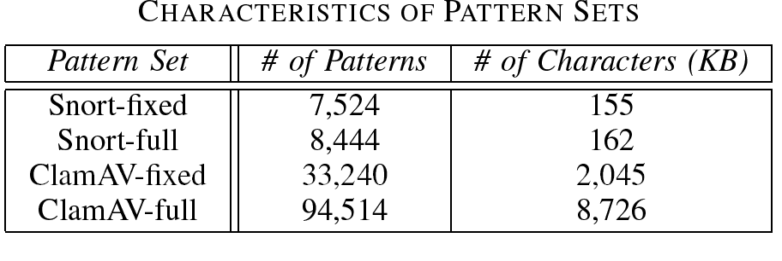
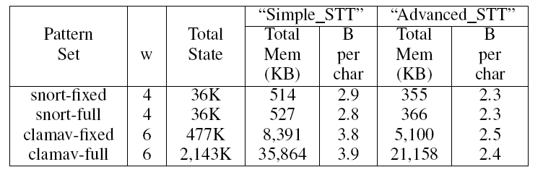
Evaluation Pattern Sets & Memory Efficiency
  Snort-full and ClamAV-full also includes the fixed strings extracted from the Regular Expressions (in snort) or the advanced rules (in ClamAV)

Slide 17
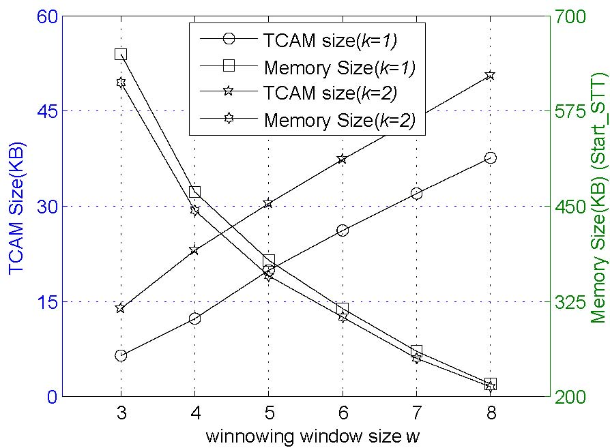
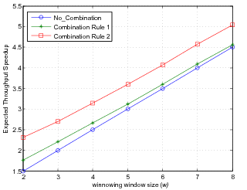


Evaluation Results: Tradeoffs of w and k
results for snort-fixed. results for ClamAv is similar
  Larger w or k results in smaller memory
  Larger w or k results in larger TCAM
  Larger w results in higher throughput

Slide 18

Conclusion & Future Work
  Multi-pattern matching is a key building block of a DPI system
  VS-DFA can process multiple bytes per step with small memory size and memory bandwidth consumption
  A single VS-DFA search engine can support 10Gbps+ throughput
  Future Work
    Find other segmentation algorithms instead of Winnowing that are more suitable for our application
    Use larger stride for higher throughput without incurring the short pattern penalty
    Extend the algorithm to support regular expression matching

