Slide 1




Can the Production Network
Be the Testbed?
Rob Sherwood
Deutsche Telekom Inc.
R&D Lab
Glen Gibb, KK Yap, Guido Appenzeller,
Martin Cassado,
Nick McKeown, Guru Parulkar
Stanford University, Big Switch Networks,
Nicira Networks

Slide 2
Problem:
Realisticly evaluating new network services is hard
  services that require changes to switches and routers
  e.g.,
    routing protocols
    traffic monitoring services
    IP mobility
Result: Many good ideas don't gets deployed;
Many deployed services still have bugs.
Notes:
"services means a lot of things to a lot of people, specifically, I mean..."
"this is frustrating to the networking community because the result is..."

Slide 3
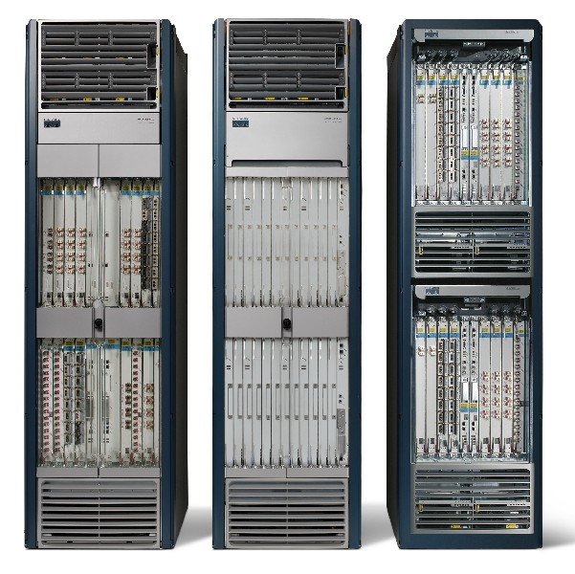
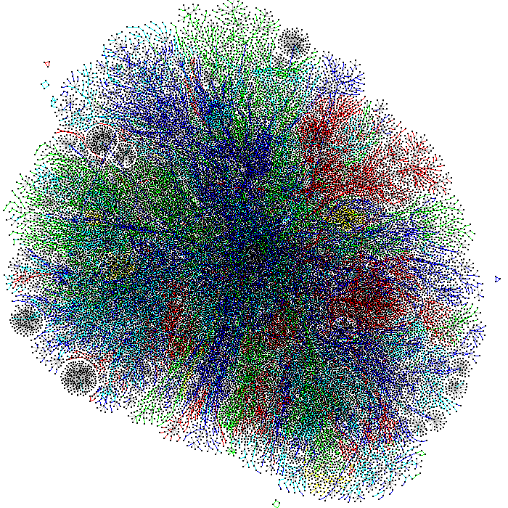



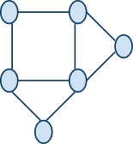
Why is Evaluation Hard?
Real
Networks
Testbeds
Notes:
real networks are:
closed, high performance systems with 100s of interfaces
10^6 nodes, complex topology
(so complex, discovering this topology is itself an open problem)
and traffic on it is generated by
real people who have come to
depend on Internet as a production service
unfortunately, for reasons of programability, costs, and isolation, network evaluations typically happen on independent testbeds
so software routers have become the norm, with slower performance and lower fanout
orders of magnitude fewer nodes configured in topologies of unknown realism
and using synthetic traffic, trying our best guess to act like real users
result: lessons learned from testbeds do not provide sufficient confidence about how things will work on the real network

Slide 4
Not a New Problem
  Build open, programmable network hardware
    NetFPGA, network processors
    but: deployment is expensive, fan-out is small
  Build bigger software testbeds
    VINI/PlanetLab, Emulab
    but: performance is slower, realistic topologies?
  Convince users to try experimental services
    personal incentive, SatelliteLab
    but: getting lots of users is hard

Slide 5
Solution Overview: Network Slicing
  Divide the production network into logical slices
    each slice/service controls its own packet forwarding
    users pick which slice controls their traffic: opt-in
    existing production services run in their own slice
      e.g., Spanning tree, OSPF/BGP
  Enforce strong isolation between slices
    actions in one slice do not affect another
  Allows the (logical) testbed to mirror the production network
    real hardware, performance, topologies, scale, users
Notes:
very text heavy; think about a picture (what!?)
"systems solution to a networking problem (this is why it's at OSDI)"

Slide 6
Rest of Talk...
  How network slicing works: FlowSpace, Opt-In
  Our prototype implementation: FlowVisor
  Isolation and performance results
  Current deployments: 8+ campuses, 2+ ISPs
  Future directions and conclusion

Slide 7
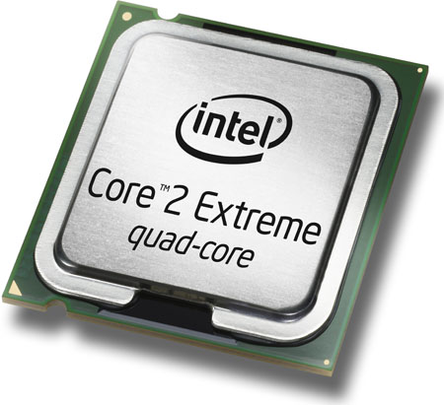

Current Network Devices
Switch/Router
  Computes forwarding rules
    “128.8.128/16 --> port 6”
  Pushes rules down to data plane
Control
Plane
General-purpose
CPU
Rules
Control/Data Protocol
Excepts
  Enforces forwarding rules
  Exceptions pushed back to control plane
    e.g., unmatched packets
Data
Plane
Custom
ASIC
Notes:
"before I can tell you about slicing, let me tell you a bit about how current switches and routers work..."
"simplified view"
"generally has a separate control and data plane"

Slide 8
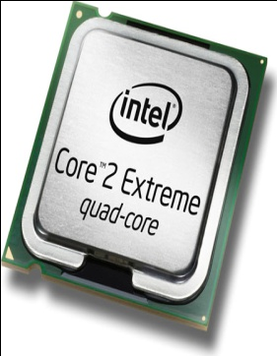

Add a Slicing Layer Between Planes
Slice 2
Control
Plane
Slice 1
Control
Plane
Slice 3
Control
Plane
Slice
Policies
Control/Data
Protocol
Rules
Excepts
Data
Plane
Notes:
"Each slice runs its own, custom control plane process and generates its own rules"
TODO: de-ugly-fy

Slide 9
Network Slicing Architecture
A network slice is a collection of sliced switches/routers
  Data plane is unmodified
  Packets forwarded with no performance penalty
  Slicing with existing ASIC
Transparent slicing layer
  each slice believes it owns the data path
  enforces isolation between slices
    i.e., rewrites, drops rules to adhere to slice police
  forwards exceptions to correct slice(s)

Slide 10
Slicing Policies
The policy specifies resource limits for each slice:
  Link bandwidth
  Maximum number of forwarding rules
  Topology
  Fraction of switch/router CPU
  FlowSpace: which packets does the slice control?

Slide 11
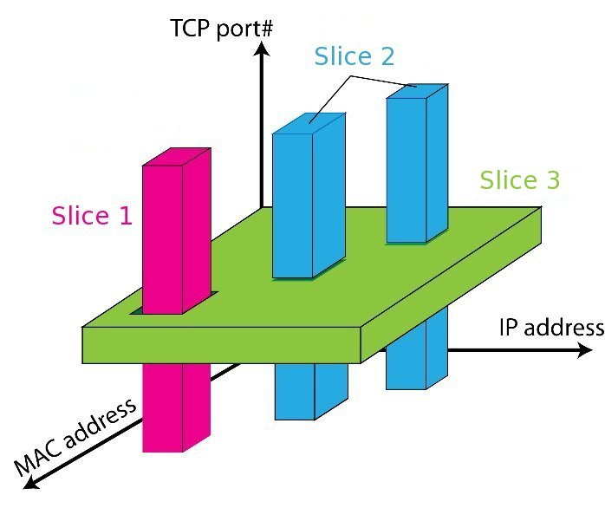
FlowSpace: Maps Packets to Slices
Notes:
"flowspace is a way of thinking about classes of packets"
"each slice has forwarding control of a specific set of packets, as specified by packet header fields"
"that is, all packets in a given flow are controlled by the same slice"
"each flow is controlled by exactly one slice" (ignoring monitoring slices for the purpose of the talk)
"in practice, flow spaces are described using ordered ACL-like rules"

Slide 12
Real User Traffic: Opt-In
  Allow users to Opt-In to services in real-time
    Users can delegate control of individual flows to Slices
    Add new FlowSpace to each slice's policy
  Example:
    "Slice 1 will handle my HTTP traffic"
    "Slice 2 will handle my VoIP traffic"
    "Slice 3 will handle everything else"
  Creates incentives for building high-quality services

Slide 13
Rest of Talk...
  How network slicing works: FlowSpace, Opt-In
  Our prototype implementation: FlowVisor
  Isolation and performance results
  Current deployments: 8+ campuses, 2+ ISPs
  Future directions and conclusion

Slide 14
Implemented on OpenFlow
Server
Custom
Control
Plane
OpenFlow
Controller
API for controlling packet forwarding
Abstraction of control plane/data plane protocol
Works on commodity hardware
  via firmware upgrade
  www.openflow.org
Network
OpenFlow
Protocol
Stub
Control
Plane
Control Path
OpenFlow
Firmware
Data
Plane
Data Path
Switch/
Router
Switch/
Router

Slide 15
FlowVisor Implemented on OpenFlow
Server
Servers
Custom
Control
Plane
OpenFlow
Controller
OpenFlow
Controller
OpenFlow
Controller
OpenFlow
Controller
OpenFlow
Network
OpenFlow
Protocol
FlowVisor
OpenFlow
Stub
Control
Plane
OpenFlow
Firmware
OpenFlow
Firmware
Data
Plane
Data Path
Data Path
Switch/
Router
Switch/
Router
Switch/
Router
Switch/
Router

Slide 16
FlowVisor Message Handling
Alice
Controller
Bob
Controller
Cathy
Controller
Rule
OpenFlow
Policy Check:
Is this rule allowed?
Policy Check:
Who controls this packet?
FlowVisor
OpenFlow
Full Line Rate
Forwarding
OpenFlow
Firmware
Exception
Packet
Data Path
Packet

Slide 17
FlowVisor Implementation
Custom handlers for each of OpenFlow's 20 message types
  Transparent OpenFlow proxy
  8261 LOC in C
  New version with extra API for GENI
Could extend to non-OpenFlow (ForCES?)
Code: `git clone git://openflow.org/flowvisor.git`

Slide 18
Rest of Talk...
  How network slicing works: FlowSpace, Opt-In
  Our prototype implementation: FlowVisor
  Isolation and performance results
  Current deployments: 8+ campuses, 2+ ISPs
  Future directions and conclusion

Slide 19
Isolation Techniques
Isolation is critical for slicing
  FlowSpace
  Topology
  Device CPU
  Link bandwidth
  Flow Entry
    As well as performance and scaling numbers

Slide 20
Flow Space Isolation
FlowVisor rewrites the messages to transparently ensure that a slice only control over its own flows and cannot affect other slices flows

Slide 21
Topology Isolation
Each slice should have its own view of network nodes and connectivity

Slide 22
Device CPU Isolation
  Ensure that no slice monopolizes Device CPU
  CPU exhaustion
    prevent rule updates
    drop LLDPs ---> Causes link flapping
  Techniques
    Limiting rule insertion rate
    Use periodic drop-rules to throttle exceptions
    Proper rate-limiting coming in OpenFlow 1.1

Slide 23
Device CPU Isolation
Low-power embedded processor and easily overloaded
Four sources of load on a switch CPU:
Generating new flow messages
Handling requests from controller
Forwarding “slow path” packets
Internal state keeping

Slide 24
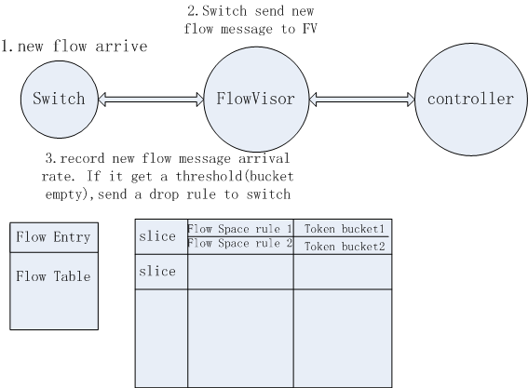
Generating new flow messages

Slide 25
Handling requests from controller
Edit the forwarding table
Query statistics
FlowVisor throttles the maximum OpenFlow message rate to limit CPU consumption
CPU consumed vary by message type and hardware implementation

Slide 26
Forwarding “slow path” packets
Slow path: consume CPU resources
Eg: ASICs send one packet out exactly two ports
Rated limited by new flow message and controller request rate limiting

Slide 27
Internal state keeping
Ensure sufficient CPU available
For: internal counters, process events, update counters, etc.

Slide 28
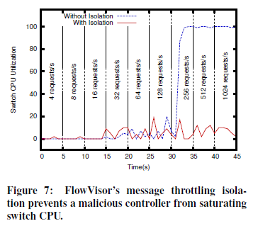
Device CPU Isolation

Slide 29
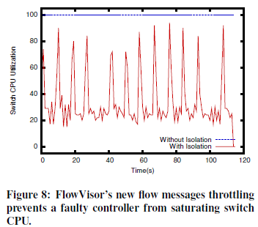
Device CPU Isolation

Slide 30
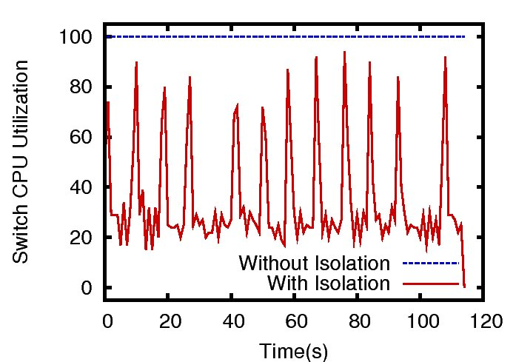
CPU Isolation: Malicious Slice

Slide 31
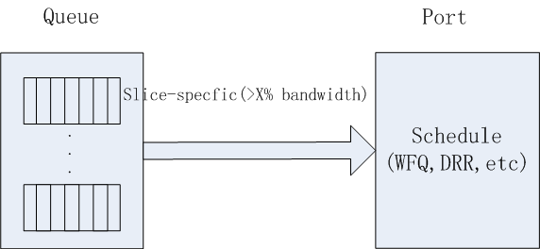
Bandwidth Isolation
Send out queue Y (slice-specific) on port X

Slide 32
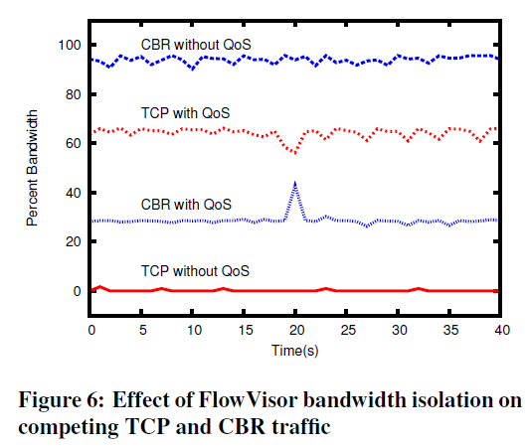
Bandwidth Isolation

Slide 33
Flow Entry Isolation
The num of each slice’s flow entries does not exceed a preset limit
Count the guest controller’s rule number: “table full” error message

Slide 34
Rest of Talk...
  How network slicing works: FlowSpace, Opt-In
  Our prototype implementation: FlowVisor
  Isolation and performance results
  Current deployments: 8+ campuses, 2+ ISPs
  Future directions and conclusion

Slide 35
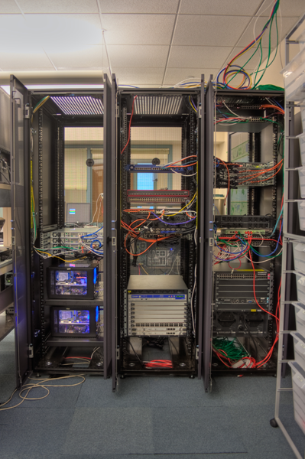
FlowVisor Deployment: Stanford
  Our real, production network
    15 switches, 35 APs
    25+ users
    1+ year of use
    my personal email and web-traffic!
  Same physical network hosts Stanford demos
    7 different demos

Slide 36
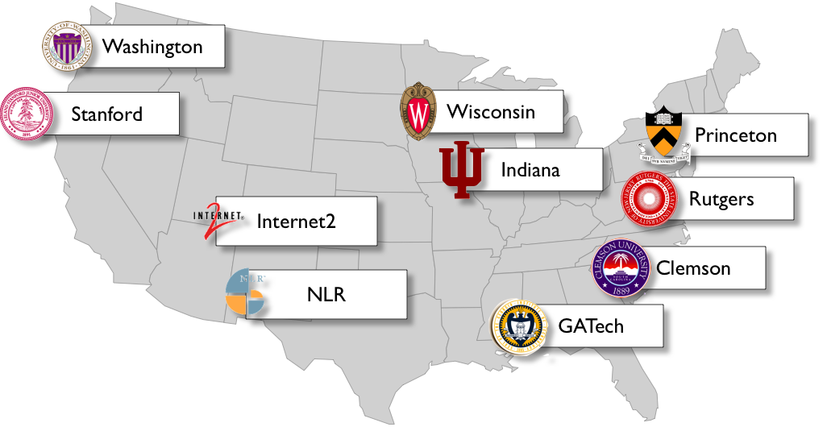
FlowVisor Deployments: GENI

Slide 37
Future Directions
  Currently limited to subsets of actual topology
    Add virtual links, nodes support
  Adaptive CPU isolation
    Change rate-limits dynamically with load
    ... message type
  More deployments, experience

Slide 38
Conclusion: Tentative Yes!
  Network slicing can help perform more realistic evaluations
  FlowVisor allows experiments to run concurrently but safely on the production network
    CPU isolation needs OpenFlow 1.1 feature
  Over one year of deployment experience
  FlowVisor+GENI coming to a campus near you!
  Questions?
  git://openflow.org/flowvisor.git

Slide 39
What about VLANs?
Can't program packet forwarding
  Stuck with learning switch and spanning tree
OpenFlow per VLAN?
  No obvious opt-in mechanism:
    Who maps a packet to a vlan? By port?
  Resource isolation more problematic
    CPU Isolation problems in existing VLANs

Slide 40
FlowSpace Isolation
Policy | Desired Rule | Result
HTTP | ALL | HTTP-only
HTTP | VoIP | Drop
  Discontinuous FlowSpace:
    (HTTP or VoIP) & ALL == two rules
  Isolation by rule priority is hard
    longest-prefix-match-like ordering issues
    need to be careful about preserving rule ordering

Slide 41
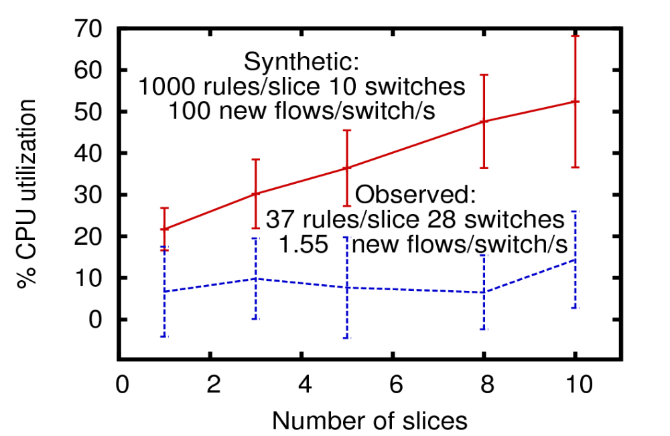
Scaling

Slide 42
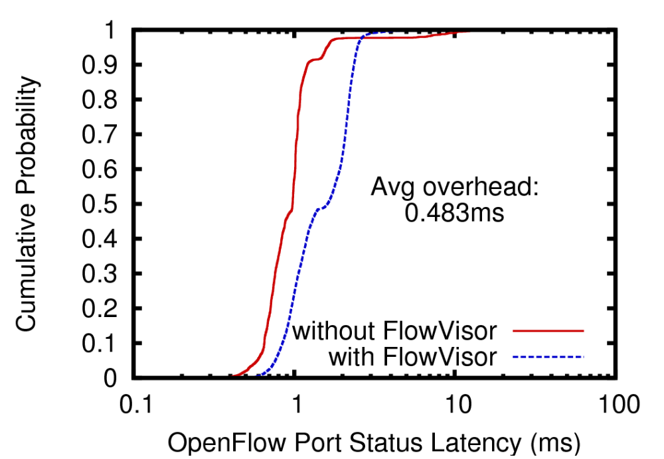
Performance

