Slide 1
Applying NOX to the Datacenter
Arsalan Tavakoli, Martin Casado, Teemu Koponen, and Scott Shenker
Hot Topics in Networks Workshop 2009
10/22/2009

Slide 2
Datacenter Networking Requirements
Scaling
Location Independence
Service Quality
Datacenter-Specific
Hot Topics in Networks Workshop 2009
10/22/2009

Slide 3
Two Tracks of Network Research
Specialized
Datacenter Networking
General
Network Management
Monsoon
4D Project
Scalable, Commodity Datacenter
Routing Control Platform
BCube
Tesseract
PortLand
Ethane
VL2
NOX
Do we need specialized solutions for the datacenter, or are general management tools sufficient?
Can NOX manage a datacenter network?
Hot Topics in Networks Workshop 2009
10/22/2009

Slide 4
Talk Outline
Datacenter Networking Requirements
Overview of Networking Research
What is NOX?
VL2: A recent datacenter-specific solution
Can NOX manage a datacenter?
Additional Capabilities of NOX
Conclusion
Hot Topics in Networks Workshop 2009
10/22/2009

Slide 5
Overview of NOX [CCR July 2008]
Centralized network management platform
Utilizes controllable switches to dictate forwarding behavior
Centralized controller maintains global network view
Provides flow-granularity control
Hot Topics in Networks Workshop 2009
10/22/2009

Slide 6
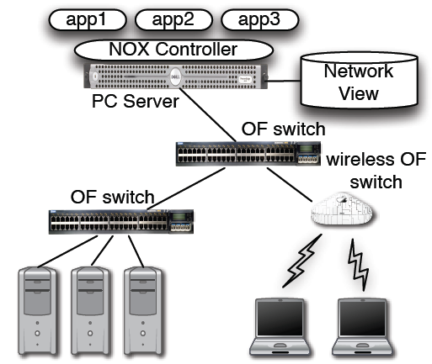
Overview of NOX [CCR July 2008]
Multiple controller support
Reactive and pro-active operation modes
Current Status
Deployed in production environments
Available for download
Hot Topics in Networks Workshop 2009
10/22/2009

Slide 7
Talk Outline
Datacenter Networking Requirements
Overview of Networking Research
What is NOX?
VL2: A recent datacenter-specific solution
Can NOX manage a datacenter?
Additional Capabilities of NOX
Conclusion
Hot Topics in Networks Workshop 2009
10/22/2009

Slide 8
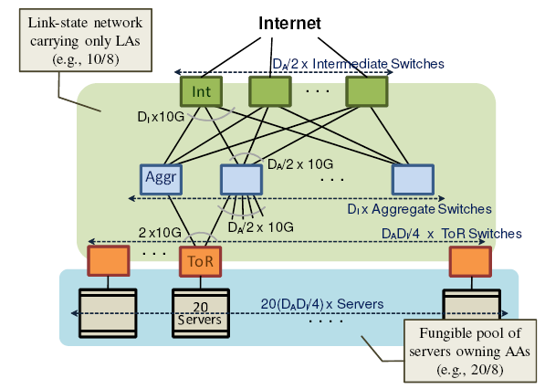
VL2 Overview
Clos Topology with no oversubscription
Valiant Load Balancing
  Using ECMP and IP-in-IP Encapsulation
Two-Distinct L3 Addressing Schemes
VL2 Directory Server(s)
Greenberg et al. VL2: A Scalable and Flexible Data Center Network, Sigcomm 2009
Hot Topics in Networks Workshop 2009
10/22/2009

Slide 9
VL2 Overview
 | VL2 | NOX
Scaling
Addressing | 2 Distinct L3 Namespaces | Addressing Agnostic
Broadcast | Centralized ARP/DHCP IP-Multicast | Centralized ARP/DHCP Private Spanning Tree
Location Independence | LA -> AA Mappings | Centralized Control
Load Balancing | Valiant Load Balancing | Valiant Load Balancing
PortLand Routing |  | Can implement
Hot Topics in Networks Workshop 2009
10/22/2009

Slide 10
Talk Outline
Datacenter Networking Requirements
Overview of Networking Research
What is NOX?
VL2: A recent datacenter-specific solution
Can NOX manage a datacenter?
Additional Capabilities of NOX
Conclusion
Hot Topics in Networks Workshop 2009
10/22/2009

Slide 11
Implementing VL2 Routing using NOX
Classifier | Action
Per-Dest. ToR | Forward using Dest. IP
Core
Core
Classifier | Action
Per-Port | Forward using CoreID or Dest. IP
Agg.
Agg.
Classifier | Action
Per-Host | Overwrite Dest. IP with Host IP Forward to Host
Classifier | Action
Per-Flow | Insert CoreID Overwrite Dest. IP with Dest. ToR Send to Agg. Switch
ToR
+
Rack
ToR
+
Rack
Hot Topics in Networks Workshop 2009
10/22/2009

Slide 12
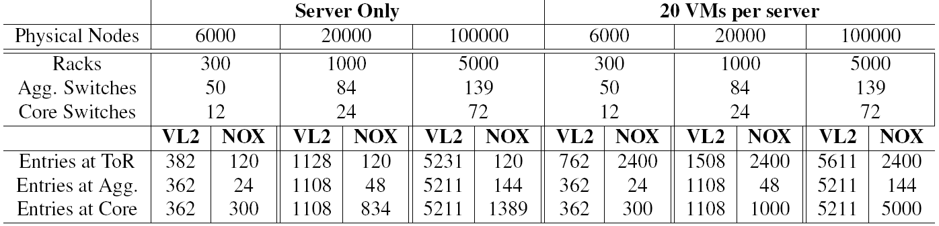
VL2 Implementation Analysis
Parameter | Value
Topology | 3-layer Clos Topology
Network Size | 6K, 20K, and 100K servers
Virtual Machines | 0 and 20 per Server
Flows per Host | 10 concurrent flows
Only dependent on neighbors
Dependent on # of hosts in rack and # of concurrent flows
Dependent on number of racks served
Hot Topics in Networks Workshop 2009
10/22/2009

Slide 13
Other Scalability Issues
Multiple Controller Consistency
  Strict consistency only needed for topology and host mappings
Bandwidth and Latency
  Early version of NOX handled 30K flows per second
  Sub 10ms install time
  2 Million VMs and 10 Flows/s = ~667 Controllers (VL2 ~ 1200)
  2 Million VMs and 100K Flows/s = ~6.7M Controllers (VL2 ~ 12M)
Broadcast Traffic
  Controller handles ARP and DHCP traffic
  Spanning Trees can be installed
Hot Topics in Networks Workshop 2009
10/22/2009

Slide 14
Does NOX Satisfy the Requirements?
 | VL2 | NOX
Scaling
Addressing | 2 Distinct L3 Namespaces | Addressing Agnostic
Broadcast | Centralized ARP/DHCP IP-Multicast | Centralized ARP/DHCP Private Spanning Tree
Location Independence | LA -> AA Mappings | Centralized Control
Load Balancing | Valiant Load Balancing | Valiant Load Balancing
PortLand Routing |  | Can implement
Hot Topics in Networks Workshop 2009
10/22/2009

Slide 15
Talk Outline
Datacenter Networking Requirements
Overview of Networking Research
What is NOX?
VL2: A recent datacenter-specific solution
Can NOX manage a datacenter?
Additional Capabilities of NOX
Conclusion
Hot Topics in Networks Workshop 2009
10/22/2009

Slide 16

VM Migration
Setup path from A to VM
VM moves from B to C
NOX flushes state at switch 2
Packet for VM received at switch 2 triggers packet-in event
New path installed
A
1
4
3
2
C
B
VM
Hot Topics in Networks Workshop 2009
10/22/2009

Slide 17
Network Monitoring
Full flow entries installed at ToRs
OpenFlow provides per-flow statistics
Use endpoints to calculate delivery rate
Walk through rest of path to find drops
Core
Core
Agg.
Agg.
ToR
+
Rack
ToR
+
Rack
Hot Topics in Networks Workshop 2009
10/22/2009

Slide 18
Additional Capabilities
Middlebox Traversal
  Policy-Aware (SIGCOMM 08) like scheme can be used
Finer-grained Control
  Use of finer-grained flow entries
  Allows for usage of varied routing schemes
Multi-tenant/application management
  Enforce access policies across entities
  Allow for customized routing control
Hot Topics in Networks Workshop 2009
10/22/2009

Slide 19
Conclusion
NOX can be effective in managing a
datacenter network
Hot Topics in Networks Workshop 2009
10/22/2009

Slide 20
Status
OpenFlow commercial switches and NOX available today
Currently implementing NOX Datacenter Toolkit
Exploring options for large-scale testing
Hot Topics in Networks Workshop 2009
10/22/2009

Slide 21
Questions?
Hot Topics in Networks Workshop 2009
10/22/2009

