Slide 1
Towards High-performance IPsec on Cavium OCTEON Platform
Xinming Chen, Zhen Chen, Beipeng Mu, Lingyun Ruan, Jinli Meng
Intrust 2010
December 13, 2010
Research Institute of Information Technology, Tsinghua University

Slide 2
Outline
About us
Background
Implementation
Experiment and Performance
Conclusion

Slide 3
Our Lab
Network Security Lab (NSLab)
  belongs to the Research Institute of Information Technology (RIIT), Tsinghua Univ.
  http://security.riit.tsinghua.edu.cn/wiki/NSLab
Research Area
  Network security algorithmics
  Network processor architecture and parallel processing
  P2P overlay network routing and network coding

Slide 4
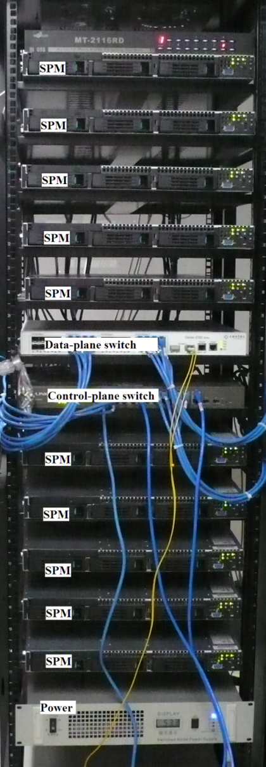
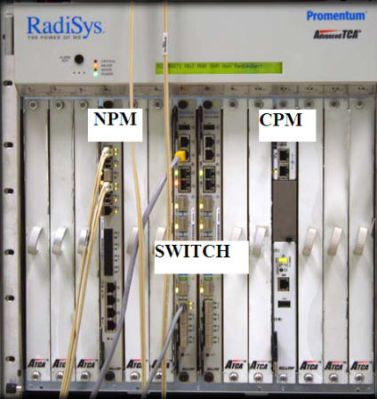
Our Recent Projects
20 Gbps Security Gateway
  National 863 Project
100 Gbps Network Algorithms
  Packet classification
  Pattern matching
Datacenter Networks
  Distributed Security Architecture
  Central Control Management

Slide 5
Our Recent Publication
Yaxuan Qi, Kai Wang, Jeffrey Fong, Weirong Jiang, Yibo Xue, Jun Li and Viktor Prasanna, FEACAN: Front-End Acceleration for Content-Aware Network Processing, the 30th IEEE INFOCOM, 2011.
Yaxuan Qi, Zongwei Zhou, Yiyao Wu, Yibo Xue and Jun Li, Towards High-performance Pattern Matching on Multi-core Network Processing Platforms, Proc. of GLOBECOM, 2010.
Fei He, Yaxuan Qi, Yibo Xue and Jun Li, YACA: Yet Another Cluster-based Architecture for Network Intrusion Prevention, Proc. of IEEE GLOBECOM 2010.
Yaxuan Qi, Lianghong Xu, Baohua Yang, Yibo Xue, and Jun Li, Packet Classification Algorithms: From Theory to Practice, Proc. of the 28th IEEE INFOCOM, 2009.
Tian Song, Wei Zhang, Dongsheng Wang, and Yibo Xue, Memory Efficient Multiple Pattern Matching Architecture for Network Security, Proc. of the 27th IEEE INFOCOM, 2008.
Bo Xu, Yaxuan Qi, Fei He, Zongwei Zhou, Yibo Xue, and Jun Li, Fast Path Session Creation on Network Processors, Proc. of ICDCS, 2008.
Yaxuan Qi, Bo Xu, Fei He, Baohua Yang, Jianming Yu, and Jun Li, Towards High-performance Flow-level Packet Processing on Multi-core Network Processors, Proc. of the ACM/IEEE Symposium on Architectures for Networking and Communications Systems (ANCS), 2007.

Slide 6
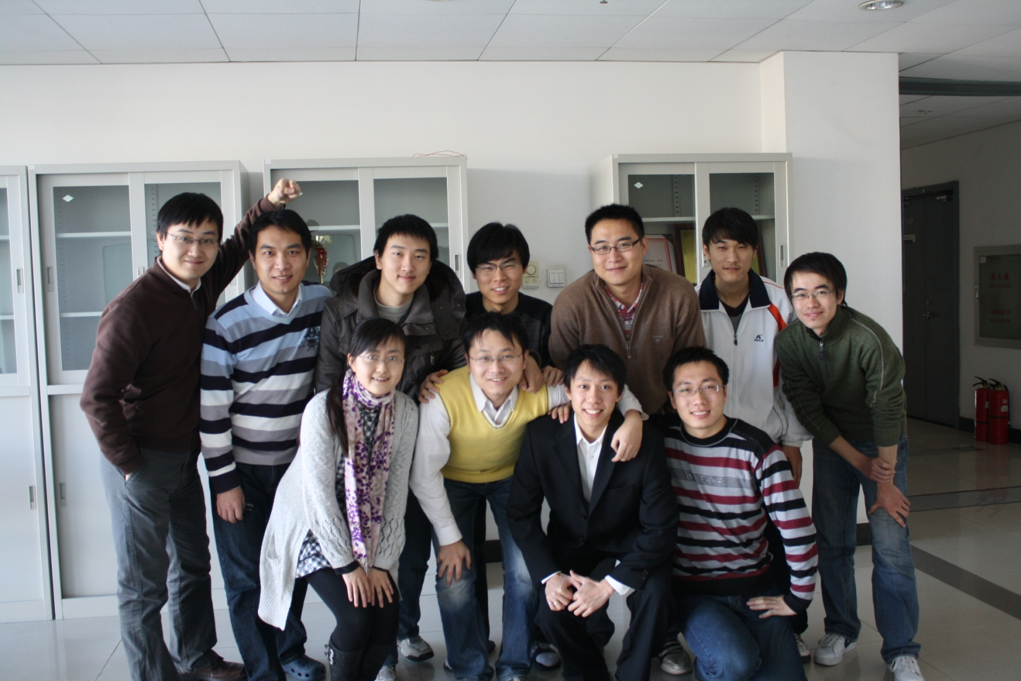
Our Team

Slide 7
Outline
About us
Background
Implementation
Experiment and Performance
Conclusion

Slide 8
Motivation
Problem: Internet’s openness brings security risks
Solution: Security mechanisms supply confidentiality, data integrity, anti-replay attack, etc.
But,
In fact: 10% of Internet Info. are protected
Reason: Security mechanisms reduce Quality of Performance, bring additional Cost and Payload
Our goal: efficient and high-performance parameters selection and implementation to protect more info. across the Internet
Notes:
为什么要做这事呢？那么网络应用越来越广泛，安全问题日渐突出，需要建立一个可信的信息交互平台，很多安全机制应运而生。然而，安全机制附加的性能和开销，负载限制了它们的应用，Internet上只有10%的信息被保护。
Internet’s openness brings enormous benefits, as well as many security risks. In order to provide a trusting information exchange environment, many security mechanisms are used across the network. However, only about 10% of the information across the Internet are protected because security mechanisms reduce quality of performance bring additional cost and payload. So our goal is efficient and high-performance parameters selection and implementation to protect more information across the Internet.

Slide 9
Outline
About us
Background
Implementation
Experiment and Performance
Conclusion

Slide 10
Implementation
Hardware Platform: Cavium OCTEON
Security mechanism: IPsec
Notes:
Our implementation depends on Cavium OCTEON

Slide 11
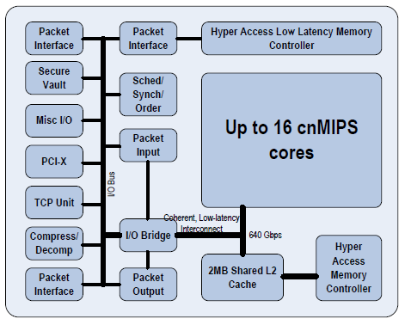
Cavium OCTEON
NP: Hardware acceleration of packet processing and encrypting (micro instructions)
Notes:
网络处理器：针对包处理和加解密的硬件加速引擎。
选择理由：MIPS64多核处理器OCTEON家族的优点：可扩展，高性能，低功耗

Slide 12
Mechanisms
Run-to-completion
Execute the whole processing of a flow in the same core
Pipeline
Divide the processing procedure of packet into several simple executives or stages, and one stage in one core.
Multiple cores can deal with packets in different stage from the same flow simultaneously. While the completion of one packet processing needs multiple cores.
Notes:
For multi-core processors, there are two ways to perform batch processing: the first one called run-to-completion is to execute the whole processing of a flow in the same core. The other one, called pipeline, is to divide the processing procedure of packet into several simple executives or stages, and one stage in one core. In this way, multiple cores can deal with packets in different stage from the same flow simultaneously, and the completion of one processing needs multiple cores. Once a packet comes, the de-scheduled module selects the shortest queue of these cores where to put the packet. If the selected queue is blocked, the blocked packet will be put aside, and the subsequent packet in the queue will be scheduled.

Slide 13
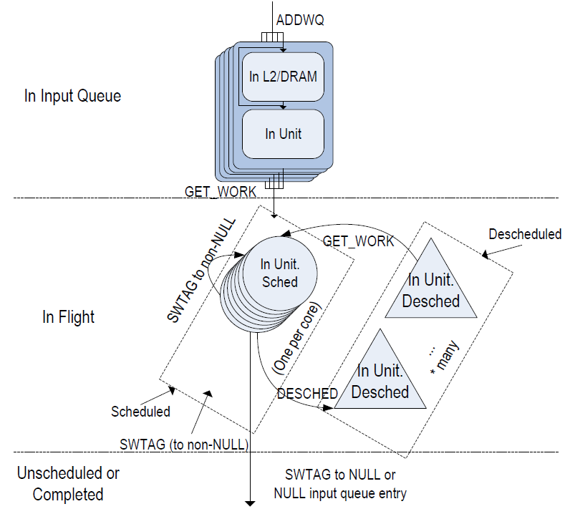
State of work flow
Notes:
1. Once a packet arrived, it will enter the queue.
2. Once a simple executive finished, and the tag is not NULL, the packet will
be put back to the queue.
3. Once the simple executive is blocked, it will quit and de-schedule.
4. Once a simple executive finished, and the tag is NULL, the packet will run
out of the system.
5. This is an endless loop.

Slide 14
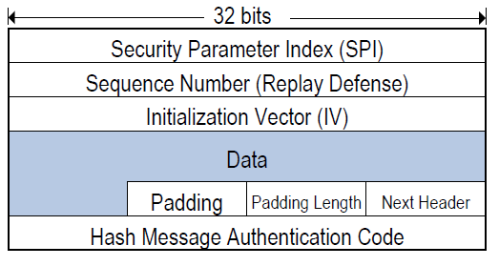
IPsec
Add security fields between IP field and transport layer
Notes:
IPsec是一种成熟的安全机制，提供保密性，数据完整性，抗重放攻击。Ipsec协议族的实现提供了多种参数选择，那么在网络处理器上如何设计、实现和优化Ipsec正是通信双方协商的内容。
SPI(security parameter index)：指向SA(security association),SA记录了共享密钥等信息。
SN(sequence number)：一个SA中的数据包编号，以防止重放攻击
IV & Padding：algorithm related
HMAC：完整性保证

Slide 15
States of IPsec work flow
Defragment: reconstruct IP packet with data fragment.
IPsec decrypt: decrypt the incoming packets and recover to the original ones.
Lookup: while forwarding the packet, it needs to check the SPD table and SA table according to the hash value of five-tuple of the packet.
Process: the necessary processing of packets before sending them out, such as NAT translation or TCP sequence number adjustment.
IPsec encrypt: encrypt the output packets.
Output: places the packet into an output queue and let Tx driver sent it out.
Notes:
解释各个阶段的功能

Slide 16
Outline
About us
Background
Implementation
Experiment and Performance
Conclusion

Slide 17
Parameters
Algorithms: AES, DES, 3DES
Packet length: 64 bytes ~ 1280 bytes
Core numbers: 1~16
System mechanisms: Pipeline vs Run-to-completion

Slide 18
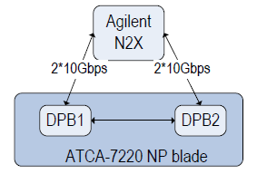
Test Environments
DPB: data processing block
Agilent N2X: multi-service test solution
Notes:
一个OCTEON的板子，两个data processing block互相通信，Agilent N2X multi-service test solution打双向10Gbps的流量
两块DPB之间通信。

Slide 19
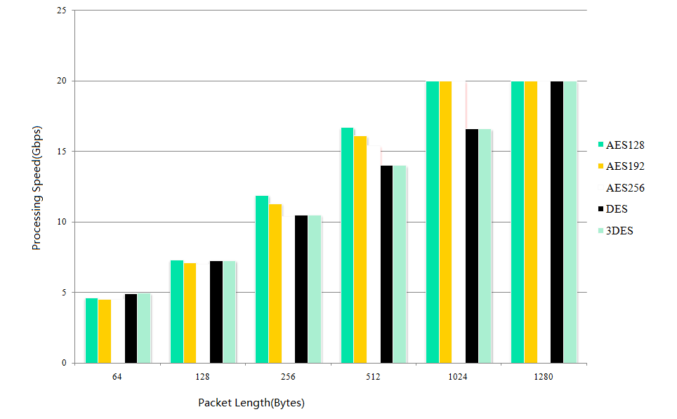
Different Algorithms and Packet Length

Slide 20
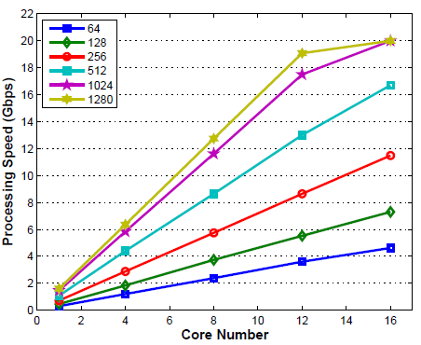
Different core numbers

Slide 21
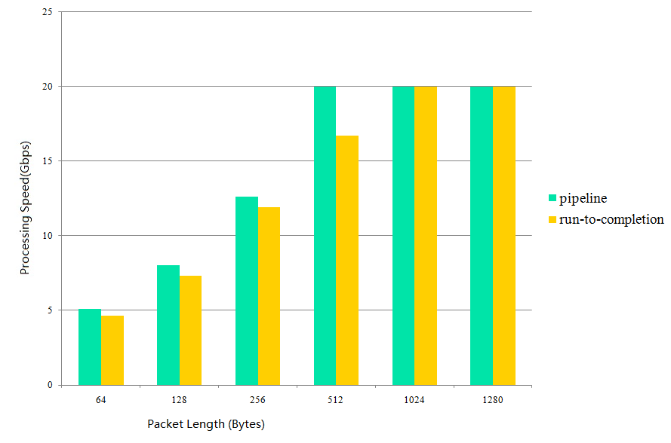
Pipeline and Run-to-completion

Slide 22
Outline
About us
Background
Implementation
Experiment and Performance
Conclusion

Slide 23
Conclusion
On Cavium OCTEON CN58XX
Algorithms: AES128
Packet length: the longer the better
Core numbers: the more the better
Mechanism: Pipeline is better than Run-to-completion
Why?

Slide 24
Algorithms
AES speed is almost the same as DES speed in hardware implementation
Smaller key makes higher processing speed

Slide 25
Packet length
The work for processing each packet is fixed
The longer the packet length is
=>The less the processed packets during a certain period are
=>The smaller the factor of processing time is
=>The larger the processing speed is
=>The better the performance is

Slide 26
Core number
Without any interaction between the cores
The throughput is linear to the core number

Slide 27
Mechanism
Mechanism | Pipeline | Run-to-completion
when access critical region | Quite and De-schedule | May be blocked
Cache hit-rate | Locality, high | low

Slide 28
Future work
Comparison with other NP and security mechanisms
General standard mechanisms of encrypting the Internet
Notes:
跟其他网络处理器，其它机制的比较

Slide 29
Q&A
Thank you for your listening!
Notes:
Working flow

