Slide 1
Multi-dimensional Packet Classification on FPGA: 100Gbps and Beyond
Yaxuan Qi, Jeffrey Fong, Weirong Jiang,
Bo Xu, Jun Li, Viktor Prasanna

Slide 2
Outline
Background and Motivation
  The packet classification problem
  Existing solutions & Challenges
Algorithm and Architecture Design
  HyperSplit
  Mapping into hardware & Optimizations
Performance Evaluation
  Test Setup
  Experimental Results
Conclusion

Slide 3
Outline
Background and Motivation
  The packet classification problem
  Existing solutions & Challenges
Algorithm and Architecture Design
  HyperSplit
  Mapping into hardware & Optimizations
Performance Evaluation
  Test Setup
  Experimental Results
Conclusion

Slide 4
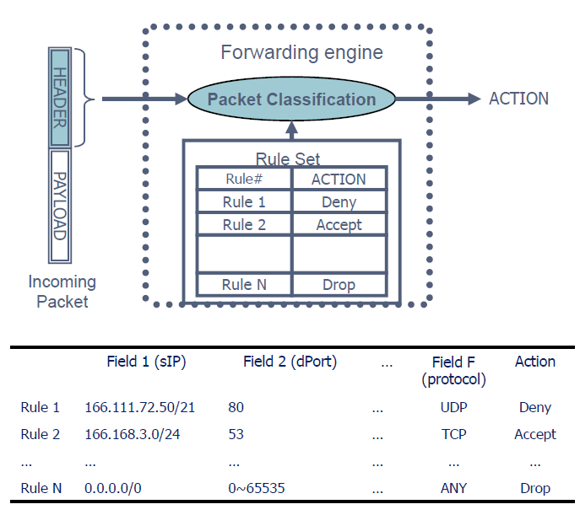
Packet Classification Problem
To identify and associate each packet to a specific rule
May match multiple rules
Used for:
  Routing
  Firewall/ Intrusion Detection System
  Quality of Service

Slide 5
Existing Solutions
SRAM Based
Software running on general hardware
  Different algorithms gives different search speed and/or number of rules
Advantage:
  Price
  (generally) # of Rules
Disadvantage
  Speed
TCAM Based
Dedicated packet matching hardware
  Different hardware architecture gives different speed
Advantage
  Speed
Disadvantage
  Price
  Energy consumption
  Chip size
  No support for Range
    Range to Prefix Conversion

Slide 6
Existing Solutions
Search Method
Algorithms
Decomposition
RFC
HSM
SRAM based Methods
Decision Tree
HiCut
HyperSplit

Slide 7
Existing Solutions
Search Method
Algorithms
Decomposition
RFC
HSM
SRAM based Methods
Decision Tree
HiCut
HyperSplit

Slide 8
Challenges & Goals
Memory Usage
  Needs to be memory efficient that can support large rulesets
High Performance
  Requires high throughput and deterministic performance
On-the-fly update
  To allow rules to be changed and updated without downtime

Slide 9
Outline
Background and Motivation
  The packet classification problem
  Existing solutions & Challenges
Algorithm and Architecture Design
  HyperSplit
  Mapping into hardware & Optimizations
Performance Evaluation
  Test Setup
  Experimental Results
Conclusion

Slide 10
HyperSplit
Memory-efficient packet classification algorithm
  Uses 1/10 (10%) of the memory that other comparable algorithms requires
Optimized k-d tree data structure
Combines the advantages of both parallel search and tree search algorithms
Uses heuristics to select the most efficient splitting point on a specific field

Slide 11
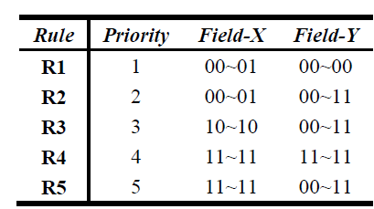
Example
11
R4
10
R2
R3
01
R5
00
R1(R2)
00
01
10
11

Slide 12
Example
Lv-1
X,01
11
R4
X<=01
X>01
10
R2
L
R
R3
01
R5
00
R1
00
01
10
11

Slide 13
Example
Lv-1
X,01
11
R4
X<=01
X>01
10
R2
Y,00
R
R3
01
R5
Lv-2
Y<=00
Y>00
00
R1
R1
R2
00
01
10
11

Slide 14
Example
Lv-1
Lv-2
X,01
11
R4
X<=01
X>01
10
R2
Y,00
X,10
R3
01
R5
Lv-2
Y<=00
Y>00
X<=10
X>10
00
R1
R1
R2
R3
RR
00
01
10
11

Slide 15
Example
Lv-1
Lv-2
X,01
11
R4
Lv-3
X<=01
X>01
10
R2
Y,00
X,10
R3
01
R5
Lv-2
Y<=00
Y>00
X<=10
X>10
00
R1
R1
R2
R3
Y,10
00
01
10
11
Y<=10
Y>10
R5
R4

Slide 16
Mapping Decision into Hardware
X,01
Y,00
X,10
R1
R2
R3
Y,10
R5
R4

Slide 17
Mapping Decision into Hardware
X,01
Y,00
X,10
R1
R2
R3
Y,10
R5
R4

Slide 18
Mapping Decision into Hardware
INPUT PACKET
X,01
STAGE 1
Y,00
X,10
STAGE 2
R1
R2
R3
Y,10
STAGE 3
R5
R4
STAGE 4
MATCHED RULE

Slide 19
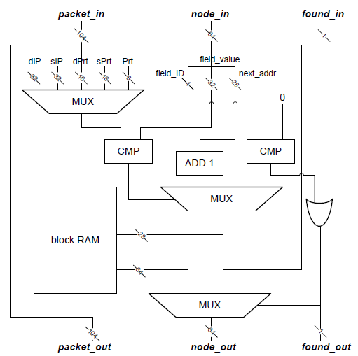
Hardware Implementation
STAGE n

Slide 20
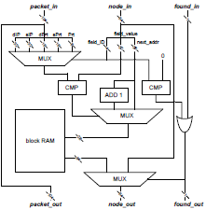
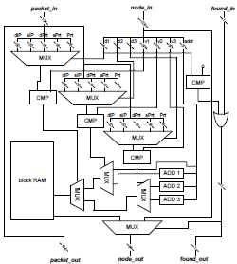
Architecture Optimization (1)
Node Merging – Pipeline Depth Reduction
@addr0
d1,v1
addr1
@addr0
d1,d2,d3
v1,v2,v3
addr1
@addr1
d1,v1
addr2
@addr1+1
d1,v1
addr3
@addr2
child1
@addr2+1
child2
@addr3
child1
@addr3+1
child2
@addr1
child1
@addr1+1
child2
@addr1+2
child3
@addr1+3
child4

Slide 21
Architecture Optimization (2)
Controlled Block RAM Allocation
Different rulesets will result in different memory usage per stage
Limits the size of a certain stage by pushing leafs to lower levels of the pipeline

Slide 22
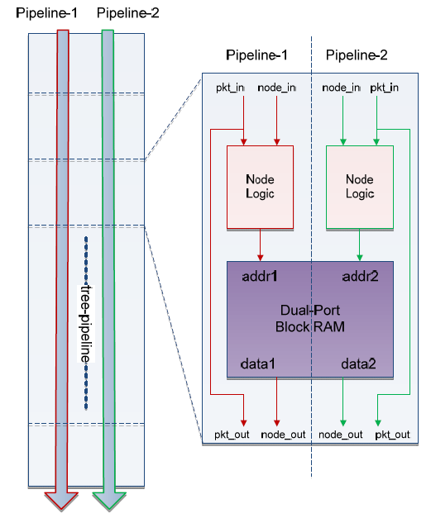
Architecture Optimization (3)
Dual-search pipeline
take advantage of dual-port BRAM

Slide 23
Outline
Background and Motivation
  The packet classification problem
  Existing solutions & Challenges
Algorithm and Architecture Design
  HyperSplit
  Mapping into hardware & Optimizations
Performance Evaluation
  Test Setup
  Experimental Results
Conclusion

Slide 24
Test Setup
Tested with a publicly available ruleset from Washington University
  Used the ACL 100, 1K, 5K, 10K rulesets
Design is implemented on a Xilinx Virtex-6
  Model: VC6VSX475T
  Containing 7,640Kb Distributed RAM and 38,304Kb Block RAM
  Using Xilinx ISE 11.5 tool

Slide 25
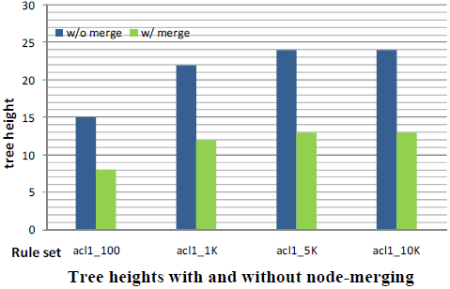
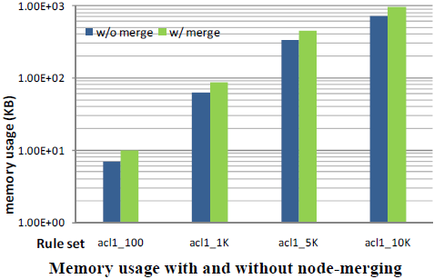
Algorithm Evaluation
Node-merging Optimization
Reduce tree height (pipeline depth) by almost 50% with minimal memory overhead!

Slide 26
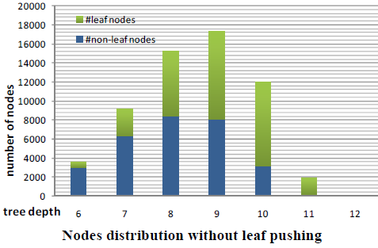
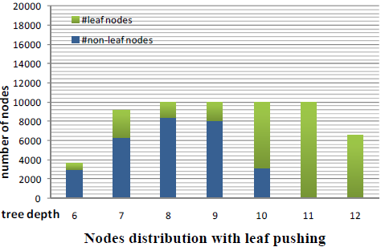
Algorithm Evaluation
Leaf-pushing Optimization

Slide 27
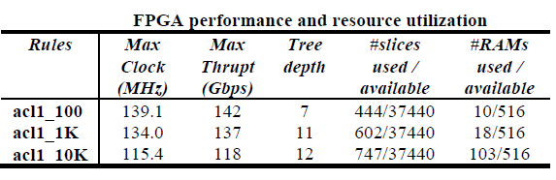
FPGA Performance

Slide 28
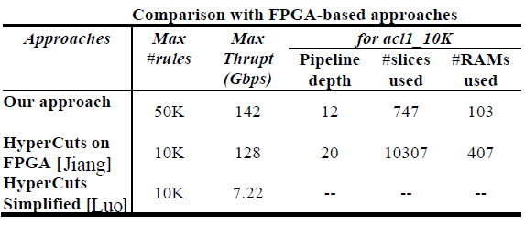
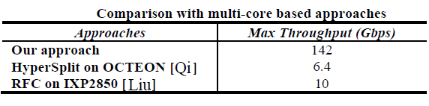
FPGA Performance

Slide 29
Outline
Background and Motivation
  The packet classification problem
  Existing solutions & Challenges
Algorithm and Architecture Design
  HyperSplit
  Mapping into hardware & Optimizations
Performance Evaluation
  Test Setup
  Experimental Results
Conclusion

Slide 30
Conclusion
FPGA provides a flexible and excellent solution to the packet classification problem
HyperSplit algorithm is suited to and provides an efficient mapping to hardware
  3 optimizations used to reduce tree length, constraint the memory usage of each stage and improve performance
Consume less resource than other FPGA-based solutions and much faster than multicore based solutions

