Slide 1
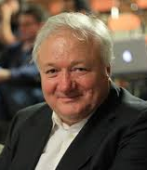
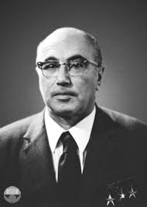
The Sunyaev-Zel'dovich Effect
Sifan Wang （王思凡）
Supervised by Prof. Zheng Cai
student seminar 2019/11/15

Slide 2
Outline
Introduction to the SZ effect
SZ measurement
Application (one example)
Summary

Slide 3
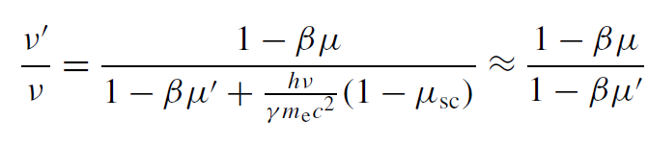





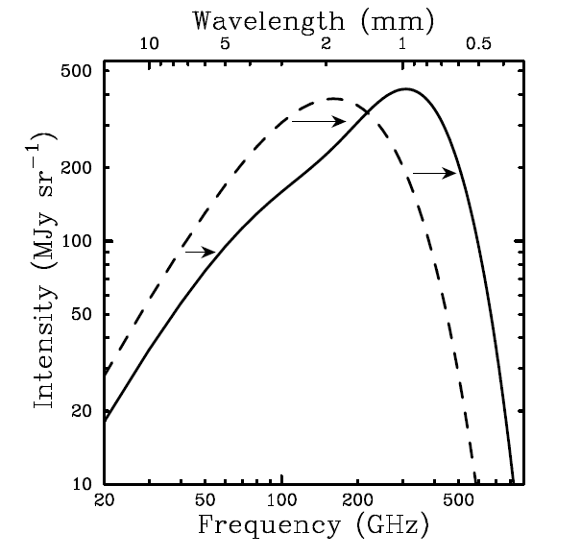
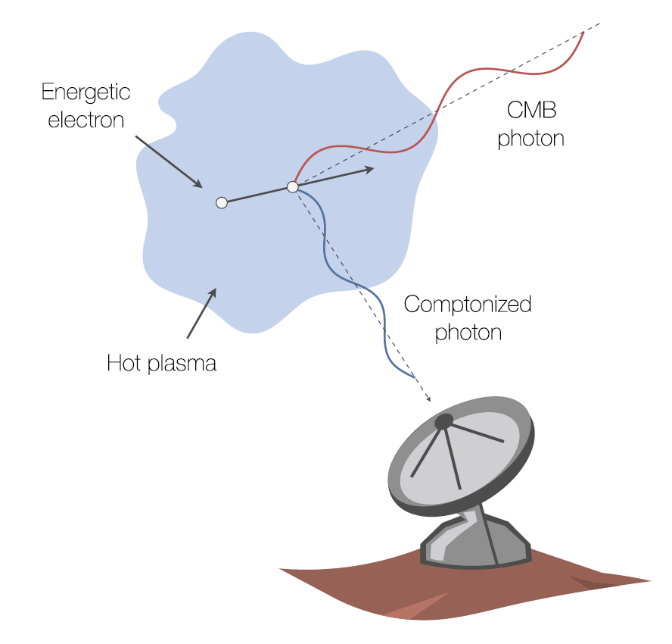


What is the (thermal) SZ effect?
Inverse-Compton scattering of CMB photons by keV electrons in the cluster of galaxies (at rest × moving √)
Up-scattering ($ν^{′}>ν$) occurs when $μ^{′}>μ$
M-B distribution
Abell 2319
1-2%
$T\sim$1e8 K
217 GHz (≈ 1.4 mm)

Slide 4
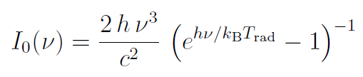
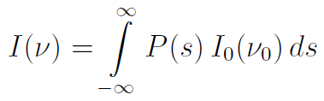




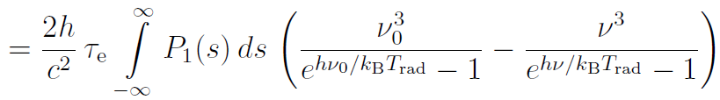

Effect on spectrum -- from 𝜈′/𝜈 to $∆I_{\text{ν}}$
Incident spectrum
Scattered spectrum

Slide 5
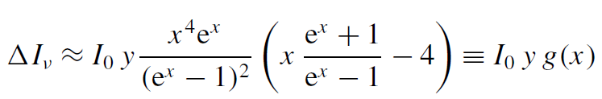

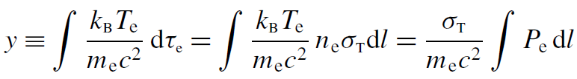
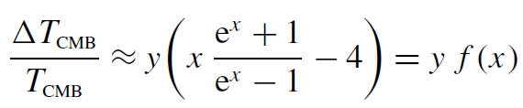

The Kompaneets approximation
In the non-relativistic limit
Typical cluster: $k_{B}T_{e}/m_{e}c^{2}$ $\sim$ 0.01-0.02, $τ_{e} \sim$1e-2, $y$ $\sim$ 1e-4
Rayleigh-Jeans limit $(x<<1): ΔT/T \sim$ $−2y$
high frequencies $(x>>1): ΔT/T \sim y(x −4)$
Compton-y parameter
Independent of redshift

Slide 6
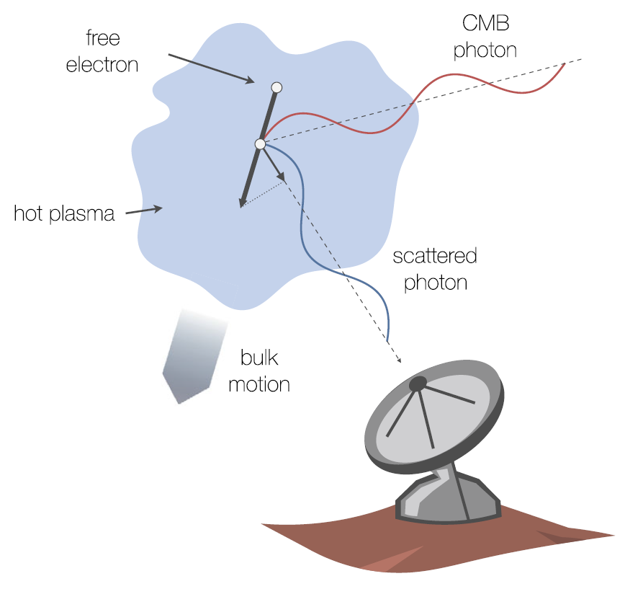
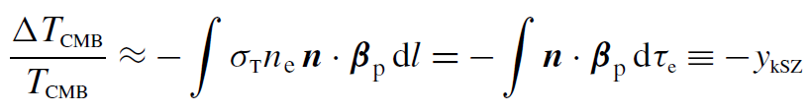

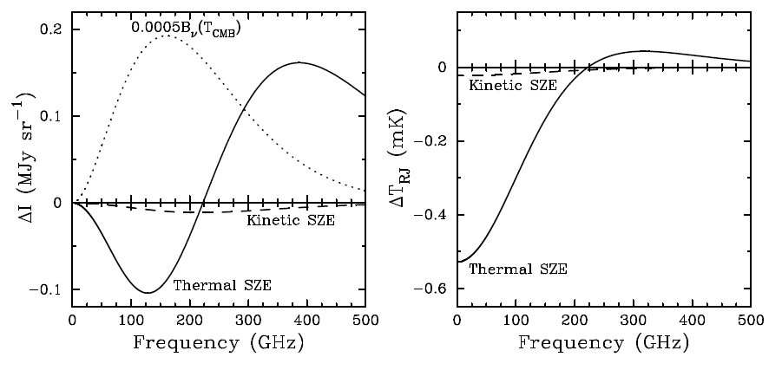




kinematic SZ effect
All SZ: spectral shape ↔ velocity distribution
kSZ: Caused by motion of the galaxy clusters
with respect to the rest frame of the CMB
Typical: $β_{p} \sim$ few e−3 (speed few 100 km/s)
$y_{kSZ}$ $\sim$ few e−5 < $y_{tSZ}$ $\sim$ 1e-4
$T_{e} \sim$ 10 keV
$y$ $\sim$ 1e-4
$β_{p} \sim$500 km/s

Slide 7
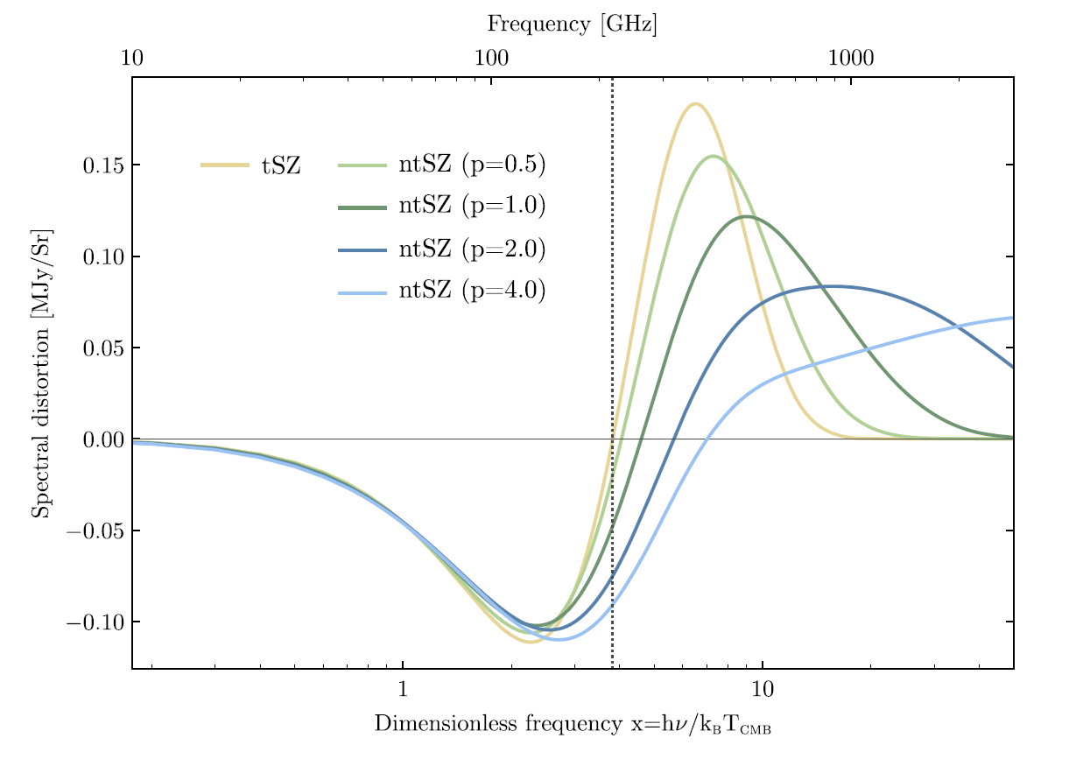

Other manifestations
The thermal SZ effect (tSZ)
The kinematic SZ effect (kSZ)
Relativistic corrections to the SZ effect
At $k_{B}T_{e}$ $\sim$ 5keV, typical speeds $β \sim \sqrt{3k_{B}T_{e}/m_{e}c^{2}}\sim$0.1–0.2
The non-thermal SZ effect
Momentum distribution can be more complex and highly relativistic
e.g., having long power-law tails at high energies
...
non-relativistic limit thermal distribution
non-relativistic limit bulk motion

Slide 8
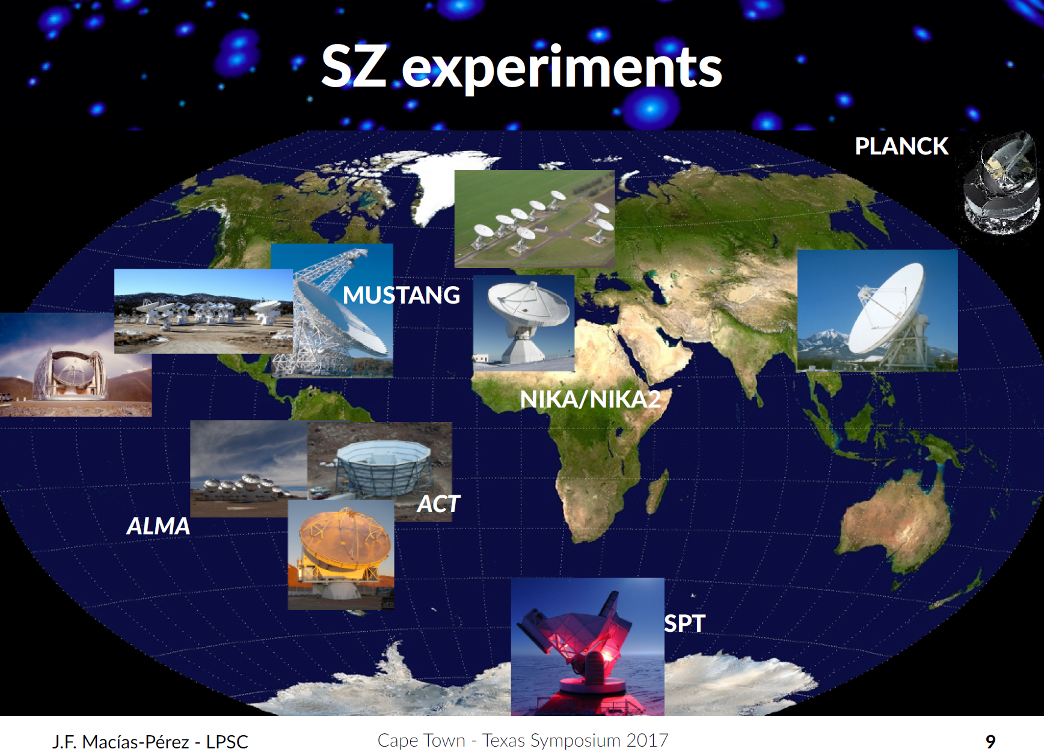
SZ measurement
Development in cm/mm/submm-wave instrumentation on ground-based facilities + Planck satellite
SZ imaging from massive objects → routine!
Single-dish radiometric / Interferometric / Bolometric methods
SQUID/TEC Array
@GBT 100m
12m * 50 ALMA
7m * 12 ACA
@ALMA
Dual band
(150 & 260 GHz)
mm KID camera
@IRAM 30m

Slide 9
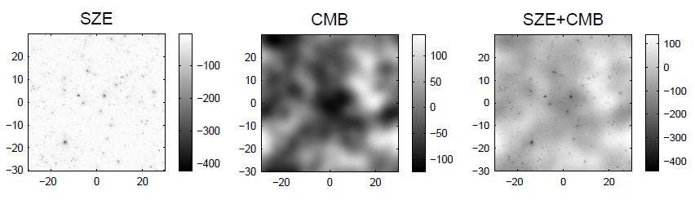
Experimental Challenge
Small signal
15mK @30GHz; 5mK @150GHz
Systematics (scale size of clusters 1Mpc → arcmin)
large angular scale → ground pick-up and atmospheric variations
Contaminations
Radio point sources (synchrotron)
Point sources in mm/submm (galactic and extragalactic dust)
Primary anisotropies of the CMB
…
150 GHz (≈ 2 mm)

Slide 10
Why is the SZ effect important?
John E. Carlstrom + (2002) & Tony Mroczkowski + (2019)
SZ effect applies in
Cluster properties
Gas properties
Cluster velocities
Intra-cluster medium (ICM) physics
Pressure Profile
Complementarity of X-ray and SZ Measurements
ICM (Sub)structure
Cosmology
…

Slide 11

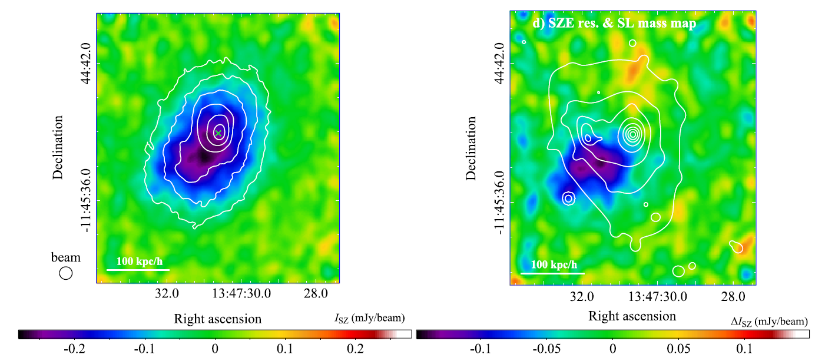
Prob pressure substructures with tSZ
gas compression driven by merger events associated with infalling substructures in the ICM
detected an offset between the dense X-ray core and the pressure peak in the cluster, overpressure caused by the merging of a sub-cluster
a comparison of the offsets between the peaks in the SZ and strong lensing signals was used to infer the self-interaction cross-section of dark matter to be less than
ALMA + ACA maps of RX J1347.5-1145 (z = 0.45)
Resolution 5”
Ueda + (2018)
the first direct observational evidence for sub-sonic nature of sloshing motion of the cool core
Notes:
Residuals after subtraction of a mean SZ profile by excluding the substructure region

Slide 12
Main Reference
Tony Mroczkowski + https://doi.org/10.1007/s11214-019-0581-2
Mark Birkinshaw https://arxiv.org/abs/astro-ph/9808050v1
John E. Carlstrom + https://arxiv.org/abs/astro-ph/0208192v1
SZ effect https://youtu.be/5S1Jjc8_gOQ
Inverse Compton scattering https://youtu.be/2KFVxPENcEw

Slide 13
Summary
SZ effect comes from the inverse Compton scattering of CMB photons by keV electrons in the cluster of galaxies and it has many manifestations.
The redshift-independency makes SZ a unique cosmological prob.
SZ measurements take the advantage of cm/mm/submm-wave instrumentation.
SZ effect has many applications in cluster physics and cosmology.

