Slide 1

ML 2024 Project Report
Slides
Authors name:- Tsion Araya / t.araya@unipi.it
Seid Asnakew / s.asnakew@studenti.unipi.it
Zhang pang /p.zhang@studenti.unipi.it
Team name:- ML-crackers
Master degree Curriculum:- Artificial Intelligence
Date:- 29/01/2025
Project Type:- A

Slide 2
Objectives
To implement and optimize neural network architectures for MONK and CUP datasets.
To evaluate the impact of different hyperparameter configurations, including activation functions, regularization, and weight initialization.
To assess performance through metrics such as Mean Squared Error (MSE) and accuracy for MONK tasks, and Mean Euclidean Error (MEE) for CUP tasks.

Slide 3
Language and tools
We have used Python as the primary programming language for implementation, leveraging NumPy for numerical computations, Pandas for data processing, and Matplotlib for visualization.
The model training process involved cross-validation to ensure robustness, with hyperparameter tuning optimizing network architecture, activation functions, learning rates, and weight initialization techniques.

Slide 4
Code Description
1. Preprocessing Pipeline
MONK Datasets:-
One-hot encoding for categorical features of the training and testing datasets.
Target values retained as-is for classification.
CUP Dataset:-
Training Data split into 80% training and 20% testing sets. So that to perform the cross validation in the training test set.

Slide 5
Code Description
2. Hidden Layer Configurations: Neural networks are designed with varying depth and width to adapt to dataset complexity.
MONK Datasets: Configurations range from shallow to deep architectures: Examples: (17, 8, 1), (17, 4, 1), (17, 12, 6, 1), and (17, 16, 8, 1). The choice of configuration ensures the model captures relevant patterns while balancing complexity and performance.
For MONK-3, regularization techniques are applied to mitigate overfitting due to inherent noise.
CUP Dataset: Moderate-depth configurations like (12, 6, 3) are used to manage regression complexity and ensure effective feature extraction.

Slide 6
Code Description
3. Activation Functions:
A combination of ReLU, Sigmoid, Tanh, and Identity is employed based on task requirements.
General Purpose: These functions introduce non-linearity, enabling the network to learn complex decision boundaries.
Application in MONK and CUP:
ReLU and Tanh: Capture intricate patterns in MONK datasets (classification).
Sigmoid and Identity: Suitable for output layers in binary classification and regression tasks in CUP.

Slide 7
Code Description
4. Weight Initialization:
Xavier Initialization: Balances weights for smooth gradients, suitable for Sigmoid/Tanh activations.
He Initialization: Optimized for ReLU-based activations to avoid vanishing/exploding gradients.
These techniques ensure stable training and faster convergence, crucial for effectively learning from MONK and CUP datasets.

Slide 8
Code Description
5. Hyperparameter Tuning
A set of possible values is defined for key parameters like network architecture, learning rates, momentum, weight decay, and dropout (where applicable). These values serve as the foundation for systematic model tuning.
Grid Search & Evaluation:
Grid Search: Hyperparameters like learning rates, activation functions, hidden layer sizes, regularization strength, and momentum were explored.
MONK: 324 configurations for all task of the monk.
CUP: 144 configurations Iterative tuning with performance tracked for validation MEE.

Slide 9
Code Description
6. Loss Functions:
MSE (Mean Squared Error): Used for classification tasks
MEE (Mean Euclidean Error): Applied for regression tasks.
Optimization Algorithm:
Stochastic Gradient Descent (SGD) with momentum for stable updates.
Regularization & Dynamic Updates:
Dropout applied conditionally for MONK-3 with L2 regularization.

Slide 10
Code Description
7. Validation Strategy:
5-fold Cross-Validation applied to both MONK and CUP datasets for robust model selection. In terms of the monk we perform 5-folding in the training dataset.
CUP Dataset Split: Initially divided into 80% training, 20% internal test.
Cross-validation performed on the development set (training + validation) while keeping the internal test set separate for final evaluation.

Slide 11
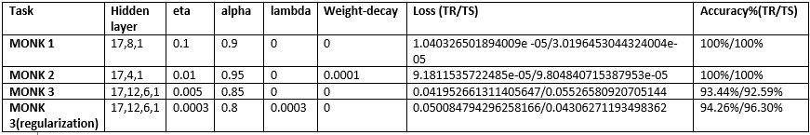
Summrized Monks Results

Slide 12
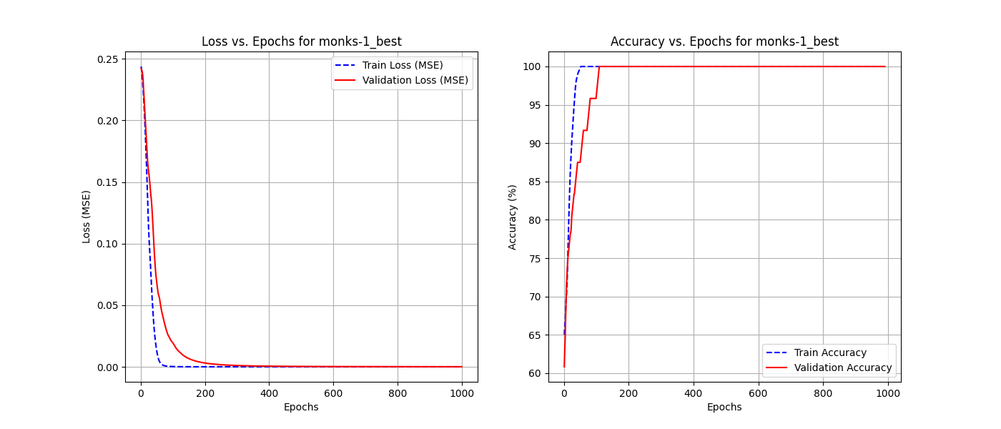
Monks 1

Slide 13
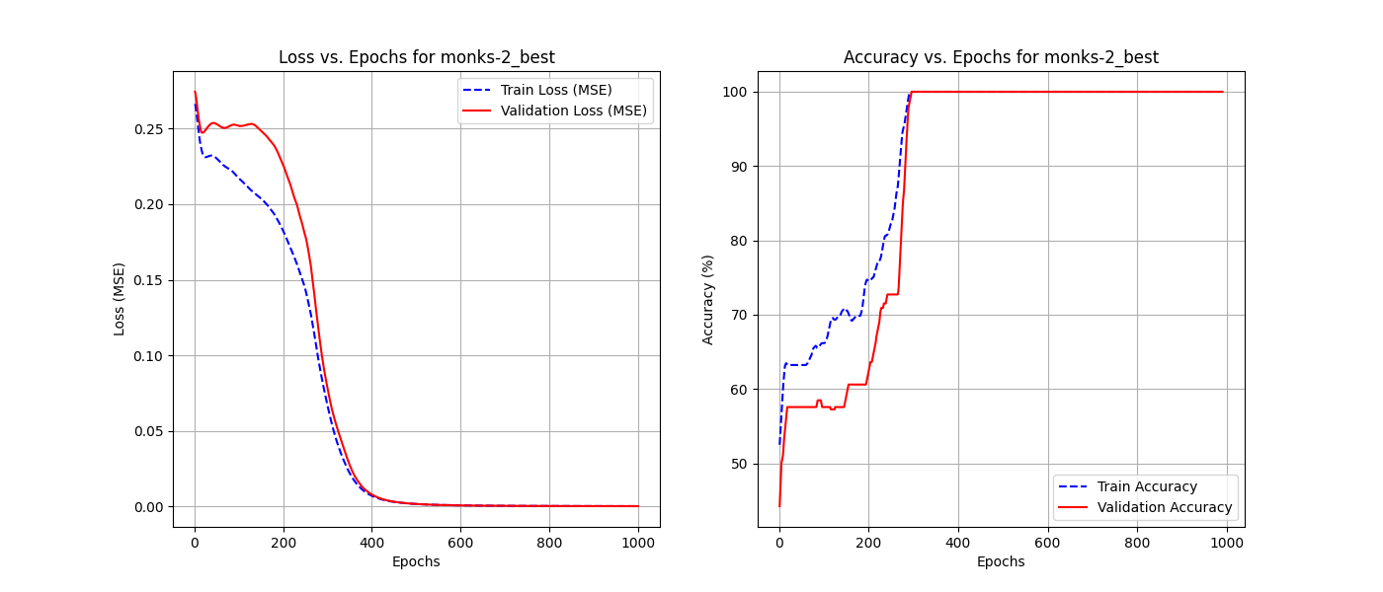
Monks 2

Slide 14
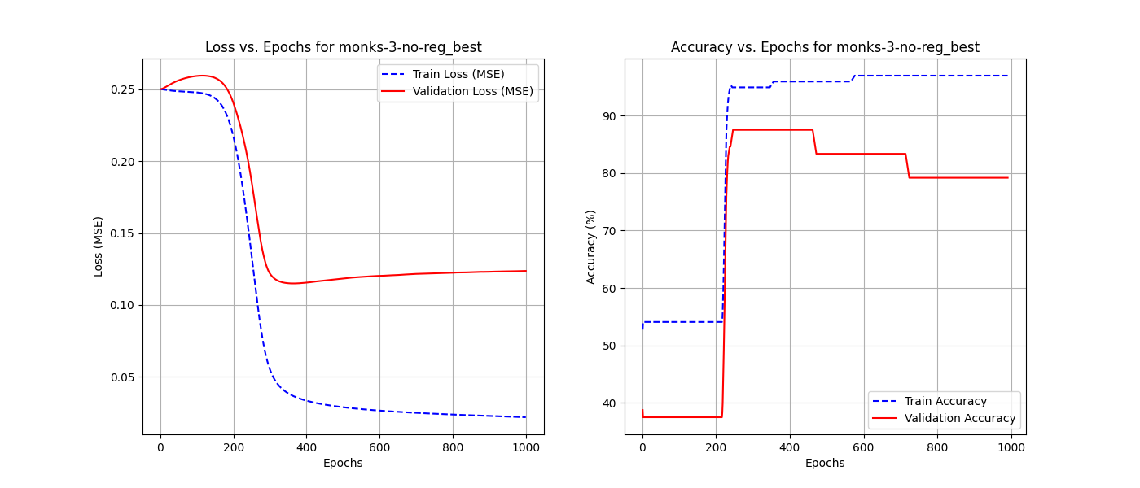
Monks-3 (without regularization)

Slide 15
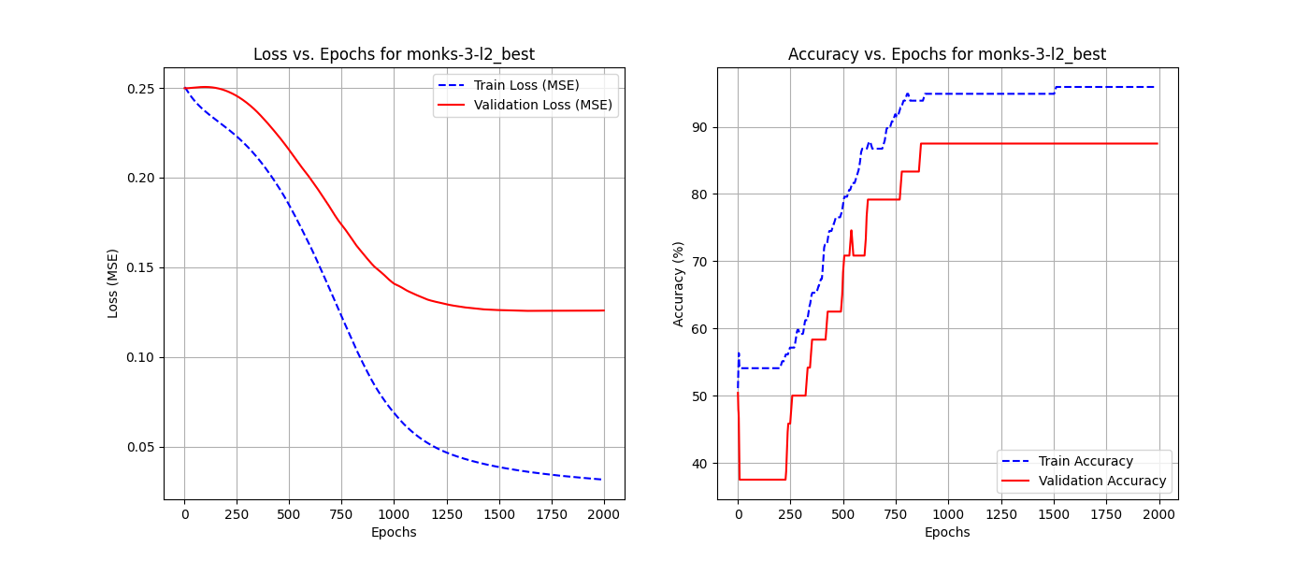
Monk 3- with regularization

Slide 16
CUP Validation schema: data splitting
Data Splitting Approach:
80% training and 10% internal test is split from the original training dataset.
5-fold cross-validation applied was applied on the 80% training set.
Validation Schema:
Used k-fold cross-validation for model selection using the above split training set.
Retraining of final model on full dataset before blind test.

Slide 17
CUP Validation schema: model selection
Selection Criteria:
Each combination was evaluated based on validation loss (MEE).
The model achieving the lowest average validation loss across multiple runs was selected.
The final model selection was based on stability and consistency in performance, ensuring it generalizes well to unseen data.
Comparative analysis of different architectures further guided the decision.

Slide 18
CUP Validation schema: model assesment
The models were ranked based on validation loss, and the top-performing ones were further assessed on the test set. To enhance reliability, multiple hyperparameter combinations were explored, and the best five models were saved for deeper analysis. The final selected model achieved the best trade-off between minimizing error (MEE) and avoiding overfitting, as reflected in its competitive test performance.

Slide 19
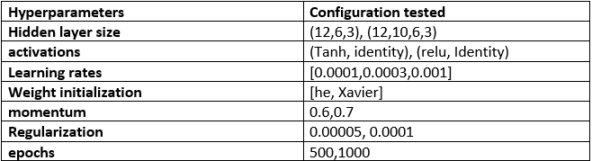
CUP task tested combinations

Slide 20
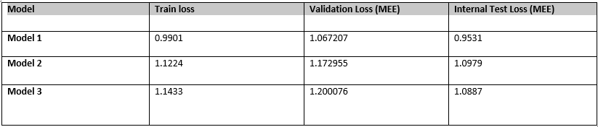
CUP Results

Slide 21
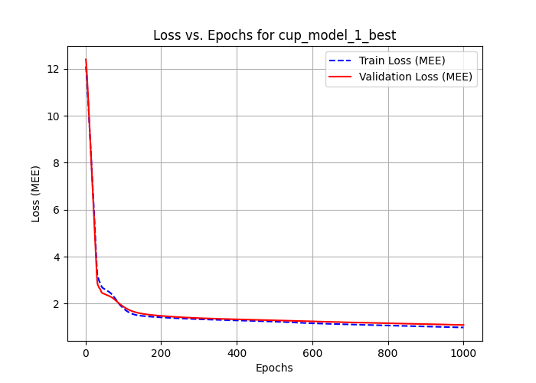
CUP Results best model result

Slide 22
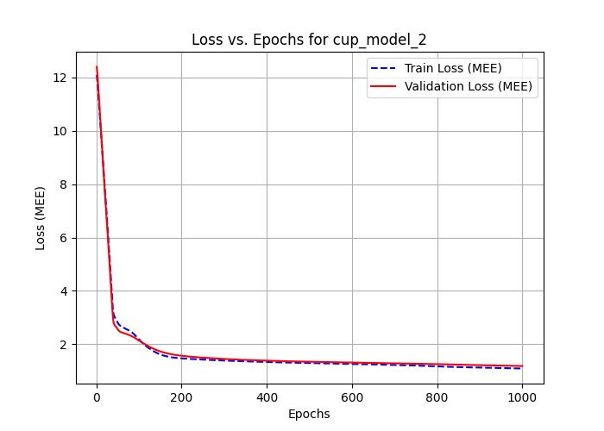
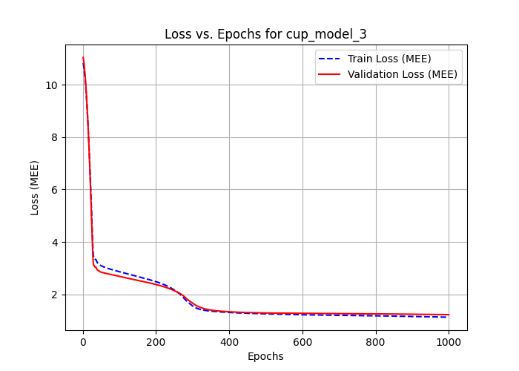
CUP Results model 2 and 3

Slide 23
Discussion
Findings and Insights
The impact of different neural network architectures on model performance was observed, highlighting how varying the number of layers and neurons influenced learning dynamics.
The choice of weight initialization played a crucial role in model stability, affecting convergence speed and final accuracy.

Slide 24
Discussion
Challenges Faced
Overfitting was a significant challenge, especially in deeper networks, requiring careful regularization and hyperparameter tuning.
Managing the computational complexity of exploring large hyperparameter spaces was demanding, necessitating an efficient approach to model selection.

Slide 25
Acknowledgments
We would like to express our sincere gratitude to Professor Alessio Micheli for providing us with this valuable opportunity to explore and implement advanced concepts in neural networks and machine learning.
We agree to the disclosure and publication of our name, and of the results with preliminary and final ranking.

Slide 26
Blind Test Results
Final Predictions
Results saved in results/blind_test_predictions.csv.
Project nickname: ML-crackers

Slide 27
Reference
References [1] Y. Bengio X. Glorot. Understanding the difficulty of training deep feedforward neural networks. page 4.2.1. DIRO Montreal, 2010.

