Slide 1

ML 2024 Project Report
Slides
Authors name:- Tsion Araya / t.araya@unipi.it
Seid Asnakew / s.asnakew@studenti.unipi.it
Zhang pang /p.zhang@studenti.unipi.it
Team name:-ML crackers
Master degree Curriculum:- Artificial Intelligence
Date:- 28/01/2025
Project Type:- A

Slide 2
Objectives
To implement and optimize neural network architectures for MONK and CUP datasets.
To evaluate the impact of different hyperparameter configurations, including activation functions, regularization, and weight initialization.
To assess performance through metrics such as Mean Squared Error (MSE) and accuracy for MONK tasks, and Mean Euclidean Error (MEE) for CUP tasks.

Slide 3
Code Description
1. Model Architecture:
MONK: Architectures range from shallow networks like (17, 8, 1) to deeper networks like (17, 16, 8, 1).
CUP: Configurations such as (12, 8, 3) and (12, 16, 8, 3) were tested.
2. Activation Functions: Hidden Layers: ReLU, Tanh, Leaky ReLU.
3. Output Layer: Sigmoid (classification), Identity (regression).

Slide 4
Code Description
3. Training Algorithm:-
Stochastic Gradient Descent (SGD) with momentum.
Adaptive variants like Adam were explored for CUP tasks.
4. Batch/Online/Minibatch:
Mini-batch training implemented for all datasets.
5. Weight Initialization:
Xavier initialization for balanced scaling.
He initialization for ReLU-based networks.

Slide 5
Code Description
6. Regularization Schema:
MONK-3-No-Reg: No regularization.
MONK-3-L2: L2 regularization (0.0001 to 0.005).
CUP: L2 regularization with optional dropout (0.1, 0.2).
7. Stop Condition:
Fixed epochs (1000).
Early stopping not allowed for MONK tasks, used for CUP validation during trials.

Slide 6
Code Description
8. Validation Schema:
MONK: 5-fold cross-validation for model selection.
CUP: Data split into 60% training, 20% validation, 20% internal test.
9. Hyperparameter Tuning:
Grid Search: Hyperparameters like learning rates, activation functions, hidden layer sizes, regularization strength, and momentum were explored.
MONK: 432 configurations per task.
CUP: Iterative tuning with performance tracked for validation MEE.

Slide 7
Models Novelties
Innovations Introduced:
Customized dropout techniques for better generalization.
Experimentation with different activation function combinations.
Layer-wise hyperparameter tuning.

Slide 8
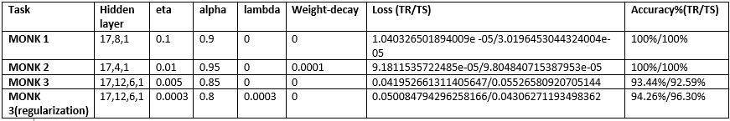
Monks Results

Slide 9
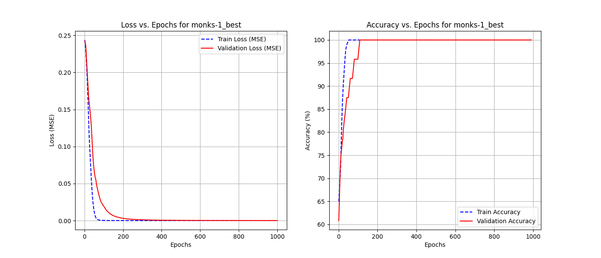
Monks 1

Slide 10
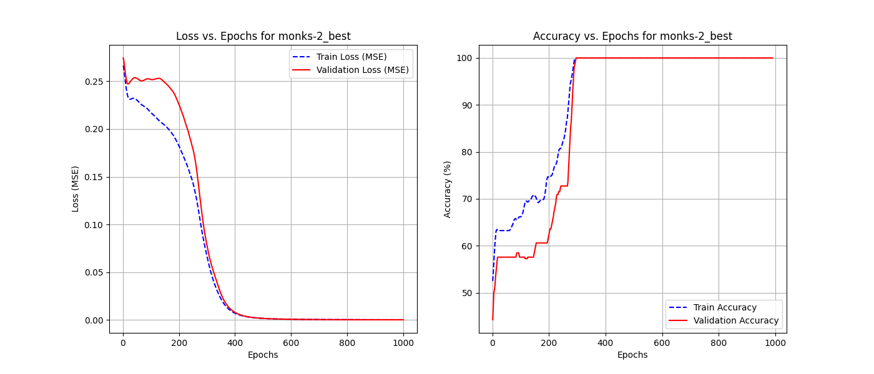
Monks 2

Slide 11
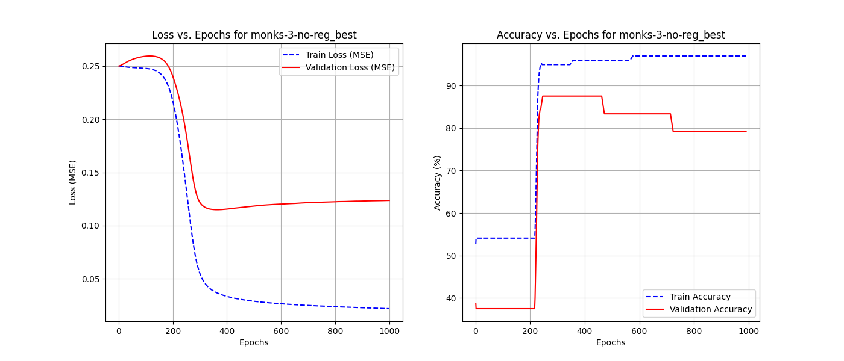
Monks-3 (without regularization)

Slide 12
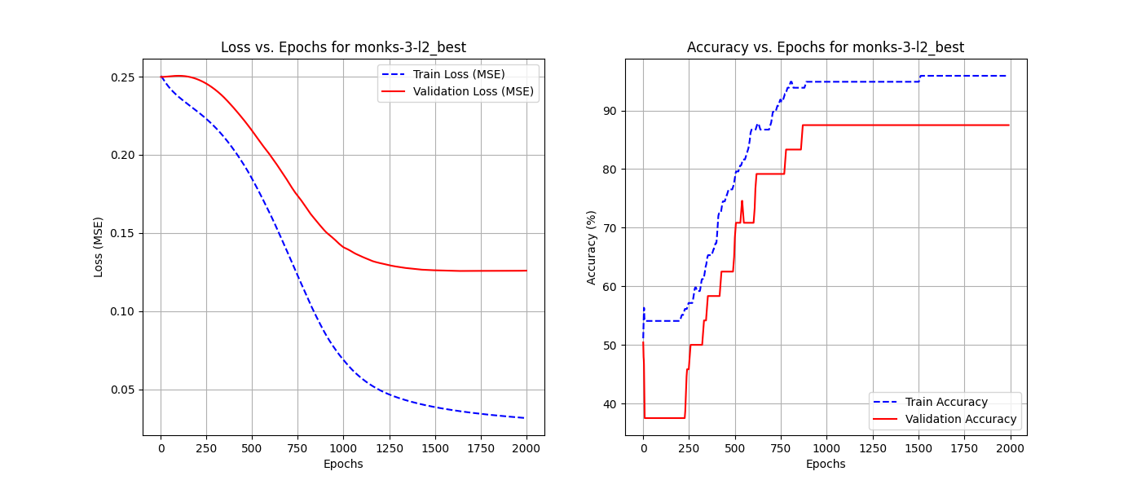
Monk 3- with regularization

Slide 13
CUP Validation schema: data splitting
Data Splitting Approach:
80% training and 10% internal test is split from the original training dataset.
5-fold cross-validation applied was applied on the 80% training set.
Validation Schema:
Used k-fold cross-validation for model selection using the above split training set.
Retraining of final model on full dataset before blind test.

Slide 14
CUP Validation schema: model selection
Hyperparameter Exploration:
Grid search applied with parameter ranges:
Learning rates: [0.0001, 0.001]
Batch sizes: [8, 16]
Momentum: [0.2, 0.8]
Final Model Selection:
Chosen based on lowest validation loss and error (MEE).
Comparison of different architectures.

Slide 15
CUP Results
Table of the cup dataset

Slide 16
Discussion
Findings and Insights:
How different architectures impacted performance.
Model stability with different weight initializations.
Effect of batch size on convergence speed.
Challenges Faced:
Overfitting issues with deeper networks.
Computational complexity of tuning large parameter spaces.

Slide 17
Conclusions
Key Takeaways:
Optimal model achieved with moderate depth and regularization.
Cup task required careful tuning of dropout and batch size.
MONK datasets showed the importance of activation function choices.

Slide 18
Blind Test Results
Final Predictions:
Results saved in results/blind_test_predictions.csv.
MEE on blind test set: xx.xx
Project nickname: your_team_name

Slide 19
Bibliography
Refer to the provided references in ML-24-Report-info for further details.

Slide 20
Appendix - not shown in the time slot
Additional performance metrics.
Extended hyperparameter tuning details.

