Slide 1
Servlet examples
By: Tsiupak Olena

Slide 2
Steps to Write Java Servlet Program
Create one root directory with your own name, and create another directory within that directory with name ‘src’ and now write one servlet program and copy into that ‘src’ folder
Now create another folder ‘web-inf’ in the root directory, this web-inf folder contains web.xml file will see later
Create ‘classes’ folder with in web-inf folder
Compile our servlet program which is in src folder, so we will get one .class file right, just copy this .class file into classes folder in web-inf folder
By the way, we are going to run our servlet by using Tomcat server. So we must set the class path for Tomcat related jar file, servlet-api.jar
You can find this jar file in your Tomcat directory\common\lib\,
Similarly if we are using Weblogic server, we need to set the class path for weblogic related jar files, i.e weblogic.jar which is in c [your drive]:\bea\weblogic\server\lib
If our servlet is dealing with any database like MySql or Oracle, it is mandatory for us to create a folder ‘lib’ with in web-inf folder
Once everything is done, just copy our root director into Tomcat/webapps folder, and start the server and check the output, i will show you how in the first application

Slide 3
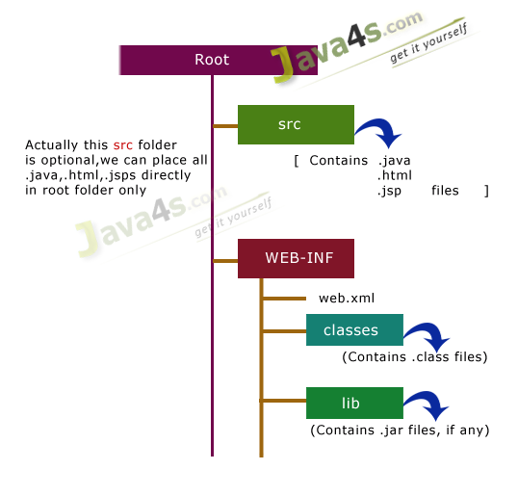
Directory Structure

Slide 4
Set servlet-api.jar ( Will be available in your tomcat/lib folder ) in your class path
Open notepad or any text editor EditPlus or some thing
Import javax.servlet.*;
Import javax.servlet.http.*;
Create one user defined class whose modifier must be public, which must extends javax.servlet.GenericServlet[Not recommended] or javax.servlet.http.HttpServlet[recommended]
We know GenericServlet implementing Servlet interface, and HttpServlet is the sub class of GenericServlet. So by default all life cycle methods will be overridden in GenericServlet class, so just override the required [No need all] life cycle methods of servlet in HttpServlet.

Slide 5
How to Write Deployment Descriptor, web.xml In Servlet
This web.xml is like index of book, web.xml is containing details of static web resource programs and dynamic web resource programs. The purpose of web.xml is to hide [or] to achieve the security for the web application by not showing [ in the URL ] the type of technology used for development of web application.

Slide 6
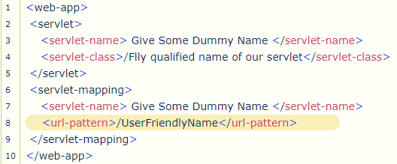
We must call our servlet by typing its <url-pattern> only
For example http://localhost:8080/OurServletApplicationFolderName/UserFriendlyName
Once we call our servlet just like above, then the server will first loads web.xml and verifies whether the url pattern we are calling is same as what in <url-pattern> tag in web.xml [Line number 8] or not
If matched, it will checks the <servlet-name> [Line number 7] and will jump to <servlet-name> [Line number 3] in <servlet> tag and, will check whether the value of <servlet-name> in line number 3 & line number 7 are same or not if same it will load our class in <servlet-class> [line number 4]
Finally our .class file will be executed, so we can check the output

Slide 7
How to Retrieve Client Input Data in Servlet
When client send some input data to the servlet, that data will be available in the form of requestobject. We can retrieve that input data through HttpServletRequest or ServletRequestinterfaces. There are 4 approaches to retrieve the client data which is present in request object.
public String getParameter(“input variable”);
public Enumeration getParameterNames();
public Map getParameterMap();
public String[] getParamterValues(“input variable contains muliple values”);
All these methods are present in javax.servlet.ServletRequest interface, and HttpServletRequest is the sub interface of ServletRequest, ok let us see how to use these methods with an example.

Slide 8
Example of request.getparameter(), Retrieve Parameters from HTML Form
Let us see how to use request.getParameter() method in the servlet class, to retrieve the input values from HTML page. Let us calculate sum of two numbers [ by taking these numbers from the input HTML page ]
Files Required
index.html
OngetParameter.java
web.xml

Slide 9
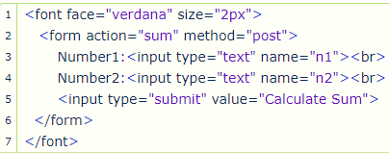
index.html

Slide 10
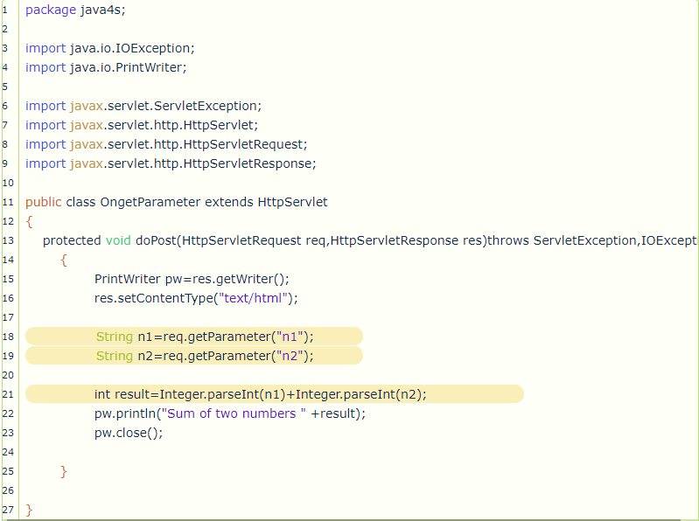
OngetParameter.java

Slide 11
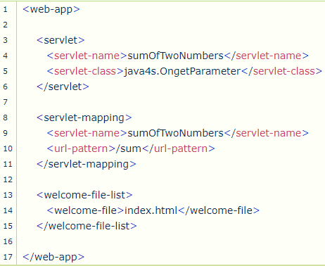
web.xml

Slide 12
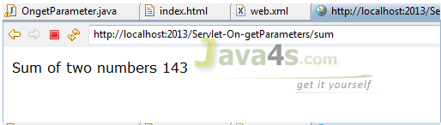
Explanations & results
Once we run the application, browser will display index.html as front page. Because we have given index.html in welcome file list [ line number 14 in web.xml ]
Enter input values and press ‘Calculate Sum‘ button
Now come to OngetParameter.java > just retrieve the input values like req.getParameter(“n1”) & req.getParameter(“n2”)
getParameter() is the method in request object, which returns String value always
So convert that string output to Integer [ line number 21]
Integer.parseInt(-String-) gives integer value
Output

Slide 13
Example on getParameterNames() method of Servlet Request Object
If a client send the data to the servlet, that data will be available in the object of HttpServletRequestinterface. In case of getParameter() method we have to pass input parameter name and it will give the value. If you are not aware of input parameter name ? or if you have 50+ input values its really tedious to use getParameter() method.
That’s why this getParameterNames() came into picture.

Slide 14
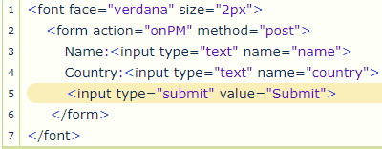
index.html

Slide 15
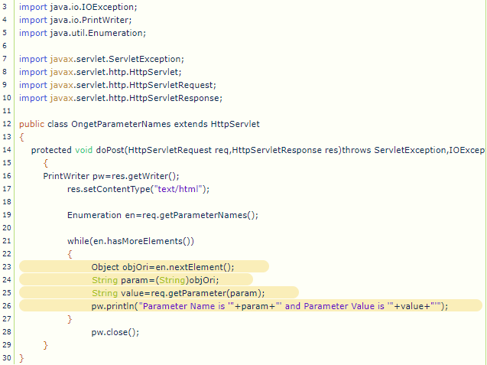
OngetParameterNames.java

Slide 16
Example on getParameterMap() method of Servlet Request Object
Let us see about getParameterMap() method of servlet request object. This method is little more useful compared to previous methods [ getParameter(), getParameterNames() ].
Syntax
Map m = request.getParameterMap()
getParameterMap() method always returns Map object
But how we will get input parameter names and their values ? in the form of key and value pairs
Previous methods [ getParameter(), getParameterNames() ] will be used if there is a chance of getting single value for particular parameter name, something for example check the output screen, there we can give only one value (Sivateja) in Name field right ?
So what if there is a need of selecting more than one value, for example if you would like your customers to select their habits, here they can have more than one habit right ? so we have to provide check boxes [Means multiple values]
That’s why this getParameterMap() came into picture

Slide 17
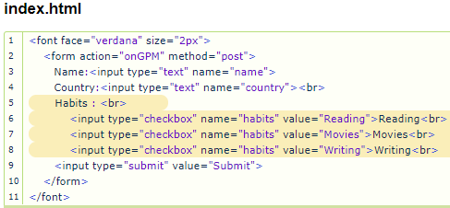

Slide 18
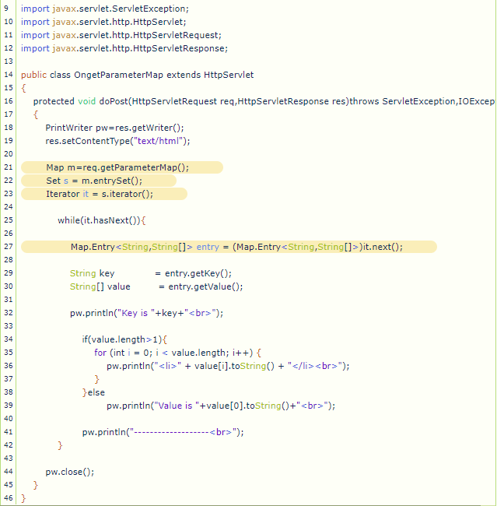
OngetParameterNames.java

Slide 19
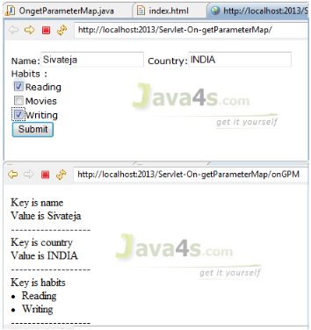
Explanations & results
Line number 21, we are getting input parameter values by using getParameterMap() method, which always returns Map object
So we have all input parameter names and its values in the form of key–value pairs in the Map object, then how to iterate them ?
We don’t have iterator() method in the Map interface so how ? In the Map interface we have entrySet() method which always returns Set object, so first get that Set object [ that’s what we did at line number 22 ]
Now iterate that Set object [ line number 23 ]
line number 27, we are converting the Set generated value into Map.Entry<String,String[]>, means assume one row(Entry) contains key = value ( little imagination will be needed here 😉 )
Finally i am printing the values.

Slide 20
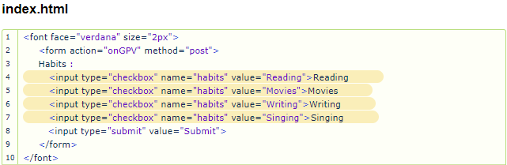
Example on getParameterValues()method of Servlet Request
The method getParameterValues() will generally came into picture if there is a chance of getting multiple values for any input parameter, this method will retrieve all of it values and store as string array.

Slide 21
