Slide 1
Java Servlet
By: Tsiupak Olena

Slide 2
What are Servlets?
Java Servlets are programs that run on a Web or Application server and act as a middle layer between a requests coming from a Web browser or other HTTP client and databases or applications on the HTTP server.
Using Servlets, you can collect input from users through web page forms, present records from a database or another source, and create web pages dynamically.
Java Servlets often serve the same purpose as programs implemented using the Common Gateway Interface (CGI). But Servlets offer several advantages in comparison with the CGI.
Common Gateway Interface (CGI) offers a standard protocol for web servers to execute programs that execute like console applications (also called command-line interface programs) running on a server that generates web pages dynamically. Such programs are known as CGI scripts or simply as CGIs. The specifics of how the script is executed by the server are determined by the server. In the common case, a CGI script executes at the time a request is made and generates HTML.

Slide 3
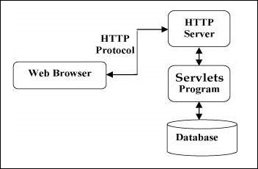
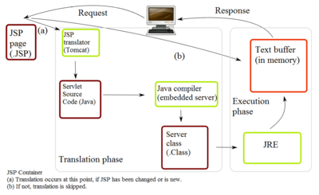

Slide 4
Advantages in comparison with the CGI:
Performance is significantly better.
Servlets execute within the address space of a Web server. It is not necessary to create a separate process to handle each client request.
Servlets are platform-independent because they are written in Java.
Java security manager on the server enforces a set of restrictions to protect the resources on a server machine. So servlets are trusted.
The full functionality of the Java class libraries is available to a servlet. It can communicate with applets, databases, or other software via the sockets and RMI mechanisms that you have seen already.

Slide 5
Servlets Tasks
Servlets perform the following major tasks:
Read the explicit data sent by the clients (browsers). This includes an HTML form on a Web page or it could also come from an applet or a custom HTTP client program.
Read the implicit HTTP request data sent by the clients (browsers). This includes cookies, media types and compression schemes the browser understands, and so forth.
Process the data and generate the results. This process may require talking to a database, executing an RMI or CORBA call, invoking a Web service, or computing the response directly.
Send the explicit data (i.e., the document) to the clients (browsers). This document can be sent in a variety of formats, including text (HTML or XML), binary (GIF images), Excel, etc.
Send the implicit HTTP response to the clients (browsers). This includes telling the browsers or other clients what type of document is being returned (e.g., HTML), setting cookies and caching parameters, and other such tasks.
Java Remote Method Invocation is a Java API that performs remote method invocation, the object-oriented equivalent of remote procedure calls (RPC).
The Common Object Request Broker Architecture (CORBA) is a standard defined by the Object Management Group (OMG) designed to facilitate the communication of systems that are deployed on diverse platforms

Slide 6
Servlets Packages
Java Servlets are Java classes run by a web server that has an interpreter that supports the Java Servlet specification.
Servlets can be created using the javax.servlet and javax.servlet.httppackages, which are a standard part of the Java's enterprise edition, an expanded version of the Java class library that supports large-scale development projects.
These classes implement the Java Servlet and JSP specifications.
Java servlets have been created and compiled just like any other Java class. After you install the servlet packages and add them to your computer's Classpath, you can compile servlets with the JDK's Java compiler or any other current compiler.
JavaServer Pages is a technology that helps software developers create dynamically generated web pages based on HTML, XML, or other document types

Slide 7
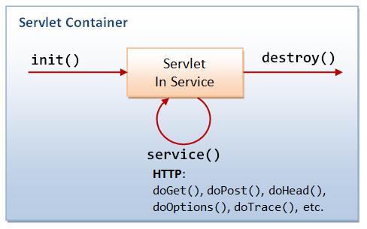
Servlet life cycle
A servlet life cycle can be defined as the entire process from its creation till the destruction. The following are the paths followed by a servlet.
The servlet is initialized by calling the init() method.
The servlet calls service() method to process a client's request.
The servlet is terminated by calling the destroy() method.
Finally, servlet is garbage collected by the garbage collector of the JVM.
Now let us discuss the life cycle methods in detail.

Slide 8
The init() Method
The init method is called only once. It is called only when the servlet is created, and not called for any user requests afterwards. So, it is used for one-time initializations, just as with the init method of applets.
The servlet is normally created when a user first invokes a URL corresponding to the servlet, but you can also specify that the servlet be loaded when the server is first started.
When a user invokes a servlet, a single instance of each servlet gets created, with each user request resulting in a new thread that is handed off to doGet or doPost as appropriate. The init() method simply creates or loads some data that will be used throughout the life of the servlet.

Slide 9
The service() Method
The service() method is the main method to perform the actual task. The servlet container (i.e. web server) calls the service() method to handle requests coming from the client( browsers) and to write the formatted response back to the client.
Each time the server receives a request for a servlet, the server spawns a new thread and calls service. The service() method checks the HTTP request type (GET, POST, PUT, DELETE, etc.) and calls doGet, doPost, doPut, doDelete, etc. methods as appropriate. You have nothing to do with service() method but you override either doGet() or doPost() depending on what type of request you receive from the client.
A GET request results from a normal request for a URL or from an HTML form that has no METHOD specified and it should be handled by doGet() method.
A POST request results from an HTML form that specifically lists POST as the METHOD and it should be handled by doPost() method.

Slide 10
The destroy() Method
The destroy() method is called only once at the end of the life cycle of a servlet. This method gives your servlet a chance to close database connections, halt background threads, write cookie lists or hit counts to disk, and perform other such cleanup activities.
After the destroy() method is called, the servlet object is marked for garbage collection.

Slide 11
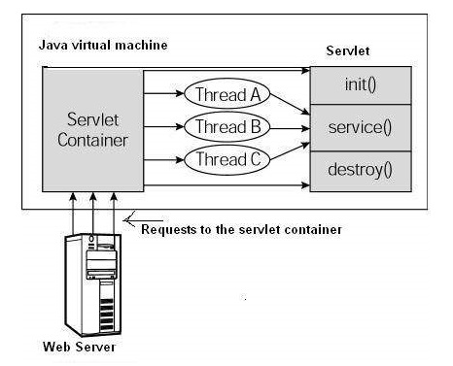
Architecture Diagram
The following figure depicts a typical servlet life-cycle scenario.
First the HTTP requests coming to the server are delegated to the servlet container.
The servlet container loads the servlet before invoking the service() method.
Then the servlet container handles multiple requests by spawning multiple threads, each thread executing the service() method of a single instance of the servlet.

Slide 12
GET Method
The GET method sends the encoded user information appended to the page request. The page and the encoded information are separated by the ? (question mark) symbol as follows:
http://www.test.com/hello?key1 = value1&key2 = value2
The GET method is the default method to pass information from browser to web server and it produces a long string that appears in your browser's Location:box. Never use the GET method if you have password or other sensitive information to pass to the server. The GET method has size limitation: only 1024 characters can be used in a request string. This information is passed using QUERY_STRING header and will be accessible through QUERY_STRING environment variable and Servlet handles this type of requests using doGet() method.

Slide 13
POST Method
A generally more reliable method of passing information to a backend program is the POST method. This packages the information in exactly the same way as GET method, but instead of sending it as a text string after a ? (question mark) in the URL it sends it as a separate message. This message comes to the backend program in the form of the standard input which you can parse and use for your processing. Servlet handles this type of requests using doPost() method.

Slide 14
Reading Form Data using Servlet
Servlets handles form data parsing automatically using the following methods depending on the situation
getParameter() − You call request.getParameter() method to get the value of a form parameter.
getParameterValues() − Call this method if the parameter appears more than once and returns multiple values, for example checkbox.
getParameterNames() − Call this method if you want a complete list of all parameters in the current request.

Slide 15
HTTP Header Request
When a browser requests for a web page, it sends lot of information to the web server which cannot be read directly because this information travel as a part of header of HTTP request.
Here are some methods which can be used to read HTTP header in your servlet program. These methods are available with HttpServletRequest object:
Cookie[] getCookies() Returns an array containing all of the Cookie objects the client sent with this request.
Enumeration getAttributeNames() Returns an Enumeration containing the names of the attributes available to this request.
Enumeration getParameterNames() Returns an Enumeration of String objects containing the names of the parameters contained in this request
HttpSession getSession() Returns the current session associated with this request, or if the request does not have a session, creates one.

Slide 16
Server HTTP Response
Web server responds to an HTTP request, the response typically consists of a status line, some response headers, a blank line, and the document. A typical response looks like this:
HTTP/1.1 200 OK
Content-Type: text/html
Header2: ...
...
HeaderN: ...
(Blank Line)
<!doctype ...>
<html>
</html>
The status line consists of the HTTP version (HTTP/1.1 in the example), a status code (200 in the example), and a very short message corresponding to the
status code (OK in the example).

Slide 17
Server HTTP Response
Here are following methods which can be used to set HTTP response header in your servlet program. These methods are available with HttpServletResponse object.
String encodeRedirectURL(String url) Encodes the specified URL for use in the sendRedirect method or, if encoding is not needed, returns the URL unchanged.
String encodeURL(String url) Encodes the specified URL by including the session ID in it, or, if encoding is not needed, returns the URL unchanged. boolean isCommitted() Returns a Boolean indicating if the response has been committed.
void addCookie(Cookie cookie) Adds the specified cookie to the response.
void sendError(int sc, String msg) Sends an error response to the client using the specified status.

Slide 18
Http Status Codes
Following is a list of HTTP status codes and associated messages that might be returned from the Web Server:
200 OK - The request is OK
302 Found - The requested page has moved temporarily to a new url
400 Bad Request - The server did not understand the request
401 Unauthorized - The requested page needs a username and a password
403 Forbidden - Access is forbidden to the requested page
404 Not Found - The server cannot find the requested page.
408 Request Timeout - The request took longer than the server was prepared to wait. 415 Unsupported Media Type - The server will not accept the request, because the media type is not supported.

Slide 19
The following methods can be used to set HTTP Status Code in your servlet program. These methods are available with HttpServletResponse object:
public void setStatus ( int statusCode ) This method sets an arbitrary status code. The setStatus method takes an int (the status code) as an argument. If your response includes a special status code and a document, be sure to call setStatus before actually returning any of the content with the PrintWriter.
public void sendRedirect(String url) This method generates a 302 response along with a Location header giving the URL of the new document
public void sendError(int code, String message) This method sends a status code (usually 404) along with a short message that is automatically formatted inside an HTML document and sent to the client.

