Slide 1
Creating SOAP Web Service using Spring Boot
Prepared by
T S Karthikeyan
karthikeyan.t-s@Capgemini.com

Slide 2
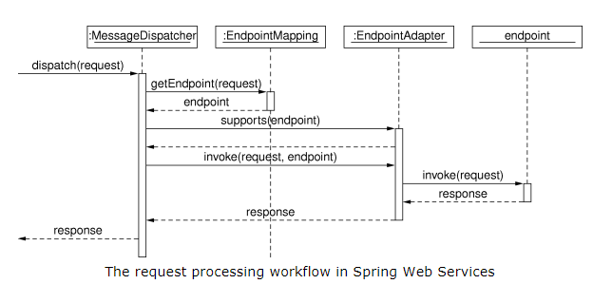
Developing SOAP based web service
SOAP based web service can be created from Spring Boot. This article will explain the steps to create SOAP based web service from xml schema definition(XSD) using Apache Maven XJC plugin

Slide 3
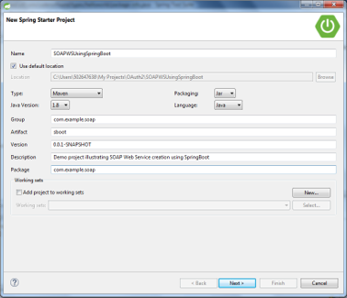
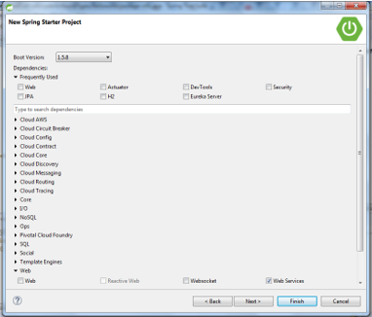
Step 1: Create New Spring Project
1. Create new spring project from STS and add the maven web service dependencies. It will include the “spring-boot-starter-web-services”

Slide 4
Step 2: Setup Maven
Add “wsdl4j” dependency for wsdl configuration functionality
<dependency>
<groupId>wsdl4j</groupId>
<artifactId>wsdl4j</artifactId>
</dependency>
<plugin>
<groupId>org.codehaus.mojo</groupId>
<artifactId>jaxb2-maven-plugin</artifactId>
<version>1.6</version>
<executions>
<execution>
<id>xjc</id>
<goals>
<goal>xjc</goal>
</goals>
</execution>
</executions>
<configuration>
<schemaDirectory>${project.basedir}/src/main/resources/</schemaDirectory>
<outputDirectory>${project.basedir}/src/main/java</outputDirectory>
<clearOutputDir>false</clearOutputDir>
</configuration>
</plugin>
jaxb2-maven-plugin XJC used to generate java classes from XSD
<schemaDirectory> used to mention the folder where the xsd file located
<outputDirectory> used to mention where the generated java files should be stored
<clearOutputDir> used to mention whether its to be cleared. True or False

Slide 5
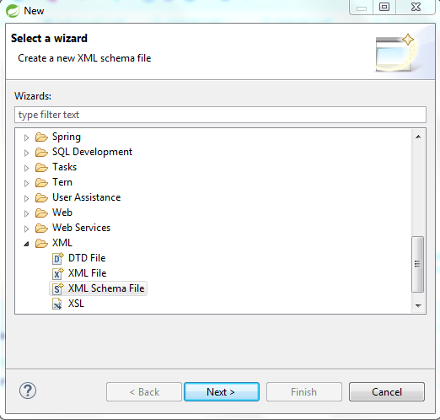
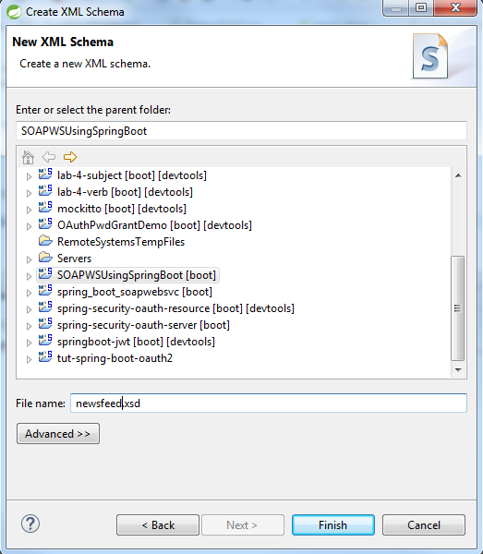
Step 3: Defining Webservice Domain
Here in this schema file, define the request & response formats for all the operations and also the bean definition used for this operations

Slide 6
Step 3 Continued Schema Definition File
<?xml version="1.0" encoding="UTF-8"?>
<xs:schema xmlns:xs="http://www.w3.org/2001/XMLSchema"
targetNamespace="http://com/example/soap/newsfeed"
xmlns:tns="http://com/example/soap/newsfeed"
elementFormDefault="qualified">
<xs:element name="getNewsfeedRequest">
<xs:complexType>
<xs:sequence> <xs:element name="name" type="xs:string" /> </xs:sequence>
</xs:complexType>
</xs:element>
<xs:element name="getNewsfeedResponse">
<xs:complexType>
<xs:sequence> <xs:element name="newsfeed" type="tns:newsfeed" /> </xs:sequence>
</xs:complexType>
</xs:element>
<xs:element name="createNewsfeedRequest">
<xs:complexType>
<xs:sequence> <xs:element name="newsfeed" type="tns:newsfeed" /> </xs:sequence>
</xs:complexType>
</xs:element>
<xs:element name="createNewsfeedResponse">
<xs:complexType>
<xs:sequence> <xs:element name="status" type="xs:string" /> </xs:sequence>
</xs:complexType>
</xs:element>
<xs:complexType name="newsfeed">
<xs:sequence>
<xs:element name="name" type="xs:string" />
<xs:element name="author" type="xs:string" />
</xs:sequence>
</xs:complexType>
</xs:schema>

Slide 7
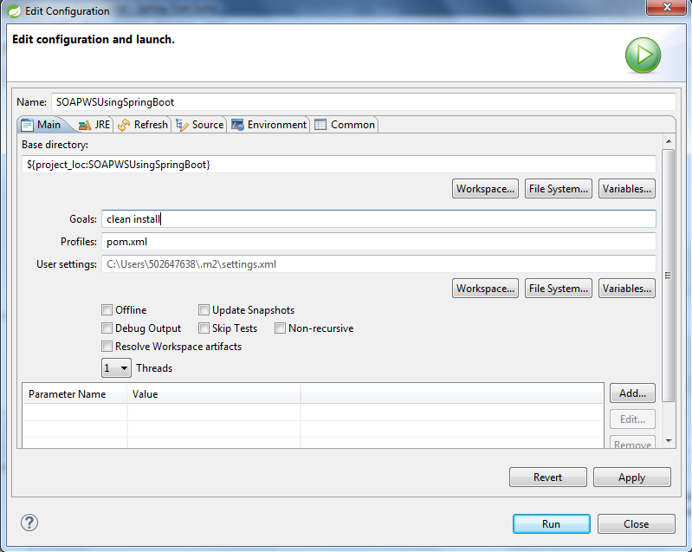
Step 4: Maven Build
Run maven build from the eclipse using “clean install” command. After the build, all the stub classes will be created under the destination directory given in the POM.xml file. In this case, its src/main/java folder.

Slide 8
Step 5: Creating Repository for newsfeed object
package com.example.soap;
import java.util.ArrayList;
import java.util.List;
import javax.annotation.PostConstruct;
import org.example.sample.Newsfeed;
import org.springframework.stereotype.Component;
import org.springframework.util.Assert;
@Component
public class NewsfeedRepository {
private static final List<Newsfeed> newsfeeds = new ArrayList<Newsfeed>();
@PostConstruct
public void initData() {
Newsfeed newsfeed1 = new Newsfeed();
newsfeed1.setName(“Hello World");
newsfeed1.setAuthor(“Bob");
newsfeeds.add(newsfeed1);
Newsfeed newsfeed2 = new Newsfeed();
newsfeed2.setName(“Welcome to SOAP WS");
newsfeed2.setAuthor(“John");
newsfeeds.add(newsfeed2);
}
public Newsfeed findNewsfeed(String name) {
Assert.notNull(name);
Newsfeed result = null;
for (Newsfeed newsfeed : newsfeeds) {
if (name.equals(newsfeed.getName())) { result = newsfeed; }
}
return result;
}
public void addNewsfeed(Newsfeed newsfeed) {
newsfeeds.add(newsfeed);
}
}

Slide 9
Step 6: Creating Endpoint
This Endpoint class will be annotated with @Endpoint. Here NameSpaceURI will be configured for handling each incoming requests(SOAP messages). Its like the controller for mapping the incoming requests.
@PayloadRoot will be used to choose the method by matching the namespace & localpart attributes
@RequestPayload – mapping the incoming request to the method’s param
@ResponsePayload will be used to map the return value to the response payload
To handle Request and Response, stub classes which is created from the XSD file will be used.

Slide 10
Step 6 Continued…
package com.example.soap;
import org.springframework.beans.factory.annotation.Autowired;
import org.springframework.ws.server.endpoint.annotation.Endpoint;
import org.springframework.ws.server.endpoint.annotation.PayloadRoot;
import org.springframework.ws.server.endpoint.annotation.RequestPayload;
import org.springframework.ws.server.endpoint.annotation.ResponsePayload;
import com.example.soap.newsfeed.CreateNewsfeedRequest;
import com.example.soap.newsfeed.CreateNewsfeedResponse;
import com.example.soap.newsfeed.GetNewsfeedRequest;
import com.example.soap.newsfeed.GetNewsfeedResponse;
@Endpoint
public class NFEndPoint {
private static final String NAMESPACE_URI = "http://com/example/soap/newsfeed";
private NewsfeedRepository newsfeedRepository;
@Autowired
public NFEndPoint(NewsfeedRepository newsfeedRepository) {
this.newsfeedRepository = newsfeedRepository;
}
// To handle getNewsfeedRequest
@PayloadRoot(namespace = NAMESPACE_URI, localPart = "getNewsfeedRequest")
@ResponsePayload
public GetNewsfeedResponse getNewsfeed(@RequestPayload GetNewsfeedRequest request) {
GetNewsfeedResponse response = new GetNewsfeedResponse();
response.setNewsfeed(newsfeedRepository.findNewsfeed(request.getName()));
return response;
}
// To handle createNewsfeedRequest
@PayloadRoot(namespace = NAMESPACE_URI, localPart = "createNewsfeedRequest")
@ResponsePayload
public CreateNewsfeedResponse createNewsfeed(@RequestPayload CreateNewsfeedRequest request) {
CreateNewsfeedResponse response = new CreateNewsfeedResponse();
newsfeedRepository.addNewsfeed(request.getNewsfeed());
response.setStatus("SUCCESS");
return response;
}
}

Slide 11
Step 7: Configure Spring Bean and WSDL
Spring Web Configuration has to be defined in a bean using WsConfigurerAdapter
@EnableWs - Enabling Web Services Addressing support for JAX-WS applications using addressing annotations. WS Addressing provides transport-neutral mechanisms to address Web services and messages
MessageDispatcherServlet is the special type of servlet helps Spring WS for request handling. ApplicationContext has to be set to this servlet. So that Spring WS will detect the spring beans.
transformWsdlLocations(true) ensures that this is generated dynamically based on whatever URL is being used to access the service.
DefaultWsdl11Definition – Used to generate the WSDL and WSDL URL.
setPortTypeNames – used to group the operations
setLocationUri – to set the URI which will the url path after <host>:<port>
setTargetNameSpace – to set the name space uri
setSchema – to configured the xsd file

Slide 12
Step 7 Continued..
package com.example.soap;
import org.springframework.boot.web.servlet.ServletRegistrationBean;
import org.springframework.context.ApplicationContext;
import org.springframework.context.annotation.Bean;
import org.springframework.context.annotation.Configuration;
import org.springframework.core.io.ClassPathResource;
import org.springframework.ws.config.annotation.EnableWs;
import org.springframework.ws.config.annotation.WsConfigurerAdapter;
import org.springframework.ws.transport.http.MessageDispatcherServlet;
import org.springframework.ws.wsdl.wsdl11.DefaultWsdl11Definition;
import org.springframework.xml.xsd.SimpleXsdSchema;
import org.springframework.xml.xsd.XsdSchema;
@EnableWs
@Configuration
public class SpringWebConfig extends WsConfigurerAdapter{
@Bean
public ServletRegistrationBean messageDispatcherServlet(ApplicationContext applicationContext) {
MessageDispatcherServlet servlet = new MessageDispatcherServlet();
servlet.setApplicationContext(applicationContext);
servlet.setTransformWsdlLocations(true);
return new ServletRegistrationBean(servlet, "/ws/*");
}
@Bean(name = "newsfeed")
public DefaultWsdl11Definition defaultBookWsdl11Definition(XsdSchema newsfeedSchema) {
DefaultWsdl11Definition wsdl11Definition = new DefaultWsdl11Definition();
wsdl11Definition.setPortTypeName("NFPort");
wsdl11Definition.setLocationUri("/ws");
wsdl11Definition.setTargetNamespace("http://com/example/soap/newsfeed");
wsdl11Definition.setSchema(newsfeedSchema());
return wsdl11Definition;
}
@Bean
public XsdSchema newsfeedSchema() {
return new SimpleXsdSchema(new ClassPathResource("newsfeed.xsd"));
}
}

Slide 13
Step 8: Modify Spring Boot main application
package com.example.soap;
import org.springframework.boot.SpringApplication;
import org.springframework.boot.autoconfigure.SpringBootApplication;
import org.springframework.context.annotation.ComponentScan;
import org.springframework.security.config.annotation.authentication.builders.AuthenticationManagerBuilder;
import org.springframework.security.config.annotation.authentication.configuration.EnableGlobalAuthentication;
import org.springframework.security.config.annotation.authentication.configurers.GlobalAuthenticationConfigurerAdapter;
@SpringBootApplication
@ComponentScan({ "org.example.soap.newsfeed" })
public class SoapwsUsingSpringBootApplication {
public static void main(String[] args) {
SpringApplication.run(SoapwsUsingSpringBootApplication.class, args);
}
@EnableGlobalAuthentication
static class AuthenticationConfig extends GlobalAuthenticationConfigurerAdapter {
@Override
public void init(AuthenticationManagerBuilder auth) throws Exception {
auth.inMemoryAuthentication()
.withUser("user").password("password").roles("USER");
}
}
}

Slide 14
Step 9: Define the application properties
Define application Context path & port in application.properties
server.contextPath=/newsfeed
server.port=8083

Slide 15
Step 10: Test the application using WSDL
Run the spring boot application and access the WSDL url in the browser. It will show the WSDL file content which can be shared to the client who is going to access the service.
http://localhost:8083/newsfeed/ws/newsfeed.wsdl

