Slide 1
Configuring SOAP Web Service with Akana
Prepared by
T S Karthikeyan

Slide 2
Why Web Service is needed to configure in Akana?
Akana is the tool where configure any web services (REST or SOAP) which are not available outside the network.
For example) if a web service is available in GE network and not available in internet. In this case, we can configure that web service in Akana to make it available on the internet.

Slide 3
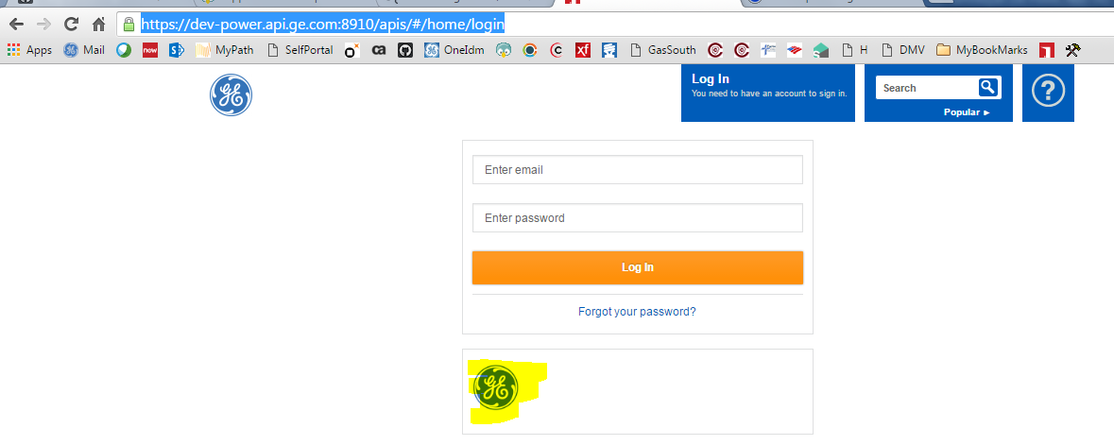
Steps to follow for SOAP Web Service Configuration in Akana
Visit the Akana Home page : https://dev-power.api.ge.com:8910/apis/#/home/login
SSO users can login by clicking the GE logo
3. Create an App and create APIs under that app.
4. For example, for one application, 5 webservices going to be configured in Akana, then create 1 App and create 5 APIs and tag all those 5 APIs into App. So everyone will easily understand those 5 APIs are created for that particular app. Give the app and api names relevant to your project/application. Refer this link for self help: https://devcloud.swcoe.ge.com/devspace/pages/viewpage.action?spaceKey=QRSJX&title=Akana+Self+Service

Slide 4
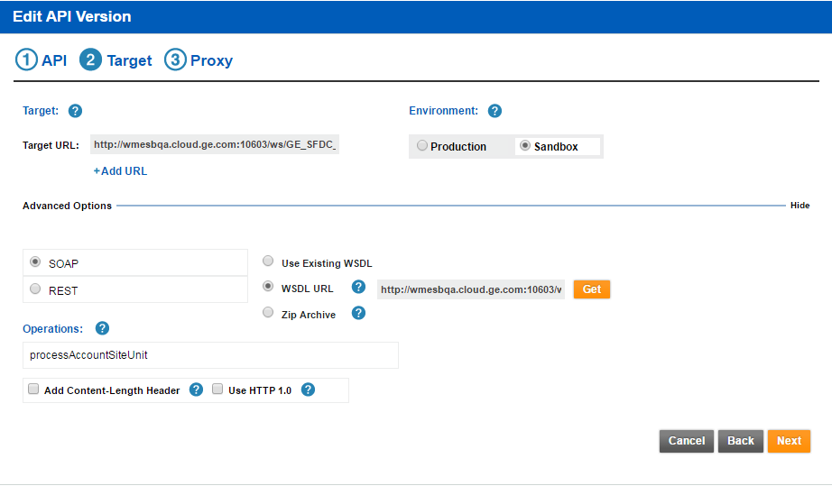
Steps Continued..
4. When creating API, enter the Step 2 Target like below:
Target URL : enter the original SOAP Service End Point URL

Slide 5
Steps Continued..
For example) http://wmesbqa.cloud.ge.com:10603/ws/GE_SFDC_PW_AccountSiteUnit_Services.WebServices.Provider:processAccountSiteUnit_WSD
Environment: select “Sandbox” in case of Dev or select “Production” in case of production
And in the Advanced option, select “SOAP” check box and “WSDL URL” check box
And enter the WSDL URL in the text box like http://wmesbqa.cloud.ge.com:10603/ws/GE_SFDC_PW_AccountSiteUnit_Services.WebServices.Provider:processAccountSiteUnit_WSD?WSDL
Now click the “Get” button, it will auto populate the Proc Name in the Operations text box if the WSDL is valid.

Slide 6
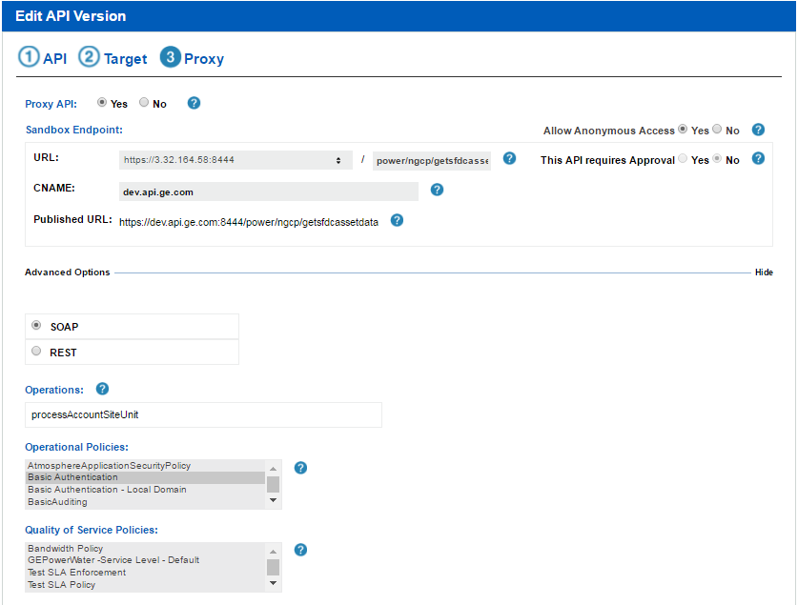
Steps Continued…
5. Enter details for Step 3 Proxy like below

Slide 7
Steps Continued..
Proxy API – Select “Yes” to give the listener details
Allow Anonymous Access – Select “Yes”
URL : value will be automatically filled. After the “/”, enter the path name. path name can be anything. Its better to enter values relevant to business unit and application
CNAME: enter own value. But follow the naming convention like dev.ge.com or dev.api.ge.com
Published URL : this value will be automatically changed based on the CNAME + pathname
Advanced Options – select “SOAP” checkbox. Then Operations will be filled automatically.
Operational Policies : select “Basic Authentication” if the WS needs authentication (username & password)
Quality of Service Policies : no need

Slide 8
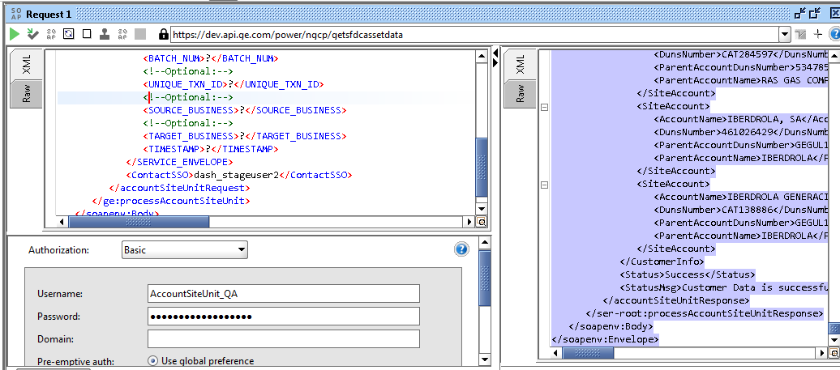
Steps continued
6. Click Save and save the configuration
Here the Akana Service EndPoint URL is https://dev.api.ge.com/power/ngcp/getsfdcassetdata.
7. Access this URL from SOAP UI from outside GE N/W and inside GE N/W. In both cases, you should get the response. In SOAP UI, we testing this URL, give the parameter value for the SOAP request and authentication.
For example:

Slide 9
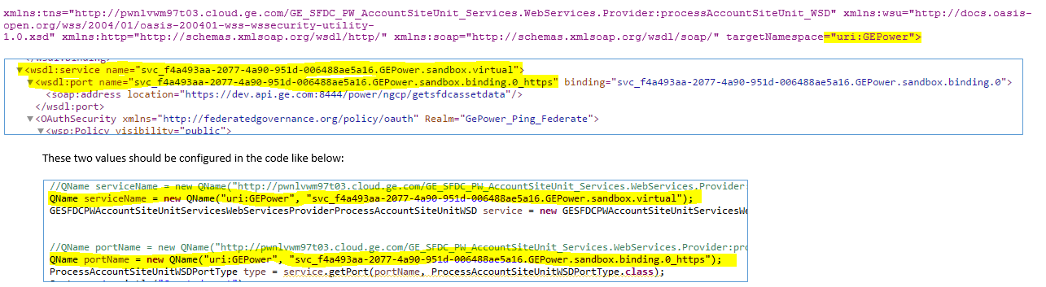
Steps Continued…
8. Check the Akana WSDL URL in browser to check the wsdl content and note down the below attribute or tag values like “wsdl:service”, “wsdl:port” , “targetNamespace”
These values only should be used in the Java code(not the original SOAP targetNamespace, service, port.
All these value should be used in the java client code to access this WS from the code like below:

Slide 10
Steps Continued…
9. Now the new WSDL which is created thru Akana can also be used to generate the stub classes and make it as a Jar file. This Jar file can be placed in the Class Path or you can save it in the local repo and add the dependency in case of Maven. Once the Stub classes and Jar created, while configuring the targetNamespace, service, port.
10. In the client code, while connecting to the web service, these values from the WSDL created from Akana can be used to connect and call the required methods using the stub classes.

Slide 11
Sample Java Client Code
String wsdlLocation = "https://dev.api.ge.com/power/ngcp/getsfdcassetdata" + "?WSDL";
QName serviceName = new QName("uri:GEPower", "svc_f4a493aa-2077-4a90-951d006488ae5a16.GEPower.sandbox.virtual");
GESFDCPWAccountSiteUnitServicesWebServicesProviderProcessAccountSiteUnitWSD service = new GESFDCPWAccountSiteUnitServicesWebServicesProviderProcessAccountSiteUnitWSD( new URL(wsdlLocation), serviceName);
QName portName = new QName("uri:GEPower", "svc_f4a493aa-2077-4a90-951d-006488ae5a16.GEPower.sandbox.binding.0_https");
ProcessAccountSiteUnitWSDPortType type = service.getPort(portName, ProcessAccountSiteUnitWSDPortType.class);
BindingProvider port = (BindingProvider) type;
port.getRequestContext().put(BindingProvider.USERNAME_PROPERTY, "AccountSiteUnit_QA");
port.getRequestContext().put(BindingProvider.PASSWORD_PROPERTY, "AccountSiteUnit_QA");
port.getRequestContext().put(BindingProvider.ENDPOINT_ADDRESS_PROPERTY, "https://dev.api.ge.com/power/ngcp/getsfdcassetdata");

Slide 12
Steps Continued
port.getRequestContext().put("com.sun.xml.internal.ws.request.timeout", 30000);
port.getBinding().getHandlerChain().add(new SoapLogginHandler());
com.ge.cloud.pwnlvwm97t03.ge_sfdc_pw_accountsiteunit_services_webservices_provider.processaccountsiteunit_wsd.ObjectFactory objectFactory = new com.ge.cloud.pwnlvwm97t03.ge_sfdc_pw_accountsiteunit_services_webservices_provider.processaccountsiteunit_wsd.ObjectFactory();
AccountSiteUnitRequest request = objectFactory.createAccountSiteUnitRequest();
request.setContactSSO(user);
long before = System.currentTimeMillis();
response = type.processAccountSiteUnit(request);

Slide 13
Reference
Akana Self Help: https://devcloud.swcoe.ge.com/devspace/pages/viewpage.action?pageId=1111972029

