Slide 1
Capstone Results Sample size: 100
June 24
Notes:
Q: How many data points (at 10 explanatory variables) does it take to see no difference in accuracy?
X: number of observations
Y: Accuracy
Lines: number of noise variables for a fixed number of explanatory variables
Convergence = doesn’t make a difference in how many noise variables anymore because it has enough power
10, 100, 500, 1000
###################
Look into f score, precision, recall numbers in both algs and their index
What index of precision and recall are used to calculate f?
Is alpha 0.5?
Validate table by hand
Are comparing them fairly – if lr is at 0.5, what is rf at?
####################
Fix the axis on boxplots
####################
Case 2: 1000 sims, 1000 data points, 5 Ex Vars Small/ Med/ Large coefficients
Somewhere between 20 and 50 it makes a difference – flat in beginning – add 100 in here

Slide 2
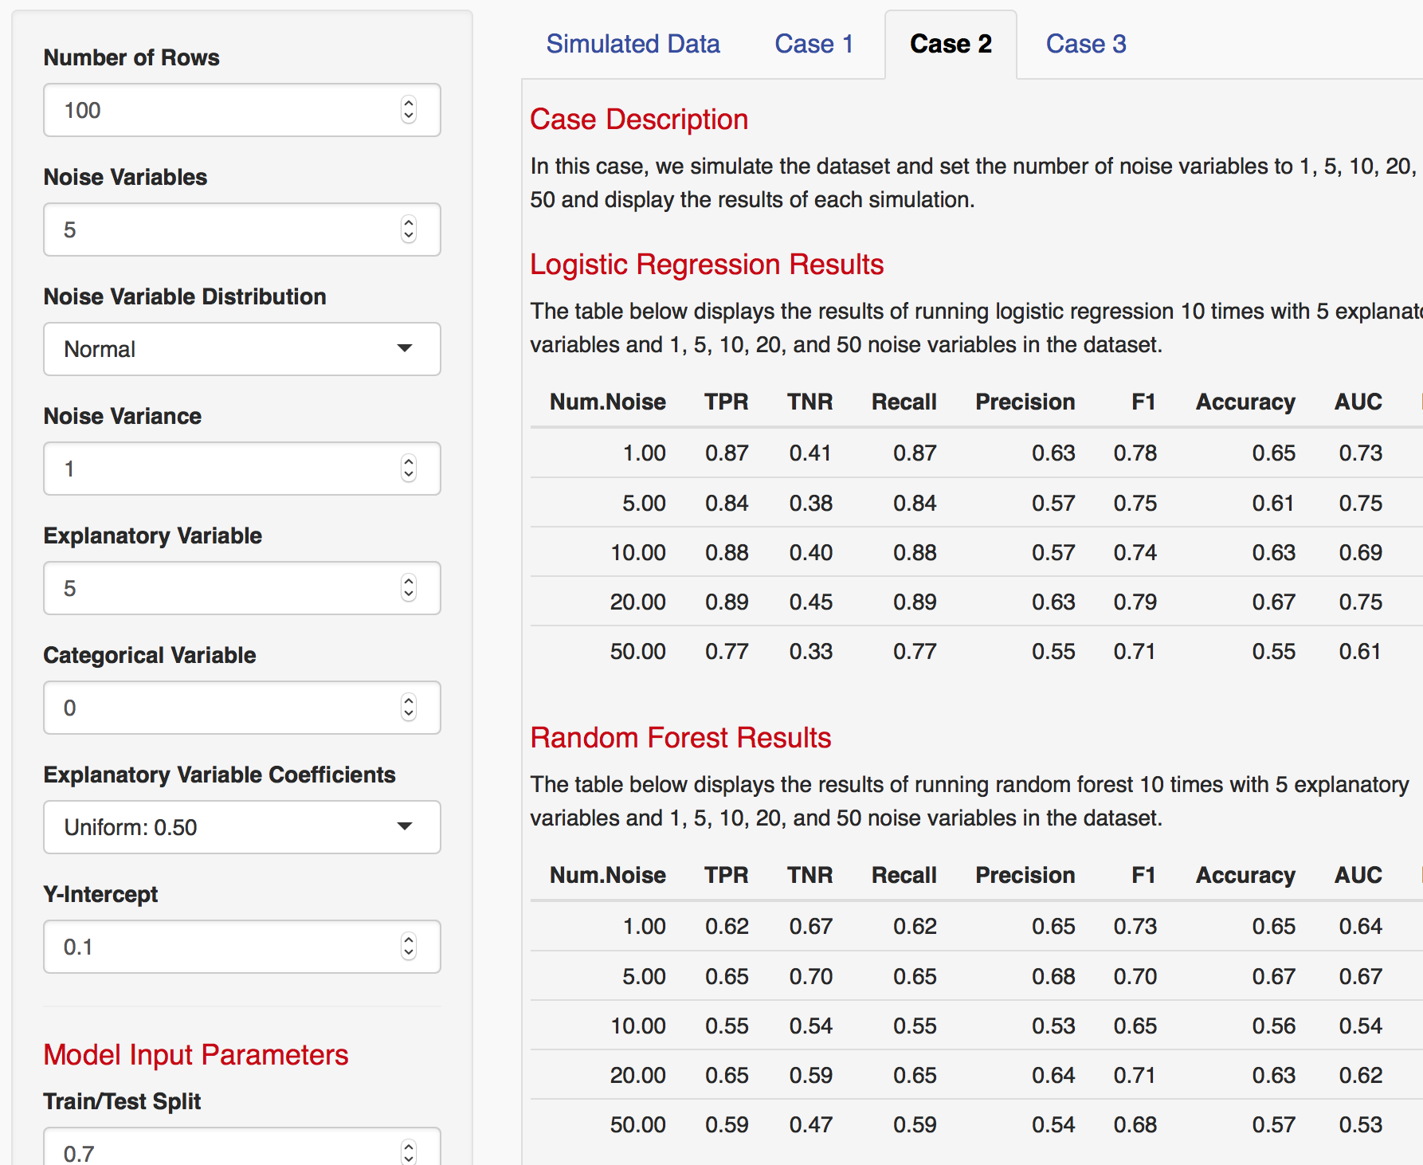
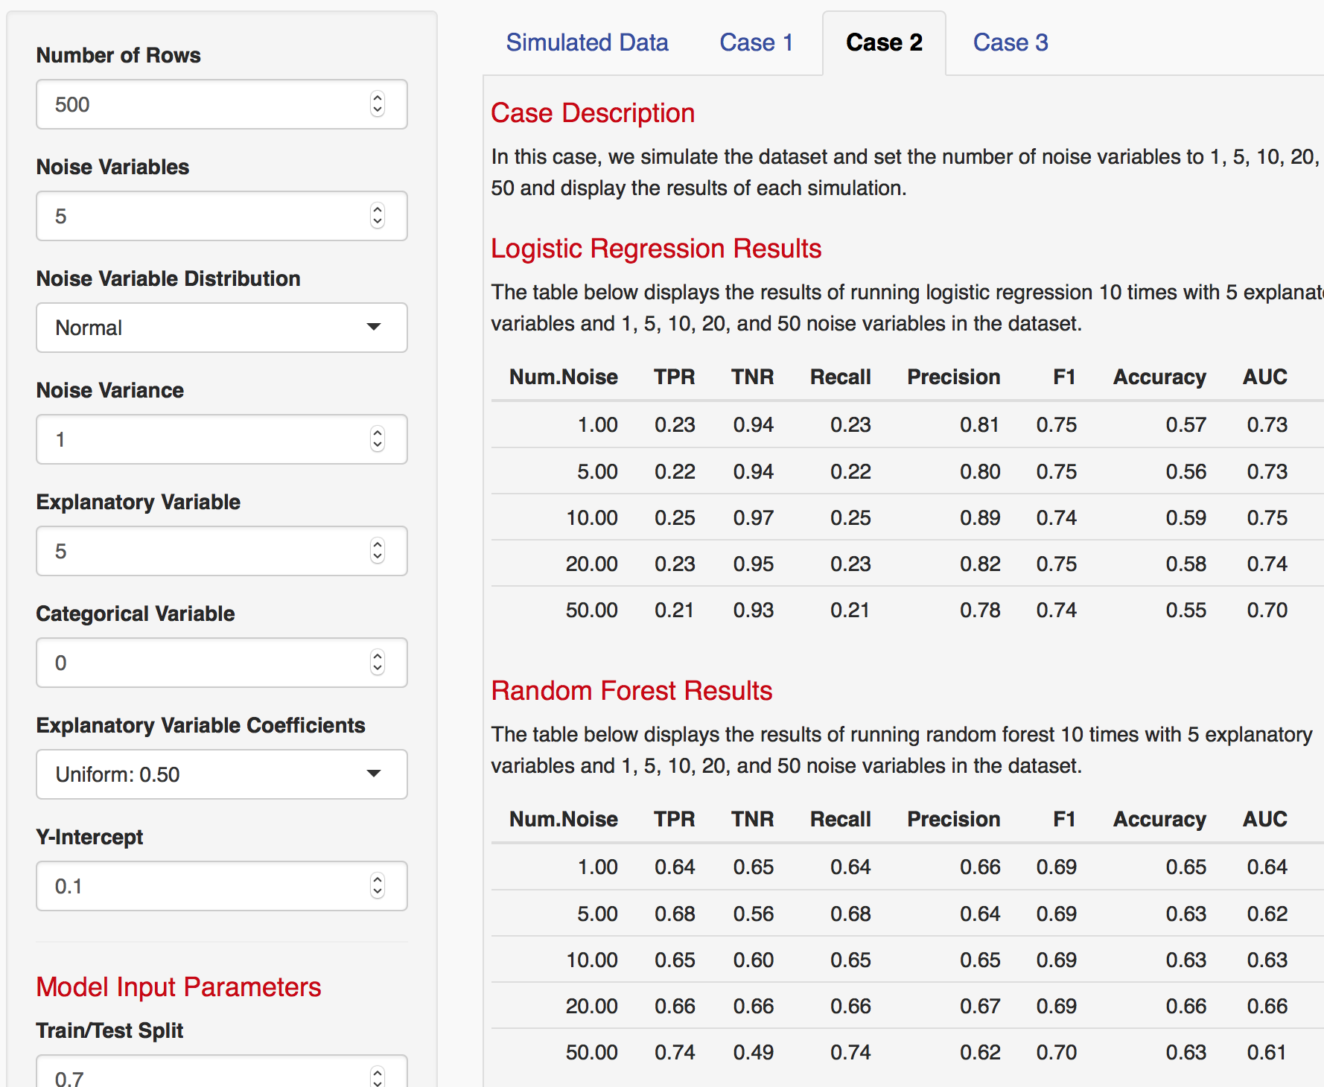
Varying Data Points
Notes:
Q: How many data points (at 10 explanatory variables) does it take to see no difference in accuracy?
X: number of observations
Y: Accuracy
Lines: number of noise variables for a fixed number of explanatory variables
Convergence = doesn’t make a difference in how many noise variables anymore because it has enough power
10, 100, 500, 1000

Slide 3
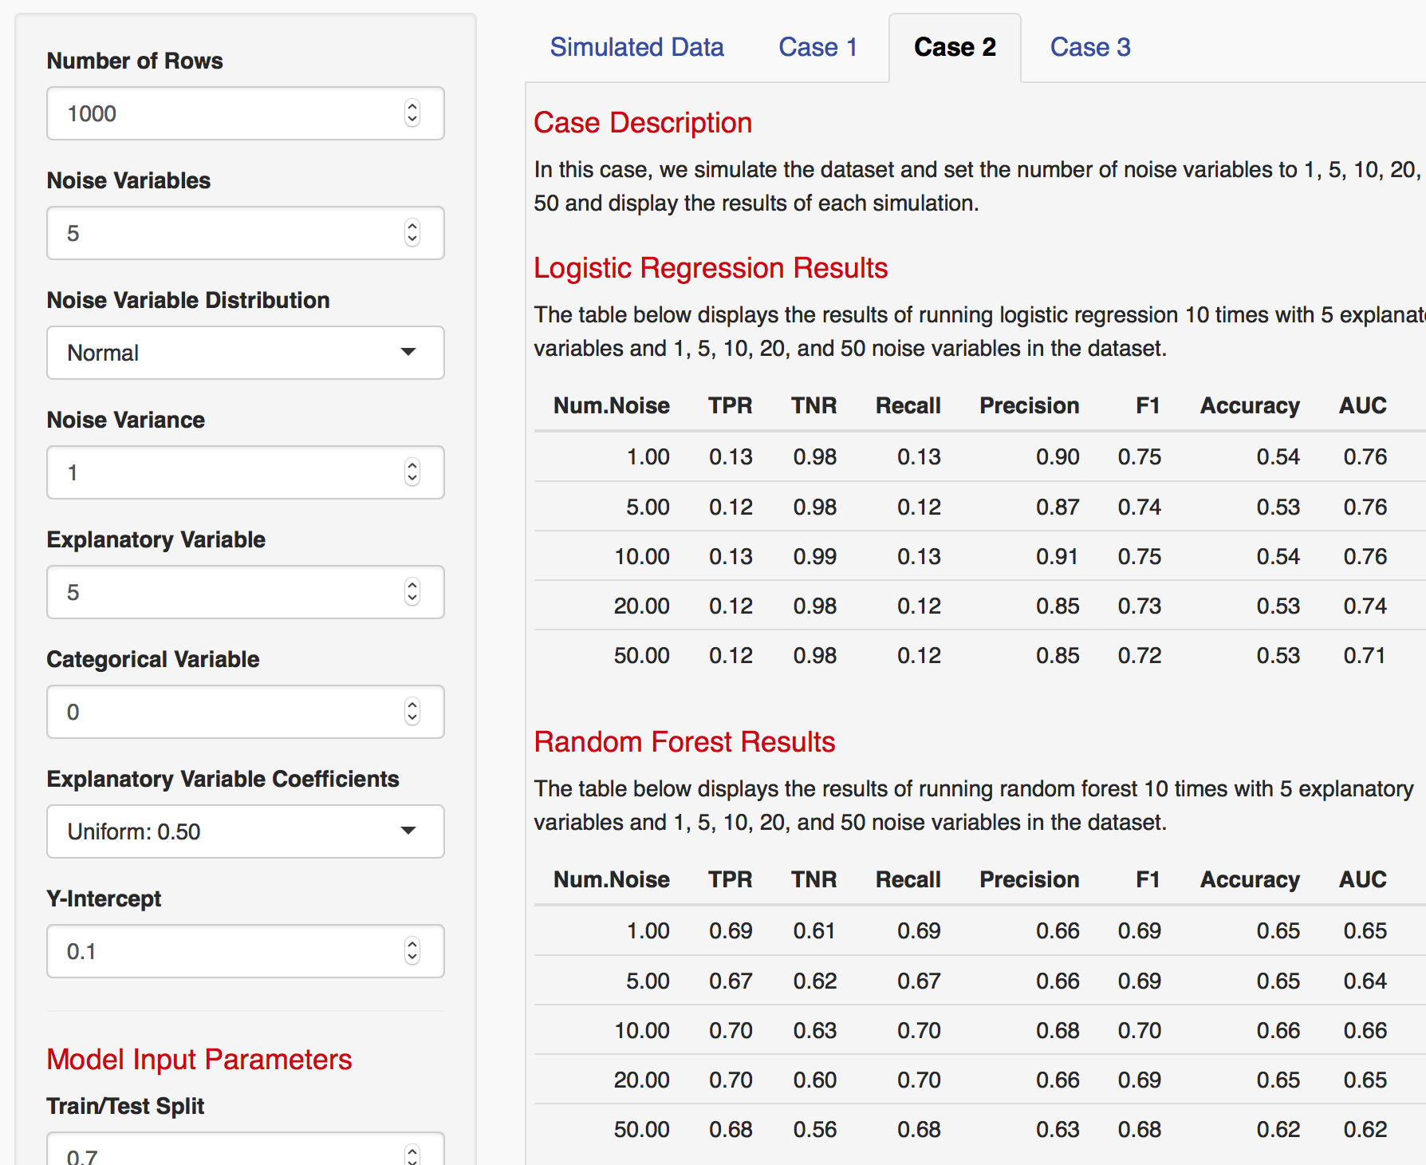
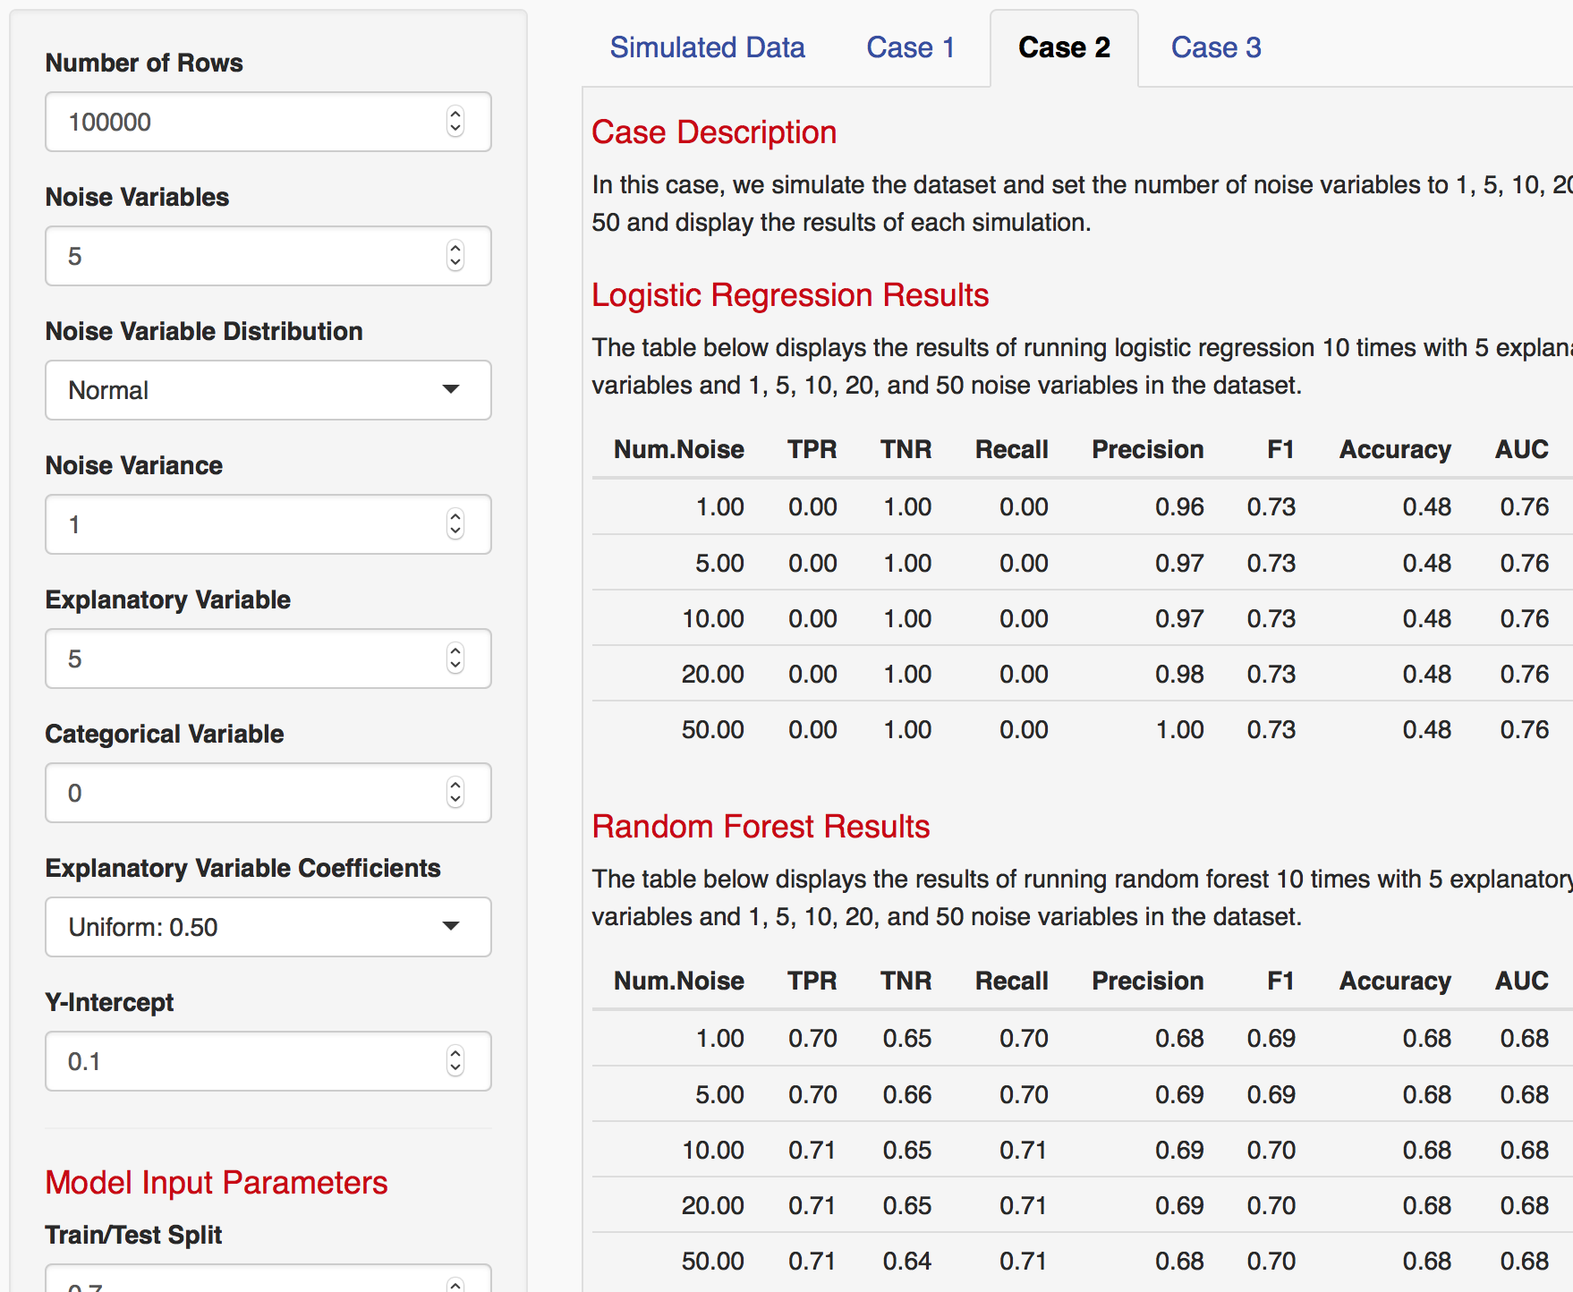
Varying Data Points

Slide 4
Case 1
In this case, we simulate the dataset and set the variance of each variable (noise and explanatory) to 0.5 to 5.0 in an interval of 0.5 and display the results of each simulation.
(Trace) 5 noise, 10 explanatory
(KK) 10 noise / 10 explanatory, 10 noise / 5 explanatory
All 1000 data points, 1000 sims

Slide 5
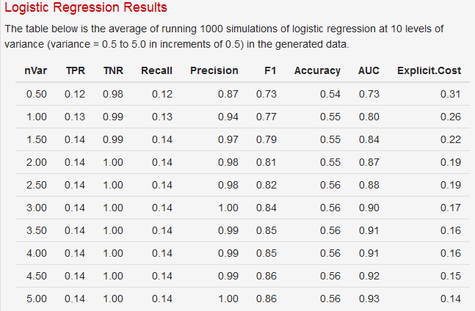
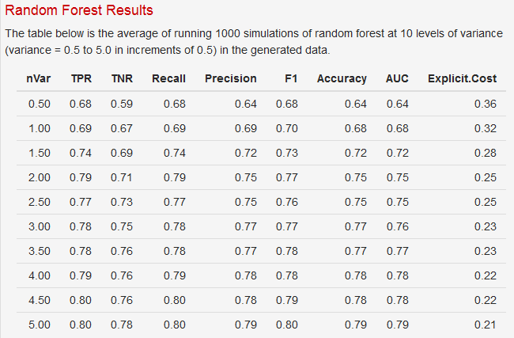
Case 1 - 10 noise / 10 explanatory

Slide 6
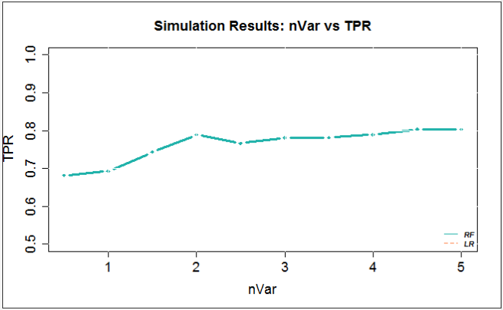
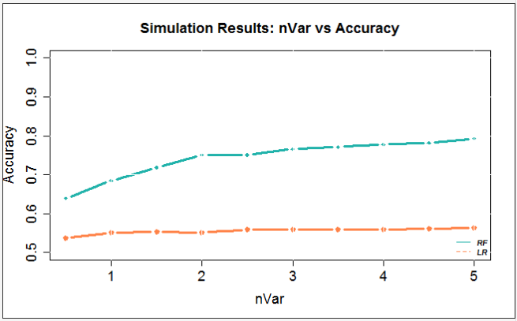
Case 1 - 10 noise / 10 explanatory

Slide 7
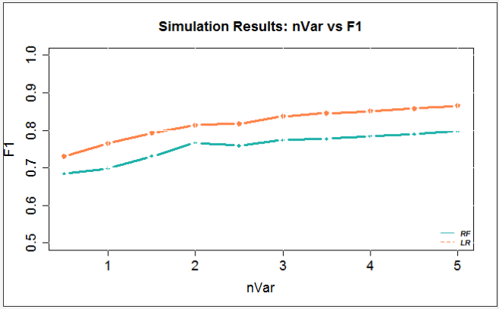
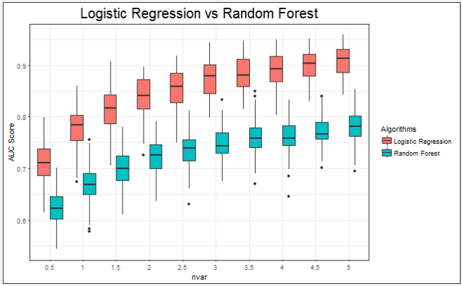
Case 1 - 10 noise / 10 explanatory

Slide 8
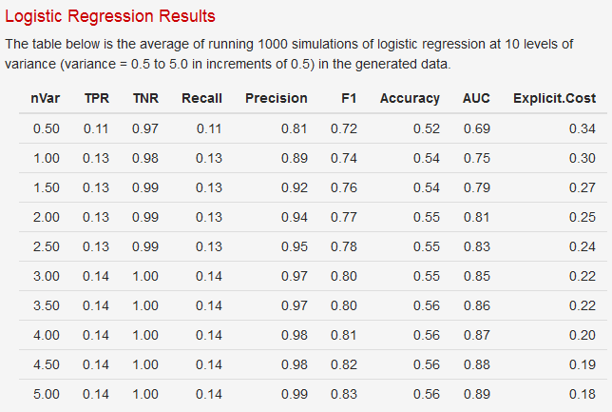
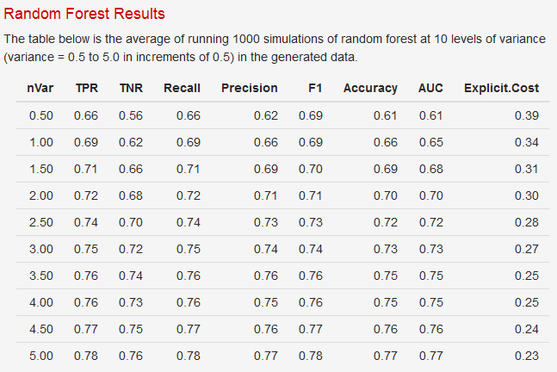
Case 1 - 10 noise / 5 explanatory

Slide 9
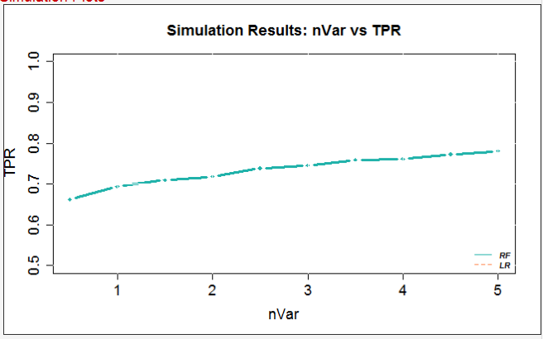
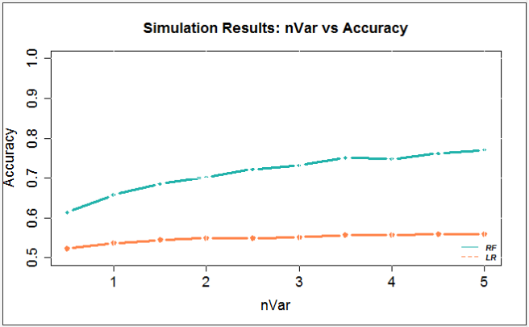
Case 1 - 10 noise / 5 explanatory

Slide 10
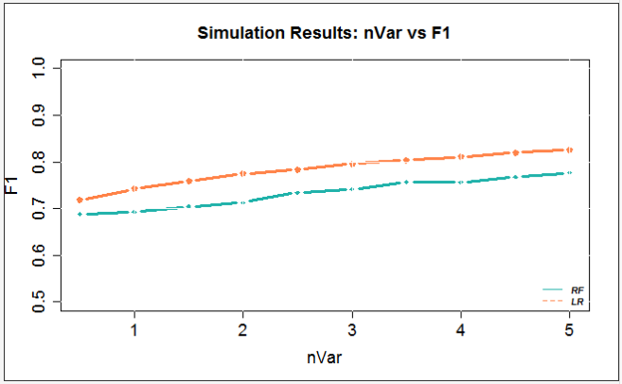
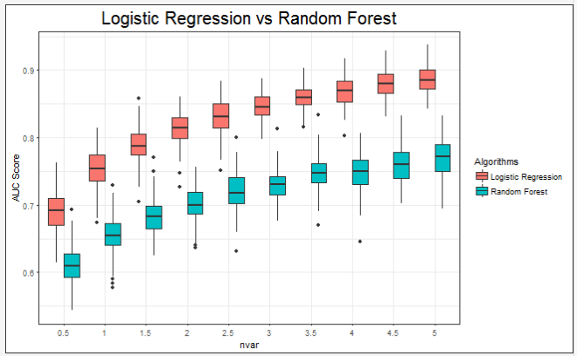
Case 1 - 10 noise / 5 explanatory

Slide 11
Case 2
In this case, we simulate the dataset and set the number of noise variables to 1, 5, 10, 20, and 50 and display the results of each simulation.
Run with 1000 sims
100, 1000 and 100,000 data points
1, 5, 10, 20 explanatory variables
Uniform 0.5 Coefficients – no difference
Small/Medium/Large: 0.20, 0.50, 0.80 – no difference
Forward & backward + Small/ med/ large

Slide 12
Case 2: 1000 sims, 1000 datapoints, 1 Ex Vars

Slide 13
Case 2: 1000 sims, 1000 datapoints, 1 Ex Vars

Slide 14
Case 2: 1000 sims, 1000 datapoints, 1 Ex Vars

Slide 15
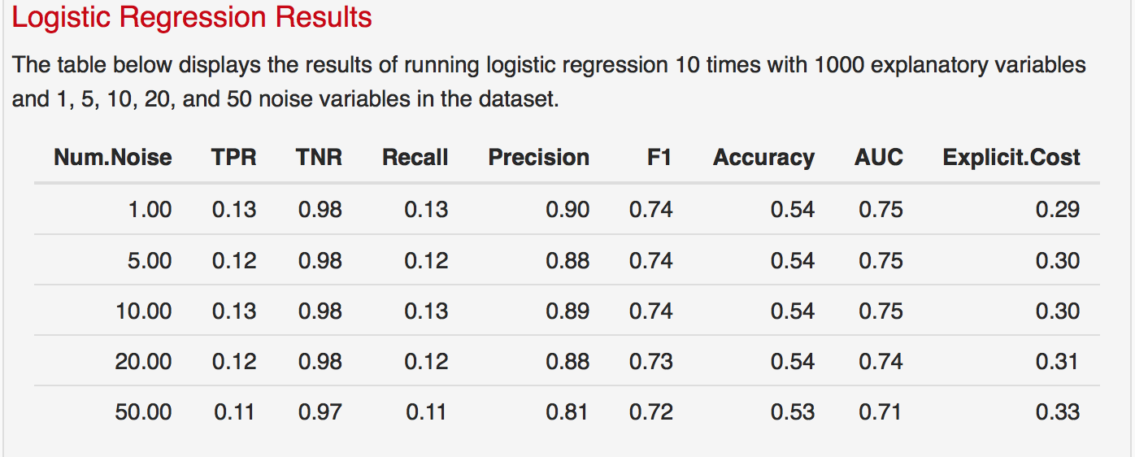
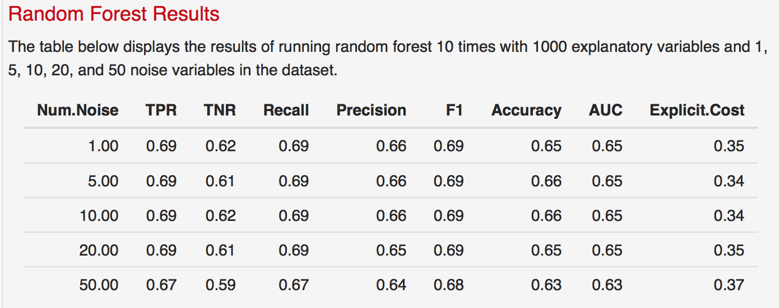
Case 2: 1000 sims, 1000 data points, 5 Ex Vars
*Description is hardcoded
*TPR for LR is the only one that is incorrect – reran to fix it

Slide 16
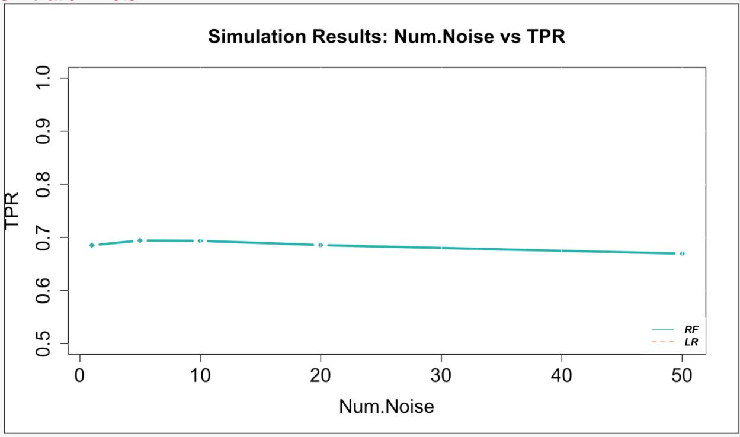
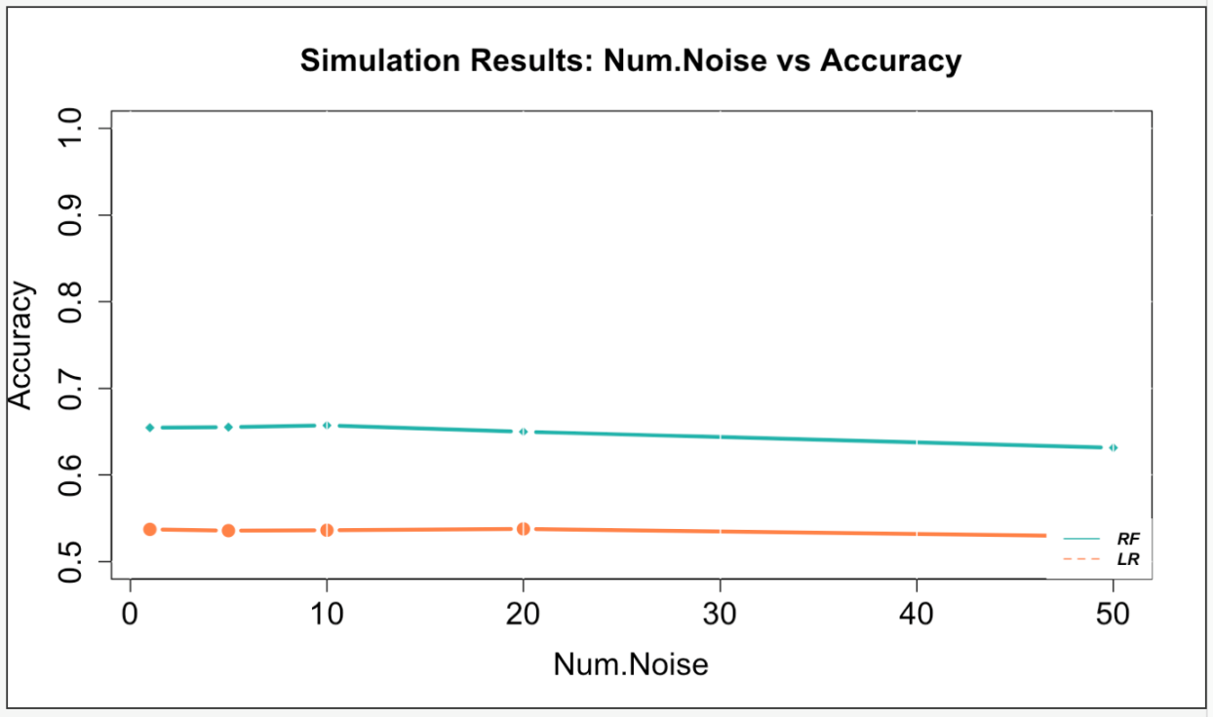
Case 2: 1000 sims, 1000 data points, 5 Ex Vars

Slide 17
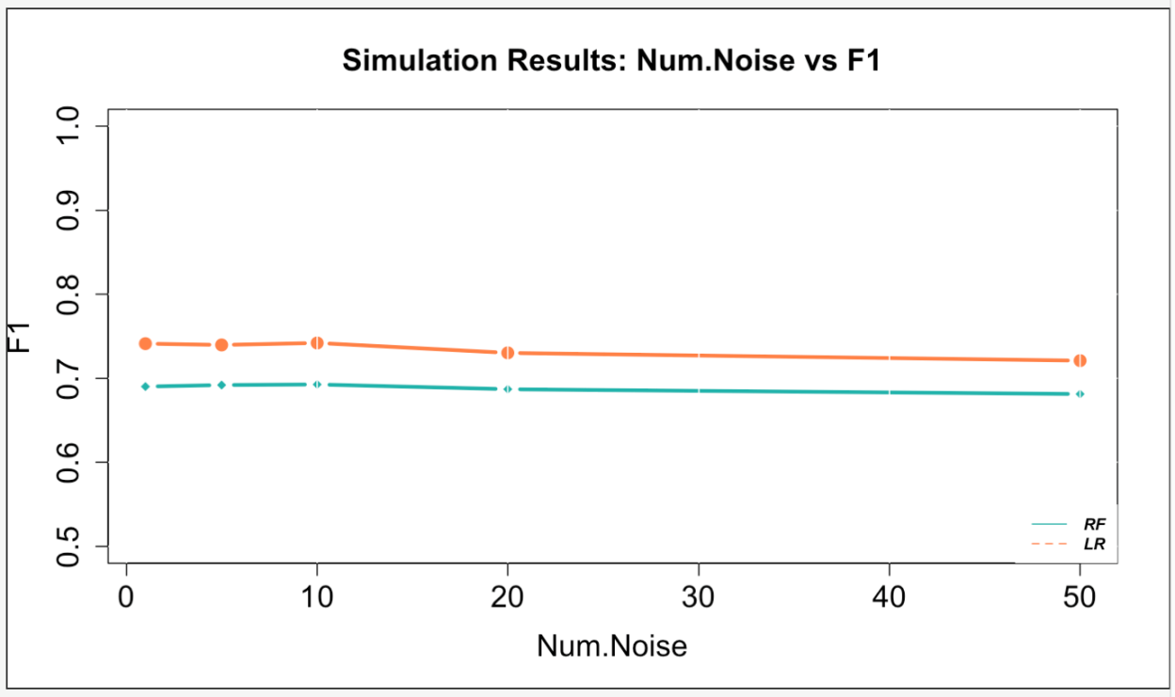
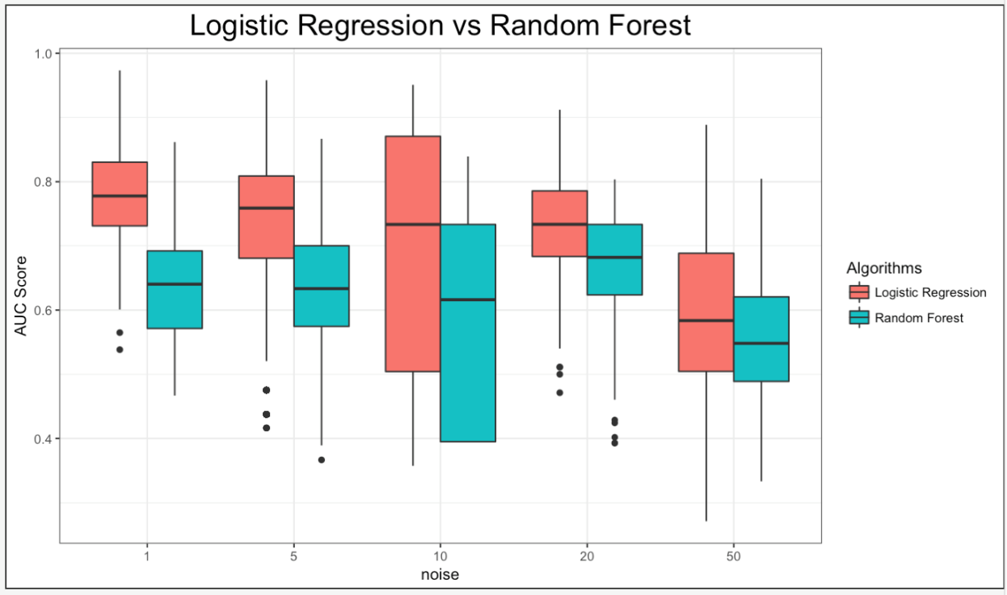
Case 2: 1000 sims, 1000 data points, 5 Ex Vars

Slide 18
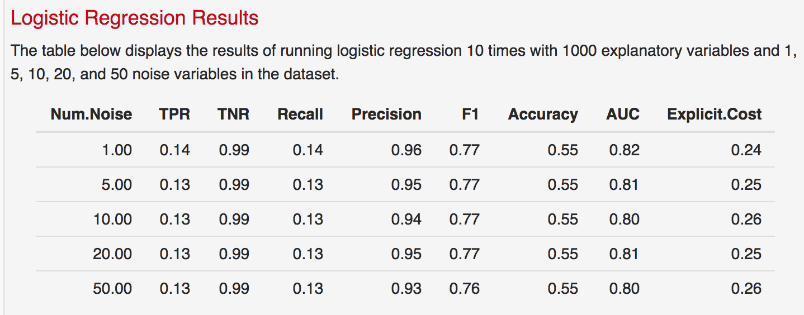
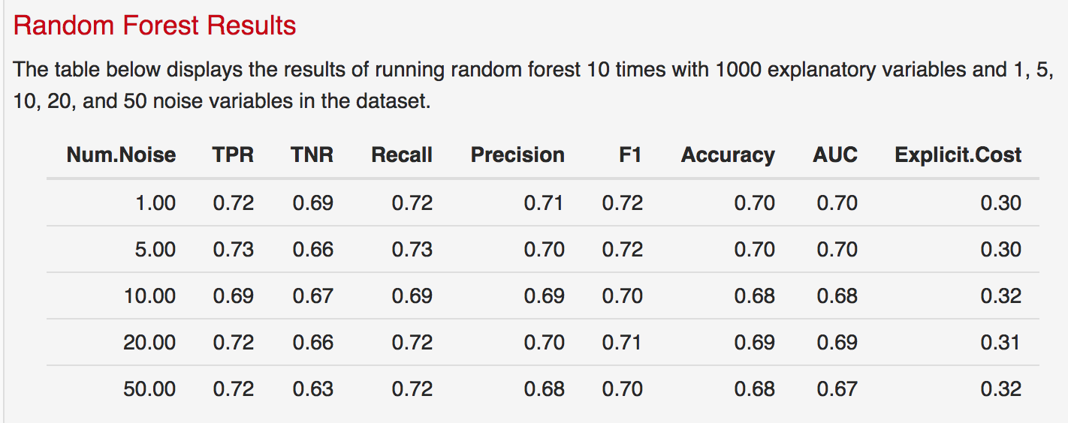
Case 2: 1000 sims, 1000 data points, 10 Ex Vars
*Description is hardcoded
*TPR for LR is the only one that is incorrect – reran to fix it

Slide 19
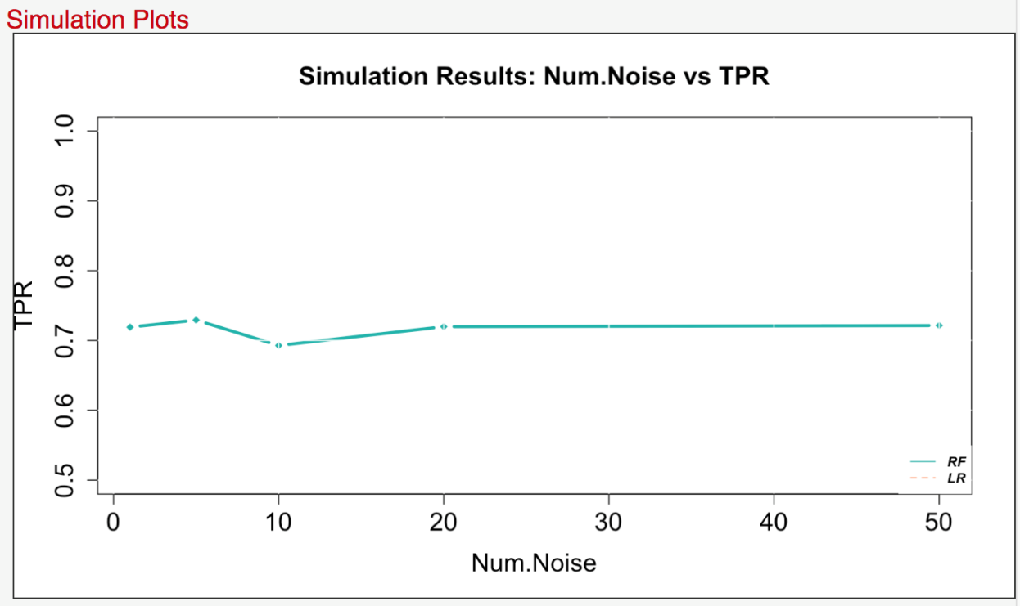
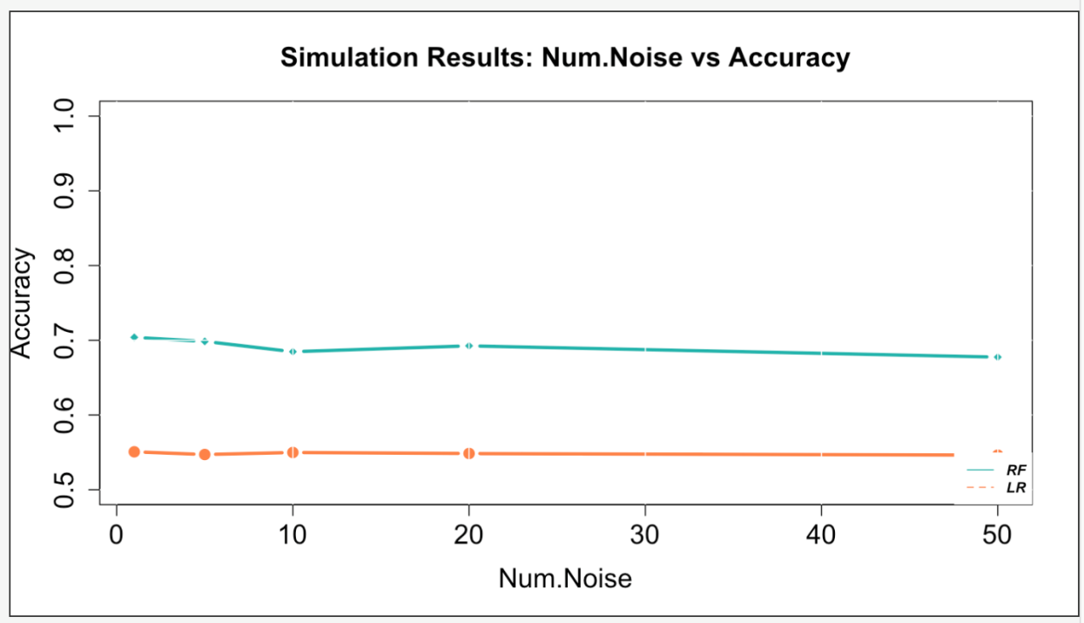
Case 2: 1000 sims, 1000 data points, 10 Ex Vars
*TPR for LR is the only one that is incorrect – reran to fix it

Slide 20
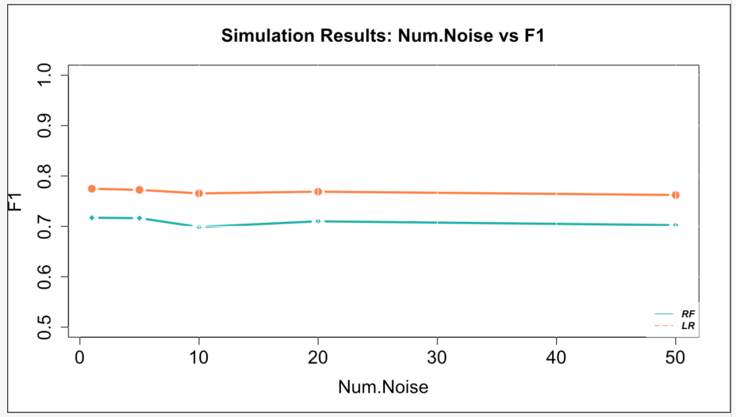
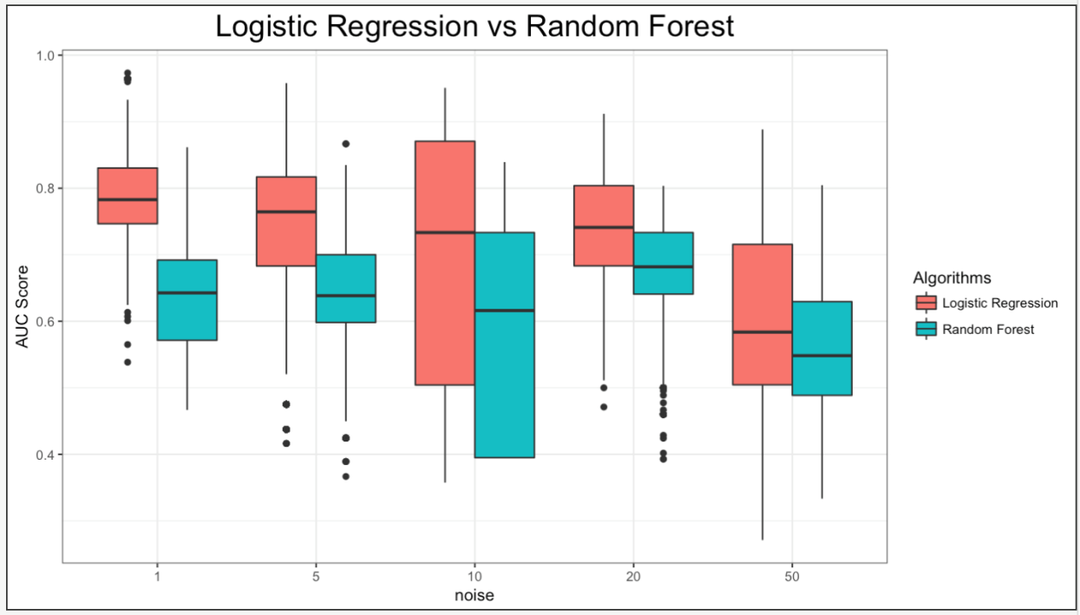
Case 2: 1000 sims, 1000 data points, 10 Ex Vars

Slide 21
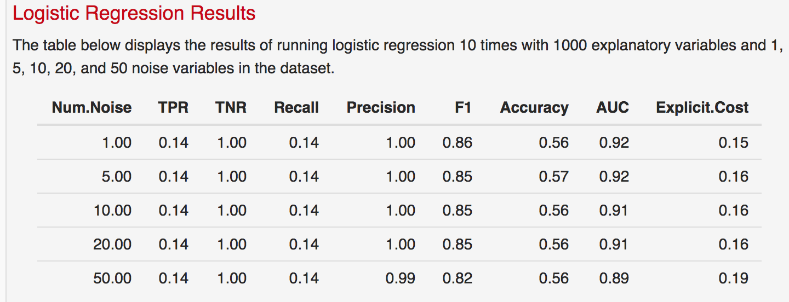
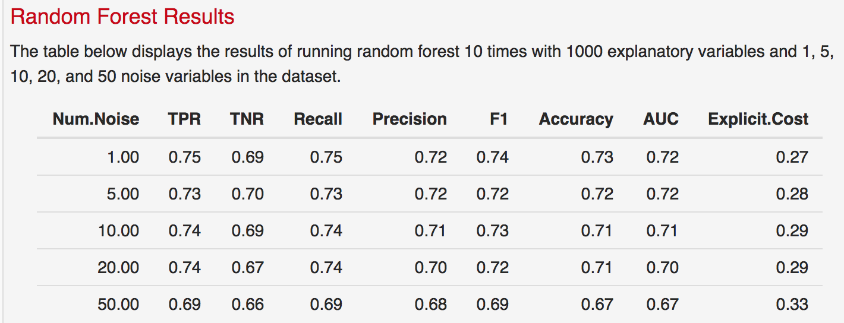
Case 2: 1000 sims, 1000 data points, 50 Ex Vars

Slide 22
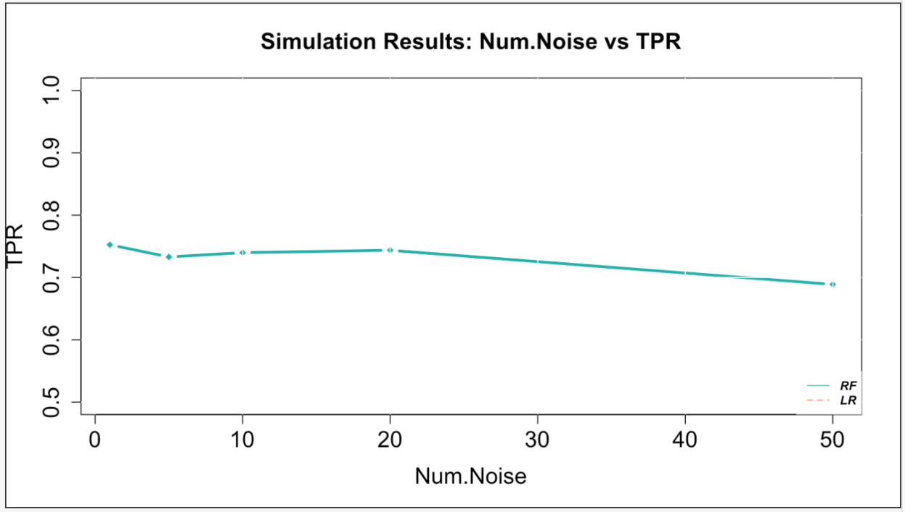
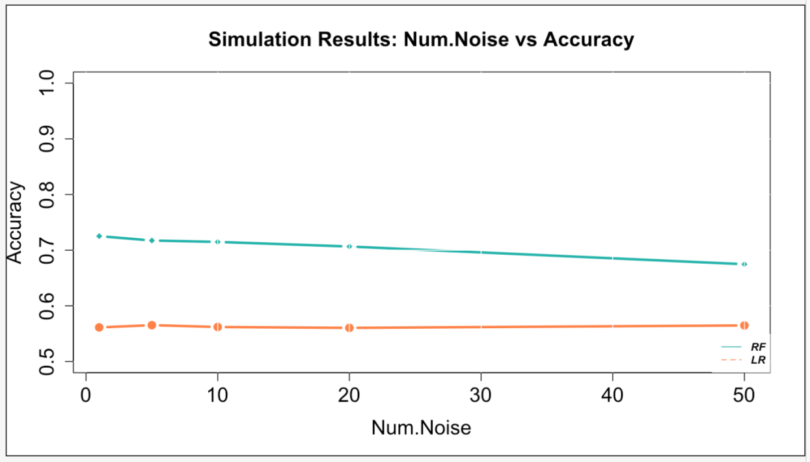
Case 2: 1000 sims, 1000 data points, 50 Ex Vars

Slide 23
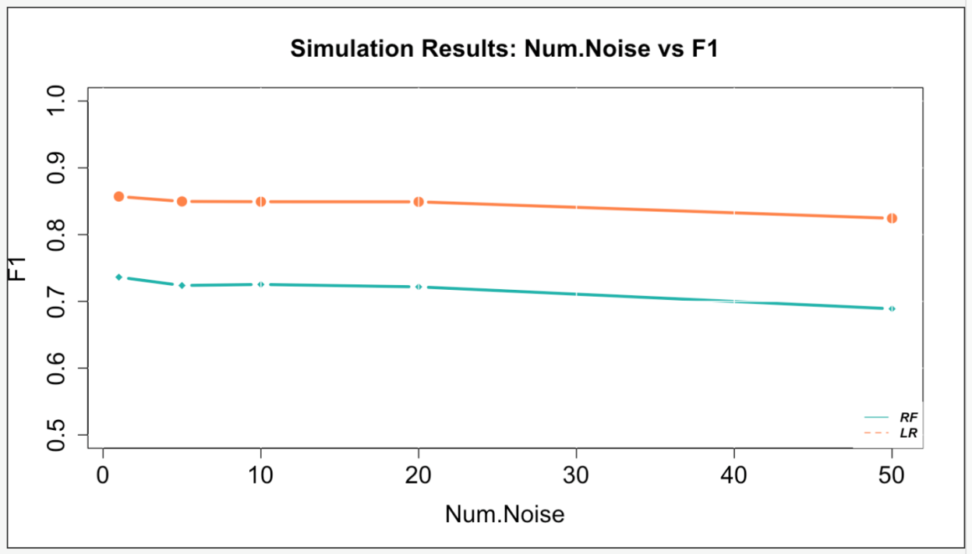
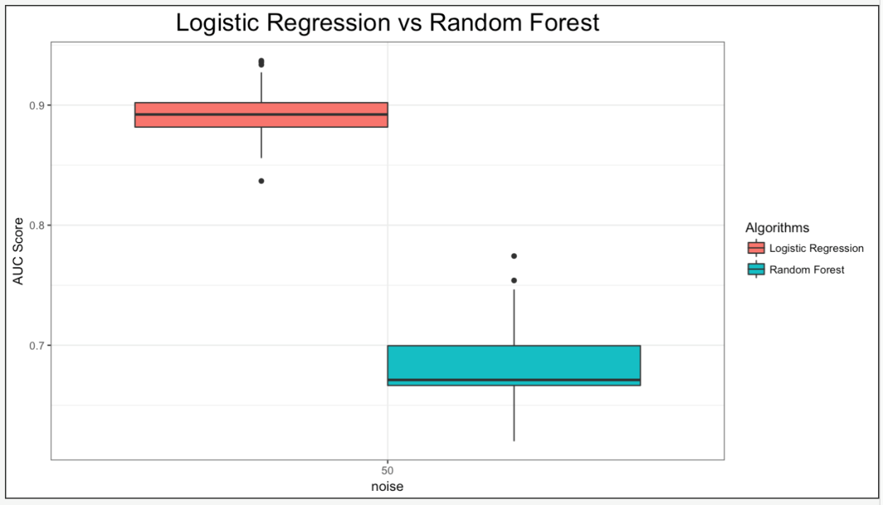
Case 2: 1000 sims, 1000 data points, 50 Ex Vars

Slide 24
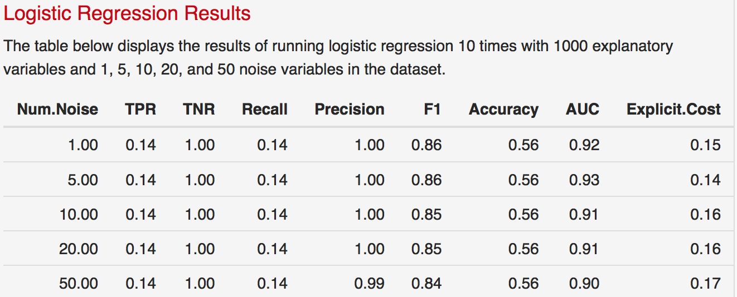
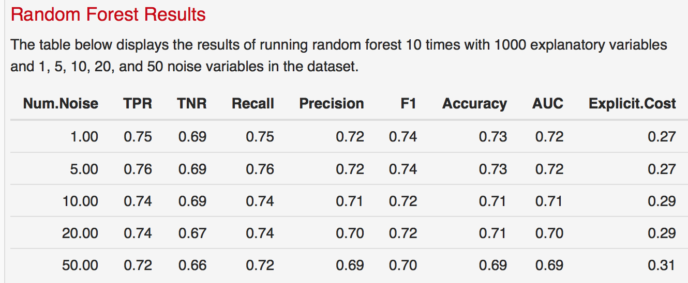
Case 2 – Run 2: 1000 sims, 1000 data points, 50 Ex Vars

Slide 25
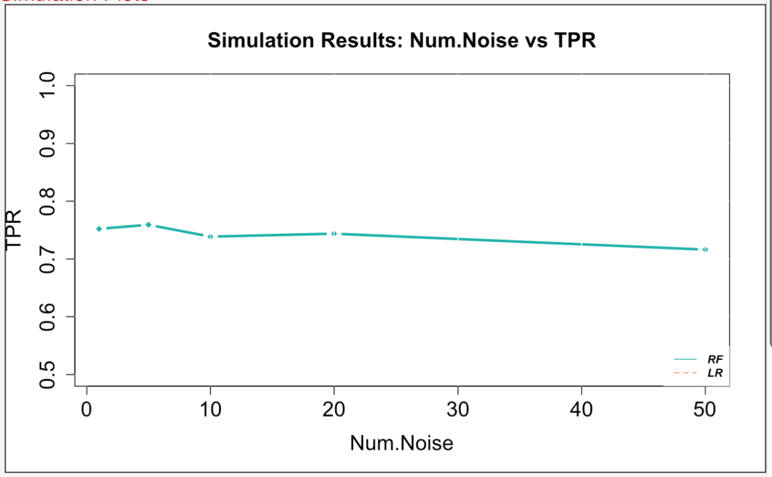
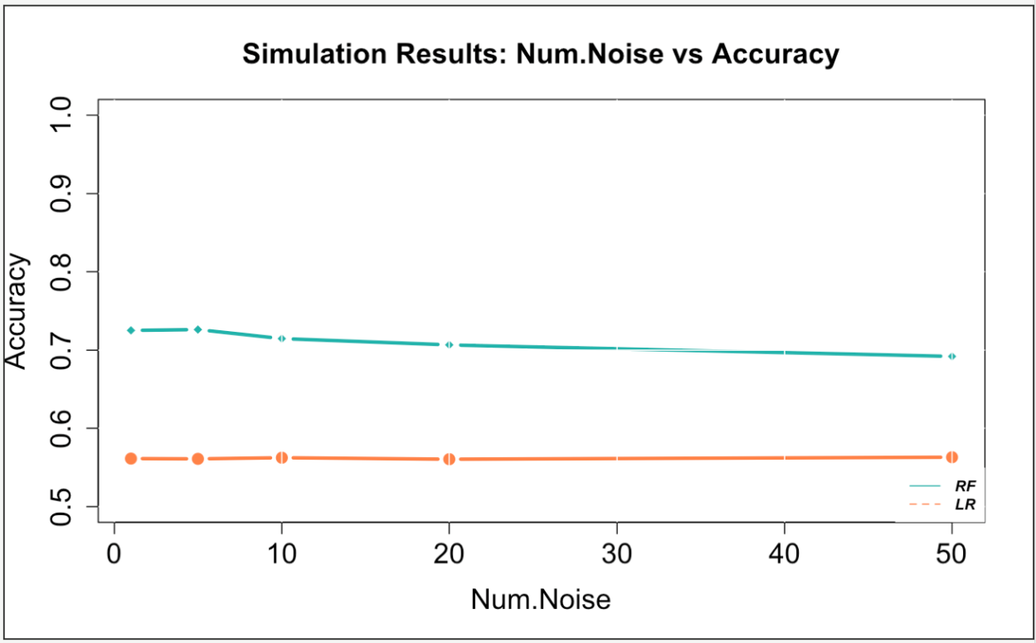
Case 2 – Run 2: 1000 sims, 1000 data points, 50 Ex Vars

Slide 26
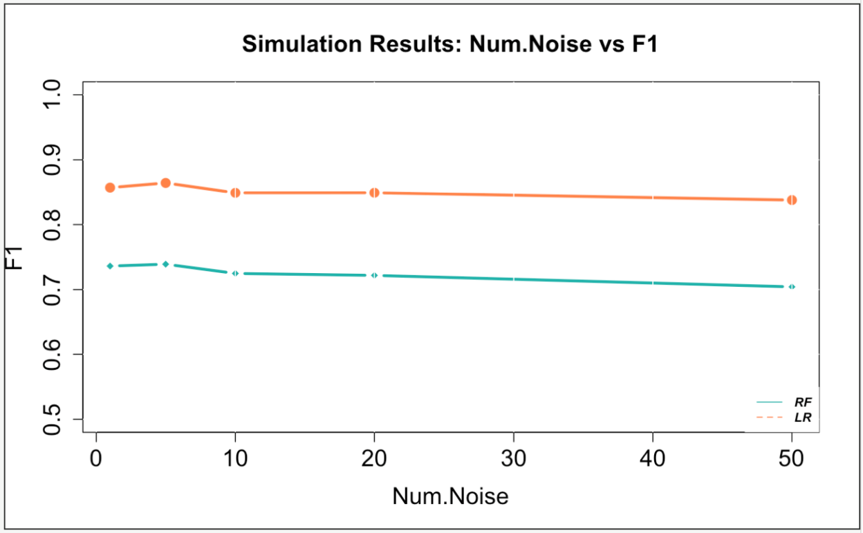
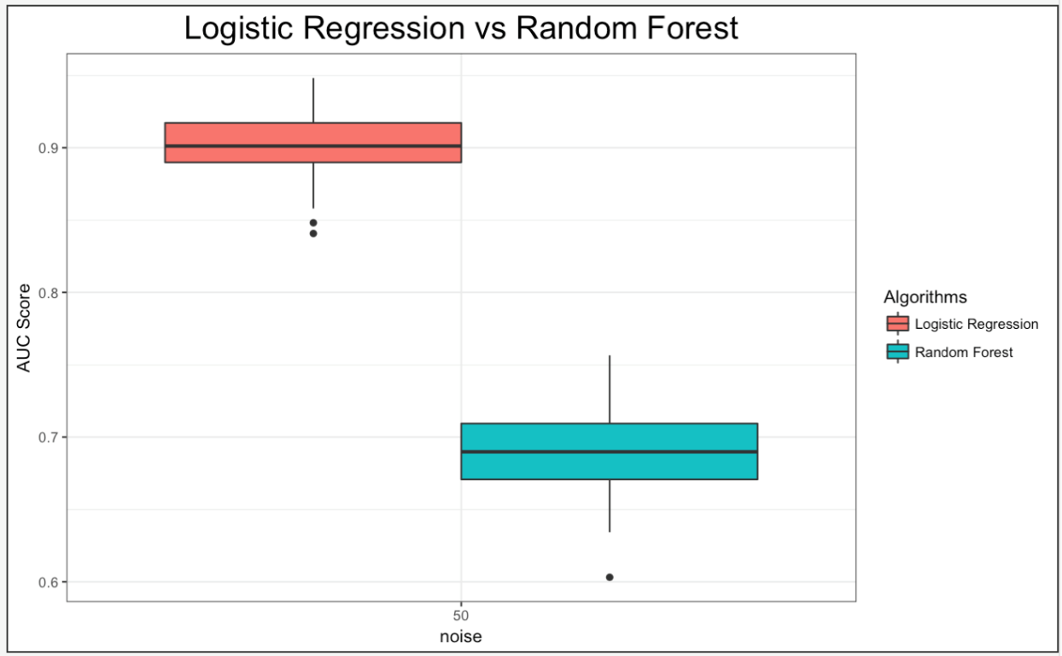
Case 2 – Run 2: 1000 sims, 1000 data points, 50 Ex Vars

Slide 27
Case 2: 1000 sims, 100,000 data points, 5 Ex Vars
Overnight: was on 10 noise vars
24 hours: got to 20 noise vars
24hrs + overnight: got to 50 noise vars
48 hours still running

Slide 28
Case 2: 1000 sims, 100,000 data points, 5 Ex Vars

Slide 29
Case 2: 1000 sims, 100,000 data points, 5 Ex Vars

Slide 30
Case 2: 1000 sims, 100,000 data points, 10 Ex Vars

Slide 31
Case 2: 1000 sims, 100,000 data points, 10 Ex Vars

Slide 32
Case 2: 1000 sims, 100,000 data points, 10 Ex Vars

Slide 33
Case 2: 1000 sims, 100,000 data points, 50 Ex Vars

Slide 34
Case 2: 1000 sims, 100,000 data points, 50 Ex Vars

Slide 35
Case 2: 1000 sims, 100,000 data points, 50 Ex Vars

Slide 36
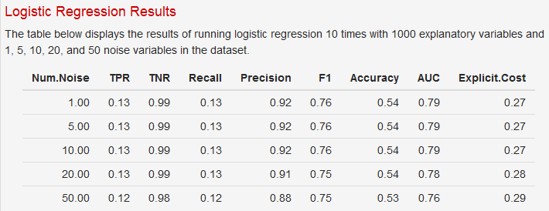
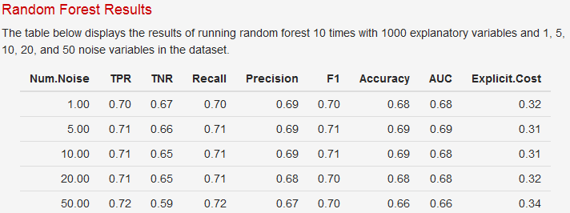
Case 2: 1000 sims, 1000 data points, 5 Ex Vars Small/ Med/ Large coefficients

Slide 37
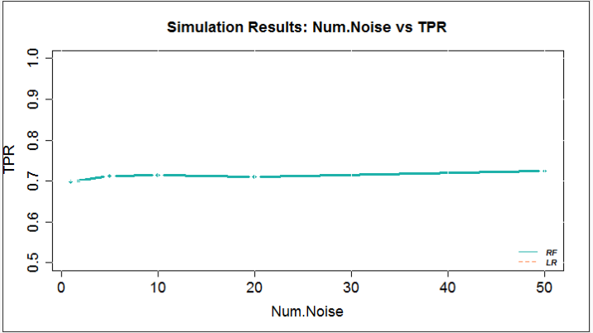
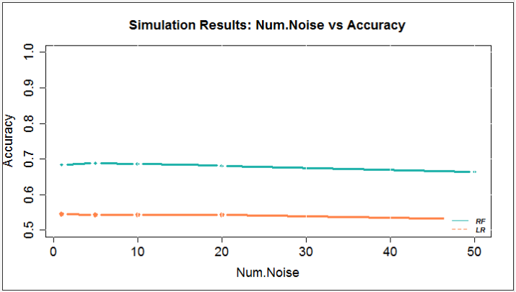
Case 2: 1000 sims, 1000 data points, 5 Ex Vars Small/ Med/ Large coefficients

Slide 38
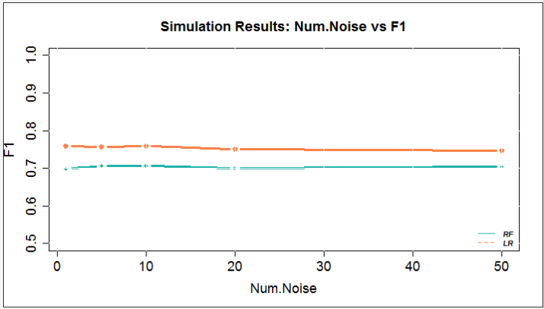
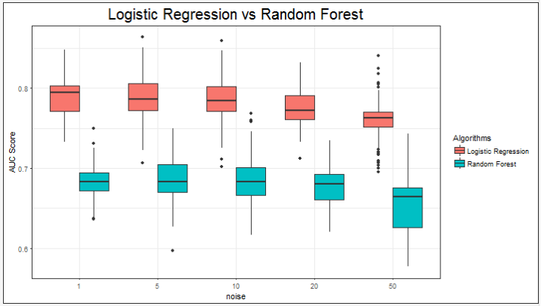
Case 2: 1000 sims, 1000 data points, 5 Ex Vars Small/ Med/ Large coefficients
Notes:
Case 2: 1000 sims, 1000 data points, 5 Ex Vars Small/ Med/ Large coefficients
Somewhere between 20 and 50 it makes a difference – flat in beginning – add 100 in here

Slide 39
Case 2: 1000 sims, 1000 data points, 5 Ex Vars Small/ Med/ Large coefficients + forward/ backward
Crashed – might have errors

