Slide 1
Feb 11 - SimStudy
Kaitlin

Slide 2
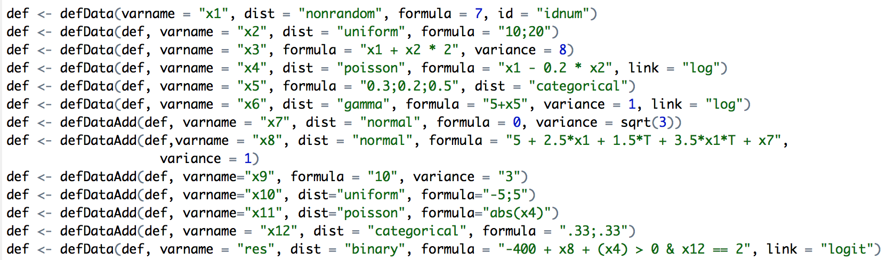
Definitions

Slide 3
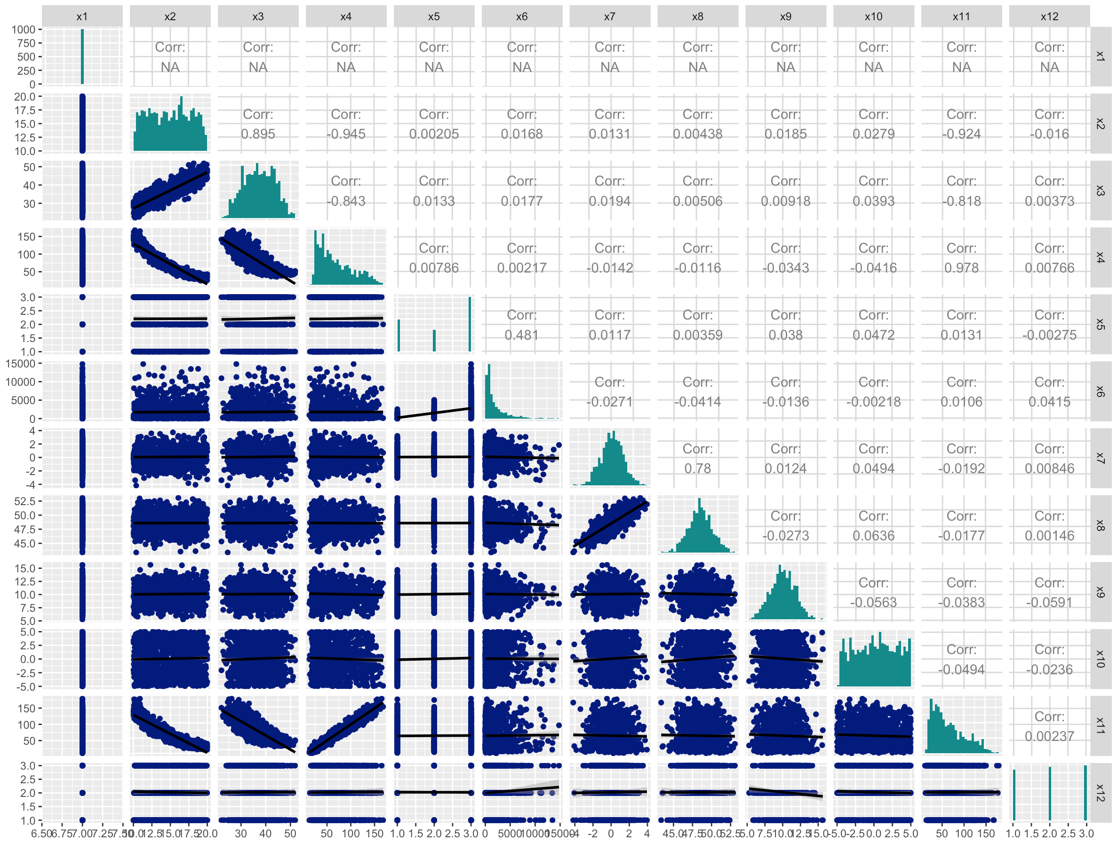
Variables

Slide 4
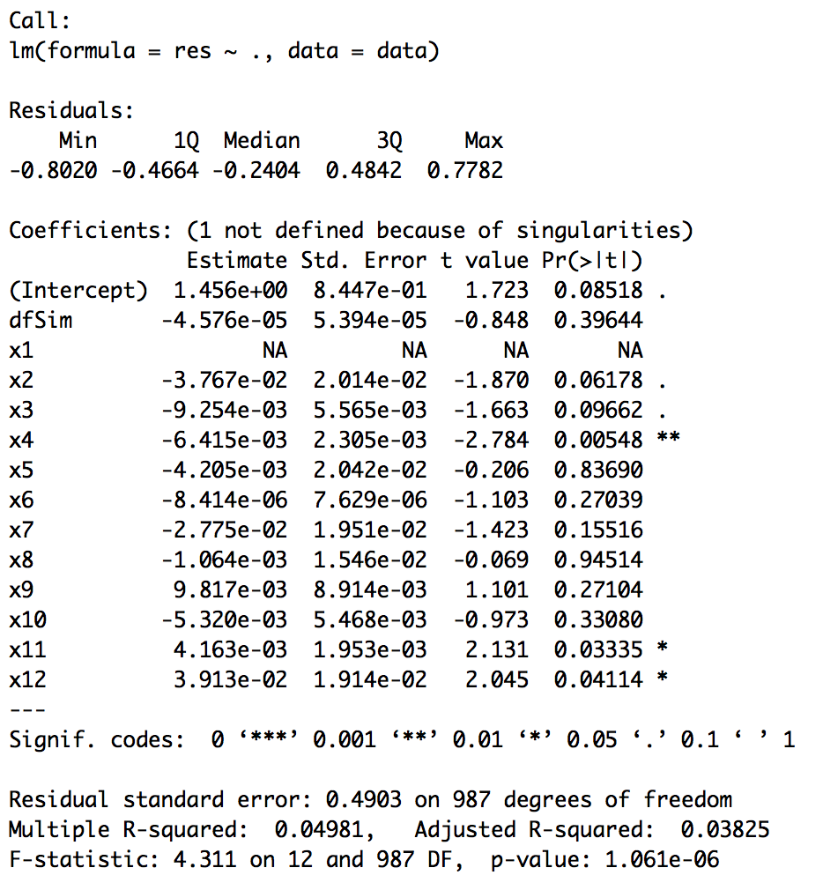
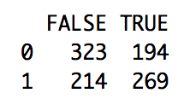
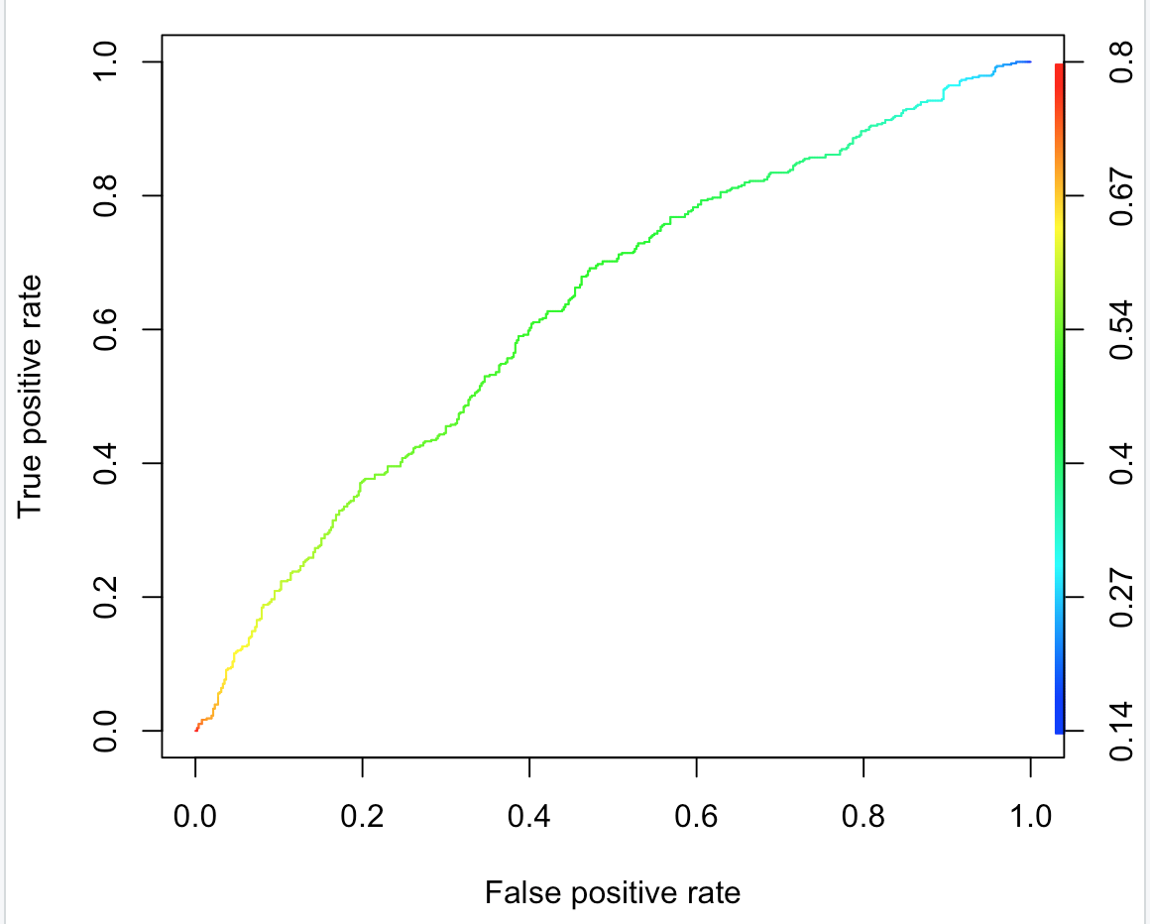
Initial model
Accuracy: 59.2%
TP: 55.7%
FN: 62.8%

